Slide 1
Chapter 2
Java Fundamentals

Slide 2
Main Topics
  The Parts of a Java Program
  The print and println Methods, and the Java API
  Variables and Literals
  Primitive Data Types
  Arithmetic Operators
  Combined Assignment Operators
  Creating named constants with final
  The String class
  Scope
  Comments
  Programming style
  Using the Scanner class for input
  Dialog boxes

Slide 3
Analyzing The Example
package simple_Pbm;
// This is a simple Java program.
public class Simple
{
public static void main(String[] args)
{
System.out.println(“Hi!”);
}
}

Slide 4
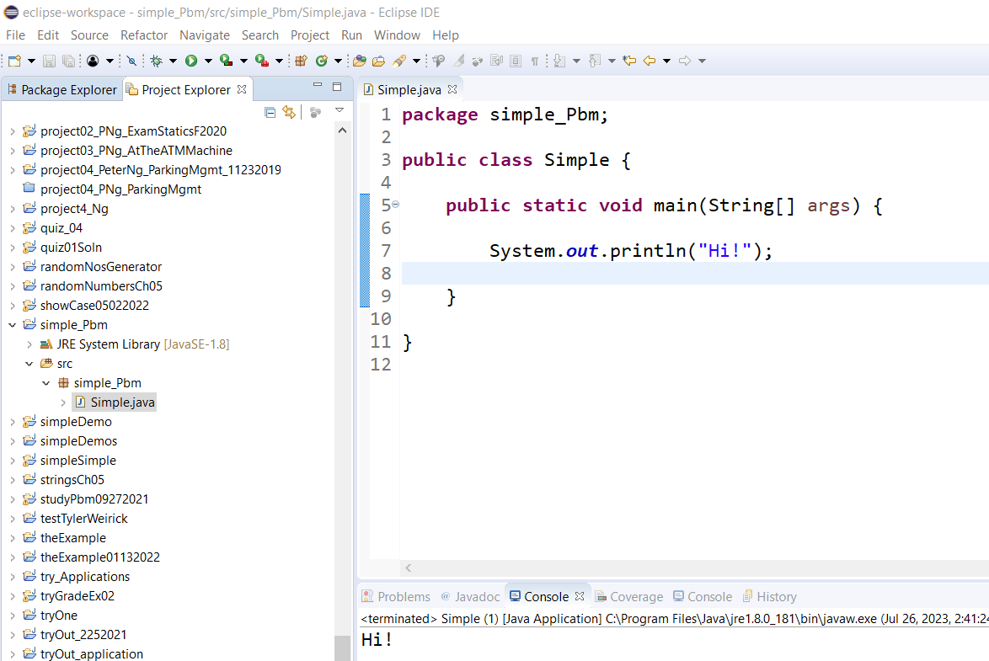
In text-editor, on the left column, it shows that:
  a project name: smiple_Pbm, which contains
  an src folder, which contains
  a package folder: named simple_Pbm, which contains
  a Java source code file (called Simple.java) which must match the class name Simple, which appeared in the “pubic class Simple {…}”.
  .java is a .java JAVA file extension

Slide 5
Summary
The simple_Pbm File folder contains:
The bin File folder contains the simple_Pbm (package) File folder, which contains the Simple.class CLASS File. It is a byte code for the Simple.java JAVA file extension for JVM.
The src folder has the simple_Pbm package FILE folder, which contains the Simple.java JAVA file extension.
Very often, they are more than one .java file extension in this package folder.

Slide 6
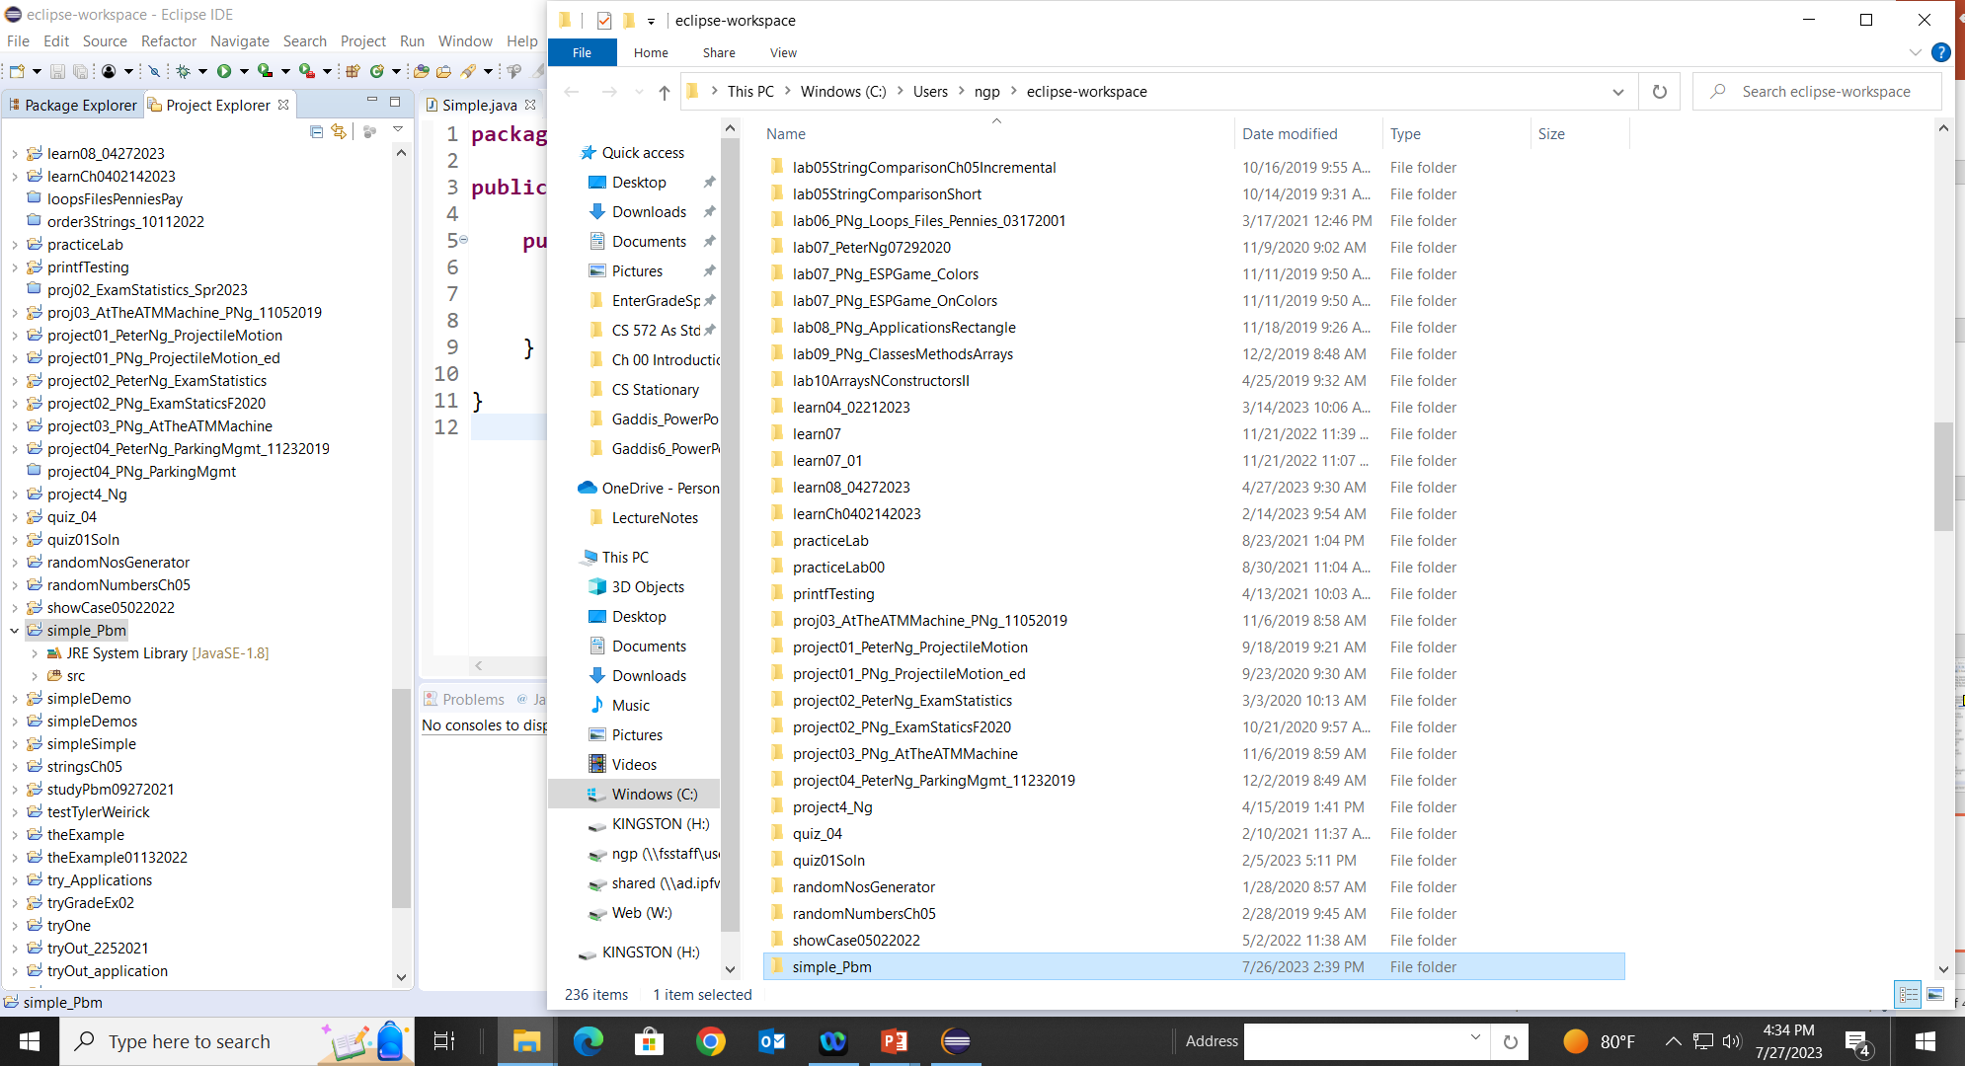
Zip your file for submission
1. Right click on simple_Pbm folder. Highlight on Show In
and System Explorer

Slide 7
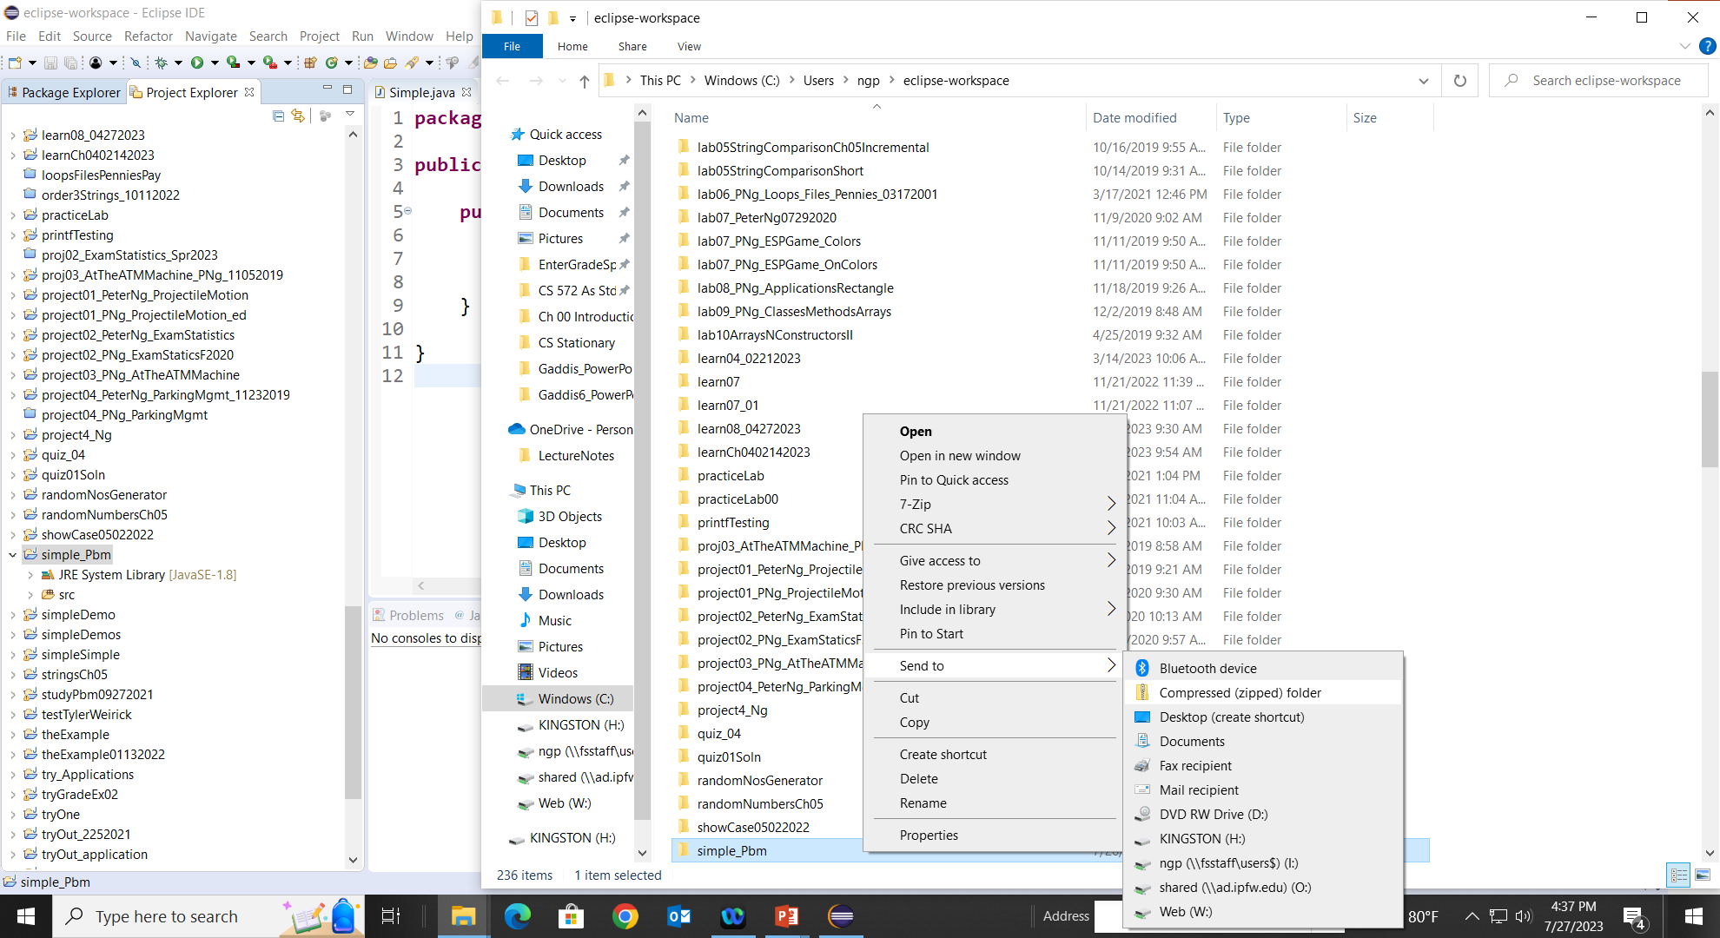
Zip your file for submission
2. Right-click on simple_Pbm. Move the cursor to Send to, and then Compressed (zipped) folder. Left-click on the Compressed (zipped) folder

Slide 8
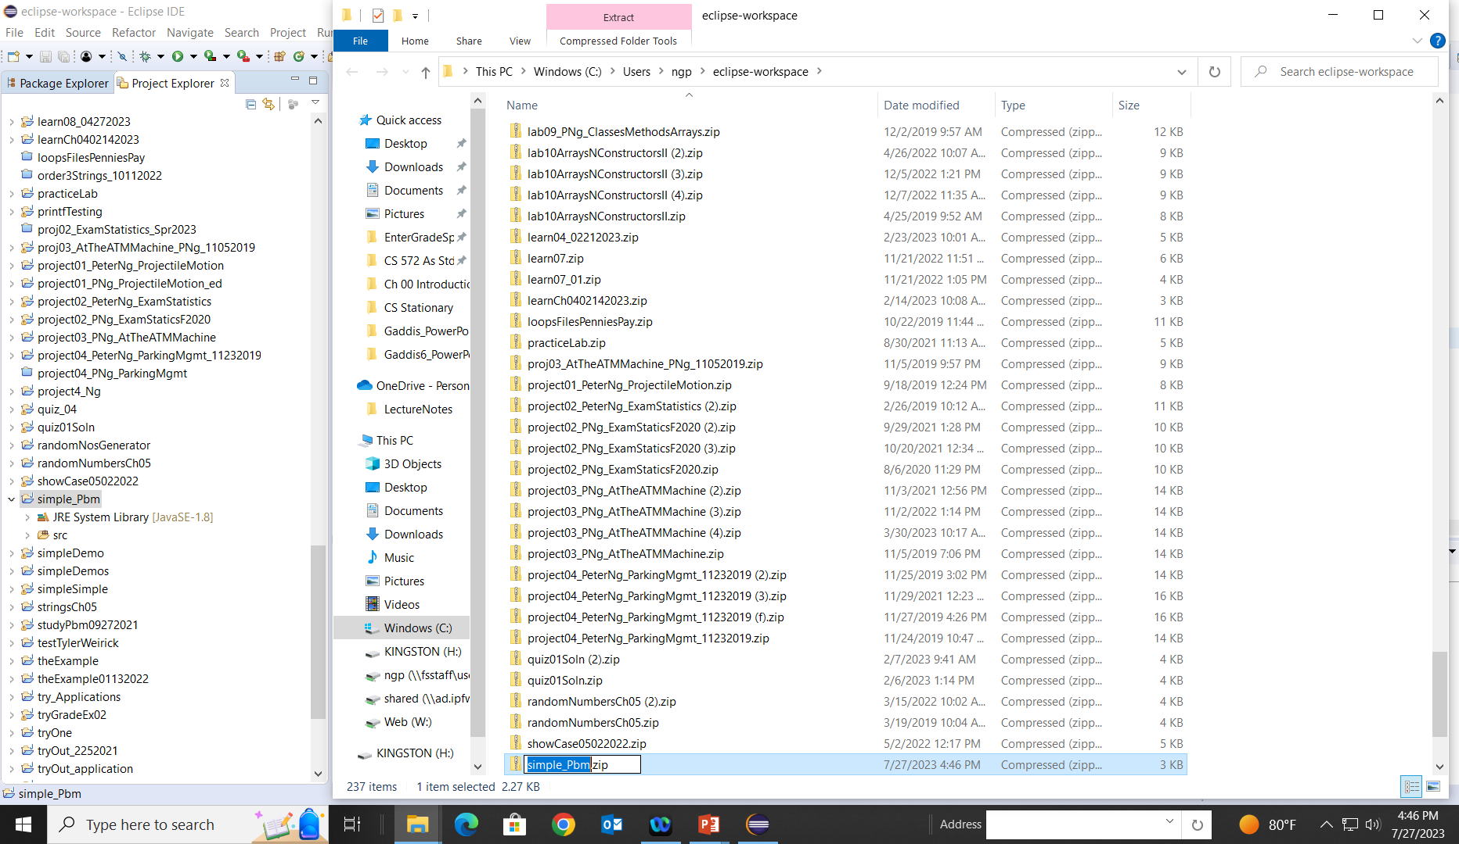
Zip your file for submission
3. The zipped file simple_Pbm.zip is obtained. Copy or drag this zipped file for submission.

Slide 9
Parts of a Java Program
Give an example: a source code (src) file: Simple.java
To compile the example:
  javac Simple.java
    Notice the .java file extension is needed.
    This will result in a file named Simple.class being created.
To run the example:
  java Simple
    Notice there is no file extension here.
    The java command assumes the extension is .class. (i.e., Simple.class, called .class file extension)

Slide 11
Analyzing The Example
package simple_Pbm;
// This is a simple Java program.
public class Simple
{
public static void main(String[] args)
{
System.out.println(“Hi!”);
}
}

Slide 12
Analyzing The Example
Simple.java
public class Simple{
public static void main(String[] args){
//TODO Auto-generated method stub
}
}
J
.Java file extension
Simple.Java file extension has a class named Simple, without Java file extension.

Slide 13
Analyzing The Example
This is a Java comment. It is ignored by the compiler.
// This is a simple Java program.
public class Simple
{
public static void main(String[] args)
{
System.out.println(“Hi!”);
}
}
This is the class header
for the class Simple (Simple.class)
This area is the body (definition) of the class Simple.
All of the data and methods for this class
will be between these curly braces {}.
public – a Java keyword, an access specifier, access to the class is unrestricted, open to the public.
class – a Java keyword, that indicates the beginning of a class definition.
Simple – the class name, programmer-defined name.

Slide 14
Analyzing The Example
In the src folder, the Java source code file Simple.java is translated by the Java compiler and created in another file named Simple.class, containing byte code. (This file is in the bin folder)
In the bin folder, the Byte code instructions are not machine language and cannot be directly executed by the CPU.
The Java Virtual Machine (JVM) is an interpreter, which reads this byte code and executes them as they are read.
Source code file named Simple.java
// This is a simple Java program.
public class Simple
{
}
The line of code tells the compiler that a publicly accessible class named Simple is being defined.

Slide 15
Analyzing The Example
//Source code file named Simple.java inside the src folder
// This is a simple Java program.
public class Simple //allows to create a file named Simple.class
{ //contained in the bin folder of the src folder.
}
A Java program must have at least one class definition.
We may create more than one class in a src file folder: e.g.,
for the definition of the public class Simple, the src File folder contains a JAVA file called Simple.java);
Simple.java is of JAVA File type, and is .java file extension.
We may have only one public class per JAVA file.
In the bin file folder, it contains .class file extension for each .java file extension. e.g.,
for the Simple.java has a Simple.class of CLASS File type in the bin file folder..

Slide 16
Analyzing The Example
// This is a simple Java program.
This is the main method header
The main method is where a Java application begins.
public class Simple
{
}//end of class Simple
public static void main(String[] args)
{
}//end of main
This area is the body of the main method.
All the statements for carrying out tasks for the main method will be between these curly braces.

Slide 17
Analyzing The Example
// This is a simple Java program.
public class Simple
{
}
public static void main(String [] args)
{ //class: System; object: out; method: println();
System.out.println("Programming is great fun!");
}
This is a Java statement (an instruction) that is executed when the program runs.

Slide 18
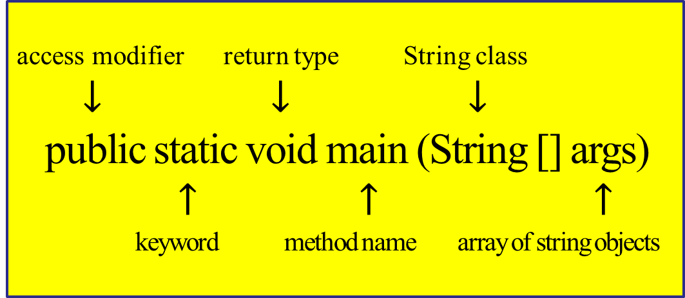
Analyzing The Example
// This is a simple Java program.
public class Simple
{
}
public static void main(String [] args)
{
System.out.println("Programming is great fun!");
}

Slide 19
Analyzing The Example
// This is a simple Java program.
public class Simple
{
}
public static void main(String [] args)
{
System.out.println("Programming is great fun!");
}
public
This is the access modifier of the main method.
It has to be public so that the Java runtime system (JVM) can call to execute this method, main.
Java runtime is outside the current class Simple.

Slide 20
Analyzing The Example
// This is a simple Java program.
public class Simple
{
}
public static void main(String [] args)
{
System.out.println("Programming is great fun!");
}
static
When the Java runtime system starts, there is no object of the class present. This has to have a static method to allow invocation from the class. For the main method to be static, JVM can load the class into memory and call the main method. If the main method is not static, JVM would not be able to call it because there is no object of the class present.

Slide 21
Analyzing The Example
// This is a simple Java program.
public class Simple
{
}
public static void main(String [] args)
{
System.out.println("Programming is great fun!");
}
void
Java programming mandates that every method signature provide the return type, such as void, int, double, String, etc.
Java main method with return type “void” doesn’t return anything.
Once the main method is finished executing, the Java program terminates. There is nothing that can be done for the returned object by JVM.
If we try to return something from the main method, it will give a compilation error as an unexpected return value.

Slide 22
Analyzing The Example
// This is a simple Java program.
public class Simple
{
}
public static void main(String [] args)
{
System.out.println("Programming is great fun!");
}
main
The name of a Java main method().
This name, main, is fixed.
The main method is the starting point of a Java program.
As it's called by the JVM, the main method serves as the entry point for an application.

Slide 23
Analyzing The Example
// This is a simple Java program.
public class Simple
{
}
public static void main(String [] args)
{
System.out.println("Programming is great fun!");
}
String[] args
Java main method accepts a single argument of a type String array, which is also called Java command line arguments.
String [] arguments is a Java array of String objects.
  The main function expects an array of Strings.
This array of strings typically holds all command line parameter arguments passed in when the program is run from the command line.

Slide 24
Analyzing The Example
// This is a simple Java program.
public class Simple
{
}
public static void main(String [] args)
{
System.out.println("Programming is great fun!");
}

Slide 25
Parts of a Java Program
Comments
  The line is ignored by the compiler.
  The comment in the example is a single-line comment.
Class Header
  The class header tells the compiler things about the class such as,
    what other classes can use it (public);
    it is a Java class (class); and
    the name of that class (Simple).
Curly Braces
  When associated with the class header, they define the scope of the class.
  When associated with a method, they define the scope of the method.

Slide 26
Parts of a Java Program
The main Method
public static void main(String [ ] args) { …. }
  Every Java application must have a main method().
  This main method starts the Java program.
  This line must be the same as shown (except that
  the args variable name can be programmer defined).
  This is the line of code that the java command will run first.
Java Statements
  When the program runs, the statements within the main method will be executed.

Slide 27
Java Statements
The only Java statement in the program is the line that ends with a semi-colon.
  System.out.println("Programming is great fun!");
The rest of the code is either a comment or other Java framework code.
//This is a simple java program
public class Simple
{
public static void main(String[] args)
{
System.out.println("Programming is "
+ "not fun at all!");
}
}

Slide 28
Analyzing The Example
// This is a simple Java program.
//class header
public class Simple
{
}//end of class Simple
public static void main(String [] args)
{
System.out.println("Programming is "
+ "not fun at all!");
System.out.println("Programming is great fun!");
} //end of main
//curly braces
These are Java statements that
are executed when the program runs.

Slide 29
Java Statements
Comments are ignored by the Java compiler so they need no semi-colons. e.g.,
    //This is a program Simple
    //written by John Carrier. (line comment)
    /*
    * This is a program Simple, written by
    * John Carrier, Jr. (block comments)
    */
Other Java code elements that do not need semi-colons include:
  class headers
    Terminated by the code within its curly braces.
  method headers
    Terminated by the code within its curly braces.
  curly braces
    Part of framework code that needs no semi-colon termination.

Slide 30
Short Review
Java is a case-sensitive language. (case, Cases)
All Java programs must be stored in a file with a .java file extension.
Comments are ignored by the compiler.
A .java file may contain many classes but may only have one public class.
If a .java file has a public class, the class must have the same name as the file, such as Simple
Java applications must have a main method.
For every left brace, or opening brace, there must be a corresponding right brace or closing brace.
Statements are terminated with semicolons.
  Comments, class headers, method headers, and braces are not considered Java statements.

Slide 31
Special Characters
// | double slash | Marks the beginning of a single line comment.
( ) | open and close parenthesis | Used in a method header to mark the parameter list. e.g., main(String[] args)
{ } | open and close curly braces | Encloses a group of statements, such as the contents of a class or a method.
“ ” “ ” | quotation marks | Encloses a string of characters, such as a message that is to be printed on the screen
; | semi-colon | Marks the end of a complete programming statement

Slide 32
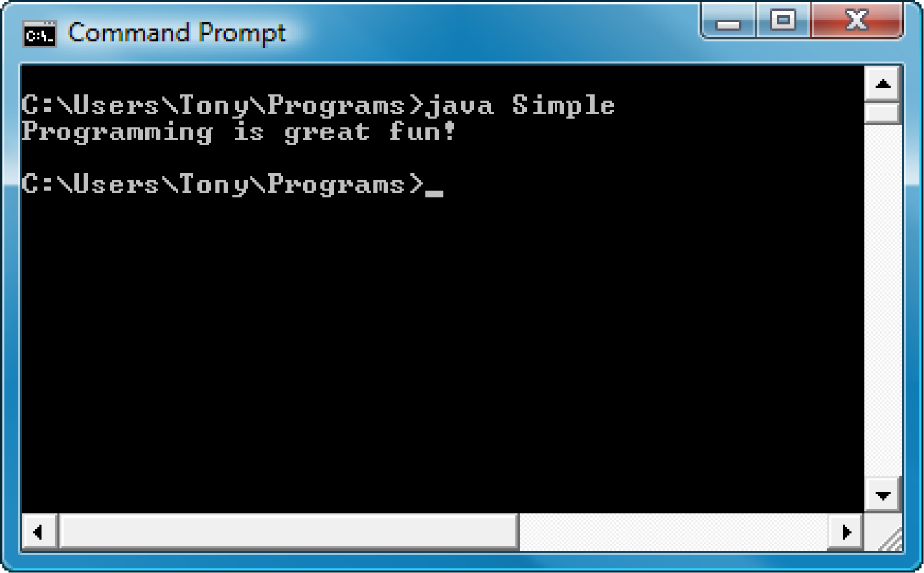
Console Output
Many of the programs that you will write will run in a console window.

Slide 33
Console Output
The standard input device:
  the keyboard.
The standard output device:
  The console window that starts a Java application
Use a Java class (named System) stored in the standard Java library
  Java sends information to the standard output device
  System.out.println(“CS 16000-01 Intro to CS”);
  Math.sqrt(144);
  Math.cbrt(27);

Slide 34
Console Output
Use the Java Applications Programming Interface (API) to access Java classes in the standard Java library.
The standard Java library is commonly referred to as the Java API.
Java library
public class System
Object out
API
Methods:
print()
println()
printf()
public class Scanner
public class JOptionPane

Slide 35
Console Output
The previous example:
System.out.println("Programming is great fun!");
This statement uses the System class from the standard Java library.
The System class contains objects and methods that perform system-level tasks.
The out object, a member of the System class, contains the methods print(), println(), and printf().
      System.out.print("x = 3.25;\n");
      System.out.println("x = 3.25;");
      System.out.printf("x = %.2f.", 3.25);
      System.out.println("x = " + 16/5 + ";");
      System.out.println("x = " + 16./5 + ".");
x = 3.25;
x = 3.25;
x = 3.25.
x = 3;
x = 3.20.

Slide 36
Console Output
The print and println methods perform the task of sending characters to the output device.
The line:
  System.out.println("Programming is great fun!");
  is pronounced: System dot out dot println …
The value inside the parenthesis will be sent to the output device (in this case, a string).

Slide 37
Console Output
The println method places a newline character “\n” at the end of whatever is being printed out.
The following lines:
    System.out.println("This is being printed out");
    System.out.println("on two separate lines.");
    Equivalently,
    System.out.print("This is being printed out\n");
    System.out.print("on two separate lines.\n");
  Would be printed out on separate lines since the first statement sends a newline command to the screen.
  System.out.println("");

Slide 38
Console Output
System.out.print("These lines will be\n"); System.out.print("printed on ");
System.out.println(“ the same line.\n"); // \n
The print statement works very similarly to the println statement.
However, the print statement does not put a newline character at the end of the output.
The lines:
    System.out.print("These lines will be");
    System.out.print("printed on");
    System.out.println("the same line.");
    System.out.println("The End.");
  will output:
  These lines will beprinted onthe same line.
  The End.
  Notice the odd spacing? Why are some words run together?

Slide 39
Console Output
In the previous examples, we have been printing out strings of characters.
Will see more print methods later.
Some special characters can be put into the output.
System.out.print(“ These lines will be ” + “printed on the ” +
“the same line.\n” );
The \n in the string is an escape sequence that represents the newline character.
Escape sequences allow the programmer to print characters that otherwise would be unprintable.

Slide 40
Java Escape Sequences
\n | newline | Advances the cursor to the next line for subsequent printing
\t | tab | Causes the cursor to skip over to the next tab stop
\b | backspace | Causes the cursor to back up, or move left, one position
\r | carriage return | Causes the cursor to go to the beginning of the current line, not the next line
\\ | backslash | Causes a backslash to be printed
\’ | single quote | Causes a single quotation mark to be printed
\” | double quote | Causes a double quotation mark to be printed

Slide 41
Java Escape Sequences
The escape sequences are comprised of two characters; they are treated by the compiler as a single character.
System.out.print("These are our to sellers:\n");
System.out.print("\t\"Computer games\"\n\t\"Coffee\"\n");
System.out.println("\t\"Aspirin\"");
These would result in the following output:
These are our top sellers:
"Computer games"
"Coffee"
"Asprin"
With these escape sequences, complex text output can be achieved.

Slide 43
Why Write Methods?
Divide and Conquer: Methods are commonly used to break a problem down into small manageable pieces.
Methods simplify programs.
Code Reuse: If a specific task is performed in several places in the program, write a method once to perform that task and execute it anytime needed.

Slide 44
void Methods and Value-Returning Methods
A void method is one that simply performs a task and then terminates.
System.out.println("Hi!");
class object method argument
A value-returning method not only performs a task but also sends a value back to the code that called it.
int number =Integer.parseInt("700");
method for converting a string to a number

Slide 45
Defining a void Method
To create a method, write a definition, which consists of a header and a body.
Header
A void method
public static void displayMessage()
{
System.out.println("Hello");
}
Body
public static void displayMessage()
{ System.out.println("Hello");
return;
}

Slide 46
Parts of a Method Header
Method Modifiers
Return Type
Method Name
Parentheses
public static void displayMessage ()
{
System.out.println("Hello");
}
A method executes when it is called.

Slide 47
Parts of a Method Header
Method modifiers
  Public
  method is publicly available to code outside the class
  Static
  method belongs to a class, not a specific object.
Return type
void or the data type from a value-returning method
Method name
a name that is descriptive of what the method does
Parentheses
contain nothing or a list of one or more variable declarations if the method is capable of receiving arguments. (Formal parameters list? vs actual parameters)

Slide 48
Calling a Method - extract from Chapter 5
A method executes when it is called.
The main method is automatically called when a program starts.
Other methods are executed by ‘method call’ statements.
displayMessage();
The method call statement consists of the method name with ( empty or a list of arguments or actual parameters).
Examples: SimpleMethod.java, LoopCall.java, CreditCard.java, DeepAndDeeper.java

Slide 49
package methodCall05_01PK;
public class MethodCallEx01 {
public static void main(String[] args) {
String str = "Pls. complete this task.";
double costPerUnit = 3106.75;
displayMessage(str, costPerUnit);
//a method call statement with actual parameters
}//end of main
public static void displayMessage(String strLine,
double cost) {
System.out.printf(strLine +
"\nThe unit cost is %,.2f.\n", cost);
}//end of displayMessage
}//end of class MethodCallEx01
Pls. complete this task.
The unit cost is 3,106.75.

Slide 50
Passing Arguments to a Method
Values that are sent into a method are called arguments.
  System.out.println("Hello");
  number = Integer.parseInt(str);
The data type of an argument in a method call must correspond to the variable declaration in the parentheses of the method declaration.
The (actual) parameter is the variable that holds the value being passed into a method.
By using parameter variables in your method declarations, you can design your methods that accept data this way.
See example: PassArg.java

Slide 51
Passing 5 to the displayValue Method
Argument actual parameter
The argument 5 is copied into the parameter variable num. (formal parameter)
displayValue(5);
int iNos = 5;
displayValue(iNos);
public static void displayValue(int num)
{
System.out.println("The value is " + num);
}
iNos
5
num
5
The method will display The value is 5

Slide 52
Passing Multiple Arguments
double x = 5;
double y = 10;
showSum(x, y);
Argument 5 is copied into the num1 parameter.
Argument 10 is copied into the num2 parameter.
showSum(5, 10);
public static void showSum(double num1, double num2)
{
  double sum; //storage for holding sum
  sum = num1 + num2;
  System.out.println("The sum is " + sum);
}
NOTE: Order matters!
5.0
10.0
15.0
Argument is a value of an actual parameter
formal parameter: num1 and num2.

Slide 53
Arguments are Passed by Value
In Java, all arguments of the primitive data types are passed by value -- only a copy of an argument’s value is passed into a parameter variable.
A method’s parameter variables are separate and distinct from the arguments that are listed inside the parentheses of a method call.
If (the value of) a parameter variable is changed inside a method, it does not affect the original argument (value).
See example: PassByValue.java

Slide 54
Calling a Value-Returning Method
int total = sum(value1, value2);
  public static int sum(int num1, int num2)
  {
  int result;
  result = num1 + num2;
  return result;
  }
20
40
60
return num1 + num2;

Slide 55
Calling a Value-Returning Method
package methodCallValueRetn05_02_02PK;
public class MethodCallValueReturn05_02_02 {
public static void main(String[] args) {
int value1 = 20, value2 = 40;
System.out.println("sum is " +
sum(value1, value2));
int total = sum(value1, value2);
System.out.println("total is " + total);
}
public static int sum(int num1, int num2) {
int result;
result = num1 + num2;
return result;
}
}

Slide 56
package methodCallValueRetn05_02_02PK;
public class MethodCallValueReturn05_02_02 {
public static void main(String[] args) {
int value1 = 20, value2 = 40, value3 = 30, value4 = 50;
System.out.println("sum is " + sum(value1, value2));
int total = sum(value1, value2);
System.out.println("total is " + total);
sumTotal(value3, value4);
// System.out.println("T02: result is " + result);
// result cannot be resolved to a variable
}//end of main()
public static int sum(int num1, int num2) {
int result;
result = num1 + num2;
return result;
}//end of sum()
public static void sumTotal(int num1, int num2) {
int result;
result = num1 + num2;
System.out.println("T01: result is " + result);
}//end of sumTotal(…)
}//end of class …
sum is 60
total is 60
T01: result is 80

Slide 58
Variables and Literals
A variable is a named storage location in the computer’s memory.
A literal is a value that is written into the code of a program.
    double dThree, dEleven;
      int iThree = 3;
      int iEleven = 11;
dThree = 3;
dEleven = 11.;
Programmers determine the number and type of variables a program will need.
See example:Variable.java

Slide 59

Variables and Literals
vName | dType | sLoc | aLiteral
value | int | 0x001 | 5
This line is called
a variable declaration.
int value;
The following line is known
as an assignment statement.
value = 5;
int value;
value = 5;
System.out.println("The value is " + value);
0x000
The value 5
is stored in
memory.
0x004
5
0x008
0x00C
This is a string literal. It will be printed as is.
System.out.print("The value is ");
System.out.println(value);
The integer 5 will
be printed out here.
Notice no quote marks?

Slide 60
The + Operator
The + operator can be used in two ways.
    as a concatenation operator
    as an addition operator
If either side of the + operator is a string, the result will be a string.
  System.out.println("Hello " + "World");
  System.out.println("The value is: " + +5+2);//… 52
  System.out.println("The value is: " + (+5+2));//… 7
  System.out.println("The value is: " + value); System.out.println("The value is: " + ‘\n‘ + -5);
  System.out.println("The value is: " + ‘/n‘ + 5);
  … “Invalid character constant”

Slide 61
String Concatenation
Java commands that have string literals must be treated with care.
A string literal value cannot span lines in a Java source code file.
  System.out.println("This line is too long and now it has spanned more than one line, which will cause a syntax error to be generated by the compiler. ");
  … String literal is not properly closed by a double-quote

Slide 62
String Concatenation
The String concatenation operator can be used to fix this problem.
System.out.println("These lines are " +
    "are now ok and will not " +
    "\ncause the error as before.");
    Console output:?
String concatenation can join various data types.
    System.out.println("We can join a string to " +
    "a number like this: " + 5);
    Console output:
    We can join a string to a number like this: 5
    System.out.println("We can join a string to " +
    "a number like this: " + (3+5)+ "!");
    We can join a string to a number like this: 8!

Slide 63
String Concatenation
The Concatenation operator can be used to format complex String objects.
System.out.println("The following will be printed " +
    "in a tabbed format: " +
    "\n\tFirst = " + 5 * 6 + ", " +
    "\n\tSecond = " + 6 + 4 + "," +
    "\n\tSecond = " +(6 + 4) + "," +
    "\n\tThird = " + 16.7 + ".");
Notice that if an addition operation is also needed, it must be put in parenthesis.
Console output:
The following… in a tabbed format:
First = 30,
Second = 64,
Second = 10,
Third = 16.7.

Slide 64
Identifiers
Identifiers are programmer-defined names for:
  classes
  variables …..(identifier, storage)
  methods
Identifiers may not be any of the Java reserved keywords.

Slide 65
Identifiers
Identifiers must follow certain rules:
  An identifier may only contain:
    letters a–z or A–Z,
    the digits 0–9,
    underscores _, or
    the dollar sign ($)
  The first character may not be a digit.
  Identifiers are case-sensitive.
    itemsOrdered is not the same as itemsordered.
  Identifiers cannot include spaces.

Slide 66
Java Reserved Keywords
abstract
assert
boolean
break
byte
case
catch
char
class
const
continue
default
do
double
else
enum
extends
false
for
final
finally
float
goto
if
implements
import
instanceof
int
interface
long
native
new
null
package
private
protected
public
return
short
static
strictfp
super
switch
synchronized
this
throw
throws
transient
true
try
void
volatile
while

Slide 67
Variable Names
Variable names should be descriptive.
Descriptive names allow the code to be more readable, and the code is more maintainable.
Ex: Which of the following is more descriptive?
double tr = 0.0725;
double salesTaxRate = 0.0725;
Java programs should be self-documenting.

Slide 68
Java Naming Conventions
Variable names should begin with a lowercase letter and then switch to a title (upper) case thereafter:
    Ex: int calTaxRate
Class names should be all title (upper) case.
    Ex: public class BigLittle
More Java naming conventions can be found at:
  http://java.sun.com/docs/codeconv/html/CodeConventions.doc8.html
A general rule of thumb about naming variables and classes is that, with some exceptions, their names tend to be nouns or noun phrases.

Slide 69
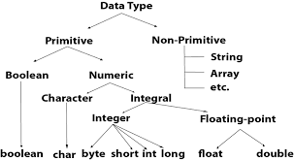
Data Types (Primitives and Derived)
IEEE 754 Floating Point Numbers

Slide 70
Primitive Data Types
Primitive data types are built into the Java language and are not derived from classes.
There are 8 Java primitive data types.
  byte
  short
  int
  long
  float
  double
  boolean
  char

Slide 71
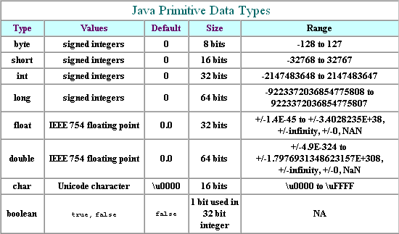
Java Primitive Data Types

Slide 72
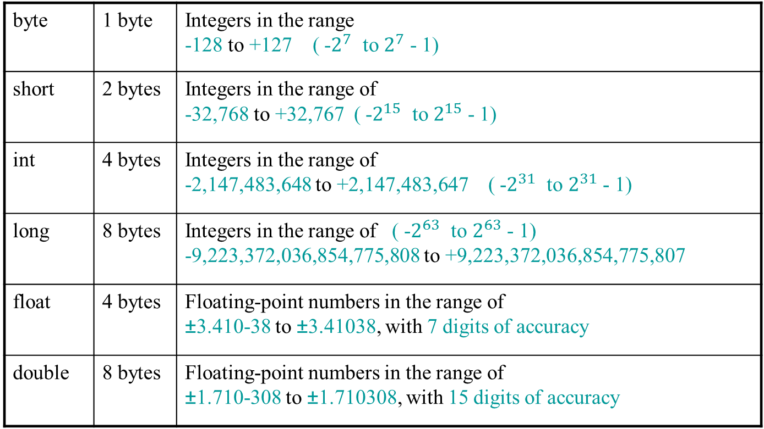
Numeric Data Types
byte | 1 byte
short | 2 bytes
int | 4 bytes
long | 8 bytes
float | 4 bytes | Floating-point numbers in the range of ±3.410-38 to ±3.41038, with 7 digits of accuracy
double | 8 bytes | Floating-point numbers in the range of ±1.710-308 to ±1.710308, with 15 digits of accuracy

Slide 73
Variable Declarations
Variable Declarations take the following form:
  DataType VariableName;
    byte inches;
    short month;
    int speed;
    long timeStamp;
    float salesCommission;
    double distance;
00000000
00000000 00000000
00000000 00000000 00000000 00000000

Slide 74
Integer Data Types
byte, short, int, and long are all integer data types.
They can hold whole numbers such as 5, 10, 23, 89, 107, etc. (within their ranges).
Integer data types cannot hold numbers with a decimal point. Unless,
Ex: int x = (int)4.56; …cast
Integers embedded into Java source code are called integer literals.
Ex: int x = 4;
See Example: IntegerVariables.java

Slide 75
Floating Point Data Types
Data types that allow fractional values are called floating-point numbers.
  1.7 and -45.316 are floating-point numbers.
In Java, two data types can represent floating-point numbers.
  float - also called single precision (8 decimal points).
  Ex. float x = 1.7F; x = (float)1.75;
  float x = 1.F/7.F; x = (float)(1./75);
  double - also called double precision (16 decimal points).
  Ex. double x = 1.7; or double x; x = 1.7;

Slide 76
Floating Point Literals
When floating point numbers are embedded into Java source code they are called floating-point literals.
The default type for floating point literals is double.
  29.75, 1.76, and 0.3151 are double data types.
  double xyzd, xywd = 1.76, xyvd = 0.3151;
  xyzd = 29.75;
Java is a strongly-typed language.
  For assigning a value to a variable,
    Java checks the data types of
      the variable and
      the value being assigned to it
    determine if they are compatible.
See example: Sale.java

Slide 77
Floating Point Literals
A double value is not compatible with a float variable because of its size and precision.
  float number;
  number = 23.5; // Error!
A double can be forced into a float by appending the letter F or f to the literal.
  float number;
  number = 23.5F; // This will work.
  number = 23.55f;

Slide 78
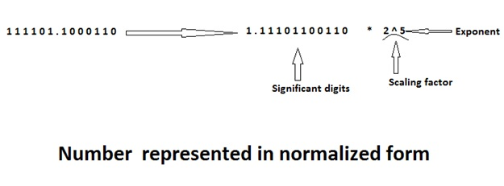
Floating Point Representation
The floating point representation has three fields:
  Sign = 0
  Significant digits (Mantissa) = 11101100110, and
  Exponents = 5
Let us consider the number 1 1 1 1 0 1. 1 0 0 0 1 1 0 (61.546875) to be represented in the floating point format.

Slide 79
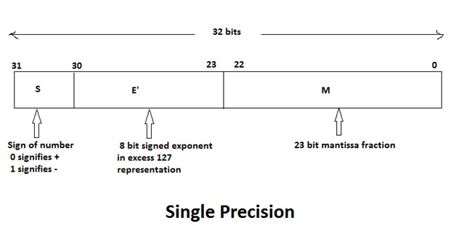
IEEE 754 Standards for Floating Point Numbers
7 digits after decimal point.
The exponent field is E' = E (Scaling factor) + bias (127), where 0 < E' < 255. This means that for 64-bit representation the actual exponent E is in the range -126 <= E <= 127.

Slide 80
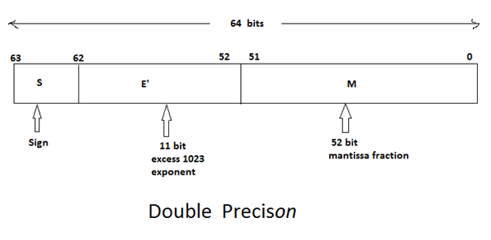
IEEE 754 Standards for Floating Point Numbers
15 digits after the decimal point.
The exponent field is E' = E (Scaling factor) + bias (1023) where 0 < E' < 2047. This means that for 64-bit representation the actual exponent E is in the range -1022 <= E <= 1023.

Slide 81
Conversion between Primitive Data Types
Primitive data type ranking:
Highest Rank double
float
long
int
short
Lowest Rank byte

Slide 82
Conversion between Primitive Data Types
Widening conversion
  In assignment statements, Java automatically converts the lower-ranked value to the highest-ranked type.
    double doubleValue;
    int intValue = 10;
    //Perform a widening conversion.
    doubleValue = intValue;
    Narrowing conversion
      The conversion of a value to a lower-ranked type.
      The conversions can potentially cause a loss of data.
      Java does not automatically perform them.

Slide 83
Conversion between Primitive Data Types
Bit representations for 127 and 128, respectively are
0000 0000 0000 0000 0000 0000 0111 1111
0000 0000 0000 0000 0000 0000 1000 0000
byte byteX; //declare …
//byteX = 128;//1000 0000 requires a cast
//Type mismatch: cannot convert from int to byte
byteX = 127; //byteX has 0111 1111;
short shortX;
shortX = byteX; //shortX has
// 0000 0000 0111 1111
int intX;
intX = byteX;
long longX;
longX = intX;
floatX = intX;
doubleX = intX;
Output Results:
byteX = 127
shortX = 127
intX = 127
longX = 127
floatX = 127.0
doubleX = 127.0

Slide 84
Conversion between Primitive Data Types
Bit representation for 128 is (2⁷ )
0000 0000 0000 0000 0000 0000 1000 0000
//byteX = 128;
//Type mismatch: cannot convert from int to byte
byteX = (byte)128;//byte has 1000 0000
shortX = byteX; //1111 1111 1000 0000
intX = byteX; //1111 1111 … 1111 1111 1000 0000 longX = intX;
float floatX;
floatX = intX;
double doubleX;
doubleX = intX;
Results:
byteX = -128
shortX = -128
intX = -128
longX = -128
floatX = -128.0
doubleX = -128.0

Slide 85
Conversion between Primitive Data Types
Bit representation for 32768 is (2¹⁵ )
0000 0000 0000 0000 1000 0000 0000 0000
//byteX = 32768; //Type mismatch: cannot convert from int to byte
byteX = (byte)32768; //byteX has 0000 0000
shortX=(short)32768; // shortX has 1000 0000 0000 0000
//which is -32768
intX = shortX; //1111 … 1111 1111 1000 0000 0000 0000
longX = intX;
floatX = intX;
doubleX = intX;
Results:
byteX = 0
shortX = -32768
intX = -32768
longX = -32768
floatX = -32768.0
doubleX = -32768.0

Slide 86
byte byteX; //declare …
byteX = -1; //initialize byteX to have 1111 1111;
short shortX; //declare…
shortX = byteX; //shortX has 1111 1111 1111 1111
int intX; //declare...
intX = shortX; //intX now has 1111 1111 1111 1111 1111 1111 1111 1111
long longX = intX;
float floatX = intX;
double doubleX = intX;
System.out.printf("Result: %s, %s, %s, %s, %f, %f\n", byteX, shortX, intX, longX, floatX, doubleX);
System.out.printf("doubleX = %f\n", doubleX);
System.out.println(byteX);
System.out.println(shortX);
System.out.println(intX);
System.out.println(longX);
System.out.println(floatX);
System.out.println(doubleX);
Result: -1, -1, -1, -1, -1.000000, -1.000000
doubleX = -1.000000
-1
-1
-1
-1
-1.0
-1.0

Slide 87
Conversion between Primitive Data Types
Cast Operators
  Allow programmers manually convert a value, even if it means that a narrow conversion will take place.
shortX = (short)intX;
longX = (long)doubleX;
intX = (int)doubleX;
byteX= (byte)1.56; //output 1

Slide 88
Floating Point Literals
Literals cannot contain embedded currency symbols or commas.
  grossPay = $1,257.00; // ERROR!
  grossPay = 1257.00; // Correct.
Floating-point literals can be represented in scientific notation.
  47,281.97 == 4.728197 x 10⁴.
Java uses E notation to represent values in scientific notation.
  4.728197x10⁴ == 4.728197E4.

Slide 89
Scientific and E Notation
Decimal Notation | Scientific Notation | E Notation
247.91 | 2.4791 x 10² | 2.4791E2
0.00072 | 7.2 x 10⁻⁴ | 7.2E-4
2,900,000 | 2.9 x 10⁶ | 2.9E6
See example: SunFacts.java

Slide 90
The boolean Data Type
The Java boolean data type can have two possible values.
    true
    false
The value of a boolean variable may only be copied into a boolean variable.
boolean truFalse; //define false //by default
truFalse = true;
truFalse = false;
See example: TrueFalse.java

Slide 91
boolean truthFalse = true;
while (truthFalse) {
System.out.println(truthFalse);
truthFalse = false;
}
System.out.println(truthFalse);
Output:
true
false
Boolean tF= true;
tF
false
true
System.out.print(…);

Slide 92
The char Data Type
The Java char data type provides access to single characters.
char symbol, letterA = 65, letterB;
symbol = 'A'; //41₁₆
letterB = 66; //42₁₆
char literals are enclosed in single-quote marks.
  'a', 'Z', '\n', '1’
  Don’t confuse char literals with string literals.
  char literals are enclosed in single quotes. 'A'
  String literals are enclosed in double-quotes. "A "
See example: Letters.java
Unicode for char is 2 bytes, ASCII for char is 1 byte.
65 is 0100 0001
66 is 0100 0010
\n is an escape sequence

Slide 93
The char Data Type
char symbol, letterA = 65, letterB;
symbol = 'A'; //41₁₆
letterB = 66; //42₁₆
System.out.println(letterA + " " + letterB + " " +
symbol + " " + (char)67 + " " +
'D' + " " + (char)68 + " " + 68);
Output: A B A C D D 68

Slide 94
Unicode
Internally, characters are stored as binary numbers.
Character data in Java is stored as Unicode characters, 2 bytes long. For example, AC is stored as
0000 0000 0100 0001 0000 0000 0100 0011
The Unicode character set can consist of 65536 (2¹⁶) individual characters, ranging from -32768 to 32767.
This means that each character takes up 2 bytes in memory.
The first 256 (2⁸) characters in the Unicode character set are compatible with the ASCII* character set.
For example, AC is stored as 0100 0001 0100 0011
See example: Letters2.java
*American Standard Code for Information Interchange (ASCII)

Slide 95
Unicode
A
Characters are
stored in memory
as binary numbers.
B
00
65
00
66
0
0
0
0
0
0
0
0
0
1
0
0
0
0
0
1
0
0
0
0
0
0
0
0
0
1
0
0
0
0
1
0

Slide 96
Unicode
A
The binary numbers
represent these
decimal values.
B
00
65
00
66
0
0
0
0
0
0
0
0
0
1
0
0
0
0
0
1
0
0
0
0
0
0
0
0
0
1
0
0
0
0
1
0

Slide 97
Unicode
A
B
00
41
The hexadecimal values
represent these
characters.
00
42
0
0
0
0
0
0
0
0
0
1
0
0
0
0
0
1
0
0
0
0
0
0
0
0
0
1
0
0
0
0
1
0

Slide 98
Variable Assignment and Initialization
To store a value in a variable, an assignment statement must be used.
The assignment operator is the equal (=) sign.
The operand on the left side of the assignment operator must be a variable name.
The operand on the right side must be
  either a literal or int x = 4, y = 6, z;
  expression z = 3*(x - 2*y) + x*y/3%5; //18-1
  that evaluates to a type that is compatible with the type of the variable.

Slide 99
Variable Assignment and Initialization
// This program shows variable assignments.
public class Initialize
{
public static void main(String[] args)
{
int month, days;
month = 2;
days = 28;
System.out.println("Month " + month +
" has " +
days + " Days.");
}
}
//The variables must be declared before they can be used.

Slide 100
Variable Assignment and Initialization
// This program shows variable assignments.
public class Initialize
{
public static void main(String[] args)
{
int month, days;
//Once declared, they can then receive a value (initialization);
//however the value must be compatible with the variable’s
//declared type.
month = 2; //inintialize a value (literal) 2
days = 28;
System.out.println("Month " + month + " has " +
days + " Days.");
System.out.printf("Month %d has %d Days.",
month, days);
}
}

Slide 101
Variable Assignment and Initialization
// This program shows variable assignments.
public class Initialize
{
public static void main(String[] args)
{
int month, days;
month = 2;
days = 28;
  /*
  * After receiving a value, the variables can then be
  * be used output statements or in other calculations.
  */
  System.out.println("Month " + month + " has " +
  days + " Days.");
  }
}

Slide 102
Variable Assignment and Initialization
// This program shows variable initialization.
public class Initialize
{
public static void main(String[] args)
{
/*
* Local variables can be declared and initialized on
* the same line.
*/
int month = 2, days = 28;
System.out.println("Month " + month + " has "
+ days + " Days.");
}
}

Slide 103
Variable Assignment and Initialization
Variables can only hold one value at a time.
Local variables do not receive a default value.
Local variables must have a valid type to be used.
public static void main(String [] args)
{
int month, days; //No value given…
//Trying to use uninitialized variables will generate a Syntax
// Error when the code is compiled.…
// The local variable days and months may not have been initialized
System.out.println("Month " + month + " has " +
days + " Days.");
}

Slide 104
Arithmetic Operators
The arithmetic operators are called binary operators because they must have two operands.
Each operator must have left and right operands.
e.g., aNum + bNum
See example: Wages.java
The arithmetic operators work as one would expect.
It is an error to try to divide any number by zero.
a/0
When working with two integer operands, the division operator requires special attention.
14/3 = 4; 14/3. = 3.66….

Slide 105
Arithmetic Operators
Java has five (5) arithmetic operators.
Operator | Meaning | Type | Example
+ | Addition | Binary | total = cost + tax;
- | Subtraction | Binary | cost = total – tax;
* | Multiplication | Binary | tax = cost * rate;
/ | Division | Binary | salePrice = original / 2;
% | Modulus | Binary | remainder = value % 5;

Slide 106

Integer Division
Division can be tricky.
  In a Java program, what is the value of 1/2?
  You might think the answer is 0.5…
  But, that’s wrong.
  The answer is simply 0.
Integer division will truncate any decimal remainder.
int iResult = ½; //iResult has 0;
double dResult = ½; //dResult has 0.0
double dResult = 1./2; //dResult has 0.5
double dResult = (double)1/2; dResult has 0.5
double dResult = (double)(1/2); dResult has 0.0

Slide 107
Operator Precedence
Mathematical expressions can be very complex.
There is a set order in which arithmetic operations will be carried out.
Operator | Associativity | Example | Result
- (unary negation) | Right to left | x = -4 + 3; | -1
* / % | Left to right | x = -4 + 4 % 3 * 13 + 2; | 11
+ - | Left to right | x = 6 + 3 – 4 + 6 * 3; | 23
Higher
Priority
Lower
Priority

Slide 108
Grouping with Parenthesis
When parentheses are used in an expression, the innermost parenthesis is processed first.
If two sets of parenthesis are at the same level, they are processed left to right.
x = ((4*5) / (5-2) ) – 25; //result = -19
3
1
2
4

Slide 109
Combined Assignment Operators
Java has some combined assignment operators.
These operators allow the programmer to perform an arithmetic operation and assignment with a single operator.
int x += 10;
Although not required, these operators are popular since they shorten simple equations.
  int x;
x = x + 10;

Slide 110
Combined Assignment Operators
Operator | Example | Equivalent | Value of variable after operation
+= | x += 5; | x = x + 5; | The old value of x plus 5.
-= | y -= 2; | y = y – 2; | The old value of y minus 2
*= | z *= 10; | z = z * 10; | The old value of z times 10
/= | a /= b; | a = a / b; | The old value of a divided by b.
%= | c %= 3; | c = c % 3; | The remainder of the division of the old value of c is divided by 3.

Slide 111
Creating Constants
literal value
  final double CAL_SALES_TAX = 0.725;
double salesAmount, salesTax;
salesAmount = 12000.50;
salesTax = salesAmount * CAL_SALES_TAX;
//CAL_SALES_TAX = 0.625; //error!
System.out.println(“Sales Tax = ” +
salesTax);
Console Output:
Sales Tax = 8700.3625

Slide 112
Creating Constants
Many programs have data that does not need to be changed.
Littering programs with literal values can make the program hard to read and maintain.
Replacing literal values with constants remedies this problem.
Constants allow the programmer to use a name rather than a value throughout the program.
Constants also give a singular point for changing those values when needed.

Slide 113
Creating Constants
Constants keep the program organized and easier to maintain.
Constants are identifiers that can hold only a single value.
Constants are declared using the keyword final.
Constants need not be initialized when declared;
  they must be initialized before they are used or a compiler error will be generated. e.g.,
final double CAL_SALES_TAX;
double totalAmount;
CAL_SALES_TAX = 0.0725; //7.25%
totalAmount = 100 + 100*CAL_SALES_TAX;

Slide 114
Creating Constants
Once initialized with a value, constants cannot be changed programmatically.
By convention, constants are all upper case, and words are separated by the underscore character.
final double CAL_SALES_TAX = 0.725;
final int CAL_SALES_TAX = 0.725;
  … Type mismatch: cannot convert from double to int
final int CAL_SALES_TAX = 3;
final double CAL_SALES_TAX = 3;

Slide 115
The String Class
Java has a non-primitive data type that holds a series of characters.
The String class from the Java standard library is used for this purpose.
To be useful, then a variable must be created to reference a String object.
  String number;
Notice the S in String is upper case.
By convention, class names should always begin with an uppercase character.

Slide 116
Primitive vs. Reference Variables
Primitive variables contain the value that they have been assigned. number
  short number = 25;
The value 25 will be stored in the memory location associated with the variable number.
Objects are not stored in variables, however. Objects are referenced by variables.
String number = "25"; // 0032₁₆ 0035₁₆ ;
// 50₁₀ 53₁₀
number
0000000 00011001
The object contains the string “25”
0000000000110010 0000000000110101

Slide 117
Primitive vs. Reference Variables
When a variable references an object, it contains the memory address of the object’s location.
Then it is said that the variable references the object.
  String cityName = "Charleston";
The object that contains the
character string “Charleston”
cityName
address to the object
Charleston
The cityName variable holds the address of a String object.
A String object

Slide 118
String Objects
A variable can be assigned a String literal.
  String value = "Hello";
Strings are the only objects that can be created in this way.
String value = "Hello";
A variable can be created using the new keyword.
  String value = new String("Hello");
This is the method that all other objects must use when they are created.
See example: StringDemo.java

Slide 119
The String Methods
String value = new String("250F");
String value = "250F";
Since String is a class, objects that are instances of it (the String class) have methods.
One of those methods is the length method.
  stringSize = value.length();
This statement runs the length method on the object pointed to by the value variable.
referenceVariable.method(arguments…)
See example: StringLength.java

Slide 120
String Methods
The String class contains many methods that help with the manipulation of String objects.
String objects are immutable, meaning that they cannot be changed.
Many of the methods of a String object can create new versions of the object.
String str = new String(“I am ”);
int strSize = str.length(); //5
str = “who am I”;
strSize = str.length(); //8
str = new String (“!?!”);
strSize = str.length(); //3
See example: StringMethods.java
strSize
5 8 3
str
I am
who am I
!?!

Slide 121
Scope
Scope refers to the part of a program that has access to a variable’s contents.
Variables declared inside a method (like the main method) are called local variables.
Local variables’ scope begins at the declaration of the variable and ends at the end of the method in which it was declared.
See example: Scope.java (This program contains an intentional error.)

Slide 122
Parts of a Java Program
import java.util.Random;
public class Methods01_5_1 {
public static void main(String[] args) {
int number = 101;
displayNumber(); //calling a method
System.out.println("\nThe obtained random number is " +
displayRandomNumber());
System.out.println("\n" + number);
} //end of main
public static void displayNumber() {
int number = 7;
System.out.println(number);
} //end of displayNumber
public static int displayRandomNumber() {
int number;
Random rand = new Random(); /*declare a variable named rand of Random class. Create an instance of the Random class. Assign the address of the Random class to the variable rand.*/
number = rand.nextInt();
return number;
} //end of displayRandomNumber
} //end of class
number
101
number
7
number
0

Slide 123
Commenting Code
Java provides three methods for commenting code.
Comment Style | Description
// | Single line comment. Anything after the // on the line will be ignored by the compiler.
/* * Com */ | Block comment. Everything beginning with /* and ending with the first */ will be ignored by the compiler. This comment type cannot be nested.
/** *… * … */ | Javadoc comment. This is a special version of the previous block comment that allows comments to be documented by the javadoc utility program. Everything beginning with the /** and ending with the first */ will be ignored by the compiler. This comment type cannot be nested.

Slide 124
Commenting Code
Javadoc comments can be built into HTML documentation.
See example: Comment3.java
To create the documentation:
  Run the javadoc program with the source file as an argument
  Ex: javadoc Comment3.java
The javadoc program will create index.html and several other documentation files in the same directory as the input file.

Slide 125
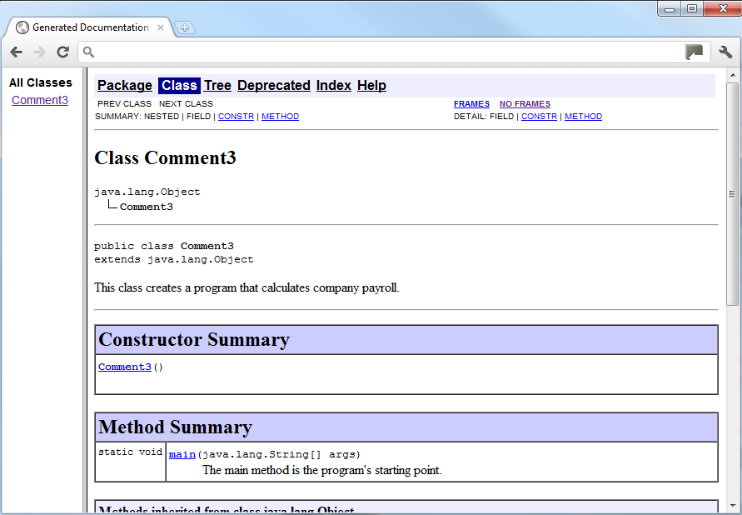
Commenting Code
Example index.html:

Slide 126
Programming Style
Although Java has a strict syntax, whitespace characters are ignored by the compiler.
The Java whitespace characters are:
  space
  tab
  newline
  carriage return
  form feed
See example: Compact.java

Slide 127
Indentation
Programs should use proper indentation.
Each block of code should be indented a few spaces from its surrounding block.
Two to four spaces are sufficient.
Tab characters should be avoided.
  Tabs can vary in size between applications and devices.
  Most programming text editors allow the user to replace the tab with spaces.
See example: Readable.java

Slide 128
The Scanner Class
To read input from the keyboard we can use the Scanner class.
The Scanner class is defined in java.util, so we will use the following statement, which must be at the top of our programs, before the program’s class header:
import java.util.Scanner;
This tells the compiler where to find the Scanner class.

Slide 129
The Scanner Class
Scanner objects work with System.in
To create a Scanner object:
Scanner keyboard = new Scanner(System.in);
Scanner class methods are listed in Table 2-17 in the text.
See example: Payroll.java
This declares a variable named keyboard. The variable can reference an object of the Scanner class.
This creates a Scanner object in memory. The object will read input from System.in
The = operator assigns the address of the Scanner object to the keyboard variable.

Slide 130
The Scanner Class - methods
Table 2-17
nextByte | byte byteX; //declaring byte byteX; Scanner keyboard = new Scanner(System.in); System.out.println(“Enter a byte value: ”); byteX = keyboard.nextByte(); Description: Returns input as a byte.
nextDouble | double dNumber; //declaring double dNumber; Scanner keyboard = new Scanner(System.in); System.out.println(“Enter a double value: ”); dNumber = keyboard.nextDouble(); Description: Returns input as a double.
nextFloat | float fNumber; //declaring float fNumber; Scanner keyboard = new Scanner(System.in); System.out.println(“Enter a float value: ”); fNumber = keyboard.nextFloat(); Description: Returns input as a float.

Slide 131
The Scanner Class - methods
nextInt | int intNumber; //declaring int intNumber; Scanner keyboard = new Scanner(System.in); System.out.println(“Enter an int value: ”); intNumber = keyboard.nextInt(); Description: Returns input as an int.
nextLine | String sName; //declaring String sName; Scanner keyboard = new Scanner(System.in); System.out.println(“Enter your name: ”); sName = keyboard.nextLine(); Description: Returns input as a String.
nextLong | long longNumber; //declaring long longNumber; Scanner keyboard = new Scanner(System.in); System.out.println(“Enter a long value: ”); longNumber = keyboard.nextLong(); Description: Returns input as a long.

Slide 132
The Scanner Class - methods
nextShort | short sNumber; //declaring short sNumber; Scanner keyboard = new Scanner(System.in); System.out.println(“Enter a long value: ”); sNumber = keyboard.nextShort(); Description: Returns input as a short. Integers in the range of -32768 (-2¹⁵) to 32767 (2¹⁵-1)
next | String firstName, middleName, lastName; Scanner keyboard = new Scanner(System.in); System.out.println(“Enter your fullname: ”); firstName = keyboard.next(); middleName = keyboard.next(); lastName = keyboard.next(); Description: Returns input as a String.
nextLine | //consume the remaining newline. keyboard.nextLine();

Slide 133
System.out.println("enter input") ;
Scanner kb = new Scanner(System.in);
kb.next();
System.out.println(kb.next() + " " + kb.next());
// kb.nextLine(); //consume the remaining newline.
System.out.println(kb.next());
System.exit(0);
Output:
enter input
John Kennedy, Jr. 12,234.0012345000. salesTax.
Kennedy, Jr.
12,234.0012345000.

Slide 134
int number;
Scanner keyboard = new Scanner(System.in);
System.out.println("Enter an int value: ");
number = keyboard.nextInt();
System.out.println(number);
System.out.println(); //skip a line
Scanner keyboard1 = new Scanner("12345");
number = keyboard1.nextInt();
System.out.println(number);
Enter an int value:
3456
3456
12345

Slide 135
//Scanner kb = new Scanner(System.in);
//System.out.println("Enter three numbers: ");
Scanner kb = new Scanner("123.45 111 222");
double number1D = kb.nextDouble();
double number2D = kb.nextDouble();
System.out.println("sum = "+ (number1D + number2D));
double sum = number1D + number2D;
//double number3D = kb.nextDouble();
//System.out.println("Total sum = " + (sum += number3D));
System.out.println("Total sum = " + (sum += kb.nextDouble()));
System.exit(0);
sum = 234.45
Total sum = 456.45

Slide 136
The Scanner Class
To read input from the keyboard we can use the Scanner class.
The Scanner class is defined in java.util.
  import java.util.Scanner;
  Scanner keyboard = new Scanner(System.in);
The keyboard variable
can hold the address A Scanner object
of a Scanner object
“This Scanner object is configured to read input from System.in”
address

Slide 137
Scanner kb = new Scanner(System.in);
System.out.println("Enter a floating point number: ");
double numberd = kb.nextDouble();
kb.nextLine(); //consume the remaining newline
System.out.println("Enter a string : ");
String numberS = kb.nextLine();
System.out.println(numberd + " and " + numberS);
Try the about statements without kb.nextLine();
Try the following statements without kb2.nextLine();
Scanner kb1 = new Scanner(System.in);
System.out.println("Enter a floating point number: ");
numberd = kb1.nextDouble();
Scanner kb2 = new Scanner(System.in);
System.out.println("Enter a string : ");
String numberS2 = kb2.nextLine();
System.out.println(numberd + " and " + numberS2);

Slide 138
The Scanner Class
int iNumber;
double dNumber;
String str;
//create a Scanner object to read input
Scanner kbInput = new Scanner(System.in);
System.out.print(“Enter the name of a person: ”);
str = kbInput.nextLine();
kbInput.nextLine(); // Consume the remaining // newLine;
System.out.print(“Enter an integer value: ”);
iNumber = kbInput.nextInt();
System.out.print(“Enter a floating point value: ”);
dNumber = kbInput.nextDouble();

Slide 139
The Scanner Class Methods
//create a Scanner object to read input
Scanner kbInput = new Scanner(System.in);
System.out.print(“Enter a byte value: ”);
byte bValue = kbInput.nextByte();
System.out.print(“Enter a float value: ”);
float fNumber = kbInput.nextFloat();
System.out.print(“Enter a long value: ”);
long lNumber = kbInput.nextLong();
System.out.print(“Enter a short value: ”);
short sNumber = kbInput.nextShort();
System.out.print(“Do you want to attend the” +
“ party? Yes or No: ”);
String inputLine = kbInput.nextLine();
char answer = inputLine.charAt(0);
int nosOfCharacter = inputLine.length();

Slide 140
import java.util.Scanner;
Scanner inputKB = new Scanner(System.in);
System.out.print("Enter 2 integers ");
int integerNos = inputKB.nextInt();
int integerNos2 = inputKB.nextInt();
System.out.println(2*integerNos);
System.out.println(inputKB.nextInt() + inputKB.nextInt());
//inputKB.nextLine();//consume the remaining newline.
System.out.print("Do you want to attend the" +
" party? Yes or No: ");
String inputLine = inputKB.nextLine();
char answer = inputLine.charAt(0);
System.out.print(answer + "\n");
Do you want to attend the party? Yes or No: Exception in thread "main" java.lang.StringIndexOutOfBoundsException: String index out of range: 0
at java.lang.String.charAt(Unknown Source)
at tryOnePK.Tryout.main(Tryout.java:23)

Slide 142
Dialog Boxes
A dialog box is a small graphical window that displays a message to the user or requests input.
A variety of dialog boxes can be displayed using the JOptionPane class.
Two of the dialog boxes are:
  Message Dialog - a dialog box that displays a message.
  Input Dialog - a dialog box that prompts the user for input.

Slide 143
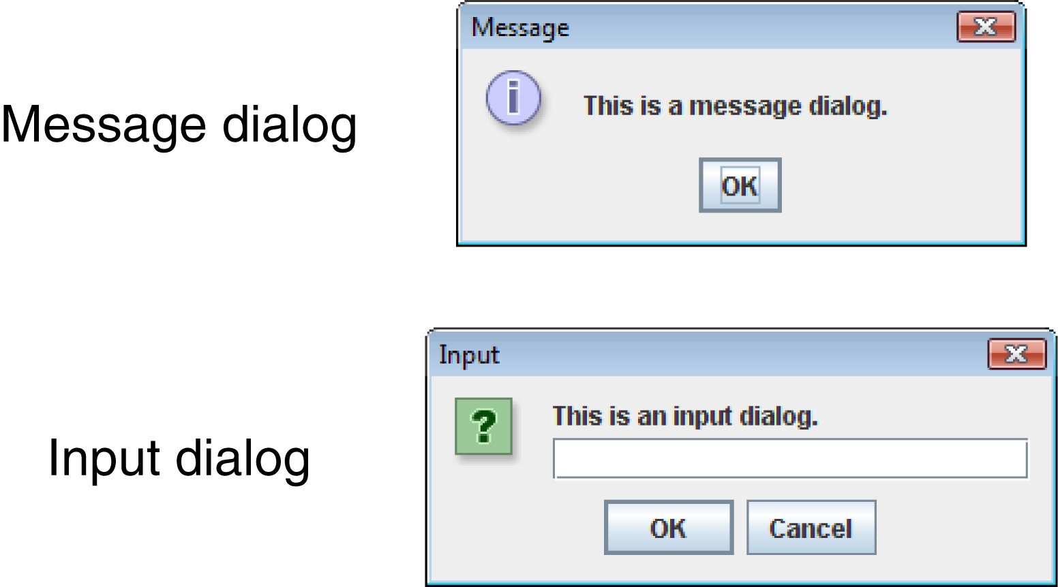
The JOptionPane Class
The JOptionPane class provides methods to display each type of dialog box.

Slide 144
The JOptionPane Class
The JOptionPane class is not automatically available to your Java programs.
JOptionPane is part of the Swing library for handling GUI (Graphical User Interface).
The following statement must be before the program’s class header:
  import javax.swing.JOptionPane;
This statement tells the compiler where to find the JOptionPane class.

Slide 145
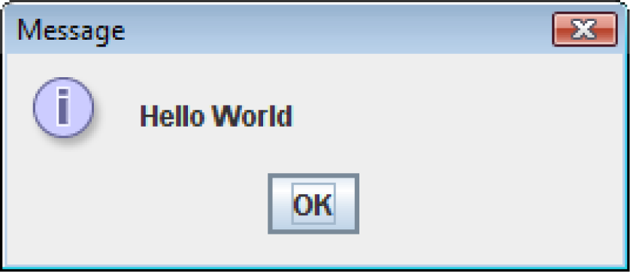
Message Dialogs
JOptionPane.showMessageDialog method is used to display a message dialog.
  JOptionPane.showMessageDialog(null, "Hello World");
The first argument is the Component parentComponent, indicating the parent window) and will be discussed in Chapter 7.
The second argument is the Object message, a message to be displayed in the message parameter.

Slide 146
Input Dialogs
An input dialog is a quick and simple way to ask the user to enter data.
The dialog displays a text field, an Ok button, and a Cancel button.
If Ok is pressed, the dialog returns the user’s input.
If Cancel is pressed, the dialog returns null.

Slide 147
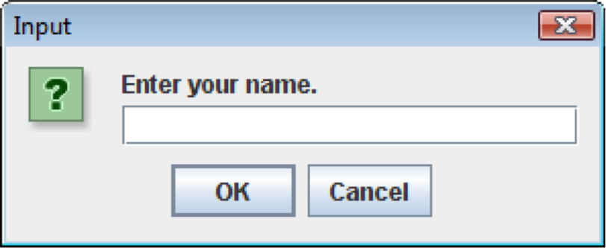
Input Dialogs
  String name;
  name = JOptionPane.showInputDialog(
  "Enter your name.");
The argument passed to the method is the message to display, such as JOptionPane.showMessageDialog(null, name);
If the user clicks on the OK button, the name references the string entered by the user.
If the user clicks on the Cancel button, the name references to null.

Slide 148
package simpleDemoP;
import javax.swing.JOptionPane;
public class SimpleCheck {
public static void main(String[] args) {
String name;
name = JOptionPane.showInputDialog(
"Enter your name.");
JOptionPane.showMessageDialog(null, name);
JOptionPane.showMessageDialog(null,
JOptionPane.showInputDialog(
"Enter your name."));
System.exit(0);
}
}

Slide 149
The System.exit Method
A program that uses JOptionPane does not automatically stop executing when the end of the main method is reached.
Java generates a thread, which is a process running in the computer when a JOptionPane is created.
If the System.exit method is not called, this thread continues to execute…System.exit(0);

Slide 150
The System.exit Method
The System.exit method requires an integer argument.
  System.exit(0);
This argument is an exit code that is passed back to the operating system.
This code is usually ignored; however, it can be used outside the program:
  to indicate whether the program ended successfully or as the result of a failure.
  The value 0 traditionally indicates that the program ended successfully.

Slide 151
Converting a String to a Number
The JOptionPane’s showInputDialog method always returns the user's input as a String
A String containing a number, such as “127.89”, can be converted to a numeric data type.
String str = JOptionPane.showInputDialog(
"Enter a floating point number.");
double dVar = Double.parseDouble(str);

Slide 152
The Parse Methods
Each of the numeric wrapper classes, (covered in Chapter 9) has a method that converts a string to a number.
      The Integer class has a method that converts a string to an int,
      The Double class has a method that converts a string to a double, and so forth
These methods are known as parse methods because their names begin with the word “parse.”

Slide 153
The Parse Methods
  // Store 1 in bVar. Convert a string to a byte
  byte bVar = Byte.parseByte("1");
  // Store 2599 in iVar.
  int iVar = Integer.parseInt("2599");
  // Store 10 in sVar.
  short sVar = Short.parseShort("10");
  // Store 15908 in lVar.
  long lVar = Long.parseLong("15908");
  // Store 12.3 in fVar.
  float fVar = Float.parseFloat("12.3");
  // Store 7945.6 in dVar.
  double dVar = Double.parseDouble("7945.6");

Slide 154
Reading an Integer with an Input Dialog
int number;
String str;
str = JOptionPane.showInputDialog(
"Enter a number.");
number = Integer.parseInt(str);

Slide 155
Reading an Integer with an Input Dialog
double price;
String str;
str = JOptionPane.showInputDialog(
"Enter the retail price.");
price = Double.parseDouble(str);
See example: PayrollDialog.java

Slide 156
JOptionPane Class’ Message Types
import javax.swing.JOptionPane;
public class QuestionInformationMessageJOP {
public static void main(String[] args) {
// about JOptionPane class’ message type
int x = 25;
double y = 1.0/3.0;
//JOptionpane message types, showConfirmDialog, showInputDialog, showMessageDialog,
//showOptionDialog
JOptionPane.showInputDialog("Enter the integer number: ", JOptionPane.QUESTION_MESSAGE);
JOptionPane.showMessageDialog(null, "initial velocity:"+ " "+x +"\ny ="+ y ,
"Trajectory data report", JOptionPane.YES_NO_OPTION);
JOptionPane.showMessageDialog(null, "initial velocity:"+ " "+x +"\ny ="+ (x + y) ,
"Trajectory data report1",JOptionPane.ERROR_MESSAGE);
JOptionPane.showMessageDialog(null, "initial velocity:"+ " "+x +"\ny ="+ y ,
"Trajectory data report2",JOptionPane.PLAIN_MESSAGE);
JOptionPane.showMessageDialog(null, "initial velocity:"+ " "+x +"\ny ="+ y ,
"Trajectory data report3",JOptionPane.INFORMATION_MESSAGE);
JOptionPane.showMessageDialog(null, "initial velocity:"+ " "+x +"\ny ="+ y ,
"Trajectory data report4",JOptionPane.QUESTION_MESSAGE);
JOptionPane.showMessageDialog(null, "initial velocity:"+ " "+x +"\ny ="+ y ,
"Trajectory data report5",JOptionPane.WARNING_MESSAGE);
JOptionPane.showConfirmDialog(null,"yes or no","",JOptionPane.YES_NO_OPTION);
JOptionPane.showConfirmDialog(null,"yes or no","Do you want to attend the party? ", JOptionPane.YES_NO_CANCEL_OPTION);
System.exit(0);
}
}

Slide 157
import java.util.Scanner;//Needed for Scanner class;
import javax.swing.JOptionPane;
public class NumericTypes_Read {
public static void main(String[] args) {
Scanner kb = new Scanner(System.in);
System.out.println("Pls. enter a string such as (Pls. Enter a Number): ");
String title = kb.nextLine();
int numberBox;
String strBox;
strBox = JOptionPane.showInputDialog( title);
numberBox = Integer.parseInt(strBox);
JOptionPane.showMessageDialog(null,
"The entered number is " + numberBox);
strBox = JOptionPane.showInputDialog(
"Enter a number.");
numberBox = Integer.parseInt(strBox);
JOptionPane.showMessageDialog(null,
"The entered number is " + numberBox);
System.exit(0);
}
}

Slide 158
package joptionPaneCh02_03P;
import javax.swing.JOptionPane;
public class DemoJOptionPane01 {
public static void main(String[] args) {
String str, task, title;
int intX, intY;
task = "Enter an integer: ";
title = "Input Data";
str = JOptionPane.showInputDialog(task, JOptionPane.QUESTION_MESSAGE);
intX= Integer.parseInt(str);
// intY= Integer.parseInt(str);
JOptionPane.showMessageDialog(null, task + intX, title, JOptionPane.INFORMATION_MESSAGE);
str = JOptionPane.showInputDialog(task, JOptionPane.QUESTION_MESSAGE);
intY= Integer.parseInt(str);
JOptionPane.showMessageDialog(null, task + intY, title, JOptionPane.INFORMATION_MESSAGE);
task = "Their sum is ";
JOptionPane.showMessageDialog(null, task + (intX + intY), title, JOptionPane.INFORMATION_MESSAGE);
task = "is x > y? ";
JOptionPane.showMessageDialog(null, task + (intX > intY),
"The result of the input data", JOptionPane.QUESTION_MESSAGE);
System.exit(0);
}
}

Slide 159
int number;
String str;
String task = "The entered number is ";
String taskSum = "Sum of the two numbers is ";
str = JOptionPane.showInputDialog(null,
"Enter a number.", "Get Input",
JOptionPane.INFORMATION_MESSAGE);
number = Integer.parseInt(str);
JOptionPane.showMessageDialog(null, task + number);
str = JOptionPane.showInputDialog(null,
"Enter a number.", "Get Input",
JOptionPane.QUESTION_MESSAGE);
double dNumber = Double.parseDouble(str);
JOptionPane.showMessageDialog(null, task + dNumber,
"New Number:", JOptionPane.WARNING_MESSAGE);
JOptionPane.showMessageDialog(null, taskSum + (number + dNumber),
"Their Sum", JOptionPane.WARNING_MESSAGE);
System.out.printf(taskSum + "%.2f", (number + dNumber));
System.exit(0);

Slide 160
JOptionPane.showConfirmDialog(null,"yes or no", "TryOut", JOptionPane.YES_NO_OPTION);
int yesNo = JOptionPane.showConfirmDialog(null,"yes or no", "Do you want to attend the party? ",
JOptionPane.YES_NO_CANCEL_OPTION);
if (yesNo == JOptionPane.YES_OPTION)
System.out.println("It is a yes!");
else if (yesNo == JOptionPane.NO_OPTION)
System.out.println("It is a no!");
else if(yesNo == JOptionPane.CANCEL_OPTION)
System.out.println("It is a cancel");
System.exit(0);

