Slide 1
Chapter 1
Introduction to Computers and Java

Slide 2
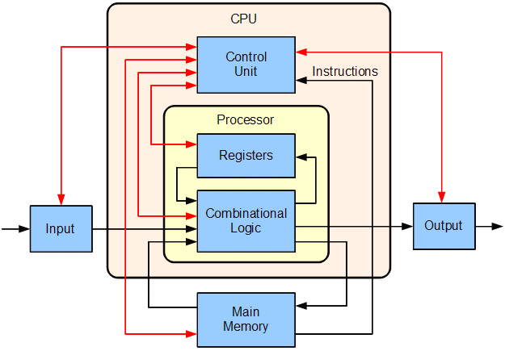
Computer System: Hardware and Software
Central processing unit.
The arithmetic and logic unit (ALU)
Random access memory (RAM)
Block diagram of a basic computer with a uniprocessor CPU. Black lines indicate data flow, whereas red lines indicate control flow. Arrows indicate the direction of flow.

Slide 3
Computer System: Hardware and Software:
the central processing unit (CPU).
program: a sequence of instructions stored in the memory.
When a computer is running a program:
  The CPU engages in a fetch/decoded and execute cycle process:
    Fetch The control unit fetches, from the main memory, the next instruction in the sequence of program instructions, encoded in the form of a number.
    Decode The control unit decodes the instruction and generates an electronic signal.
    Execute The signal is routed to the appropriate component of the computer, such as ALU, a disk drive, or other devices.
    The signal causes the component to perform an operation

Slide 4
Programming Languages
A programming language
  used to write computer programs.
Syntax – strict rules
  programming languages have.
  must be carefully followed.
A computer program
  a set of instructions a computer follows
  solve a problem or perform a task.
Algorithm
  Collectively, these instructions form an algorithm

Slide 5
Programming Languages
An algorithm
  a set of well-defined steps to completing a task.
  These steps are performed sequentially.
A computer needs the algorithm to be written in machine language.
Use binary numbers to write machine language
The binary numbering system (base 2)
  only has two digits (0 and 1).

Slide 6
Programming Languages
    Example, ASCII code: American Standard Code for Information Exchange ASCII, such as
  00100000 [32₁₀, (20₁₆)] represents space;
  01000001 [65₁₀, (41₁₆)] represents A;
  01100001 [97₁₀, (61₁₆)] represents a
  0011 0000 [48₁₀, (30₁₆)] for 0;
unicode

Slide 7
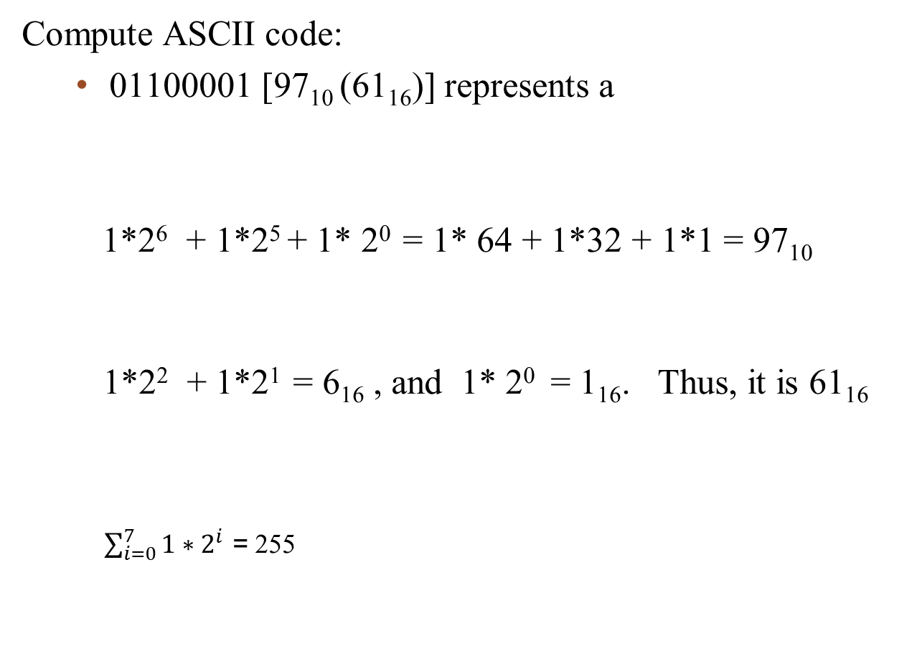
Programming Languages
0 | 1 | 1 | 0 | 0 | 0 | 0 | 1
2⁷ | 2⁶ | 2⁵ | 2⁴ | 2³ | 2² | 2¹ | 2⁰
0 | 1 | 1 | 0 | 0 | 0 | 0 | 1
2³ | 2² | 2¹ | 2⁰ | 2³ | 2² | 2¹ | 2⁰
1 | 1 | 1 | 1 | 1 | 1 | 1 | 1
2⁷ | 2⁶ | 2⁵ | 2⁴ | 2³ | 2² | 2¹ | 2⁰

Slide 8
Programming Languages
In the distant past, programmers wrote programs in machine language.
The first of these was assembler.
Assembler made things easier but was also processor dependent.
Programmers developed higher-level programming languages to make things easier.

Slide 9
Programming Languages
High-level programming languages followed that were not processor-dependent.
Some common programming languages:
BASIC
C++
Ruby
FORTRAN
C#
Perl
COBOL
Java
PHP
Pascal
JavaScript
Visual Basic
C
Python

Slide 10
Programming Languages:
Common Language Elements
Common concepts to all programming languages:
  Keywords: public, static, void, return
  Operators: *, /, +, -, %
  Punctuation: , , ;,
  Programmer-defined identifiers
  Strict syntactic rules.

Slide 11
Programming Languages
An Example of a Java Program
public class HelloWorld
{
public static void main(String[] args)
{
String message = "Hello World";
System.out.println(message + "!");
}
}

Slide 12
Programming Languages
An Example of a Java Program
Coding Listing – Payroll.java
public class Payroll
{
public static void main(String[] args)
{
int hours = 40;
double grossPay, payrate = 25.0;
grossPay = hours * payrate;
System.out.println(
“Your gross pay is $” + grossPay);
}
}

Slide 13
Programming Languages
Sample Programs
Keywords in the sample program are:
Keywords are lower-case (Java is a case-sensitive language).
Keywords cannot be used as a programmer-defined identifier (or programmer-defined name).
  Name of a variable
  Name of a memory location
  public
  class
  static
  void

Slide 14
Programming Languages
Sample Programs
Names of methods are:
System: a final class, a default package in Java, and cannot be instantiated.
out: a public (its access specifier) and static member field of System class, and is of type PrintStream.
println() is an overloaded method of PrintStream class
  main()
  println()
System.out.println();//Leave a line space

Slide 15
Programming Languages
Semi-colons (;) are used to end Java statements; however, not all lines of a Java program end a statement.
String message = "Hello World";
System.out.println(message + "!");
System.out.println(message + "!"
+ " My name is John Kenny. "
+ "I have $" + (20 + 40)+ ".");
Part of learning Java is to learn where to properly use punctuation.

Slide 16
Programming Languages
Lines vs Statements
There are differences between lines and statements when discussing source code.
System.out.println(
message);
This is one Java statement written using two lines.
Do you see the difference?
System.out.println(message);
A statement is a complete Java instruction that causes the computer’s output device to perform an action.
System.out.println(
“Your gross pay is $” + grossPay);

Slide 17
Programming Languages
Variables
Data in a Java program is stored in memory.
Variable name represents a location in memory.
Variables in Java are sometimes called fields.
Variables are created by the programmer and are called programmer-defined identifiers.
    example: int hours = 40;
The variable hours is created as an integer and assigned
the value of 40.
hours
(0x204)
00000000 00000000 00000000 00101000

Slide 18
Programming Languages
Variables
example: int hours = 40;
Variable is simply a name given to represent a location in memory.
0x000
0x004
0x008
hours
Its content
has the
value 40
0x00C
00000000 00000000 00000000 00101000
0x010
0x014
0x018
0x01C

Slide 19
Programming Languages
Variables
00000000 -- 01001000
The Java Virtual Machine (JVM)
decides where the value
will be placed in memory.
Assume that this
variable declaration
has been made.
int length = 72;
0x000
0x004
0x008
0x00C
72
72
0x010
0x014
The variable length
is a symbolic name for the memory location addressed 0x00C.
0x018
0x01C

Slide 21
The Compiler and the Java Virtual Machine
workspace – Java – simpleProgram/src/simpleProgramPK/HelloWorld.java – Eclipse
folder names Project name src Package name class name (JAVA File)
A programmer writes Java programming statements for a program.
    package simpleProgramPK;
    public class HelloWorld {
    public static void main(String[] args) {
    String message = "Hello World";
    System.out.println(message + "!");
    }
    }
These statements are known as source code.

Slide 22
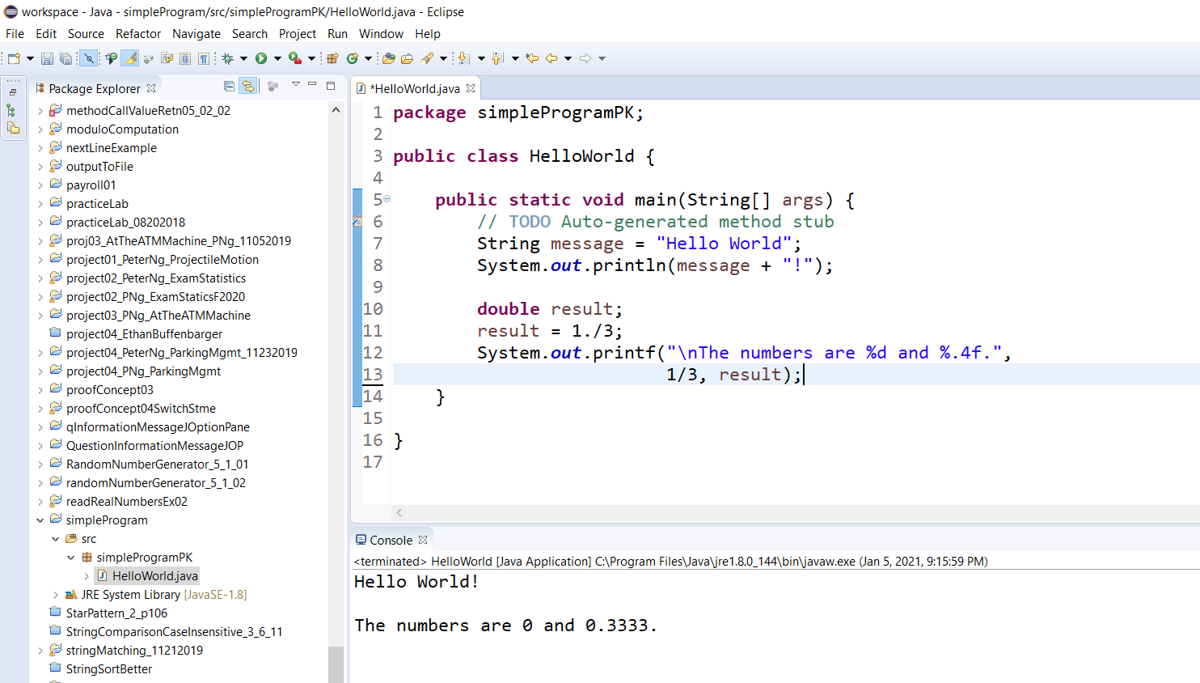
workspace – Java – simpleProgram/src/simpleProgramPK/HelloWorld.java – Eclipse
folder names Project name src Package name class name (JAVA File)
A Java source code file

Slide 23
The Compiler and the Java Virtual Machine
A compiler
  is run using a source code file as input.
Syntax errors
  That may be in the program will be discovered during compilation.
Syntax errors are mistakes that the programmer has made that violate the rules of the programming language.
The compiler creates another file that holds the translated instructions.

Slide 24
The Compiler and the Java Virtual Machine
Most compilers translate source code into executable files (folder bin) containing machine code.
binFolder bin;
packageFolder simpleProgramPK
byte code file HelloWorld.class
The Java compiler translates a Java source file into a file that contains byte code instructions.
Byte code instructions are the machine language of the Java Virtual Machine (JVM) and cannot be directly executed by the CPU.

Slide 25
The Compiler and the Java Virtual Machine
Byte code files end with the .class file extension. (folder bin)
For example: Byte code file HelloWorld.class
The JVM is a program that emulates a microprocessor.
  The JVM executes instructions as they are read.
JVM is often called an interpreter.
Java is often referred to as an interpreted language.

Slide 26
Program Development Process
Text editor
Saves Java statements
Source code
(.java)
Is read by
Java compiler
Byte code
(.class)
Produces
Is interpreted by
Java
Virtual
Machine
Program
Execution
Results in

Slide 27
Portability
Portable means that
  a program may be written on one type of computer and
  then run on a wide variety of computers, with little or no modification.
Java byte code runs on the JVM and not on any particular CPU; therefore, compiled Java programs are highly portable.
JVMs exist on many platforms:
Windows
Mac
Linux
Unix
BSD
etc.

Slide 28
Portability
With most programming languages,
  portability is achieved by compiling a program for each CPU it will run on.
Java provides a JVM for each platform
  programmers do not have to recompile for different platforms.

Slide 29
Portability
Byte code
(.class)
Java Virtual
Machine for Windows
Java Virtual
Machine for Unix
Java Virtual
Machine for Linux
Java Virtual
Machine for Mac

Slide 30
Compiling a Java Program
The Java compiler is a command line utility.
The command to compile a program is:
    javac filename.java
javac is the Java compiler.
The .java file extension must be used.
Example:
  To compile a java source code file named Payroll.java you would use the command:
    javac Payroll.java

Slide 32
The Programming Process
1. Clearly define what the program is to do.
2. Visualize the program running on the computer.
3. Use design tools to create a model of the program.
4. Check the model for logical errors.

Slide 33
The Programming Process
5. Enter the code and compile it.
6. Correct any errors found during compilation.
  Repeat Steps 5 and 6 as many times as necessary.
7. Run the program with test data for input.
8. Correct any runtime errors found while running the program.
  Repeat Steps 5 through 8 as many times as necessary.
9. Validate the results of the program.

Slide 34
Software Engineering
Encompasses the whole process of crafting computer software.
Software engineers perform several tasks in the development of complex software projects.
  designing,
  writing,
  testing,
  debugging,
  documenting,
  modifying, and
  maintaining.

Slide 35
Software Engineering
Software engineers develop:
  program specifications,
  diagrams of screen output,
  diagrams representing the program components and the flow of data (data flow diagrams and a architectural diagram),
  pseudocode,
  examples of expected input and desired output.

Slide 36
Software Engineering
Software engineers also use special software designed for testing programs.
Most commercial software applications are large and complex.
Usually a team of programmers, not a single individual, develops them.
Program requirements are thoroughly analyzed and divided into subtasks that are handled by
  individual teams
  individuals within a team.

Slide 37
Procedural Programming
Older programming languages were procedural.
A procedure is a set of programming language statements that, together, perform a specific task.
Procedures typically operate on data items that are separate from the procedures.
In a procedural program, the data items are commonly passed from one procedure to another.

Slide 38
Procedural Programming
Data Element
Procedure A
Procedure B

Slide 39
Procedural Programming
In procedural programming, procedures are developed to operate on the program’s data.
Data in the program tends to be global to the entire program.
Data formats might change and thus, the procedures that operate on that data must change.
n elements stored in array A in any order.
Used sequential search procedure to search whether key k is in the array A.
If n elements are stored in a binary search tree T, then the sequential search procedure can no longer be used.

Slide 40
import java.util.Random;
public class Methods01_5_1 {
public static void main(String[] args) {
double number = 14.712;
displayNumber(number); //calls a method
displayNumber(); //calls a method
System.out.println("\nThe obtained random number is " +
displayRandomNumber());
} //end of main
public static void displayNumber() {
int number = 7;
System.out.println(number);
}
public static void displayNumber(double nos) {
System.out.println(nos);
}
public static int displayRandomNumber() {
int number; .
Random rand = new Random(); /*declare a variable named rand of Random class. Create an instance of the Random class. Assign the address of the Random class to the variable rand.*/
number = rand.nextInt();
return number;
}
} //end of class methods01_5_1
Example of Procedure Programming

Slide 41
Object-Oriented Programming
Object-oriented programming is centered on creating objects rather than procedures.
Objects are a melding of data and procedures that manipulate that data.
Data in an object are known as attributes.
Procedures in an object are known as methods.

Slide 42
Object-Oriented Programming
Object
public class ArrayA{
private int[] X;
public void findx(int key){
...;
return found;}
…
}
Attributes (data)
Methods
(behaviors / procedures)
public static void main(…){
final int A_SIZE = 1000;
int[] ArrayA = new int[A_SIZE];
int keyfound = findx(55);
…
} //end of main()

Slide 43
Object-Oriented Programming
Object-oriented programming combines data and behavior (methods) via encapsulation.
Data hiding is the ability of an object to hide data from other objects in the program.
Only an object’s methods should be able to directly manipulate its attributes.
Other objects are allowed to manipulate an object’s attributes via the object’s methods.
This indirect access is known as a programming interface.

Slide 44
Object-Oriented Programming
Object
Programming
Interface
Attributes (data)
typically private to this object
Application
Programming
Interface (API)
Math.sqrt()
Methods
(behaviors / procedures)
Other
objects

Slide 45
Appendix

Slide 46
The Compiler and the Java Virtual Machine
workspace – Java – simpleProgram/src/simpleProgramPK/HelloWorld.java – Eclipse
folder names Project name src Package name class name (JAVA File)
A programmer writes Java programming statements for a program.
    package simpleProgramPK;
    public class HelloWorld {
    public static void main(String[] args) {
    String message = "Hello World";
    System.out.println(message + "!");
    }
    }
These statements are known as source code.

Slide 47
workspace – Java – simpleProgram/src/simpleProgramPK/HelloWorld.java – Eclipse
folder names Project name src Package name class name (JAVA File)
A Java source code file

Slide 48
workspace – Java – simpleProgram/src/simpleProgramPK/HelloWorld.java – Eclipse
folder names Project name src Package name class name (JAVA File)
Package name: simpleProgramPK
Class name: HelloWorld
main method header
Project name
.java file extension

Slide 49
The Compiler and the Java Virtual Machine
workspace – Java – simpleProgram/src/simpleProgramPK/HelloWorld.java – Eclipse
folder names Project name src Package name class name (JAVA File)
Eclipse: a text editor that is used to edit and save a Java source code file.
Source code file has a .java file extension. The source code of this program is in HelloWorld.java JAVA File.
This JAVA File is contained in a package file folder named simpleProgramPK.
This simpleProgramPK is contained in a file folder named src, which is in a folder with the project name: simpleProgram.
A compiler is a program that translates source code into an executable form.

Slide 50
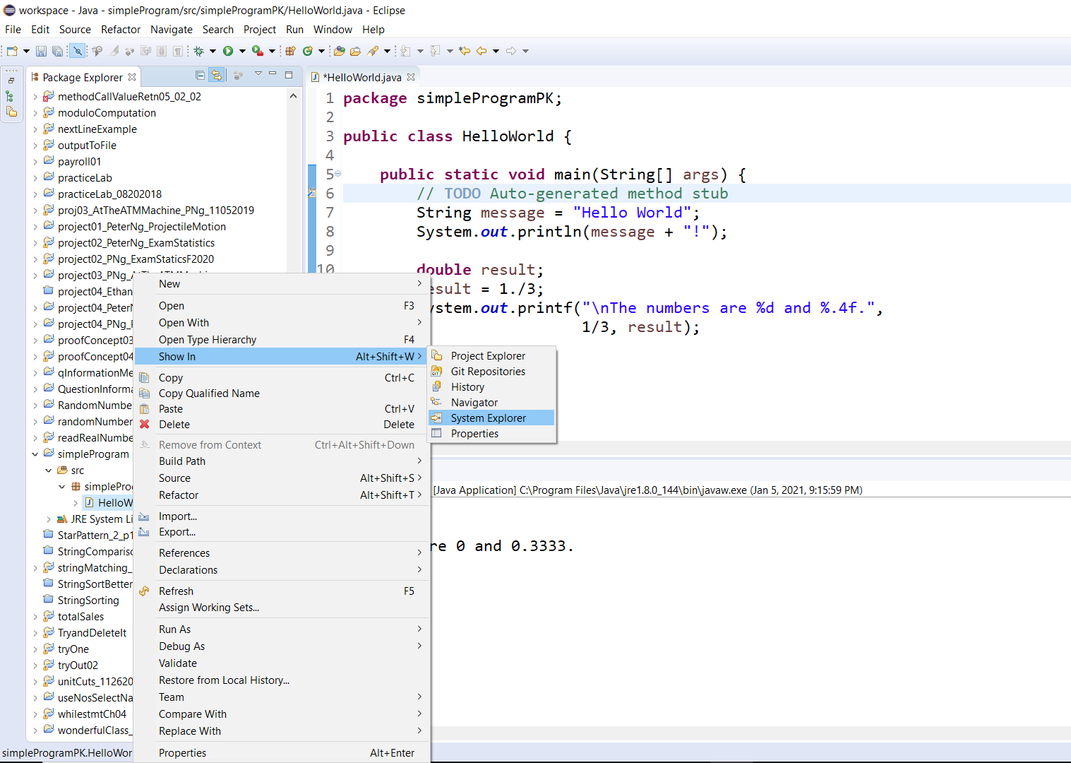
Place the cursor in simpleProgram (right click), bring the cursor to the Show In in the dropdown window, then continue to move the cursor to the right and the System Explorer (left click)

Slide 51
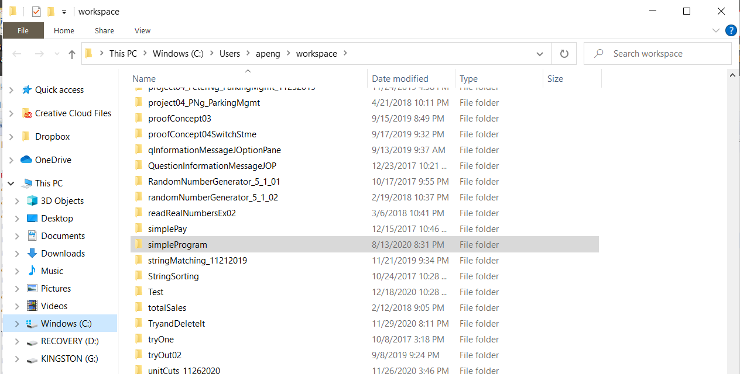
Click on simple program to open the folder

Slide 52
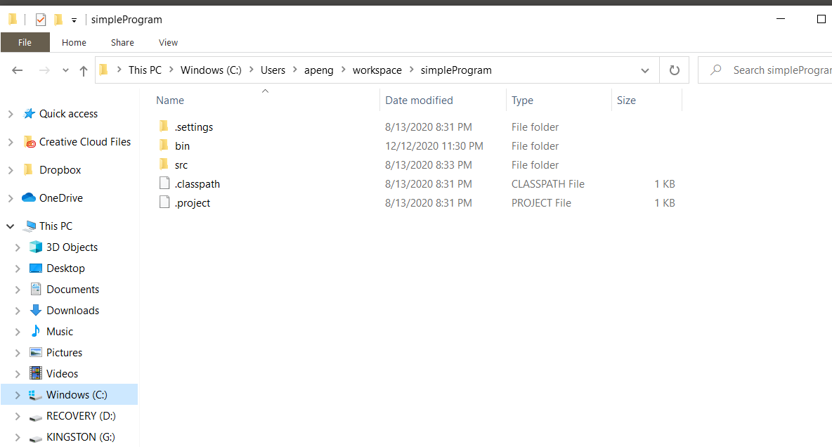
The simpleProgram File folder contains .settings File folder, bin File folder, src File folder, .classpath CLASSPATH File and .project PROJECT File.

Slide 53
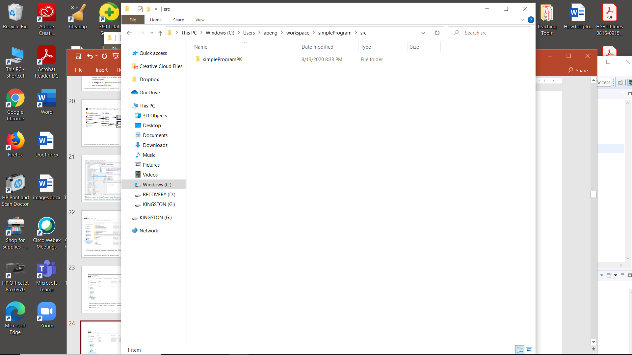

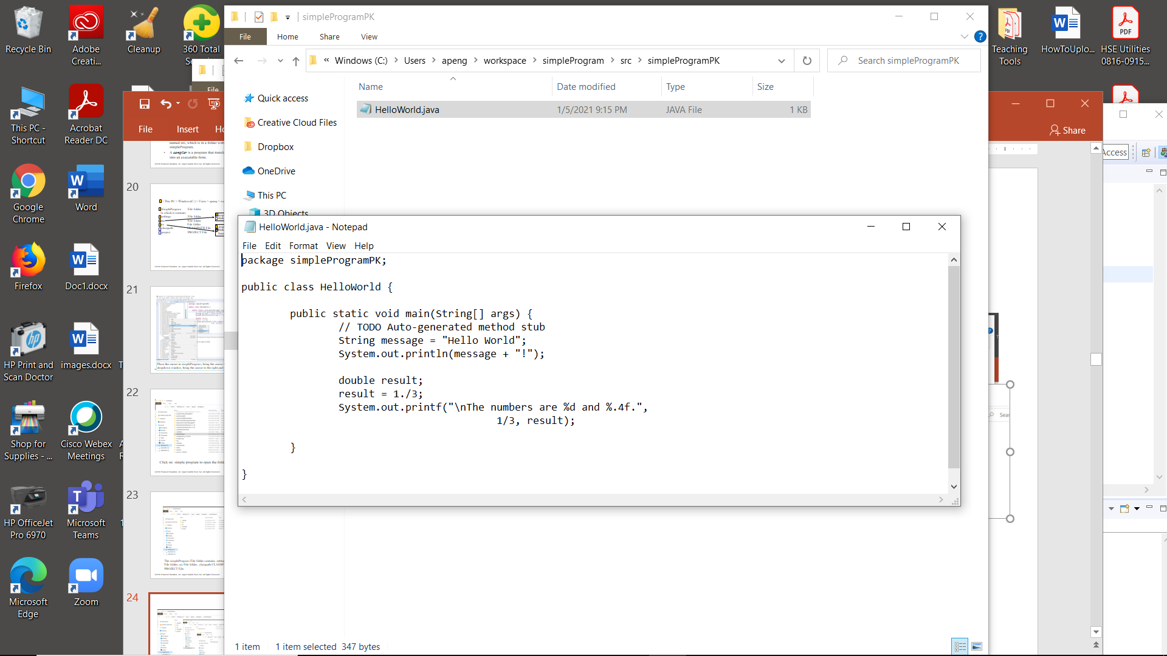
Open the src File folder to give the simpleProgramPK File folder, which contains the HelloWorld.java file extension, which has the source code.
Java source code file.
The class name which has a .java file extension
A Java source code file: A programmer writes Java programming statements for a program.

Slide 54
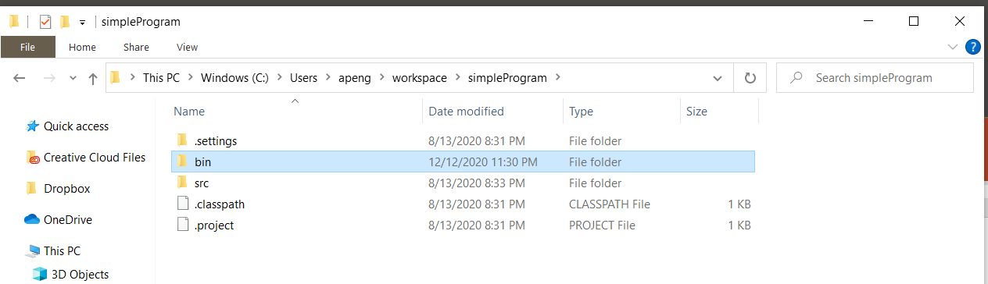
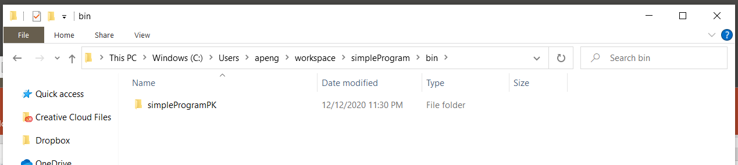

Open the bin File folder to have the simpleProgramPK File folder which contains the HelloWorld.class Class File.
Byte code

Slide 56
A way to show:
Zip your program to be a zipped file.
Submit (upload) this zipped file for your assignment.

Slide 57
Place the cursor in simpleProgram (right click), bring the cursor to the Show In in the dropdown window, then continue to move the cursor to the right and the System Explorer (left click)

Slide 58
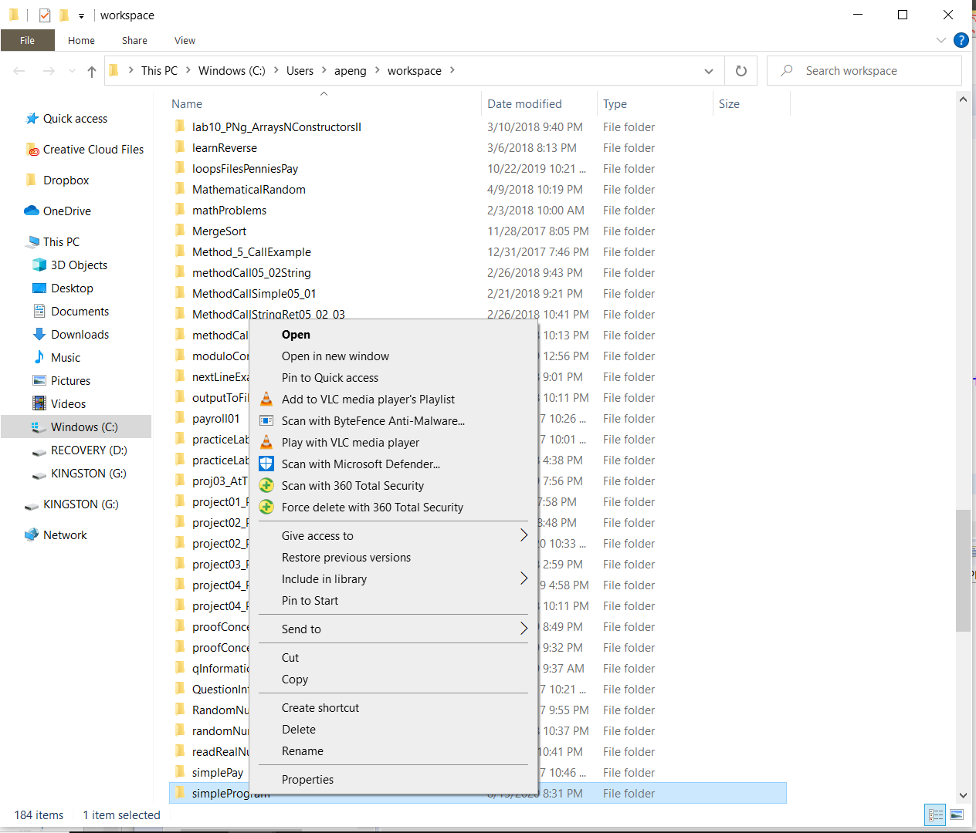
Place your cursor on the simpleProgram, right-click on it, and a dropdown window is generated.

Slide 59
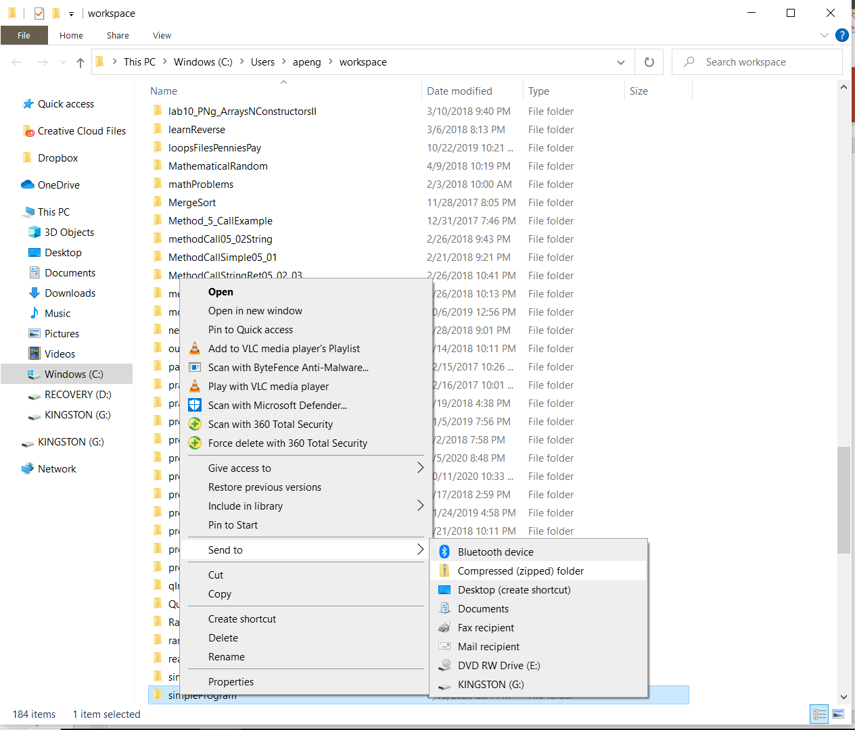
Move the cursor to Send to and then to the right to the Compressed (Zipped) folder. Then left click. A zipped file is generated.

Slide 60
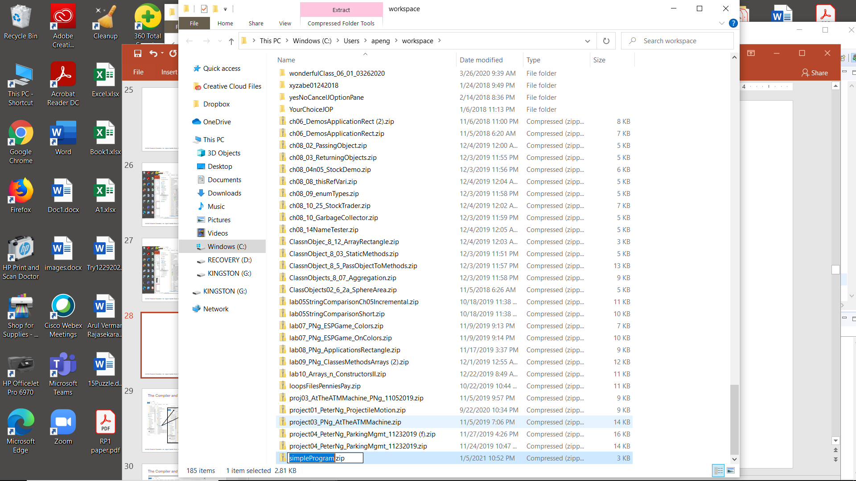
A zipped file is generated. Submit (upload) this zip file for your assignment.

Slide 62
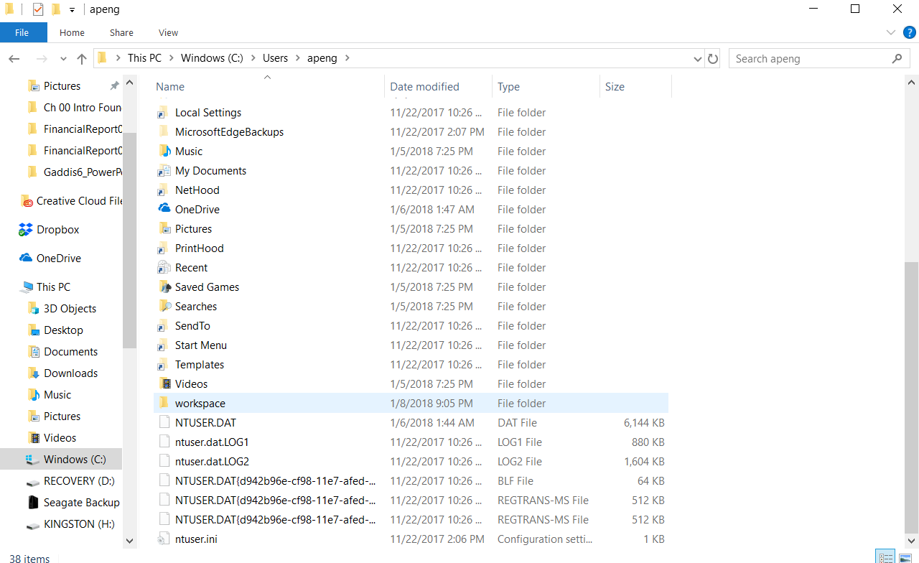
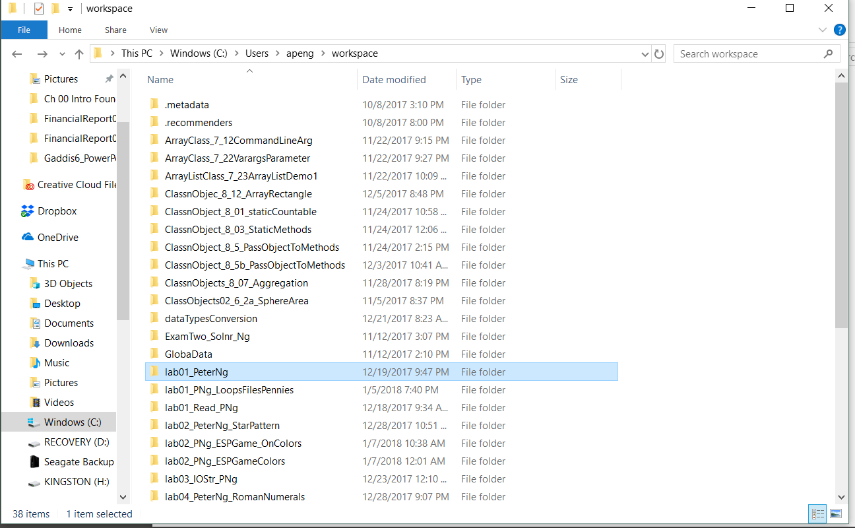
The Compiler and the Java Virtual Machine
Project name

Slide 63
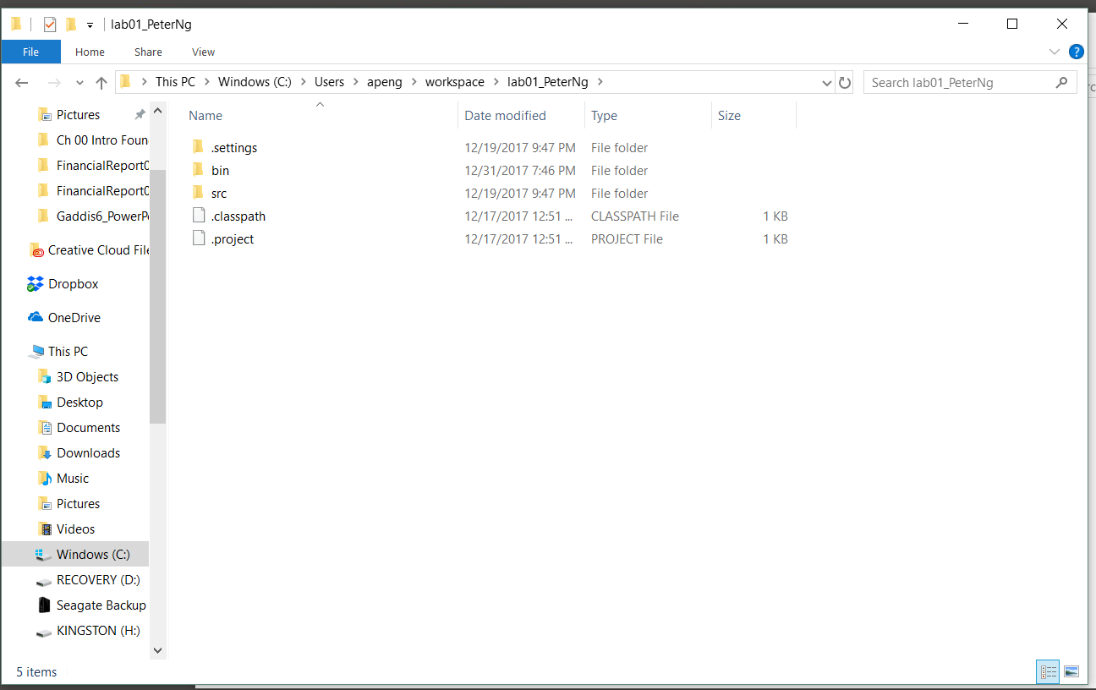
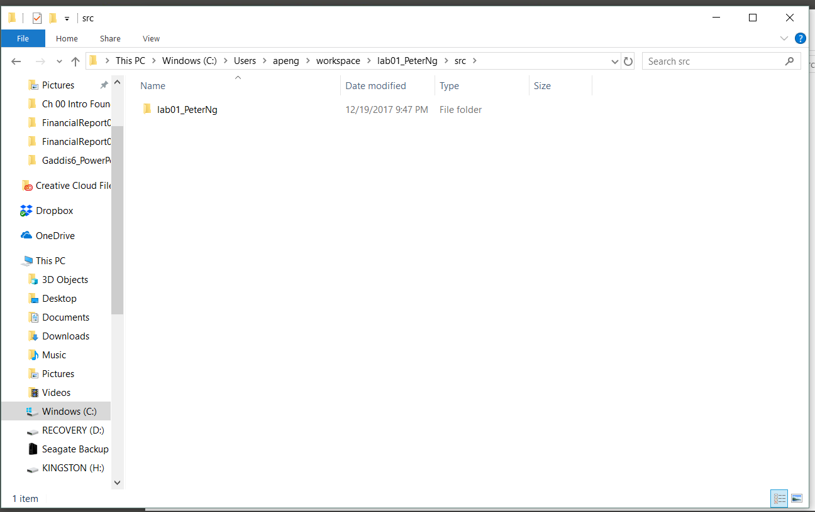
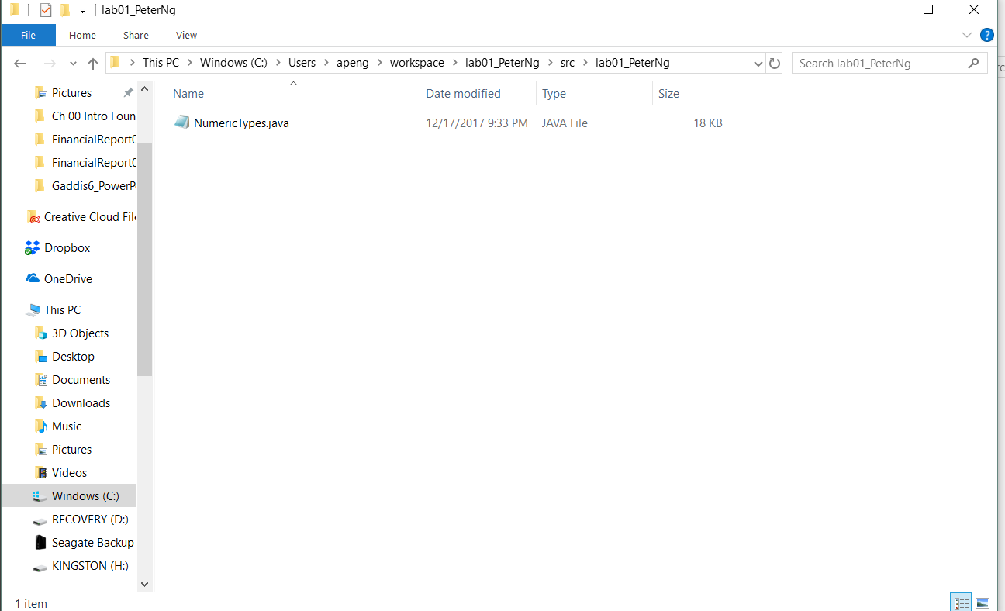
The Compiler and the Java Virtual Machine
Package name
Java source code file
The class name which has .java file extension

Slide 65
Java Versions
The software you use to write Java programs is called the Java Development Kit, or JDK.
Eclipse is a widely used Integrated Development Environment (IDE) for Java programming. It provides a comprehensive set of tools to facilitate the development, debugging, and deployment of Java applications
Download the version of Eclipse IDE for Java Developers to your computer using Windows x86_64 or macOS x86_64

Slide 66
JVM:
Java Virtual Machine (JVM) is an abstract computing machine.
Java programs are written against the JVM specification.
JVM is specific for OS platform and they translate the Java instructions to the underlying platform-specific instructions and execute them.
JVM enables Java programs to be platform-independent.

Slide 67
JRE:
Java Runtime Environment (JRE) is an implementation of the JVM and Java API (Applications Programming Interface).

Slide 68
JDK:
Java Development Kit (JDK) contains JRE along with various development tools like Java libraries, Java source compilers, Java debuggers, bundling, and deployment tools.

Slide 69
JIT:
Just-in-time Compiler (JIT)JIT is the part of the Java Virtual Machine (JVM) that is used to speed up the execution time.
JIT compiles parts of the byte code that have similar functionality at the same time, and hence reduces the amount of time needed for compilation.
The term “compiler” refers to a translator from the instruction set of a Java virtual machine (JVM) to the instruction set of a specific CPU.

Slide 70
Java is Dynamic
The compiler compiles .java files into .class files containing byte code.
The compiler searches the current directory and directories specified in the CLASSPATH environment variable to find other classes explicitly referenced by name in each source code file.

