Slide 1
Chapter 05
Brute Force and Exhaustive Search
and
String Matching

Slide 2

Brute Force and Exhaustive Search
The brute-force approach – another way of saying,
  “Just do it!”
Brute force is a straightforward approach to solving a problem, usually directly based on
  the problem statement and definitions of the concepts involved.
The “force” is, implied by the strategy’s definition,
  that of a computer and
  not that of one’s intellect.

Slide 3
Examples of Brute Force:
Consider the exponentiation problem:
compute a^{n} for a given nonzero number a and a nonnegative integer n.
A principal component of a leading encryption algorithm:
Compute a^{n} mod m for some large integers.
3. An algorithm for computing gcd(m, n):
  Consecutive integer checking algorithm for computing gcd(m, n).
4. Algorithm MatrixMultiplication(A[0..n-1, 0..n-1], B [0..n-1, 0..n-1]).

Slide 4
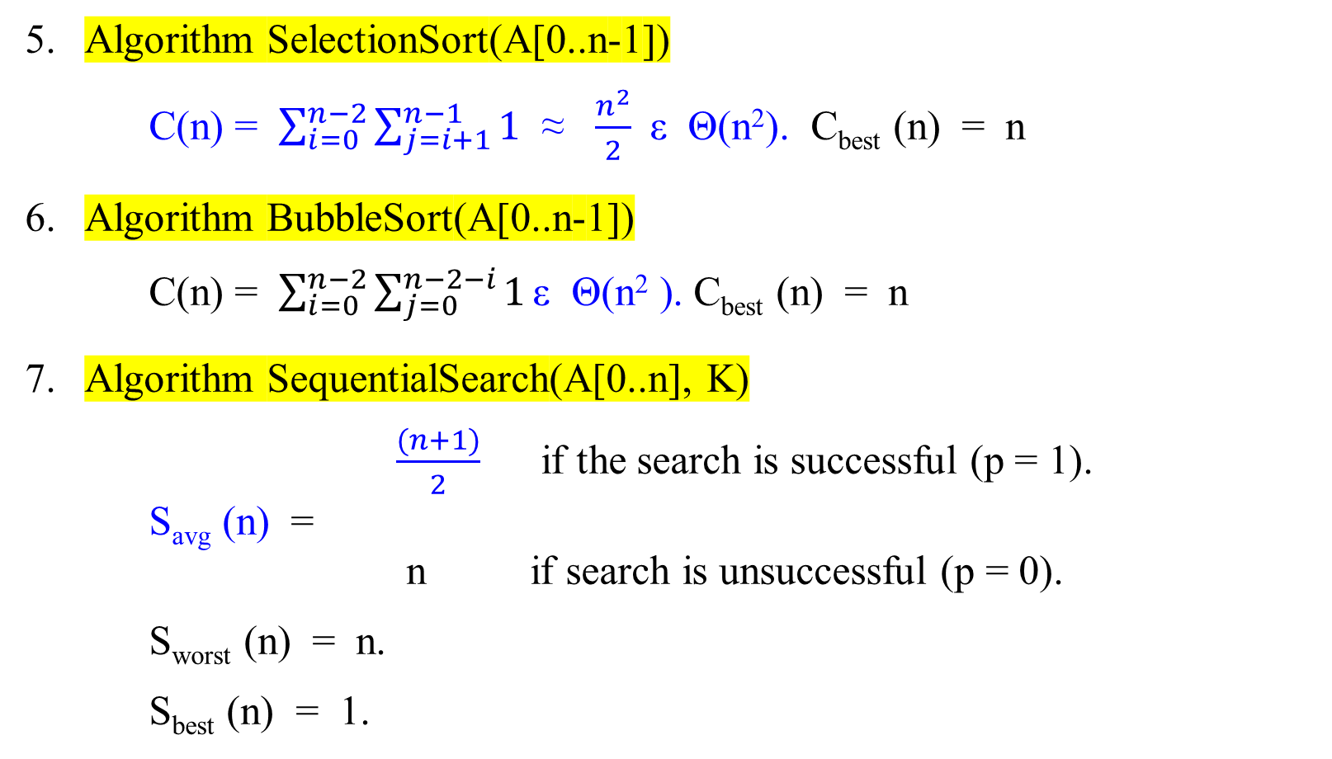
5. Algorithm SelectionSort(A[0..n-1])
C(n) = $\sum_{i=0}^{n−2}{\sum_{j=i+1}^{n−1}{1}}$ ≈ $\frac{n^{2}}{2}$ε Θ(n²). C_{best} (n) = n
6. Algorithm BubbleSort(A[0..n-1])
C(n) = $\sum_{i=0}^{n−2}{\sum_{j=0}^{n−2−i}{1}}\text{ε} \text{Θ}\text{(}\text{n}\text{2}\text{ )}$. C_{best} (n) = n
7. Algorithm SequentialSearch(A[0..n], K)
$\frac{(n+1)}{2}$ if the search is successful (p = 1).
S_{avg} (n) =
n if search is unsuccessful (p = 0).
S_{worst} (n) = n.
S_{best} (n) = 1.

Slide 5
Selection Sort
  Start selection sort by scanning the entire given list to find its smallest element and exchange it with the first element, putting the smallest element in its final position in the sorted list.
  2. Then scan the list, starting with the second element to find the smallest among the last n-1 elements and exchange it with the second element, putting the second smallest element in its final position.
  3. Generally, on the ith pass through the list, which we number from 0 to n-2, the algorithm searches for the smallest item among the last n-i elements and swaps it with A_{i} :
A₀ ≤ A₁ ≤ … ≤ A_{i-1} | A_{i} , . . . , A_{min} , . . . , A_{n-1}
in their final position the last n-i elements. [n-1-(i-1) = n-i]
  4. After n-1 passes, the list is sorted.

Slide 6
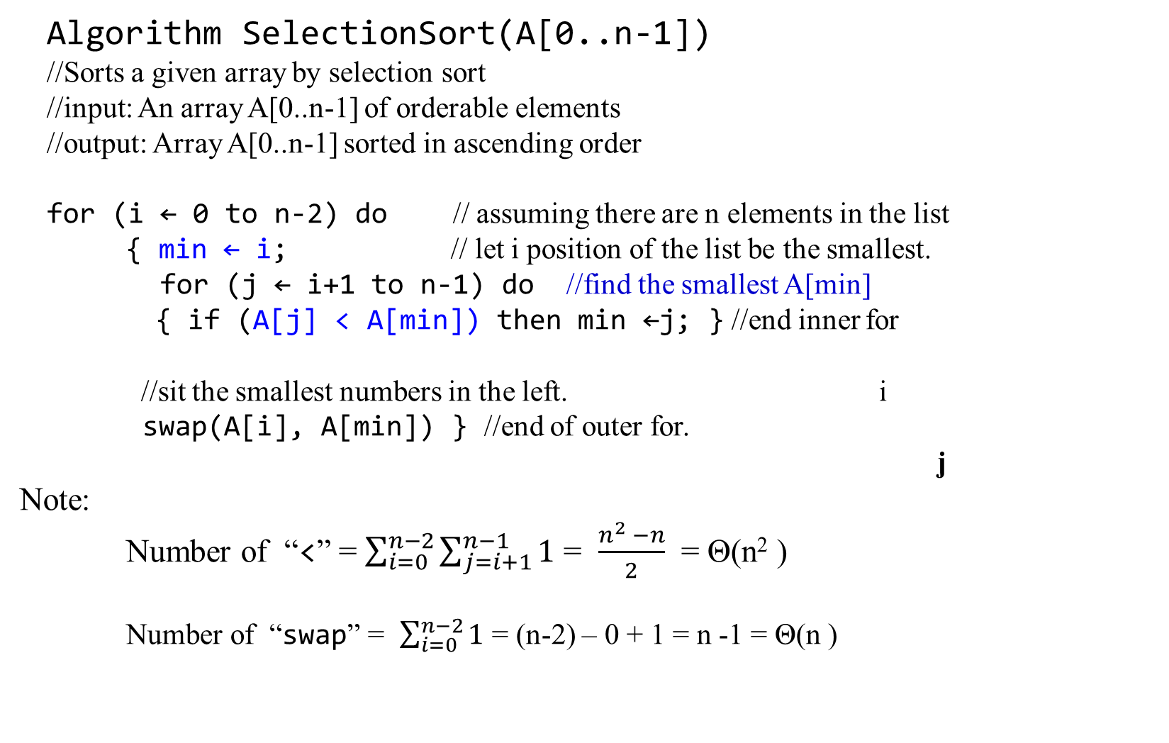
Algorithm SelectionSort(A[0..n-1])
//Sorts a given array by selection sort
//input: An array A[0..n-1] of orderable elements
//output: Array A[0..n-1] sorted in ascending order
for (i ← 0 to n-2) do // assuming there are n elements in the list
{ min ← i; // let i position of the list be the smallest.
for (j ← i+1 to n-1) do //find the smallest A[min]
{ if (A[j] < A[min]) then min ←j; } //end inner for
//sit the smallest numbers in the left. i
swap(A[i], A[min]) } //end of outer for.
j
Note:
Number of “<” = $\sum_{i=0}^{n−2}{\sum_{j=i+1}^{n−1}{1}}$ = $\frac{n^{2} −n}{2}$ = Θ(n² )
Number of “swap” = $\sum_{i=0}^{n−2}{1}$ = (n-2) – 0 + 1 = n -1 = Θ(n )

Slide 7
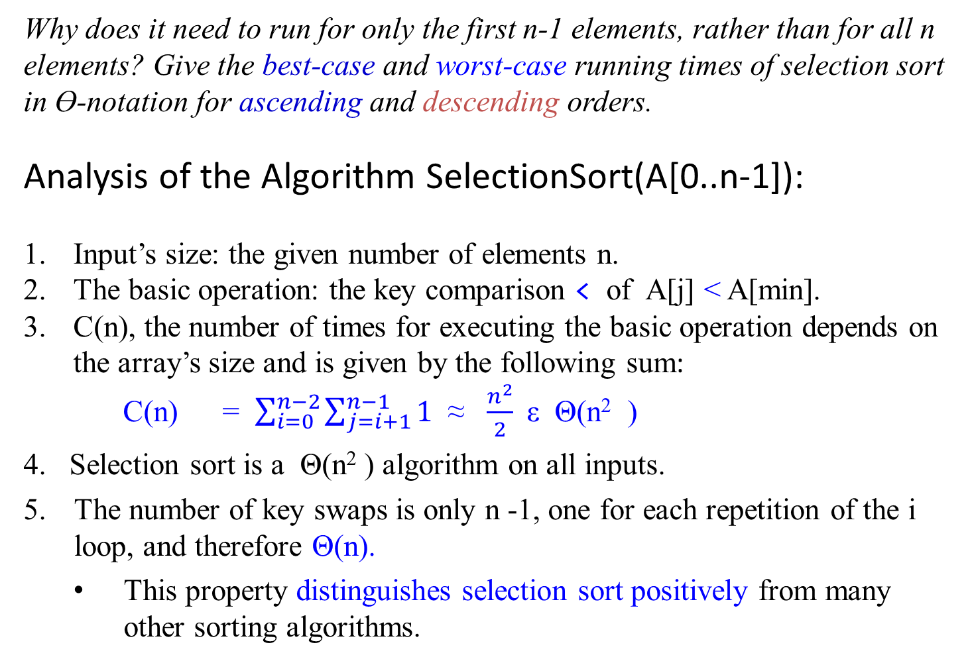
Why does it need to run for only the first n-1 elements, rather than for all n elements? Give the best-case and worst-case running times of selection sort in Ɵ-notation for ascending and descending orders.
Analysis of the Algorithm SelectionSort(A[0..n-1]):
Input’s size: the given number of elements n.
The basic operation: the key comparison < of A[j] < A[min].
C(n), the number of times for executing the basic operation depends on the array’s size and is given by the following sum:
C(n) = $\sum_{i=0}^{n−2}{\sum_{j=i+1}^{n−1}{1}}$ ≈ $\frac{n^{2}}{2}$ε Θ(n² )
4. Selection sort is a Θ(n² ) algorithm on all inputs.
The number of key swaps is only n -1, one for each repetition of the i loop, and therefore Θ(n).
  This property distinguishes selection sort positively from many other sorting algorithms.

Slide 8


C(n) = $\sum_{i=0}^{n−2}{\sum_{j=i+1}^{n−1}{1}}$
= $\sum_{i=0}^{n−2}{[\left(n−1\right)−\left(i+1\right)+1]}$
= $\sum_{i=0}^{n−2}{[n−1−i]}$
= n $\sum_{i=0}^{n−2}{1}$ – $\sum_{i=0}^{n−2}{1}$ - $\sum_{i=0}^{n−2}{i}$
= n (n - 2 + 1)(n – 1) – $\frac{1}{2}$*(n – 2)(n -1)
= n² - 2n + n – n + 2 -1 – $\frac{1}{2}$* (n² – 3n + 2)
= $\frac{\text{(2 }\text{n}\text{2}\text{ – 4}\text{n}\text{ + 2 − }\text{n}\text{2}\text{ + 3}\text{n}\text{ − 2 )}}{2}$
= $\frac{\text{(}\text{n}\text{2}\text{ – }\text{n}\text{ )}}{2}$
≈ $\frac{ \text{n}\text{2} }{2}$ ε Θ(n² )

Slide 9
Bubble Sort
Another brute-force application to the sorting problem:
  Repeatedly, bubbling up the largest element to the last position on the list.
  The next pass bubbles up the second largest element and so on until after n-1 passes, the list is sort.
  Pass i (0 ≤ i ≤ n-2) of bubble sort can be represented by the following diagrams:
  A₀, … , A_{j} ←?→ A_{j+1}, … A_{n-i-1} | A_{n-i} ≤ … ≤ A_{n-1}
  in their final positions

Slide 10
A pseudocode of this algorithm is as follows:
Algorithm BubbleSort(A[0..n-1])
//Sort a given array by bubble sort
//Input: An array A[0..n-1] of orderable elements
//Output: Array A[0..n-1] sorted in ascending order
//consider only n elements, and i moves from the 1st to n-1th element.
for (i ← 0 to n-2) do {
//allow j moves from 0 to next largest elements placing orderly in the right.
for (j ← 0 to n-2-i) do {
// compare every two elements from left to the right within j range.
if (A[j+1] < A[j]) then swap(A[j], A[j+1]) ;
//move the largest element to the right ...
} //end of inner for loop
} //end of outer for loop
i
. . . .
j

Slide 11
for (i ← 0 to n-2) do {
//allow j moves from 0 to next largest elements placing orderly in the right.
for (j ← 0 to n-2-i) do {
// compare every two elements from left to the right within j range.
if (A[j+1] < A[j]) then swap(A[j], A[j+1]) ;
}
}
When i = 0, j will go from 0 to n-2. Then,
A[1] < A[0]; A[2] < A[1]; …; A[n-2+1] < A[n-2]; This set A[n-1] is the largest.
When i = 1, j will go from 0 to n-3. Then,
A[1] < A[0]; A[2] < A[1]; …; A[n-3+1] < A[n-3]; This set A[n-2] is the second largest.
When i = n-i-1, j will go from 0 to i -1. Then,
A[1] < A[0]; A[2] < A[1]; …; A[i] < A[i-1]; This set A[i] is the i-1th largest.
When i = n-2, j will go from 0 to 0. Then,
A[1] < A[0]; This set A[1] is the least second largest and A[0] is the smallest.

Slide 12
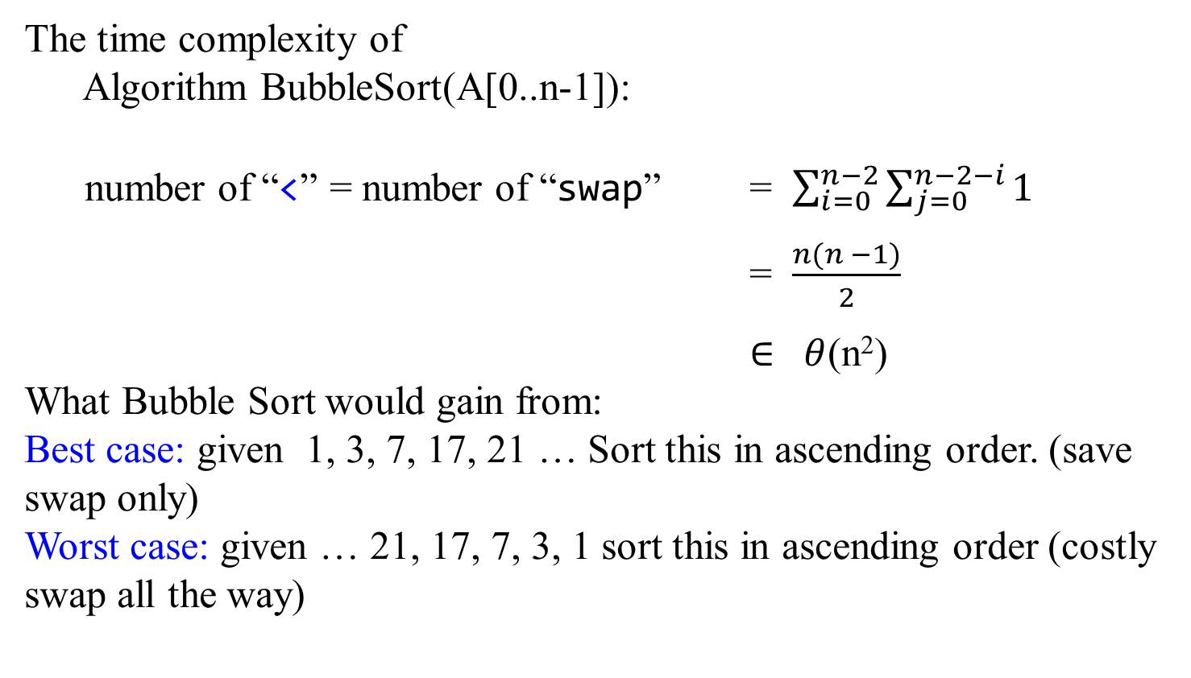
A Quick Look
The time complexity of
Algorithm BubbleSort(A[0..n-1]):
number of “<” = number of “swap” = $\sum_{i=0}^{n−2}{\sum_{j=0}^{n−2−i}{1}}$
= $\frac{n(n −1)}{2}$
$∈ θ$(n²)
What Bubble Sort would gain from:
Best case: given 1, 3, 7, 17, 21 … Sort this in ascending order. (save swap only)
Worst case: given … 21, 17, 7, 3, 1 sort this in ascending order (costly swap all the way)

Slide 13
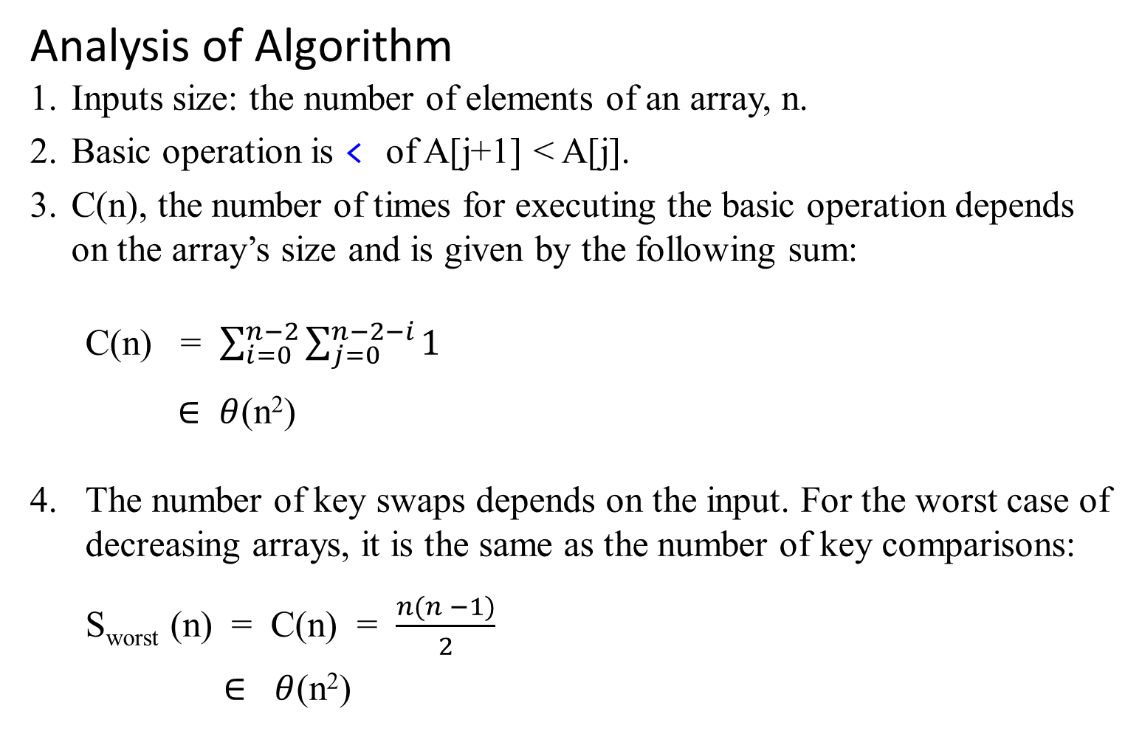
Analysis of Algorithm
Inputs size: the number of elements of an array, n.
Basic operation is < of A[j+1] < A[j].
C(n), the number of times for executing the basic operation depends on the array’s size and is given by the following sum:
C(n) = $\sum_{i=0}^{n−2}{\sum_{j=0}^{n−2−i}{1}}$
$∈ θ$(n²)
The number of key swaps depends on the input. For the worst case of
decreasing arrays, it is the same as the number of key comparisons:
S_{worst} (n) = C(n) = $\frac{n(n −1)}{2}$
$∈$ $θ$(n²)

Slide 14
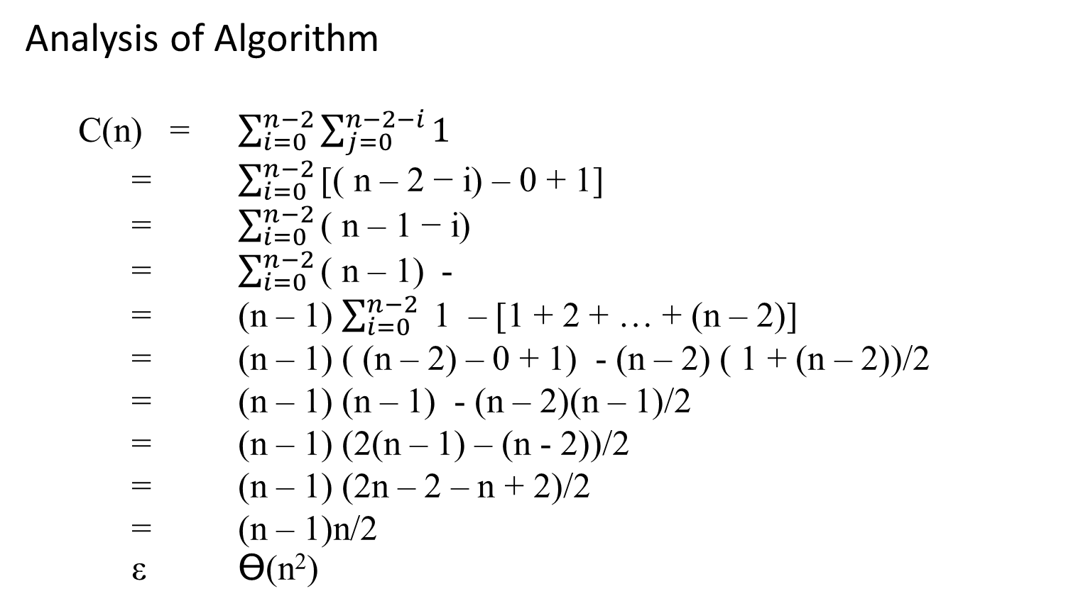
Analysis of Algorithm
C(n) = $\sum_{i=0}^{n−2}{\sum_{j=0}^{n−2−i}{1}}$
= $\sum_{i=0}^{n−2}{\text{[( }\text{n}\text{ – 2 − }\text{i}\text{) – 0 + 1]}}$
= $\sum_{i=0}^{n−2}{\text{( }\text{n}\text{ – 1 − }\text{i}\text{) }}$
= $\sum_{i=0}^{n−2}{\text{( }\text{n}\text{ – 1) }}$ -
= (n – 1) $\sum_{i=0}^{n−2}{ \text{1} }$ – [1 + 2 + … + (n – 2)]
= (n – 1) ( (n – 2) – 0 + 1) - (n – 2) ( 1 + (n – 2))/2
= (n – 1) (n – 1) - (n – 2)(n – 1)/2
= (n – 1) (2(n – 1) – (n - 2))/2
= (n – 1) (2n – 2 – n + 2)/2
= (n – 1)n/2
ε Ɵ(n²)

Slide 15
A sorting algorithm is called STABLE if it preserves the relative order of any two equal elements in its input.
That is, if an input list contains two equal elements in positions i and j where i < j, then in the sorted list they have to be in positions i ’ and j ’, respectively, such that i ’ < j ’.
Before sorted, A[i] =x = A[j] = y After sorted, A[i ’] =x = A[j ’] = y
… | i | … | j | … |  |  |  | … | … | i’ | J’ | …
 | x |  | y |  |  |  |  |  |  | x | y

Slide 16

Sequential Search
To repeat, the algorithm compares successive elements of a given list with a given search key until either a match is encountered (successful search) or the list is exhausted without finding a match (unsuccessful search).
A simple trick:
if we append the search key to the end of the list, the search for the key will have to be successful, and
therefore we can eliminate a check for the list’s end on each iteration of the algorithm.

Slide 17

Algorithm SequentialSearch(A[0..n], K)
// Implements sequential search with a search key as a sentinel
// Input: An array A of n elements and a search key K
// Output: The index of the first element in A[0..n-1] whose
// value is equal to K or -1 if no such element is found.
A[n] ← K;
i ← 0;
while (A[i] ≠ K) do { | while (i < n && A[i] ≠ K) do
i ← i + 1; }
if (i < n) then return i
else return -1;

Slide 18

Another improvement for the sequential search is:
if a given list is known to be sorted: search in such a list can be stopped as soon as an element greater than or equal to the search key is encountered.
while (K < A[i]) do {
i ← i + 1; }
if (K = A[i]) then {if (i < n} then return i
else return -1;}
else return -1;

Slide 19
Analysis of Algorithm:
Input size: the number of elements, n.
The basic operation: key comparison ≠ of A[i] ≠ K or addition + in i ← i + 1.
The running time of this algorithm can be quite different for the same list size n.
In the worst case, when there are no matching elements or the first matching element happens to be the last one on the list, the algorithm makes the largest number of key comparisons among all possible inputs of size n:
S_{worst} (n) = n.

Slide 20
5. The best-case efficiency of the algorithm is its efficiency for the best-case inputs which are lists of size n with their first elements equal to a search key;
S_{best} (n) = 1.
6. The average-case efficiency of the algorithm:
We must make some assumptions about possible inputs of size n:
the probability of a successful search is equal to p
(0 ≤ p ≤ 1) and
the probability of the first match occurring in the i^{th} position
of the list is the same for every i.
Under these assumptions, we can find the average number of key comparisons S_{avg} (n) as follows:

Slide 21
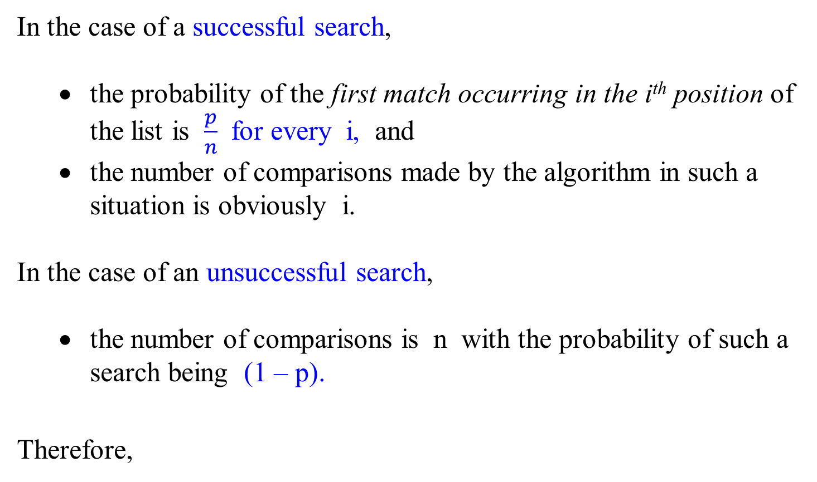
In the case of a successful search,
  the probability of the first match occurring in the i^{th} position of the list is $\frac{p}{n}$ for every i, and
  the number of comparisons made by the algorithm in such a situation is obviously i.
In the case of an unsuccessful search,
  the number of comparisons is n with the probability of such a search being (1 – p).
Therefore,

Slide 22
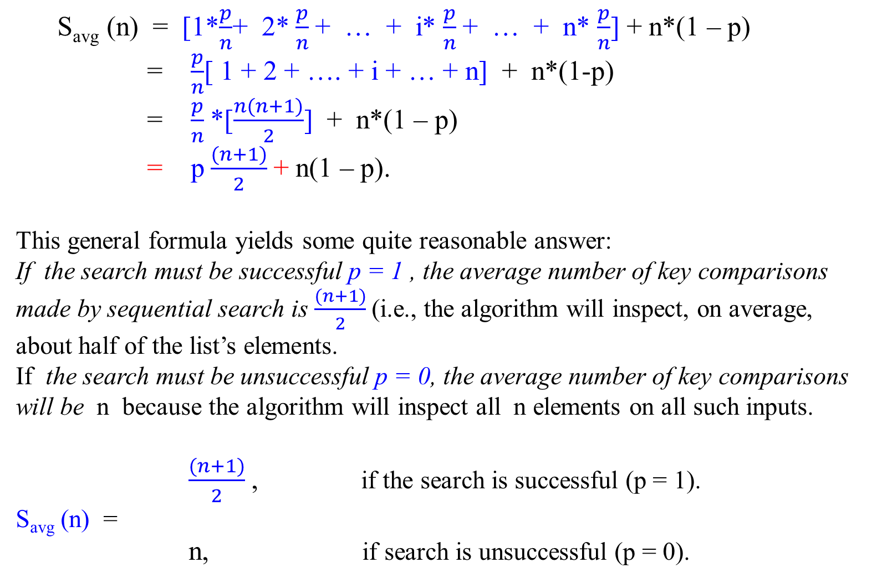
S_{avg} (n) = [1*$\frac{p}{n}$+ 2* $\frac{p}{n}$+ … + i* $\frac{p}{n}$+ … + n* $\frac{p}{n}$] + n*(1 – p)
= $\frac{p}{n}$[ 1 + 2 + …. + i + … + n] + n*(1-p)
= $\frac{p}{n}$*[$\frac{n(n+1)}{2}$] + n*(1 – p)
= p $\frac{(n+1)}{2}$+ n(1 – p).
This general formula yields some quite reasonable answer:
If the search must be successful p = 1 , the average number of key comparisons made by sequential search is $\frac{(n+1)}{2}$(i.e., the algorithm will inspect, on average, about half of the list’s elements.
If the search must be unsuccessful p = 0, the average number of key comparisons will be n because the algorithm will inspect all n elements on all such inputs.
$\frac{(n+1)}{2}$, if the search is successful (p = 1).
S_{avg} (n) =
n, if search is unsuccessful (p = 0).

Slide 23
String Matching

Slide 24
Brute-force String Matching
Given a text string of n characters,
t_{0,} t_{1,} …, t_{i-1}, t_{i}, t_{i+1}, …, t_{i+j} , …, t_{i+m-1} , …., t_{n-1} (text T)
and a pattern string of m characters (m ≤ n),
p₀, p₁, …, p_{j}, …, p_{m-1} (pattern P)
find a substring of the text that matches the pattern.
A string-matching algorithm for finding a substring of the text that matches the pattern can simply continue comparing characters of the text by characters of the pattern until the entire text is exhausted.

Slide 25
An example of brute-force string matching.
The pattern’s characters that are compared with their text counterparts are in bold type.
Given Text T
N O B O D Y N O T I C E D … H I M
N O T
N O T
N O T
N O T
N O T
N O T
→ → → → → → N O T pattern T
s = 6 shifts
N O T
Note that for this example, the algorithm shifts the pattern almost always after a single character comparison. (11 comparisons)

Slide 26
Brute-force String Matching
Problem: Find the index i of the leftmost character of the first matching substring in the text, such that
t_{i} = p₀, t_{i+1} = p₁, …, t_{i+j} = p_{j}, …, t_{i+m-1} = p_{m-1}.
t_{0,} … t_{i-1}, t_{i}, t_{i+1}, …, t_{i+j} , …, t_{i+m-1} , …., t_{n-1} text T
↕ ↕ ↕ ↕
→ … p₀, p₁, …, p_{j}, …, p_{m-1} pattern P
s = i
A string-matching algorithm for finding a substring of the text that matches the pattern can simply continue working until the entire text is exhausted. Stop the process after matching P against t_{n-m} , …., t_{n-1} where | t_{n-m} , …., t_{n-1} | = m.
n-1 - (m-1) = n -m
Or n-1 – (n-m) = n-m

Slide 27
A brute-force algorithm for the string-matching problem is:
Given the text: t_{0,} … t_{i}, t_{i+1}, …, t_{i+j} , …, t_{i+m-1} , …., t_{n-1} and
a pattern: p₀, p₁, …, p_{j}, …, p_{m-1 ,}
find a substring of the text that matches the pattern。
Starting at the first position (i = 0) in the text, align the pattern against the first m characters of the text.
Start matching the corresponding pairs of characters from left to right
until either all m pairs of the characters match and the algorithm stops
or a mismatching pair is encountered.
3. If a mismatching pair is encountered, then
  shift the entire pattern one position to the right of the text (i.e., s = i-1 → s = i ) and
  resume character comparisons, starting again with the first character of the pattern and the text at position i.

Slide 28
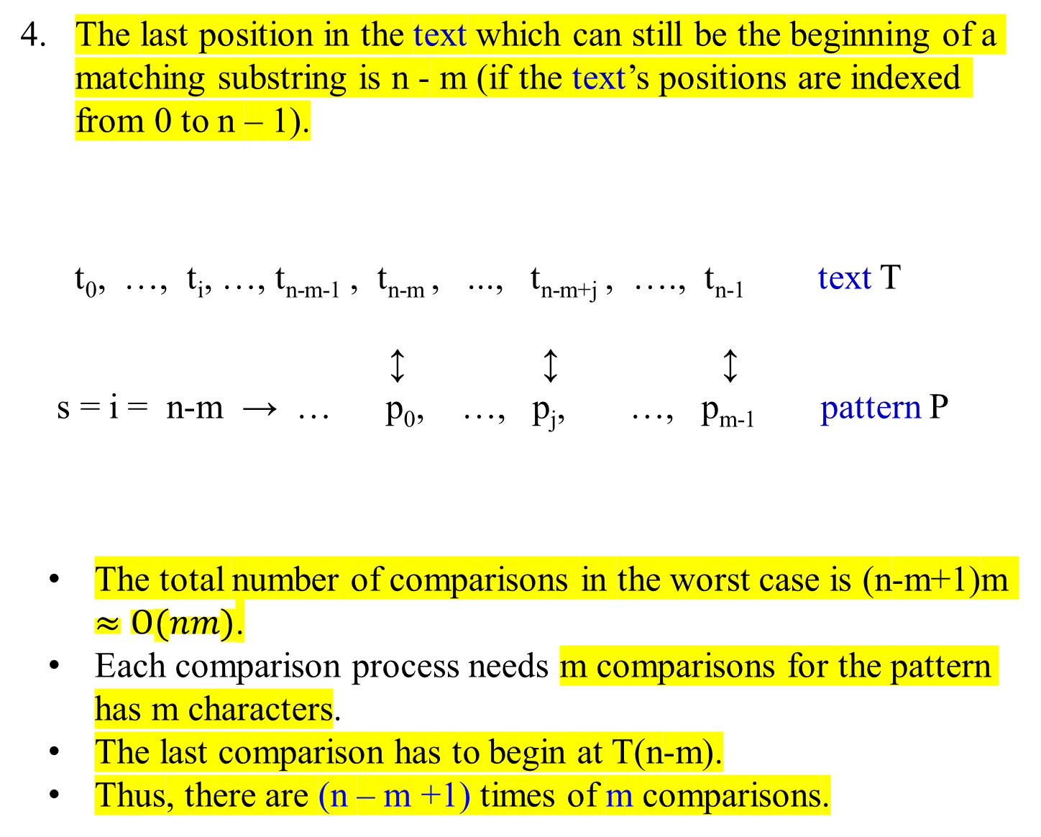
The last position in the text which can still be the beginning of a matching substring is n - m (if the text’s positions are indexed from 0 to n – 1).
t₀, …, t_{i}, …, t_{n-m-1} , t_{n-m} , ..., t_{n-m+j} , …., t_{n-1} text T
↕ ↕ ↕
s = i = n-m → … p₀, …, p_{j}, …, p_{m-1} pattern P
The total number of comparisons in the worst case is (n-m+1)m $≈O(nm)$.
Each comparison process needs m comparisons for the pattern has m characters.
The last comparison has to begin at T(n-m).
Thus, there are (n – m +1) times of m comparisons.
n characters in text T.
P: m-1-(0) +1 = m
The last position is at n-m
T: n-1-(n-m)+1 = m
m characters P.

Slide 29

If P occurs with shift s in T, then s is a valid shift; otherwise, the shift s is an invalid shift. [“P[0] occurs” means T[s] = P[0]].
The string-matching problem is the problem of finding all valid shifts with which a given pattern P occurs in a given text T.
For the worst case for finding out whether P occurs in the given T, (n-m+1)m comparisons is required.
Example: (n-m+1)m = (12-4+1)4 = 9*4 = 36 comparisons.
The last comparison happens at T(n-m)
T[0] | T[1] | T[2] | T[3] | T[4] | T[5] | T[6] | T[7] | T[8] | T[9] | T[10] | T[11]
t₀ | t₁ | t₂ | t₃ | t₄ | t₅ | t₆ | t₇ | t₈ | t₉ | t₁₀ | t₁₁
s=0 | s=1 | s=2
 |  | p₀ | p₁ | p₂ | p₃
 |  | P[0] | P[1] | P[2] | P[3]
 |  |  | … |  |  |  |  | s=8
 |  |  |  |  |  |  |  | p₀ | p₁ | p₂ | p₃
 |  |  |  |  |  |  |  | P[0] | P[1] | P[2] | P[3]
(n-m+1) sets of m comparisons for the worst case

Slide 30
Algorithm | Preprocessing time | Matching time
BruceForceStringMatching | 0 | O((n – m + 1)m)
Rabin-Karp | Θ(m) | O((n – m + 1)m)
Finite Automaton | O(m | Σ |) | Θ (n)
Knuth-Morris-Pratt (KMP) | Θ (m) | Θ (n)
Each time, it needs m comparisons, for the pattern has m characters.
The last comparison has to begin at T(n-m).
Thus, there are (n – m +1) times of m comparisons.

Slide 31
Algorithm BruteForceStringMatching(T[0..n-1],P[0..m-1])
//Implements brute-force string matching
//Input: An array T[0 .. n-1] of n characters representing a text and
// an array P[0 ..m-1] of m characters representing a pattern
//Output: The index of the first character in the text that starts matching
// substring or -1 if the search is unsuccessful.
// algorithms uses i to denote s shifts.
for (i ← 0 to n – m) do //i is pointing at T. (n – m +1) times
{ j ← 0; //j is pointing at P.
while (j < m && P[j] = =T[i+j]) do //Check if next char of P matches. m
{ j ← j + 1;} //end do-while
if j = m return i;} //end for //if all the m char of P matched.
return -1; //if not matched.

Slide 32
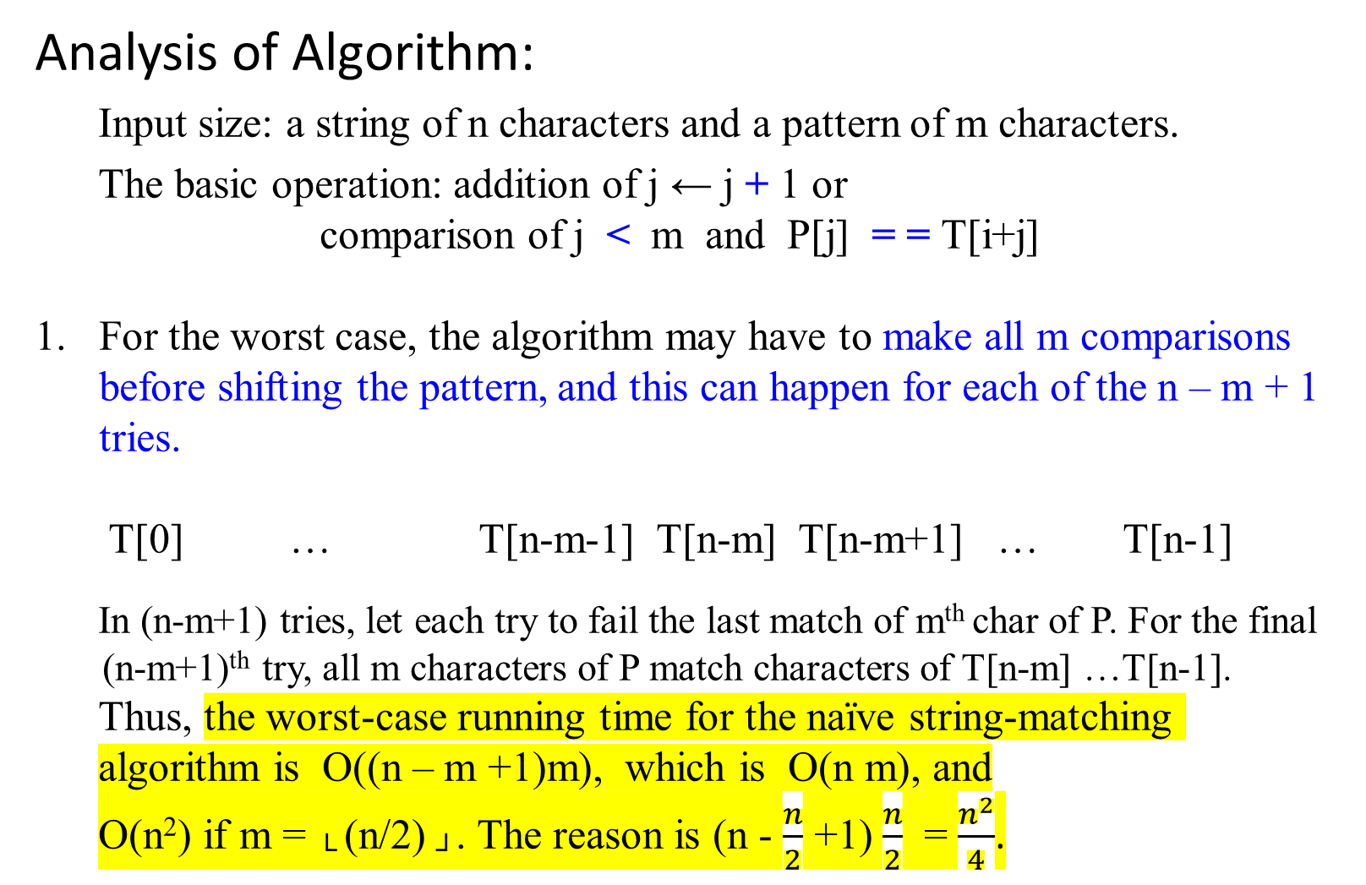
Analysis of Algorithm:
  Input size: a string of n characters and a pattern of m characters.
  The basic operation: addition of j ← j + 1 or
comparison of j < m and P[j] = = T[i+j]
For the worst case, the algorithm may have to make all m comparisons before shifting the pattern, and this can happen for each of the n – m + 1 tries.
T[0] … T[n-m-1] T[n-m] T[n-m+1] … T[n-1]
In (n-m+1) tries, let each try to fail the last match of m^{th} char of P. For the final
(n-m+1)^{th} try, all m characters of P match characters of T[n-m] …T[n-1].
  Thus, the worst-case running time for the naïve string-matching algorithm is O((n – m +1)m), which is O(n m), and
  O(n²) if m = └ (n/2) ┘. The reason is (n - $\frac{n}{2}$ +1) $\frac{n}{2}$ = $\frac{n^{2}}{4}$.

Slide 33

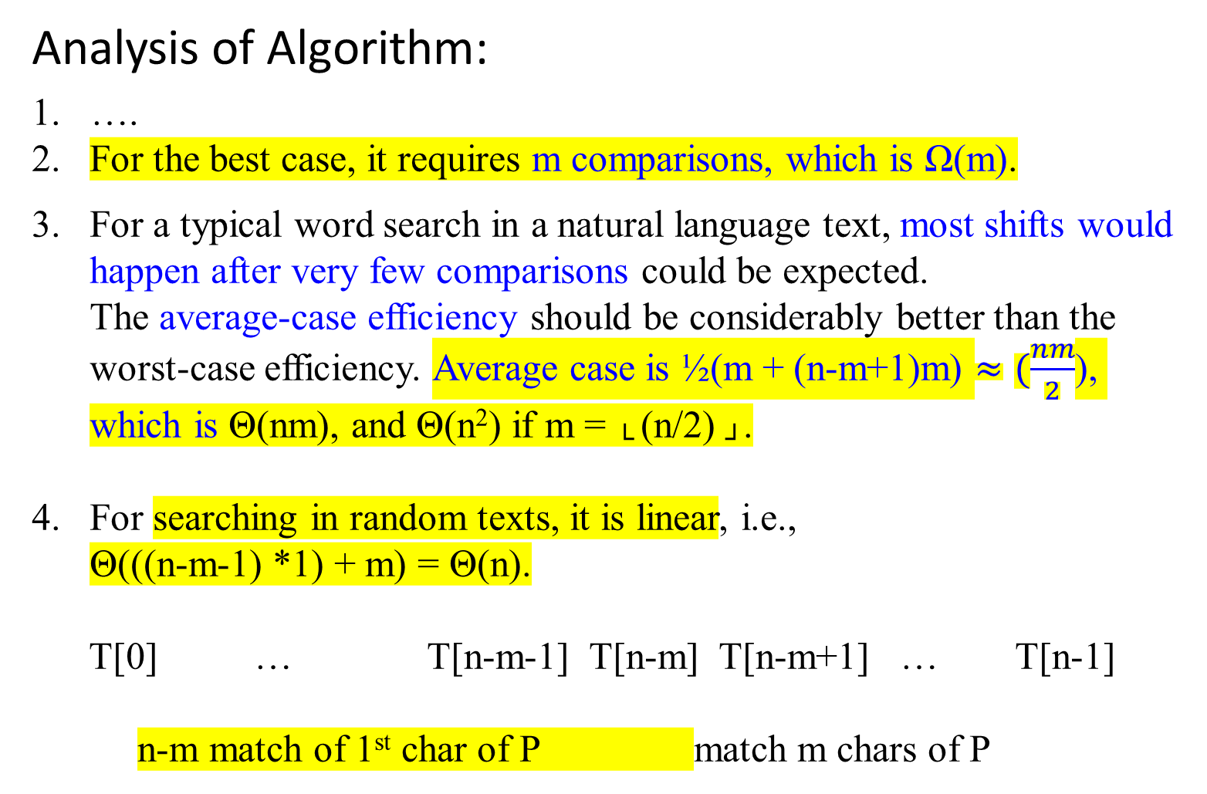
Analysis of Algorithm:
….
For the best case, it requires m comparisons, which is Ω(m).
For a typical word search in a natural language text, most shifts would happen after very few comparisons could be expected.
  The average-case efficiency should be considerably better than the worst-case efficiency. Average case is ½(m + (n-m+1)m) $≈(\frac{nm}{2}$), which is Θ(nm), and Θ(n²) if m = └ (n/2) ┘.
For searching in random texts, it is linear, i.e.,
Θ(((n-m-1) *1) + m) = Θ(n).
T[0] … T[n-m-1] T[n-m] T[n-m+1] … T[n-1]
n-m match of 1st char of P match m chars of P

Slide 34
String Matching with
The Rabin-Karp algorithm,

Slide 35
String Representation
Let Σ be a finite set of alphabet
Let Σ* denote the set of all finite-length strings formed using characters from the alphabet Σ.
For example: Σ = {0, 1}. Then
Σ* = {ε, 0, 1, 00, 01, 10, 11, 000, 001, …}
where ε is a zero-length empty string.
The concatenation of two strings x and y denote xy, has length |x| + |y|.

Slide 36
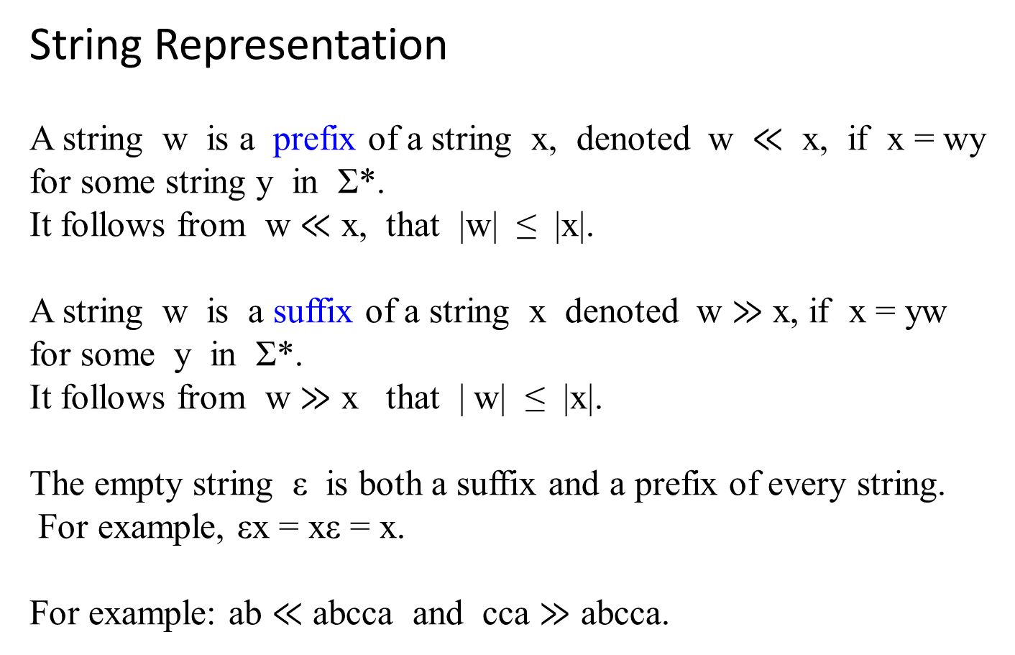
String Representation
A string w is a prefix of a string x, denoted w $≪$ x, if x = wy for some string y in Σ*.
It follows from w $≪$ x, that |w| ≤ |x|.
A string w is a suffix of a string x denoted w $≫$ x, if x = yw for some y in Σ*.
It follows from w $≫$ x that | w| ≤ |x|.
The empty string ε is both a suffix and a prefix of every string.
For example, εx = xε = x.
For example: ab $≪$ abcca and cca $≫$ abcca.

Slide 37

The Rabin-Karp algorithm – A string-matching algorithm
Figure 32.5. The Rabin-Karp algorithm (a).
Each character is a decimal digit, and we compute value modulo 13.
2 | 3 | 5 | 9 | 0 | 2 | 3 | 1 | 4 | 1 | 5 | 2 | 6 | 7 | 3 | 9 | 9 | 2 | 1
Mod 13
7
p
A text string T. A window of length 5 is shown shaded. The numerical
value 31415 of the shaded number, computed modulo 13, yields the value 7. That is, 31415 ≡ 7 mod 13,

Slide 38
(b) The same text string T with values computed modulo 13 for each possible position of a length-5 window. Assuming the pattern P = 31415, we look for windows whose value modulo 13 is 7, since 31415 ≡ 7 (mod 13). The algorithm finds two such windows, shown shaded in the figure. The first, beginning at text position 7, is indeed an occurrence of the pattern, while the second, beginning at text position 13, is a spurious hit.
1 2 3 4 5 6 7 8 9 10 11 12 13 14 15 16 17 18 19
2 | 3 | 5 | 9 | 0 | 2 | 3 | 1 | 4 | 1 | 5 | 2 | 6 | 7 | 3 | 9 | 9 | 2 | 1
… … … mod 13
8 | 9 | 3 | 11 | 0 | 1 | 7 | 8 | 4 | 5 | 10 | 11 | 7 | 9 | 11
valid match spurious hit
Figure 32.5. The Rabin-Karp algorithm (b).

Slide 39
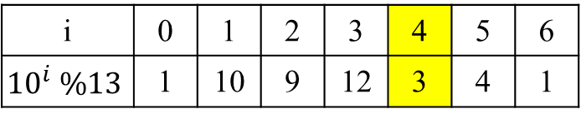
Figure 32.5. The Rabin-Karp algorithm (c).
If 31415 mod 13 ≡ 7, compute 14152 mod 13 is as follows:
old new high-order low-order
digit digit
old new
high-order low-order
digit shift digit
14152 ≡ ((31415 – 3*10000)*10 + 2 )(mod 13)
≡ ((7 – 3*3)*10 + 2) (mod 13)
≡ -18 (mod 13)
≡ -5 (mod 13)
≡ 8 (mod 13)
10000 (mod 13) = 3 (mod 13)
This takes time O(m) to compute, where m is |31415|
3 | 1 | 4 | 1 | 5 | 2
7 | 8
(c)
i | 0 | 1 | 2 | 3 | 4 | 5 | 6
$${10}^{i} \%13$$ | 1 | 10 | 9 | 12 | 3 | 4 | 1

Slide 40
Figure 32.5. The Rabin-Karp algorithm (c).
(c) How to compute the value for a window in constant time, given the value for the previous window. The first window has value 31415. Dropping the high-order digit 3, shifting left (multiplying by 10), and then adding in the low-order digit 2 gives us the new value 14152. Because all computations are performed modulo 13, the value for the first window is 7, and the value for the new window is 8. [ Note that …, -18, -5, 8, 21, … are the same class of 8 (mod 13).

Slide 41
The Rabin-Karp algorithm
Assume each character is a decimal digit in Σ = {0, 1, 2, …, 9}.
Assume that each character is a digit in radix – d notation, where d = | Σ |. For this case, d = 10.
Then, a string of k consecutive characters is representing a length-k decimal number.
  The character string 31415 thus corresponds to the decimal number 31,415.

Slide 42
The Rabin-Karp algorithm
Given a pattern P[1 .. m], let p denote its corresponding decimal value.
For example, let P[1]=3, P[2]=1, P[3]=4, P[4]=1 and P[5]=5; and p = 7 since 31415 mod 13 = 7
Given a text T[1 .. n], let t_{s} denote the decimal value of the length-m substring T[s + 1 .. s +m] for s = 0, 1, …, n – m.
For example,
1 2 3 4 5 6 7 8 9 10 11 12 13 14 15 16 17 18 19
T[1..19]
2 | 3 | 5 | 9 | 0 | 2 | 3 | 1 | 4 | 1 | 5 | 2 | 6 | 7 | 3 | 9 | 9 | 2 | 1
… … … mod 13
t_{s}
8 | 9 | 3 | 11 | 0 | 1 | 7 | 8 | 4 | 5 | 10 | 11 | 7 | 9 | 11
t₀ t₁ t₂ t₃ t₄ t₅ t₆ t₇ t₈ t₉ t₁₀ t₁₁ t₁₂ t₁₃ t₁₄
when s=6 and m=5, T[s + 1 .. s +m]= T[7..11] which has 31415.
And t₆ = 31415 mod 13 = 7.

Slide 43
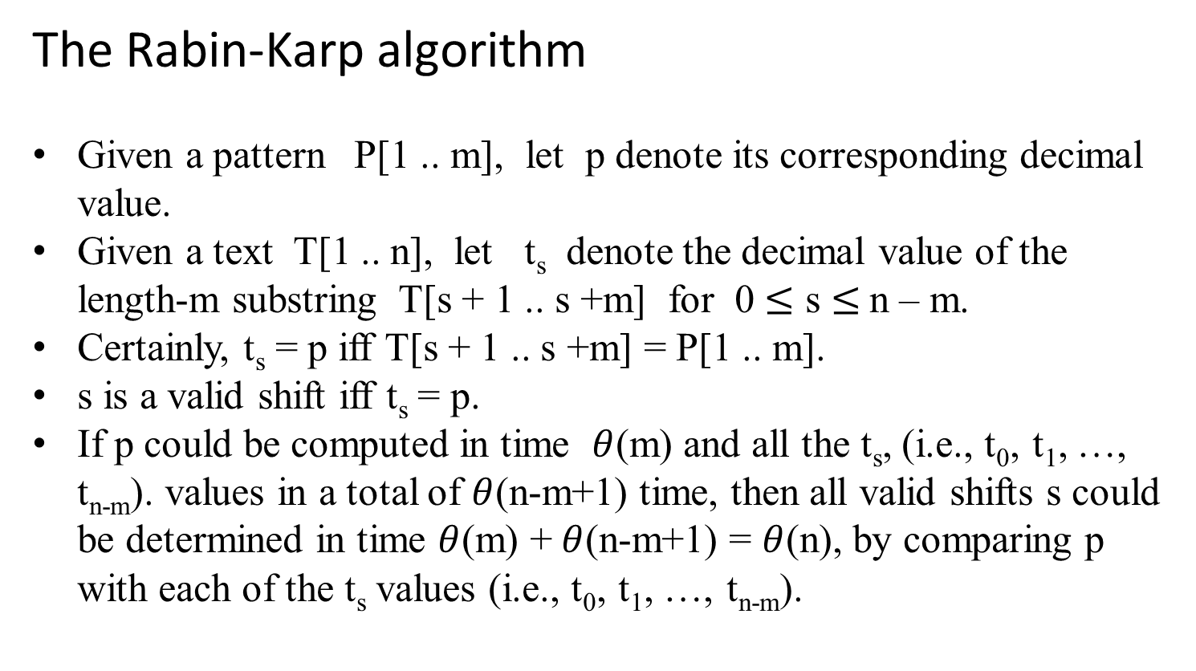
The Rabin-Karp algorithm
Given a pattern P[1 .. m], let p denote its corresponding decimal value.
Given a text T[1 .. n], let t_{s} denote the decimal value of the length-m substring T[s + 1 .. s +m] for 0 $≤$ s $≤$n – m.
Certainly, t_{s} = p iff T[s + 1 .. s +m] = P[1 .. m].
s is a valid shift iff t_{s} = p.
If p could be computed in time $θ$(m) and all the t_{s}, (i.e., t₀, t₁, …, t_{n-m}). values in a total of $θ$(n-m+1) time, then all valid shifts s could be determined in time $θ$(m) + $θ$(n-m+1) = $θ$(n), by comparing p with each of the t_{s} values (i.e., t₀, t₁, …, t_{n-m}).

Slide 44
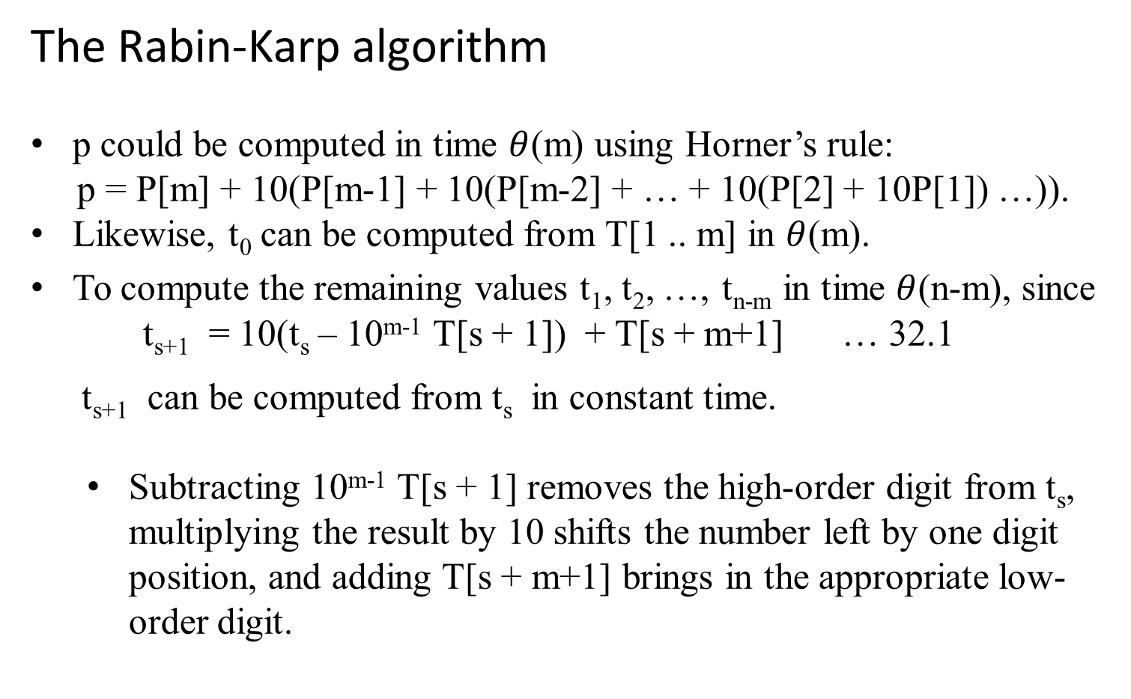
The Rabin-Karp algorithm
p could be computed in time $θ$(m) using Horner’s rule:
p = P[m] + 10(P[m-1] + 10(P[m-2] + … + 10(P[2] + 10P[1]) …)).
Likewise, t₀ can be computed from T[1 .. m] in $θ$(m).
To compute the remaining values t₁, t₂, …, t_{n-m} in time $θ$(n-m), since t_{s+1} = 10(t_{s} – 10^{m-1} T[s + 1]) + T[s + m+1] … 32.1
t_{s+1} can be computed from t_{s} in constant time.
  Subtracting 10^{m-1} T[s + 1] removes the high-order digit from t_{s}, multiplying the result by 10 shifts the number left by one digit position, and adding T[s + m+1] brings in the appropriate low-order digit.

Slide 45

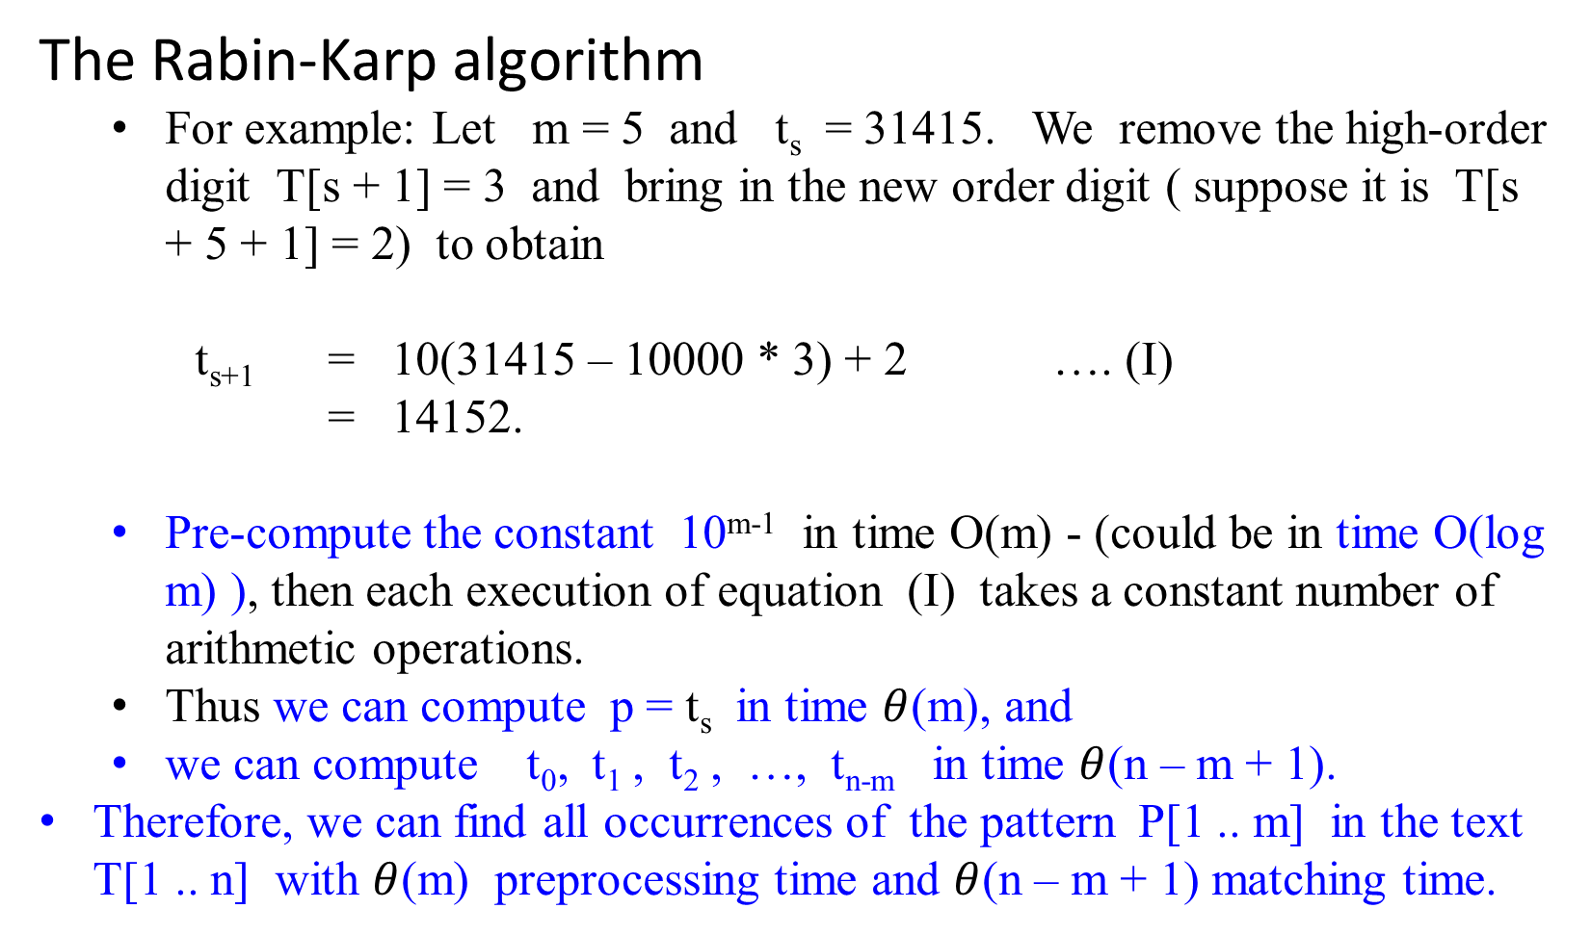
The Rabin-Karp algorithm
  For example: Let m = 5 and t_{s} = 31415. We remove the high-order digit T[s + 1] = 3 and bring in the new order digit ( suppose it is T[s + 5 + 1] = 2) to obtain
t_{s+1} = 10(31415 – 10000 * 3) + 2 …. (I)
= 14152.
  Pre-compute the constant 10^{m-1} in time O(m) - (could be in time O(log m) ), then each execution of equation (I) takes a constant number of arithmetic operations.
  Thus we can compute p = t_{s} in time $θ$(m), and
  we can compute t₀, t₁ , t₂ , …, t_{n-m} in time $θ$(n – m + 1).
Therefore, we can find all occurrences of the pattern P[1 .. m] in the text T[1 .. n] with $θ$(m) preprocessing time and $θ$(n – m + 1) matching time.

Slide 46
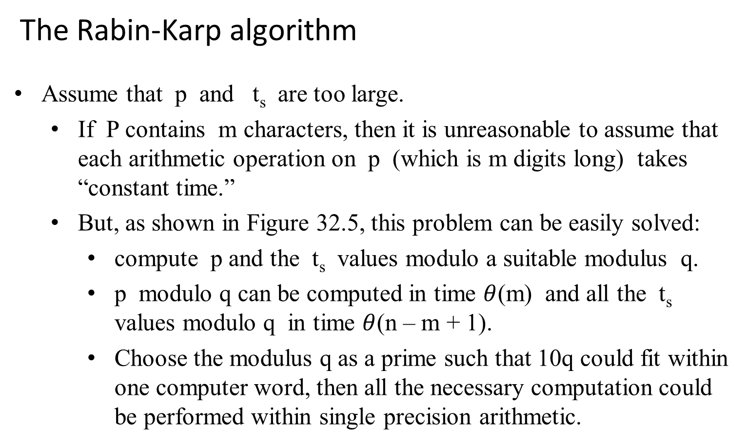
The Rabin-Karp algorithm
Assume that p and t_{s} are too large.
  If P contains m characters, then it is unreasonable to assume that each arithmetic operation on p (which is m digits long) takes “constant time.”
  But, as shown in Figure 32.5, this problem can be easily solved:
    compute p and the t_{s} values modulo a suitable modulus q.
    p modulo q can be computed in time $θ$(m) and all the t_{s} values modulo q in time $θ$(n – m + 1).
    Choose the modulus q as a prime such that 10q could fit within one computer word, then all the necessary computation could be performed within single precision arithmetic.

Slide 47
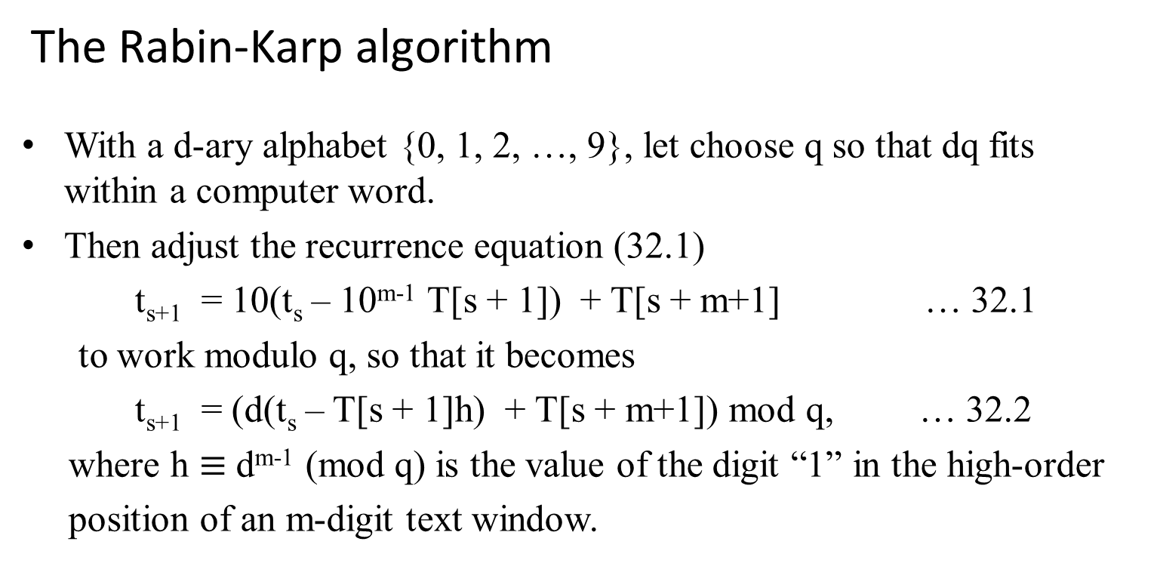
The Rabin-Karp algorithm
With a d-ary alphabet {0, 1, 2, …, 9}, let choose q so that dq fits within a computer word.
Then adjust the recurrence equation (32.1)
t_{s+1} = 10(t_{s} – 10^{m-1} T[s + 1]) + T[s + m+1] … 32.1
  to work modulo q, so that it becomes
  t_{s+1} = (d(t_{s} – T[s + 1]h) + T[s + m+1]) mod q, … 32.2
where h $≡$ d^{m-1} (mod q) is the value of the digit “1” in the high-order
position of an m-digit text window.

Slide 48
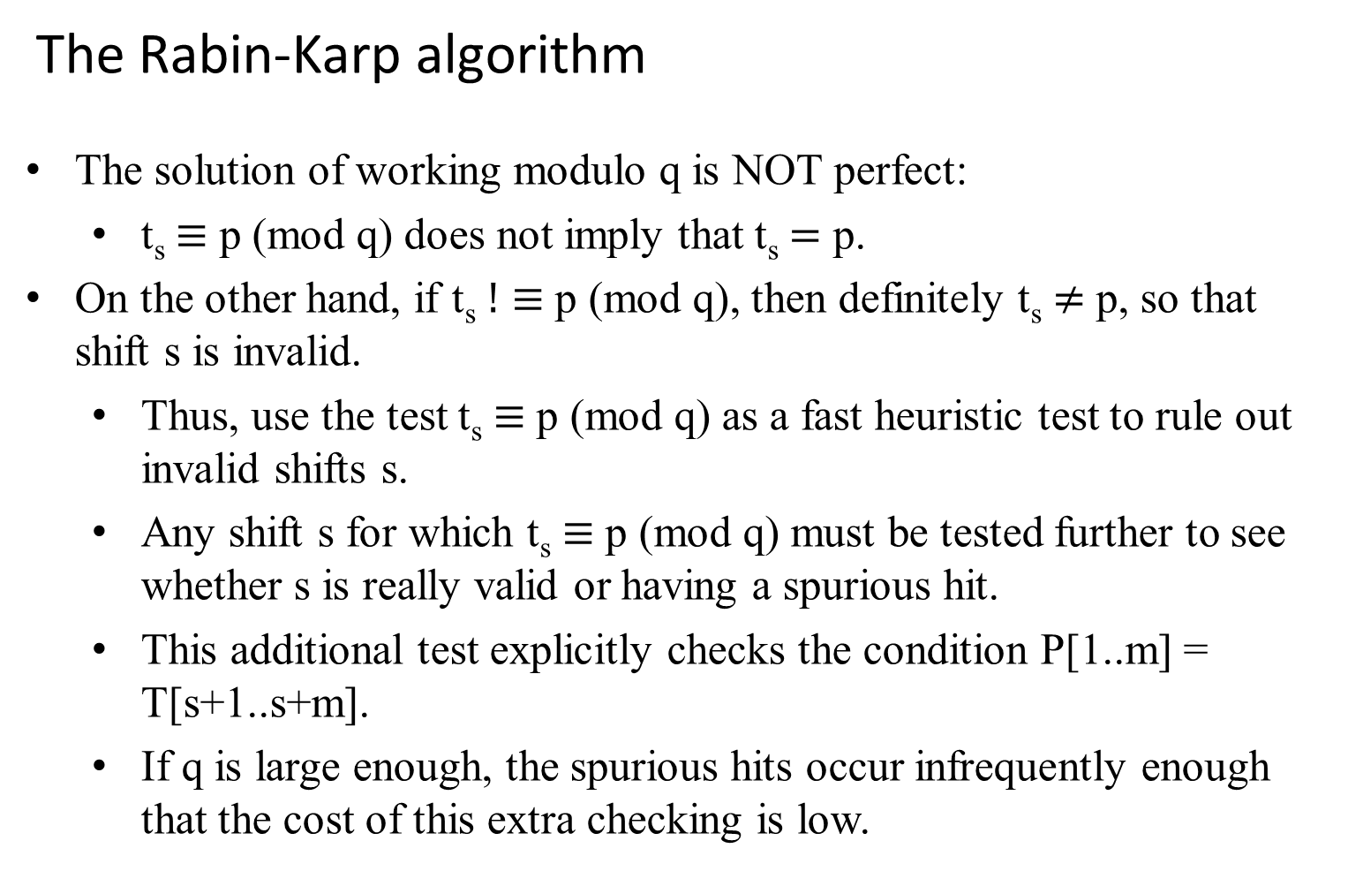
The Rabin-Karp algorithm
The solution of working modulo q is NOT perfect:
  t_{s} $≡$ p (mod q) does not imply that t_{s} $=$ p.
On the other hand, if t_{s} $!≡$ p (mod q), then definitely t_{s} $≠$ p, so that shift s is invalid.
  Thus, use the test t_{s} $≡$ p (mod q) as a fast heuristic test to rule out invalid shifts s.
  Any shift s for which t_{s} $≡$ p (mod q) must be tested further to see whether s is really valid or having a spurious hit.
  This additional test explicitly checks the condition P[1..m] = T[s+1..s+m].
  If q is large enough, the spurious hits occur infrequently enough that the cost of this extra checking is low.

Slide 49
The Rabin-Karp algorithm
Let formulate the entire ideas in term of the following procedure. The inputs to the procedure are the text T, the pattern P, the radix d to use (which is typically taken to be |∑ | ), and the prime q.

Slide 50
Rabin-Karp Algorithm(T, P, d, q)
n = T.length;
m = P.length;
h = d^{m-1}(mod q);
p = 0;
t₀ = 0 ;
for i = 1 to m do { //preprocessing
p = (d*p + P[i]) mod q;
t₀ = (d*t₀ + T[i]) mod q; //end for Θ(m)
}//end for
for s = 0 to n-m do { //matching Θ((n – m + 1)m) because of //spurious hits
if (p == t_{s}) then
if (P[1 .. m] == T[s+1 .. s+m]) then
print “Pattern occurs with shift” s; //end if if
if (s < n–m) then
t_{s+1} = (d*(t_{s} - T[s+1]*h) + T[s+m+1])mod q; //end if
}//end for
//end algorithm

Slide 51
RKM takes Θ(m) preprocessing, and its matching times is Θ((n – m + 1) m) in the worst case since (like the naïve string-matching algorithm) RKM algorithm explicitly verifies every valid shift . If P = a^{m} and T = a^{n} , then verifying takes time Θ((n – m + 1) m) , since each of the n – m + 1 possible shifts is valid.
Recall:
Algorithm | Preprocessing time | Matching time
BruceForceStringMatching | 0 | Θ((n – m + 1)m)
Rabin-Karp | Θ(m) | Θ((n – m + 1)m)
Finite Automaton | O(m | Σ |) | Θ (n)
Knuth-Morris-Pratt (KMP) | Θ (m) | Θ (n)

Slide 52
String Matching with
Finite Automata

Slide 53
String Matching with finite automata
Many string-matching algorithms build a finite automaton that scans the text string T for all occurrences of the pattern P.
These string-matching automata are very efficient:
    they examine each text character exactly once, taking constant time per text character.
The matching time used – after preprocessing the pattern to build the automaton – is therefore Θ(n).
The time to build the automaton, however can be large if Σ is large. There is a clever way around this problem.

Slide 54
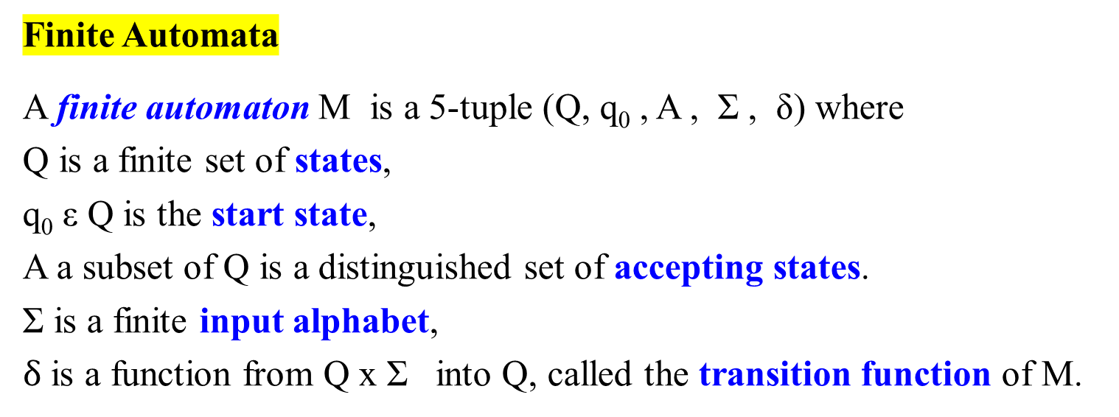
Finite Automata
A finite automaton M is a 5-tuple (Q, q₀ , A , Σ , δ) where
Q is a finite set of states,
q₀ ε Q is the start state,
A a subset of Q is a distinguished set of accepting states.
Σ is a finite input alphabet,
$δ$ is a function from Q x Σ into Q, called the transition function of M.

Slide 55
The finite automaton begins in state q₀ and reads the characters of its input string one at a time.
If the automaton is in state q and reads input character a, it moves (“makes a transition”) from state q to state δ(q, a) = q’.
Whenever its current state q is a member of A, machine M is said to have accepted the string read so far.
An input that is not accepted is said to be rejected.

Slide 56
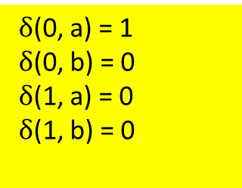
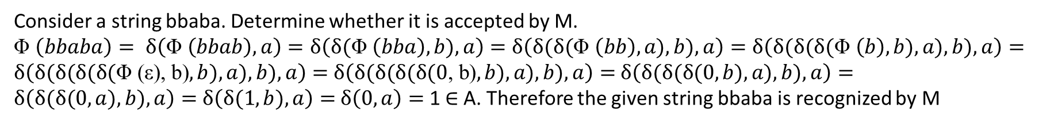
M = (Q, q₀ , A , Σ , δ)
where
Q = {0, 1}
Σ = {a, b }
A = { 1 }
q₀ = 0
$δ$(0, a) = 1
$δ$(0, b) = 0
$δ$(1, a) = 0
$δ$(1, b) = 0
input
a
a
a
 | a | b
0 | 1 | 0
1 | 0 | 0
b
0
1
state
a
b
For example:
A simple two-state finite automata with state set Q = {0, 1}, start state is 0, accepting state 1, and input alphabet Σ = {a, b}. L(Q) = b* (a (a|b) b* )*a
Consider a string bbaba. Determine whether it is accepted by M.
Φ $\left(bbaba\right)= δ\left(\text{Φ} \left(bbab\right), a\right)=δ\left(δ\text{(}\text{Φ} \left(bba\right),b), a\right)=$ $δ\left(δ\text{(}δ\text{(}\text{Φ} \left(bb\right), a),b), a\right)=δ\left(δ\text{(}δ\text{(}δ\text{(}\text{Φ} \left(b\right),b), a),b), a\right)=δ\left(δ\text{(}δ\text{(}δ\text{(}δ\text{(}\text{Φ}\text{ (}\text{ε}\text{), }\text{b}\text{)},b), a),b), a\right)=$ $δ\left(δ\text{(}δ\text{(}δ\text{(}δ\text{(}\text{0}\text{, }\text{b}\text{)},b), a),b), a\right)=$ $δ\left(δ\text{(}δ\text{(}δ\text{(}0,b), a),b), a\right)=$ $δ\left(δ\text{(}δ\text{(}0,a),b), a\right)=$ $δ\left(δ\text{(}1,b), a\right)=$ $δ\left(0, a\right)=$ 1 $∈$ A. Therefore the given string bbaba is recognized by M

Slide 57
A finite automaton M induces a function Φ, called the final-state function, from Σ* to Q such that Φ(ω) is the state where M ends up after scanning the string ω. Thus, M accepts a string ω if and only if Φ(ω) is in A (accepting states). The function Φ is defined by the recursive relation
Φ : Σ* → Q such that
Φ(ε) = q₀,
Φ(ωa) = δ(Φ(ω), a) for ω in Σ* and a in Σ
String-matching automata
There is a string-matching automation for every pattern P; this automaton must be constructed from the pattern in a preprocessing step before it can be used to search the text string.

Slide 58
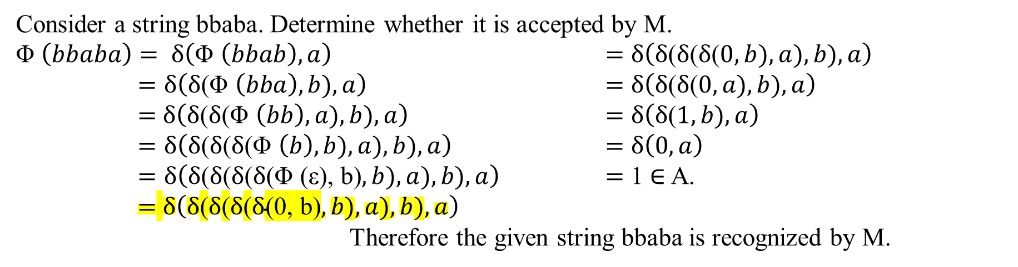
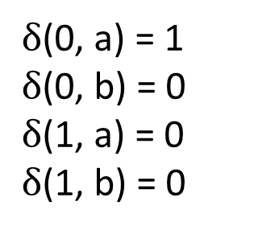
M = (Q, q₀ , A , Σ , δ)
where
Q = {0, 1}, Σ = {a, b }
A = { 1 }, q₀ = 0
$δ$(0, a) = 1
$δ$(0, b) = 0
$δ$(1, a) = 0
$δ$(1, b) = 0
input
a
a
a
 | a | b
0 | 1 | 0
1 | 0 | 0
b
0
1
state
a
b
For example:
Consider a string bbaba. Determine whether it is accepted by M.
Φ $\left(bbaba\right)= δ\left(\text{Φ} \left(bbab\right), a\right)$ $=$ $δ\left(δ\text{(}δ\text{(}δ\text{(}0,b), a),b), a\right)$
$=δ\left(δ\text{(}\text{Φ} \left(bba\right),b), a\right)$ $=$ $δ\left(δ\text{(}δ\text{(}0,a),b), a\right)$
$=$ $δ\left(δ\text{(}δ\text{(}\text{Φ} \left(bb\right), a),b), a\right)$ $=$ $δ\left(δ\text{(}1,b), a\right)$
$=δ\left(δ\text{(}δ\text{(}δ\text{(}\text{Φ} \left(b\right),b), a),b), a\right)$ $=$ $δ\left(0, a\right)$
$=δ\left(δ\text{(}δ\text{(}δ\text{(}δ\text{(}\text{Φ}\text{ (}\text{ε}\text{), }\text{b}\text{)},b), a),b), a\right)$ $=$ 1 $∈$ A.
$=$ $δ\left(δ\text{(}δ\text{(}δ\text{(}δ\text{(}\text{0}\text{, }\text{b}\text{)},b), a),b), a\right)$
Therefore the given string bbaba is recognized by M.

Slide 59
The following figure illustrates this construction for the pattern P = ababaca.
 | input
state | a | b | c | P
0 | 1 | 0 | 0 | a
1 | 1 | 2 | 0 | b
2 | 3 | 0 | 0 | a
3 | 1 | 4 | 0 | b
4 | 5 | 0 | 0 | a
5 | 1 | 4 | 6 | c
6 | 7 | 0 | 0 | a
7 | 1 | 2 | 0
Σ = {a, b, c}
P = ababaca
abc? aab acab?
[(b|c)*|(ac)*|(aa*c)*]* a₁ b₂ [bb*|c*|(ac)*|(aa*c)*]* a₃
{[a(b|(a*(b|c)*|a]* | c [(b|c)*|(ac)*|(aa*c)*ba]* }*b₄ …

Slide 60
(b) [(b|c)*|(ac)*|(aa*c)*]* a₁ b₂ [bb*|c*|(ac)*|(aa*c)*]* a₃ {[a(b|(a*(b|c)*|a]* | c [(b|c)*|(ac)*|(aa*c)*ba]* }*b₄ …
For the pattern P = ababaca.
a
a
b,c
a
c
a
a
b
a
b
a
c
a
0
1
2
3
4
5
6
7
c
b
b
 | input
state | a | b | c | P
0 | 1 | 0 | 0 | a
1 | 1 | 2 | 0 | b
2 | 3 | 0 | 0 | a
3 | 1 | 4 | 0 | b
4 | 5 | 0 | 0 | a
5 | 1 | 4 | 6 | c
6 | 7 | 0 | 0 | a
7 | 1 | 2 | 0
b,c
b
c
[(b|c)*|(ac)*|(aa*c)*]* a₁ b₂ [bb*|c*|(ac)*|(aa*c)*]* a₃
{[a(b|(a*(b|c)*|a]* | c [(b|c)*|(ac)*|(aa*c)*ba]* }*b₄ …
(c)
i | - | 1 | 2 | 3 | 4 | 5 | 6 | 7 | 8 | 9 | 10 | 11
T[i] | - | a | b | a | b | a | b | a | c | a | b | a
State Φ(T_{i}) | 0 | 1 | 2 | 3 | 4 | 5 | 4 | 5 | 6 | 7 | 2 | 3

Slide 61

FINITE-AUTOMATON-MATCHER(T, δ, m)
n ← T.length;
q ← 0;
for i ← 1 to n do
{ q ← δ(q, T[i]);
if (q == m) //m is a final state; m is the length of P.
then print “Pattern occurs with shift” i – m; } //end for
 | input
state | a | b | c | P
0 | 1 | 0 | 0 | a
1 | 1 | 2 | 0 | b
2 | 3 | 0 | 0 | a
3 | 1 | 4 | 0 | b
4 | 5 | 0 | 0 | a
5 | 1 | 4 | 6 | c
6 | 7 | 0 | 0 | a
7 | 1 | 2 | 0
i | - | 1 | 2 | 3 | 4 | 5 | 6 | 7 | 8 | 9 | 10 | 11
T[i] | - | a | b | a | b | a | b | a | c | a | b | a
State Φ(T_{i}) | 0 | 1 | 2 | 3 | 4 | 5 | 4 | 5 | 6 | 7 | 2 | 3

Slide 62
The simple loop structure of FINITE-AUTOMATON-MATCHER implies that its matching time on a text string of length n is Θ(n). This matching time, however, does not include the preprocessing time required to compute the transition function δ.
Algorithm | Preprocessing time | Matching time
BruceForceStringMatching | 0 | Θ((n – m + 1)m)
Rabin-Karp | Θ(m) | Θ((n – m + 1)m)
Finite Automaton | O(m | Σ |) | Θ (n)
Knuth-Morris-Pratt (KMP) | Θ (m) | Θ (n)

Slide 63
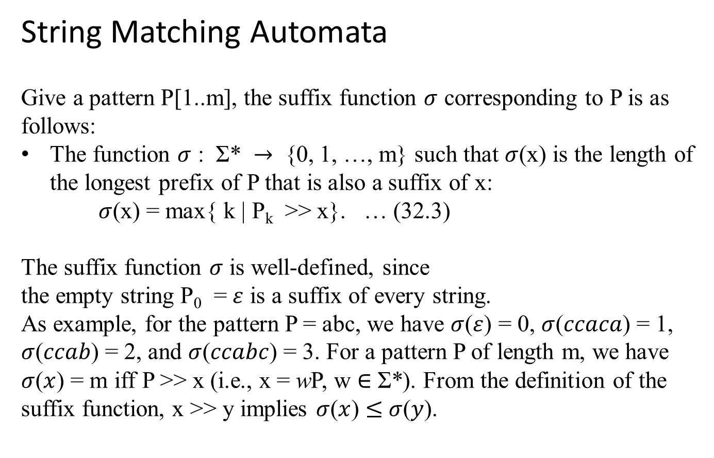
String Matching Automata
Give a pattern P[1..m], the suffix function $σ$ corresponding to P is as follows:
The function $σ$ : Σ* $→$ {0, 1, …, m} such that $σ$(x) is the length of the longest prefix of P that is also a suffix of x:
$σ$(x) = max{ k | P_{k} >> x}. … (32.3)
The suffix function $σ$ is well-defined, since
the empty string P₀ = $ε$ is a suffix of every string.
As example, for the pattern P = abc, we have $σ$($ε$) = 0, $σ$($ccaca$) = 1, $σ$($ccab$) = 2, and $σ$($ccabc$) = 3. For a pattern P of length m, we have $σ$($x$) = m iff P >> x (i.e., x = wP, w $∈$ Σ*). From the definition of the suffix function, x >> y implies $σ$($x$) $≤$ $σ$($y$).

Slide 64
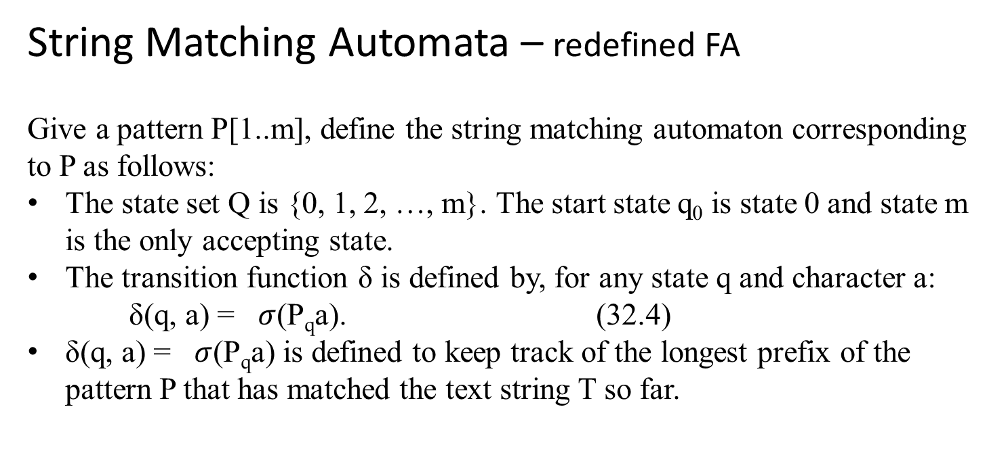
String Matching Automata – redefined FA
Give a pattern P[1..m], define the string matching automaton corresponding to P as follows:
The state set Q is {0, 1, 2, …, m}. The start state q₀ is state 0 and state m is the only accepting state.
The transition function δ is defined by, for any state q and character a:
δ(q, a) = $σ$(P_{q}a). (32.4)
δ(q, a) = $σ$(P_{q}a) is defined to keep track of the longest prefix of the pattern P that has matched the text string T so far.

Slide 65
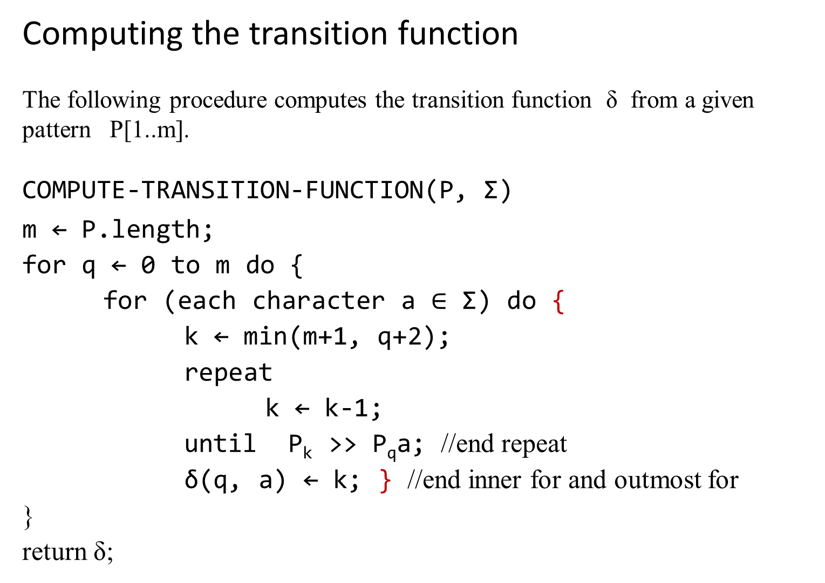
Computing the transition function
The following procedure computes the transition function δ from a given pattern P[1..m].
COMPUTE-TRANSITION-FUNCTION(P, Σ)
m ← P.length;
for q ← 0 to m do {
for (each character a $∈$ Σ) do {
k ← min(m+1, q+2);
repeat
k ← k-1;
until P_{k} >> P_{q}a; //end repeat
δ(q, a) ← k; } //end inner for and outmost for
}
return δ;

Slide 66
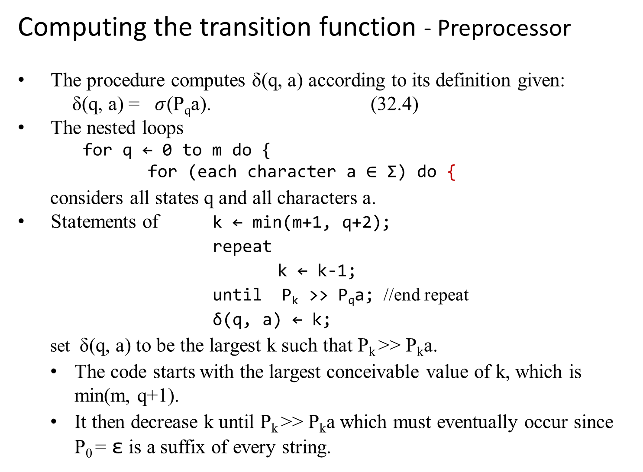
Computing the transition function - Preprocessor
The procedure computes δ(q, a) according to its definition given:
δ(q, a) = $σ$(P_{q}a). (32.4)
The nested loops
    for q ← 0 to m do {
    for (each character a $∈$ Σ) do {
  considers all states q and all characters a.
Statements of k ← min(m+1, q+2);
repeat
k ← k-1;
until P_{k} >> P_{q}a; //end repeat
δ(q, a) ← k;
  set δ(q, a) to be the largest k such that P_{k} >> P_{k}a.
  The code starts with the largest conceivable value of k, which is min(m, q+1).
  It then decrease k until P_{k} >> P_{k}a which must eventually occur since P₀ = ε is a suffix of every string.

Slide 67
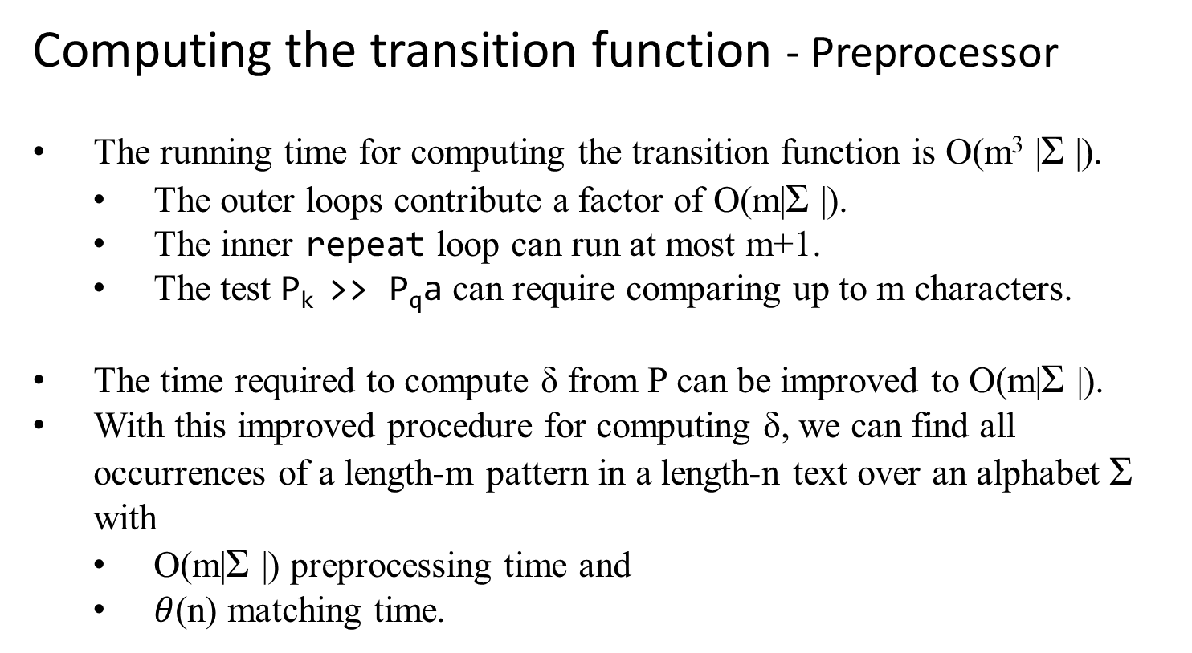
Computing the transition function - Preprocessor
The running time for computing the transition function is O(m³ |Σ |).
  The outer loops contribute a factor of O(m|Σ |).
  The inner repeat loop can run at most m+1.
  The test P_{k} >> P_{q}a can require comparing up to m characters.
The time required to compute δ from P can be improved to O(m|Σ |).
With this improved procedure for computing δ, we can find all occurrences of a length-m pattern in a length-n text over an alphabet Σ with
  O(m|Σ |) preprocessing time and
  $θ$(n) matching time.

Slide 68

Applications:
String-matching automata have applications in various fields, including
  text processing,
  bioinformatics,
  data mining, and
  information retrieval.
They are used in algorithms for tasks such as searching for keywords in documents, finding similar sequences in biological data, and identifying patterns in large datasets.

Slide 69
Text Processing:
Keyword Search: In document processing or search engines, string-matching automata are used to efficiently find occurrences of keywords or phrases within documents or text corpora.
Syntax Highlighting: Text editors and integrated development environments (IDEs) use string-matching automata to perform syntax highlighting by quickly identifying and highlighting keywords, functions, and syntax elements.
Spell Checking: String-matching automata can be employed in spell-checking algorithms to efficiently identify misspelled words by searching for similar patterns in a dictionary or word list.

Slide 70
Bioinformatics:
Sequence Alignment: In bioinformatics, string-matching automata play a crucial role in sequence alignment algorithms for comparing DNA, RNA, or protein sequences. They help identify similar regions between sequences, facilitating tasks such as genome assembly, sequence homology detection, and evolutionary analysis.
Motif Finding: String-matching automata are used to search for specific motifs or patterns within biological sequences, such as regulatory elements in DNA sequences or functional domains in protein sequences.

Slide 71
Data Mining:
Pattern Recognition: In data mining and machine learning, string-matching automata are used for pattern recognition tasks, such as identifying recurring patterns or sequences in time-series data, text data, or sensor data.
Anomaly Detection: String-matching automata can aid in anomaly detection by searching for unusual patterns or sequences within large datasets, helping to identify outliers or abnormal behavior.

Slide 72
Information Retrieval:
Web Search: Search engines utilize string-matching automata to efficiently index web pages and match user queries with relevant documents or web pages based on keywords or phrases.

Slide 73
The Knuth-Morris-Pratt (KMP) algorithm

Slide 74
A summary of how the KMP algorithm works:
1. Preprocessing (Building the Failure Function):
The KMP algorithm preprocesses the pattern to construct a failure function (also known as the "prefix function" or "partial match table").
The failure function is an array that stores information about the longest proper prefix of the pattern that is also a suffix of the pattern for each position in the pattern.

Slide 75
2. Searching:
Once the failure function is computed, the algorithm begins
searching for occurrences of the pattern within the text.
It compares characters of the text with characters of the
pattern from left to right.
During the comparison process, if a mismatch occurs at
position i in the pattern, the algorithm uses the information
from the failure function to determine the next position to
start comparing in the pattern.
This allows the algorithm to skip unnecessary comparisons
and avoid backtracking, resulting in efficient searching.

Slide 76
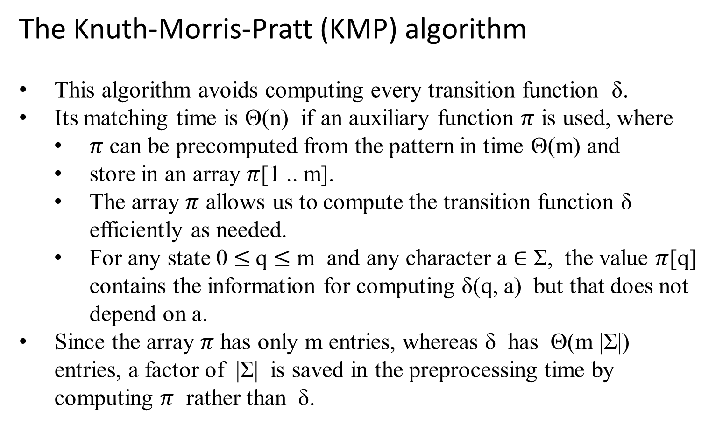
The Knuth-Morris-Pratt (KMP) algorithm
This algorithm avoids computing every transition function δ.
Its matching time is Θ(n) if an auxiliary function $π$ is used, where
  $π$ can be precomputed from the pattern in time Θ(m) and
  store in an array $π$[1 .. m].
  The array $π$ allows us to compute the transition function δ efficiently as needed.
  For any state 0 $≤$q $≤$ m and any character a $∈$ Σ, the value $π$[q] contains the information for computing δ(q, a) but that does not depend on a.
Since the array $π$ has only m entries, whereas δ has Θ(m |Σ|) entries, a factor of |Σ| is saved in the preprocessing time by computing $π$ rather than δ.

Slide 77

The prefix function $π$ for a pattern
Consider the operation of the naïve BruceForceStringMatcher.
b | a | c | b | a | b | a | b | a | a | b | c | b | a | b
(a)
s
P
a | b | a | b | a | c | a
q
The pattern P = ababaca aligns with a text T so that the first q = 5 characters match. Matching characters, shown shaded, are connected by vertical lines.
b | a | c | b | a | b | a | b | a | a | b | c | b | a | b
(b)
s' = s + 2
P
a | b | a | b | a | c | a

Slide 78
(b) Using the only knowledge of the 5 matched characters, this can deduce that a shift of s + 1 is invalid, but that a shift of s' = s + 2 is consistent with everything known about the text and therefore is potentially valid.
b | a | c | b | a | b | a | b | a | a | b | c | b | a | b
(b)
s' = s + 2
P
a | b | a | b | a | c | a
k
P_{q}
a | b | a | b | a
(c)
P_{k}
a | b | a

Slide 79
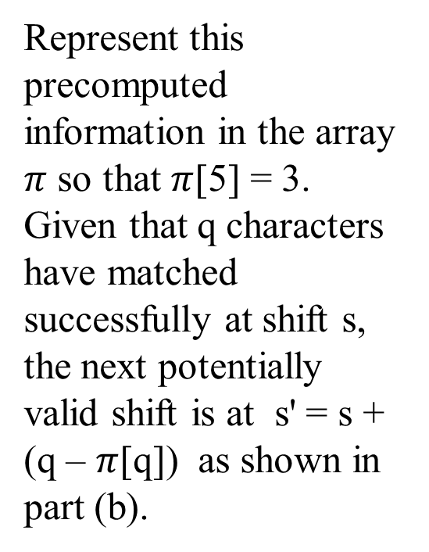
(c) Precompute this useful information for such deductions by comparing
the pattern with itself. The longest prefix of P that is also a proper
suffix of P₅ is P₃.
Represent this precomputed information in the array $π$ so that $π$[5] = 3. Given that q characters have matched successfully at shift s, the next potentially valid shift is at s' = s + (q – $π$[q]) as shown in part (b).
b | a | c | b | a | b | a | b | a | a | b | c | b | a | b
s' = s + 2
P
a | b | a | b | a | c | a
(b)
k
P_{q}
a | b | a | b | a
(c)
P_{k}
a | b | a

Slide 80
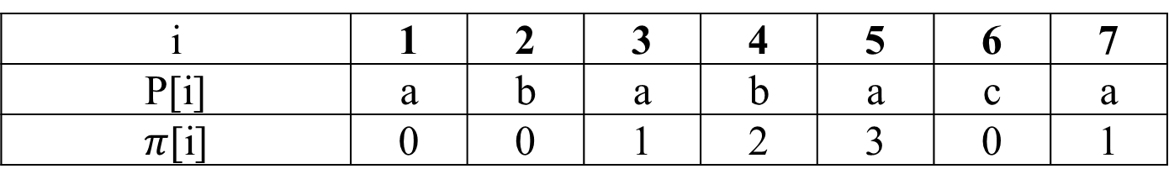
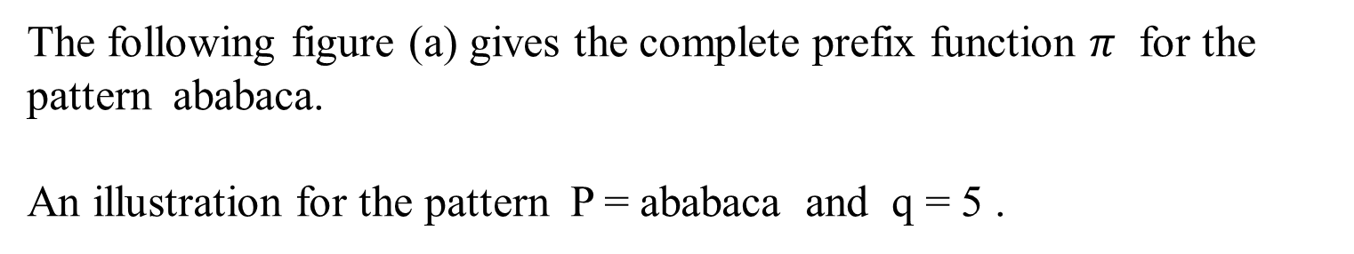
The following figure (a) gives the complete prefix function $π$ for the pattern ababaca.
An illustration for the pattern P = ababaca and q = 5 .
i | 1 | 2 | 3 | 4 | 5 | 6 | 7
P[i] | a | b | a | b | a | c | a
$π$[i] | 0 | 0 | 1 | 2 | 3 | 0 | 1

Slide 81
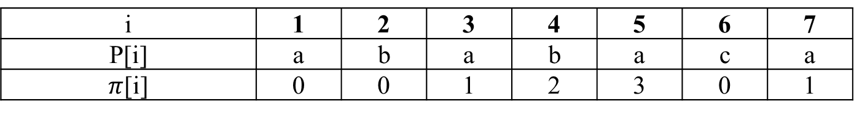
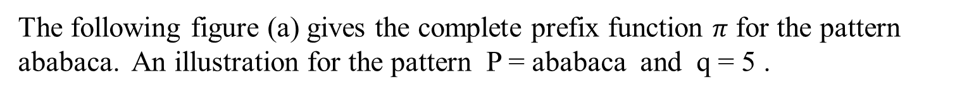
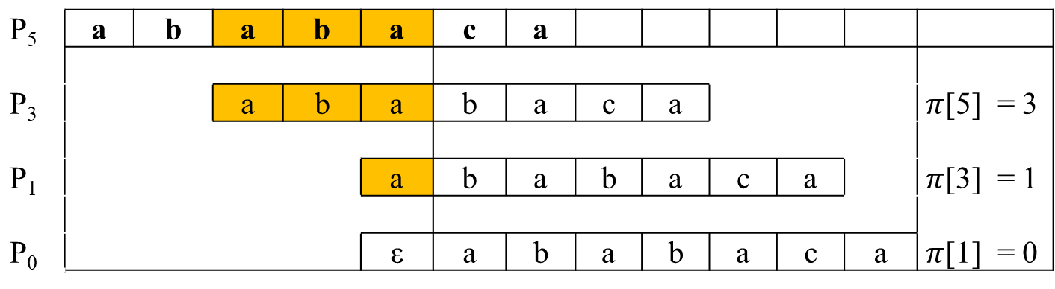
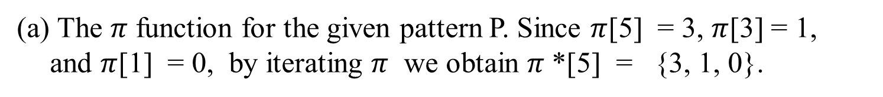
The following figure (a) gives the complete prefix function $π$ for the pattern ababaca. An illustration for the pattern P = ababaca and q = 5 .
i | 1 | 2 | 3 | 4 | 5 | 6 | 7
P[i] | a | b | a | b | a | c | a
$π$[i] | 0 | 0 | 1 | 2 | 3 | 0 | 1
The $π$ function for the given pattern P. Since $π$[5] = 3, $π$[3] = 1, and $π$[1] = 0, by iterating $π$ we obtain $π$*[5] = {3, 1, 0}.
P₅ P₃ P₁ P₀ | a | b | a | b | a | c | a
 |  |  | a | b | a | b | a | c | a |  |  |  | $π$[5] = 3
 |  |  |  |  | a | b | a | b | a | c | a |  | $π$[3] = 1
 |  |  |  |  | ε | a | b | a | b | a | c | a | $π$[1] = 0

Slide 82
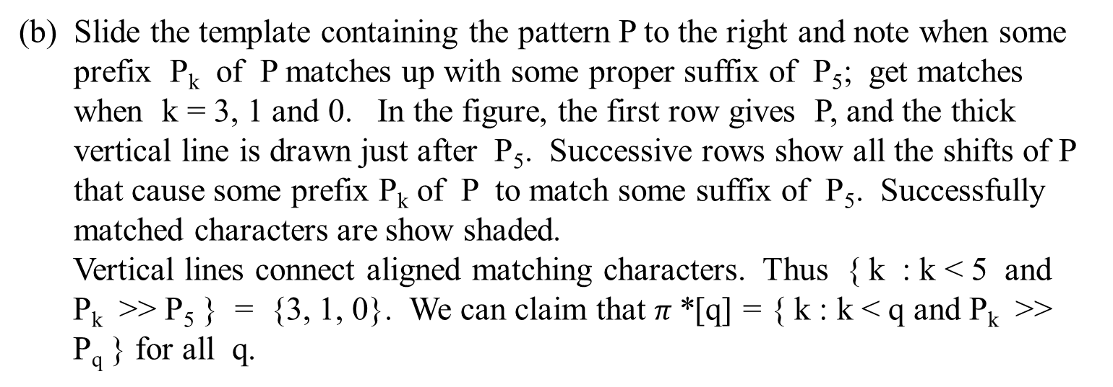
Slide the template containing the pattern P to the right and note when some prefix P_{k} of P matches up with some proper suffix of P₅; get matches when k = 3, 1 and 0. In the figure, the first row gives P, and the thick vertical line is drawn just after P₅. Successive rows show all the shifts of P that cause some prefix P_{k} of P to match some suffix of P₅. Successfully matched characters are show shaded.
  Vertical lines connect aligned matching characters. Thus { k : k < 5 and P_{k} >> P₅ } = {3, 1, 0}. We can claim that $π$*[q] = { k : k < q and P_{k} >> P_{q} } for all q.
P₅ P₃ P₁ P₀ | a | b | a | b | a | c | a
 |  |  | a | b | a | b | a | c | a |  |  |  | $π$[5] = 3
 |  |  |  |  | a | b | a | b | a | c | a |  | $π$[3] = 1
 |  |  |  |  | ε | a | b | a | b | a | c | a | $π$[1] = 0

Slide 83
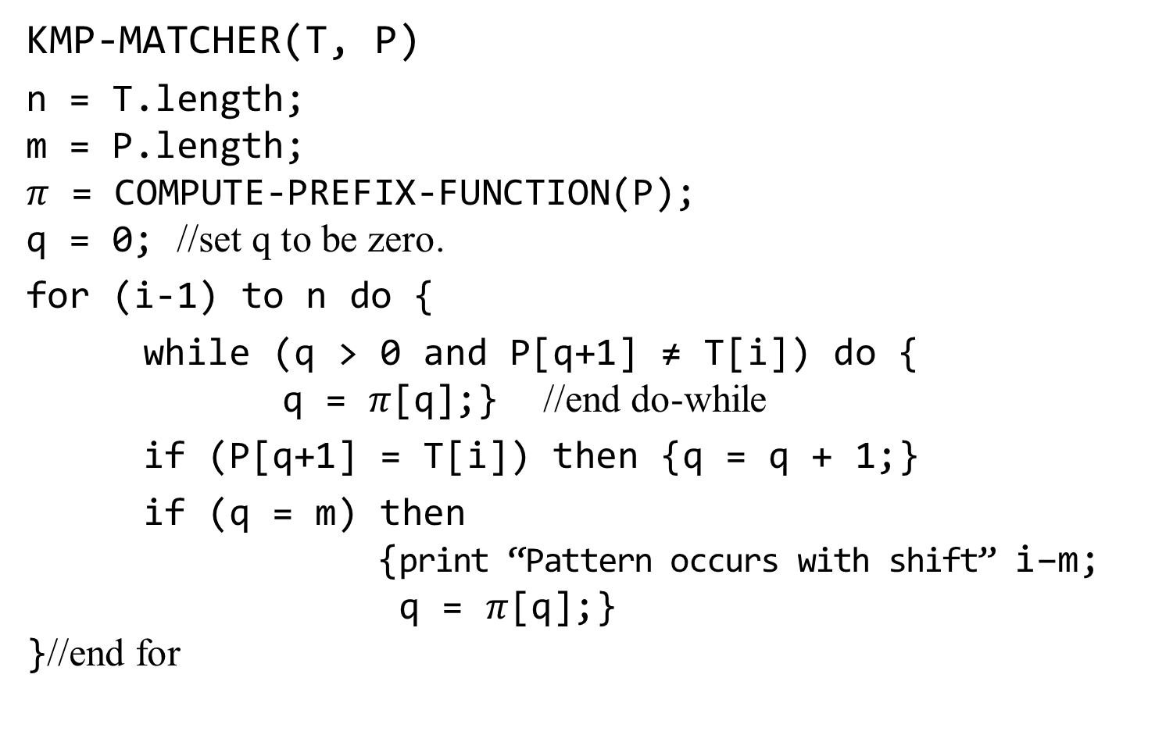
KMP-MATCHER(T, P)
n = T.length;
m = P.length;
$π$ = COMPUTE-PREFIX-FUNCTION(P);
q = 0; //set q to be zero.
for (i-1) to n do {
while (q > 0 and P[q+1] ≠ T[i]) do {
q = $π$[q];} //end do-while
if (P[q+1] = T[i]) then {q = q + 1;}
if (q = m) then
{print “Pattern occurs with shift” i–m;
q = $π$[q];}
}//end for

Slide 84
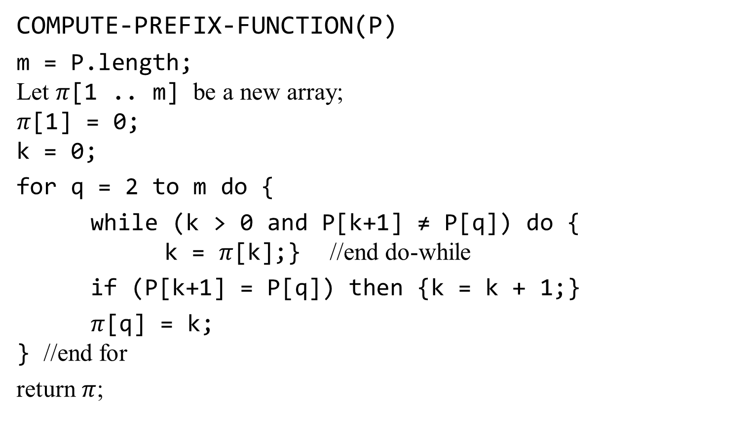
COMPUTE-PREFIX-FUNCTION(P)
m = P.length;
Let $π$[1 .. m] be a new array;
$π$[1] = 0;
k = 0;
for q = 2 to m do {
while (k > 0 and P[k+1] ≠ P[q]) do {
k = $π$[k];} //end do-while
if (P[k+1] = P[q]) then {k = k + 1;}
$π$[q] = k;
} //end for
return $π$;

Slide 85
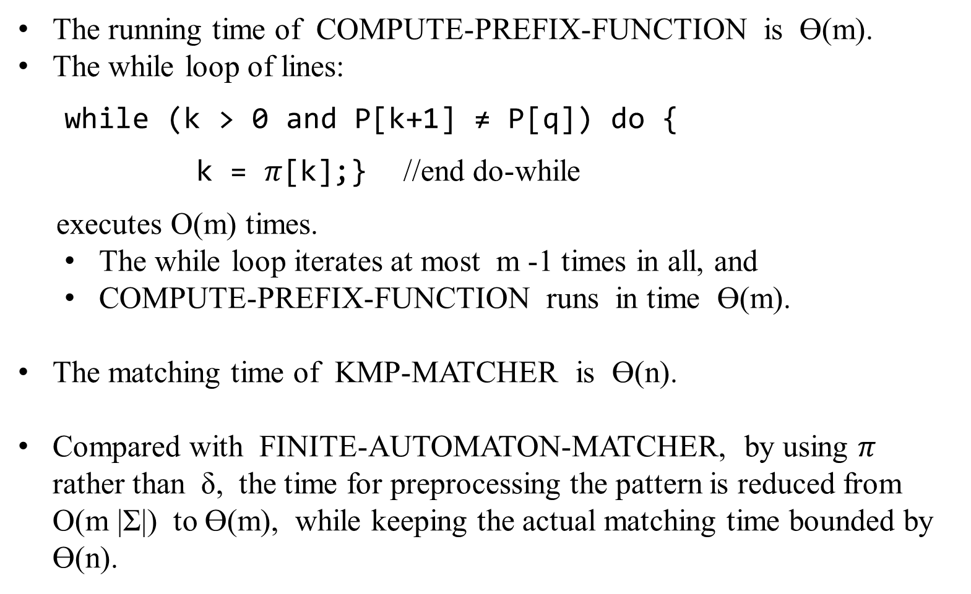
The running time of COMPUTE-PREFIX-FUNCTION is Ɵ(m).
The while loop of lines:
while (k > 0 and P[k+1] ≠ P[q]) do {
k = $π$[k];} //end do-while
executes O(m) times.
  The while loop iterates at most m -1 times in all, and
  COMPUTE-PREFIX-FUNCTION runs in time Ɵ(m).
The matching time of KMP-MATCHER is Ɵ(n).
Compared with FINITE-AUTOMATON-MATCHER, by using $π$ rather than δ, the time for preprocessing the pattern is reduced from O(m |Σ|) to Ɵ(m), while keeping the actual matching time bounded by Ɵ(n).

Slide 86
Exhaustive Search
It is simply a brute-force approach to combinatorial problems.
It suggests generating each and every element of the problem’s domain, selecting those of them that satisfy all the constraints, and then finding a desired element (e.g., the one that optimizes some objective function).
Illustrate exhaustive search by applying it to three important problems: t
The traveling salesman problem
The Knapsack problem
The assignment problem
[Will return to these problems]

