Slide 1
Chapter 1
Fundamentals of the Analysis of Algorithm Efficiency

Slide 2

Body of Knowledge Coverage:
Basis Analysis (AL)
Basis Analysis (AL)
  Asymptotic Analysis, empirical measurement.
  Differences among best, average, and worst case behaviors of an algorithm.
  Complexity classes, such as constant, logarithmic linear, quadratic, and exponential.
  Recurrence Relations and their solutions.
  Time and space trade-offs in algorithms.

Slide 3
Formal Proof of Program Correctness
Using Axiomatic Semantics

Slide 4


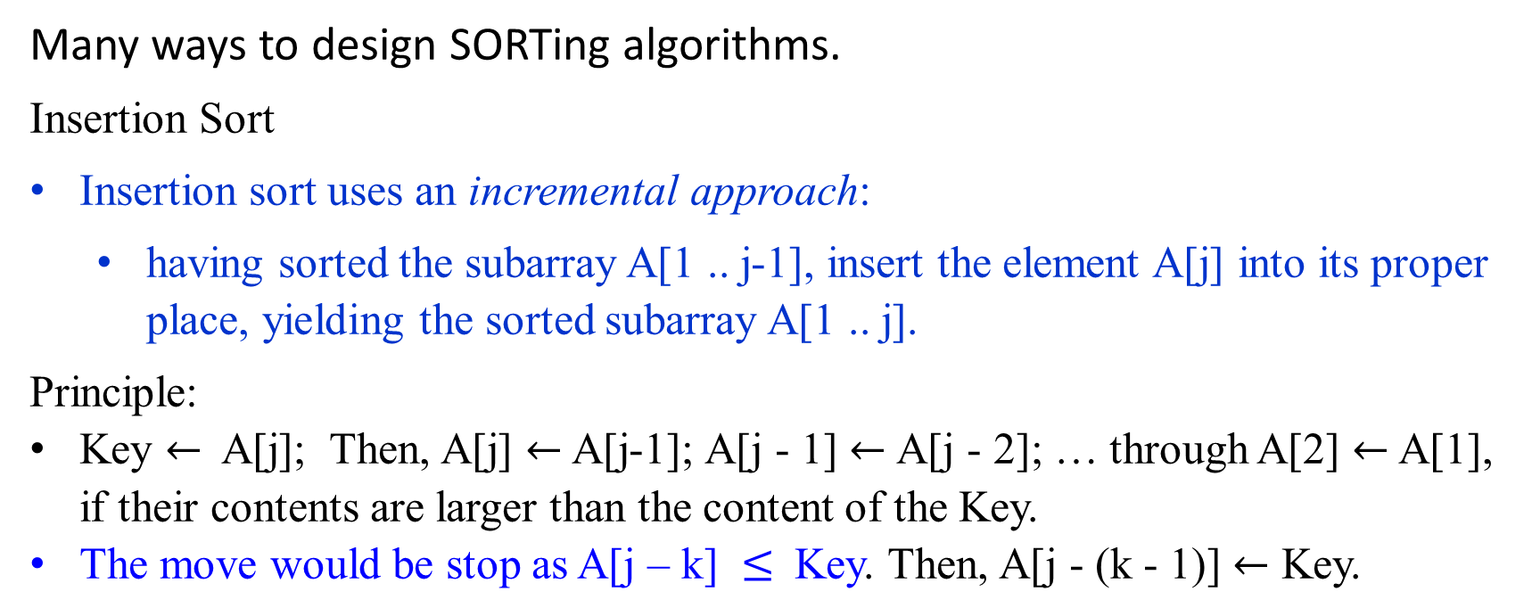
Many ways to design SORTing algorithms.
Insertion Sort
Insertion sort uses an incremental approach:
  having sorted the subarray A[1 .. j-1], insert the element A[j] into its proper place, yielding the sorted subarray A[1 .. j].
Principle:
Key $←$ A[j]; Then, A[j] $←$ A[j-1]; A[j - 1] $←$A[j - 2]; … through A[2] $←$ A[1], if their contents are larger than the content of the Key.
The move would be stop as A[j – k] $≤$ Key. Then, A[j - (k - 1)] $←$ Key.
Key$←$ A[j]
A[1] ≤ A[2] ≤ … ≤ A[j-k] < A[j-k+1] ≤ … ≤ A[j-1] | A[j] … A[n]
smaller than or equal to A[j] greater than A[j]

Slide 5

Algorithm Insertion-Sort(A)
Input: A sequence of n numbers (a₁, a₂, ..., a_{n}).
Output: A permutation (reordering) (a’₁, a’₂, …, a’_{n}) of the
input sequence such that a’₁ ≤ a’₂ ≤ …, ≤ a’_{n}.
// A[1], …, A[n], the pointer j goes from 2 to length[A]
for (j ← 2 to length[A]) do {
key ← A[j];
// Insert A[j] into the sorted sequence A[1 .. j-1].
i ← j – 1;
while (i>0 and A[i]>key) do {// pointer i goes from j -1 thru 1.
A[i+1] ← A[i]; // move A[i] to the right, if A[i] > key
i ← i – 1;} //end while-loop.
// if the current A[i] is less than key, then insert A[j] into A[i+1]
A[i+1] ← key;} // end for
n²
Can this improve? Create A[0] for each key being examined?

Slide 6

Time Efficiency for Algorithm Insert_Sort(A)
J
7 | 10 | 25 | 35 | 8 | 90 | 34 | 24
Key = 8
i
7 | 810 | 10 | 25 | 35 | 90 | 34 | 24

Slide 7
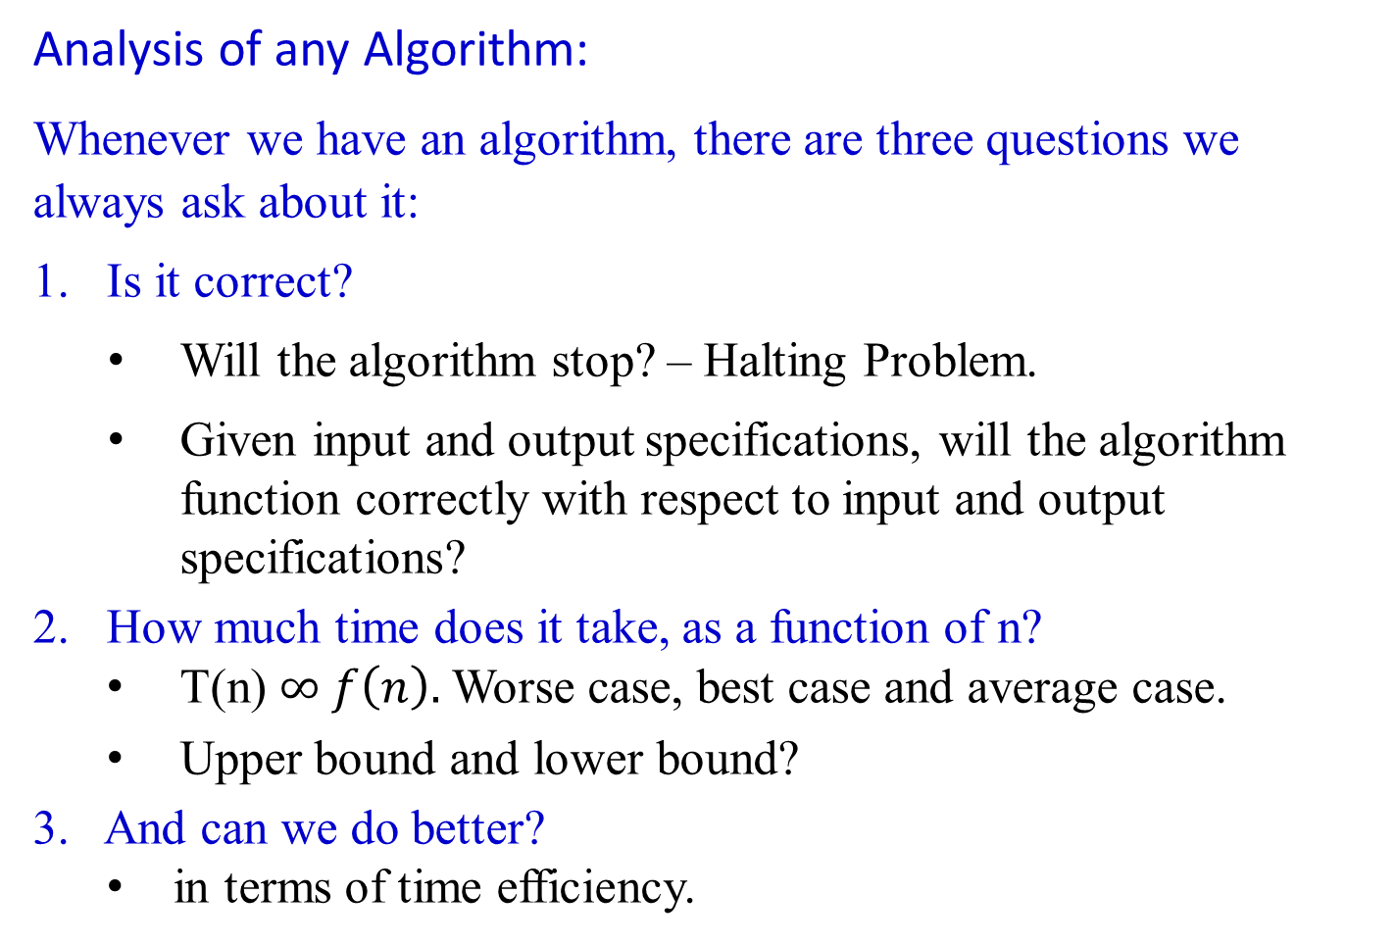
recall
Analysis of any Algorithm:
Whenever we have an algorithm, there are three questions we always ask about it:
Is it correct?
Will the algorithm stop? – Halting Problem.
Given input and output specifications, will the algorithm function correctly with respect to input and output specifications?
How much time does it take, as a function of n?
  T(n) $∞ f\left(n\right).$ Worse case, best case and average case.
  Upper bound and lower bound?
3. And can we do better?
  in terms of time efficiency.

Slide 8
Analysis of insertion sort
[Algorithm’s Correctness] For its correctness, ask
  Will the algorithm halt for the given input n items in the array?
  Whether the output data meets the output specifications {Q}with respect to the input data which meets the input specification {P}.
[Time Efficiency]
  How much time does the algorithm Insertion_Sort(A) take to arrange n number of items in an array in a nondecreasing order?
[Improvement]
  Could we design an algorithm that could be run efficiently and better than the existing one?

Slide 9
Analysis of Algorithms
Time Efficiency for Algorithm Insert_Sort(A)

Slide 10
Time Efficiency for Algorithm Insert_Sort(A)
J
7 | 10 | 25 | 35 | 8 | 90 | 34 | 24
Key = 8
i
7 | 810 | 10 | 25 | 35 | 90 | 34 | 24

Slide 11

Algorithm Insertion-Sort(A)
Input: A sequence of n numbers (a₁, a₂, ..., a_{n}).
Output: A permutation (reordering) (a’₁, a’₂, …, a’_{n}) of the
input sequence such that a’₁ ≤ a’₂ ≤ …, ≤ a’_{n}.
{ // A[1], …, A[n], the pointer j goes from 2 to length[A]
for (j ← 2 to length[A]) do {
key ← A[j];
// Insert A[j] into the sorted sequence A[1 .. j-1].
i ← j – 1;
while (i > 0 and A[i] > key) do { // pointer i goes from j -1 thru 1.
A[i+1] ← A[i]; // move A[i] to the right, if A[i] > key
i ← i – 1; } //end while-loop.
// if the current A[i] is less than key, then insert A[j] into A[i+1]
A[i+1] ← key;} // end for
for (j ← 2 to length[A]) do {
A[0] ← A[j];
i ← j – 1;
while (A[i] > A[0]) do {
A[i+1] ← A[i];
i ← i – 1;}
A[i+1] ← A[0]; }
n²

Slide 12
Analyze the efficiency of this algorithm in terms of time - by
  counting every instruction executed in
    number of times of execution with
    its estimated cost assumption.
The running time for a statement is c_{i} *n if the statement
  takes c_{i} steps (or nanoseconds) to execute and
  is executed n times.
Think - writing each statement in terms of a sequence of statements (steps) in assembler language

Slide 13
Determine the time efficiency for this algorithm Insert_Sort(A).
Consider the INSERTION_SORT procedure with
  Time “cost” c_{i} of each statement and
  Number of times n each statement is executed.
Consider for j ← 2 to length[A] do {
  For each j = 2, 3, …, n = length[A], let
  t_{j} be the number of times “while (i > 0 and A[i] > key)” is executed for the value of j.
  When a for or while loop exits in the usual way,
  the test is executed one time more than the loop body.
Comments are not executable statements, and so they take no time.

Slide 14

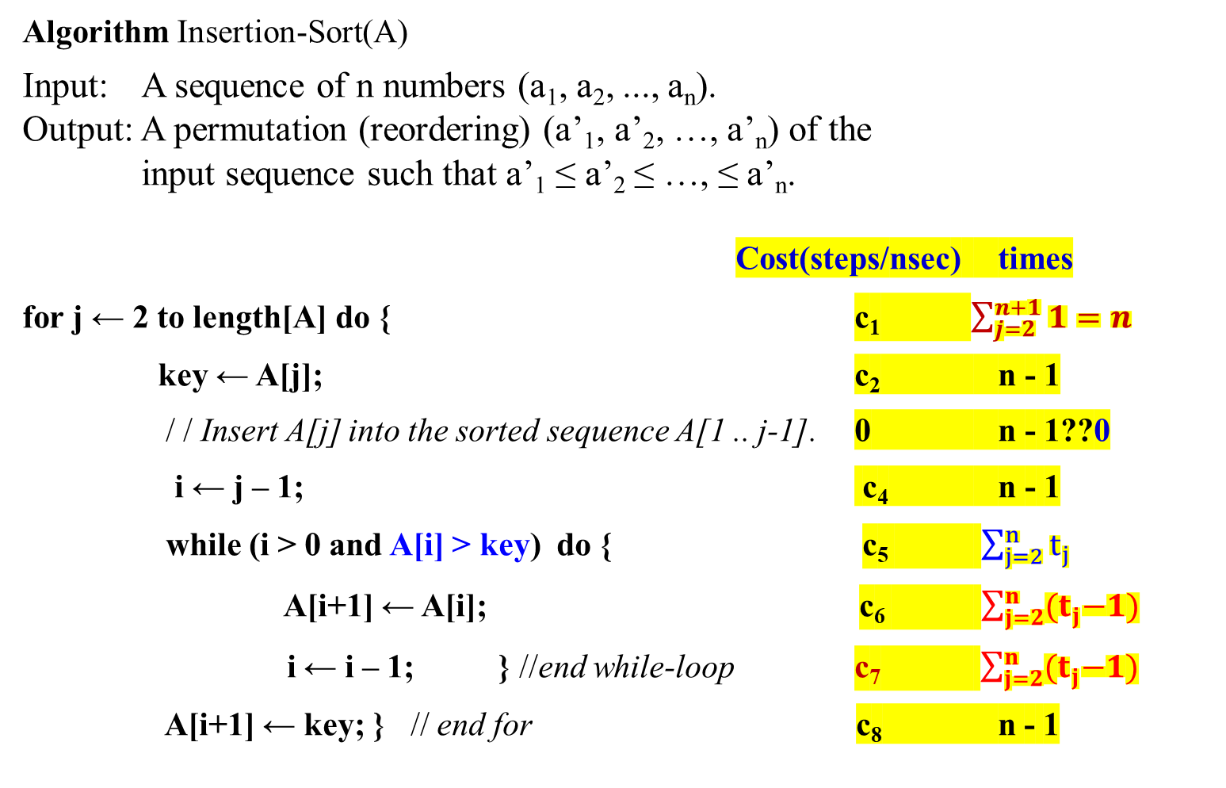
Algorithm Insertion-Sort(A)
Input: A sequence of n numbers (a₁, a₂, ..., a_{n}).
Output: A permutation (reordering) (a’₁, a’₂, …, a’_{n}) of the
input sequence such that a’₁ ≤ a’₂ ≤ …, ≤ a’_{n}.
Cost(steps/nsec) times
for j ← 2 to length[A] do { c₁ $\sum_{j=2}^{n+1}{1=n}$
key ← A[j]; c₂ n - 1
/ / Insert A[j] into the sorted sequence A[1 .. j-1]. 0 n - 1??0
i ← j – 1; c₄ n - 1
while (i > 0 and A[i] > key) do { c₅ $\sum_{j=2}^{n}{t_{j}}$
A[i+1] ← A[i]; c₆ $\sum_{j=2}^{n}{{(t}_{j}−1)}$
i ← i – 1; } //end while-loop c₇ $\sum_{j=2}^{n}{{(t}_{j}−1)}$
A[i+1] ← key; } // end for c₈ n - 1

Slide 15
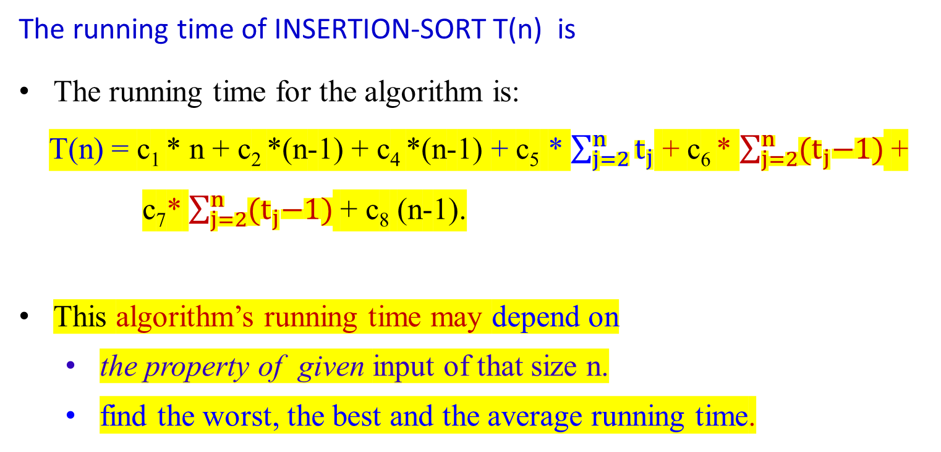
The running time of INSERTION-SORT T(n) is
The running time for the algorithm is:
T(n) = c₁ * n + c₂ *(n-1) + c₄ *(n-1) + c₅ * $\sum_{j=2}^{n}{t_{j}}$ + c₆ * $\sum_{j=2}^{n}{{(t}_{j}−1)}$ +
c₇* $\sum_{j=2}^{n}{{(t}_{j}−1)}$ + c₈ (n-1).
This algorithm’s running time may depend on
  the property of given input of that size n.
  find the worst, the best and the average running time.

Slide 16
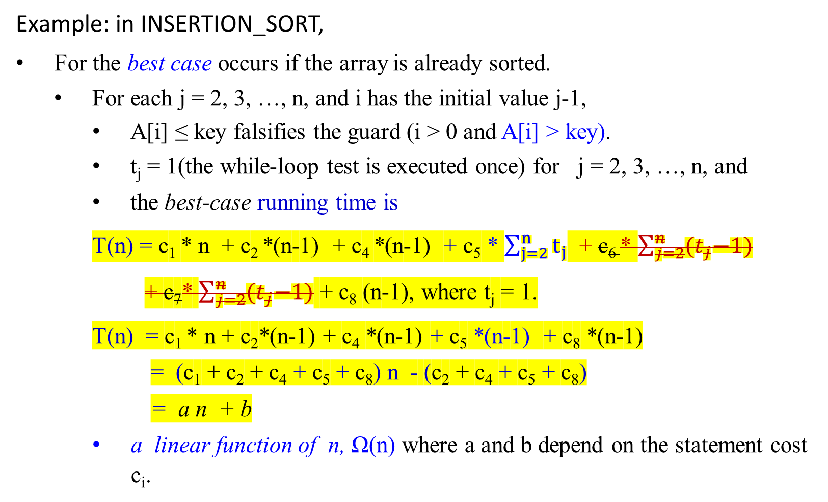
Example: in INSERTION_SORT,
For the best case occurs if the array is already sorted.
  For each j = 2, 3, …, n, and i has the initial value j-1,
    A[i] ≤ key falsifies the guard (i > 0 and A[i] > key).
    t_{j} = 1(the while-loop test is executed once) for j = 2, 3, …, n, and
    the best-case running time is
T(n) = c₁ * n + c₂ *(n-1) + c₄ *(n-1) + c₅ * $\sum_{j=2}^{n}{t_{j}}$ + c₆ * $\sum_{j=2}^{n}{{(t}_{j}−1)}$
+ c₇* $\sum_{j=2}^{n}{{(t}_{j}−1)}$ + c₈ (n-1), where t_{j} = 1.
T(n) = c₁ * n + c₂*(n-1) + c₄ *(n-1) + c₅ *(n-1) + c₈ *(n-1)
= (c₁ + c₂ + c₄ + c₅ + c₈) n - (c₂ + c₄ + c₅ + c₈)
= a n + b
a linear function of n, Ω(n) where a and b depend on the statement cost c_{i}.

Slide 17
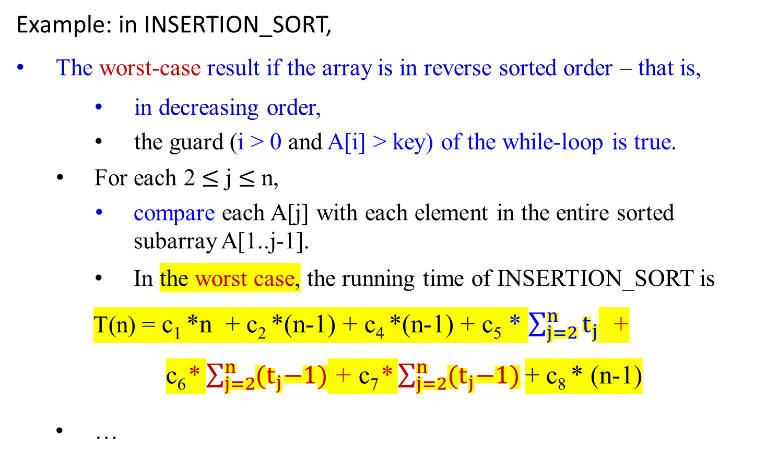
Example: in INSERTION_SORT,
The worst-case result if the array is in reverse sorted order – that is,
    in decreasing order,
    the guard (i > 0 and A[i] > key) of the while-loop is true.
For each 2 $≤$ j $≤$ n,
  compare each A[j] with each element in the entire sorted subarray A[1..j-1].
    In the worst case, the running time of INSERTION_SORT is
T(n) = c₁ *n + c₂ *(n-1) + c₄ *(n-1) + c₅ * $\sum_{j=2}^{n}{t_{j}}$ +
c₆* $\sum_{j=2}^{n}{{(t}_{j}−1)}$ + c₇* $\sum_{j=2}^{n}{{(t}_{j}−1)}$+ c₈ * (n-1)
  …

Slide 18


  Note that
$\sum_{j=2}^{n}{j}$= $\frac{n(n+1)}{2}$ - 1 and also $\sum_{j=2}^{n}{1}$= n - 2 + 1 = n - 1
and
$\sum_{j=2}^{n}{\text{(}\text{j}\text{ – 1)}}$ = $\frac{n(n−1)}{2}$
$\sum_{j=2}^{n}{\text{(}\text{j}\text{ – 1)}}$ = $\sum_{j=2}^{n}{j}$- $\sum_{j=2}^{n}{1}$
  = { $\frac{n(n+1)}{2}$ - 1} - {n - 1}
  = $\frac{n(n−1)}{2}$

Slide 19
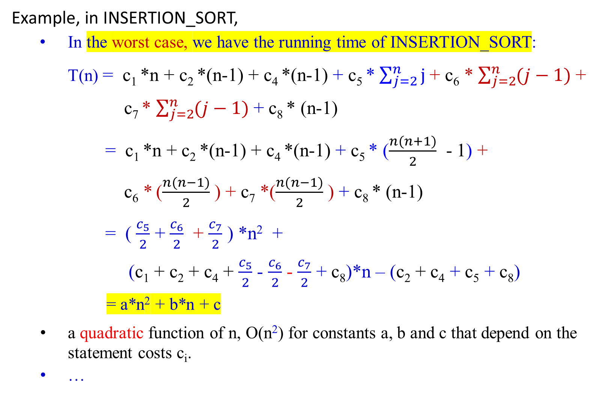
Example, in INSERTION_SORT,
  In the worst case, we have the running time of INSERTION_SORT:
T(n) = c₁ *n + c₂ *(n-1) + c₄ *(n-1) + c₅ * $\sum_{j=2}^{n}{j}$+ c₆ * $\sum_{j=2}^{n}{(j−1)}$+
c₇ * $\sum_{j=2}^{n}{(j−1)}$+ c₈ * (n-1)
= c₁ *n + c₂ *(n-1) + c₄ *(n-1) + c₅ * ($\frac{n(n+1)}{2}$ - 1) +
c₆ * ($\frac{n(n−1)}{2}$ ) + c₇ *($\frac{n(n−1)}{2}$ ) + c₈ * (n-1)
= ( $\frac{c_{5}}{2}$ + $\frac{c_{6}}{2}$ + $\frac{c_{7}}{2}$ ) *n² +
(c₁ + c₂ + c₄ + $\frac{c_{5}}{2}$ - $\frac{c_{6}}{2}$ - $\frac{c_{7}}{2}$ + c₈)*n – (c₂ + c₄ + c₅ + c₈)
= a*n² + b*n + c
a quadratic function of n, O(n²) for constants a, b and c that depend on the statement costs c_{i}.
…

Slide 20
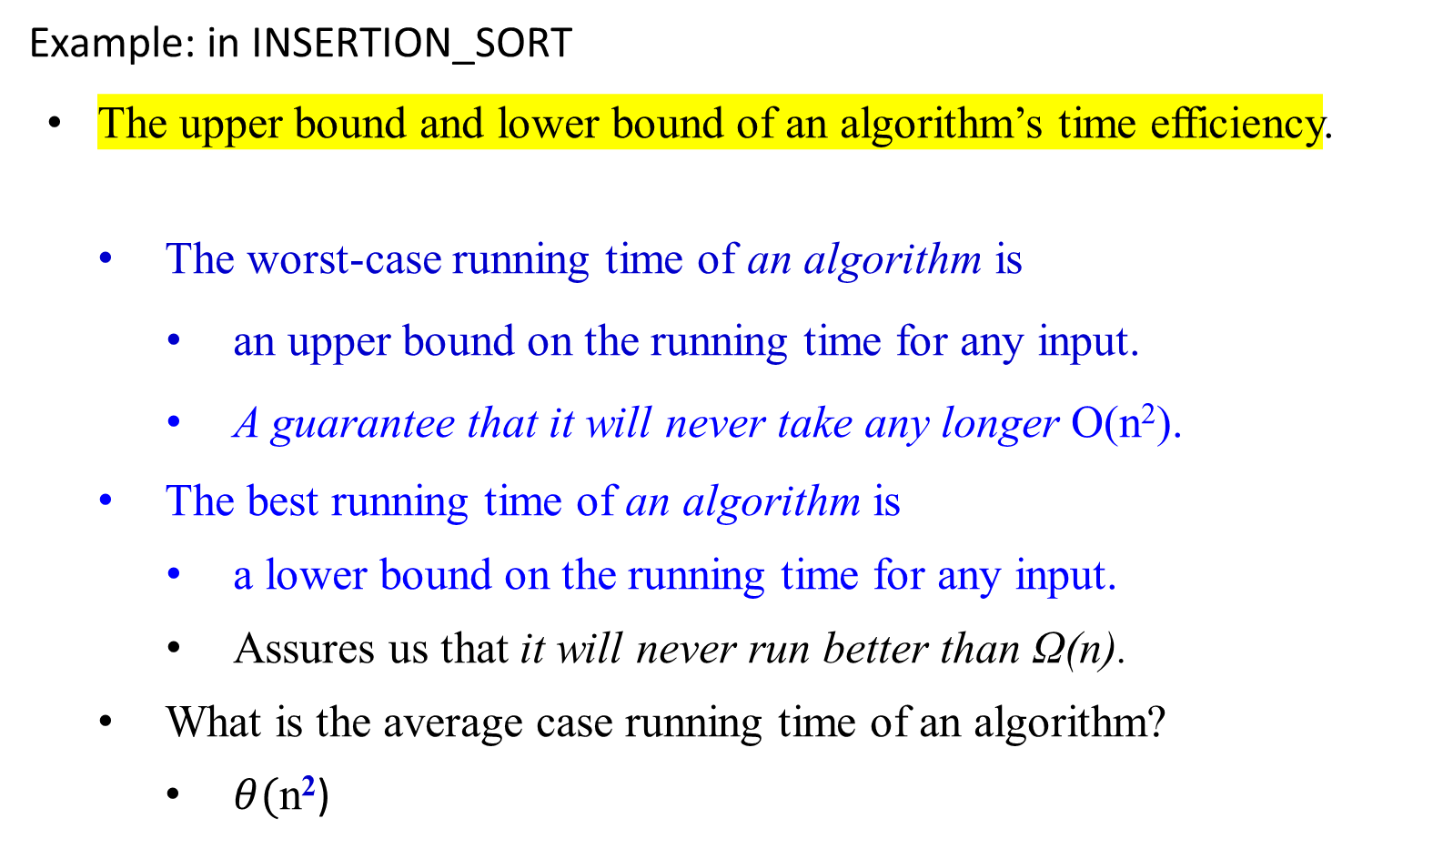
Example: in INSERTION_SORT
The upper bound and lower bound of an algorithm’s time efficiency.
The worst-case running time of an algorithm is
    an upper bound on the running time for any input.
    A guarantee that it will never take any longer O(n²).
The best running time of an algorithm is
    a lower bound on the running time for any input.
    Assures us that it will never run better than Ω(n).
What is the average case running time of an algorithm?
  $θ(\text{n}\text{2}$)

Slide 21
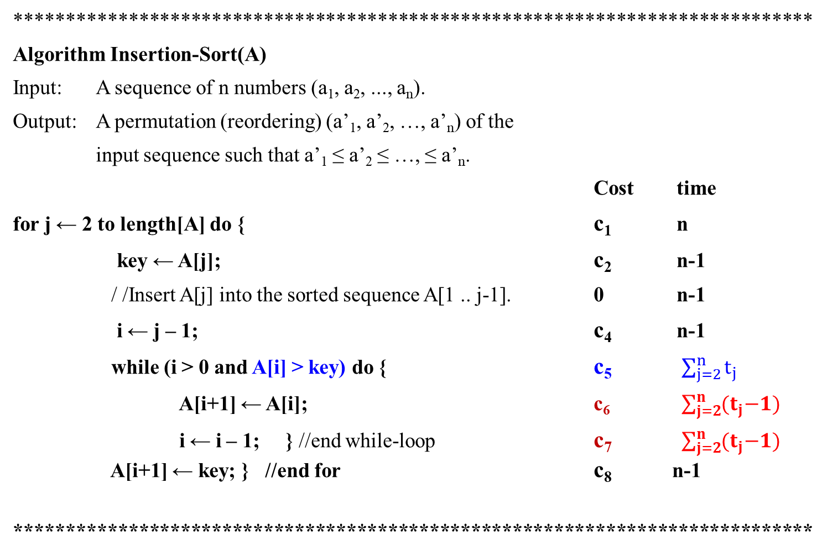
*****************************************************************************
Algorithm Insertion-Sort(A)
Input: A sequence of n numbers (a₁, a₂, ..., a_{n}).
Output: A permutation (reordering) (a’₁, a’₂, …, a’_{n}) of the
input sequence such that a’₁ ≤ a’₂ ≤ …, ≤ a’_{n}.
Cost time
for j ← 2 to length[A] do { c₁ n
key ← A[j]; c₂ n-1
/ /Insert A[j] into the sorted sequence A[1 .. j-1]. 0 n-1
i ← j – 1; c₄ n-1
while (i > 0 and A[i] > key) do { c₅ $\sum_{j=2}^{n}{t_{j}}$
A[i+1] ← A[i]; c₆ $\sum_{j=2}^{n}{{(t}_{j}−1)}$
i ← i – 1; } //end while-loop c₇ $\sum_{j=2}^{n}{{(t}_{j}−1)}$ A[i+1] ← key; } //end for c₈ n-1
*****************************************************************************

Slide 22
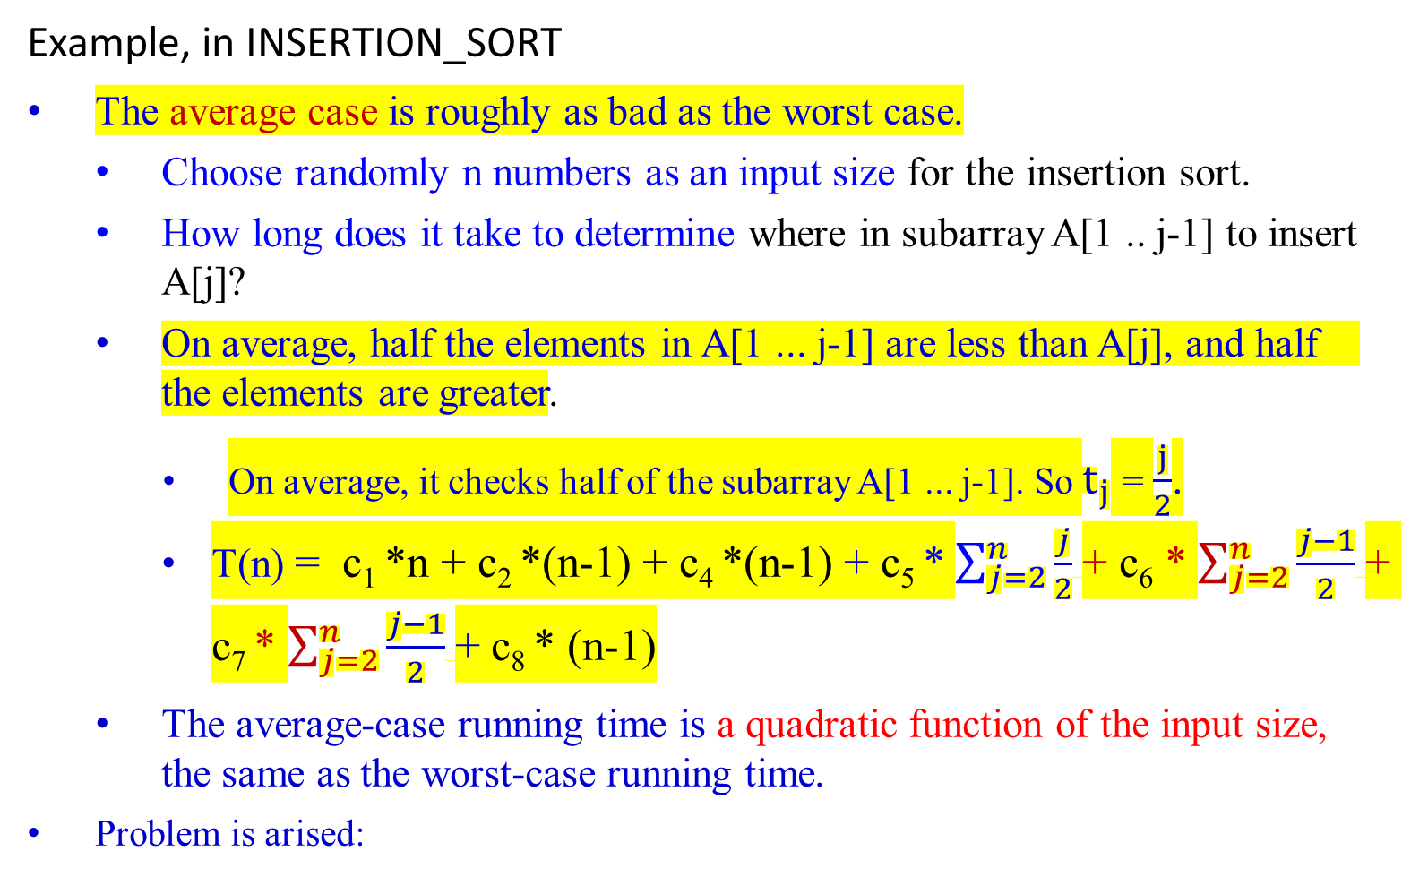
Example, in INSERTION_SORT
The average case is roughly as bad as the worst case.
Choose randomly n numbers as an input size for the insertion sort.
How long does it take to determine where in subarray A[1 .. j-1] to insert A[j]?
On average, half the elements in A[1 ... j-1] are less than A[j], and half the elements are greater.
  On average, it checks half of the subarray A[1 ... j-1]. So $t_{j}$ = $\frac{j}{2}$.
T(n) = c₁ *n + c₂ *(n-1) + c₄ *(n-1) + c₅ * $\sum_{j=2}^{n}{\frac{j}{2}}$+ c₆ * $\sum_{j=2}^{n}{\frac{j−1}{2}}$+ c₇ * $\sum_{j=2}^{n}{\frac{j−1}{2}}$+ c₈ * (n-1)
The average-case running time is a quadratic function of the input size, the same as the worst-case running time.
Problem is arised:

Slide 23

Example: in INSERTION_SORT
Performance of Insertion Sort:
The average case is roughly as bad as the worst case.
The problem in Analysis:
Problem is arised:
Our assumption: all inputs of a given size are equally likely (for all instances).
  In practice, this assumption may be violated,
Use a randomized algorithm for making random choices.
  This allows a probabilistic analysis and yields an expected running time.
an incremental approach is used to design insertion sort.

Slide 24
Using Axiomatic Semantics for
Formal Proof of Program Correctness
(Program Verification)

Slide 25
Program Correctness
For solving a problem:
  design an algorithm and then implement it as a program.
Be sure that the program always produces the correct answer:
    Remove all the bugs, only ensure that the syntax is correct.
    Test the program with all possible input.

Slide 26
Program Verification
A program is correct if it produces the correct output for every possible input.
A proof of a program correctness consists of two parts:
  the partial correctness of the program:
    shows that the correct answer is obtained if the program terminates.
  The halting problem:
    shows the program always terminates.

Slide 27
Program Verification
A program is correct if it produces the correct output for every possible input.
Program verification (the proof of programs):
  uses the rules of inference and proof techniques, including mathematical induction.
Two propositions are used:
  The initial assertion: gives the properties that the input values must have.
  The final assertion: gives the properties that the output of the program should have, if the program did what was intended.

Slide 28
Program Verification
Given the initial and final assertions of a program,
the program, or program segment, S is said to be partially correct with respect to the initial assertion p and the final assertion q (denote as p{S}q) if
  whenever p is true for the input values of S and
  S terminates,
  then q is true for the output values of S.
For example:
p: x = 1 {y := 2; z := x + y} q: z = 3

Slide 29
Program Verification
For example: Given
p: x = 1 {y := 2; z := x + y} q: z = 3
show that the program segment is correct with respect to the initial assertion p and the final assertion q.
Shown:
  Suppose p is true.
  The program begins with the true x = 1.
  Then y is assigned the value 2, and
  z is assigned the sum of the values x and y, which is 3.
  Hence, S is correct with respect to the initial assertion p and the final assertion q. Thus, p{S}q is true.

Slide 30
Program Verification (Another Method)
For example: Given
p: x = 1 {y := 2; z := x + y} q: z = 3
show that the program segment is correct with respect to the initial assertion p and the final assertion q.
Shown:
p: x = 1 x = 3 – 2 = 1 implies that p: x = 1 is true
{y := 2; x + 2 = 3 substitute 2 for y
z := x + y} x + y = 3 since replace z by x + y
q: z = 3 q: z = 3 given the final assertion

Slide 31
Axiomatic Semantics: The Inference Rule
Axioms or inference rules (also called assertions) are logic expressions defined for each statement type in the language.
Use an inference rule
  to infer the truth of one assertion based on the values of other assertions
A useful rule of inference:
  proves a program’s correctness by
    splitting the program into a sequence of subprograms
    and then showing that each subprogram is correct.

Slide 32
Axiomatic Semantics: The Inference Rule
Assume that the program S is split into subprograms S₁ and S₂. Show that p{S}q is true.
Shown:
  p{S₁}r is true, if p is true and S₁ is executed and terminated, then r is true;
  and
  r{S₂ }q is true, if r is true and S₂ is executed and terminated, then q is true.
  Thus p{S₁ ; S₂ }q is true.
    i.e., if p is true and S = S₁ ; S₂ is executed and terminated, then q is true.
This rule of inference is the composition rule, which can be stated as
p{S₁}r
r{S₂ }q
p{S₁ ; S₂ }q
p
S₁
r
S₂
q

Slide 33
Axiomatic Semantics: The Inference Rule
Conditional Statements
Assume that the program segment has the form
if condition then S
where S is a block statement.
Then S is executed if the condition is true, and S is not executed when the condition is false.
p
cond
S
q

Slide 34
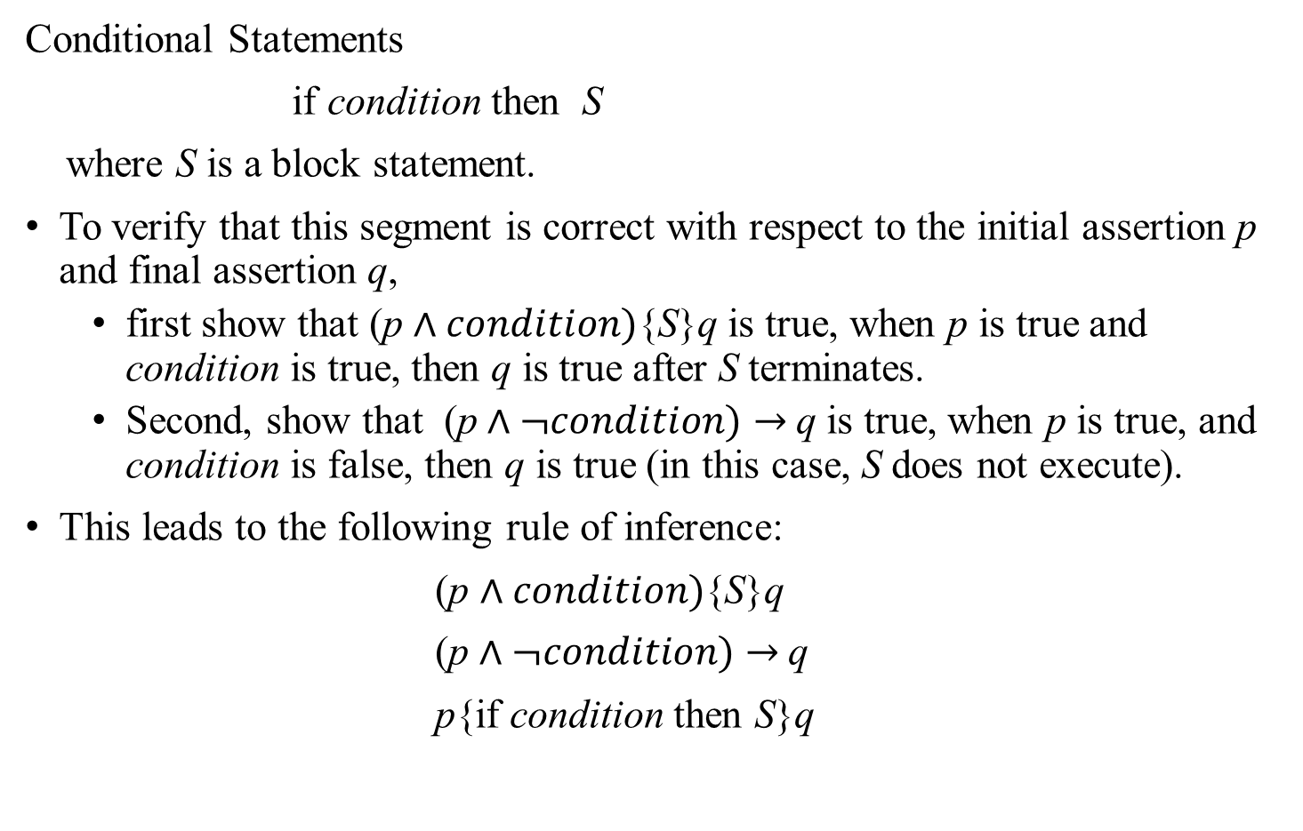
Axiomatic Semantics: The Inference Rule
Conditional Statements
if condition then S
where S is a block statement.
To verify that this segment is correct with respect to the initial assertion p and final assertion q,
  first show that (p $∧condition)${S}q is true, when p is true and condition is true, then q is true after S terminates.
  Second, show that (p $∧¬condition)$ $→$q is true, when p is true, and condition is false, then q is true (in this case, S does not execute).
This leads to the following rule of inference:
(p $∧condition)${S}q
(p $∧¬condition)$ $→$q
p{if condition then S}q

Slide 35
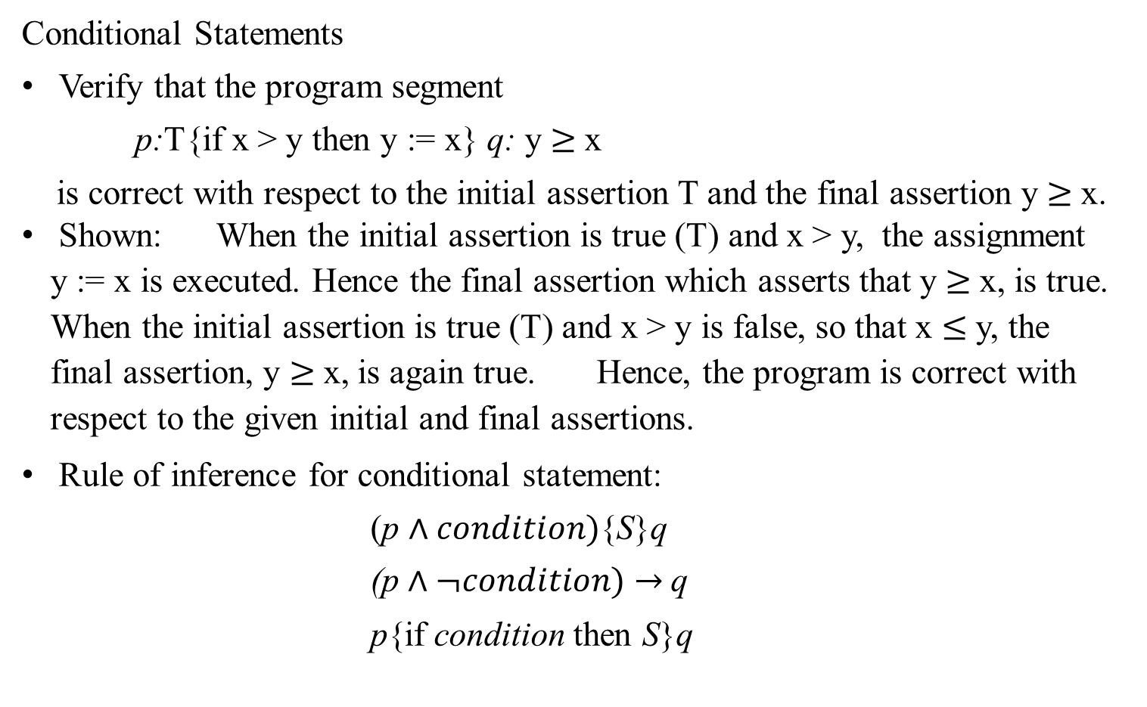
Axiomatic Semantics: The Inference Rule
Conditional Statements
Verify that the program segment
p:T{if x > y then y := x} q: y $≥$x
is correct with respect to the initial assertion T and the final assertion y $≥$x.
Shown: When the initial assertion is true (T) and x > y, the assignment y := x is executed. Hence the final assertion which asserts that y $≥$x, is true. When the initial assertion is true (T) and x > y is false, so that x $≤$ y, the final assertion, y $≥$x, is again true. Hence, the program is correct with respect to the given initial and final assertions.
Rule of inference for conditional statement:
(p $∧condition)${S}q
(p $∧¬condition)$ $→$q
p{if condition then S}q

Slide 36


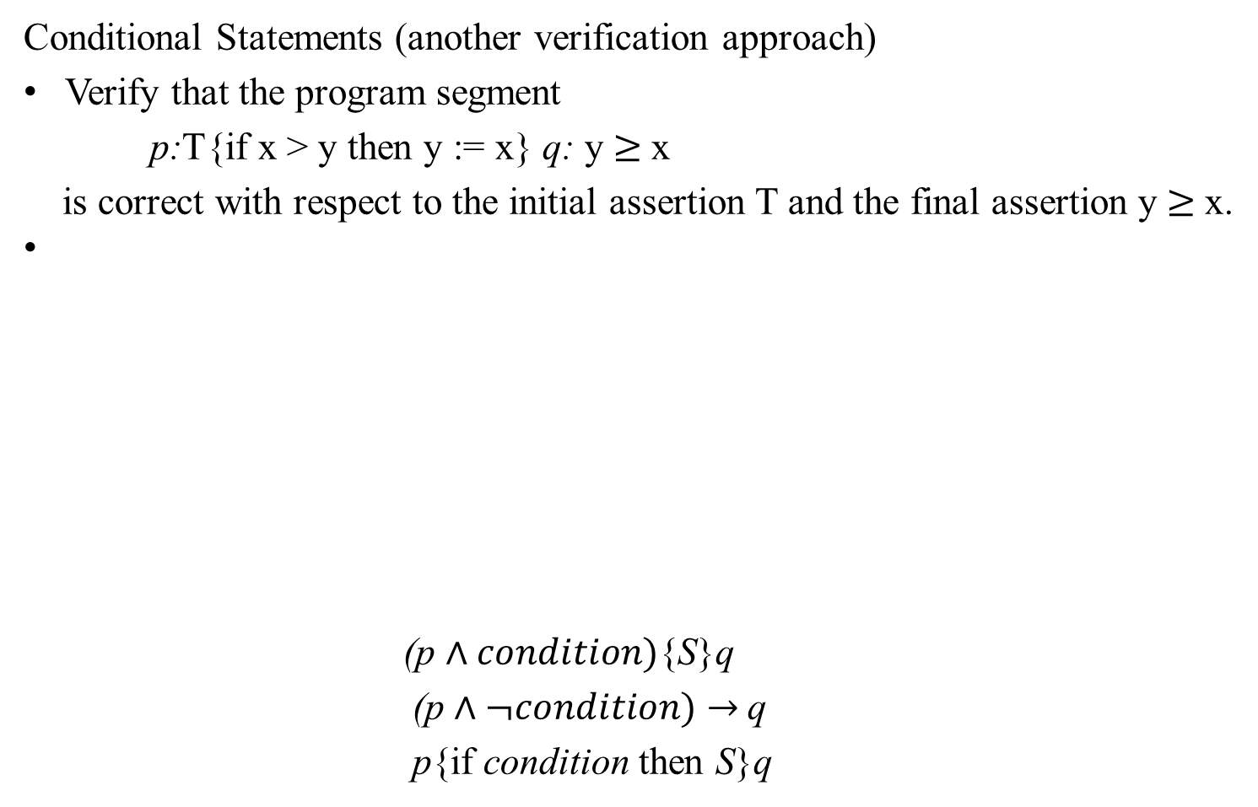



Axiomatic Semantics: The Inference Rule
Conditional Statements (another verification approach)
Verify that the program segment
p:T{if x > y then y := x} q: y $≥$x
is correct with respect to the initial assertion T and the final assertion y $≥$x.
(p $∧condition)${S}q
(p $∧¬condition)$ $→$q
p{if condition then S}q
p: T
p: T
(x > x) ∧ q: x $≥$x
$¬$(x > y) ∧ q: y $≥$x
x > y
q: x $≥$x
y := x
q: y $≥$x
q: y $≥$x

Slide 37
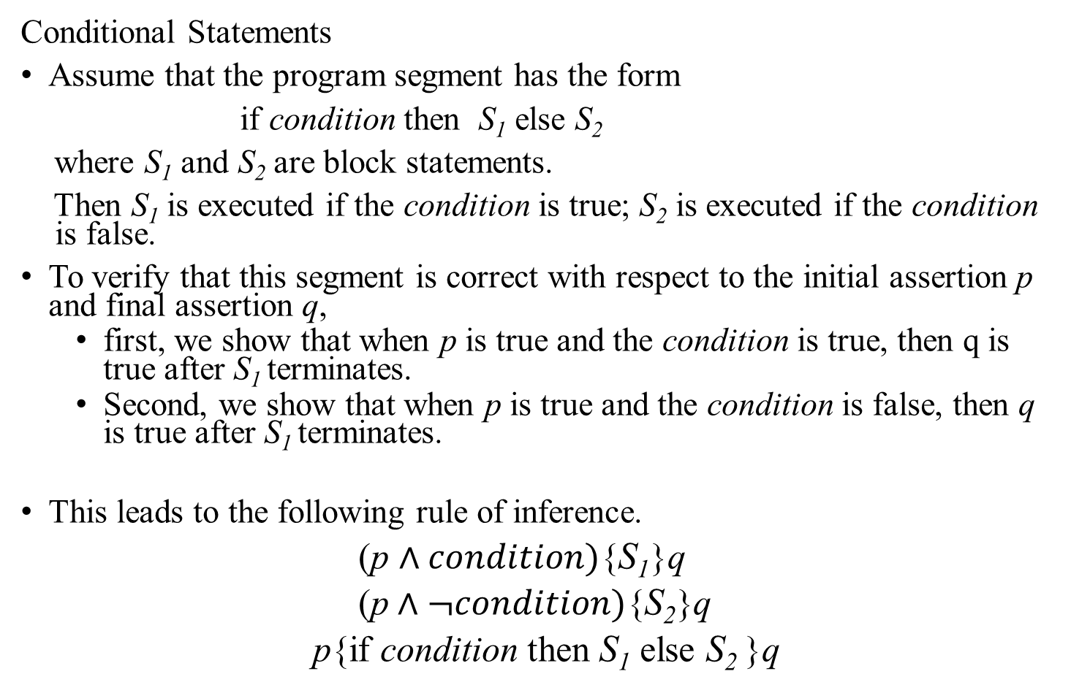
Axiomatic Semantics: The Inference Rule
Conditional Statements
Assume that the program segment has the form
if condition then S₁ else S₂
where S₁ and S₂ are block statements.
Then S₁ is executed if the condition is true; S₂ is executed if the condition is false.
To verify that this segment is correct with respect to the initial assertion p and final assertion q,
  first, we show that when p is true and the condition is true, then q is true after S₁ terminates.
  Second, we show that when p is true and the condition is false, then q is true after S₁ terminates.
This leads to the following rule of inference.
(p $∧condition)${S₁}q
(p $∧¬condition)\text{\{}\text{S}\text{2}\text{\}}$q
p{if condition then S₁ else S₂ }q

Slide 38
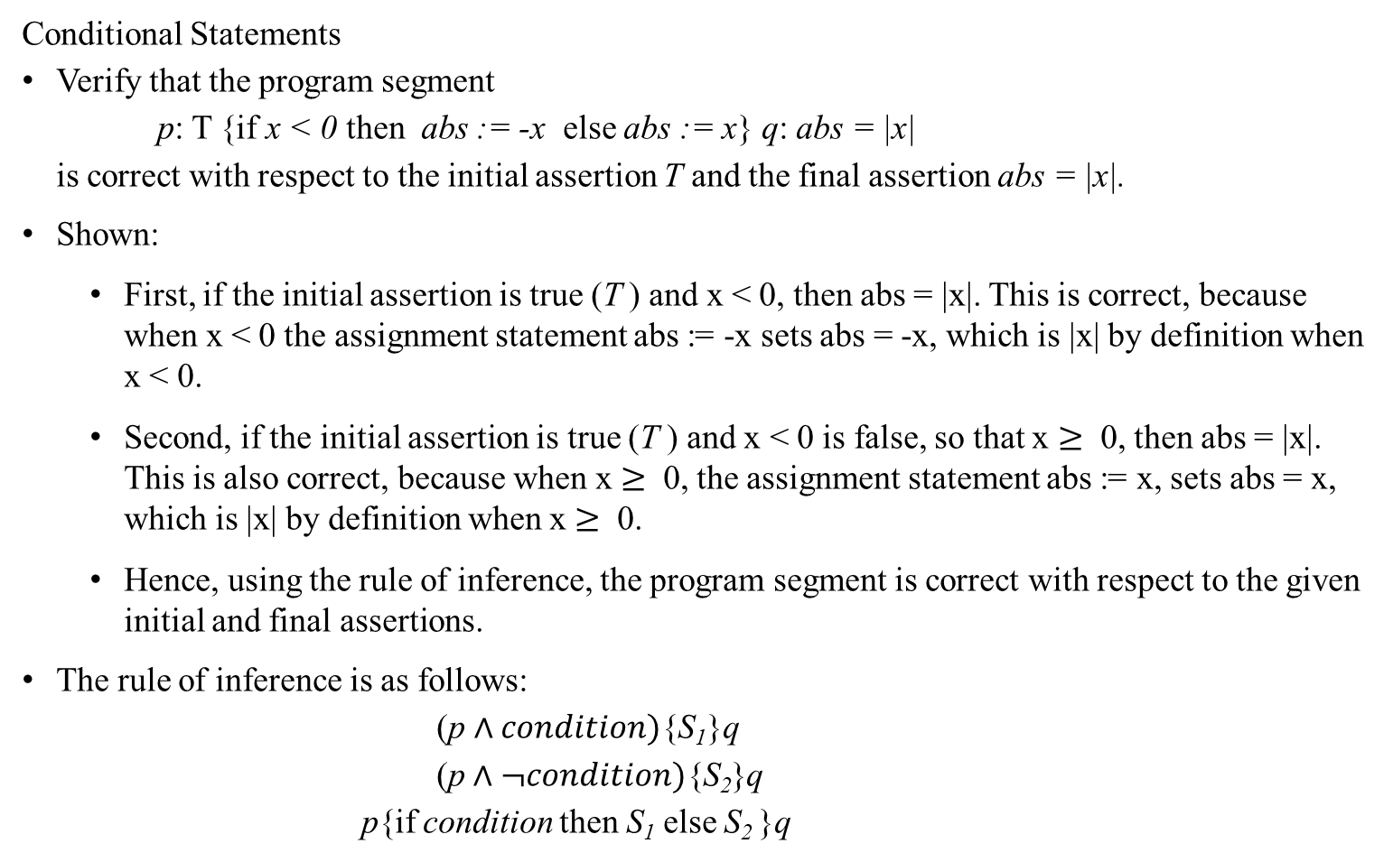
Axiomatic Semantics: The Inference Rule
Conditional Statements
Verify that the program segment
p: T {if x < 0 then abs := -x else abs := x} q: abs = |x|
is correct with respect to the initial assertion T and the final assertion abs = |x|.
Shown:
  First, if the initial assertion is true (T ) and x < 0, then abs = |x|. This is correct, because when x < 0 the assignment statement abs := -x sets abs = -x, which is |x| by definition when x < 0.
  Second, if the initial assertion is true (T ) and x < 0 is false, so that x $≥$ 0, then abs = |x|. This is also correct, because when x $≥$ 0, the assignment statement abs := x, sets abs = x, which is |x| by definition when x $≥$ 0.
  Hence, using the rule of inference, the program segment is correct with respect to the given initial and final assertions.
The rule of inference is as follows:
(p $∧condition)${S₁}q
(p $∧¬condition)\text{\{}\text{S}\text{2}\text{\}}$q
p{if condition then S₁ else S₂ }q

Slide 39


Axiomatic Semantics: The Inference Rule
Conditional Statements
Verify that the program segment
p: T {if x < 0 then abs := -x else abs := x} q: abs = |x|
is correct with respect to the initial assertion T and the final assertion abs = |x|.
Shown:
The rule of inference is as follows:
(p $∧condition)${S₁}q
(p $∧¬condition)\text{\{}\text{S}\text{2}\text{\}}$q
p{if condition then S₁ else S₂ }q
p: T
(x < 0) ∧ q: -x = |x|
$¬$(x < 0) ∧ q: x = |x|
x < 0
q: -x = |x|
q: x = |x|
abs := -x
abs := x
q: abs = |x|

Slide 40
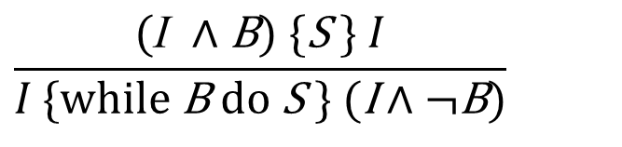
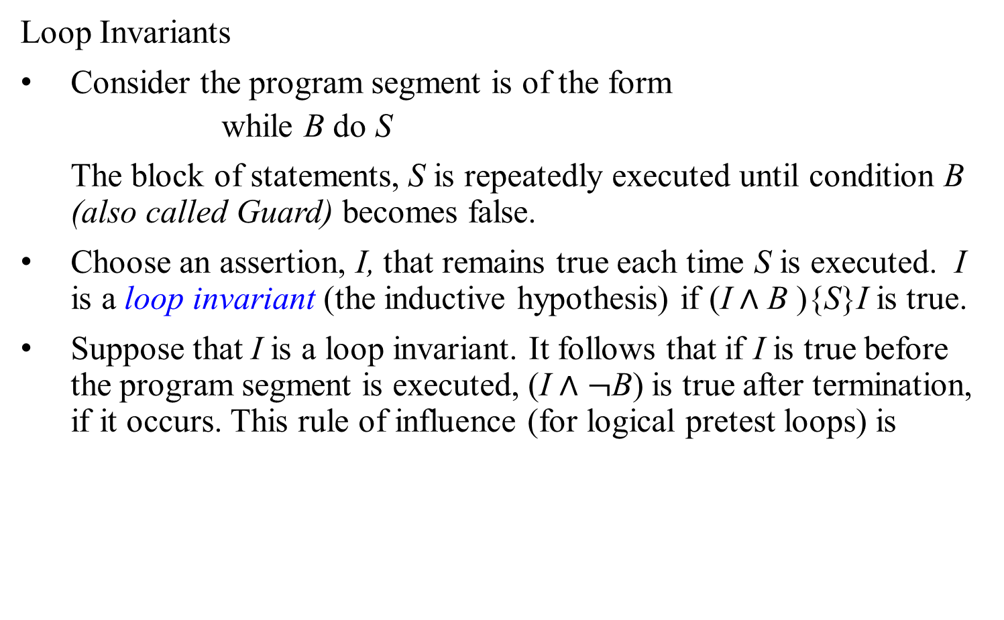
Axiomatic Semantics: The Inference Rule
Loop Invariants
Consider the program segment is of the form
  while B do S
The block of statements, S is repeatedly executed until condition B (also called Guard) becomes false.
Choose an assertion, I, that remains true each time S is executed. I is a loop invariant (the inductive hypothesis) if (I $∧$ B ){S}I is true.
Suppose that I is a loop invariant. It follows that if I is true before the program segment is executed, (I $∧$ $¬$B) is true after termination, if it occurs. This rule of influence (for logical pretest loops) is
$$\frac{(\text{I} ∧\text{B}) \text{\{}\text{S} \text{\}} I}{I \text{\{}\text{while} \text{B} \text{do} \text{S}\text{ \}} (\text{I}∧¬\text{B})}$$

Slide 41

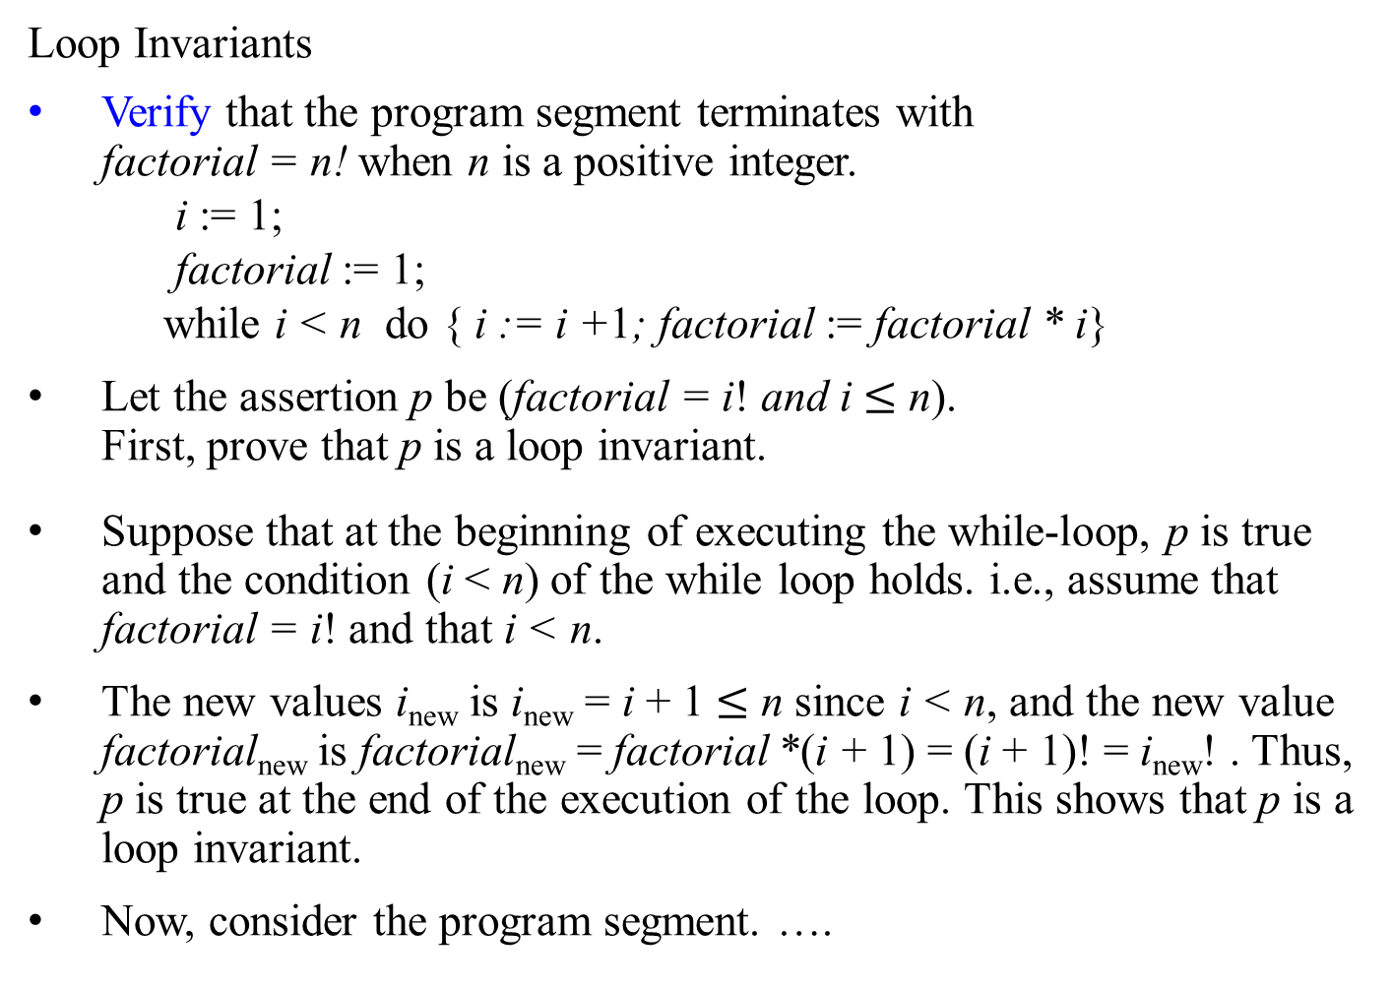


Axiomatic Semantics: The Inference Rule
1= 1! ∧ 1$≤$ n
Loop Invariants
Verify that the program segment terminates with factorial = n! when n is a positive integer.
i := 1;
factorial := 1;
while i < n do { i := i +1; factorial := factorial * i}
Let the assertion p be (factorial = i! and i $≤$ n). First, prove that p is a loop invariant.
Suppose that at the beginning of executing the while-loop, p is true and the condition (i < n) of the while loop holds. i.e., assume that factorial = i! and that i < n.
The new values i_{new} is i_{new} = i + 1 $≤$ n since i < n, and the new value factorial_{new} is factorial_{new} = factorial *(i + 1) = (i + 1)! = i_{new}! . Thus, p is true at the end of the execution of the loop. This shows that p is a loop invariant.
Now, consider the program segment. ….
i := 1
1= i! ∧ i $≤$ n
factorial := 1
p: factorial = i! ∧ i $≤$ n
i < n
…

Slide 42




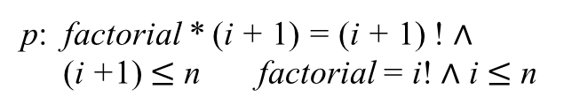

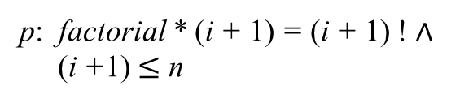


Axiomatic Semantics: The Inference Rule
1= 1! ∧ 1$≤$ n
Loop Invariants (another approach)
Verify that the following program segment terminates with factorial = n! when n is a positive integer.
i := 1;
factorial := 1;
while i < n do { i := i +1; factorial := factorial * i}
i := 1
1= i! ∧ i $≤$ n
factorial := 1
p: factorial = i! ∧ i $≤$ n
i < n
…
1= 1! ∧ 1$≤$ n
i := 1
1= i! ∧ i $≤$ n
factorial := 1
p: factorial * (i + 1) = (i + 1) ! ∧
(i +1) $≤$ n factorial = i! ∧ i $≤$ n
p: factorial = i! ∧ i $≤$ n
i < n
p: factorial * (i + 1) = (i + 1) ! ∧
(i +1) $≤$ n
i := i + 1
p: factorial * i = i! ∧ i $≤$ n
factorial := factorial * i
p: factorial = i! ∧ i $≤$ n

Slide 43

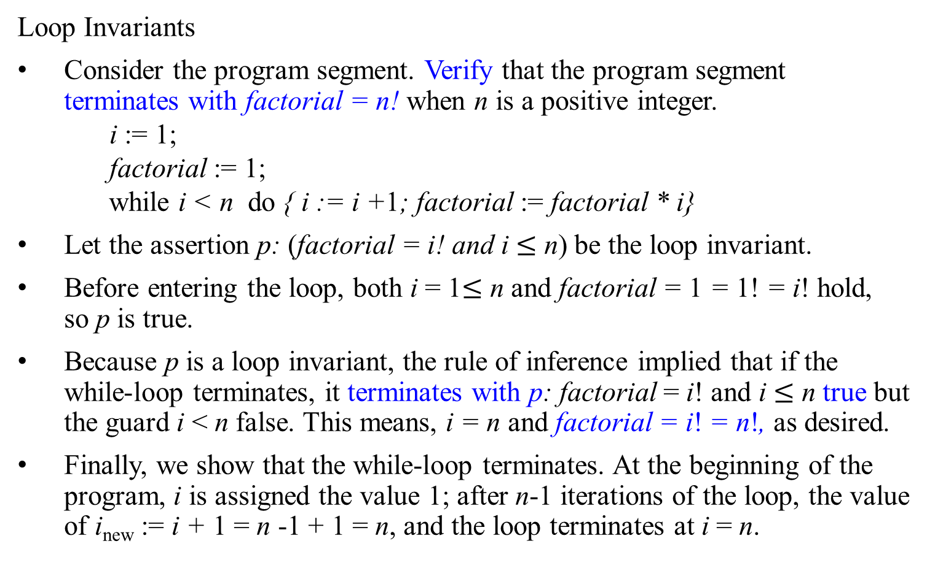
Axiomatic Semantics: The Inference Rule
Loop Invariants
Consider the program segment. Verify that the program segment terminates with factorial = n! when n is a positive integer.
i := 1;
factorial := 1;
while i < n do { i := i +1; factorial := factorial * i}
Let the assertion p: (factorial = i! and i $≤$ n) be the loop invariant.
Before entering the loop, both i = 1$≤$ n and factorial = 1 = 1! = i! hold, so p is true.
Because p is a loop invariant, the rule of inference implied that if the while-loop terminates, it terminates with p: factorial = i! and i $≤$ n true but the guard i < n false. This means, i = n and factorial = i! = n!, as desired.
Finally, we show that the while-loop terminates. At the beginning of the program, i is assigned the value 1; after n-1 iterations of the loop, the value of i_{new} := i + 1 = n -1 + 1 = n, and the loop terminates at i = n.
p : (factorial = i! and i $≤$ n)

Slide 44
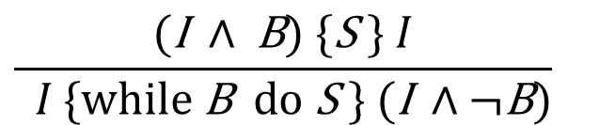
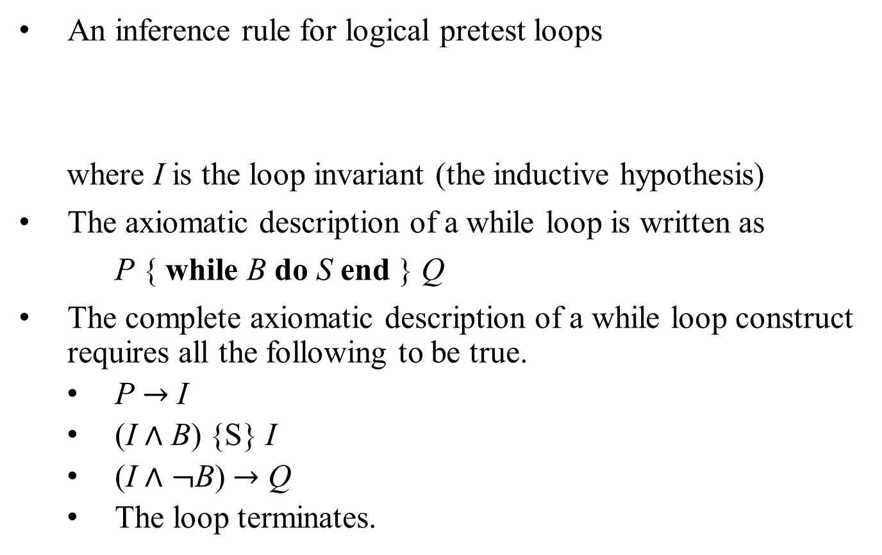
Axiomatic Semantics: The Inference Rule
An inference rule for logical pretest loops
where I is the loop invariant (the inductive hypothesis)
The axiomatic description of a while loop is written as
P { while B do S end } Q
The complete axiomatic description of a while loop construct requires all the following to be true.
  P $→$ I
  (I $∧$ B) {S} I
  (I $∧$ $¬$B) $→$ Q
  The loop terminates.
$$\frac{(\text{I} ∧ \text{B}) \text{\{}\text{S} \text{\}} I}{ I \text{\{}\text{while} \text{B} \text{do} \text{S} \} (\text{I} ∧¬\text{B})}$$

Slide 45
Example: How to verify the correctness of the program S for computing the product of two integers.
procedure multiply(m, n: integers)
    if n < 0 then a := -n
    else a := n;
    k := 0;
    x := 0;
    while k < a do {
    x := x + m;
    k := k + 1}
    if n < 0 then product := -x
    else product := x;
    return product;
    {product equals mn}
S₁
The goal is to prove that after S is executed and then terminated, the product has the value mn.
The proof of correctness can be carried out by splitting S into four segments with S = S₁; S₂; S₃; S₄.
We will build the correctness proof using the rule of reference.
S₂
S₃
S₄

Slide 46

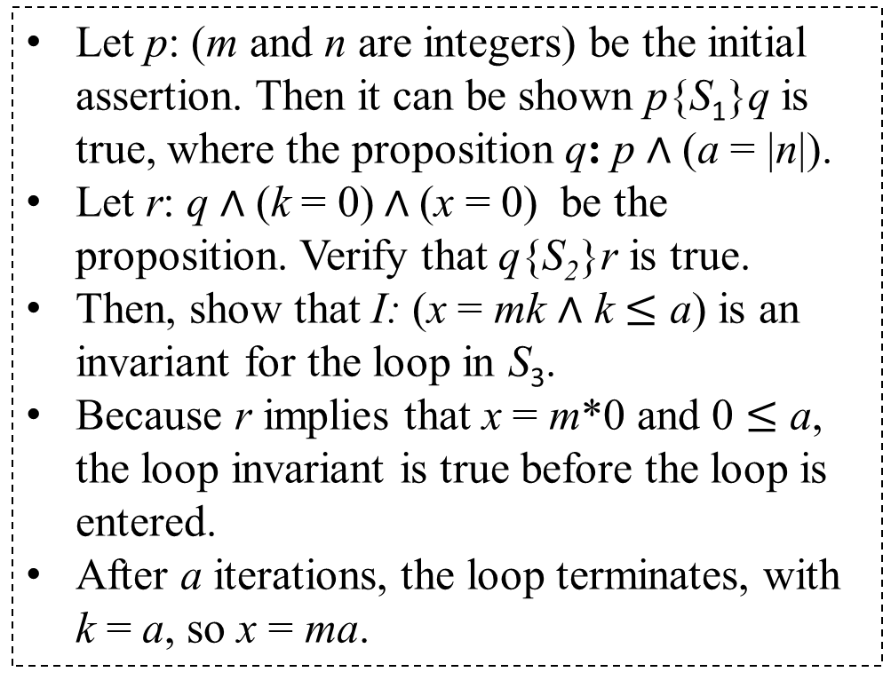



Example: How to verify the correctness of the program S for computing the product of two integers.
p: (m and n $∈Z$)
procedure multiply(m, n: integers)
    if n < 0 then a := -n
    else a := n;
    k := 0;
    x := 0;
    while k < a do {
    x := x + m;
    k := k + 1}
    if n < 0 then product := -x
    else product := x;
    return product;
    {t: product = mn}
Let p: (m and n are integers) be the initial assertion. Then it can be shown p{S₁}q is true, where the proposition q: p ∧ (a = |n|).
Let r: q ∧ (k = 0) ∧ (x = 0) be the proposition. Verify that q{S₂}r is true.
Then, show that I: (x = mk ∧ k $≤$ a) is an invariant for the loop in S₃.
Because r implies that x = m*0 and 0 $≤$ a, the loop invariant is true before the loop is entered.
After a iterations, the loop terminates, with k = a, so x = ma.
S₁
S₂
q: p ∧ (a = |n|)
r: q ∧ (k = 0) ∧ (x = 0)
(x = mk ∧ k $≤$ a)
S₃
s: x = ma ∧ a $=$ |n|
(x = mk ∧ k $=$ a)
S₄

Slide 47


Example: How to verify the correctness of the program S for computing the product of two integers.
p: (m and n $∈Z$)
Because the loop terminates with k = a, it follows that r{S₃}s is true, where the proposition s: (x = ma ∧ a = |n|).
It can be shown that s{S₄}t is true, where t: product = mn is the proposition; i.e., S₄ is correct with respect to the initial assertion s and final assertion t.
Putting all these together, because all p{S₁}q, q{S₂}r, r{S₃}s, and s{S₄}t are true, it follows from the rule of reference (composition) that p{S}t is true.
Furthermore, S does terminate since all four segments terminate.
This proves that the program is correct.
procedure multiply(m, n: integers)
    if n < 0 then a := -n
    else a := n;
    k := 0;
    x := 0;
    while k < a do {
    x := x + m;
    k := k + 1}
    if n < 0 then product := -x
    else product := x;
    return product;
    {t: product = mn}
S₁
S₂
q: p ∧ (a = |n|)
r: q ∧ (k = 0) ∧ (x = 0)
I: x = mk ∧ k $≤$ a
S₃
s: x = ma ∧ a $=$ |n|
S₄

Slide 48
Verify Program Correctness for the Insertion_Sort
Proof will not be provided.

Slide 49
Algorithm Insertion-Sort(A)
Input: A sequence of n numbers (a₁, a₂, ..., a_{n}).
Output: A permutation (reordering) (a’₁, a’₂, …, a’_{n}) of the
input sequence such that a’₁ ≤ a’₂ ≤ …, ≤ a’_{n}.
for (j ← 2 to length[A]) do {
key ← A[j];
i ← j – 1;
while (i > 0 and A[i] > key) do {
A[i+1] ← A[i];
i ← i – 1; } //end while-loop.
A[i+1] ← key;} // end for

Slide 50
An Approach for Proof of Program Correctness
To show the algorithm is correct, we must show three things about a loop invariant.
Initialization: It is true prior to the first iteration of the loop. [i.e., after j := 2]
Maintenance: If it is true before an iteration of the loop, it remains true
before the next iteration.
Termination: When the loop terminates, the invariant gives us a useful
property that helps show that the algorithm is correct.
Proof will not be provided.

Slide 51
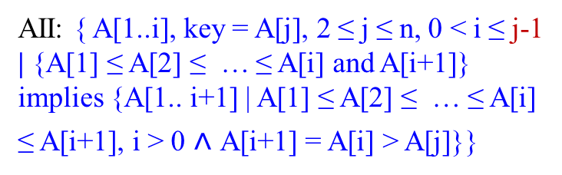
AI: { A[1..j ≤ n ] | key = A[j] ˄ A[1] ≤ A[2] ≤ … ≤ A[j-1], 2 ≤ j ≤ n}
j := 2
j <= Length[A]
AII: { A[1..i], key = A[j], 2 ≤ j ≤ n, 0 < i ≤ j-1 | {A[1] ≤ A[2] ≤ … ≤ A[i] and A[i+1]} implies {A[1.. i+1] | A[1] ≤ A[2] ≤ … ≤ A[i] ≤ A[i+1], i > 0 $˄$ A[i+1] = A[i] > A[j]}}
key := A[j]
i := j -1
i > 0 and A[i] > Key
A[i+1] := A[i]
A[i+1] := key
i := i - 1
j := j + 1

Slide 52
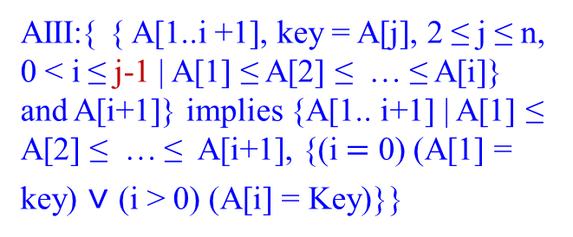
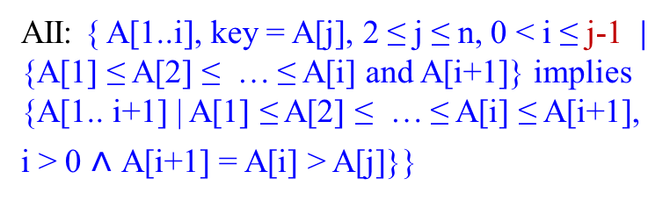
P: The original {A[1..j ≤ n] | key = A[j] not(A[1] ≤ A[2] ≤ … ≤ A[j ≤ n]), 2 ≤ j ≤ n) }
AI: { A[1..j ≤ n ] | key = A[j] ˄ A[1] ≤ A[2] ≤ … ≤ A[j-1], 2 ≤ j ≤ n}
Loop Invariants
j := 2
Q: {A[1..n] |A[1] ≤ A[2] ≤ … ≤ A[n], 1 ≤ n < j + 1}
j <= Length[A]
AII: { A[1..i], key = A[j], 2 ≤ j ≤ n, 0 < i ≤ j-1 | {A[1] ≤ A[2] ≤ … ≤ A[i] and A[i+1]} implies {A[1.. i+1] | A[1] ≤ A[2] ≤ … ≤ A[i] ≤ A[i+1], i > 0 $˄$ A[i+1] = A[i] > A[j]}}
key := A[j]
i := j -1
AIII:{ { A[1..i +1], key = A[j], 2 ≤ j ≤ n, 0 < i ≤ j-1 | A[1] ≤ A[2] ≤ … ≤ A[i]} and A[i+1]} implies {A[1.. i+1] | A[1] ≤ A[2] ≤ … ≤ A[i+1], {(i $=$ 0) (A[1] = key) $˅$ (i > 0) (A[i] = Key)}}
i > 0 and A[i] > Key
A[i+1] := A[i]
A[i+1] := key
i := i - 1
j := j + 1

Slide 53
To be continued

