Slide 1
Chapter 1
Fundamentals of the Analysis of Algorithm Efficiency

Slide 2
Body of Knowledge Coverage:
Basis Analysis (AL)
Basis Analysis (AL)
  Asymptotic Analysis, empirical measurement.
  Differences among best, average, and worst case behaviors of an algorithm.
  Complexity classes, such as constant, logarithmic linear, quadratic, and exponential.
  Recurrence Relations and their solutions.
  Time and space trade-offs in algorithms.

Slide 3
Algorithm Analysis Framework with Examples

Slide 4
The Analysis Framework: Analyzing an Algorithm:
Time efficiency: measured by counting the number of times the algorithm’s basic operation is executed.
Space efficiency: measured by counting the number of extra memory units consumed by the algorithm.
Measuring an Input’s size
Both time and space efficiency: measured as functions of the algorithm’s input size [T(n) ∝ f(n)] and [S(n) ∝ f(n)] respectively.

Slide 5
Defining Running Time:
The running time T(n) of an algorithm or program is defined as a function of the size of its input, T(n) ∞ f(n).
  the time taken by an algorithm grows with the size of the input.
  Measuring Input Size:
  General Input Size Measurement:
The input size is measured by the number of items in the input.
  For sorting algorithms, the input size is measured by the number of items in the array as n. T(n) ∝ f(n).

Slide 6
Measuring Input Size:
Input Size by Symbols:
For many other algorithms, the input size is the number of symbols used to encode n, which is └ log₂ n ┘ + 1.
  For an algorithm computing the nth Fibonacci item, the input size is the magnitude n represented by └ log₂ n ┘ + 1 bits. n =13 = 1101₂.
  For the recursive division of two integers n and m, the input size is └ log₂ n ┘ + 1 bits.
  The input size for the iterative division of two integers is their magnitude.
  For multiplying two integers n, m is the total number of bits for n and m.
  (i.e, bits(n) * bits(m)) = ((└ log₂ n ┘ + 1) * (└ log₂ m ┘ + 1)).

Slide 7
The Analysis Framework: Analyzing an Algorithm:
Units for measuring the running time of an algorithm
Identify the basic operation of the algorithm:
The operation contributes significantly to the running time.
Compute the number of times the basic operation is executed.
Estimate the running time T(n) of an algorithm or program:
T(n) ≈ c_{op} * C(n), where
  C(n) is the number of times this operation needed to be executed for the algorithm.
  c_{op} is the execution time (such as nanosec/instruction) of the algorithm’s basic operation on a particular computer.

Slide 8
Therefore, analyze the algorithm’s efficiency by:
  Identifying the basic operation of the algorithm.
  Time Complexity: Determining the number of times the basic operation is executed as a function of the size of the input.
    T(n) ∝ f(n).
    Space Complexity: The algorithm uses the amount of space with respect to the growth of input size n.
      S(n) ∝ f(n).

Slide 9
To determine how efficiently an algorithm solves a problem, we analyze the efficiency of an algorithm in terms of time.
Do not determine the actual number of CPU cycles
  because this depends on the particular computer on which the algorithm is run.
Do not count every instruction executed,
  because the number of instructions depends on the programming languages used to implement the algorithm and the way the programmer writes the program.
Use a measure which is independent of
  computer,
  programming language, the programmer, and
  all the complex details of the algorithm such as incrementing of loop indices, setting pointers, and so forth.

Slide 10

Order of growth
The primary interest of the analysis framework lies in
  the order of growth of the algorithm’s running time as its input size n approaches infinity.
  A hierarchy of growth rates, from smallest to largest:
  log₂ n < n < n log₂ n < n² < n³ < 2^{n} < n!
Algorithms with a growth rate of 2^{n} (exponential number) or higher operations are generally impractical for larger inputs because the running time increases too rapidly. Such algorithms are only for solving problems of very small sizes.

Slide 11
Order of growth
Figure 1.0 Growth rates of common complexity functions.

Slide 12
Recapitulation of the Analysis Framework
Summarize the main points of the framework:
Both time and space efficiencies are measured as functions of the algorithm’s input size. (i.e, T(n) ∞ f(n)).
Time efficiency is measured by counting the number of times the algorithm’s basic operation is executed, expressed as T(n) ≈ c_{op} * C(n)).
Space efficiency is measured by counting the number of extra memory units consumed by the algorithm.
The efficiencies of some algorithms may vary significantly for inputs of the same size, but also depending on the input’s properties.
  For such algorithms, e.g., insert sort algorithm, we need to distinguish between the worst-case, average-case, and best-case efficiencies.
The analysis framework lies in the order of growth of the algorithm’s
running time as its input size goes to infinity.

Slide 13
Examples of Algorithms
A 1.1 Sequential Search
Problem: Is the key K in the array A of n keys?
Inputs (parameters): positive integer n, array of keys A indexed from 0
to n-1 and a key K.
Outputs: The index of the first element of A that matches K
or -1 if there are no matching elements.

Slide 14
Algorithm SequentialSearch(A[0 .. n-1], K)
// Searches for a given value in a given array by sequential search
Input: An array A[0 .. n-1] and a search key K
Output: The index of the first element of A that matches K
or -1 if there are no matching elements
i := 0;
while (i < n and A[i] ≠ K) do {
i := i + 1;
}
if (i < n) return i;
else return -1;
Q: which is the basic operation? Why?
Which one costs most?
Is there any different in terms of execution time, if we design as ?
i := 0;
while (i < n)
{if (A[i] ≠ K) {i := i +1;}}
if (i < n) return i;
else return -1;
Evaluate AND operator

Slide 15
Algorithm SequentialSearch(A[0 .. n-1], K)
// Searches for a given value in a given array by sequential search
Input: An array A[0 .. n-1] and a search key K
Output: The index of the first element of A that matches K
or -1 if there are no matching elements
i := 0;
A[n] := K;
while (A[i] ≠ K) do {
i := i + 1;
}
if (i < n) return i;
else return -1;
This algorithm modifies the array by setting A[n] = K. This might not be desirable if the array should not be altered.
The choice between the two algorithms depends on whether the array can be modified and whether the slight efficiency gain is critical.

Slide 16

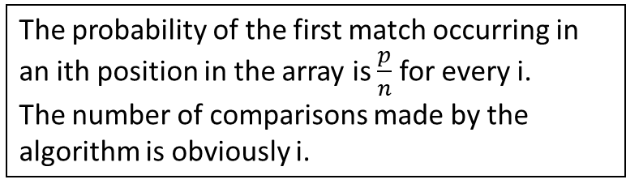
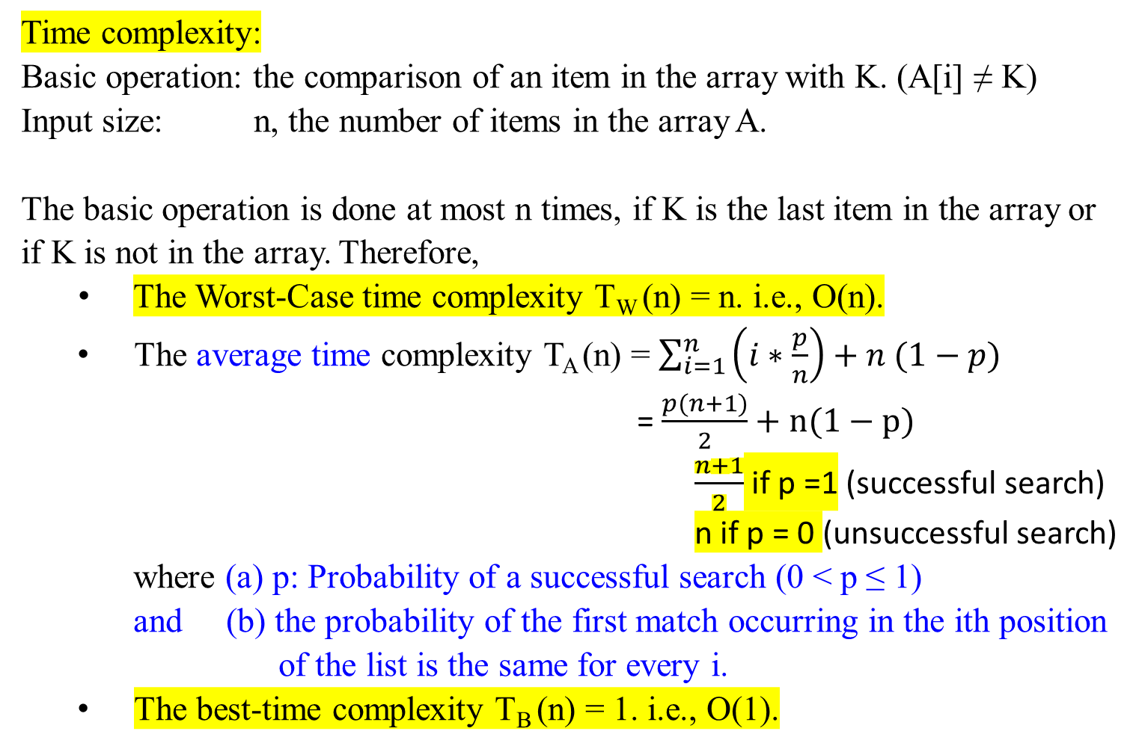
Time complexity:
Basic operation: the comparison of an item in the array with K. (A[i] ≠ K)
Input size: n, the number of items in the array A.
The basic operation is done at most n times, if K is the last item in the array or if K is not in the array. Therefore,
The Worst-Case time complexity T_{W} (n) = n. i.e., O(n).
  The average time complexity T_{A} (n) = $\sum_{i=1}^{n}{\left(i∗\frac{p}{n}\right)+n (1−p)}$
= $\frac{p(n+1)}{2}+n(1−p)$
$\frac{n+1}{2}$ if p =1 (successful search)
n if p = 0 (unsuccessful search)
where (a) p: Probability of a successful search (0 < p ≤ 1) and (b) the probability of the first match occurring in the ith position
of the list is the same for every i.
  The best-time complexity T_{B} (n) = 1. i.e., O(1).
The probability of the first match occurring in an ith position in the array is $\frac{p}{n}$for every i.
The number of comparisons made by the algorithm is obviously i.
=

Slide 17
A 1.2 Add Array Members
Problem: Add all the numbers in the array A of n numbers.
Inputs: positive integer n, array of numbers A indexed from 0 to n-1.
Outputs: result, the sum of the numbers in A.
Number sum (int n, const number A[ ])
{
index i;
number result;
result = 0;
for (i = 0; i < n; i++)
result = result + A[i];
return result;
}
Q: Which one is basic operation? Why?
Which one costs most?
Is there any different in terms of execution time? if we design as i = 0;
while (i < n)
{ result = result + A[i];
i++;}

Slide 18
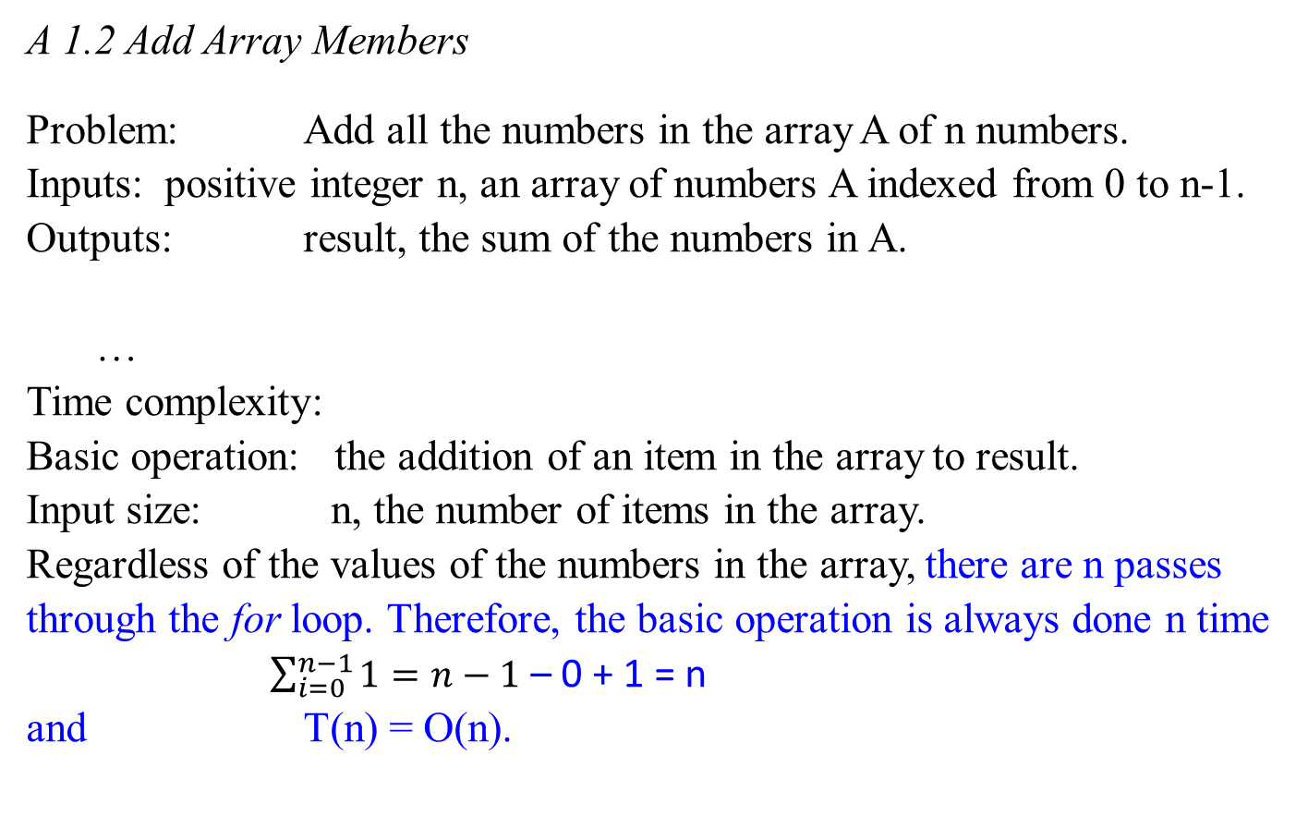
A 1.2 Add Array Members
Problem: Add all the numbers in the array A of n numbers.
Inputs: positive integer n, an array of numbers A indexed from 0 to n-1.
Outputs: result, the sum of the numbers in A.
…
Time complexity:
Basic operation: the addition of an item in the array to result.
Input size: n, the number of items in the array.
Regardless of the values of the numbers in the array, there are n passes through the for loop. Therefore, the basic operation is always done n time
$\sum_{i=0}^{n−1}{1}=n−1$ – 0 + 1 = n
and T(n) = O(n).

Slide 19
A 1.3 Exchange Sort
Problem: Sort n keys in nondecreasing order.
Inputs: positive integer n, array of keys A indexed from 0 to n -1.
Outputs: the array A containing the keys in nondecreasing order.
void exchangeSort (int n, array A[ ])
{
index i, j;
for ( i = 0; i < n; i++)
{ for (j = i + 1; j < n; j++)
{ if (A[j] < A[i])
exchange A[i] and A[j];
}
}
}
Q: which one is the basic operation? why?
For each i (0 < i < n) , you need n-i (A[j] < A[i])-comparisons.
Will these comparisons guarantee that the A[1] A[2] … A[i] are in order?
How do you arrange this in decreasing order?
Is time efficiency T[n] in n².
5 4 3 2 1
4 5 3 2 1
3 5 4 2 1
2 5 4 3 1
1 5 4 3 2
1 5 4 3 2
1 4 5 3 2
1 3 5 4 2
1 2 5 4 3
1 2 5 4 3
1 2 4 5 3
1 2 3 5 4
1 2 3 5 4
1 2 3 4 5

Slide 20

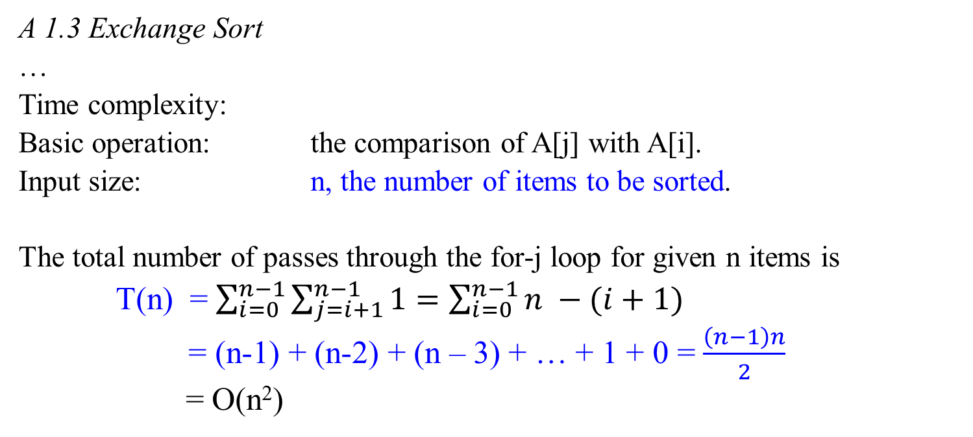

Q: Can we conclude that time efficiency for a nested-for would be a quadratic function.
for ( i = 0; i < n; i++)
{ for (j = i + 1; j < n; j++)
if (A[j] < A[i])
exchange A[i] and A[j]; }
A 1.3 Exchange Sort
…
Time complexity:
Basic operation: the comparison of A[j] with A[i].
Input size: n, the number of items to be sorted.
The total number of passes through the for-j loop for given n items is
T(n) = $\sum_{i=0}^{n−1}{\sum_{j=i+1}^{n−1}{1=\sum_{i=0}^{n−1}{n −(i+1)}}}$
= (n-1) + (n-2) + (n – 3) + … + 1 + 0 = $\frac{\left(n−1\right)n}{2}$
= O(n²)
S_{n} == $\frac{n\left(1+n\right)}{2}$
$\sum_{i=0}^{n−1}{\sum_{j=i+1}^{n−1}{1= }}$ $\sum_{i=0}^{n−1}{n−1 −\left(i+1\right)+1= \sum_{i=0}^{n−1}{n −(i+1)}}$

Slide 21
A 1.4 Matrix Multiplication
Problem: Determine the product of two n x n matrices.
Inputs: a positive integer n, two-dimensional arrays of number A and B, each of which has both its row and columns indexed from 0 to n-1.
Outputs: a two-dimensional array of numbers C, which has both its rows and columns indexed from 1 to n, containing the product of A and
B.
…

Slide 22
A 1.4 Matrix Multiplication
a₀₀ a₀₁ a₀₂ b₀₀ b₀₁ b₀₂
a₁₀ a₁₁ a₁₂ b₁₀ b₁₁ b₁₂ =
a₂₀ a₂₁ a₂₂ b₂₀ b₂₁ b₂₂
a₀₀*b₀₀ + a₀₁ *b₁₀ +a₀₂*b₂₀ a₀₀*b₀₁+a₀₁*b₁₁+a₀₂*b₂₁ a₀₀*b₀₂+a_{01*}b₁₂+a₀₂*b₂₂
a₁₀*b₀₀ + a₁₁ *b₁₀ +a₁₂*b₂₀ a₁₀*b₀₁+a₁₁*b₁₁+a₁₂*b₂₁ a₁₀*b₀₂+a_{11*}b₁₂+a₁₂*b₂₂
a₂₀*b₀₀ + a₂₁ *b₁₀ +a₂₂*b₂₀ a₂₀*b₀₁+a₂₁*b₁₁+a₂₂*b₂₁ a₂₀*b₀₂+a_{21*}b₁₂+a₂₂*b₂₂
i
i k j
j

Slide 23
A 1.4 Matrix Multiplication
a₀₀ a₀₁ a₀₂ b₀₀ b₀₁ b₀₂
a₁₀ a₁₁ a₁₂ b₁₀ b₁₁ b₁₂ =
a₂₀ a₂₁ a₂₂ b₂₀ b₂₁ b₂₂
a₀₀*b₀₀ + a₀₁ *b₁₀ +a₀₂*b₂₀ a₀₀*b₀₁+a₀₁*b₁₁+a₀₂*b₂₁ a₀₀*b₀₂+a_{01*}b₁₂+a₀₂*b₂₂
a₁₀*b₀₀ + a₁₁ *b₁₀ +a₁₂*b₂₀ a₁₀*b₀₁+a₁₁*b₁₁+a₁₂*b₂₁ a₁₀*b₀₂+a_{11*}b₁₂+a₁₂*b₂₂
a₂₀*b₀₀ + a₂₁ *b₁₀ +a₂₂*b₂₀ a₂₀*b₀₁+a₂₁*b₁₁+a₂₂*b₂₁ a₂₀*b₀₂+a_{21*}b₁₂+a₂₂*b₂₂

Slide 24
A 1.4 Matrix Multiplication
Problem: Determine the product of two n x n matrices.
Algorithm MatrixMultiplication(A[0..n-1, 0..n-1], B[0..n-1, 0..n-1])
//Multiple two n-by-n matrices A_{row x col} and B_{row x col} by the definition-based //algorithm
Input: Two n-by-n matrices A and B
Output: Matrix C = A*B
for (i ← 0 to n – 1) do //i stands for row
for ( j ← 0 to n – 1) do //j stands for column.
C[i, j] ← 0.0;
for (k ← 0 to n – 1) do
C[i, j] ← C[i, j] + A[i, k]*B[k, j]; //ith row * jth column
return C;
Q: Which one is basic operation?

Slide 25
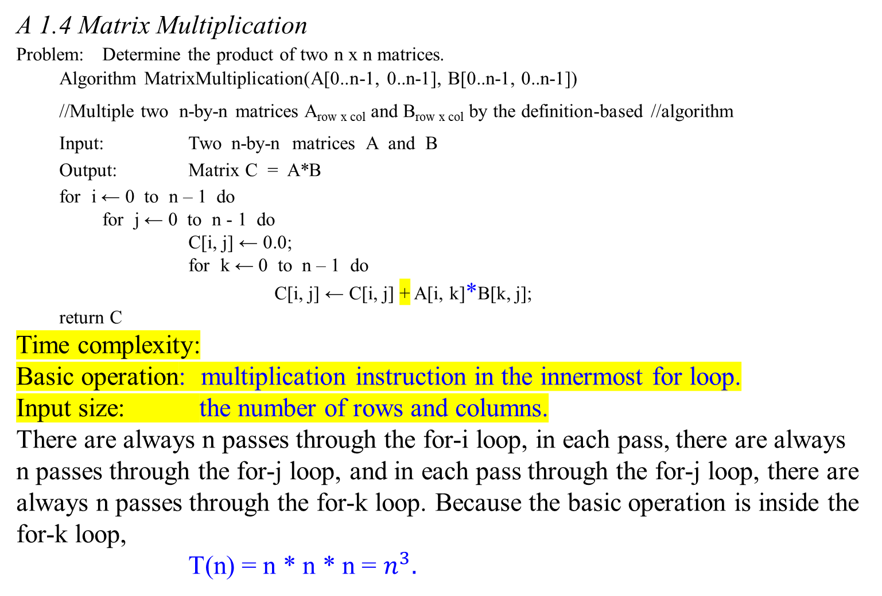
A 1.4 Matrix Multiplication
Problem: Determine the product of two n x n matrices.
Algorithm MatrixMultiplication(A[0..n-1, 0..n-1], B[0..n-1, 0..n-1])
//Multiple two n-by-n matrices A_{row x col} and B_{row x col} by the definition-based //algorithm
Input: Two n-by-n matrices A and B
Output: Matrix C = A*B
for i ← 0 to n – 1 do
for j ← 0 to n - 1 do
C[i, j] ← 0.0;
for k ← 0 to n – 1 do
C[i, j] ← C[i, j] + A[i, k]*B[k, j];
return C
Time complexity:
Basic operation: multiplication instruction in the innermost for loop.
Input size: the number of rows and columns.
There are always n passes through the for-i loop, in each pass, there are always n passes through the for-j loop, and in each pass through the for-j loop, there are always n passes through the for-k loop. Because the basic operation is inside the for-k loop,
T(n) = n * n * n = $n^{3}.$

Slide 26
A 1.5 Binary Search
Problem: Determine whether x is in the sorted array A of n keys.
Inputs: positive integer n, sorted (nondecreasing order) array of keys A
indexed from 0 to n – 1, a key K.
Outputs: location, the location of key in A (0 if K is not in A).
Algorithm BinarySearch(A[0 .. n-1], K)
//Implements nonrecursive binary search
Input: An array A[0 .. n-1] sorted in ascending order and
a search key K
Output: An index of the array’s element that is equal to K
or -1 if there is no such element
…

Slide 27
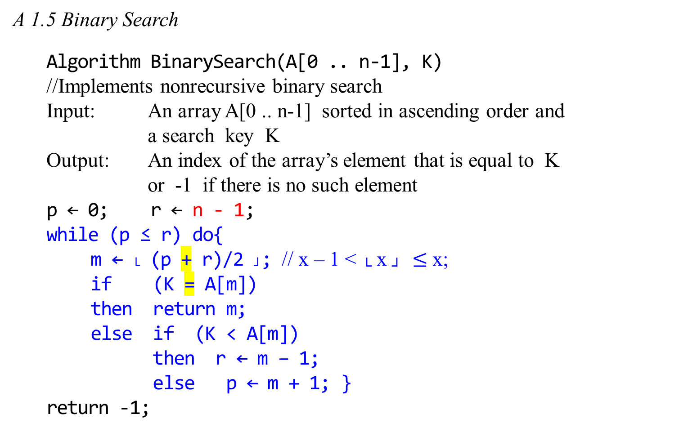
A 1.5 Binary Search
Algorithm BinarySearch(A[0 .. n-1], K)
//Implements nonrecursive binary search
Input: An array A[0 .. n-1] sorted in ascending order and
a search key K
Output: An index of the array’s element that is equal to K
or -1 if there is no such element
p ← 0; r ← n - 1;
while (p ≤ r) do{
m ← └ (p + r)/2 ┘; // x – 1 < └ x ┘ $≤$x;
if (K = A[m])
then return m;
else if (K < A[m])
then r ← m – 1;
else p ← m + 1; }
return -1;
Q: Which one is the basic operation?

Slide 28
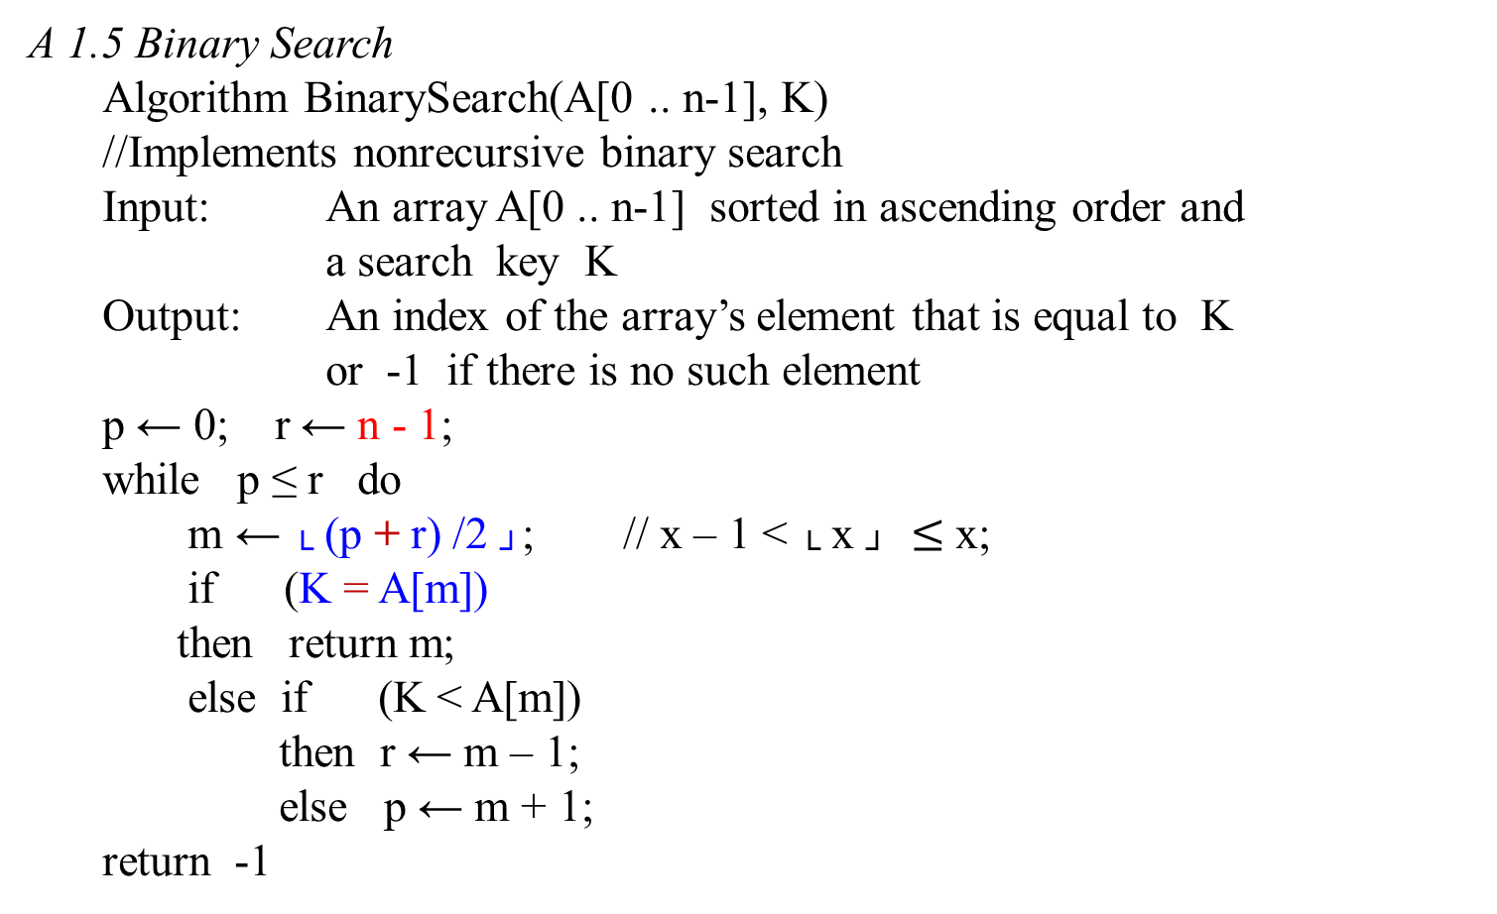
A 1.5 Binary Search
Algorithm BinarySearch(A[0 .. n-1], K)
//Implements nonrecursive binary search
Input: An array A[0 .. n-1] sorted in ascending order and
a search key K
Output: An index of the array’s element that is equal to K
or -1 if there is no such element
p ← 0; r ← n - 1;
while p ≤ r do
m ← └ (p + r) /2 ┘; // x – 1 < └ x ┘ $≤$x;
if (K = A[m])
then return m;
else if (K < A[m])
then r ← m – 1;
else p ← m + 1;
return -1
Q: Which one is the basic operation?
p
m
r

Slide 29

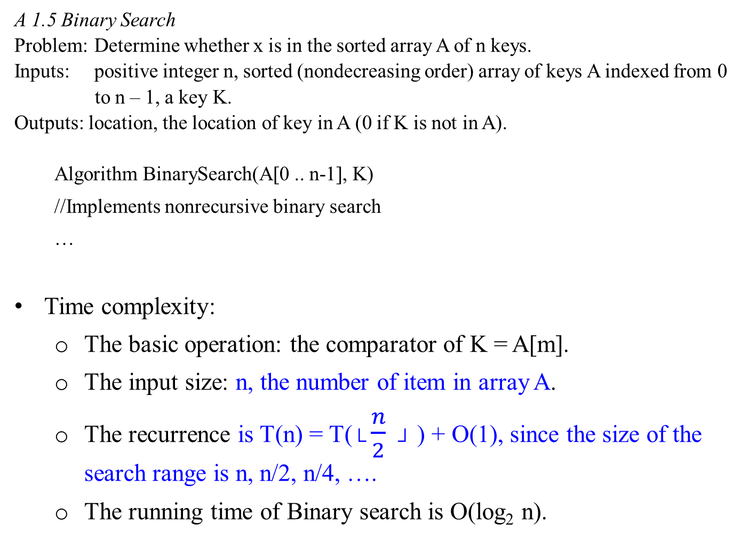
A 1.5 Binary Search
Problem: Determine whether x is in the sorted array A of n keys.
Inputs: positive integer n, sorted (nondecreasing order) array of keys A indexed from 0
to n – 1, a key K.
Outputs: location, the location of key in A (0 if K is not in A).
Algorithm BinarySearch(A[0 .. n-1], K)
//Implements nonrecursive binary search
…
Time complexity:
  The basic operation: the comparator of K = A[m].
  The input size: n, the number of item in array A.
  The recurrence is T(n) = T($└\frac{n}{2} ┘$ ) + O(1), since the size of the search range is n, n/2, n/4, ….
  The running time of Binary search is O(log₂ n).

Slide 30
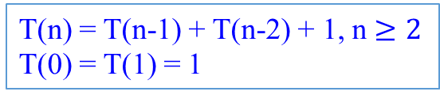
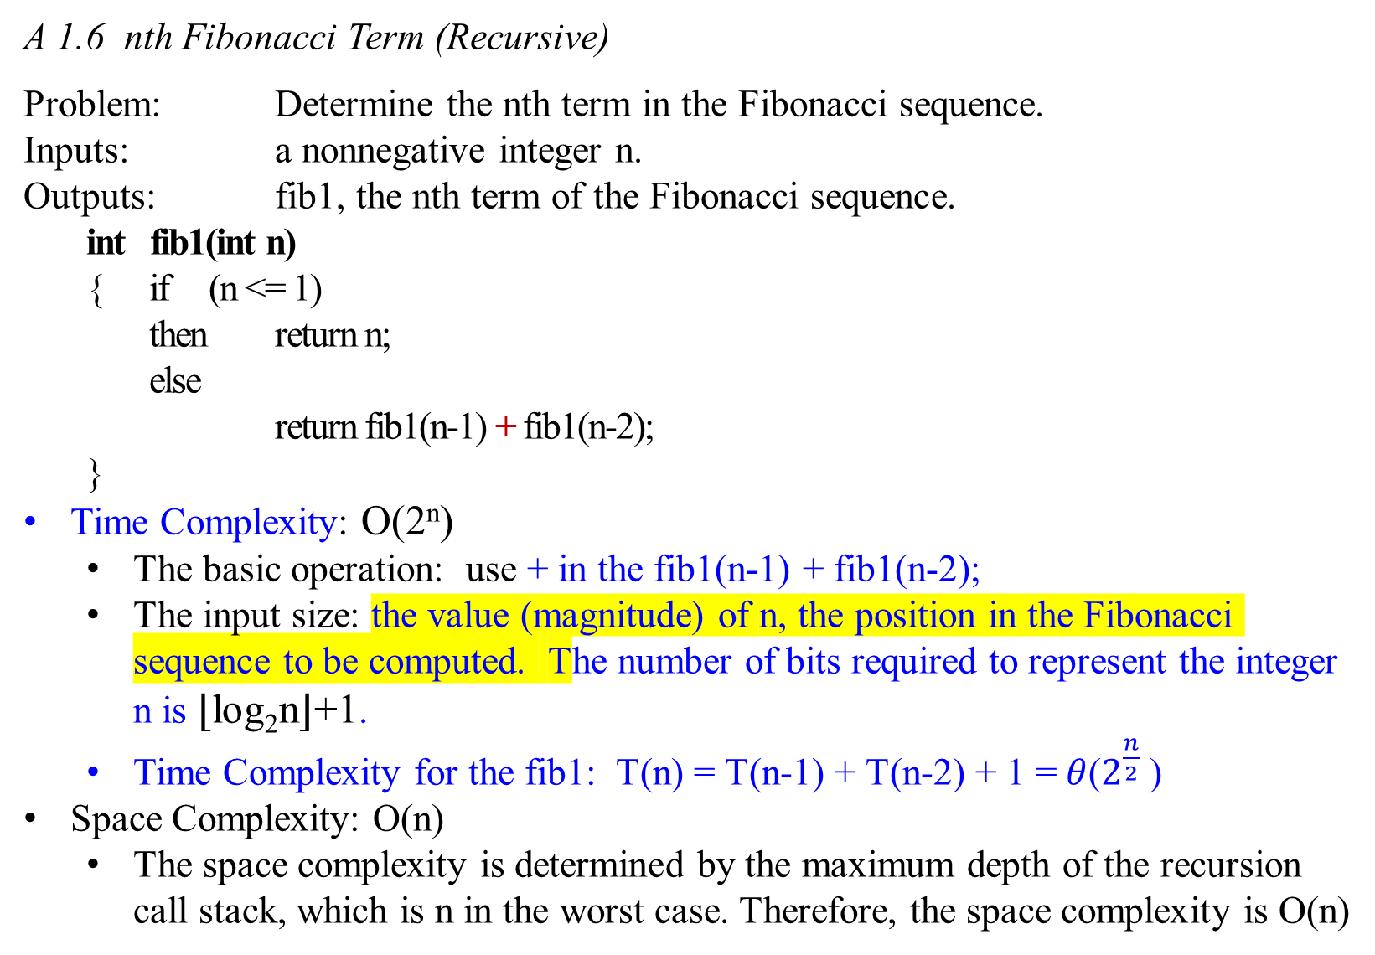
A 1.6 nth Fibonacci Term (Recursive)
Problem: Determine the nth term in the Fibonacci sequence.
Inputs: a nonnegative integer n.
Outputs: fib1, the nth term of the Fibonacci sequence.
int fib1(int n)
{ if (n <= 1)
then return n;
else
return fib1(n-1) + fib1(n-2);
}
Time Complexity: O(2^{n})
  The basic operation: use + in the fib1(n-1) + fib1(n-2);
  The input size: the value (magnitude) of n, the position in the Fibonacci sequence to be computed. The number of bits required to represent the integer n is ⌊log_{2​}n⌋+1.
  Time Complexity for the fib1: T(n) = T(n-1) + T(n-2) + 1 =$θ$($2^{\frac{n}{2}}$ )
Space Complexity: O(n)
  The space complexity is determined by the maximum depth of the recursion call stack, which is n in the worst case. Therefore, the space complexity is O(n)
Fibonacci numbers:
0 1 1 2 3 5 8 13 …
T(n) = T(n-1) + T(n-2) + 1, n $≥2$
T(0) = T(1) = 1

Slide 31

A 1.7 nth Fibonacci Term (Iterative)
Problem: Determine the nth term in the Fibonacci sequence.
Inputs: a nonnegative integer n.
Outputs: fib2, the nth term of the Fibonacci sequence.
int fib2(int n)
{
index i;
int f[0 .. n];
f[0] = 0;
if (n > 0) {//do not need it.
f[1] = 1;
for (i = 2; i <= n; i++){
f[i] = f[i – 1] + f[i - 2];} //end forLoop
} //end of if //do not need it.
return f[n];
}
The basic operation: the + in the f[i] = f[i – 1] + f[i - 2];
The input size: the value (magnitude) of n.
Time Complexity is O(n) if each iteration performs a constant amount of work O(1).
Space Complexity is O(n).

Slide 32
A 1.7 nth Fibonacci Term (Iterative)
Problem: Determine the nth term in the Fibonacci sequence.
Inputs: a nonnegative integer n.
Outputs: fib2, the nth term of the Fibonacci sequence.
int fib2(int n);
…
Time complexity:
  The basic operation: the + in the f[i] = f[i – 1] + f[i - 2];
  The input size: the value (magnitude) of n, the position in the Fibonacci sequence to be computed. The number of bits required to represent n is ⌊log_{2​}n⌋+1.
  The number of computer steps used by fib2 is linear in n. O(n)
    The inner loop consists of a single computer step and is executed n -1 times.
      Time for executing the basic operation is O(n).
  Thus T(n) = O(n²).
From exponential, we are down to polynomial O(n²), a high breakthrough in running time.

Slide 33
Compute Fibonacci Numbers

Slide 34
Al Khwarizmi’s work could not have gained a foothold in the West were it not for the efforts of one man: the 13th century Italian Mathematician Leonardo Fibonacci, who used the positional system to develop his famous sequence of numbers
0, 1, 1, 2, 3, 5, 8, 13, 21, 34, …,
Each is the sum of its two immediate predecessors.
Formally, the Fibonacci numbers F_{n} are generated by the simple rule:
F_{n-1} + F_{n-2} if n > 1
F_{n} = 1 if n = 1
0 if n = 0.
No other sequence of numbers has been studied as extensively, or applied to more fields: biology, demography, art, architecture, music, to name just a few. Fibonacci numbers and the powers of 2 are computer science’s favorite sequence.

Slide 35
The Fibonacci numbers grow almost as fast as the powers of 2:
F₃₁ is over a million (1,346,269), and
F₉₈ is already 21 digits long, and so is F₁₀₀!
In general, F_{n} ≈ 2^{0.694n}.
But what is the precise value of F₁₀₀ or F₂₀₀?
Need an algorithm for computing the nth Fibonacci number.

Slide 36
F_{n-1} + F_{n-2} if n > 1
F_{n} = 1 if n = 1
0 if n = 0.
An exponential algorithm
The algorithm for implementing the recursive definition of F_{n} is:
function fib1(n)
if n = 0 then return 0;
if n = 1 then return 1;
return fib1(n-1) + fib1(n-2);
Whenever we have an algorithm, there are three questions we always ask about it:
  Is it correct?
  How much time does it take, as a function of n?
  And can we do better?
Comment: it requires roughly 20 seconds to compute fib(46) on my pc. Take longer waiting time to compute fib(48).
int fib1(int n)
{
if ((n = 0) || (n = 1))
then return n;
else return fib1(n-1) + fib1(n-2);
}

Slide 37

There are three questions we always ask about an algorithm:
  Is it correct?
  How much time does it take, as a function of n?
  And can we do better?
The first question is moot, as the algorithm is precisely Fibonacci’s definition on F_{n}.
For the second question, the algorithm is extremely inefficient.
  For example, use this algorithm to compute fib1(5).
    Figure 1.1 gives the recursion tree corresponding to the algorithm int fib1(n) when computing the fifth Fibonacci term.
Of no practical importance; irrelevant; arguable; moot

Slide 38
fib(n) = fib1(n-1) + fib1(n-2);
fib1(6)
fib(n) = fib1(n-1) + fib1(n-2);
fib1(5)
fib1(4)
fib(5) = fib1(3) + fib1(4);
As the tree shows, the algorithm int fib1(n) is inefficient because values are computed repeatedly.
For example, fib1(2) is computed three times.
fib1(3)
fib1(4)
fib(3) = fib1(1) + fib1(2);
fib(4) = fib1(2) + fib1(3);
fib1(1)
fib1(2)
fib1(2)
fib1(3)
fib(2) = fib1(0) + fib1(1);
fib1(0)
fib1(1)
fib1(0)
fib1(1)
fib1(1)
fib1(2)
Figure 1.1 The recursion tree corresponding to algorithm when computing fib1(5).
fib1(0)
fib1(1)
fib ( 45 ) is 1134903170. 10 sec.
fib ( 46 ) is 1836311903. 21 sec.

Slide 39

How inefficient is this algorithm?
  As shown in Figure 1.1, the algorithm fib1(n) for 0 ≤ n ≤ 9 computes the following number of terms
fib(n) = fib1(n-1) + fib1(n-2);
The first six values can be obtained by counting the nodes in the subtree rooted at fib1(n) for 0 ≤ n ≤ 5.
The number of terms for fib1(6) is the sum of the nodes in the trees rooted at fib1(5) and fib1(4) plus the one node at the root.
The number of terms for fib1(7) and fib1(8) are 41, and 67, respectively; and so forth.
It is not simple to use a mathematical expression (or, a formula) to describe these numbers 1, 1, 3, 5, 9, 15, 25, 41, 67, 109, 177, 287, 465, 753, ….
In general, T(n) > T(n-1) + T(n-2) by one.
n | F(n) | Number of Terms Computed, T(n)
0 | 0 | 1
1 | 1 | 1
2 | 1 | 3
3 | 2 | 5
4 | 3 | 9
5 | 5 | 15
6 | 8 | 25
7 | 13 | 41
8 | 21 | 67
9 | 34 | 109

Slide 40

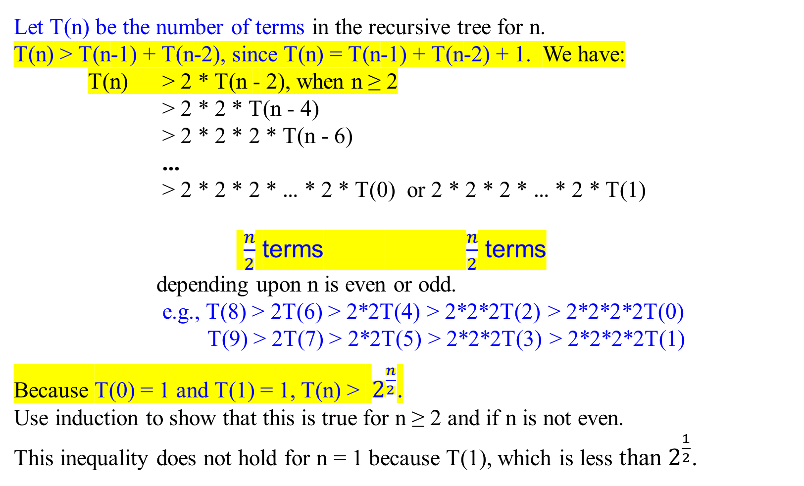
fib(n) = fib1(n-1) + fib1(n-2);
T(9) = T(8) + T(7) > 2*T(7)
T(7) = T(6) + T(5) > 2*T(5)
T(5) = T(4) + T(3) > 2*T(3)
T(3) = T(2) + T(1) > 2*T(1)
Thus,
T(9) = 2*2*2*2*T(1)
Let T(n) be the number of terms in the recursive tree for n.
T(n) > T(n-1) + T(n-2), since T(n) = T(n-1) + T(n-2) + 1. We have:
T(n) > 2 * T(n - 2), when n ≥ 2
> 2 * 2 * T(n - 4)
> 2 * 2 * 2 * T(n - 6)
...
> 2 * 2 * 2 * … * 2 * T(0) or 2 * 2 * 2 * … * 2 * T(1)
$\frac{n}{2}$ terms $\frac{n}{2}$ terms
depending upon n is even or odd. e.g., T(8) > 2T(6) > 2*2T(4) > 2*2*2T(2) > 2*2*2*2T(0)
T(9) > 2T(7) > 2*2T(5) > 2*2*2T(3) > 2*2*2*2T(1)
Because T(0) = 1 and T(1) = 1, T(n) > $2^{\frac{n}{2}}$.
Use induction to show that this is true for n ≥ 2 and if n is not even.
This inequality does not hold for n = 1 because T(1), which is less than $2^{\frac{1}{2}}$.
n | F(n) | Number of Terms Computed, T(n)
0 | 0 | 1
1 | 1 | 1
2 | 1 | 3
3 | 2 | 5
4 | 3 | 9
5 | 5 | 15
6 | 8 | 25
7 | 13 | 41
8 | 21 | 67
9 | 34 | 109

Slide 41
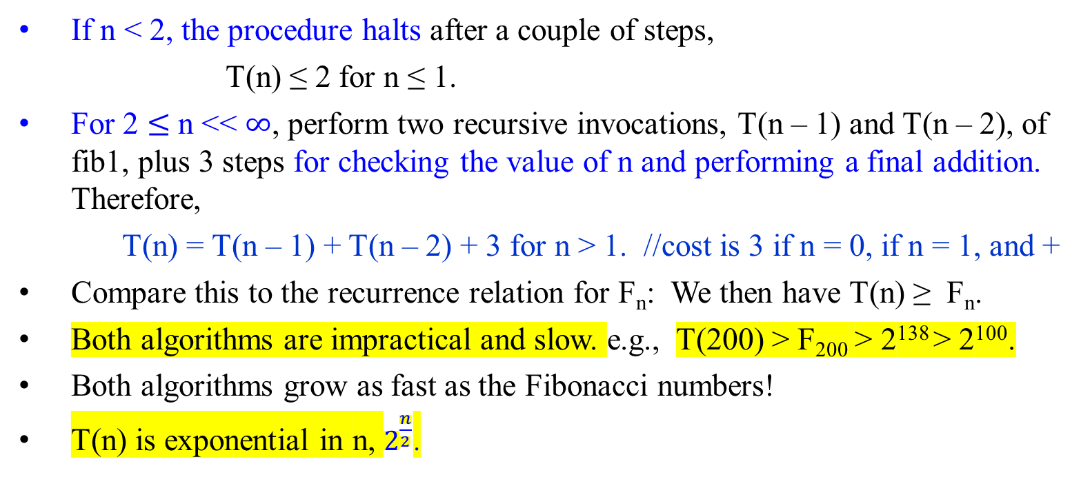
function fib1(n)
if n = 0 then return 0;
if n = 1 then return 1;
return fib1(n-1) + fib1(n-2);
int fib1(int n) {
if ((n = 0) || (n = 1))
then return n;
else return fib1(n-1) + fib1(n-2); }
If n < 2, the procedure halts after a couple of steps,
T(n) ≤ 2 for n ≤ 1.
For 2 $≤$n << $∞$, perform two recursive invocations, T(n – 1) and T(n – 2), of fib1, plus 3 steps for checking the value of n and performing a final addition. Therefore,
T(n) = T(n – 1) + T(n – 2) + 3 for n > 1. //cost is 3 if n = 0, if n = 1, and +
Compare this to the recurrence relation for F_{n}: We then have T(n) ≥ F_{n}.
Both algorithms are impractical and slow. e.g., T(200) > F₂₀₀ > 2¹³⁸ > 2¹⁰⁰.
Both algorithms grow as fast as the Fibonacci numbers!
T(n) is exponential in n, $2^{\frac{n}{2}}$.

Slide 42
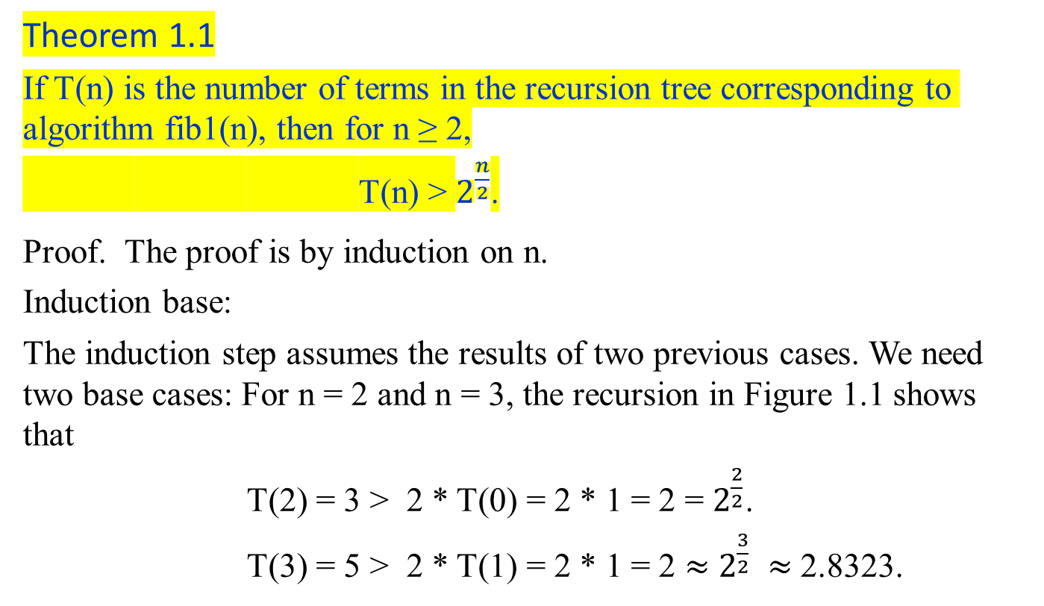
Theorem 1.1
If T(n) is the number of terms in the recursion tree corresponding to algorithm fib1(n), then for n ≥ 2,
T(n) > $2^{\frac{n}{2}}$.
Proof. The proof is by induction on n.
Induction base:
The induction step assumes the results of two previous cases. We need two base cases: For n = 2 and n = 3, the recursion in Figure 1.1 shows that
T(2) = 3 > 2 * T(0) = 2 * 1 = 2 = $2^{\frac{2}{2}}$.
T(3) = 5 > 2 * T(1) = 2 * 1 = 2 $≈$ $2^{\frac{3}{2}} ≈$2.8323.

Slide 43
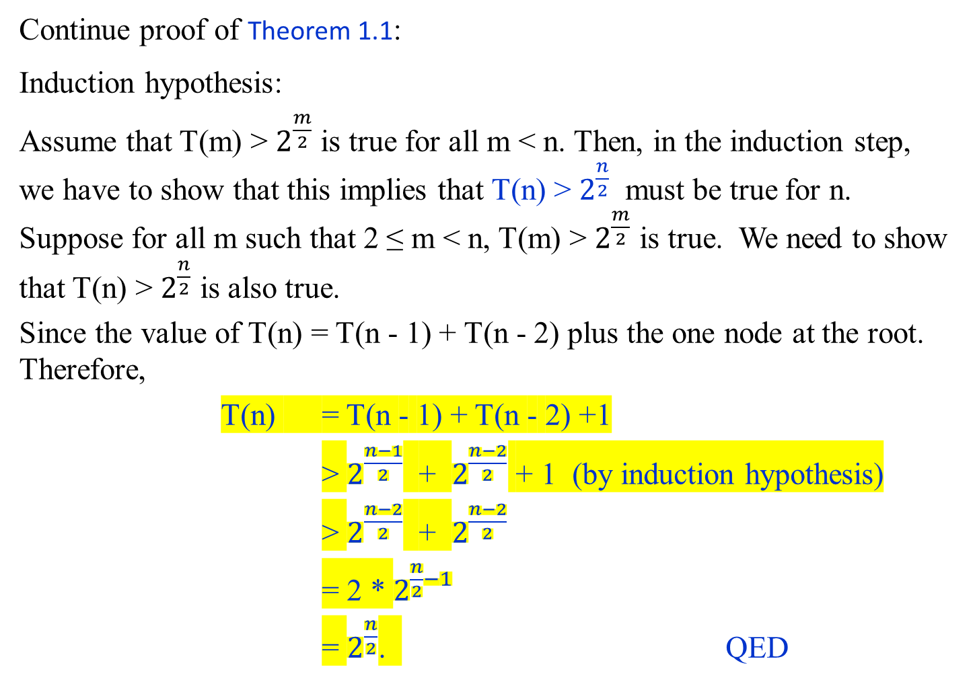
Continue proof of Theorem 1.1:
Induction hypothesis:
Assume that T(m) > $2^{\frac{m}{2}}$ is true for all m < n. Then, in the induction step, we have to show that this implies that T(n) > $2^{\frac{n}{2}}$ must be true for n. Suppose for all m such that 2 ≤ m < n, T(m) > $2^{\frac{m}{2}}$ is true. We need to show that T(n) > $2^{\frac{n}{2}}$ is also true.
Since the value of T(n) = T(n - 1) + T(n - 2) plus the one node at the root. Therefore,
T(n) = T(n - 1) + T(n - 2) +1
> $2^{\frac{n−1}{2}}$ + $2^{\frac{n−2}{2}}$ + 1 (by induction hypothesis)
> $2^{\frac{n−2}{2}}$ + $2^{\frac{n−2}{2}}$
= 2 * $2^{\frac{n}{2}−1}$
= $2^{\frac{n}{2}}$. QED

Slide 44
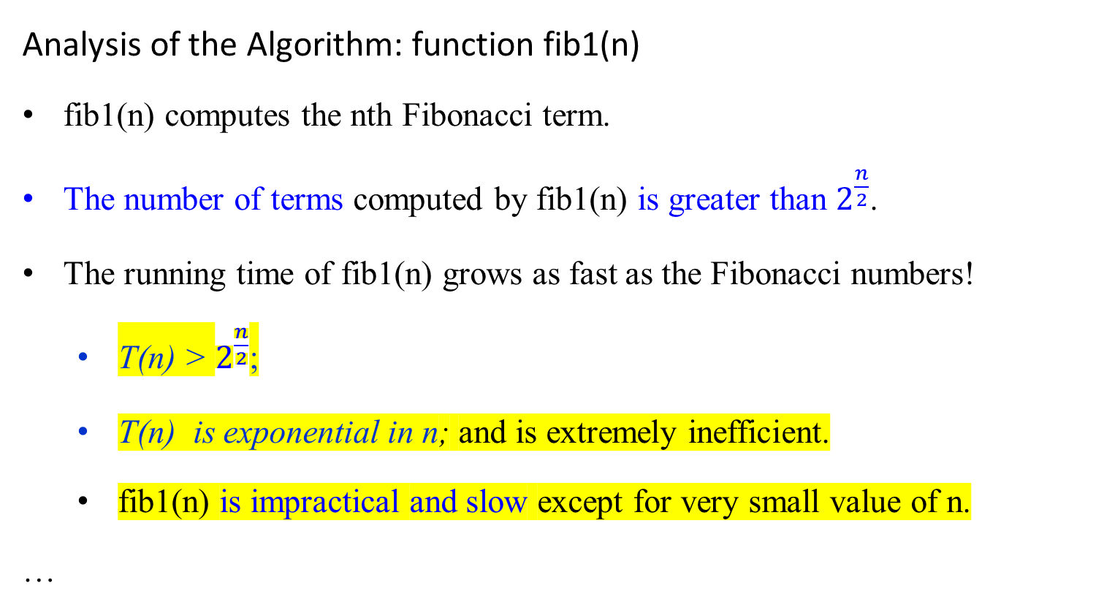
Analysis of the Algorithm: function fib1(n)
fib1(n) computes the nth Fibonacci term.
The number of terms computed by fib1(n) is greater than $2^{\frac{n}{2}}$.
The running time of fib1(n) grows as fast as the Fibonacci numbers!
  T(n) > $2^{\frac{n}{2}}$;
  T(n) is exponential in n; and is extremely inefficient.
  fib1(n) is impractical and slow except for very small value of n.
…

Slide 45

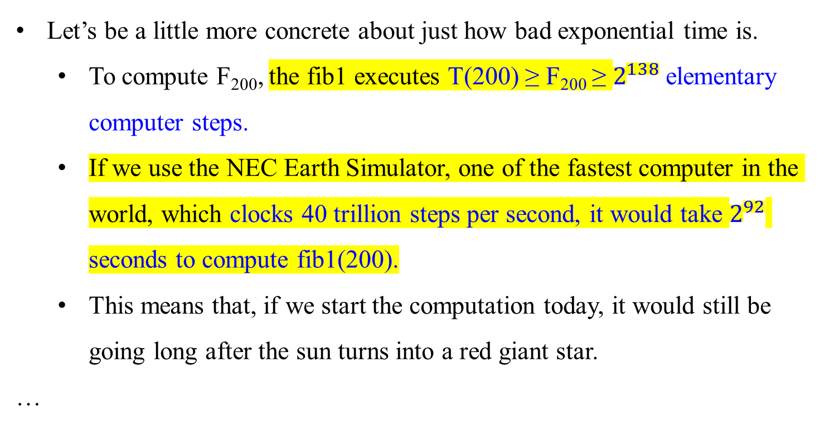
Let’s be a little more concrete about just how bad exponential time is.
  To compute F₂₀₀, the fib1 executes T(200) ≥ F₂₀₀ ≥ $2^{138}$ elementary computer steps.
  If we use the NEC Earth Simulator, one of the fastest computer in the world, which clocks 40 trillion steps per second, it would take $2^{92}$ seconds to compute fib1(200).
  This means that, if we start the computation today, it would still be going long after the sun turns into a red giant star.
…

Slide 46

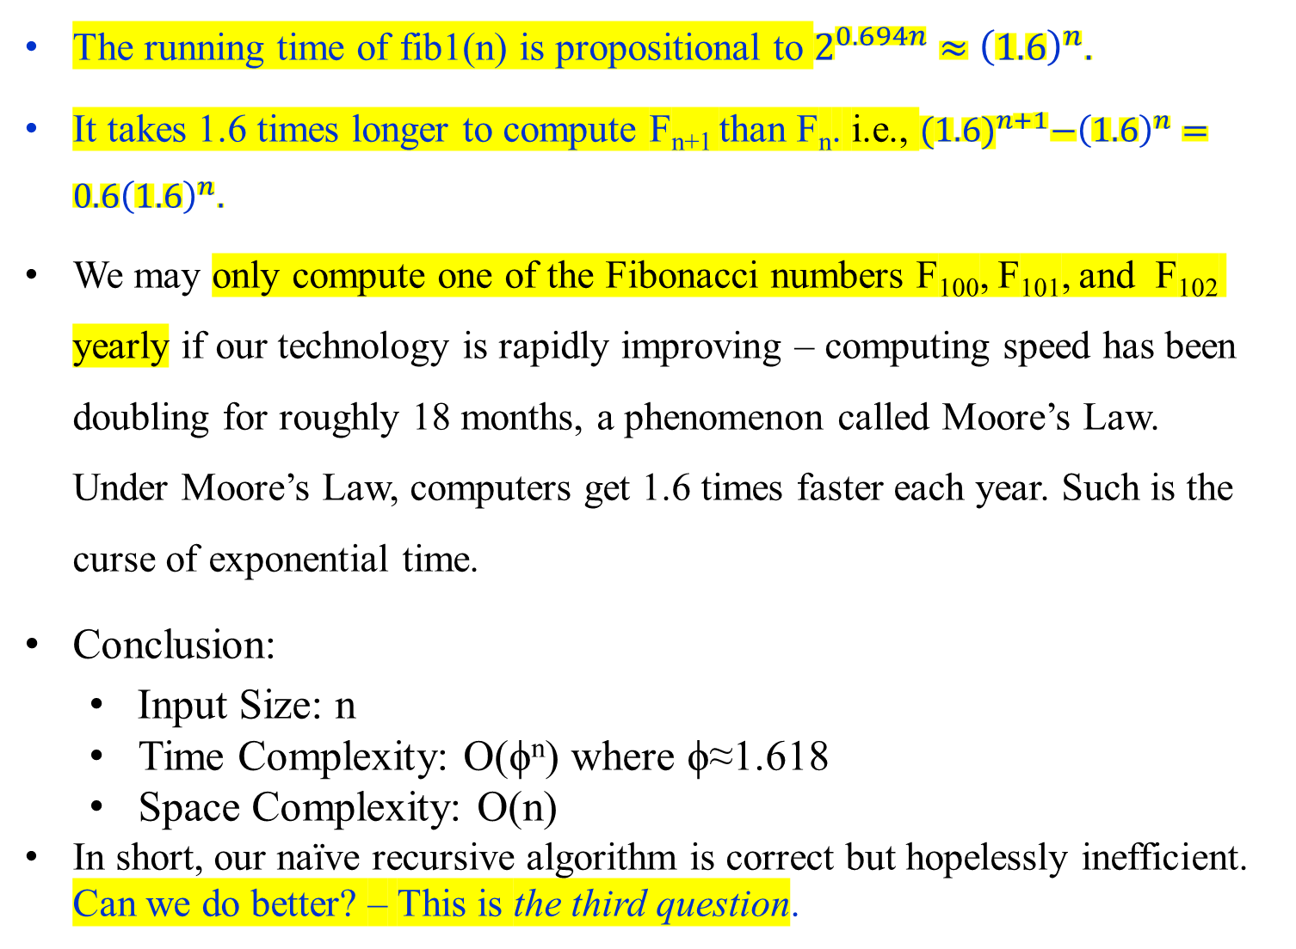
The running time of fib1(n) is propositional to $2^{0.694n}≈{\left(1.6\right)}^{n}.$
It takes 1.6 times longer to compute F_{n+1} than F_{n}. i.e., ${(1.6)}^{n+1}−{\left(1.6\right)}^{n}=0.6{\left(1.6\right)}^{n}.$
We may only compute one of the Fibonacci numbers F₁₀₀, F₁₀₁, and F₁₀₂ yearly if our technology is rapidly improving – computing speed has been doubling for roughly 18 months, a phenomenon called Moore’s Law. Under Moore’s Law, computers get 1.6 times faster each year. Such is the curse of exponential time.
Conclusion:
  Input Size: n
  Time Complexity: O(ϕ^{n}) where ϕ≈1.618
  Space Complexity: O(n)
In short, our naïve recursive algorithm is correct but hopelessly inefficient. Can we do better? – This is the third question.

Slide 47
Can we do better?
A Polynomial Algorithm
Why is fib1 so slow?
Figure 1.1 shows the cascade of recursive invocations triggered by a single call to fib1(n).
  The same value are computed repeatedly!
    Figure 1.1 shows that in determining fib1(5), fib1(2) is computed three times and fib(3) is computed two times.
A sensible solution:
  Store the intermediate results – the computed values F₀, F₁, F₂, …, F_{n-1} in an array, for avoiding recompute them.
  The following iterative algorithm uses this strategy.

Slide 48



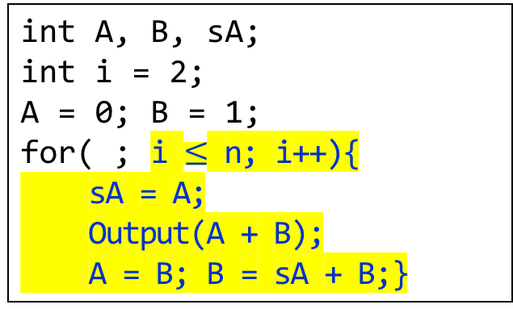
As with fib1, the correctness of this algorithm fib2(n) is self-evident because it directly uses the definition of F_{n}.
How long does it take?
  The + in the body of the for-loop is executed n -1 times. Or (i $≤$ n) is executed n times.
  The number of computed steps used by fib2 is linear in n, $θ(n)$.
  The running time is down from exponential to polynomial $θ(n2)$, a huge breakthrough in running time. (Addition requires $θ(n)$.)
  It is perfectly reasonable to computer F₂₀₀ or even F_{200,200}.
function fib2(n)
if (n == 0) then return 0;
create an array f[0 .. n];
f[0] = 0; f[1] = 1;
for (i = 2; i $≤$ n; i++){
f[i] = f[i – 1] + f[i + 2];}
return f[n];
int A, B, sA;
int i = 2;
A = 0; B = 1;
for( ; i $≤$ n; i++){
sA = A;
Output(A + B);
A = B; B = sA + B;}

Slide 49

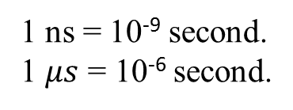
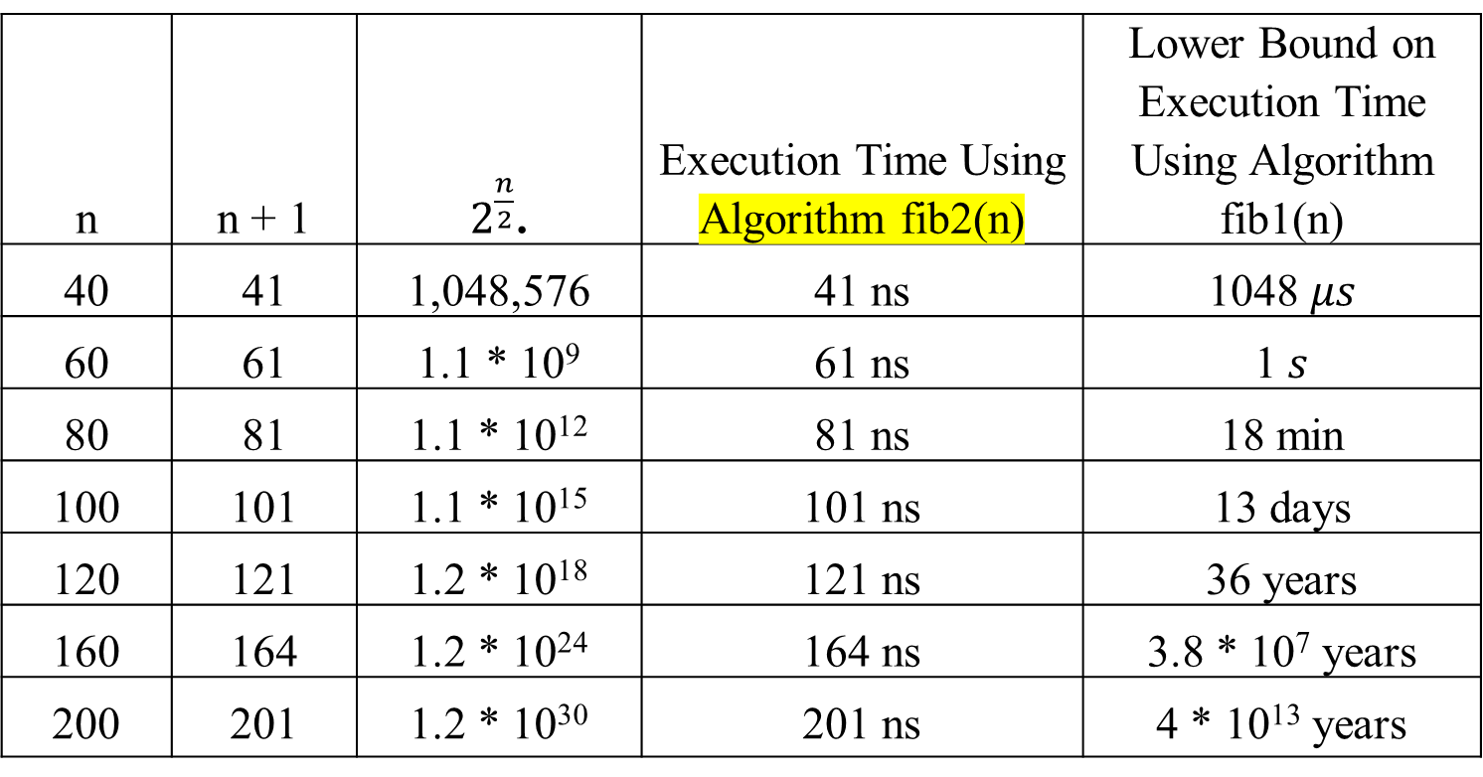
n | n + 1 | $2^{\frac{n}{2}}$. | Execution Time Using Algorithm fib2(n) | Lower Bound on Execution Time Using Algorithm fib1(n)
40 | 41 | 1,048,576 | 41 ns | 1048 $μs$
60 | 61 | 1.1 * 10⁹ | 61 ns | 1$s$
80 | 81 | 1.1 * 10¹² | 81 ns | 18 min
100 | 101 | 1.1 * 10¹⁵ | 101 ns | 13 days
120 | 121 | 1.2 * 10¹⁸ | 121 ns | 36 years
160 | 164 | 1.2 * 10²⁴ | 164 ns | 3.8 * 10⁷ years
200 | 201 | 1.2 * 10³⁰ | 201 ns | 4 * 10¹³ years
1 ns = 10⁻⁹ second.
1 $μs$ = 10⁻⁶ second.
Table 1.1 A comparison of Algorithms fib1(n) and fib2(n)

Slide 50
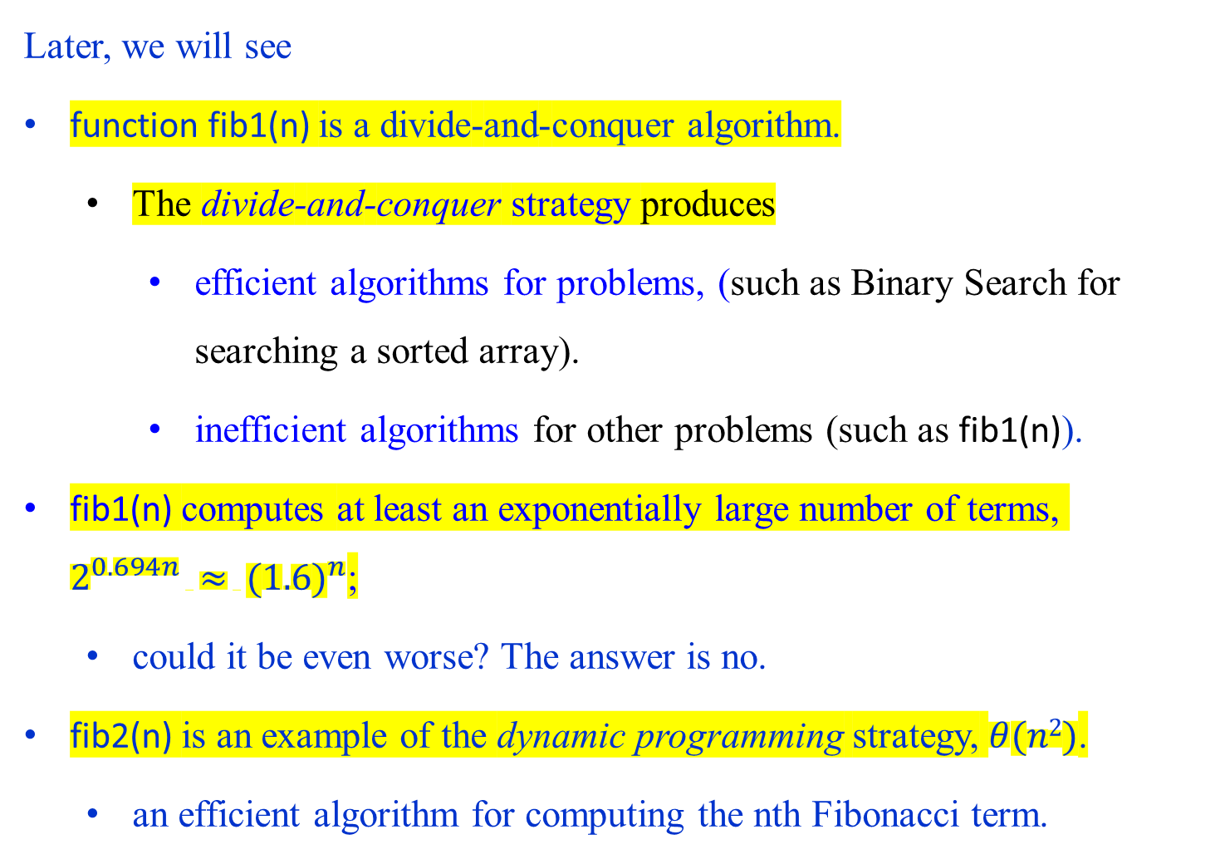
Later, we will see
function fib1(n) is a divide-and-conquer algorithm.
  The divide-and-conquer strategy produces
    efficient algorithms for problems, (such as Binary Search for searching a sorted array).
    inefficient algorithms for other problems (such as fib1(n)).
fib1(n) computes at least an exponentially large number of terms, $2^{0.694n} ≈ {(1.6)}^{n}$;
  could it be even worse? The answer is no.
fib2(n) is an example of the dynamic programming strategy, $θ(n2)$.
  an efficient algorithm for computing the nth Fibonacci term.

Slide 51
To be continued

Slide 52
The Fibonacci sequence is a series of numbers where each number is the sum of the two preceding ones, usually starting with 0 and 1. There are several algorithms to compute the n-th Fibonacci number, varying in efficiency.

Slide 53
Recursive Algorithm
This is the most straightforward but inefficient method due to its exponential time complexity.
Algorithm: (written in Python)
def fibonacci_recursive(n):
if n <= 1:
return n
else:
return fibonacci_recursive(n-1) + fibonacci_recursive(n-2)
Efficiency:
Input Size: n
Time Complexity: O(2^{n}) or a better estimate: O(ϕ^{n}) where ϕ≈1.618
Space Complexity: O(n) (due to the recursive call stack)

Slide 54
Dynamic Programming (Memoization)
This method stores the results of subproblems to avoid redundant calculations.
Algorithm: (written in Python)
def fibonacci_memoization(n, memo={}):
if n in memo:
return memo[n]
if n <= 1:
return n
memo[n] = fibonacci_memoization(n-1, memo) + fibonacci_memoization(n-2, memo)
return memo[n]
Efficiency:
Time Complexity: O(n)
Space Complexity: O(n)

Slide 55
Dynamic Programming (Bottom-Up Approach)
This method iteratively computes the Fibonacci numbers from the bottom up.
Algorithm: (Written in Python)
def fibonacci_bottom_up(n):
if n <= 1:
return n
fib = [0, 1]
for i in range(2, n + 1):
fib.append(fib[i-1] + fib[i-2])
return fib[n]
Efficiency:
Time Complexity: O(n)
Space Complexity: O(n)

Slide 56
Algorithm for Computing the n-th Fibonacci Number
We will use the Optimized Space Dynamic Programming approach to compute the n-th Fibonacci number, as it is the most efficient in terms of both time and space complexity.
Algorithm: (written in Python)
def fibonacci_optimized(n):
if n <= 1:
return n
a, b = 0, 1
for i in range(2, n + 1):
a, b = b, a + b
return b

Slide 57
Input Size
n, the position in the Fibonacci sequence we want to compute. The number of bits required to represent the integer n is ⌊log₂​n⌋+1.
Efficiency
Time Complexity: O(n)
The algorithm iterates from 2 to n, performing a constant amount of work in each iteration (assigning new values to a and b). Therefore, the time complexity is linear in terms of n.
Space Complexity: O(1)
  The space used by the algorithm does not grow with the input size n. It uses a fixed amount of space for the variables a and b. Hence, the space complexity is constant.
Utilizing the optimized space dynamic programming approach, we achieve an efficient algorithm for computing the n-th Fibonacci number with minimal space usage.

