Slide 1
Dr. Fleming’s HEL class presents:
MEDIEVAL STUDIES
Movie Night
“I do not think it means what you think it means”

Slide 2
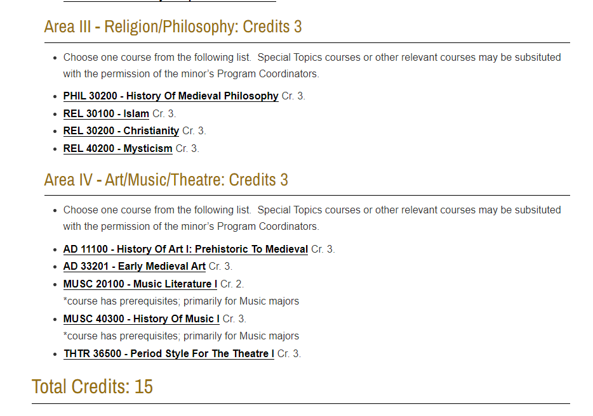

Slide 4
ENGL 40401 : Old English Language and Literature
Spring 2023
þæs ofereode, þisses swa mæg
“that passed over; let this too”
learn
1000 year-old
English
Dr. Damian Fleming
TR 3:00-4:15

