Slide 1
Shakespeare
&
The English Language
Damian Fleming
Indiana University-Purdue University, Fort Wayne
Department of English and Linguistics
Medieval Studies
Latin

Slide 2
History of the English Language
  OLD ENGLISH (700 – 1100)
    Beowulf
  MIDDLE ENGLISH (1100 – 1500)
    Chaucer, Canterbury Tales
  EARLY MODERN ENGLISH (1500 – 1700)
    King James Bible
    Collected Works of Shakespeare (First Folio)

Slide 3
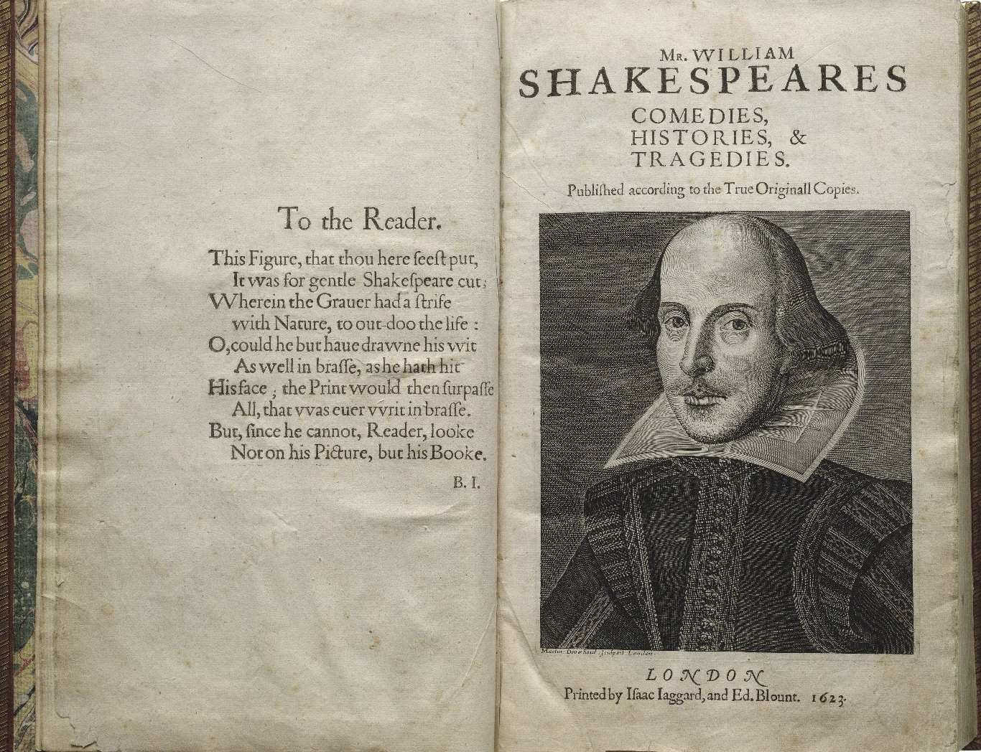

Slide 4
Famous phases
“Bated breath” — (The Merchant of Venice)
“Brave new world” — (The Tempest)
“Break the ice” — (The Taming of the Shrew)
“Dead as a doornail” — (Henry VI Part II)
“Eaten me out of house and home” — (Henry IV Part II)

Slide 5
Famous phases
“Faint hearted” — (Henry VI Part I)
“Fancy-free” — (A Midsummer Night’s Dream)
“Foregone conclusion” — (Othello)
“Full circle” — (King Lear)
“Good riddance” — (Troilus and Cressida)
“Jealousy is the green-eyed monster” — (Othello)

Slide 6
Famous phases
“Heart of gold” — (Henry V)
“Hoist with his own petard” — (Hamlet)
“Kill with kindness” — (The Taming of the Shrew)
“Laughing stock” — (The Merry Wives of Windsor)
“Live long day” — (Julius Caesar)
“Love is blind” — (The Merchant of Venice)

Slide 7
Famous phases
“Milk of human kindness” — (Macbeth)
“One fell swoop” — (Macbeth)
“Play fast and loose” — (King John)
“Set my teeth on edge” — (Henry IV Part I)
“Wear my heart upon my sleeve” — (Othello)
“Wild-goose chase” — (Romeo and Juliet)

Slide 8
Famous Phrase?
To the ________ born?

Slide 9
Hamlet, Act 1, scene 4
HORATIO: Is it a custom?
HAMLET: Ay, marry, is't:
But to my mind, though I am native here
And to the manner born, it is a custom
More honour'd in the breach than the observance.

Slide 10
Did Shakespeare “invent 10000 words”?

Slide 11
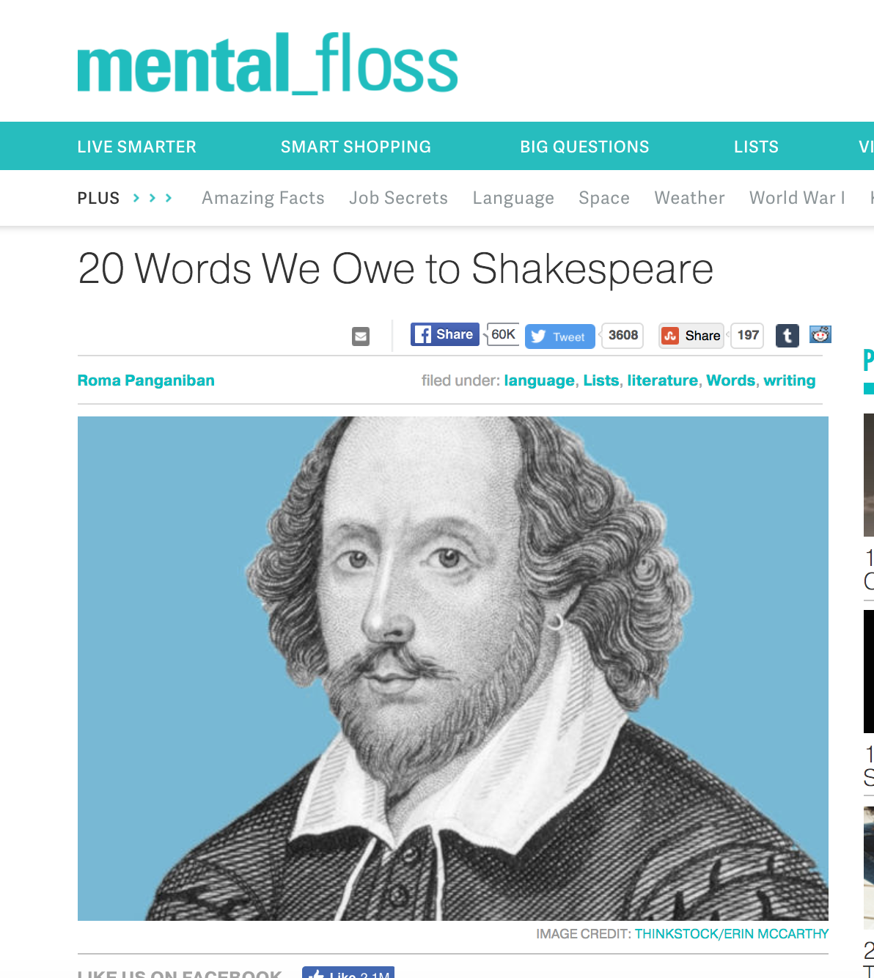

Slide 12
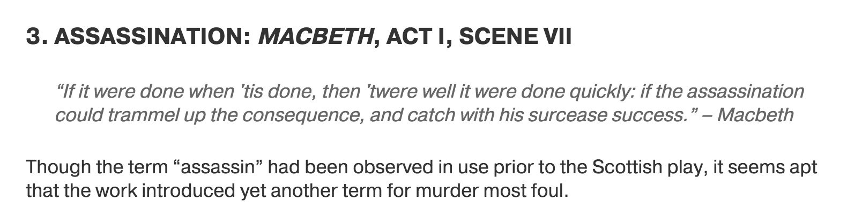
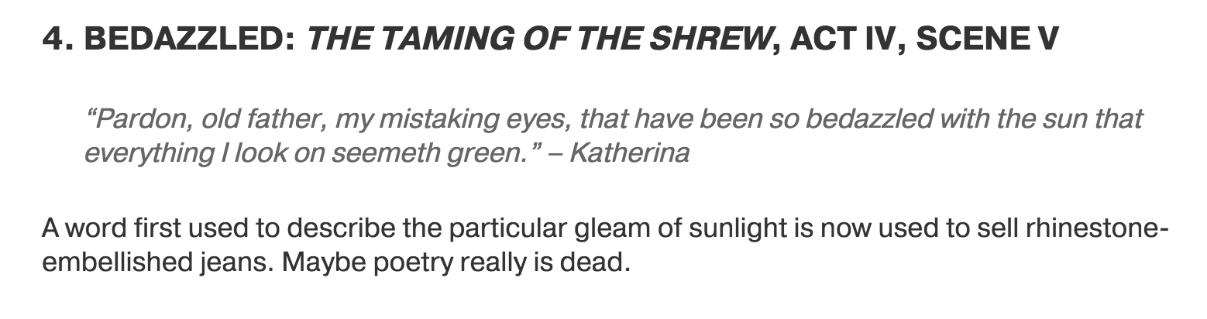
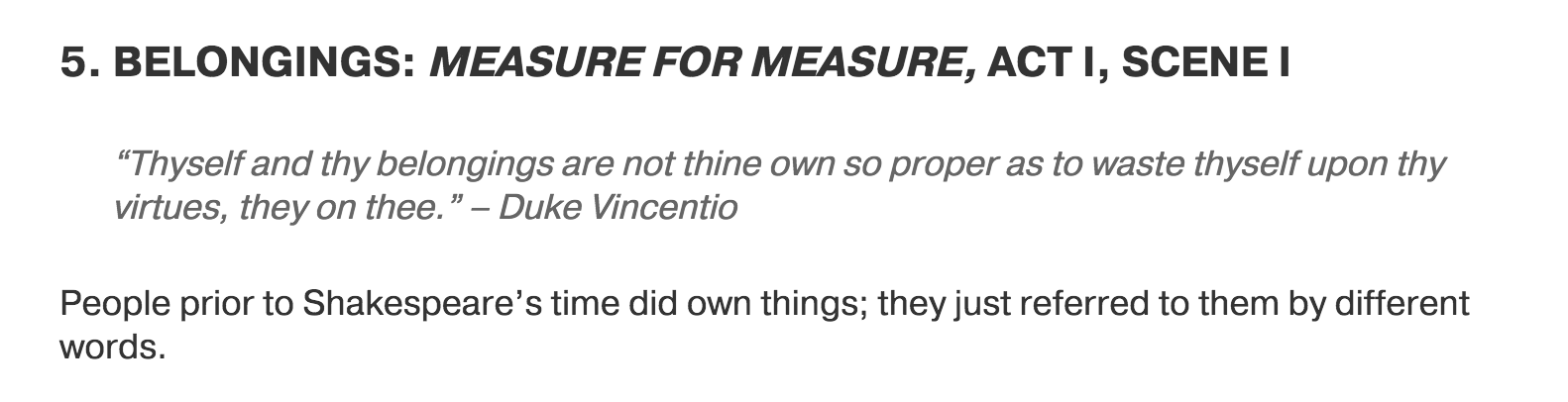

Slide 13
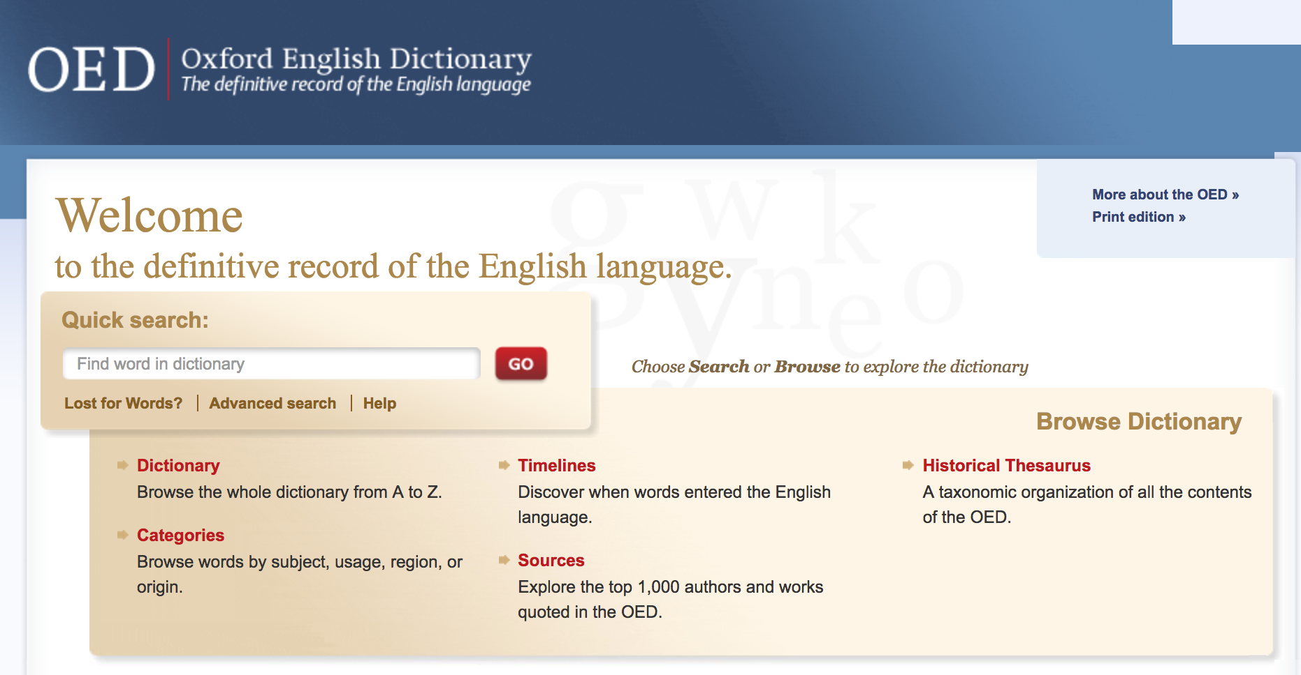

Slide 14
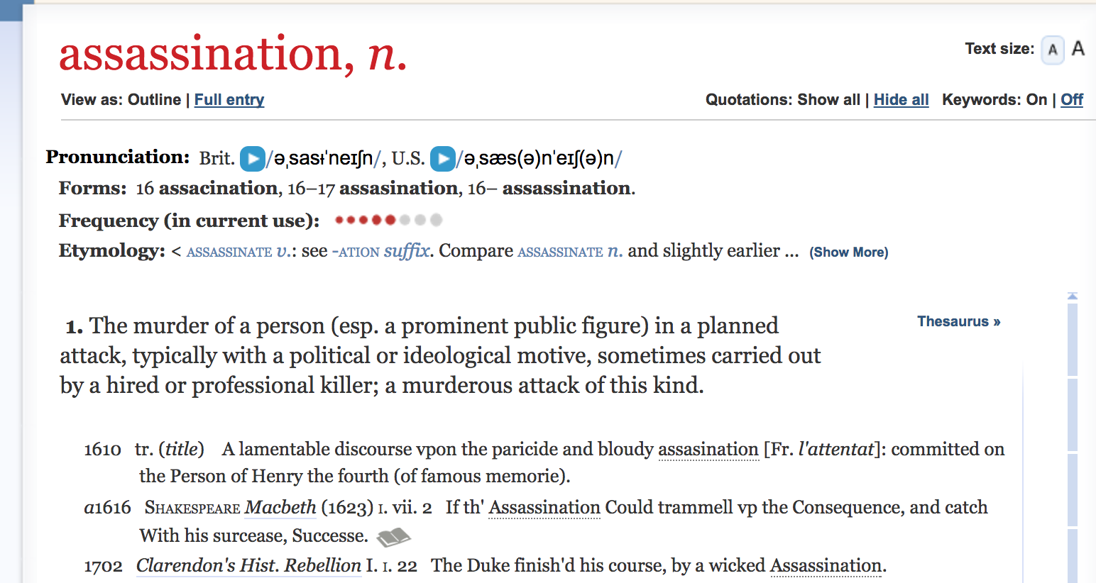

Slide 17
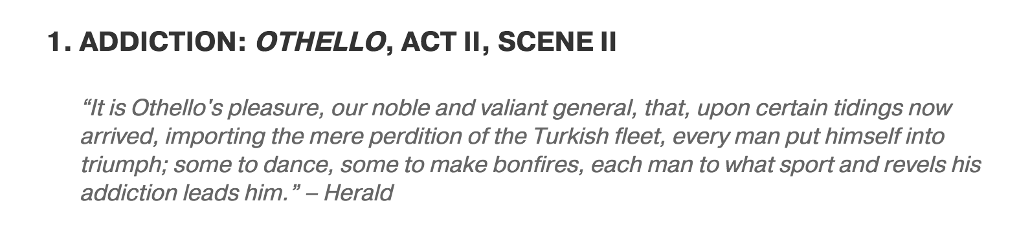
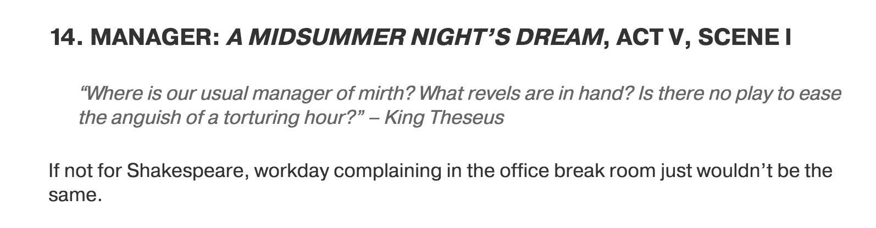
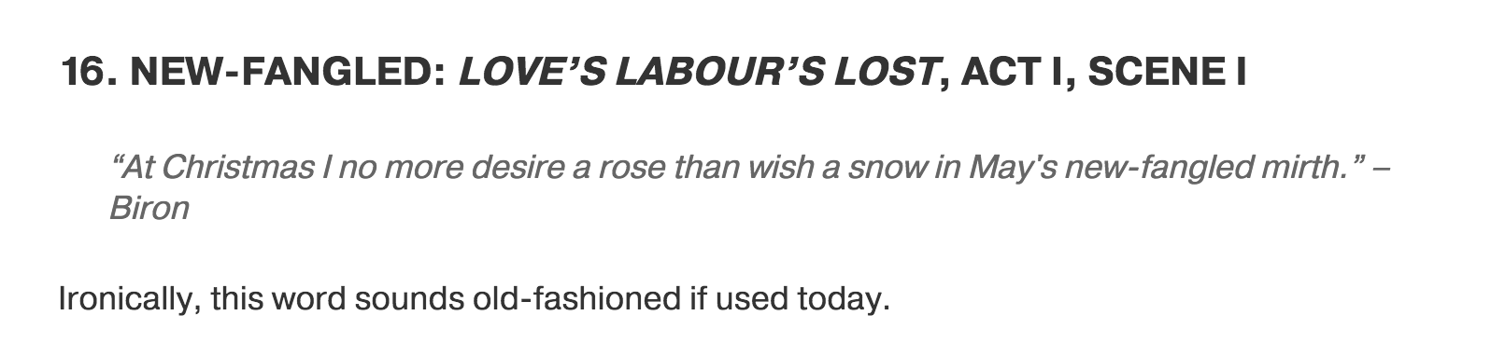

Slide 18
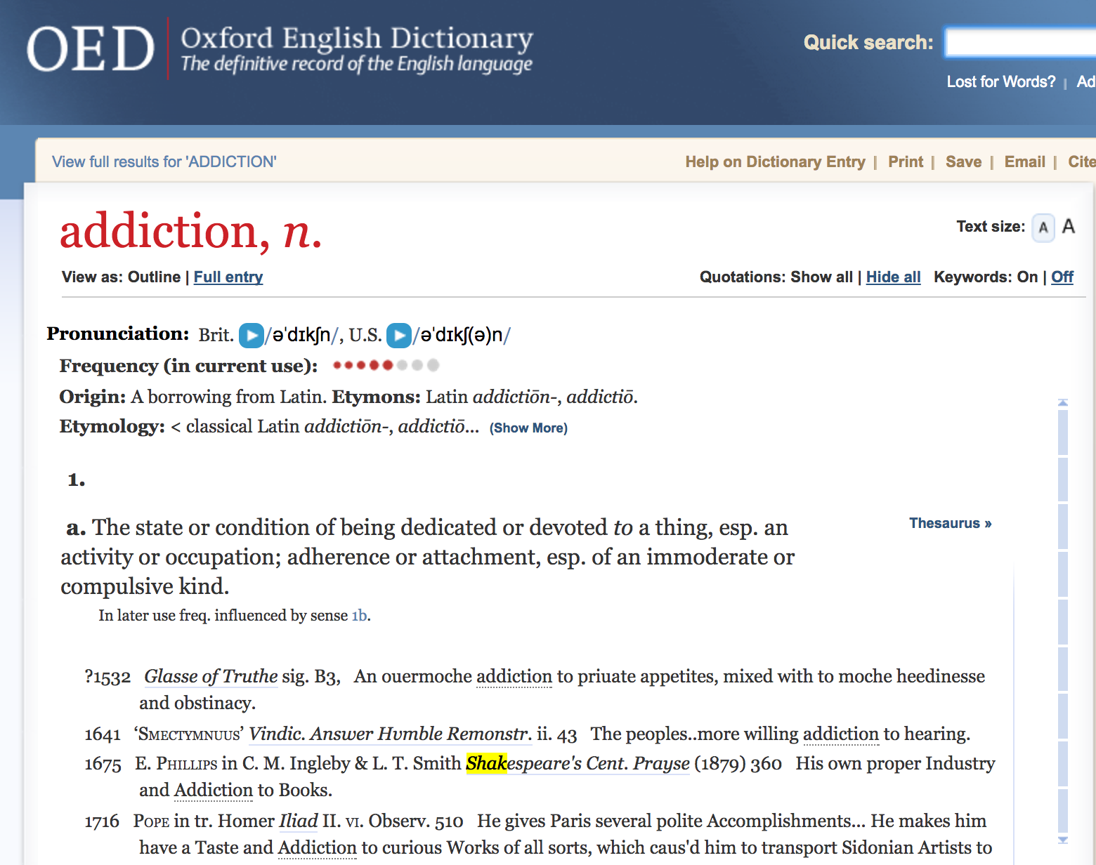

Slide 20
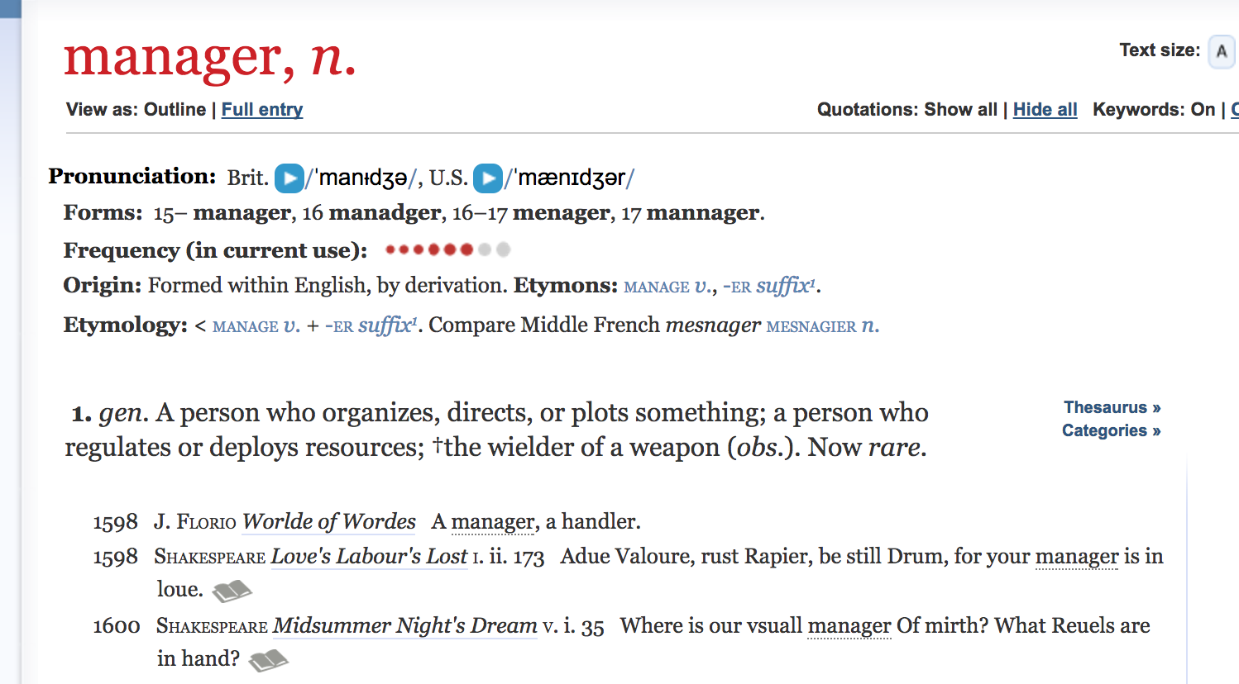

Slide 22
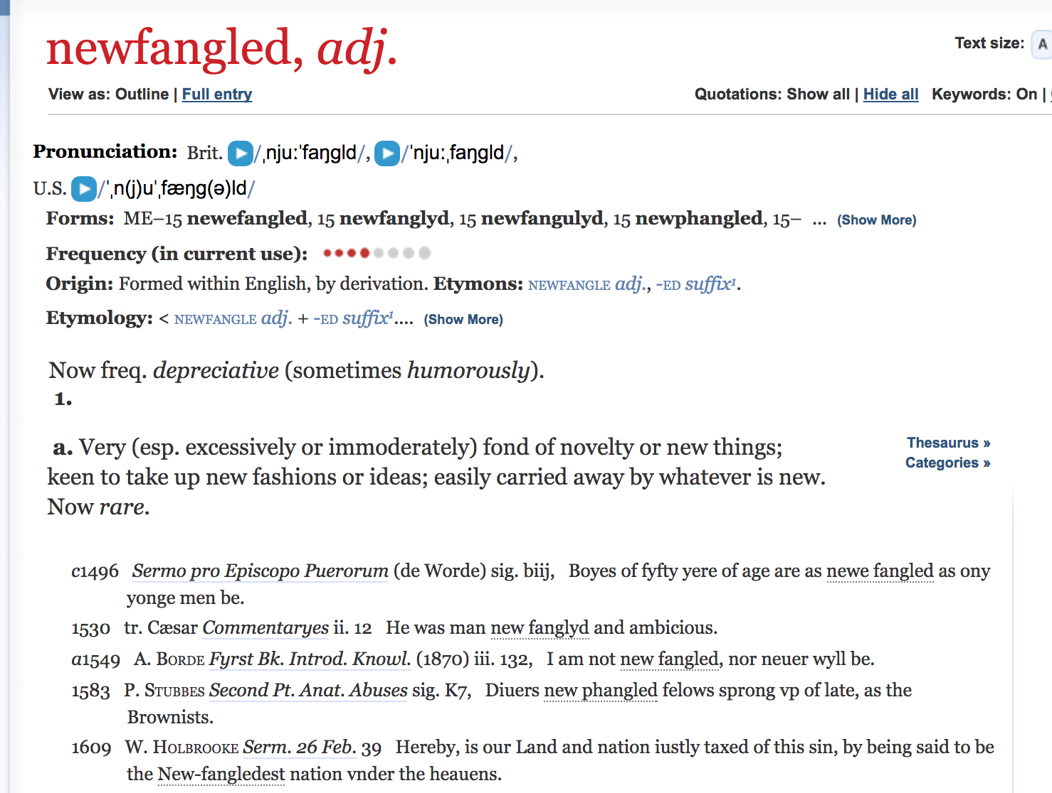

Slide 24
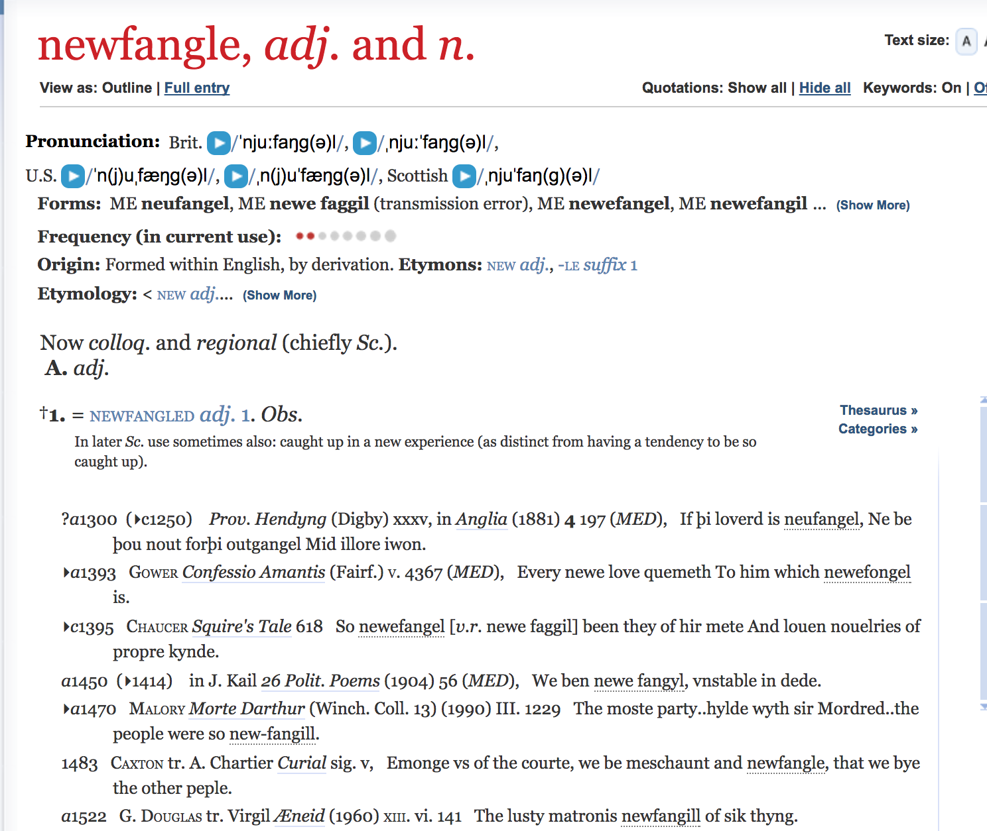

Slide 26
Shakespeare: New words through Affixes
UN-

Slide 27
Shakespeare: New words through Affixes
UN-
uncurse, undeaf, undeck, uncharge, unhand, unpeg, untent, unfix, unspeak, unsex

Slide 28
Functional Shift
Using a word which is one part of speech as another

Slide 29
Functional Shift
Using a word which is one part of speech as another
Most common NOUN > VERB
“Let’s table the discussion
“I always bike to school”

Slide 30
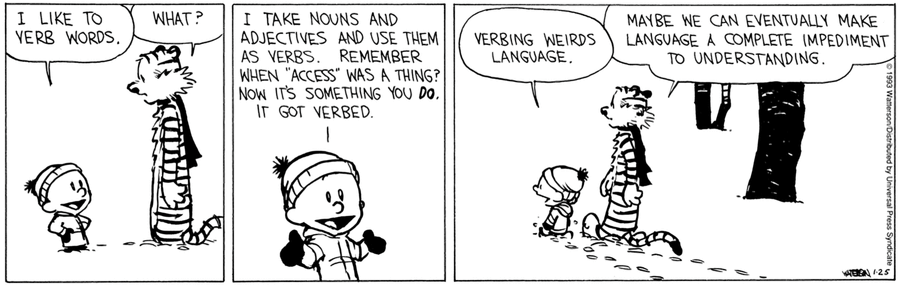

Slide 31
Shakespeare “Verbs” Nouns
KL III.vi.108 He childed as I fathered
MM III.ii.90 Lord Angelo dukes it well
Cym II.iii.46 be friended / With aptness of the season
AC IV.xii.21 The hearts / That spanieled me at heels
R2 II.iii.86 uncle me no uncle

Slide 32
Shakespeare “Verbs” Nouns
Cym IV.ii.400 come, arm him
Cym V.iv.147 such stuff as madmen / Tongue, and brain not
TNK III.i.29 I eared her language
Cor V.i.5 fall down, and knee / The way into his mercy

Slide 33
History of the English Language
  OLD ENGLISH (700 – 1100)
    Beowulf
  MIDDLE ENGLISH (1100 – 1500)
    Chaucer, Canterbury Tales
  EARLY MODERN ENGLISH (1500 – 1700)
    King James Bible
    Collected Works of Shakespeare (First Folio)

Slide 35
Our father
which art in heauen
hallowed be thy name
Thy kingdome come
Thy will be done, in earth
as it is in heauen
Giue vs this day our daily bread
And forgiue vs our debts
as we forgiue our debters
And lead vs not into temptation
but deliuer vs from euill

Slide 36
Oure fadir
þat art in heuenes
halewid be þi name
þi kyngdoom come to be.
Be þi wille don in erþe
as it is in heuene
ȝeue to vs todai oure eche dayes breed.
And forȝeue to vs oure dettis
as we forȝeuen to oure dettouris
And lede vs not into temptacion
but delyuere vs fro yuel

Slide 37
Fæder ure
þu þe eart on heofonum
si þin nama gehalgod
tobecume þin rice
gewurþe þin willa on eorðan
swa swa on heofonum
urne gedæghwamlican hlaf syle us to dæg
and forgyf us ure gyltas
swa swa we forgyfað urum gyltendum
and ne gelæd þu us on costnunge
ac alys us of yfele

Slide 38
Pronouns!
Plural
We, us, our/ours
Ye, you, your/yours
They, them, their/their
Singular
I, me, my/mine
Thou, thee, thy/thine
He, him, his
She, her, her/hers

Slide 39
Pronouns!
THOU / THEE
Always singular
Shows familiarity, affection, but also condescension
YE / YOU
Plural
Singular to show formality, respect, but also distance

Slide 40
A Scene from Hamlet
”The Closet Scene”
Hamlet (acting strangely) visits his Mother, Queen Gertrude
Polonius (advisor to the king) hides in order to eavesdrop

Slide 41
A Scene from Hamlet
”The Closet Scene”
Hamlet (acting strangely) visits his Mother, Queen Gertrude
Polonius (advisor to the king) hides in order to eavesdrop
Text

Slide 42
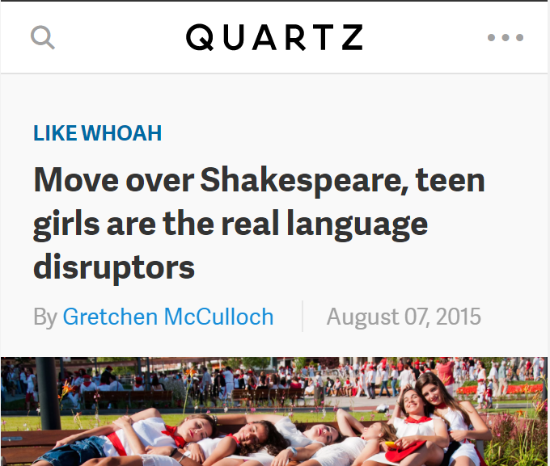

Slide 43
