Slide 1
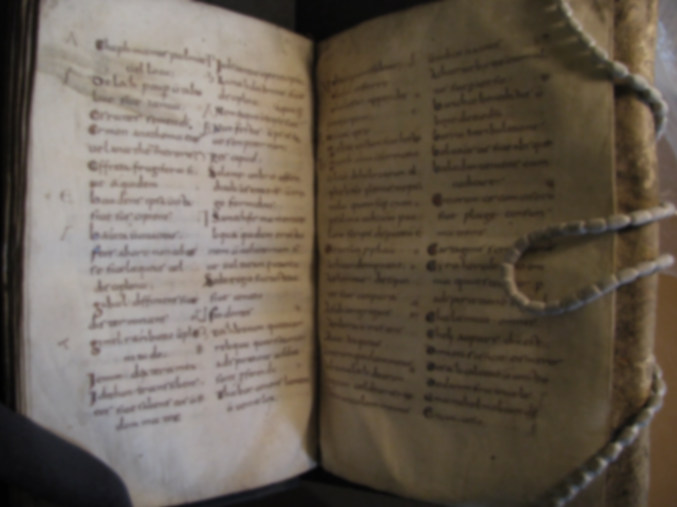
What is a Medieval Movie?
Professor Damian Fleming
Department of English
Medieval Studies
Purdue University Fort Wayne

Slide 2

What do you think of when you hear
Medieval
or
Middle Ages
PollEv.com​/damianfleming138

Slide 3
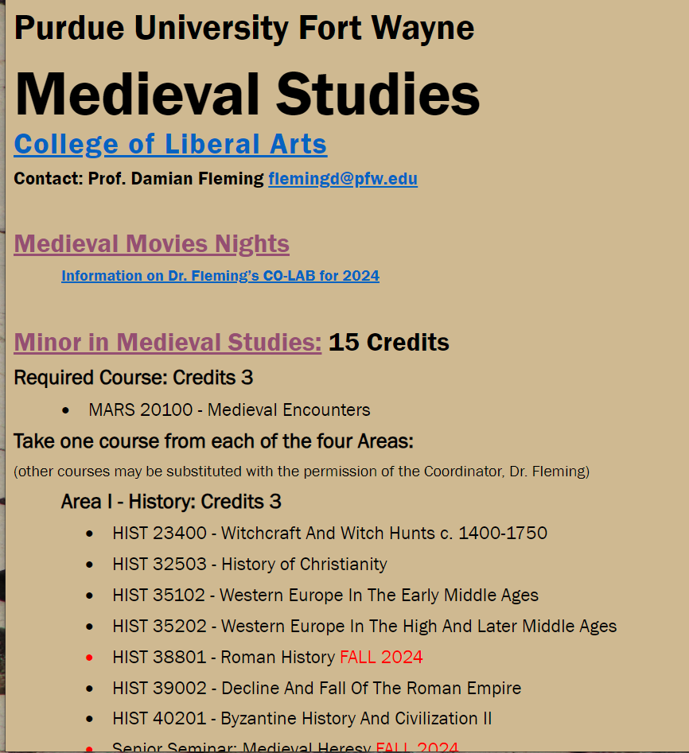
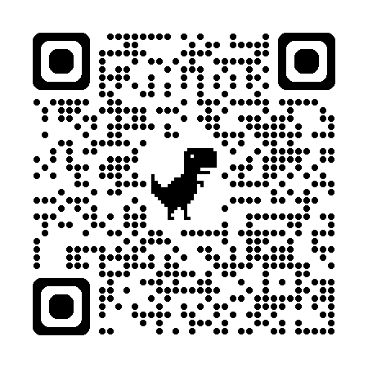

Slide 4
Dr. Damian Fleming
Teaching:
Medieval Literature
  Old English (Beowulf!)
  Middle English (Chaucer!)
History of the English Language (HEL)
Latin
Classical Mythology
Old Books / Manuscripts

Slide 5
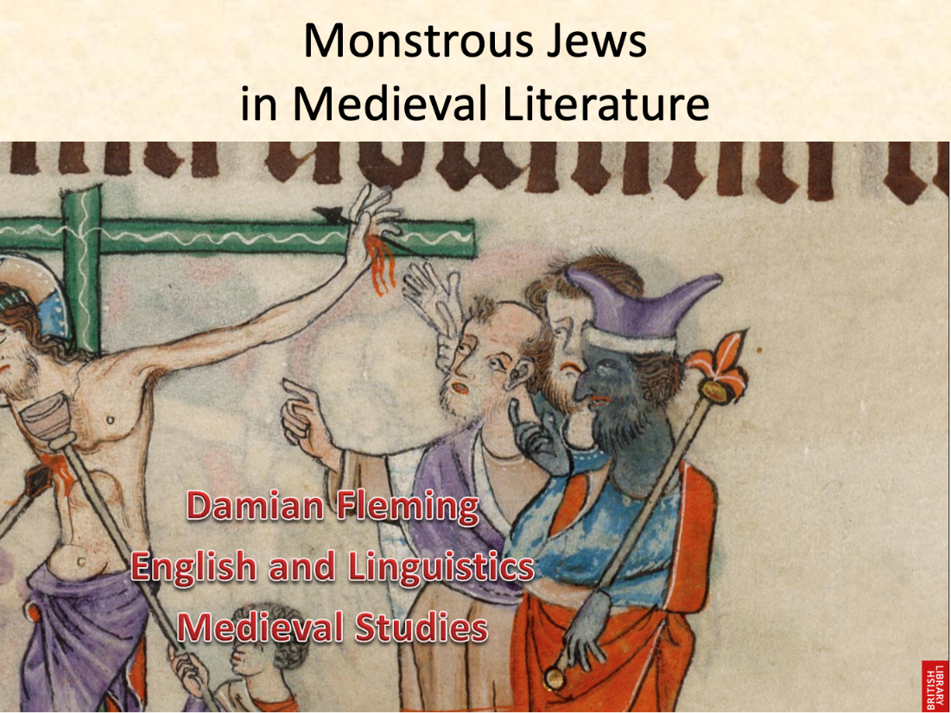
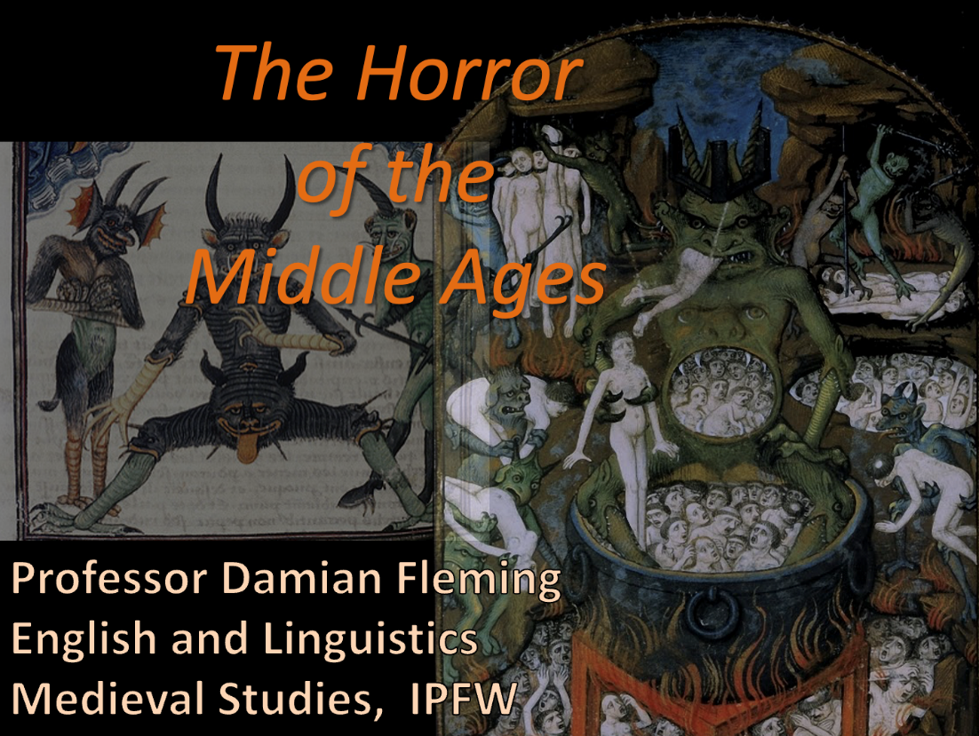
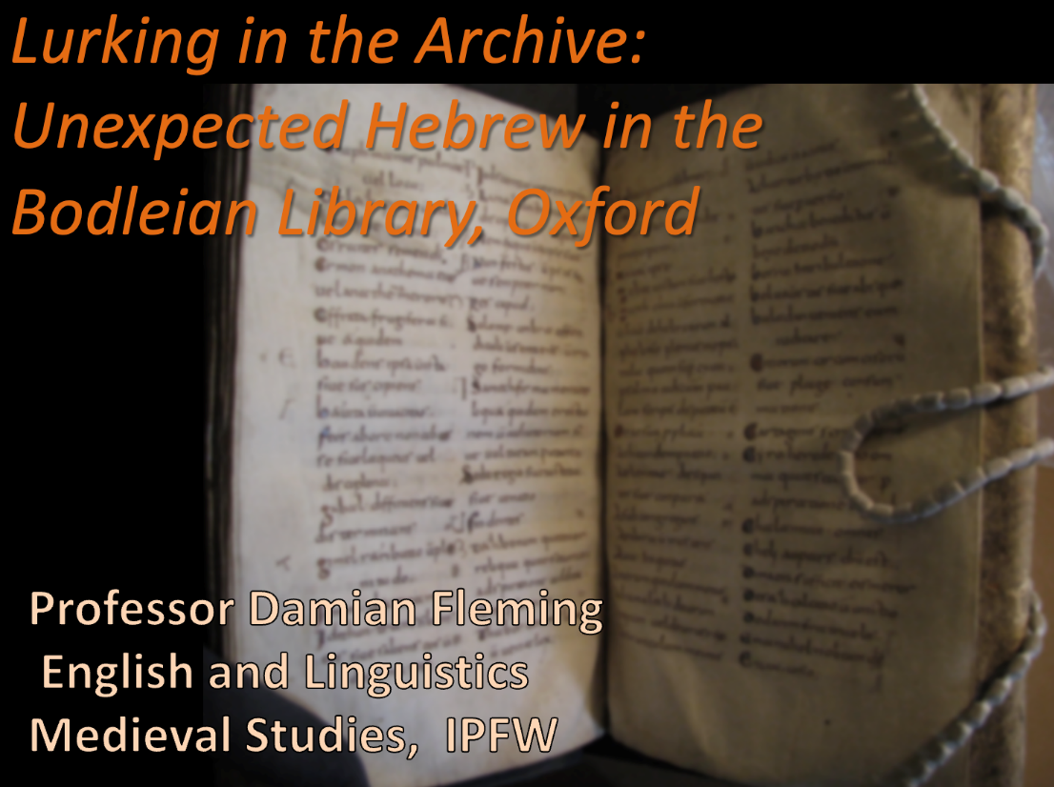
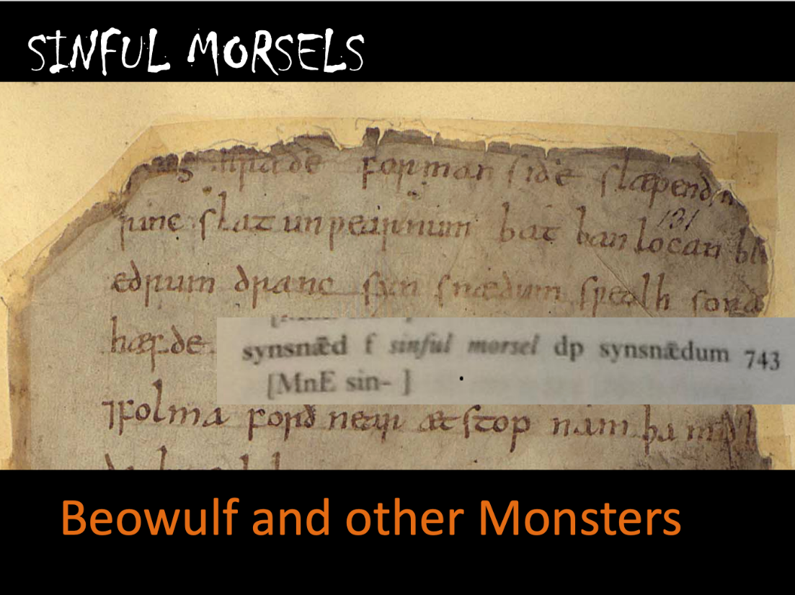

Slide 6
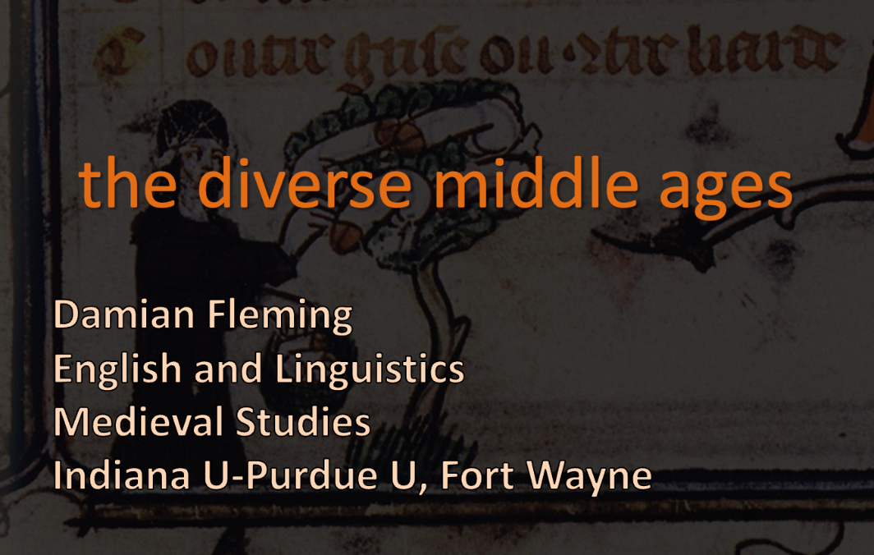
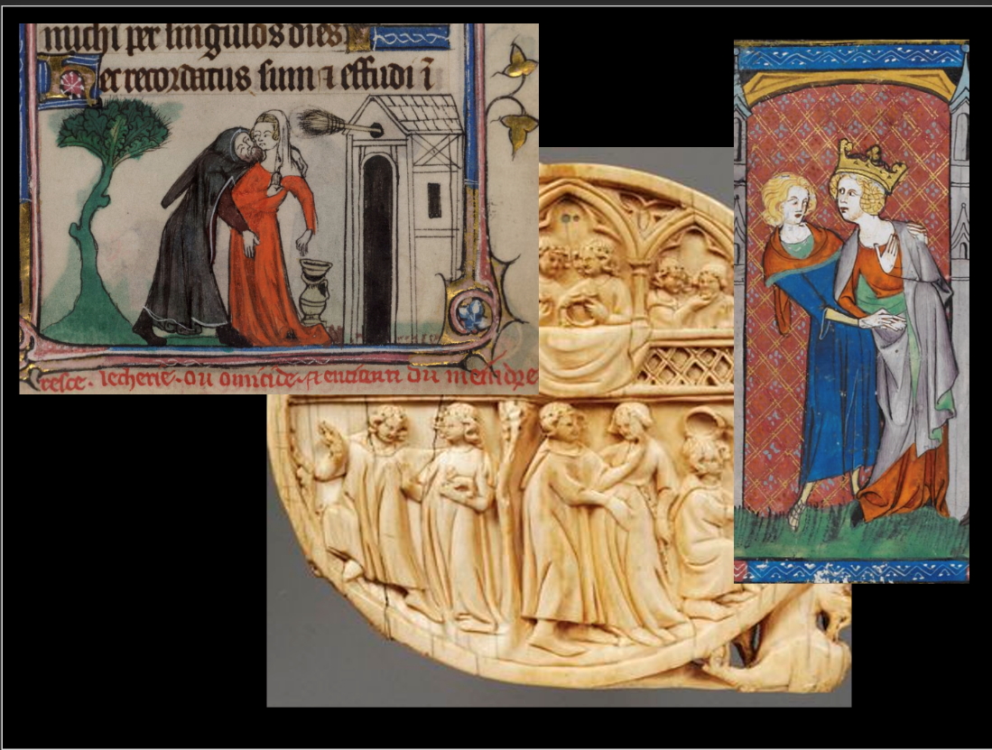
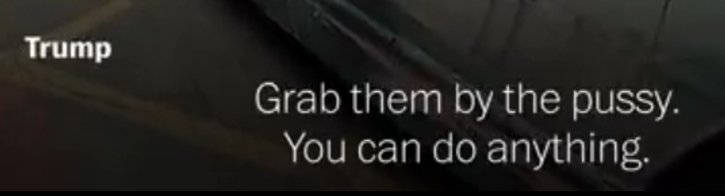
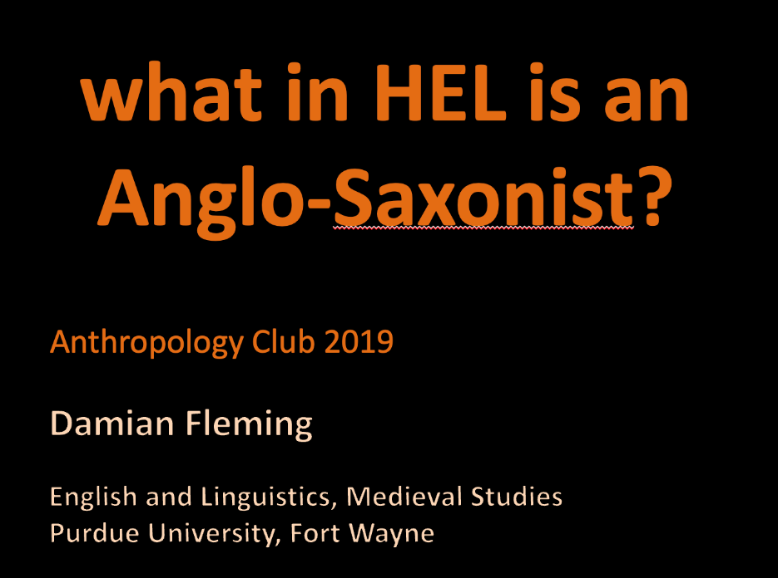
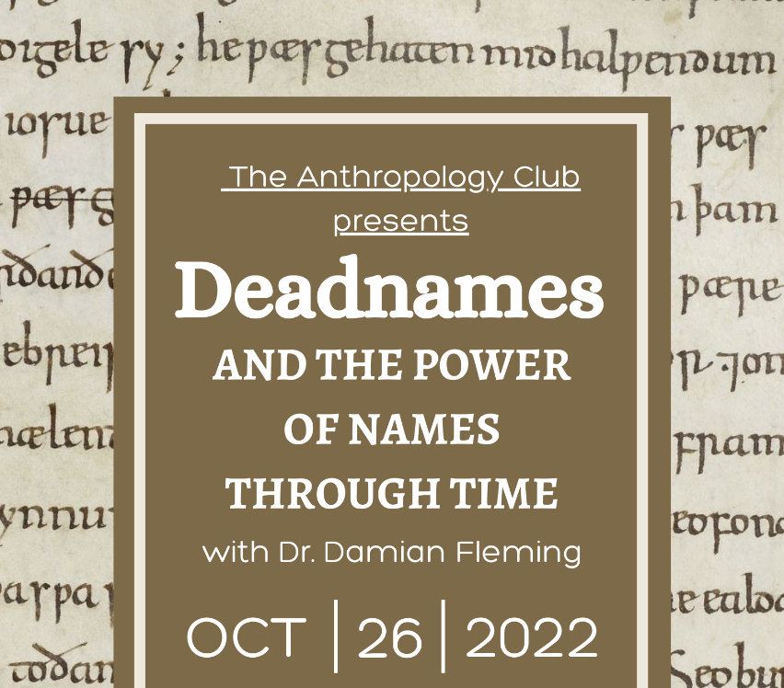

Slide 7
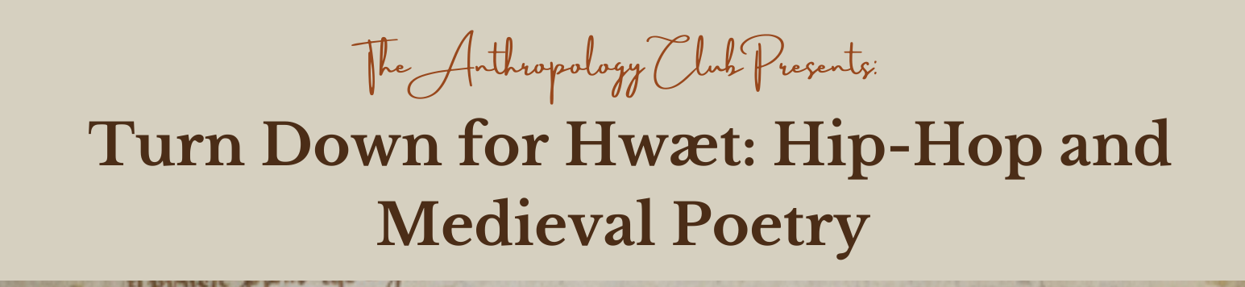
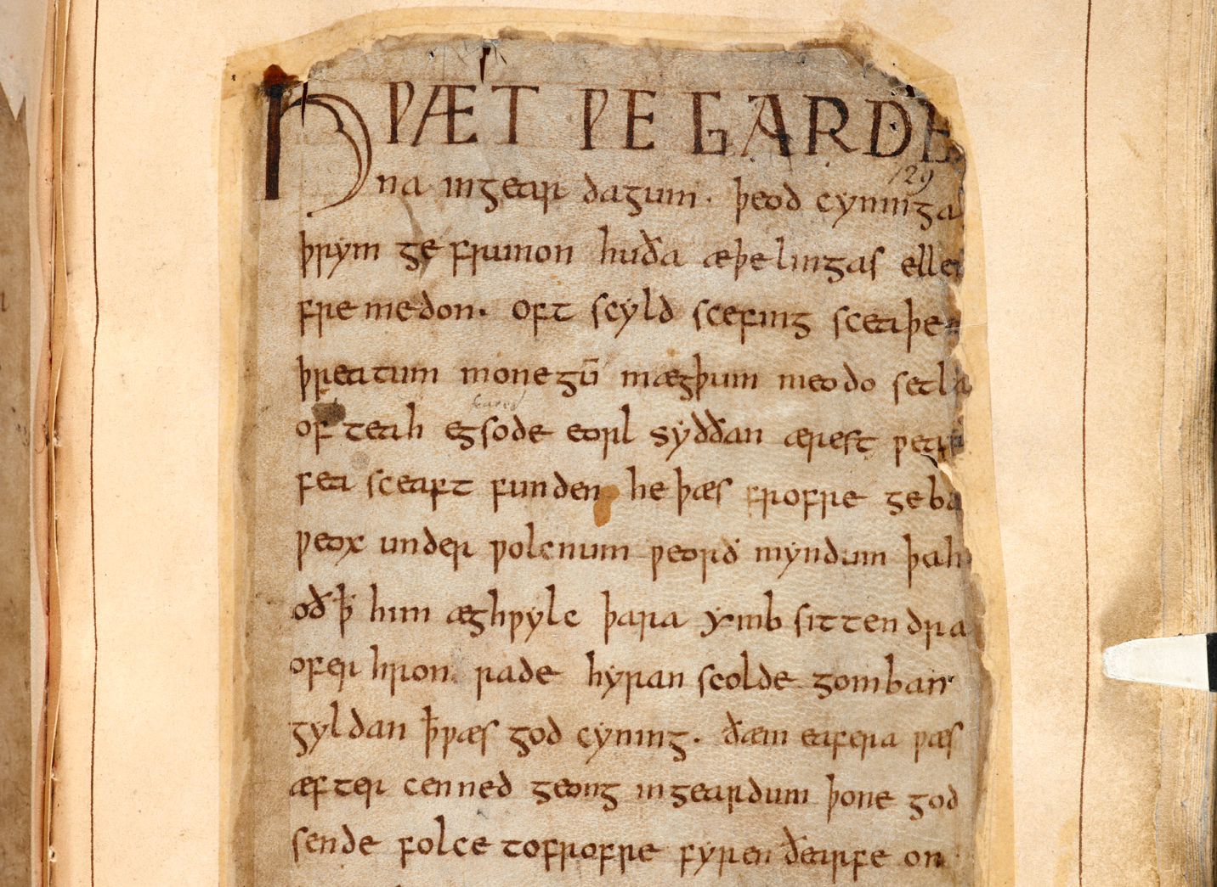
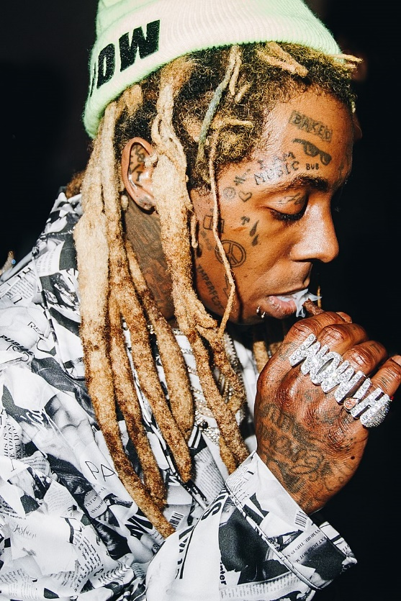

Slide 8
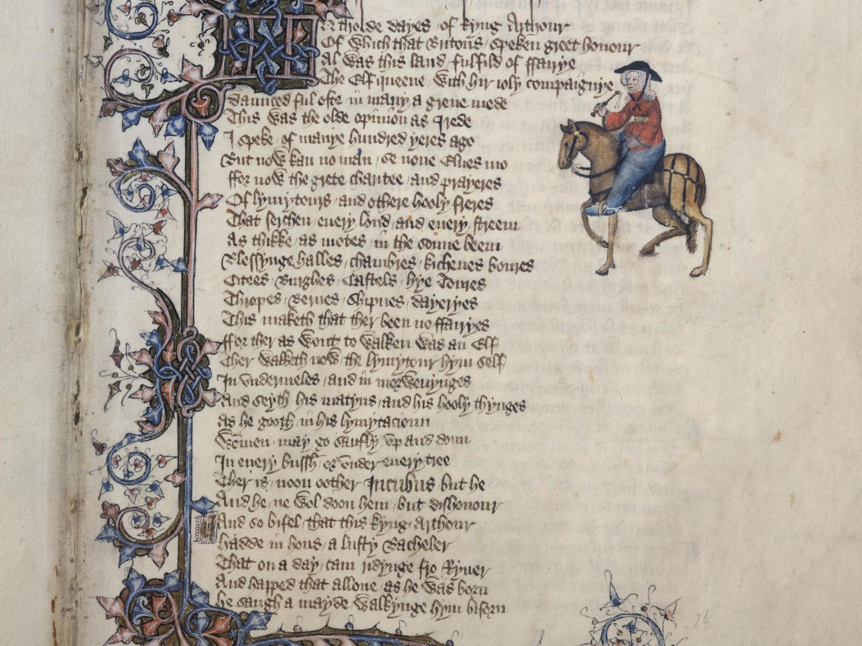
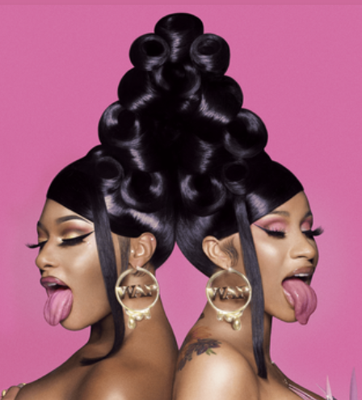
Bring a Bucket and a Mop
For this Old Ass Poetry

Slide 9
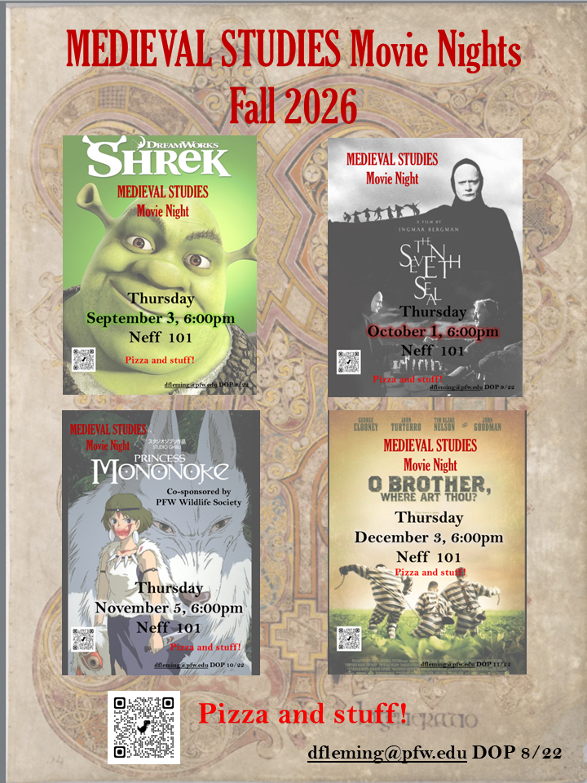

Slide 10
Enlightenment
Renaissance
Classical / Ancient
Greece and Rome
500-1500
Medieval
Middle Ages
“Dark Ages”

Slide 11
What do you think of when you hear
Medieval
or
Middle Ages
PollEv.com​/damianfleming138

Slide 12
What is a Medieval Movie?

Slide 13
Name some medieval movies
PollEv.com​/damianfleming138

Slide 14
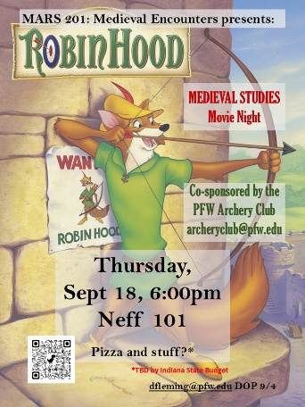
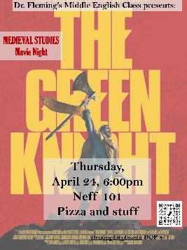
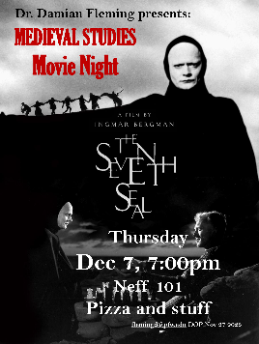
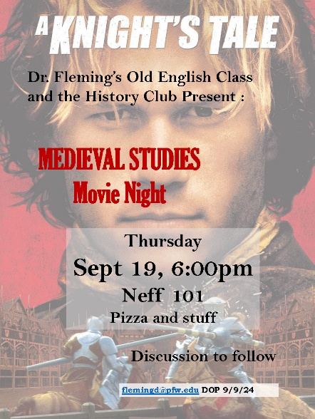
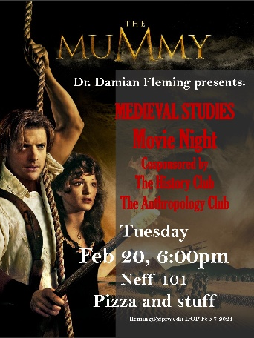
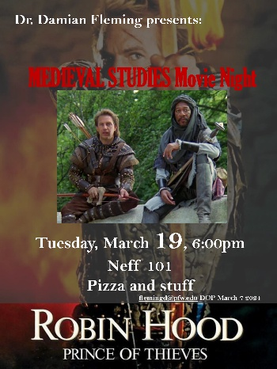
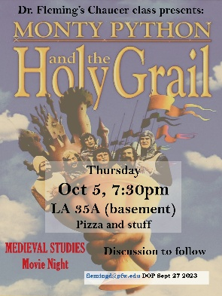
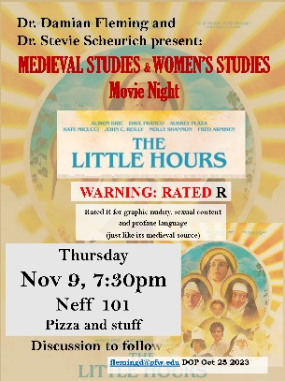
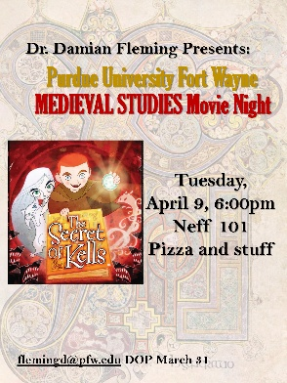
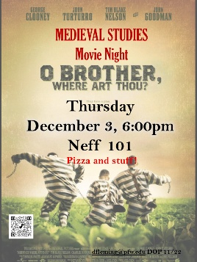
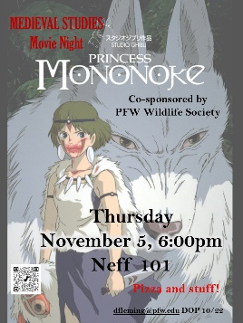
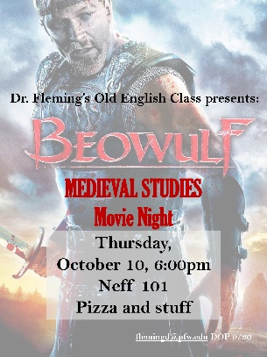
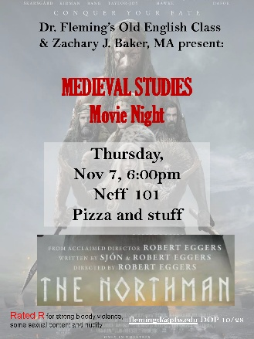
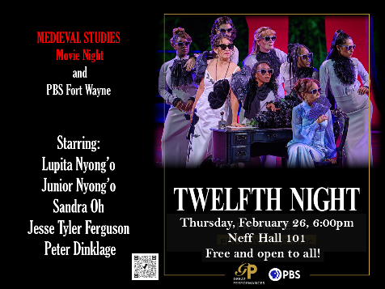
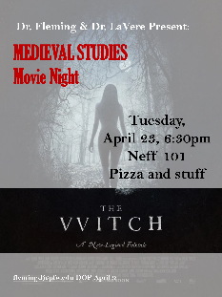
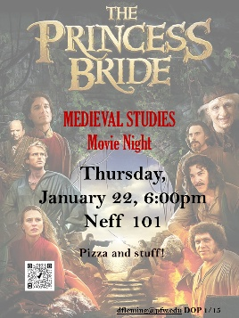
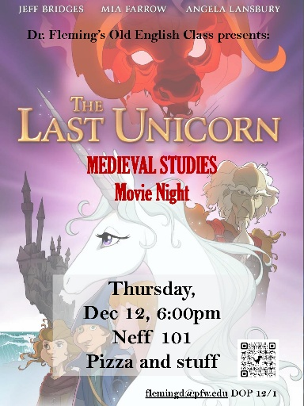
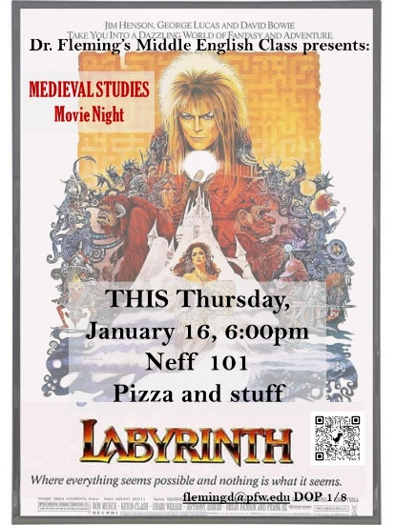
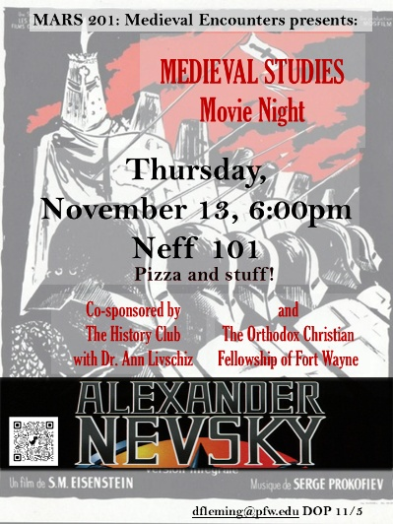
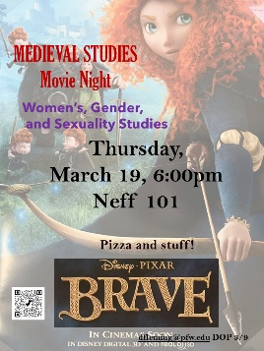
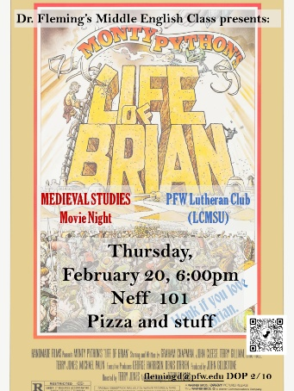
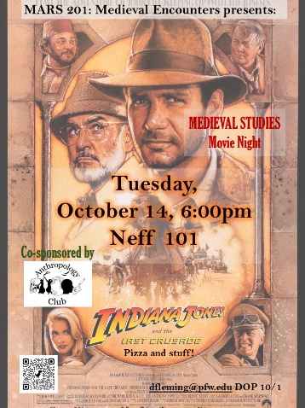
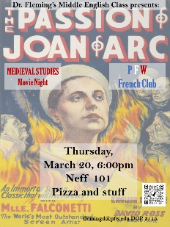
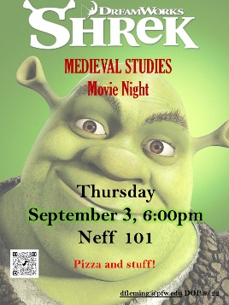
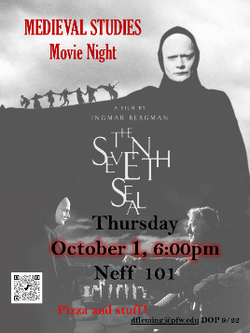
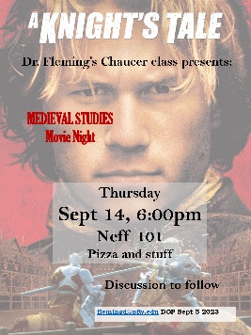
What is a Medieval Movie?

Slide 15
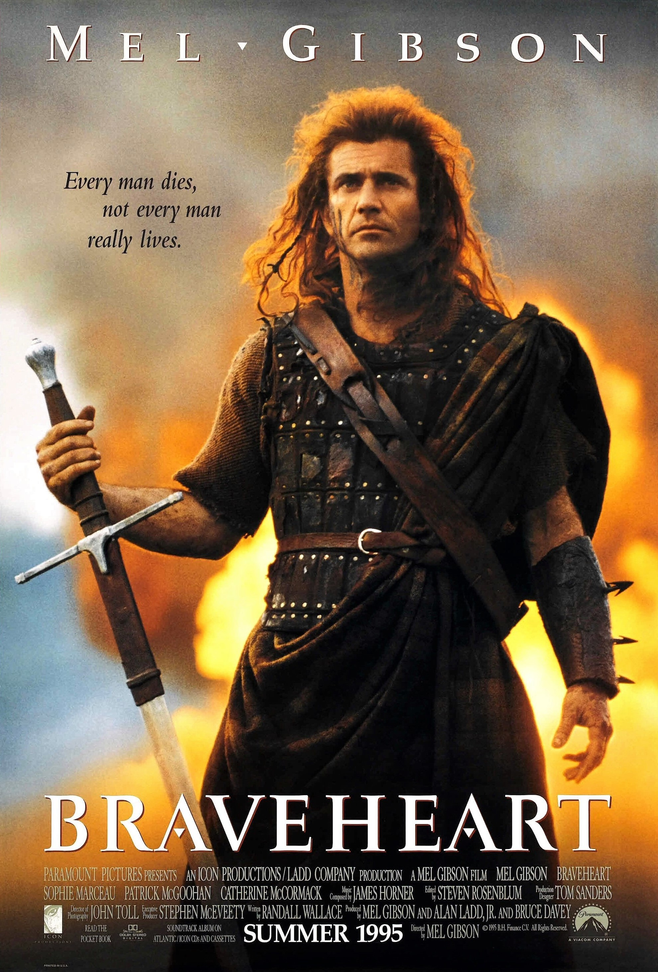
What is a Medieval Movie?
Set in medieval times
  Based on Medieval History

Slide 16
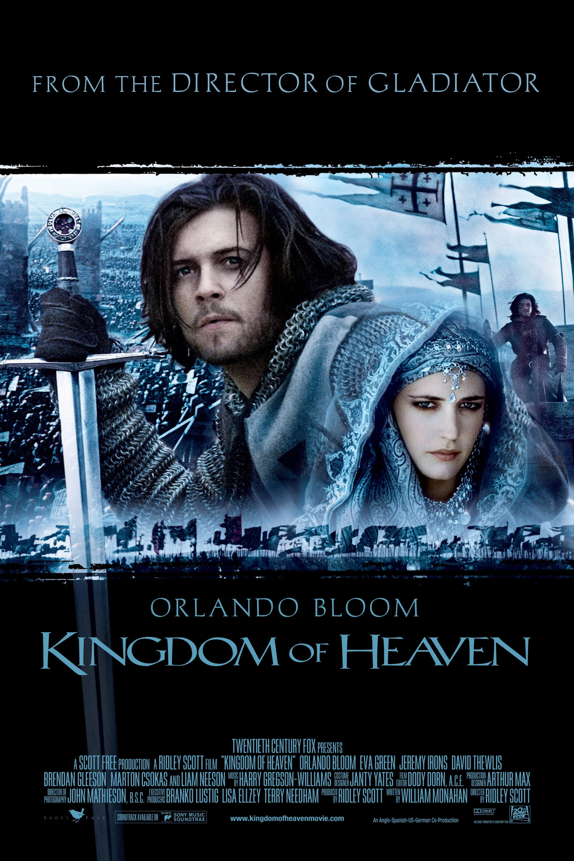
What is a Medieval Movie?
Set in medieval times
  Based on Medieval History

Slide 17
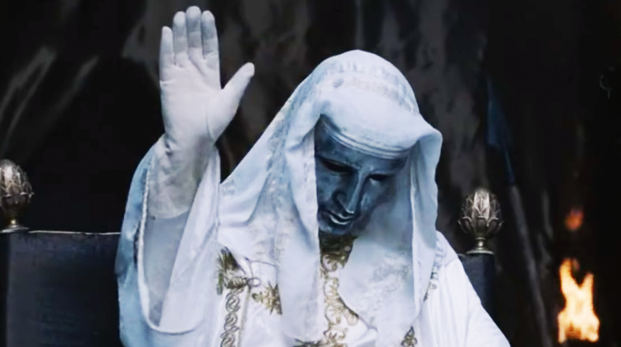
What is a Medieval Movie?
Set in medieval times
  Based on Medieval History

Slide 18
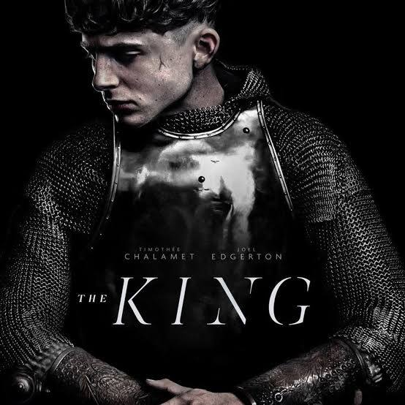
What is a Medieval Movie?
Set in medieval times
  Based on Medieval History

Slide 19
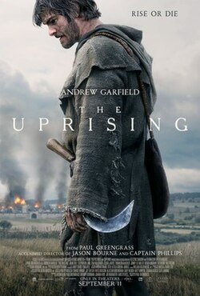
What is a Medieval Movie?
Set in medieval times
  Based on Medieval History

Slide 20
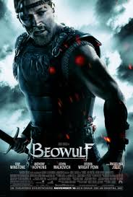



What is a Medieval Movie?
Set in medieval times
  Based on Medieval Literature

Slide 21

What is a Medieval Movie?
Set in medieval times
  Based on Medieval Literature

Slide 22



What is a Medieval Movie?
Set in medieval times
  Based on Medieval Literature

Slide 23



Slide 24

What is a Medieval Movie?
Based on Medieval Literature

Slide 25


What is a Medieval Movie?
Set in medieval times
  Based on Medieval Literature

Slide 26


Slide 27


What is a Medieval Movie?
FANTASY inspired by Medieval Literature / History

Slide 28

What is a Medieval Movie?
Fairy Tales … Princess stories?

Slide 29


Très Riches Heures de Jean, Duc de Berri

Slide 30


Slide 31



Slide 32



Slide 33


Slide 34








Slide 35


Slide 36



Slide 37
What is a Medieval Movie?
Connected to a class I was teaching

Slide 38
What is a Medieval Movie?
Connected to class

Slide 39


What is a Medieval Movie?
Movies related to classes I am teaching

Slide 40

What is a Medieval Movie?
Movies related to classes I am teaching
Spring 2027, MW 3:00-4:15

Slide 41




Slide 42



Slide 43


Slide 44



Slide 45


Slide 46



Slide 47


Slide 48



Slide 49


Slide 50


Slide 51
What is a Medieval Movie?
Movies that a medieval person would love

Slide 52
What is a Medieval Movie?
Movies that a medieval person would love
CW next slides: BLOOD

Slide 53



Slide 54



Slide 55


Slide 56
What is a Medieval Movie?
Movies that a medieval person would love

Slide 57



Slide 58




Slide 59


Slide 60


Slide 61
What is a Medieval Movie?
Movies that a medieval person would love

Slide 62

What is a Medieval Movie?
Movies that a medieval person would love

Slide 63


What is a Medieval Movie?
Movies that a medieval person would love

Slide 64
What is a Medieval Movie?
What is a
MEDIEVAL STUDIES
Movie Night
Movie?

Slide 65
What is a Medieval Movie?
What is a
MEDIEVAL STUDIES
Movie Night
Movie?
Pizza and stuff

Slide 66




What is a Movie?
MEDIEVAL STUDIES
Movie Night
Good (or at least interesting)

Slide 67



What is a Medieval Movie?
“important” films set in the middle ages

Slide 68


What is a Medieval Movie?
“important” films set in the middle ages

Slide 69



What is a Medieval Movie?
“important” films set in the middle ages

Slide 70





What is a Movie?
MEDIEVAL STUDIES
Movie Night
Good (or at least interesting)
Self aware (does not take itself too seriously

Slide 71
What is a Movie?
MEDIEVAL STUDIES
Movie Night
Good (or at least interesting)
Self aware (does not take itself too seriously
Welcoming

Slide 72

What is a Movie?
MEDIEVAL STUDIES
Movie Night
Good (or at least interesting)
Welcoming
Nostalgic

Slide 73

What is a Movie?
MEDIEVAL STUDIES
Movie Night
Good (or at least interesting)
Welcoming
Nostalgic

Slide 74

What is a Movie?
MEDIEVAL STUDIES
Movie Night
Good (or at least interesting)
Welcoming
Nostalgic

Slide 75

What is a Movie?
MEDIEVAL STUDIES
Movie Night
Good (or at least interesting)
Welcoming
Nostalgic

Slide 76

What is a Movie?
MEDIEVAL STUDIES
Movie Night
Good (or at least interesting)
Welcoming
Nostalgic

Slide 77
What is a Movie?
MEDIEVAL STUDIES
Movie Night
Good (or at least interesting)
Welcoming
Nostalgic

Slide 78

What is a Movie?
MEDIEVAL STUDIES
Movie Night
Good (or at least interesting)
Welcoming
Nostalgic
Inclusive / Diverse

Slide 79

What is a Movie?
MEDIEVAL STUDIES
Movie Night
Good (or at least interesting)
Welcoming
Nostalgic
Inclusive

Slide 80
What is a Movie?
MEDIEVAL STUDIES
Movie Night
Good (or at least interesting)
Welcoming
Nostalgic
Inclusive

Slide 81

What is a Movie?
MEDIEVAL STUDIES
Movie Night
Good (or at least interesting)
Welcoming
Nostalgic
Inclusive
  History Club / Department

Slide 82

What is a Movie?
MEDIEVAL STUDIES
Movie Night
Good (or at least interesting)
Welcoming
Nostalgic
Inclusive
  History Club / Department
  Orthodox Christian Fellowship

Slide 83

What is a Movie?
MEDIEVAL STUDIES
Movie Night
Good (or at least interesting)
Welcoming
Nostalgic
Inclusive
  History
  Women’s Gender and Sexuality Studies

Slide 84

What is a Movie?
MEDIEVAL STUDIES
Movie Night
Good (or at least interesting)
Welcoming
Nostalgic
Inclusive
  History
  Women’s Gender and Sexuality Studies

Slide 85

What is a Movie?
MEDIEVAL STUDIES
Movie Night
Good (or at least interesting)
Welcoming
Nostalgic
Inclusive
  History
  Women’s Gender and Sexuality Studies

Slide 86

What is a Movie?
MEDIEVAL STUDIES
Movie Night
Good (or at least interesting)
Welcoming
Nostalgic
Inclusive
  History
  Women’s Gender and Sexuality Studies
  French Club

Slide 87

What is a Movie?
MEDIEVAL STUDIES
Movie Night
Good (or at least interesting)
Welcoming
Nostalgic
Inclusive
  History
  WOST
  French Club
  Archery Club

Slide 88


What is a Movie?
MEDIEVAL STUDIES
Movie Night
Good (or at least interesting)
Welcoming
Nostalgic
Inclusive
  History
  WOST
  French Club
  Archery Club
  Anthropology Club

Slide 89

What is a Movie?
MEDIEVAL STUDIES
Movie Night
Good (or at least interesting)
Welcoming
Nostalgic
Inclusive
  History
  WOST
  French Club
  Archery Club
  Anthropology Club
  The Wildlife Society

Slide 90

What is a Movie?
MEDIEVAL STUDIES
Movie Night
Good (or at least interesting)
Welcoming
Nostalgic
Inclusive
  History
  WOST
  French Club
  Archery Club
  Anthropology Club
  The Wildlife Society
  Hispanos Unidos

Slide 91

What is a Movie?
MEDIEVAL STUDIES
Movie Night
Good (or at least interesting)
Welcoming
Nostalgic
Inclusive
  History
  WOST
  French Club
  Archery Club
  Anthropology Club
  The Wildlife Society
  Latinos Unidos
  Alumni !

Slide 92

What is a Movie?
MEDIEVAL STUDIES
Movie Night
Good (or at least interesting)
Welcoming
Nostalgic
Inclusive
  History
  WOST
  French Club
  Archery Club
  Anthropology Club
  The Wildlife Society
  Latinos Unidos
  Alumni !
  Lutheran Club

Slide 93
What is a Movie?
MEDIEVAL STUDIES
Movie Night
Good (or at least interesting)
Welcoming
Nostalgic
Inclusive
  History
  WOST
  French Club
  Archery Club
  Anthropology Club
  The Wildlife Society
  Latinos Unidos
  Lutherans
Anti-fascist

Slide 94

What is a Movie?
MEDIEVAL STUDIES
Movie Night
Good (or at least interesting)
Welcoming
Nostalgic
Inclusive
  History
  WOST
  French Club
  Archery Club
  Anthropology Club
  The Wildlife Society
  Latinos Unidos
  Lutherans
Anti-fascist

Slide 95
What is a Movie?
MEDIEVAL STUDIES
Movie Night
Good (or at least interesting)
Welcoming
Nostalgic
Inclusive
  History
  WOST
  French Club
  Archery Club
  Anthropology Club
  The Wildlife Society
  Latinos Unidos
  Lutherans
Anti-fascist

Slide 96
What is a Movie?
MEDIEVAL STUDIES
Movie Night
Good (or at least interesting)
Welcoming
Nostalgic
Inclusive
  History
  WOST
  French Club
  Archery Club
  Anthropology Club
  The Wildlife Society
  Latinos Unidos
  Lutherans
Anti-fascist

Slide 97

What is a Movie?
MEDIEVAL STUDIES
Movie Night
Good (or at least interesting)
Welcoming
Nostalgic
Inclusive
  History
  WOST
  French Club
  Archery Club
  Anthropology Club
  The Wildlife Society
  Latinos Unidos
  Lutherans
Anti-fascist

Slide 98
What is a Movie?
MEDIEVAL STUDIES
Movie Night
Good (or at least interesting)
Welcoming
Nostalgic
Inclusive
  History
  WOST
  French Club
  Archery Club
  Anthropology Club
  The Wildlife Society
  Latinos Unidos
  Lutherans
Anti-fascist
A little gay

Slide 99

What is a Movie?
MEDIEVAL STUDIES
Movie Night
Good (or at least interesting)
Welcoming
Nostalgic
Inclusive
  History
  WOST
  French Club
  Archery Club
  Anthropology Club
  The Wildlife Society
  Latinos Unidos
  Lutherans
Anti-fascist
A little gay

Slide 100
What is a Movie?
MEDIEVAL STUDIES
Movie Night
Good (or at least interesting)
Welcoming
Nostalgic
Inclusive
  History
  WOST
  French Club
  Archery Club
  Anthropology Club
  The Wildlife Society
  Latinos Unidos
  Lutherans
Anti-fascist
A little gay

Slide 101

What is a Movie?
MEDIEVAL STUDIES
Movie Night
Good (or at least interesting)
Welcoming
Nostalgic
Inclusive
  History
  WOST
  French Club
  Archery Club
  Anthropology Club
  The Wildlife Society
  Latinos Unidos
  Lutherans
Anti-fascist
A little gay

Slide 102
What is a Movie?
MEDIEVAL STUDIES
Movie Night
Good (or at least interesting)
Welcoming
Nostalgic
Inclusive
  History
  WOST
  French Club
  Archery Club
  Anthropology Club
  The Wildlife Society
  Latinos Unidos
  Lutherans
Anti-fascist
A little gay

Slide 103

What is a Movie?
MEDIEVAL STUDIES
Movie Night
Good (or at least interesting)
Welcoming
Nostalgic
Inclusive
  History
  WOST
  French Club
  Archery Club
  Anthropology Club
  The Wildlife Society
  Latinos Unidos
  Lutherans
Anti-fascist
A little gay

Slide 104
What is a Movie?
MEDIEVAL STUDIES
Movie Night
Good (or at least interesting)
Self aware (does not take itself too seriously)
Welcoming / Nostalgic
Inclusive Diverse
  In artists
  In local outreach
    History Club
    Orthodox Christian Fellowship
    Women Gender Sexuality Studies
    French Club
    Archery Club
    Anthropology Club
    The Wildlife Society
    Latinos Unidos
    Lutheran Club
Anti-fascist
A little gay
Whatever the hell I say it is (I do all the work)

Slide 105
What is a Movie?
MEDIEVAL STUDIES
Movie Night
Good (or at least interesting)
Welcoming
Nostalgic
Inclusive
  History
  WOST
  French Club
  Archery Club
  Anthropology Club
  The Wildlife Society
  Latinos Unidos
  Lutherans
Anti-fascist
A little gay
FUN!

Slide 107


Dirtbag medievalism …is a kind of meta-medievalism, distilled through the internet and pop culture. Dirtbag medievalism does not care much about anything that actually happened in Europe between the sixth century and the sixteenth; it cares about the idea of the medieval. While other forms of medievalism are driven by a desire for some type of connection with the medieval past that is both intimate and authentic, the dirtbag medieval is not particularly burdened by either of these things. Dirtbag medievalism is a vibe.

