Slide 1
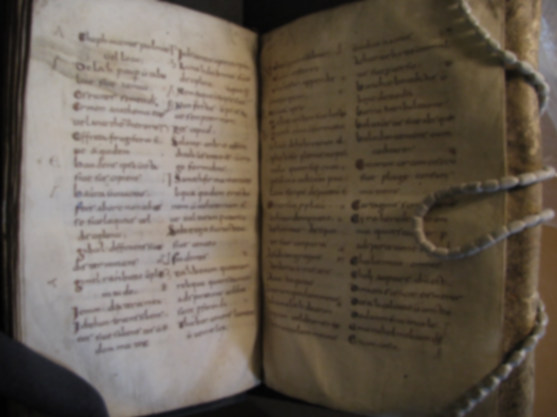
Professor Damian Fleming
Department of English
Medieval Studies
Purdue University Fort Wayne
What does a Medievalist do?

Slide 2
Medieval
Middle Ages

Slide 3
Dr. Damian Fleming
Teaching:
Medieval Literature
  Old English (Beowulf!)
  Middle English (Chaucer!)
History of the English Language (HEL)
Latin
Classical Mythology
Old Books / Manuscripts

Slide 4
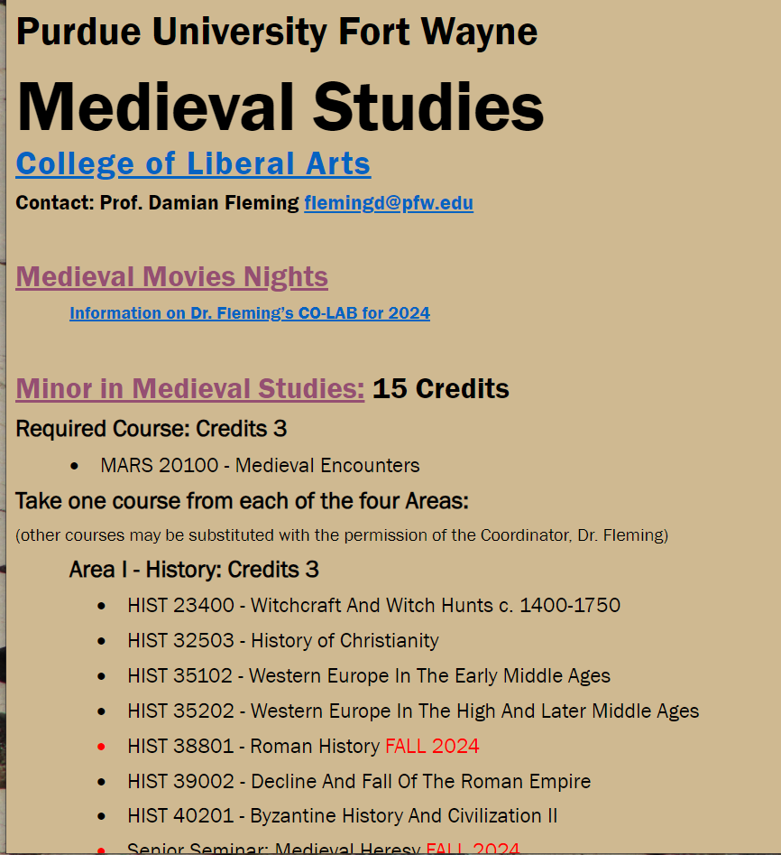
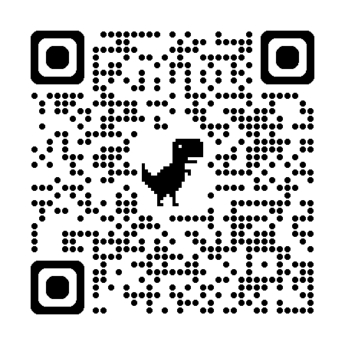

Slide 5
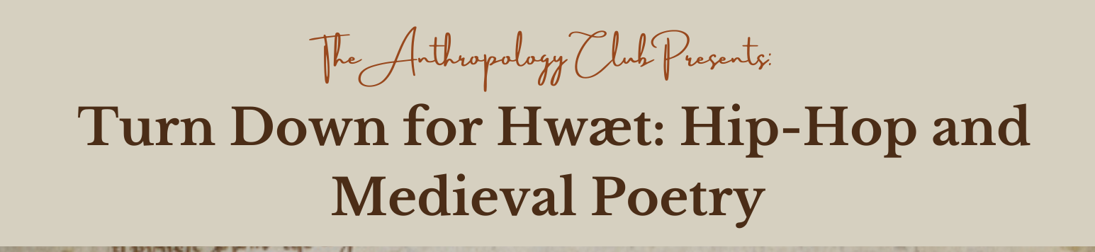
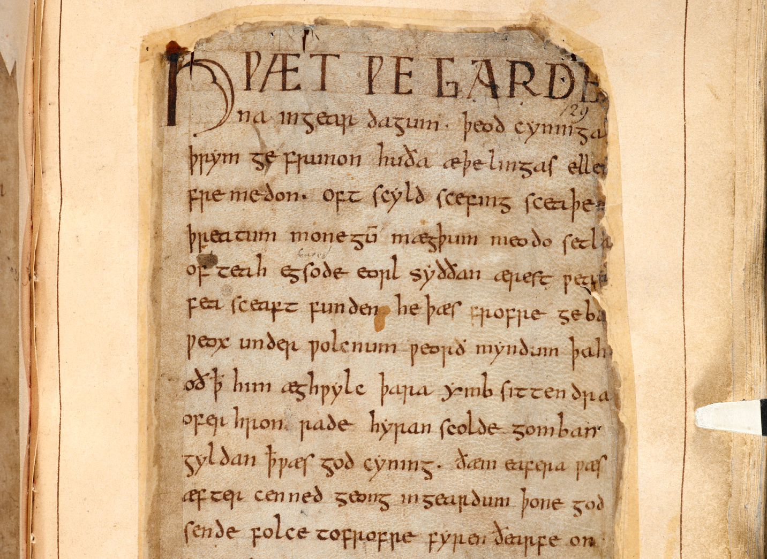
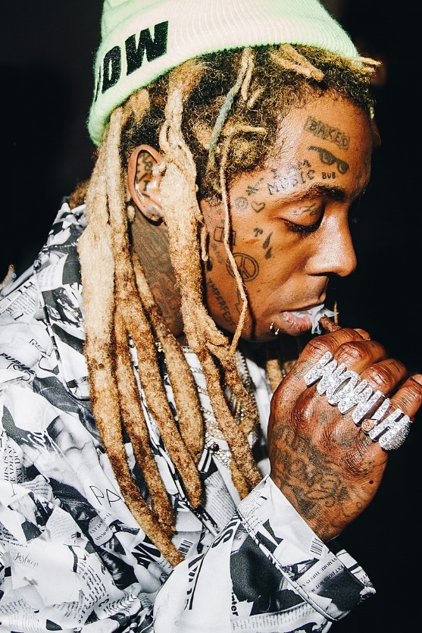
Beowulf

Slide 6
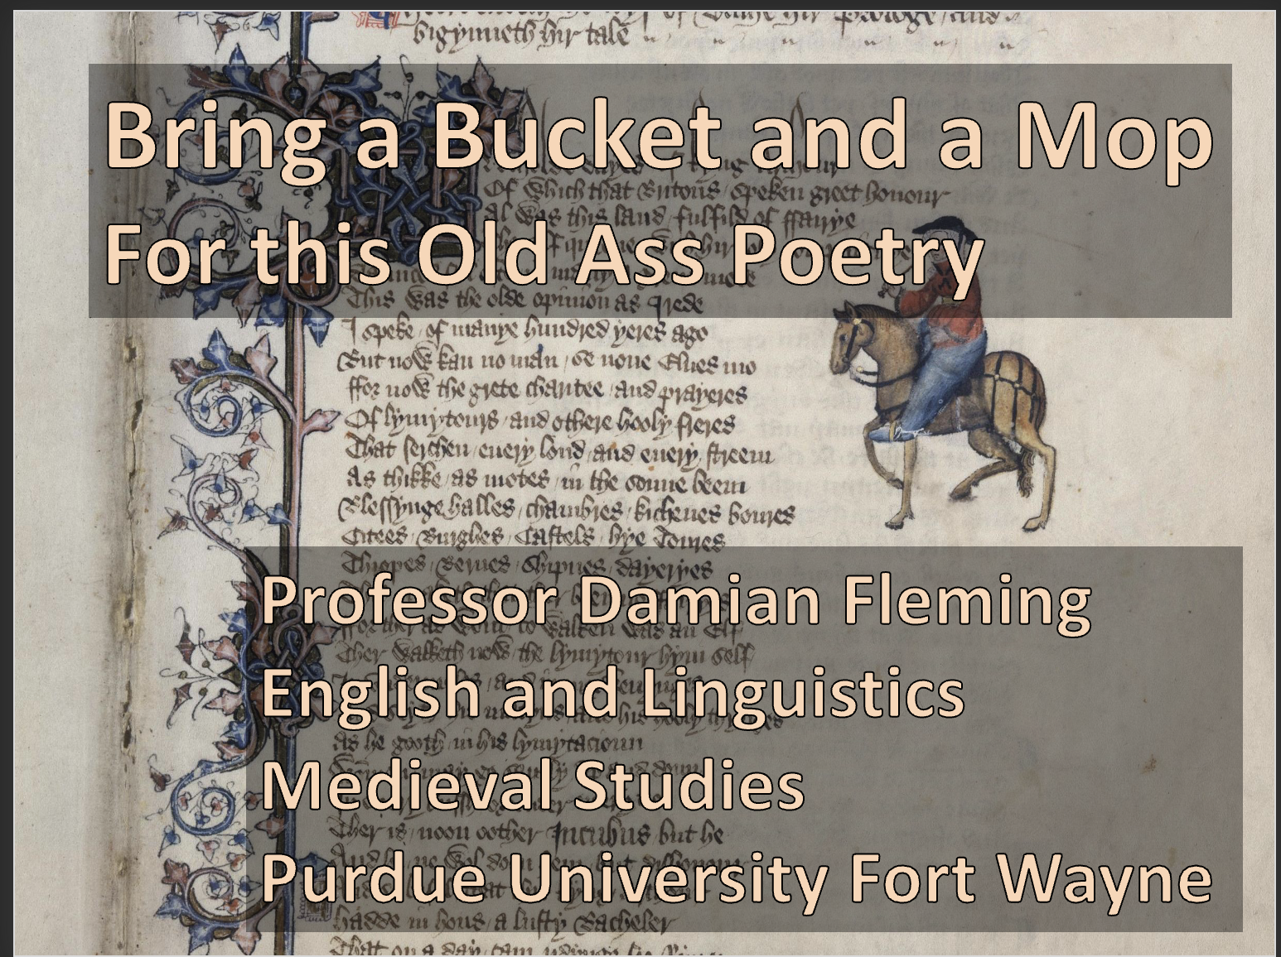

**

Slide 7
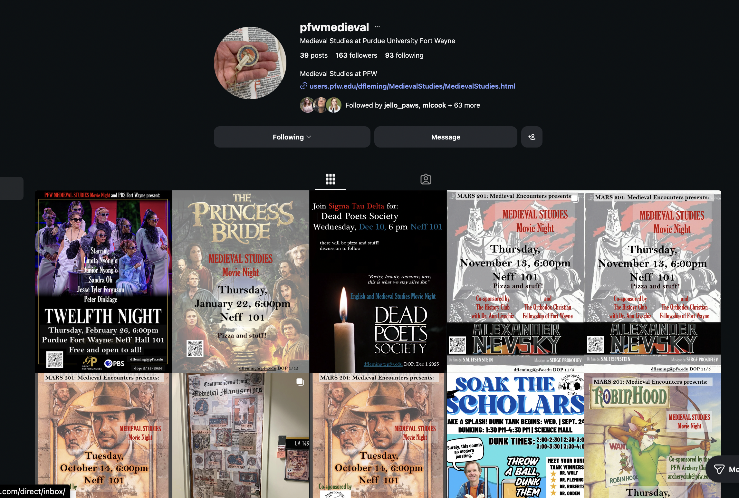

Slide 8
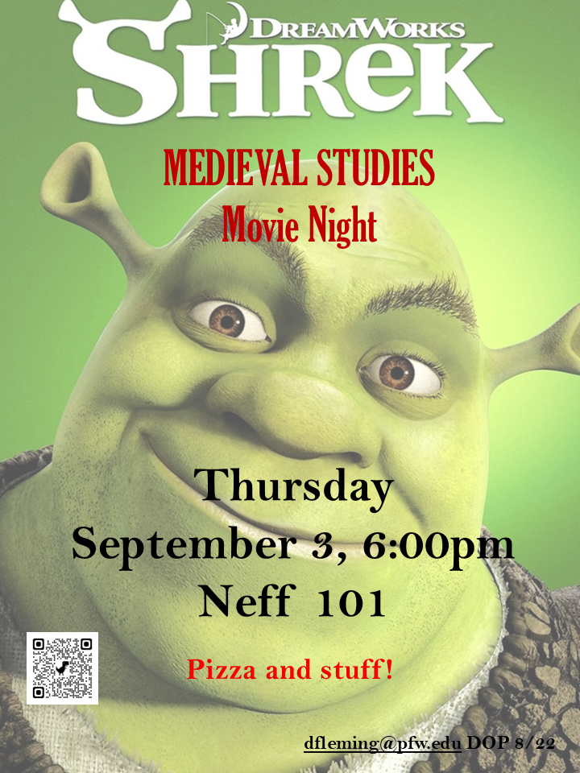

Slide 9
Old Stories
Old Languages
Old Books

Slide 10
Old English c. 1000
Fæder ure
þu þe eart on heofonum
si þin nama gehalgod
tobecume þin rice
gewurþe þin willa on eorðan
swa swa on heofonum
urne gedæghwamlican hlaf syle us to dæg
and forgyf us ure gyltas
swa swa we forgyfað urum gyltendum
and ne gelæd þu us on costnunge
ac alys us of yfele.

Slide 11
Beowulf

Slide 12
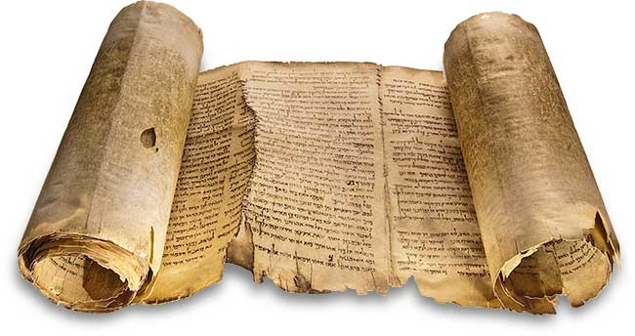
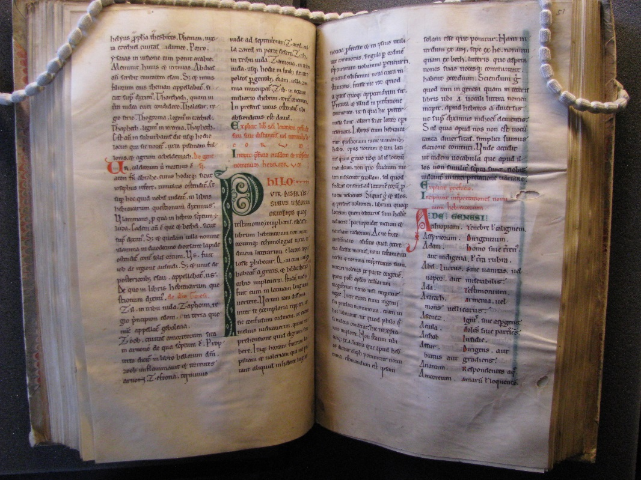
Scroll:
Papyrus (plant matter)
Fragile
Lacks random access
Written on one side
Manuscript/Book
(codex):
Parchment (animal skin)
Writing on two sides
Built-in protection
VERY durable
Random access

Slide 13
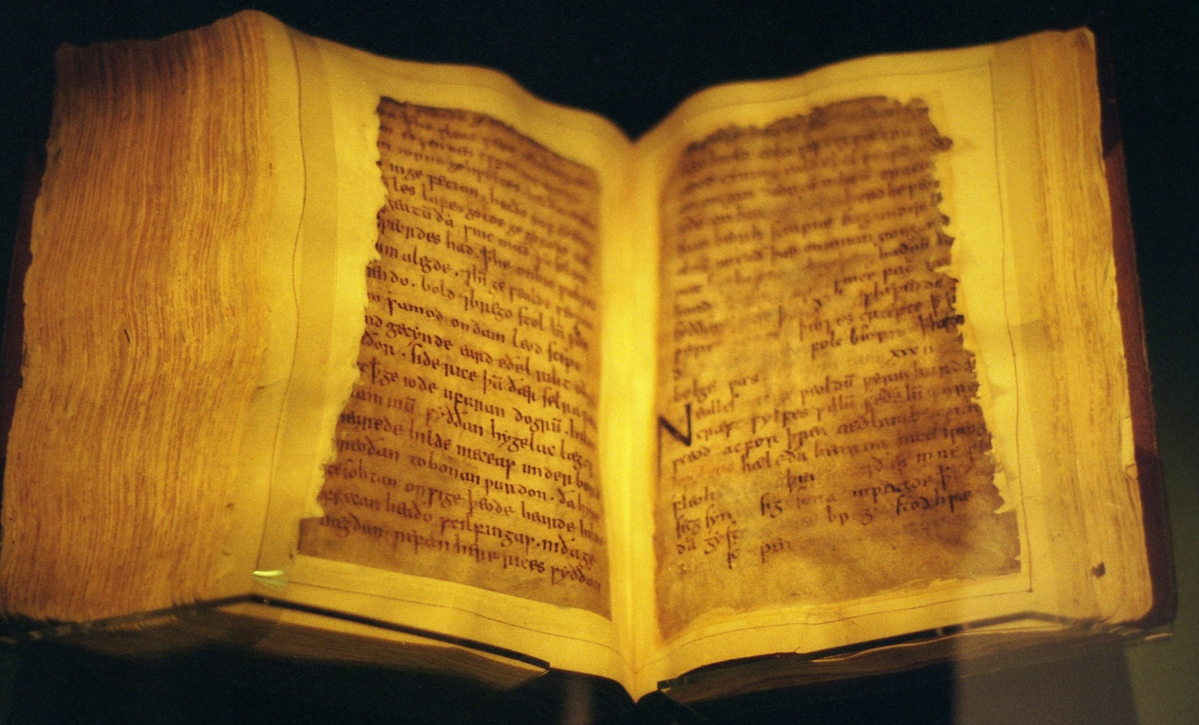
Other Texts in the Beowulf-Manuscript:
A Life of St. Christopher
The Wonders of the East
The Letter of Alexander to Aristotle
Beowulf
Judith

Slide 14
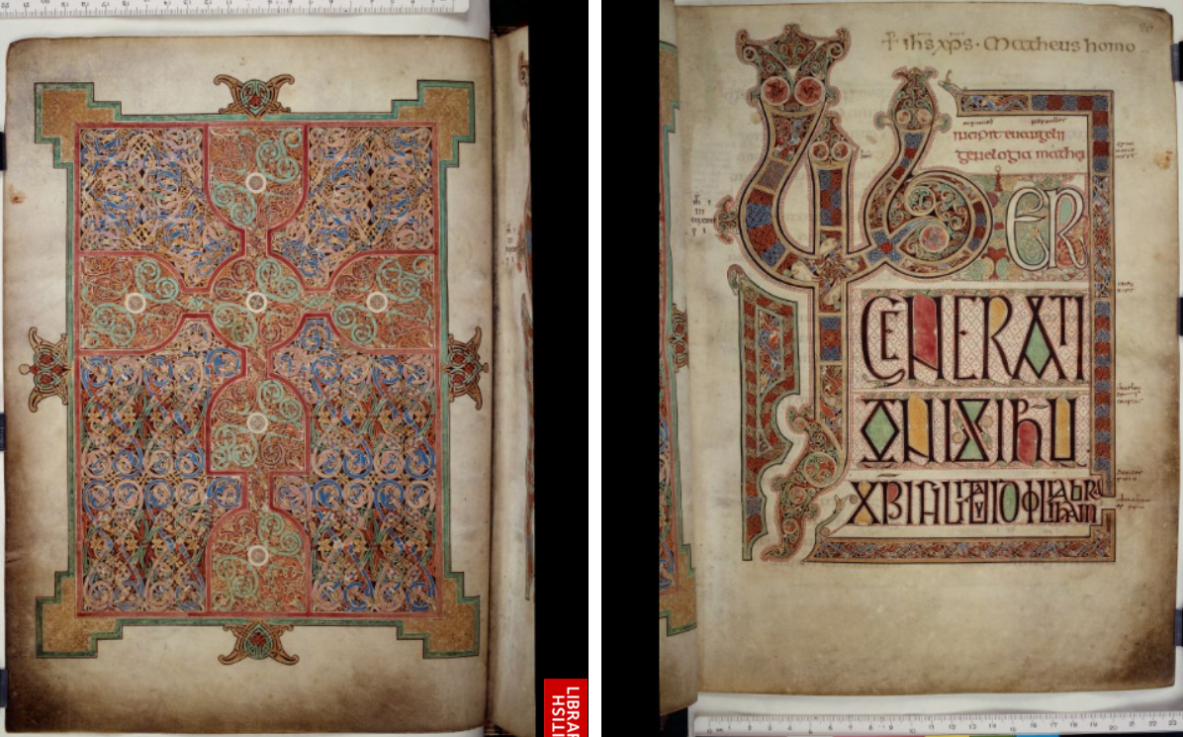
Lindisfarne Gospels (c. 700 AD)

Slide 15
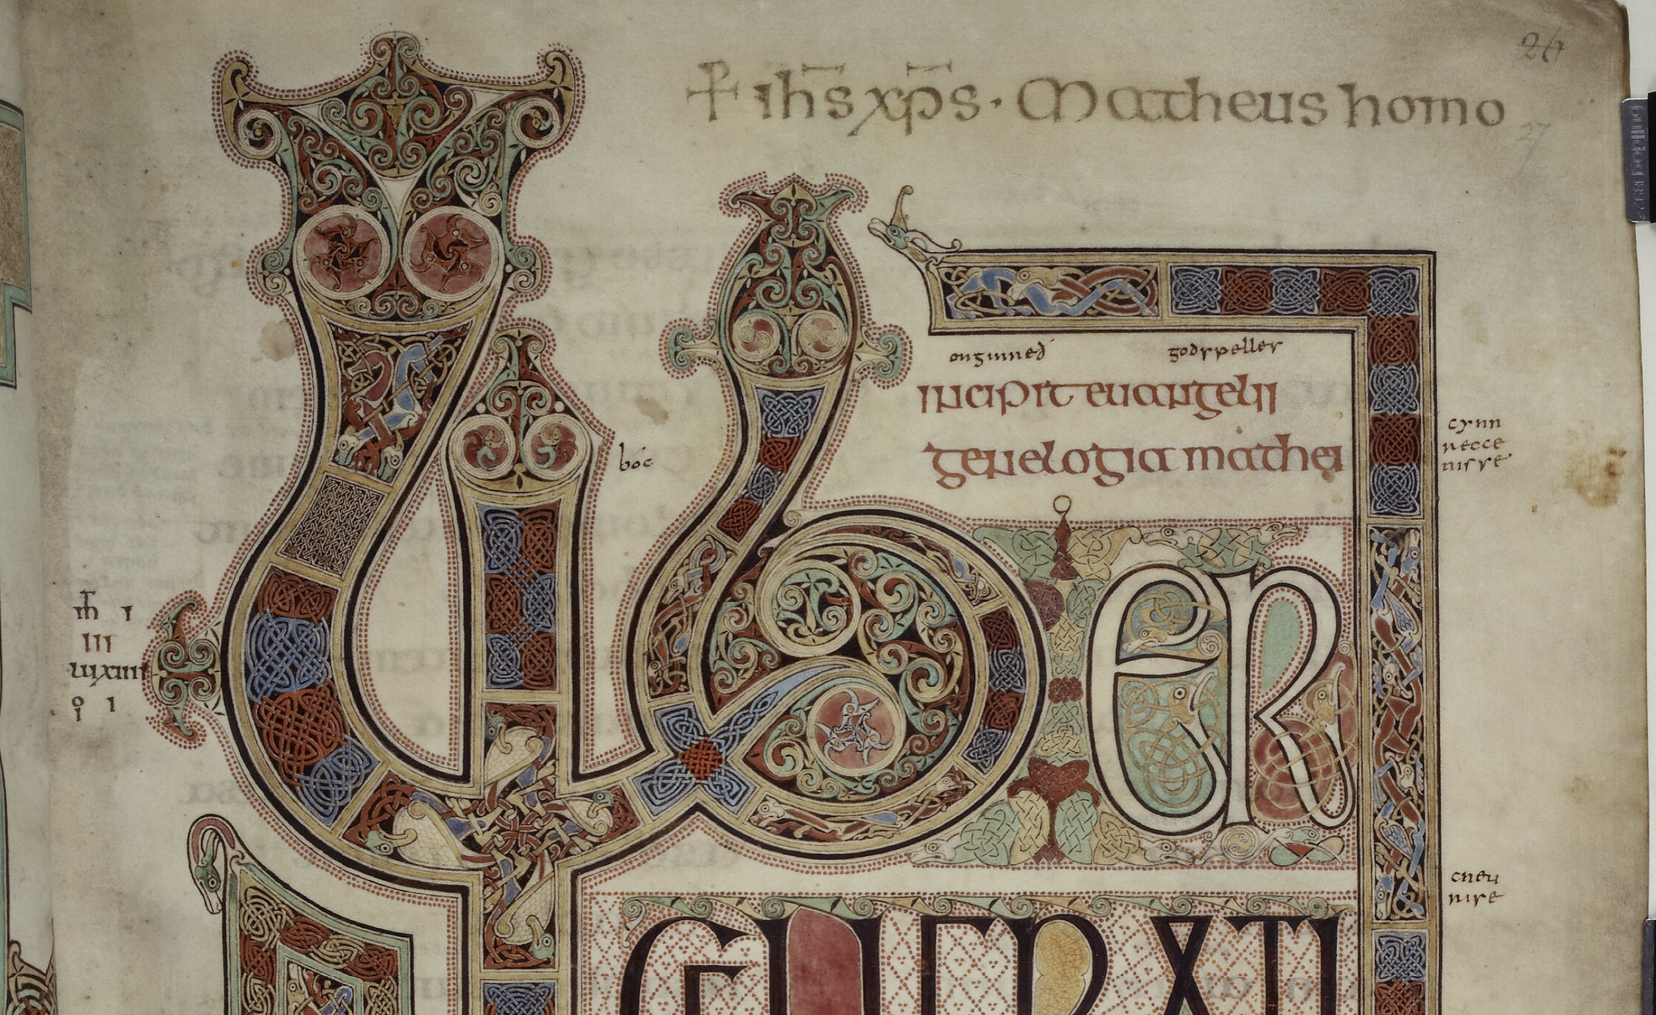
Lindisfarne Gospels (c. 700 AD)

Slide 16
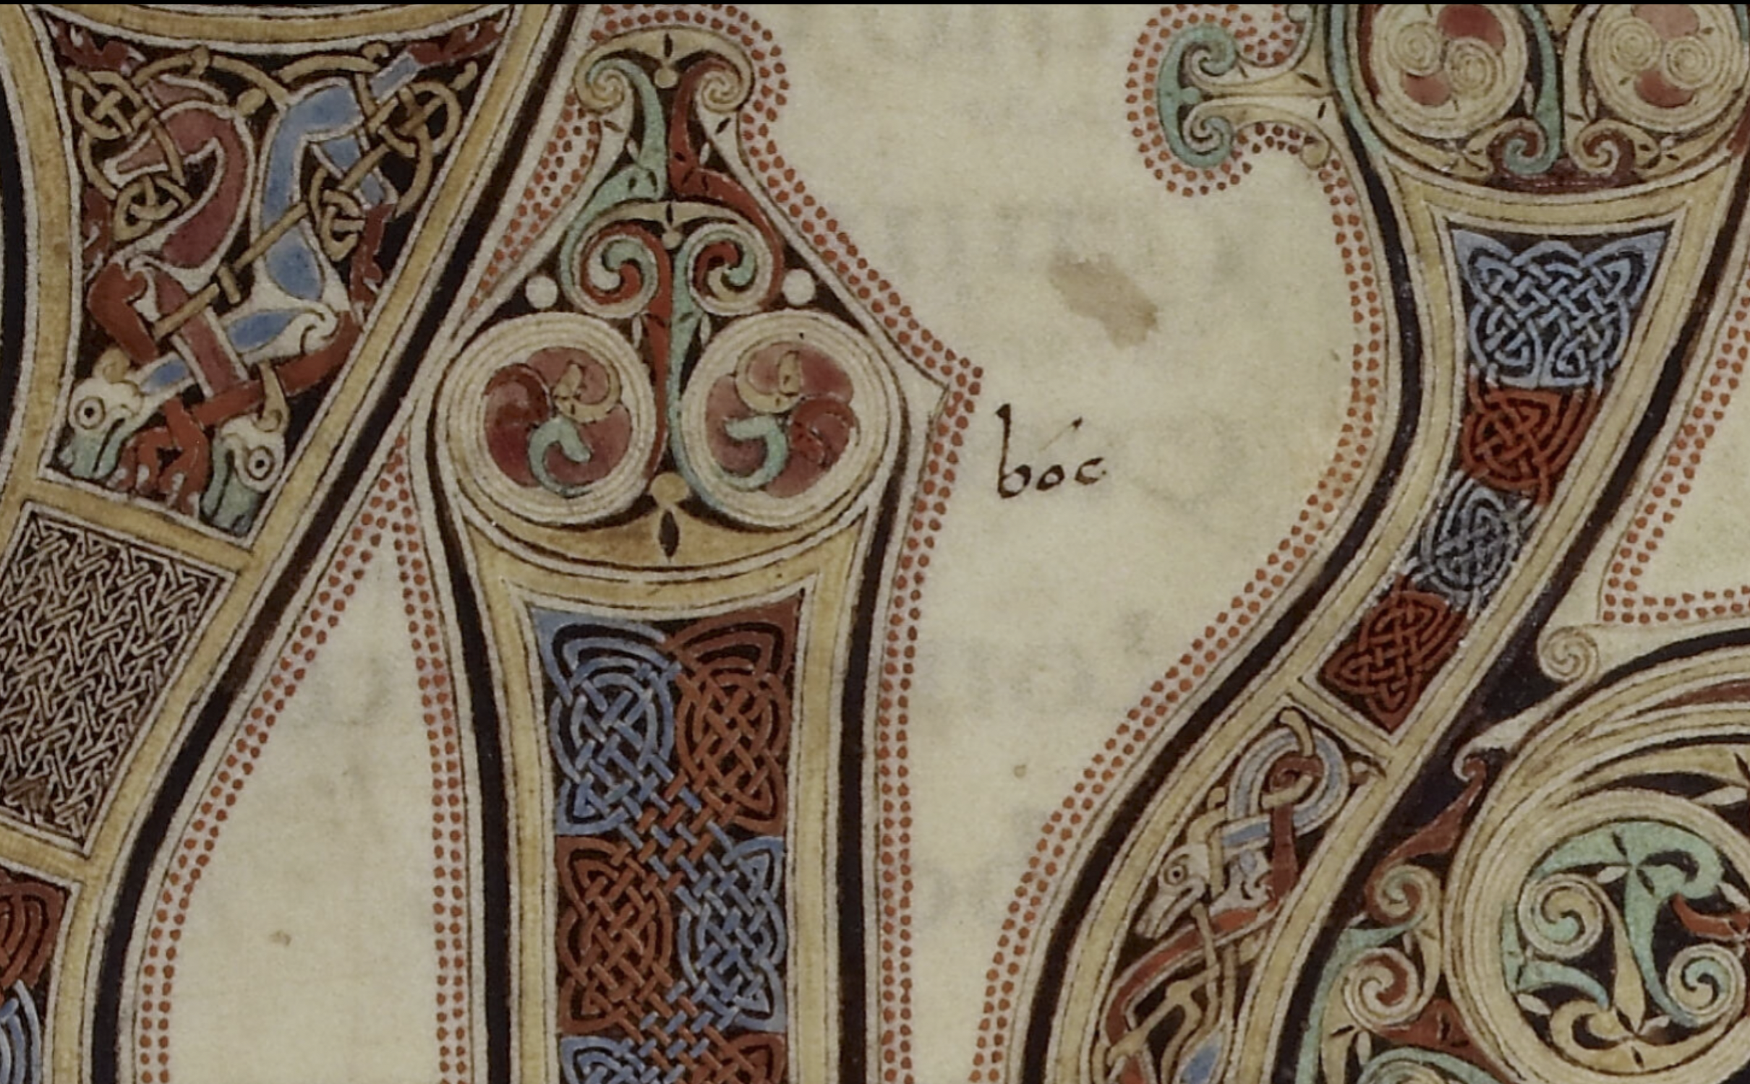

Slide 17
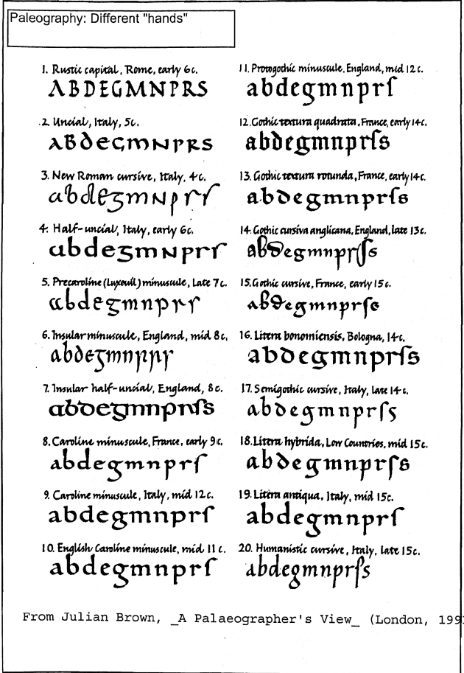
Paleography
old-writing

Slide 18
