Slide 1
Department of English
November 2024
Language & Literature Concentrations
Damian Fleming
Professor of English, Linguistics,
Medieval Studies, Latin

Slide 2
What can you do with an English degree?

Slide 3


Slide 4
end of slide show

Slide 8
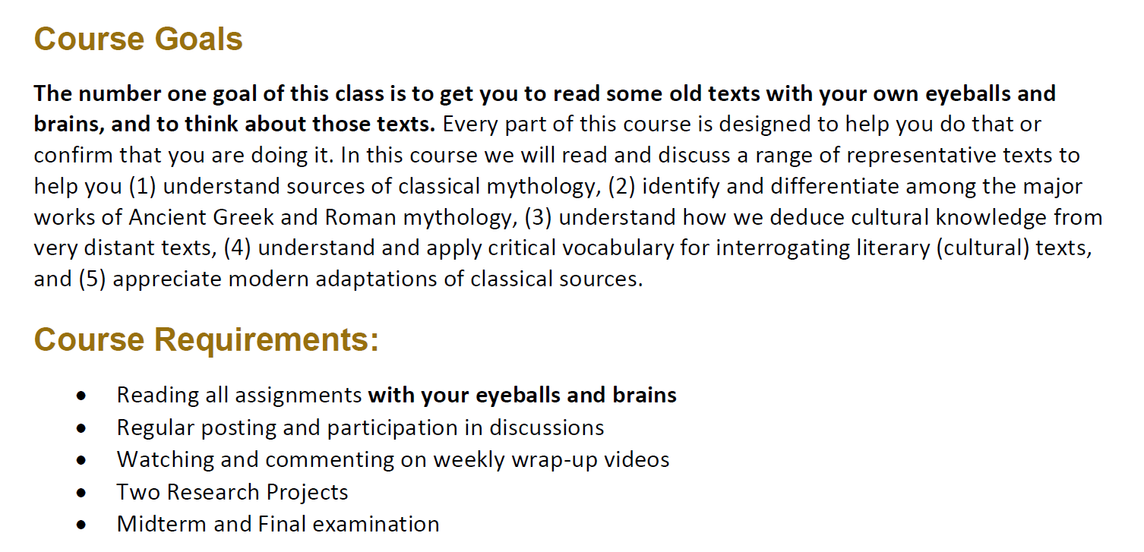

Slide 9

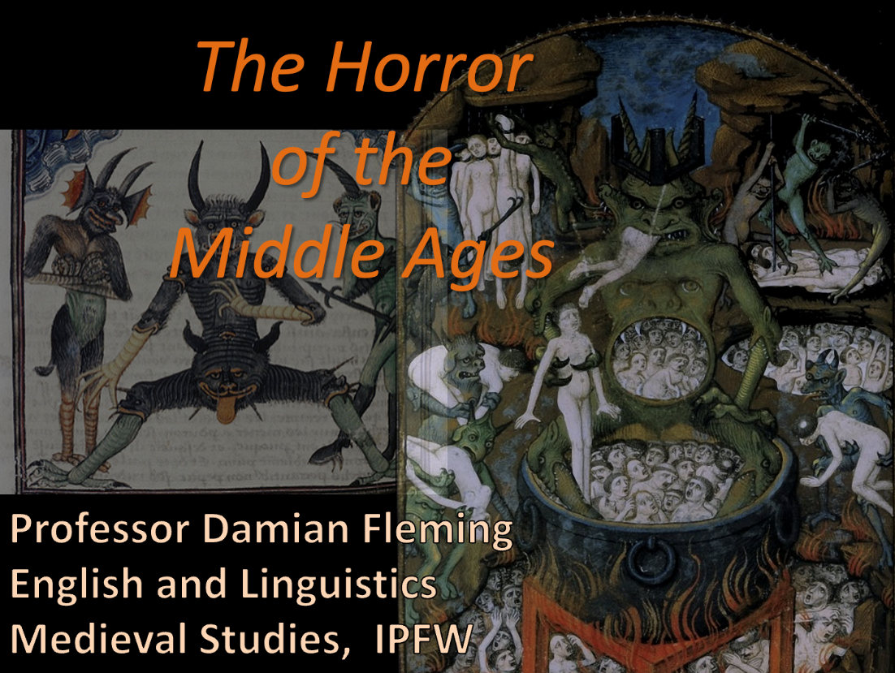

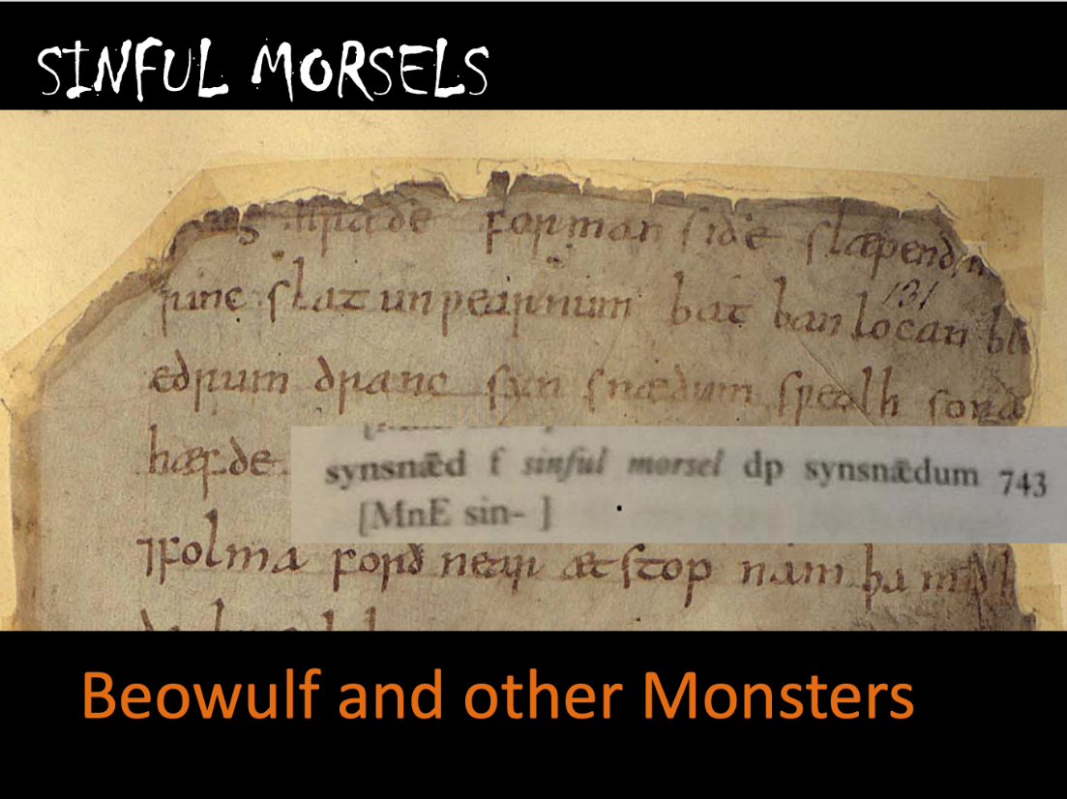

Slide 10
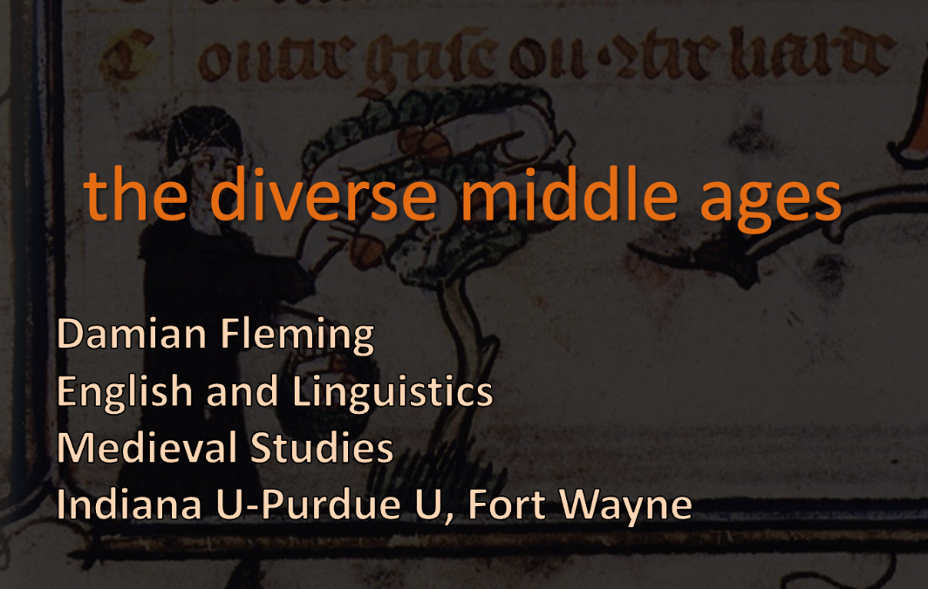
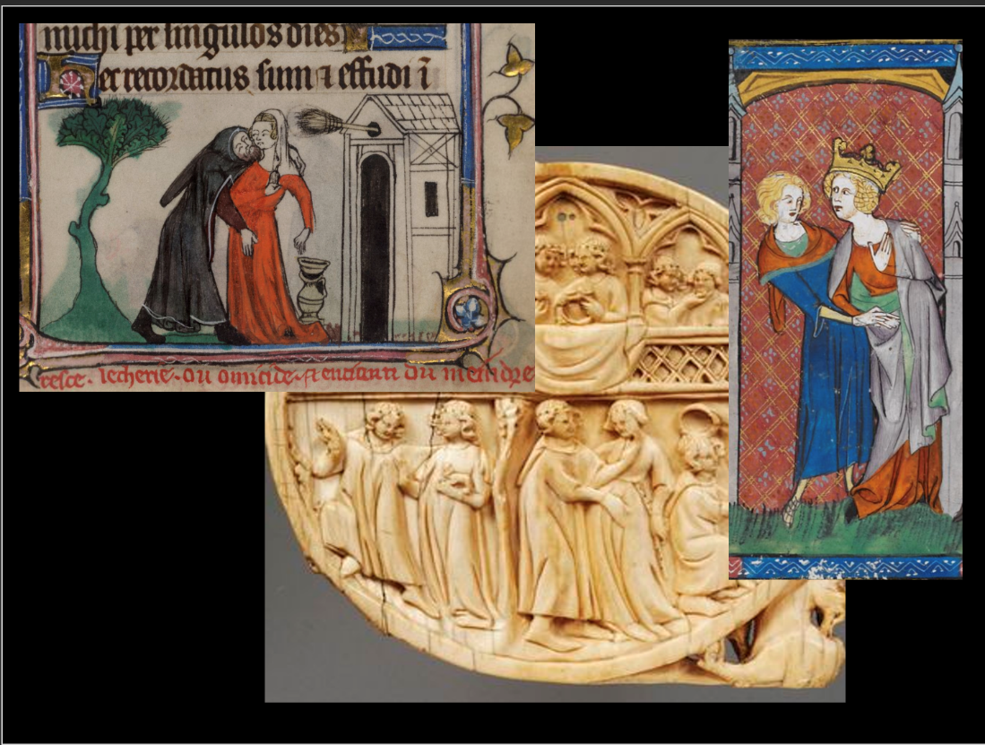

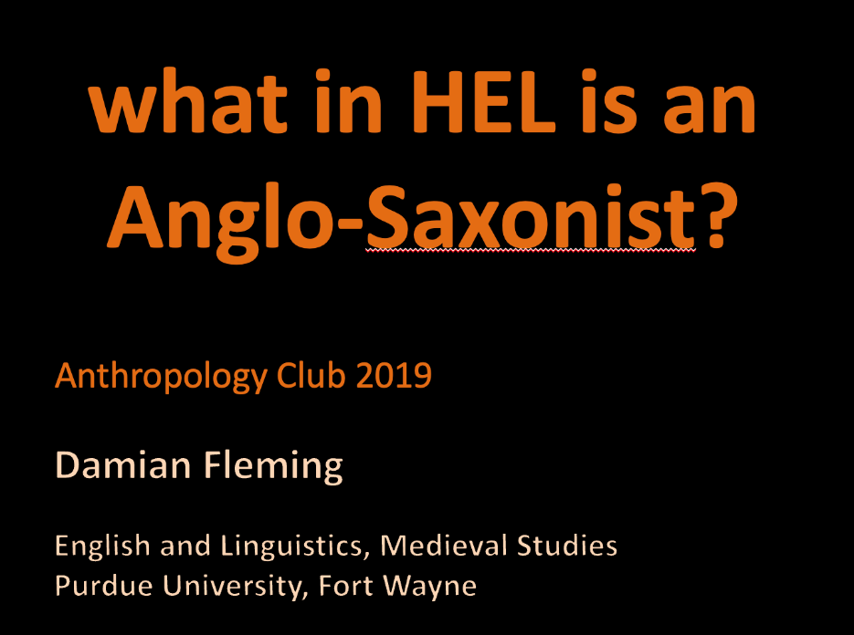
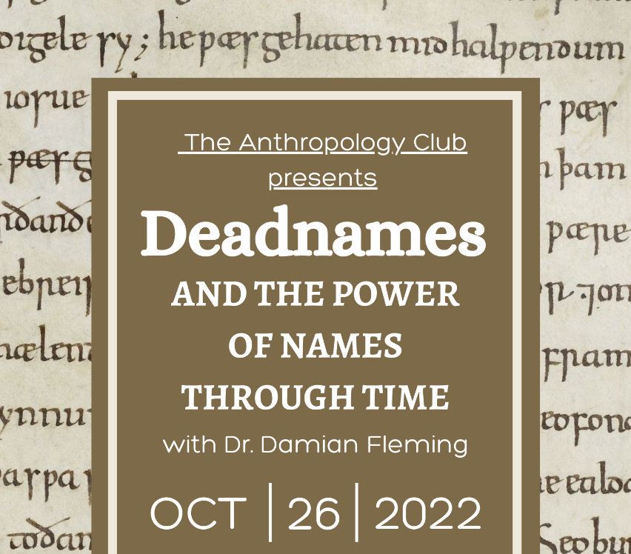

Slide 11
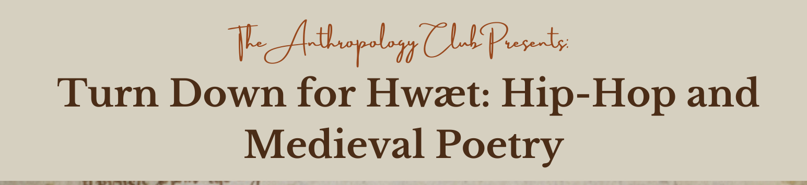
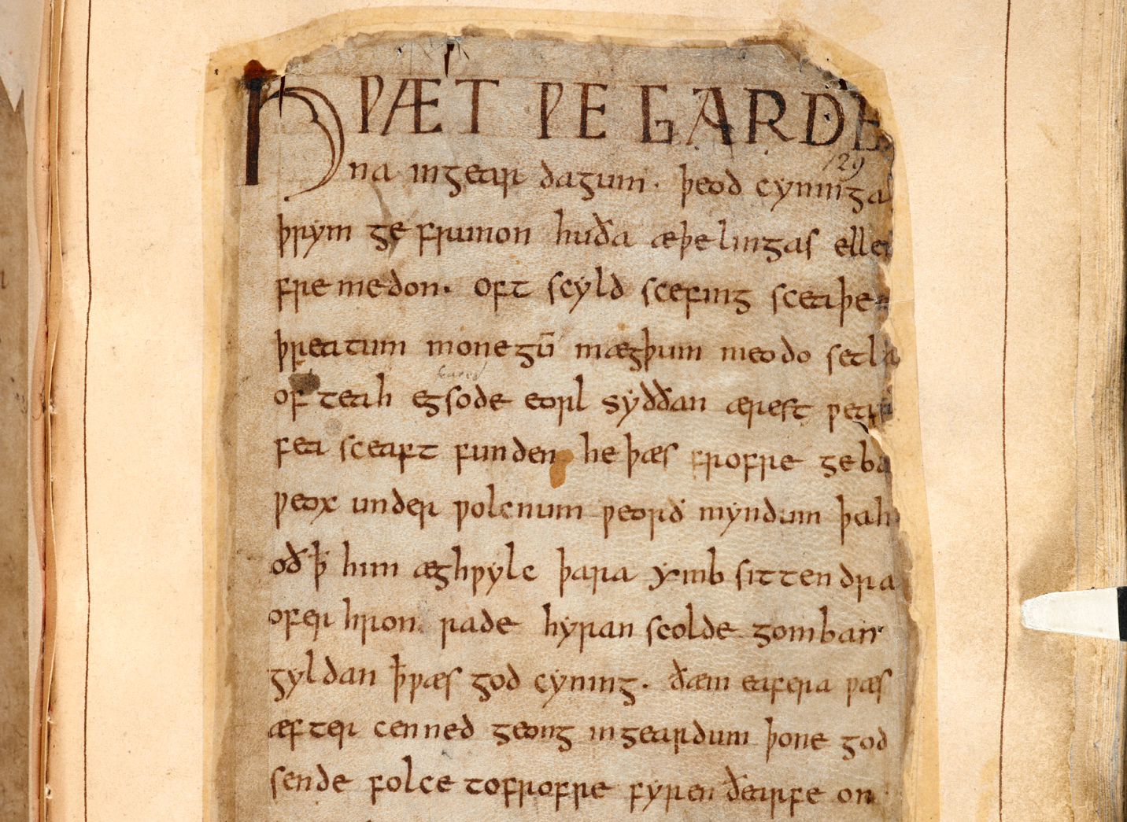
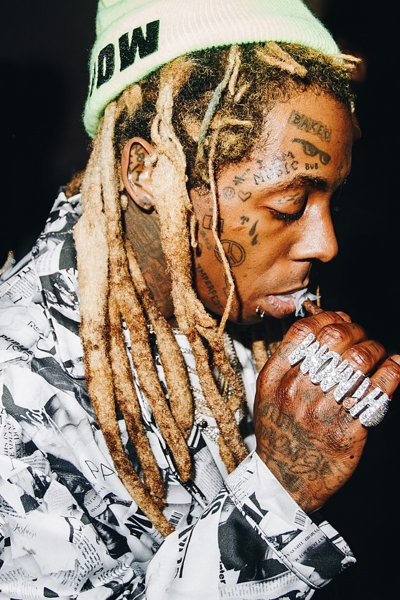
Beowulf

Slide 12
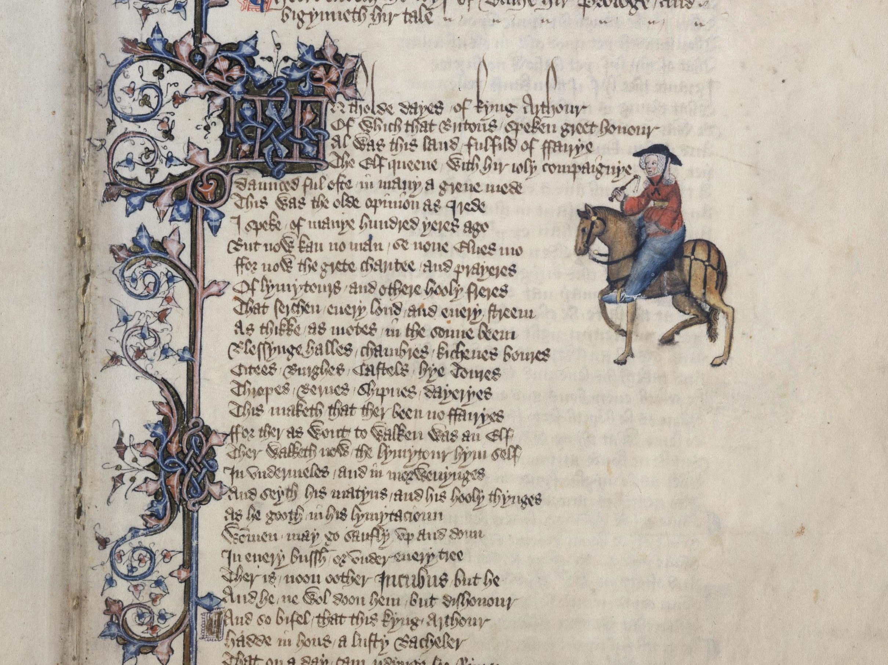
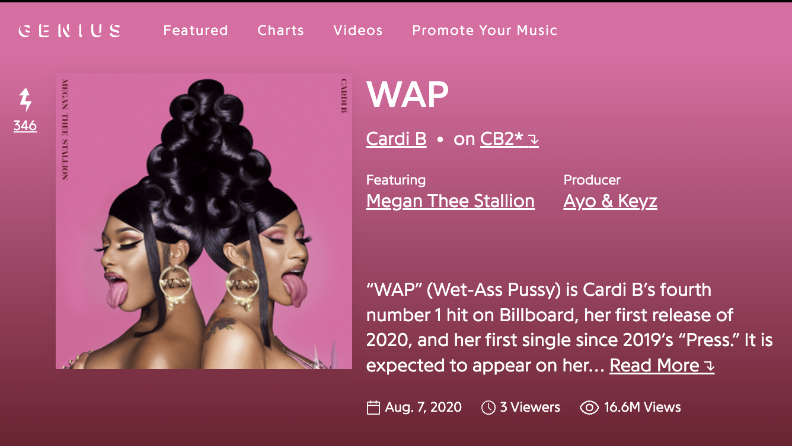
Bring a Bucket and a Mop
For this Old Ass Poetry
Professor Damian Fleming
English and Linguistics
Medieval Studies

