Slide 1
Welcome Biology Class of 2015
Elliott J Blumenthal- Biology Lead Advisor and Assistant Dean for Student Advising- COAS
Frank Paladino- Chair, Department of Biology

Slide 2
Things entering Freshmen should know:
1. Who your advisor is
Why is advising important?
Stay on right track for graduation
Learn what you can do with a degree in biology
Letters of recommendation
4 year plan of study
Resources on campus
Writing Center
CASA (Center for Academic Support and Advancement)
Tutoring
Counseling
2. What courses should you take
BINGO sheet
Unofficial Degree Evaluation under “MYIPFW” account
Placement Exams
Math and English placement
Foreign Language placement

Slide 3
3. Biology Clubs
Biology Club
Pre-Med Club
Pre-Dental Club
Big Heart Club
Become an Officer and help in the community
4. Research
Find a mentor to do research with on Biology Web Page
5. Scholarship Opportunities
Biology Web Page

Slide 4
Know your Biology Department
Faculty
Scholarships
Courses

Slide 8
Faculty Web Sites and Descriptions of Research

Slide 9
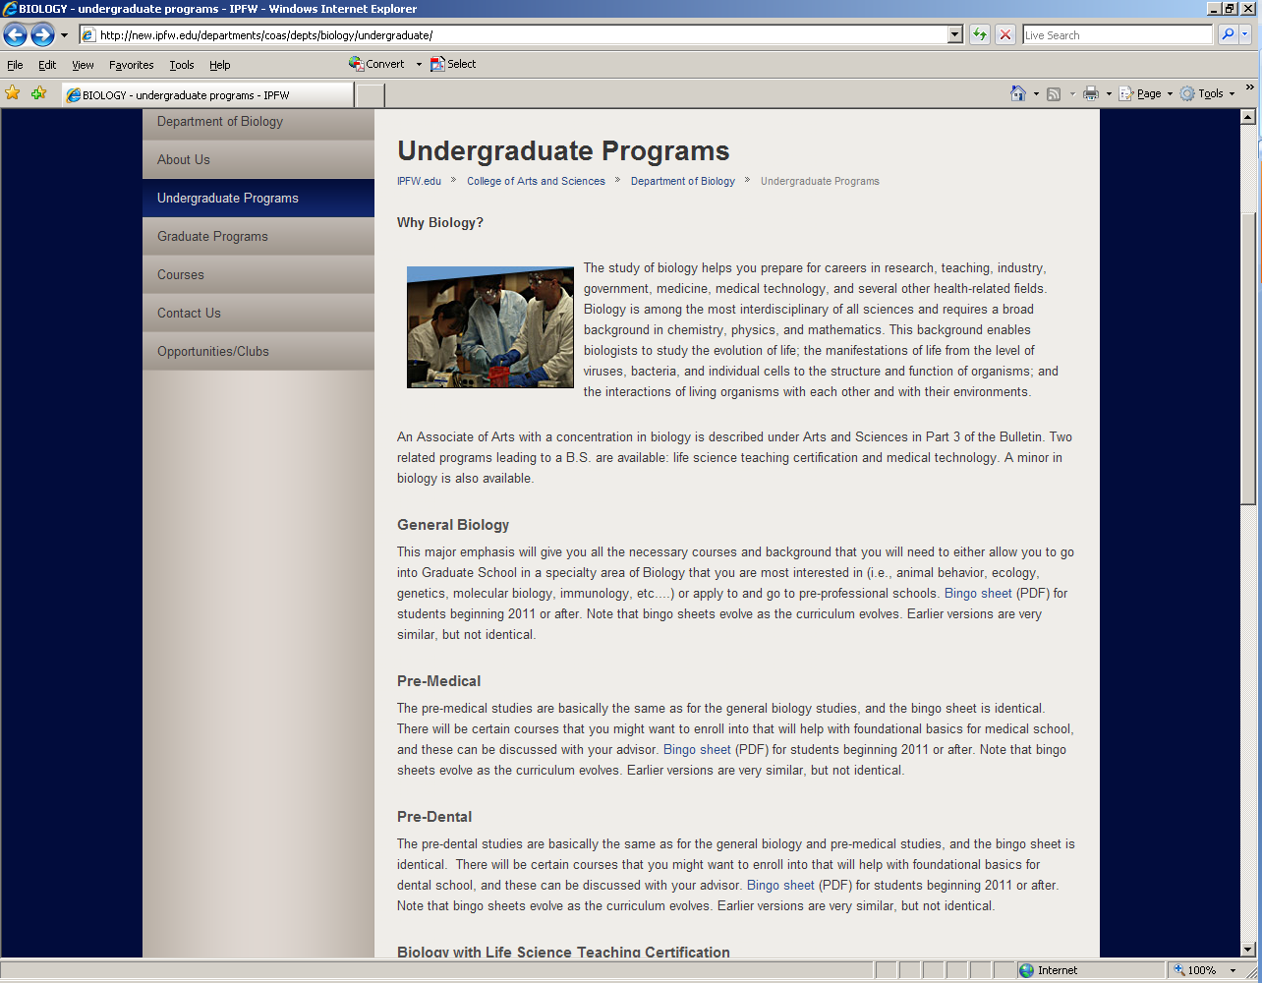

Slide 10
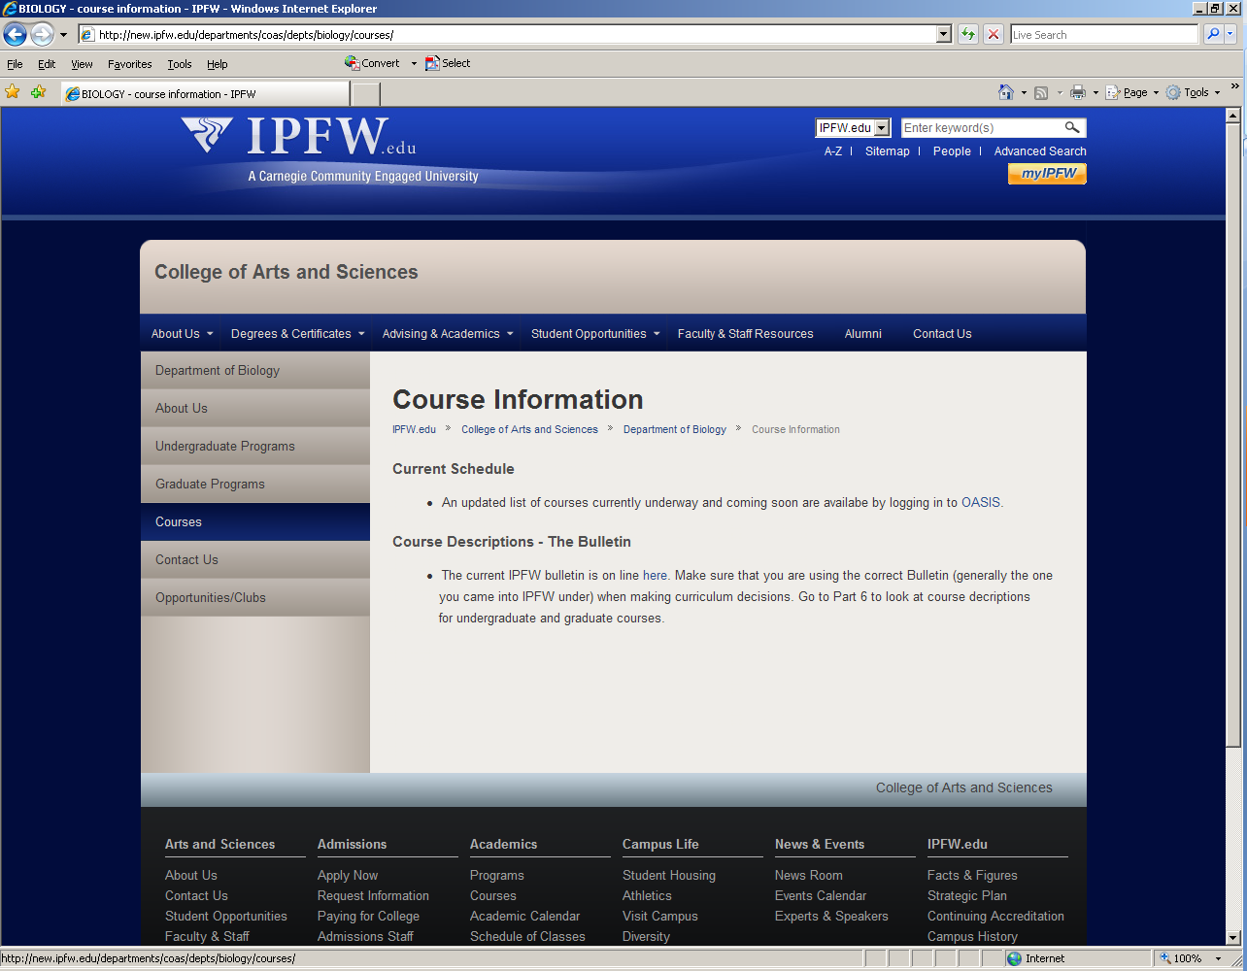

Slide 11
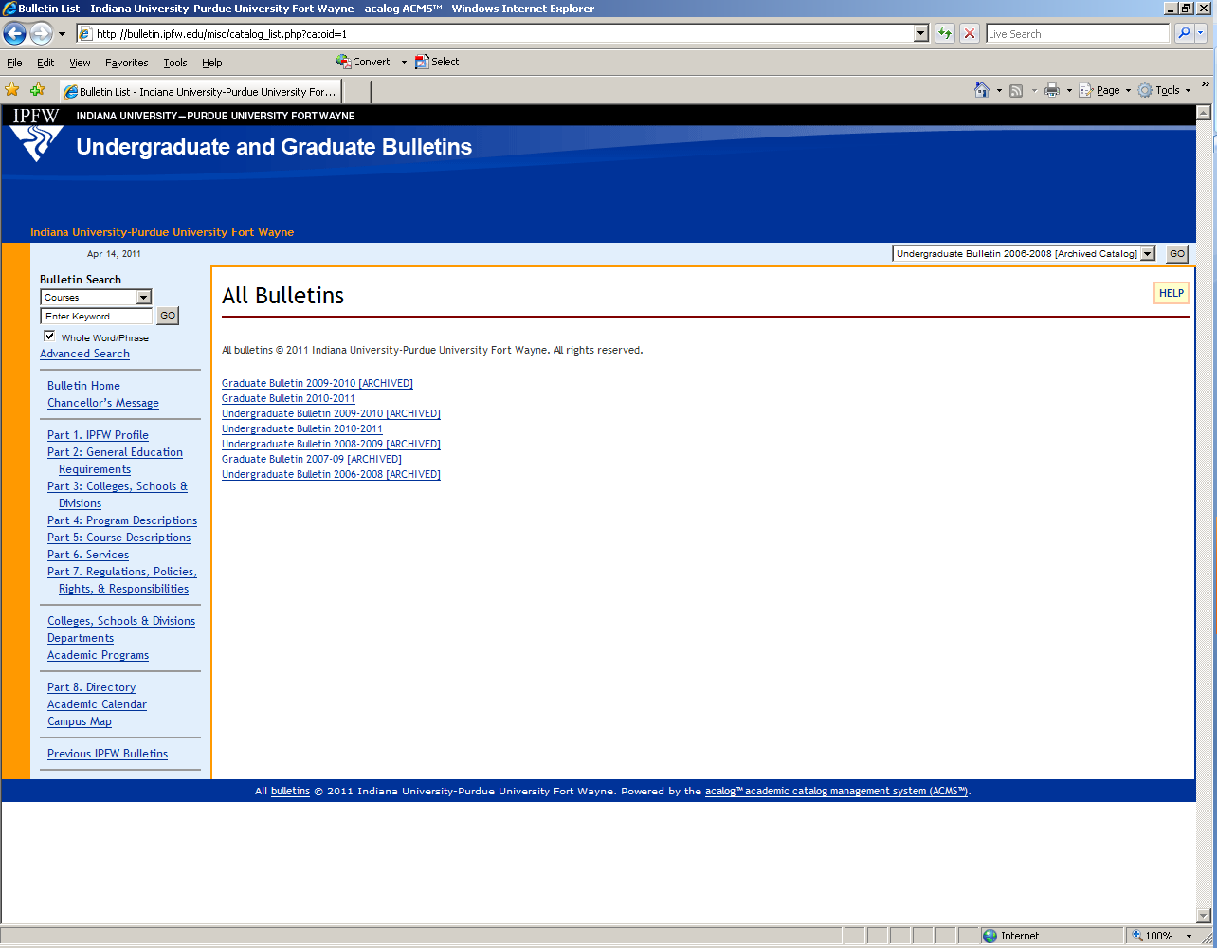

Slide 12
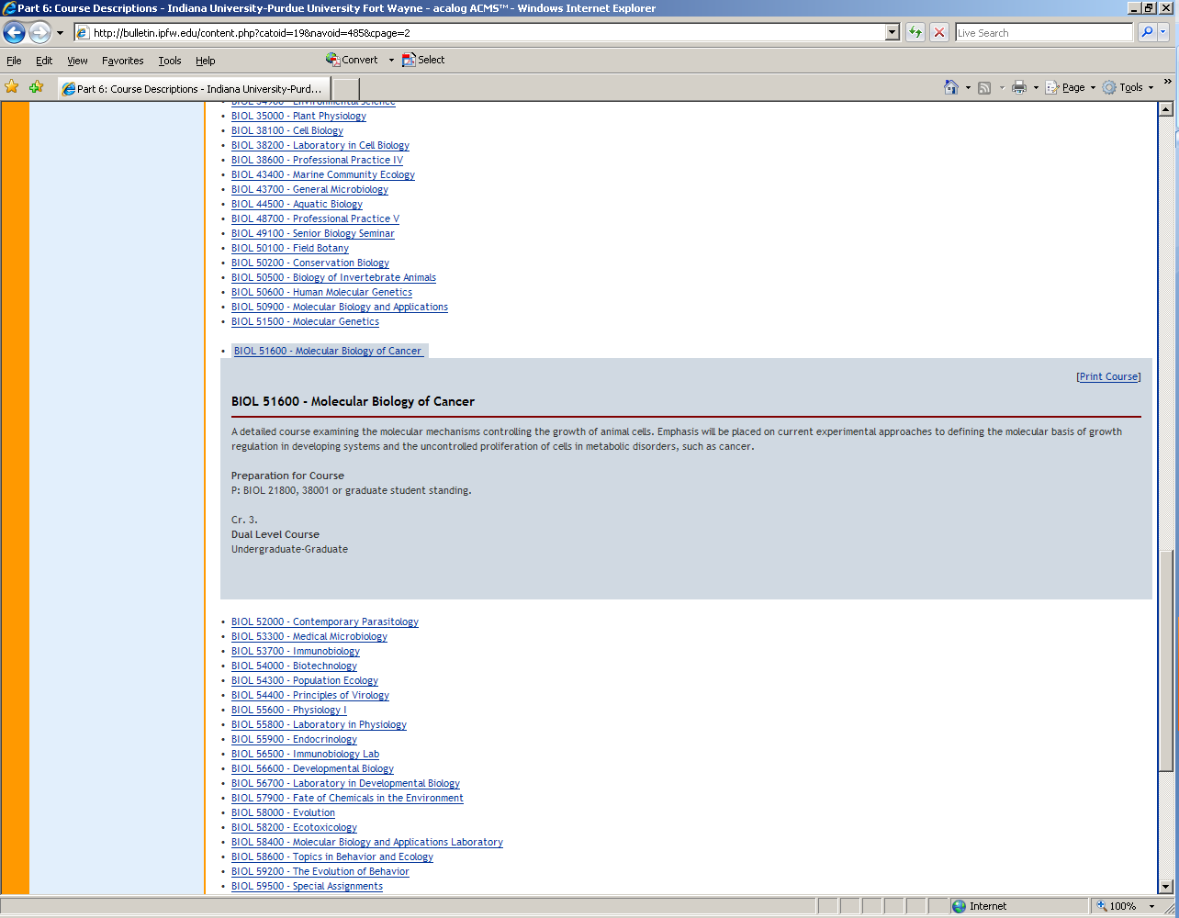

Slide 13
Careers in Biology

Slide 14
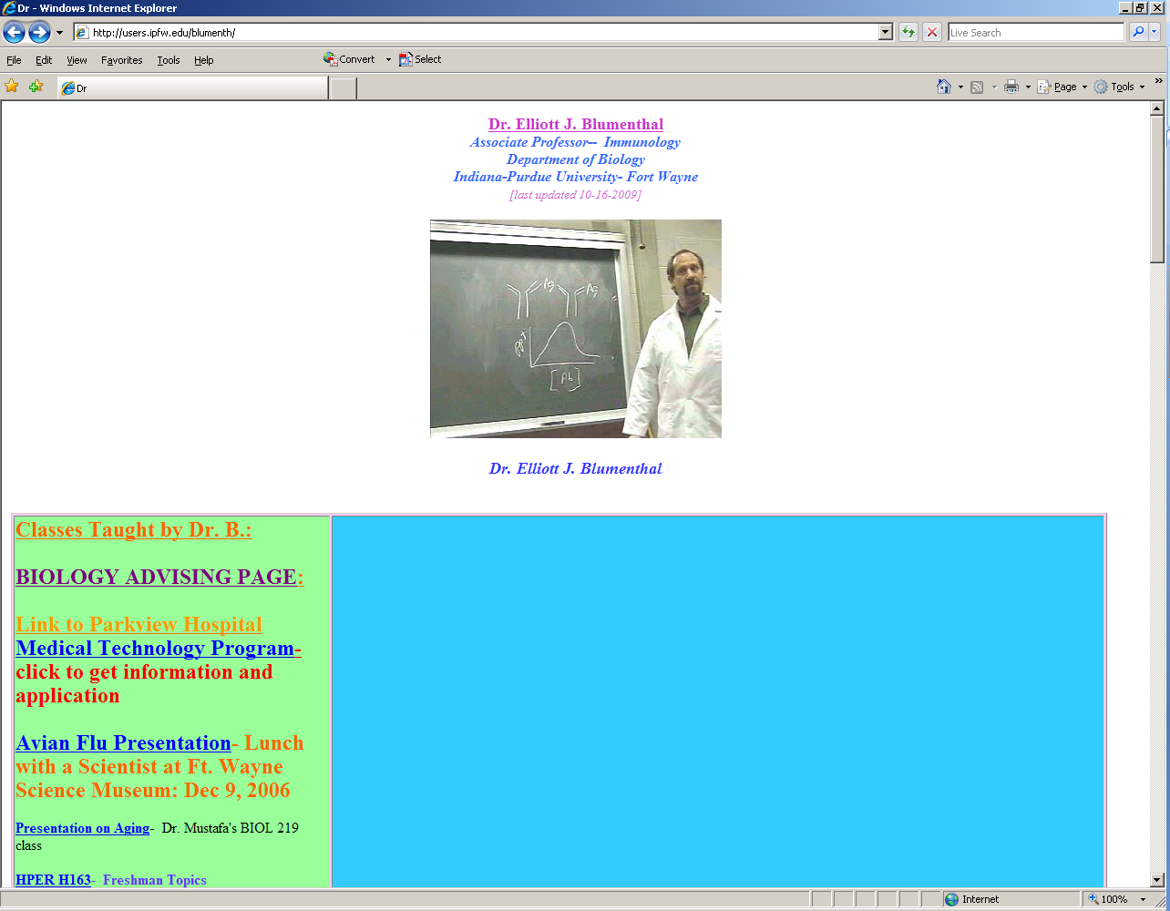

Slide 15
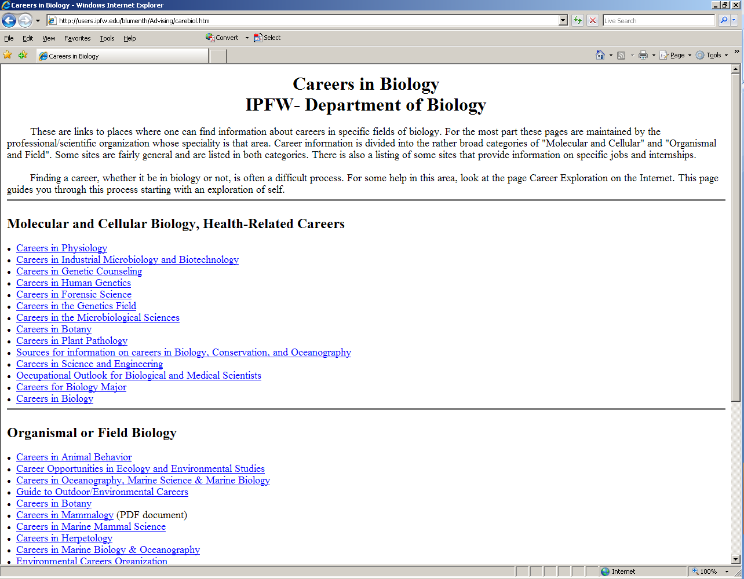

Slide 17
-Suggested Course Schedule for Biology Majors- With testing into MA 229
1st Semester Freshman 2nd Semester Freshman
BIOL 117and Lab (Must be at MA 153) BIOL 119 and Lab
CHM 115 and Lab (must be at MA 229) CHM 116 and Lab (completed MA 229 level)
ENG W131 ENG W233
MA 229 STAT 240 (Spring only)
COM 114 Foreign Language (112 or 113 level or higher)
1st Semester Sophomore 2nd Semester Sophomore
BIOL 219 and Lab BIOL 218 and Lab
CHM 255/254 (lecture and lab) CHM 256/258 (lecture and lab)
Gen Ed Area Classes (III, IV, V) Gen Ed Area Classes (III, IV, V)
Gen Ed Area Classes (III, IV, V) Gen Ed Area Classes (III, IV, V)
STAT 340 (only in Fall)
ETCS 106 ****
1st Semester Junior 2nd Semester Junior
BIOL 217 CHM 224 and Lab (Spring only) ****
BIOL A/B Electives (215,381) PHYS 221
Gen Ed Area Classes (III, IV, V) Gen Ed Area Classes (III, IV, V)
BIOL A/B Electives BIOL A/B Electives
PHYS 220
1st Semester Senior 2nd Semester Senior
BIOL 491 or in Spring BIOL A/B Electives
BIOL A/B Electives BIOL A/B Electives
BIOL A/B Electives BIOL 491 or in Fall
Suggested A/B Electives:
A Electives– BIOL 345, 434, 445, 502, 505, 579, 580
B Electives– BIOL 215, 381, 437, 506, 509, 516, 533, 537/565, 544
**** (not req with 2010-11 Bulletin)

Slide 18
-Suggested Course Schedule for Biology Majors- With testing into MA 153
1st Semester Freshman 2nd Semester Freshman
BIOL 117and Lab (Must be at MA 153) BIOL 119 and Lab
PHYS 220 PHYS 221
ENG W131 ENG W233
MA 153 MA 229
COM 114
1st Semester Sophomore 2nd Semester Sophomore
BIOL 219 and Lab BIOL 218 and Lab
Gen Ed Area Classes (III, IV, V) STAT 240 (only in Spring)
CHM 115 and Lab (must be at MA 229) CHM 116 and Lab (completed MA 229 level)
Gen Ed Area Classes (III, IV, V) Gen Ed Area Classes (III, IV, V)
ETCS 106 ****
Foreign Language (112 or 113 level or higher) Continuation of Foreign Language
1st Semester Junior 2nd Semester Junior
BIOL 217 CHM 224 and Lab (Spring only) ****
BIOL A/B Electives (215,381) Gen Ed Area Classes (III, IV, V)
Gen Ed Area Classes (III, IV, V) BIOL A/B Electives
STAT 340 (only in Fall) Gen Ed Area Classes (III, IV, V)
CHM 255/254 (lecture and lab) CHM 256/258 (lecture and lab)
1st Semester Senior 2nd Semester Senior
BIOL 491 or in Spring BIOL 491 or in Fall
BIOL A/B Electives BIOL A/B Electives
BIOL A/B Electives BIOL A/B Electives
Gen Ed Area Classes (III, IV, V) Gen Ed Area Classes (III, IV, V)
Suggested A/B Electives:
A Electives– BIOL 345, 434, 445, 502, 505, 579, 580
B Electives– BIOL 215, 381, 437, 506, 509, 516, 533, 537/565, 544
**** (not required if you entered with 2010-11 Bulletin)

Slide 19
Register for SOAR

Slide 21
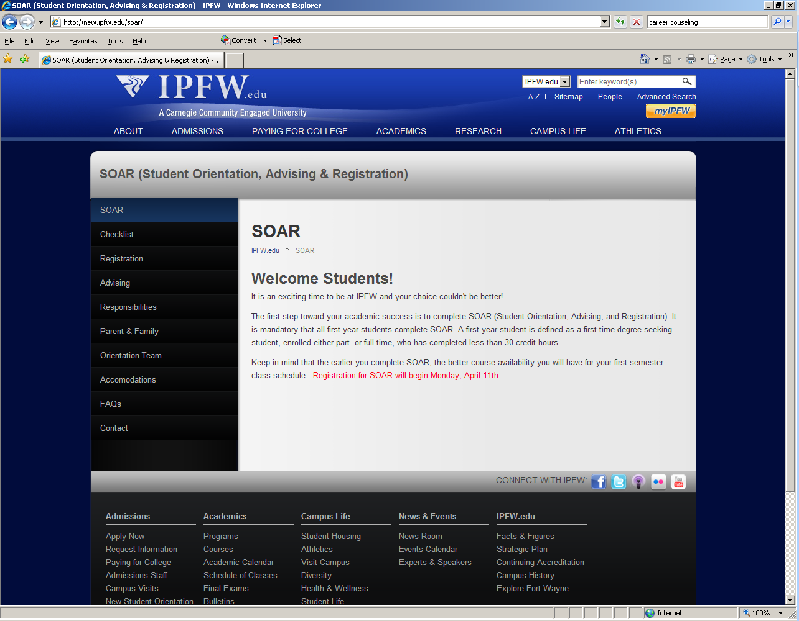

Slide 22
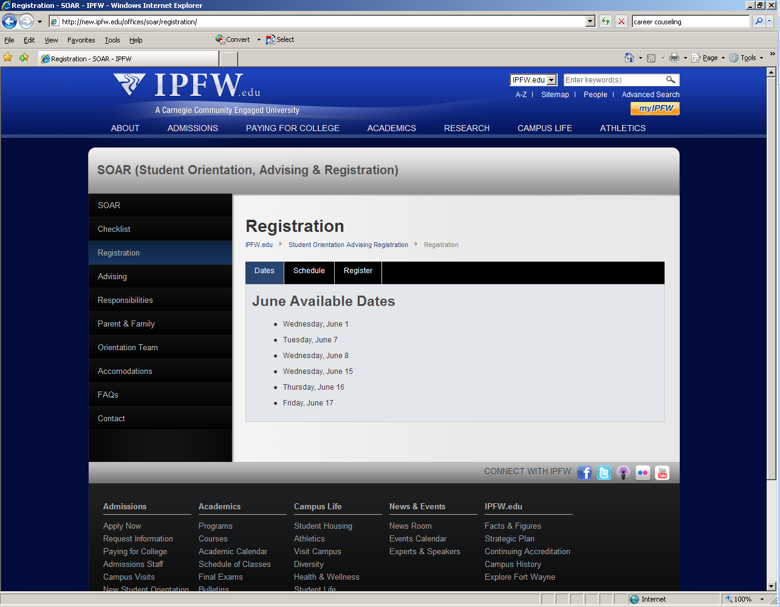

Slide 23
Know your “MYIPFW” account

Slide 24
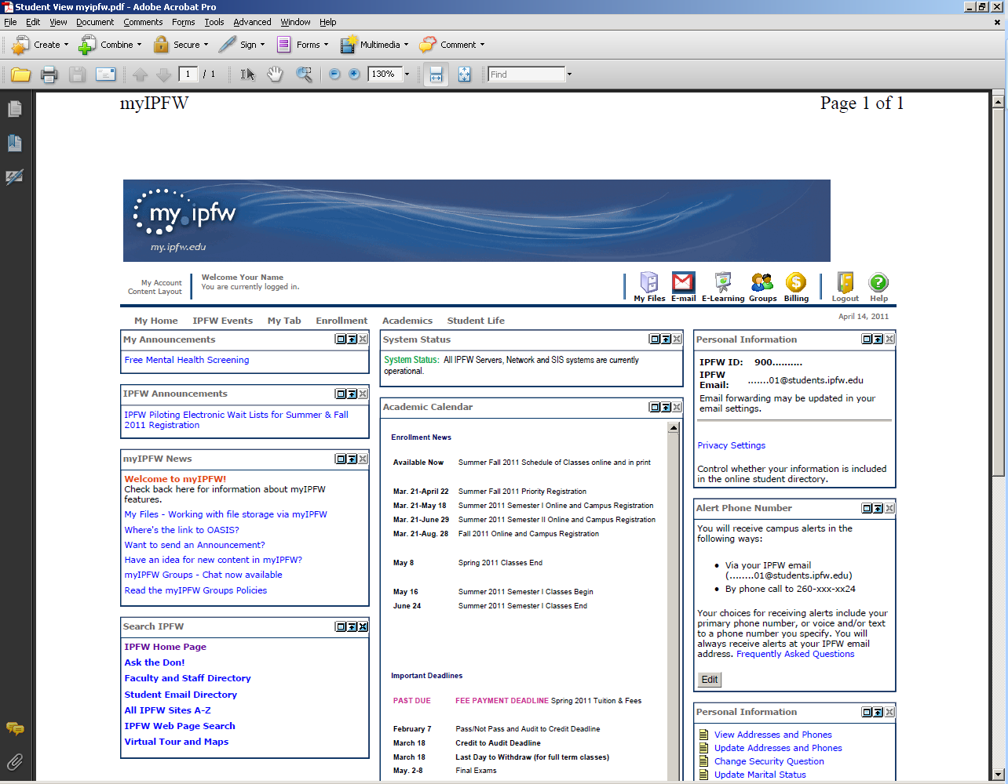

Slide 25
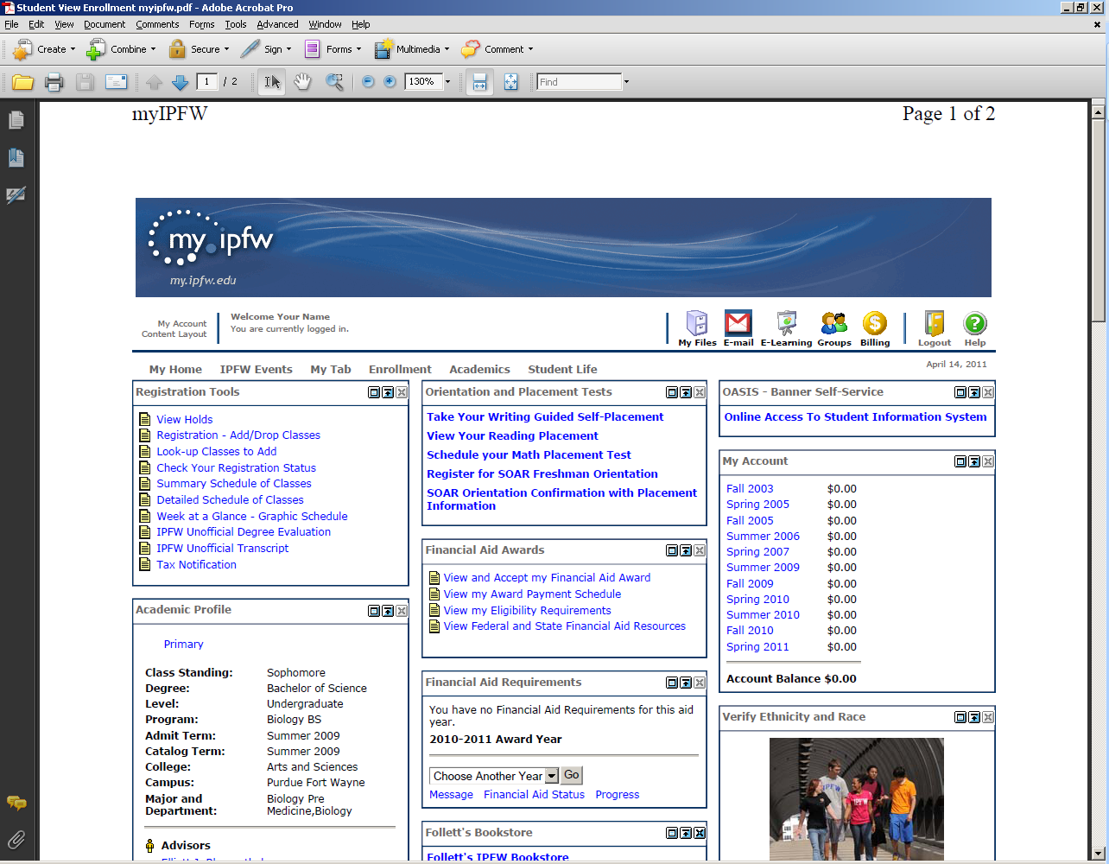

Slide 26
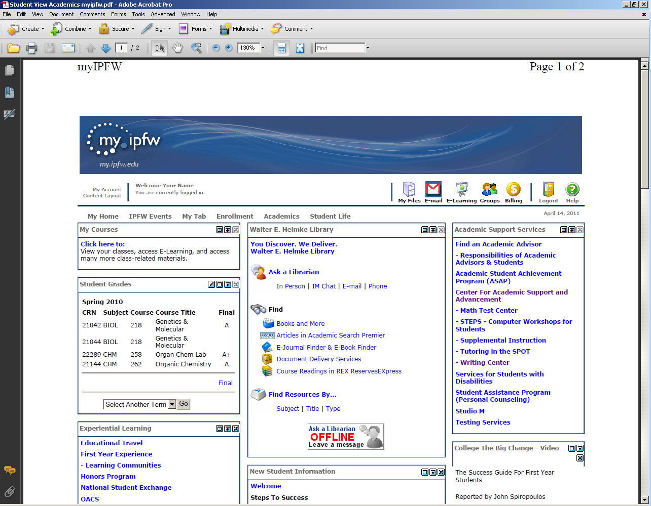

Slide 27
Know your Campus Resources

Slide 29
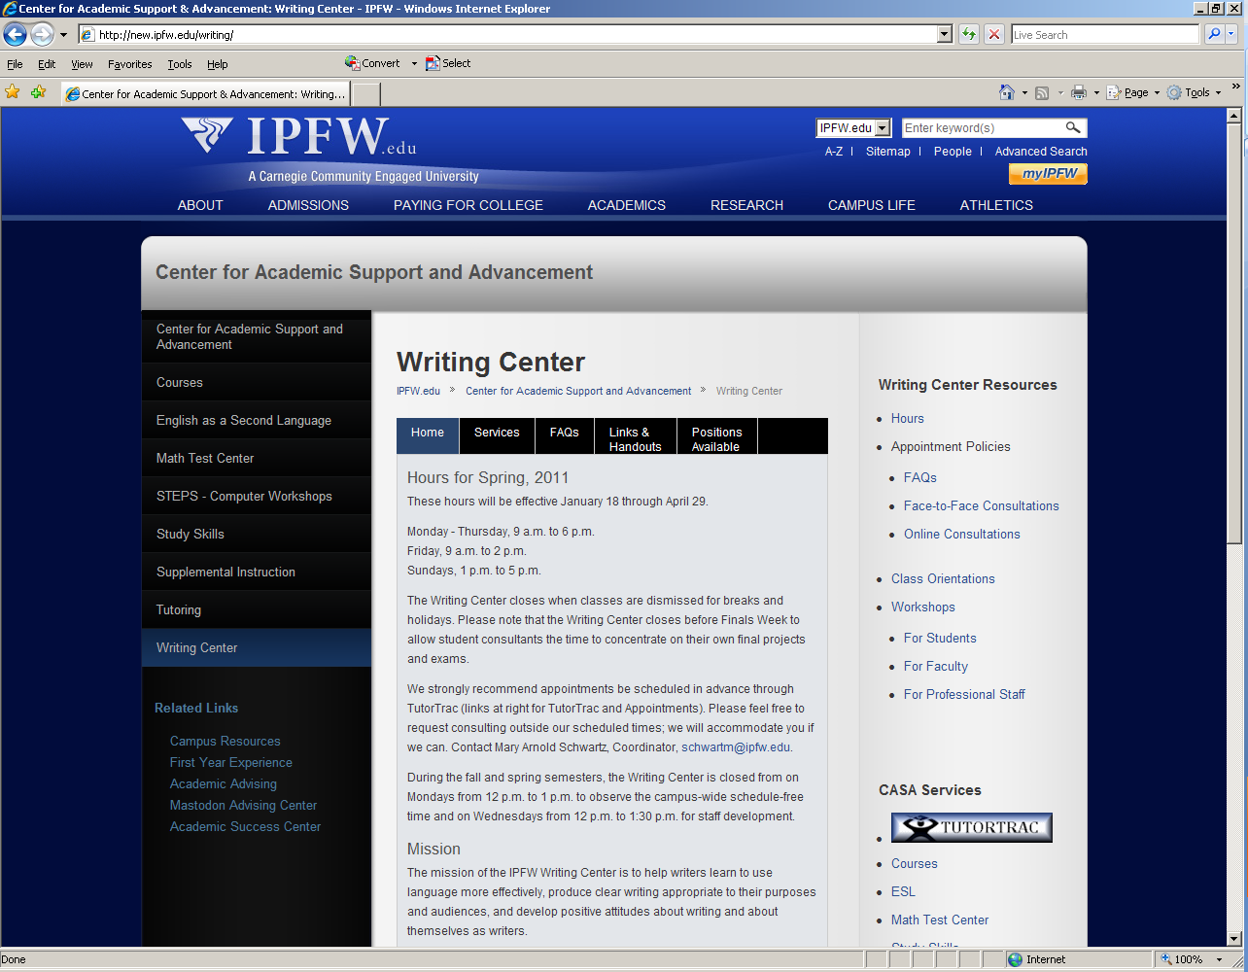

Slide 30
Thank You ☺
Dr Elliott J Blumenthal
481-6004
Science Building 390
E-mail: blumenth@ipfw.edu
Web page: http://users.ipfw.edu/blumenth

