Slide 1
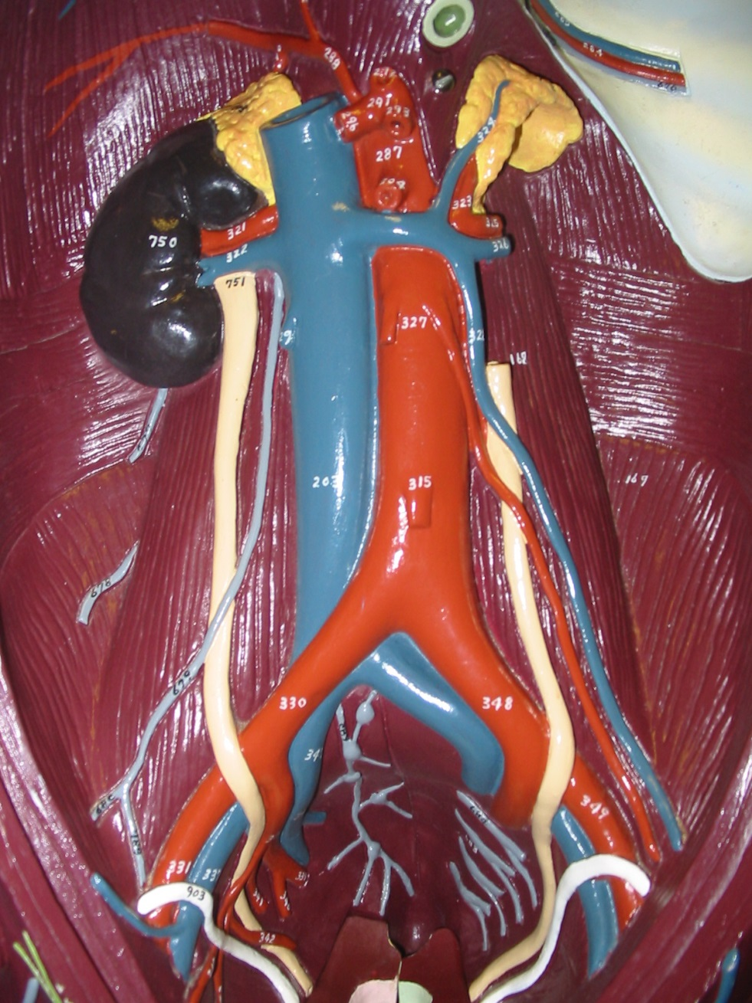
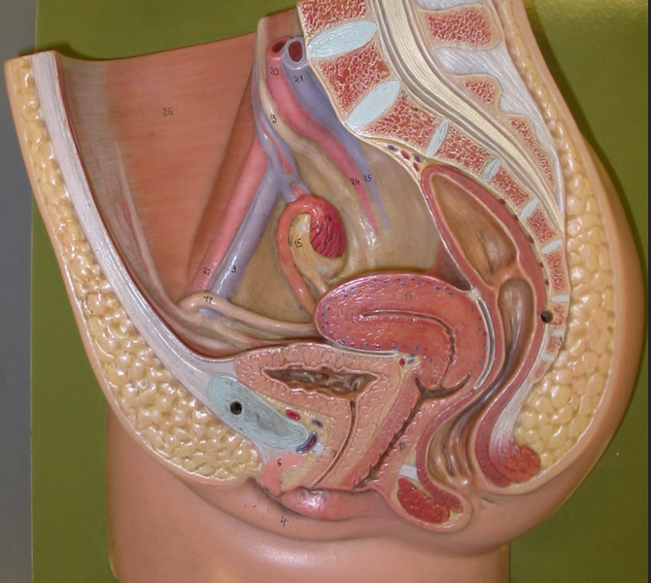
Urinary System
Instructor: Alexandra Okihiro
Photos from Karen McClellen
Adrenal Gland
Kidney
Renal Artery
Renal Vein
Female
Ureter
Bladder
Urethra

Slide 2
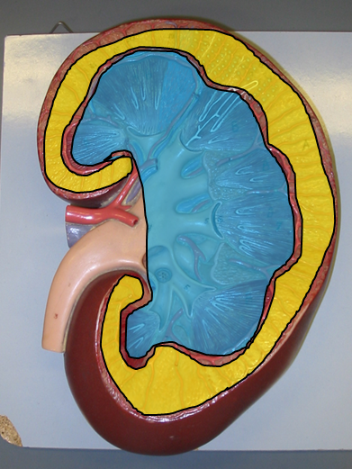
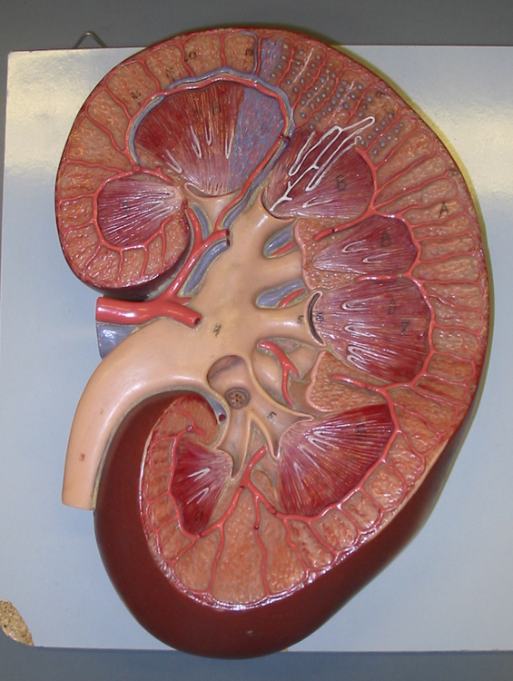
Cortex
Medulla
Renal Pyramid
Renal Papilla
Renal Column
Renal Capsule
Renal Pelvis
Major Calyx
Ureter
Minor Calyx

Slide 3
Interlobular Artery and Vein
Arcuate Artery and Vein
Segmental Artery and Vein
Interlobar Artery and Vein
Renal Artery and Vein

Slide 4
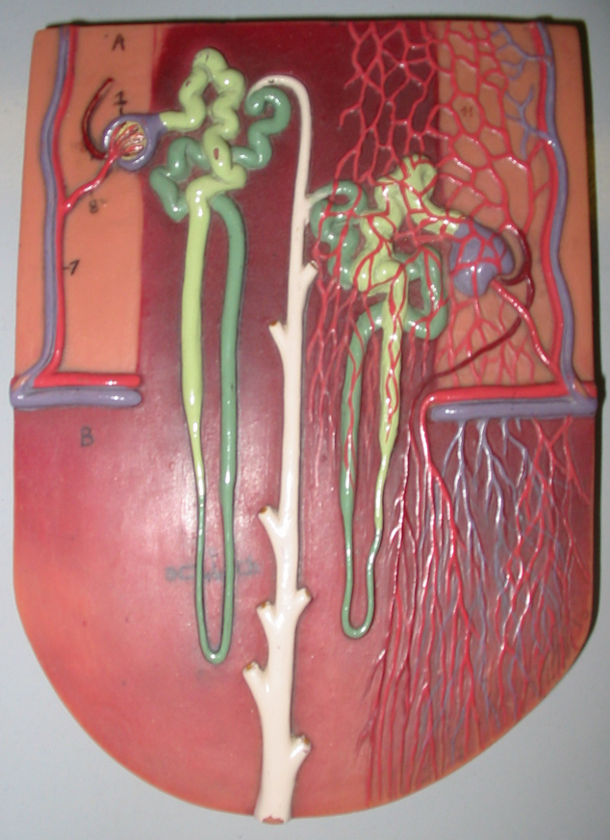
Proximal Convoluted Tubule
Renal Corpuscle
Peritubular Capillaries
Distal Convoluted Tubule
Thick Ascending Loop of Henle
Collecting Duct
Arculate Artery and Vein
Descending Loop of Henle
Vasa Recta
Thin Ascending Loop of Henle
Nephron

Slide 5
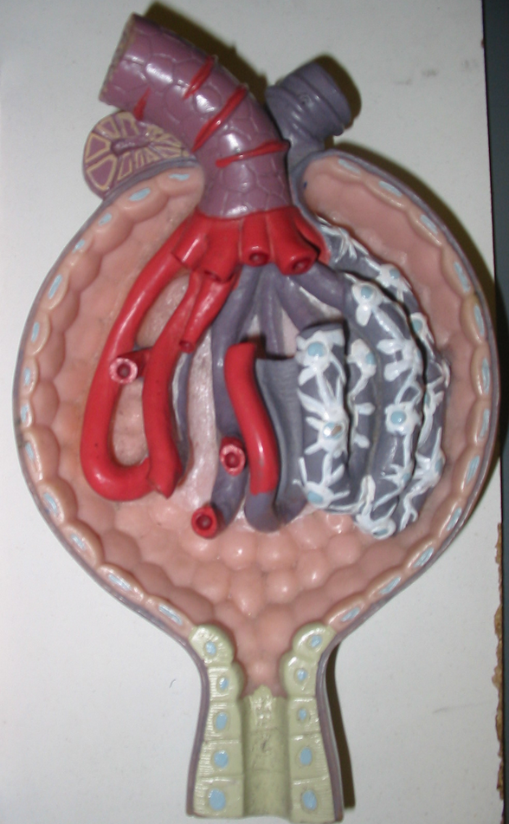
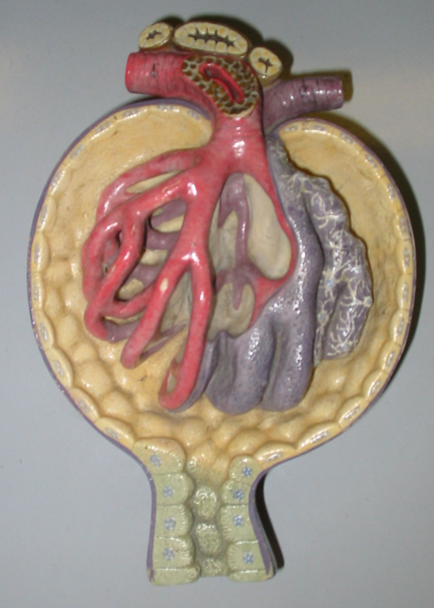
Renal Corpuscle
Afferent Arteriole
Efferent Arteriole
Parietal layer of Bowman’s Capsule
Visceral Layer of Bowman’s Capsule (dark grey) and Podocytes
Glomerulus
Juxtaglomerular Apparatus (green)
Capillary Endothelium
Basement Membrane (dark grey)

Slide 6
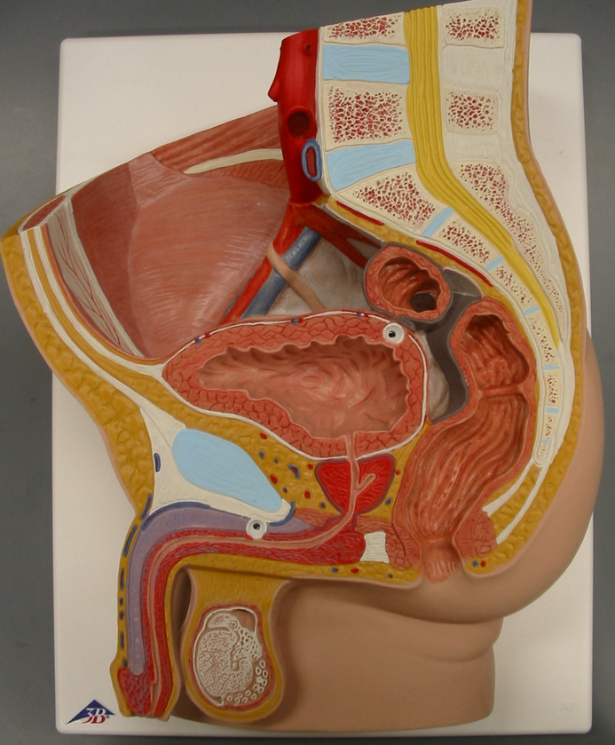
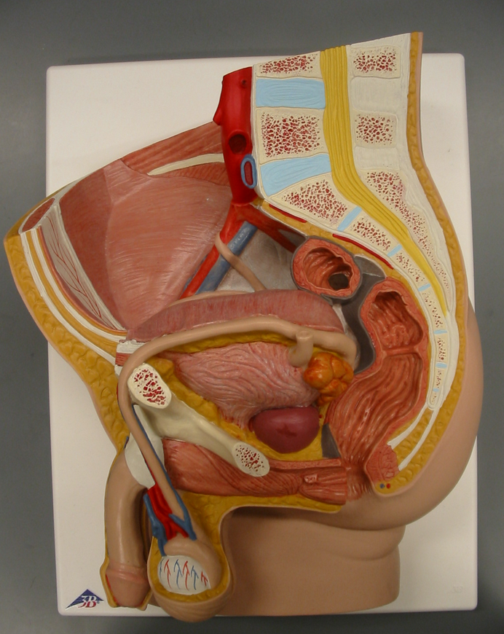
Male
Mucosa of transitional epithelium
Submucosa of connective tissue (shown as small yellow line)
Muscularis of smooth muscle
Trigone
Internal Urethral Sphincter
Serosa (is smooth)
Urethra
Adventitia (is piece-meal)
External Urethral Sphincter

