Slide 1
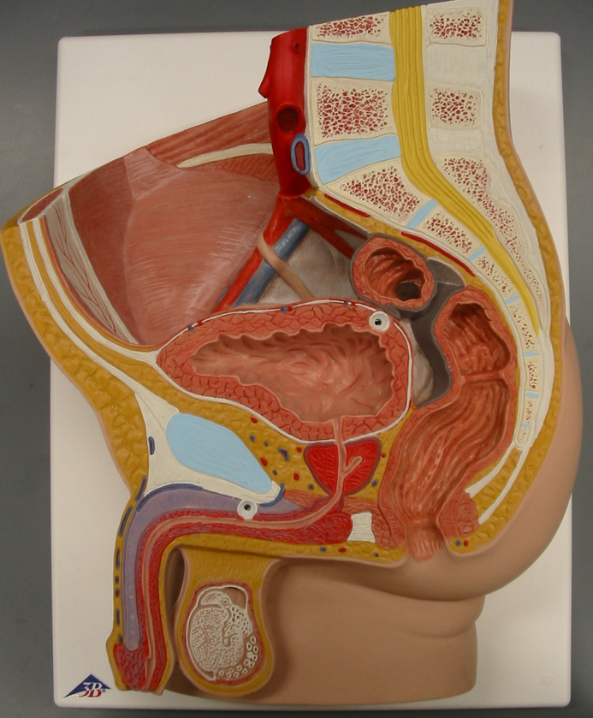
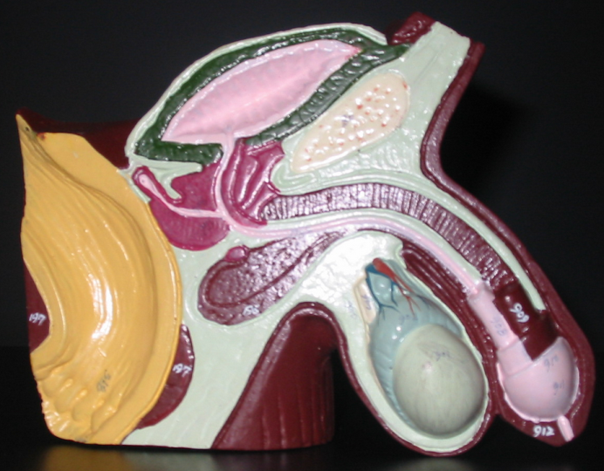
Reproductive Systems
Instructor: Alexandra Okihiro
Photos from Karen McClellen
Ejaculatory Duct
Prostate Gland
Urethra
Corpus Spongiosum (red)
Corpus Cavernosum
Bulbourethral Gland
Glans penis
Prepuce (foreskin)

Slide 2
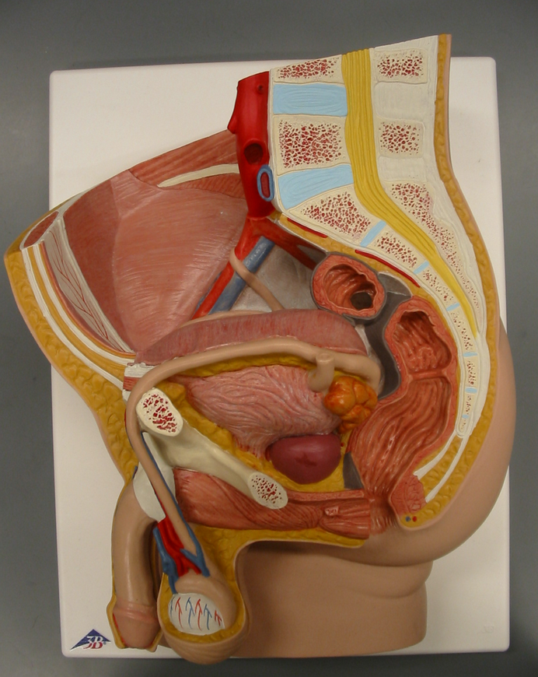
Vas Deferens
Seminal Vesicle
Prostate Gland
Epididymis
Testis
Scrotum

Slide 3
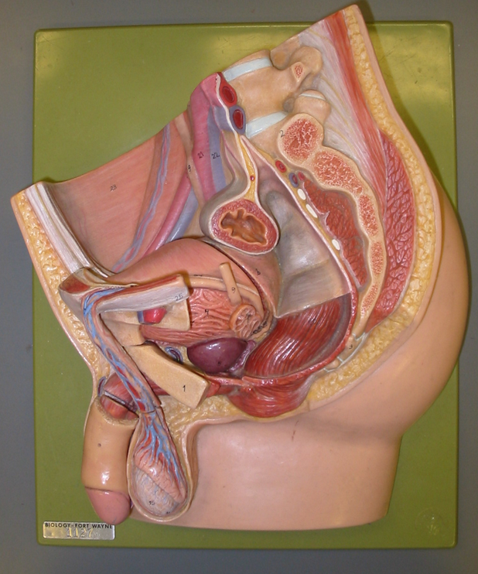
Inguinal Canal
Q: “Name this passageway”
Vas Deferens
Spermatic Cord
Testicular Artery and Vein
Cremaster Muscle
(best seen when piece is removed)

Slide 4
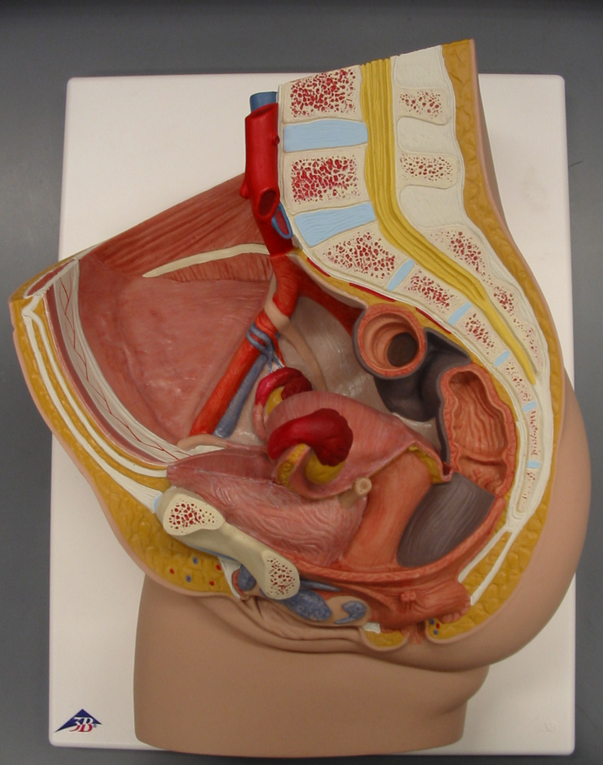
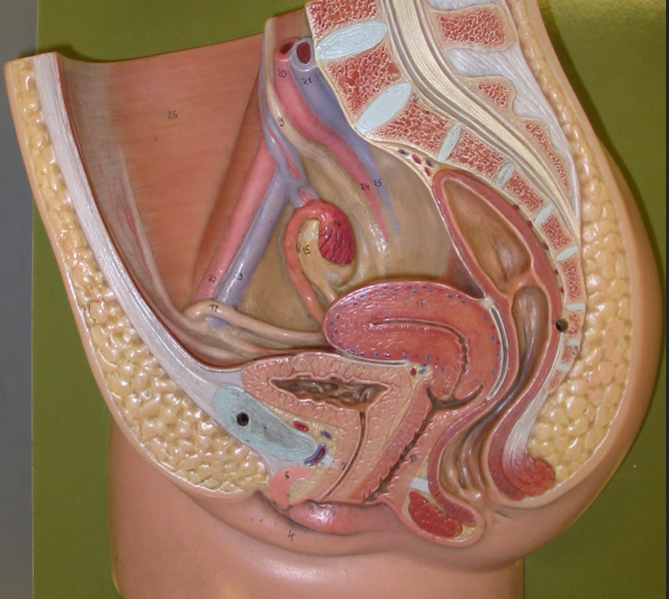
Urinary Bladder
Symphysis Pubis
Fallopian Tube
Ovary
Uterus
Pelvic Floor Muscles
Urethral Orifice
Vagina
Greater Vestibular Gland
Rectum
Mons Pubis
Clitoris
Labia Minora
Labia Majora
Vestibule
Q: “Name the Space”

Slide 5
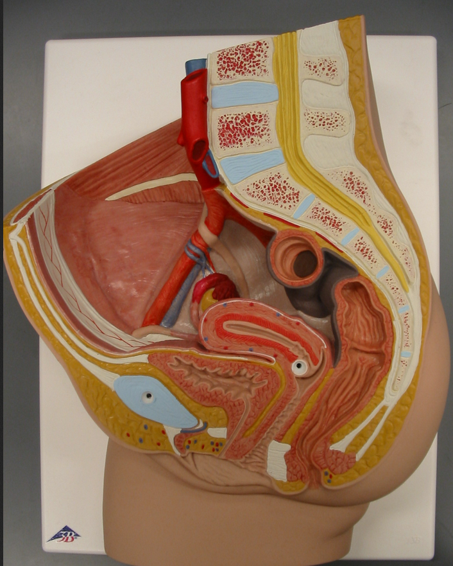
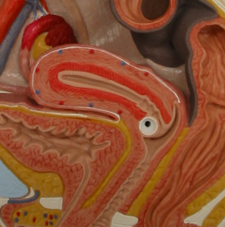
Fundus
Body
Cervix
Myometrium
Uterine Cavity
Endometrium (beige + red)

Slide 6
Fallopian Tube
Broad Ligament
Ovary
Fimbriae
Ovarian Ligament
Perimetrum (the visceral peritoneum)
Round Ligament

Slide 7
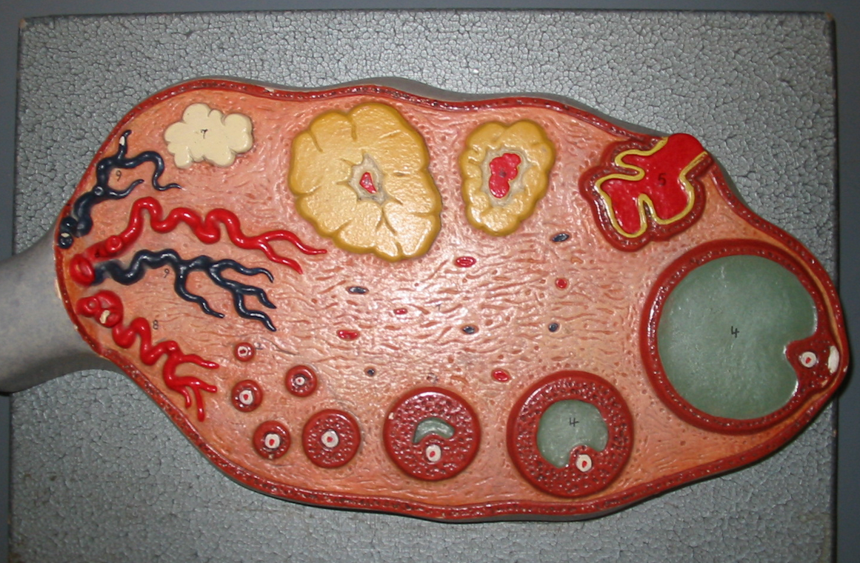
Corpus albicans
Corpus luteum
Mature Follicle
Oocyte
(white+red dot)
Primary Follicles
Secondary Follicles

Slide 8
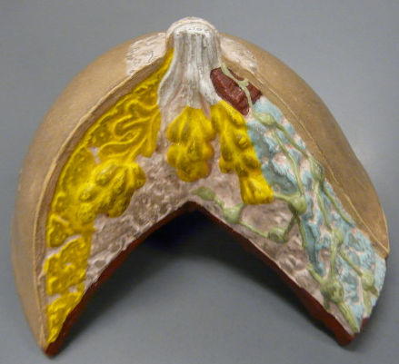
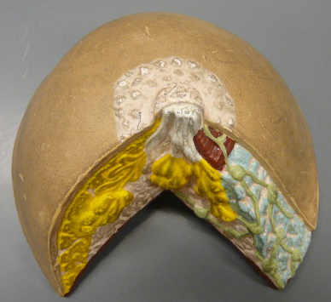
Lactiferous Duct
Lactiferous Sinus
Lobule
Lobe
Areolar Gland
Areola
Nipple

