Slide 1
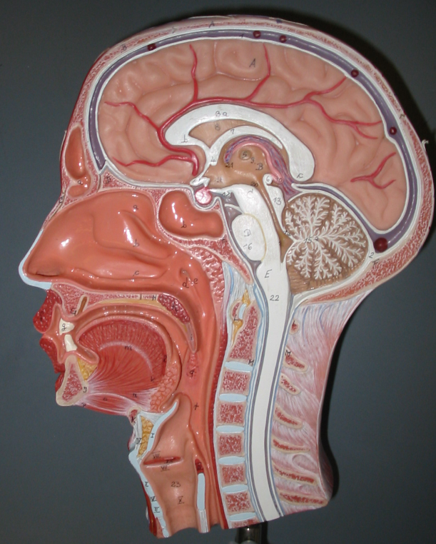
Instructor: Ali Okihiro
Photos From Karen McClellan Webpage
Superior Concha
Frontal Sinus
Superior Meatus
Middle Concha
Sphenoid[al] Sinus
Middle Meatus
Opening of Eustachian Tube (Auditory Tube)
Inferior Concha
Inferior Meatus
Pharyngeal Tonsil
Hard Palate
Uvula
Soft Palate
Palatine Tonsil
Epiglottis

Slide 2
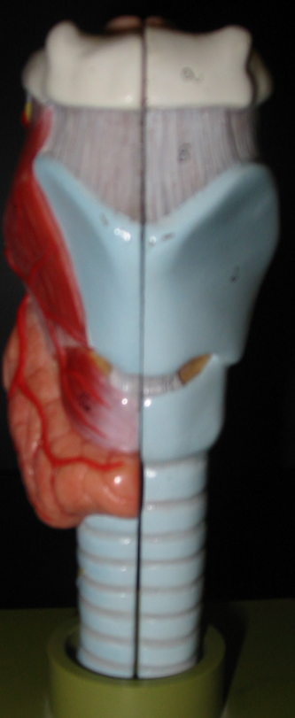
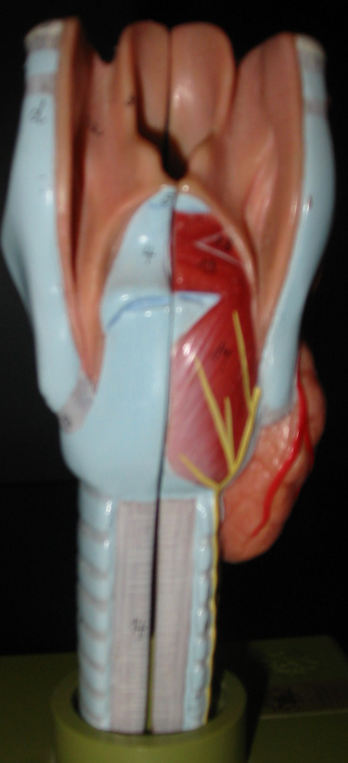
Anterior View
Posterior View
Epiglottis
Hyoid Bone
Glottis – opening between vocal folds
Thyroid Cartilage
Cricoid Cartilage
Thyroid Gland
Trachea

Slide 3
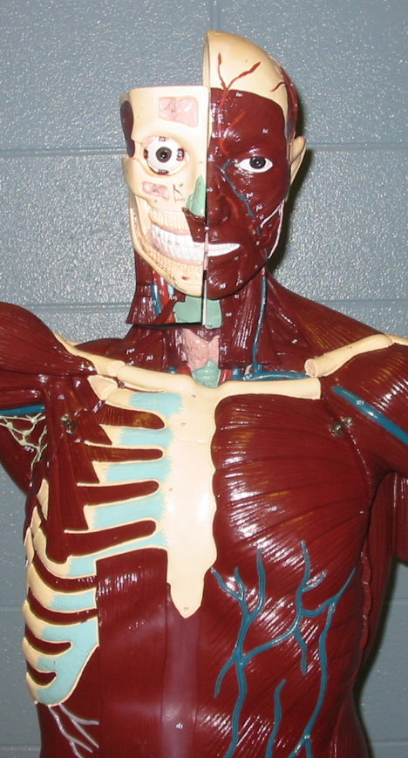
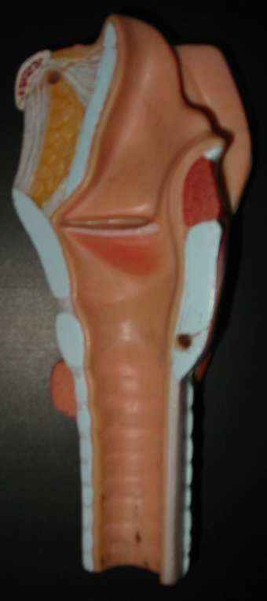
Maxillary Sinus
False Vocal Cord
Thyroid Cartilage
True Vocal Cord
Sternocleidomastoid
Cricoid Cartilage
Scalene
Pectoralis Minor
Trachea
Abdominal Muscles

Slide 4
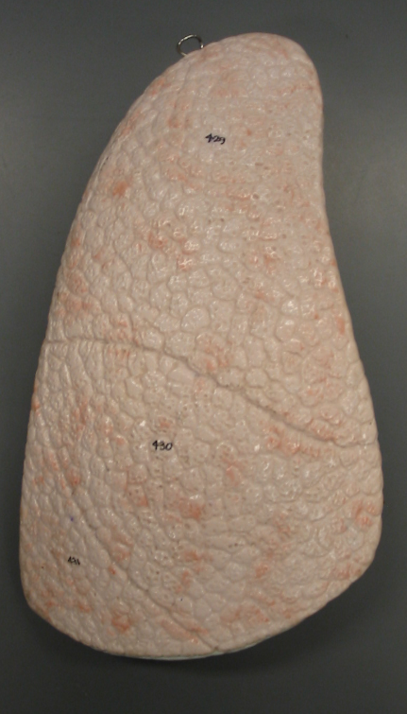
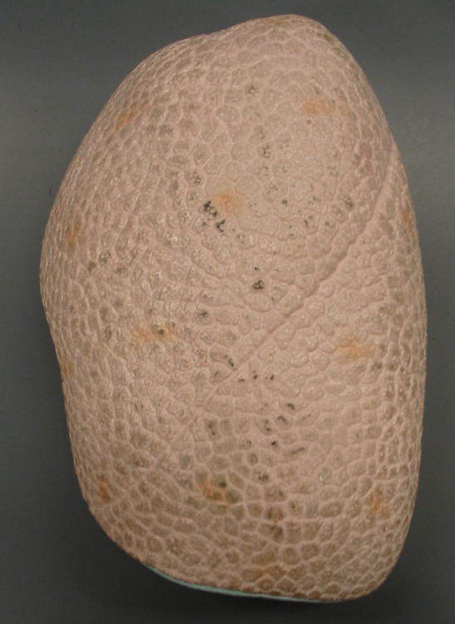
Right Lung (Larger than the Left)
Left Lung
Superior Lobe
Horizontal Fissure
Middle Lobe
Oblique Fissure
Inferior Lobe

Slide 5
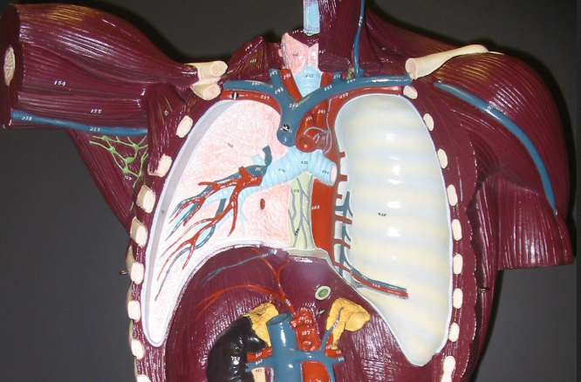
Larynx
Thyroid Gland
Trachea
Secondary Bronchus
Primary Bronchus
Tertiary Bronchus
Diaphragm

Slide 6
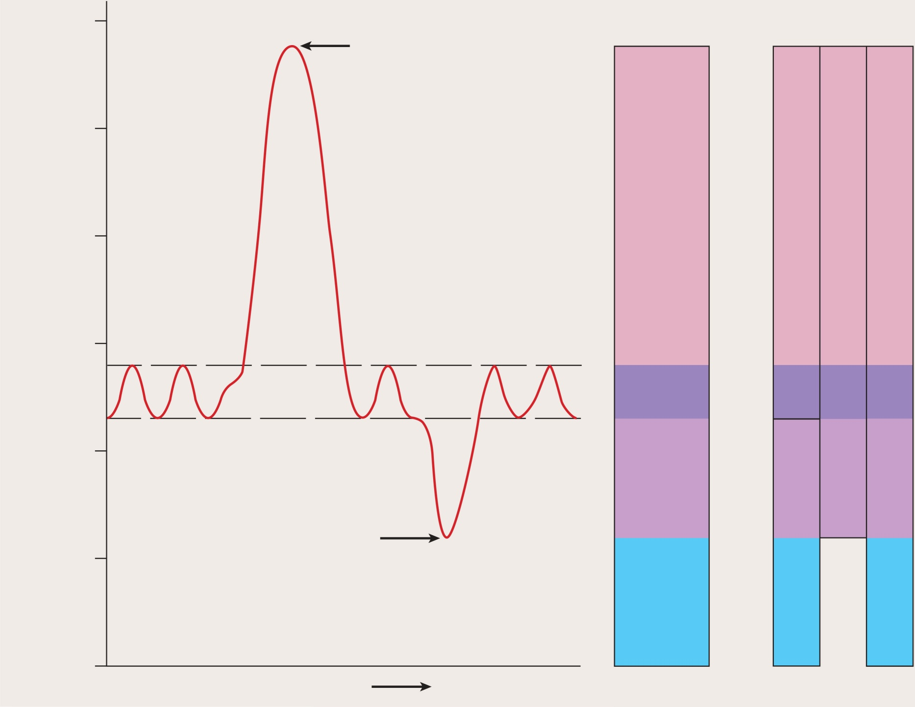
Fig. 23.15
Illustration for Practical – also don’t forget Fig. 23.12 and 23.7
Copyright © The McGraw-Hill Companies, Inc. Permission required for reproduction or display.
6000
Maximum
inspiration
Volumes
Capacities
5000
Inspiratory reserve volume
(3000 mL)
Inspiratory capacity
(3500 mL)
4000
Vital capacity (4600 mL)
Volume (mL)
3000
Tidal
volume
(500
mL)
Total lung capacity (5800 mL)
2000
Expiratory
reserve
volume
(1100 mL)
Maximum
expiration
Functional residual capacity
(2300 mL)
1000
Residual
volume
(1200 mL)
0
Time

