Slide 1
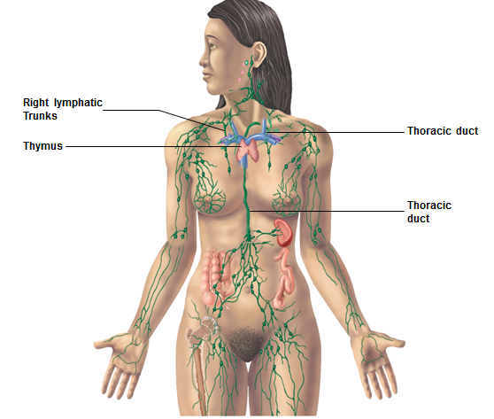
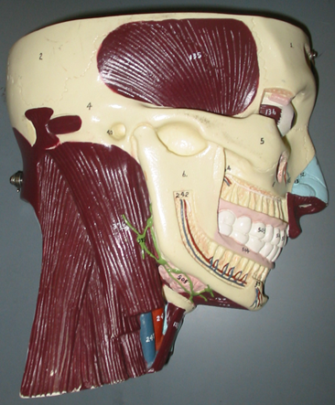
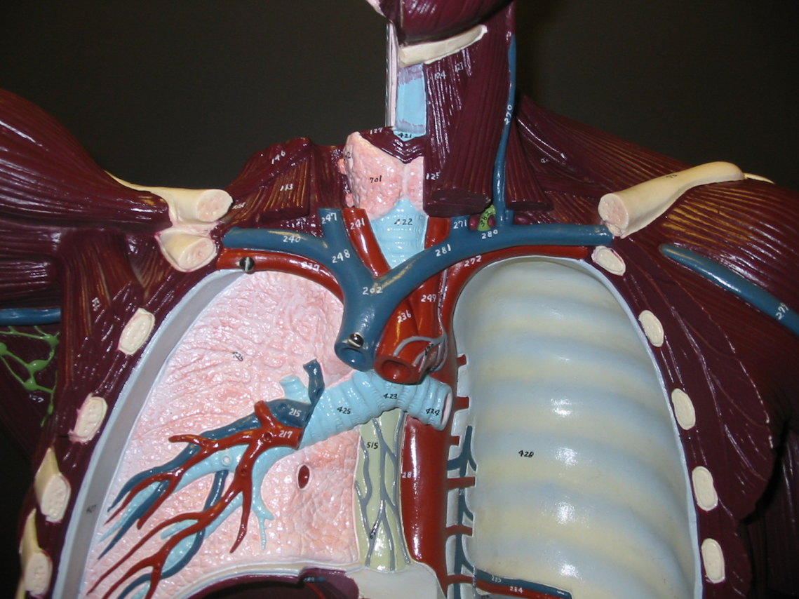
Cervical Lymph Nodes
Left Subclavian Vein
Right Subclavian Vein
Axillary Lymph Nodes
Left Pleural Cavity
(the space) and
Parietal Pleura (blue)

Slide 2
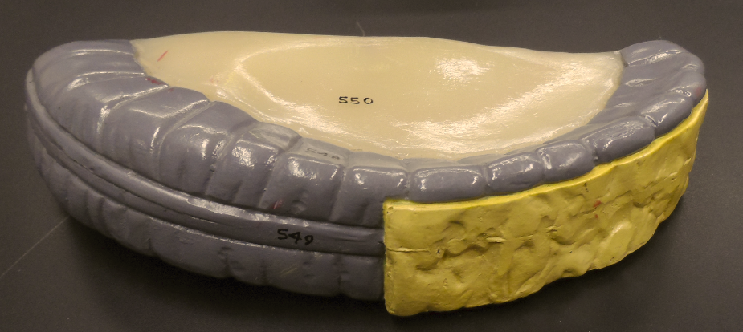
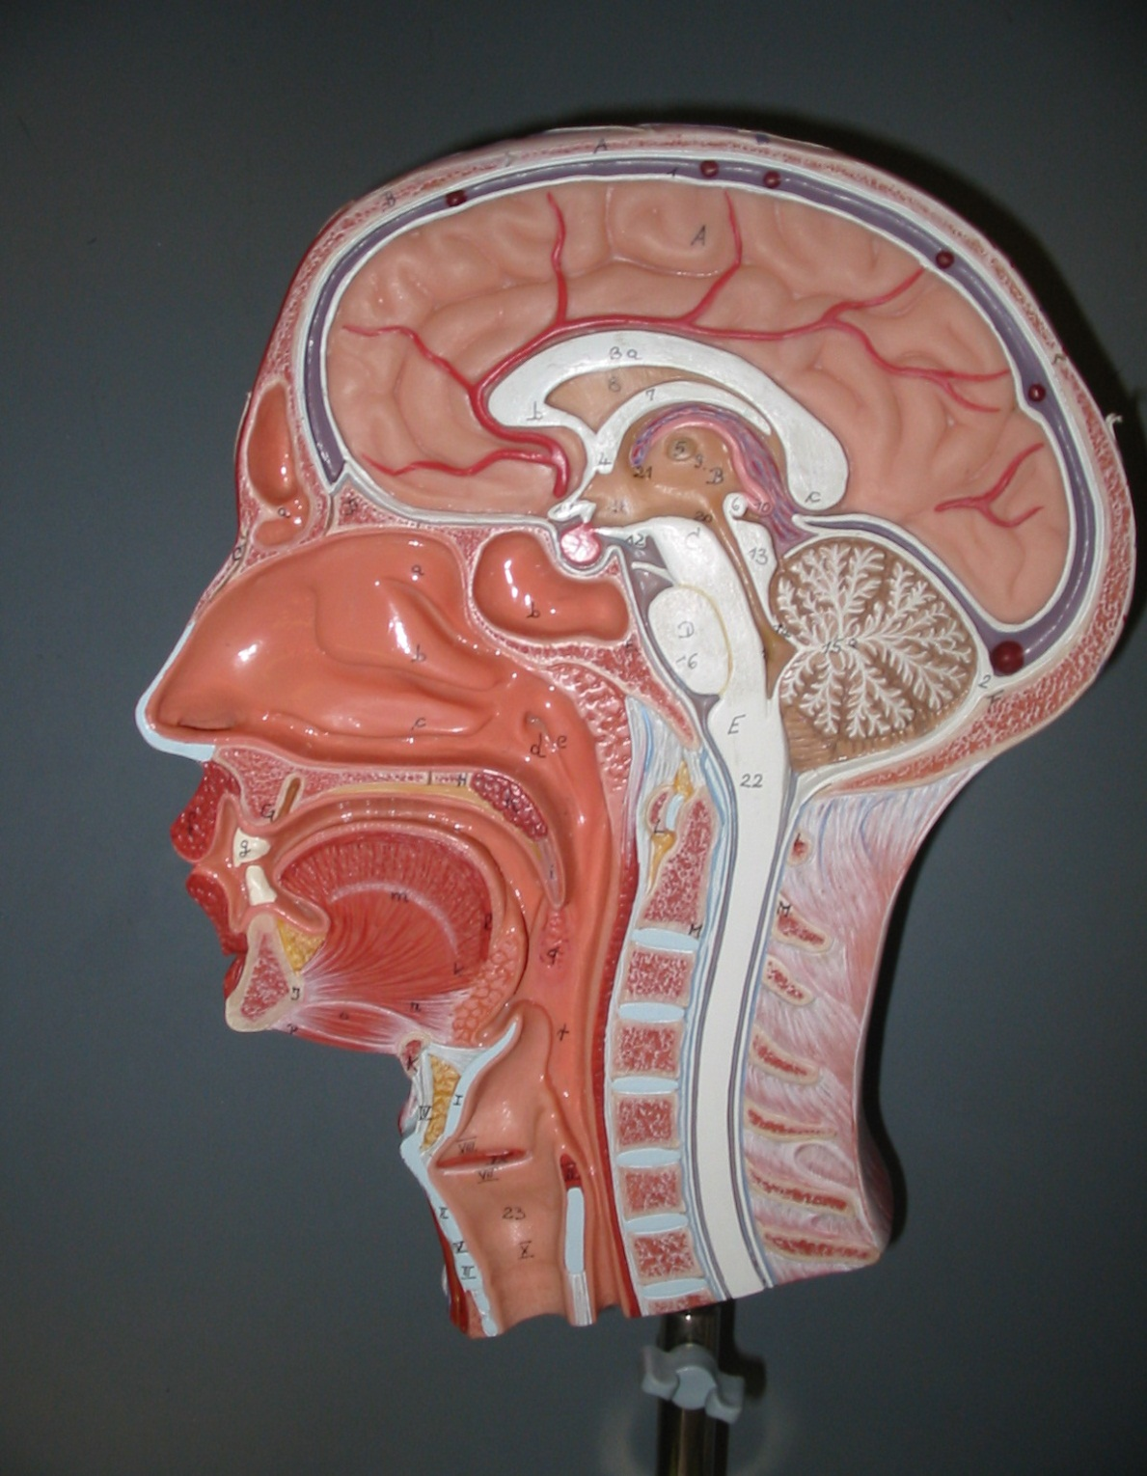
Transverse Mesocolon
Greater Omentum
Pharyngeal Tonsil (adenoids)
Palatine Tonsils
Lingual Tonsil

Slide 3
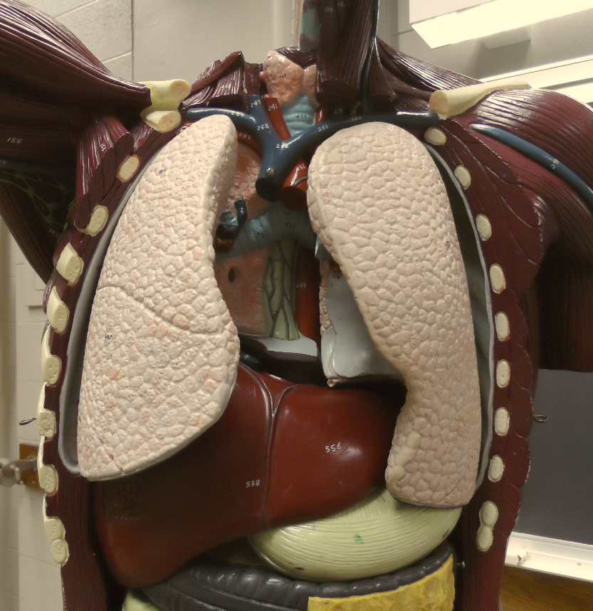
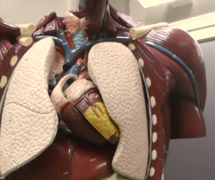
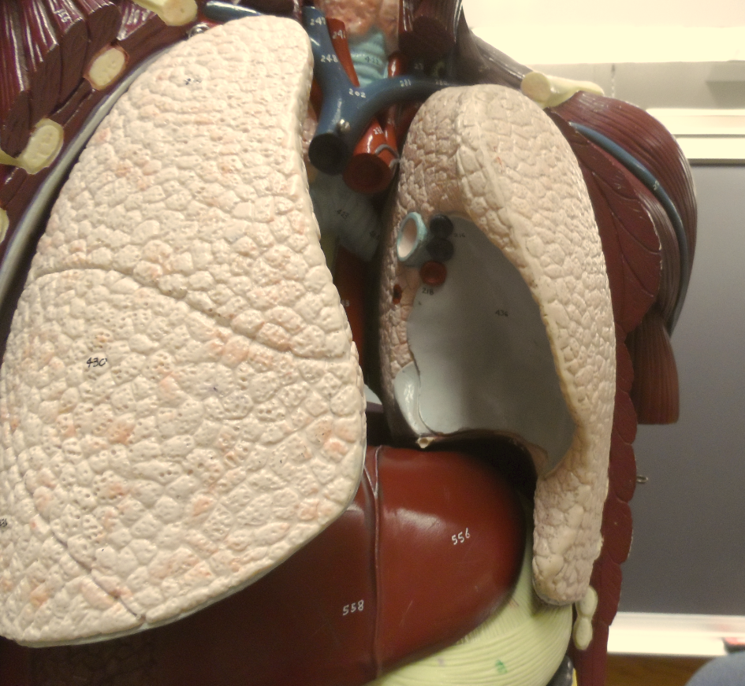
Pericardial Cavity
(the space for the heart
within the mediastimun)
Visceral Pericardium (yellow)
Falciform Ligament
“Name the inner layer serosa covering this organ”
- It is the Visceral Pleura
Parietal Pericardium (blue)

Slide 4
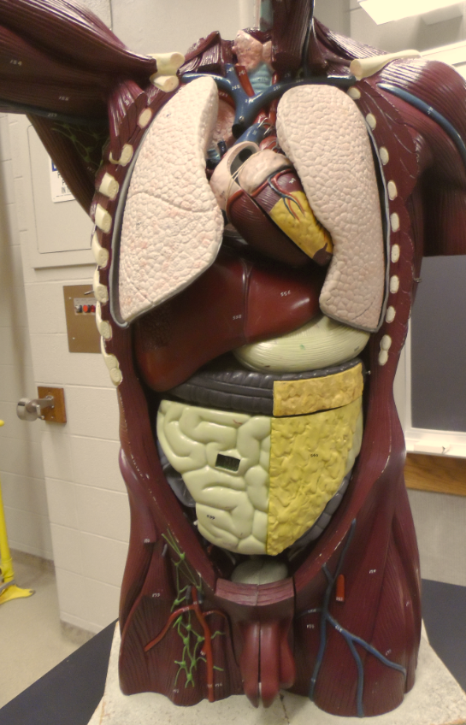
Thoracic Cavity (above diaphragm)
Abdominal Cavity
Greater Omentum
Abdominopelvic Cavity
Pelvic Cavity (sacral promontory to symphysis pubis)
Inguinal Lymph Nodes

Slide 5
9 Regions of the Abdomen:
Right Hypochondriac Region
Epigastric Region
Left Hypochondriac Region
Right Lumbar Region
Umbilical Region
Left Lumbar Region
Right Iliac Region
Hypogastric Region
Left Iliac Region
1
2
3
4
5
6
7
8
9

