Slide 1
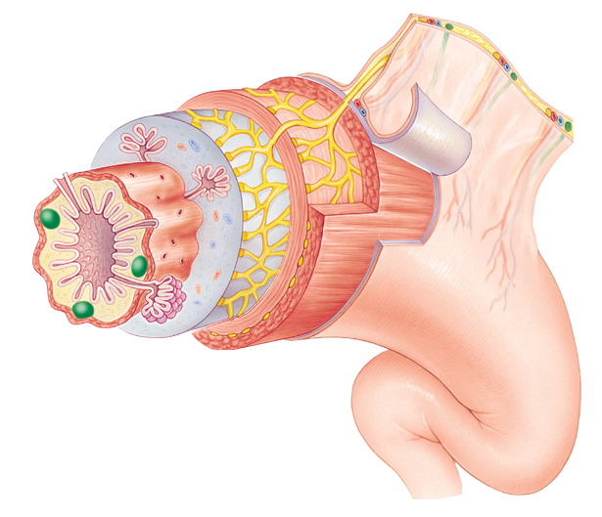
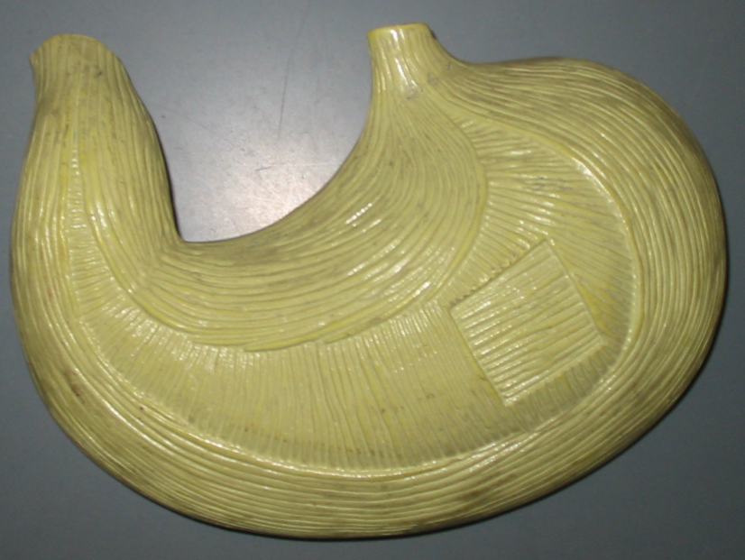
Layers of the Gut Wall
Instructor: Alexandra Okihiro
BIOL 204 Spring 2013
Photos from Karen McLellan Website
Fig. 24.4
Muscularis
Circular muscle layer
Longitudinal muscle layer
Longitudinal muscle layer
Mucosa
Circular muscle layer
Oblique muscle layer
Submucosa
Muscularis
Serosa

Slide 2
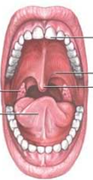
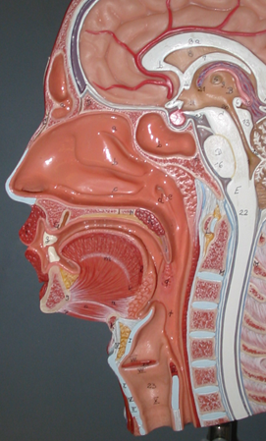
Oral Cavity
Gingiva
Soft Palate
Frenulum of upper lip
Hard Palate
Frenulum of tongue
Superior Vestibule (space posterior to lips, anterior to teeth)
Frenulum of lower lip
Lips
Uvula
Inferior Vestibule
Esophagus

Slide 3
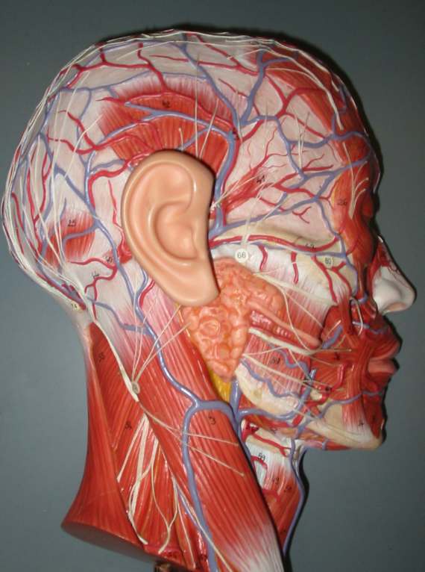
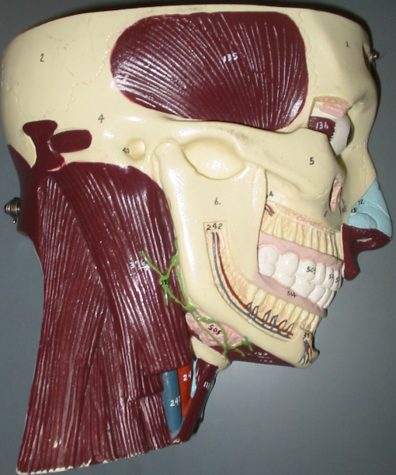
Parotid Gland
Parotid Duct
Submandibular [Submaxillary] Gland

Slide 4
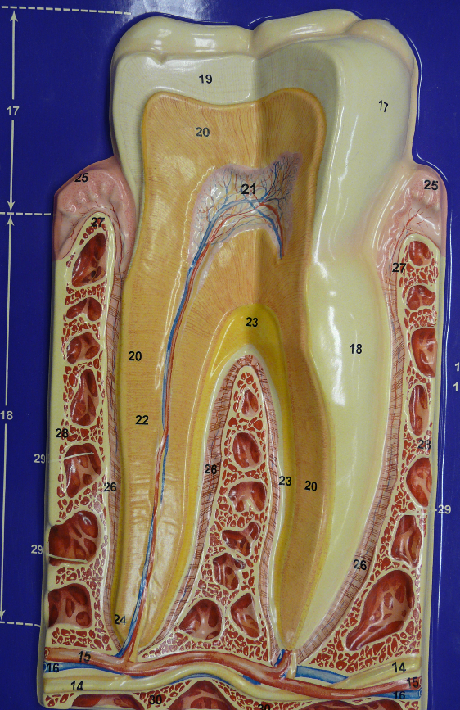
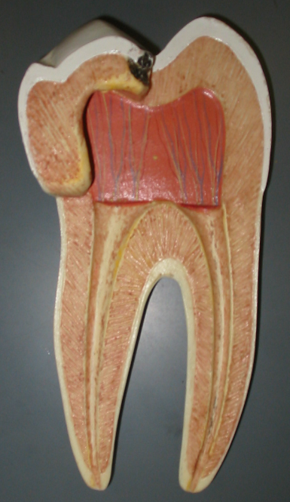
Tooth Anatomy
Cusp
Enamel
Anatomical crown
Dentin
Gingiva
Neck
Pulp Cavity
Root Canal
Root
Periodontal Ligaments

Slide 5
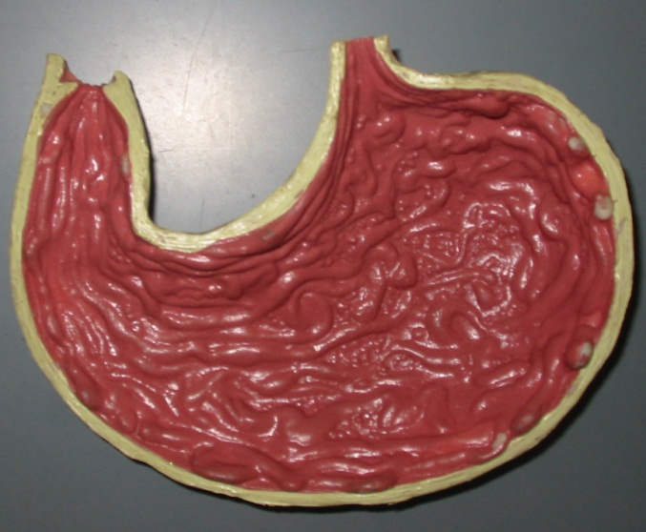
Stomach
Cardiac Part
Pyloric Sphincter
Cardiac Sphincter
Pyloric Part
Fundus
Body
Rugae

Slide 6
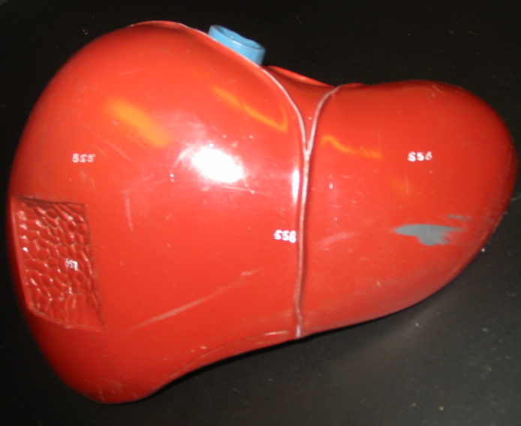
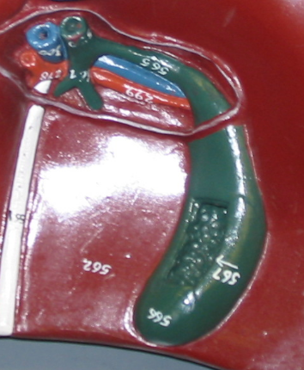
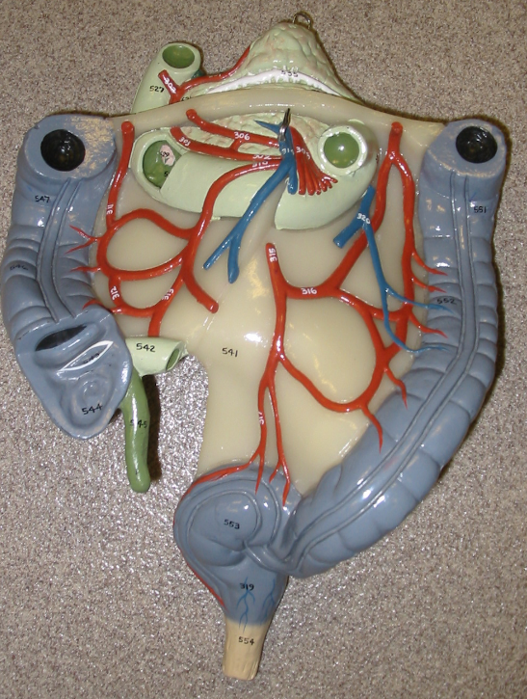
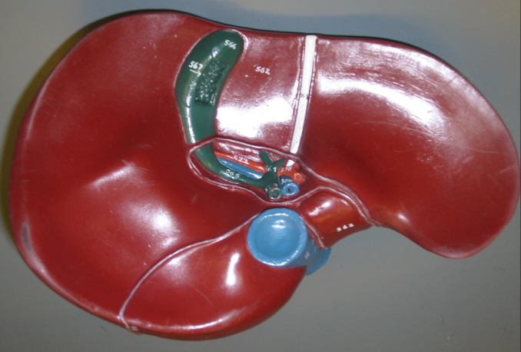
Liver, Gallbladder, and Pancreas
Round ligament
Left hepatic duct
Right hepatic duct
Common hepatic duct
Cystic duct
Common bile duct
Right Lobe
Falciform Ligament
Left Lobe
Pancreatic Duct
Major Duodenal Papilla

Slide 7
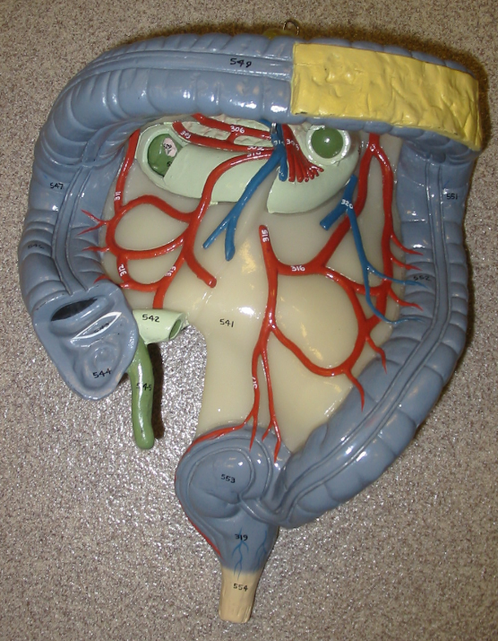
Large Intestine (Colon)
Transverse Colon
Hepatic [Right Colic] Flexure
Splenic [Left Colic] Flexure
Ascending Colon
Descending Colon
Ileocecal valve
Haustra
Cecum
Teniae Coli
Vermiform Appendix
Sigmoid Colon
Rectum
Anal Canal
* Know Internal Anal Sphincter, External Anal Sphincter, and Epiploic (Omental) Appendages from Illustration Fig. 24.25

