Slide 1
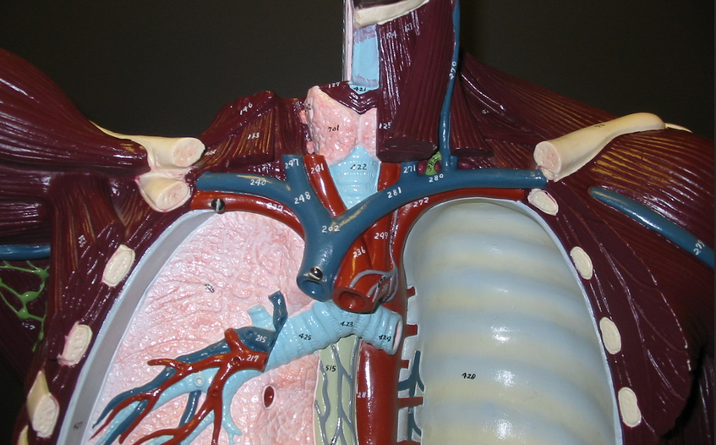
Blood Vessels:
Instructor: Ali Okihiro
Photos from Karen McClellan
- Review the Human Heart
Powerpoint for heart arteries and veins
Right Subclavian
Right Common Carotid
Brachiocephalic
Left Subclavian
Ascending Aorta
Left Common Carotid
Arteries

Slide 2
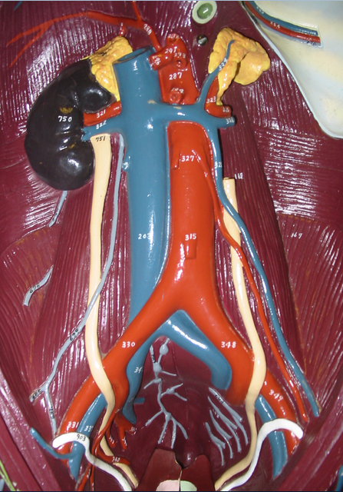
Common Hepatic
Left Gastric
Celiac Trunk
Suprarenal
Splenic
Renal
Suprarenal
Superior Mesenteric
Gonadals (Testicular/Ovarian)
Inferior Mesenteric
Common Iliac
Internal Iliac
External Iliac

Slide 3
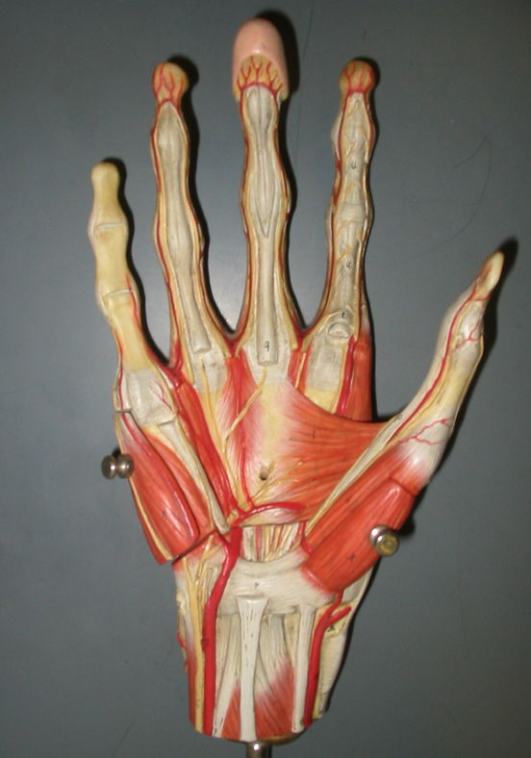
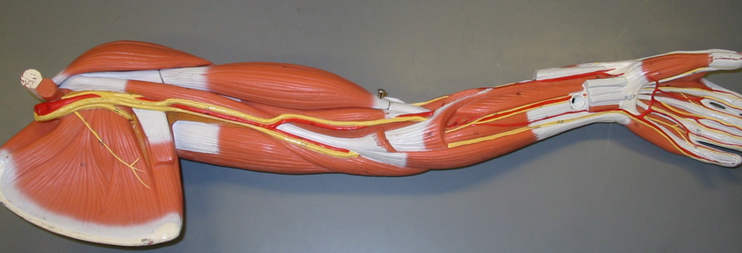
Axillary
Brachial**
Digitals
Deep Palmar Arch
Ulnar**
Radial**
Superficial Palmar Arch
** “Name the vein that follows this artery”

Slide 4
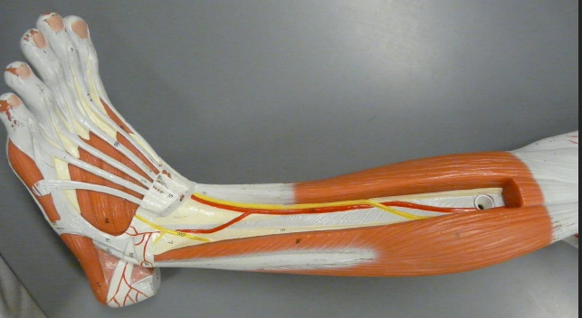
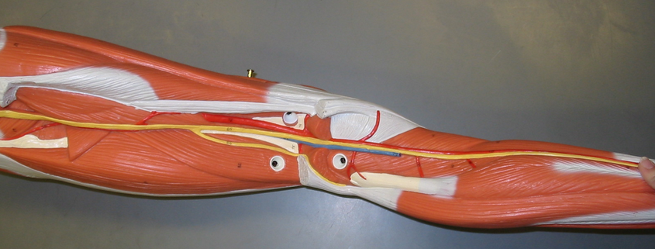
Popliteal
Anterior Tibial**
Fibular (Peroneal)**
Posterior Tibial**
Dorsalis Pedis Pulse
** “Name the vein that follows this artery”

Slide 5
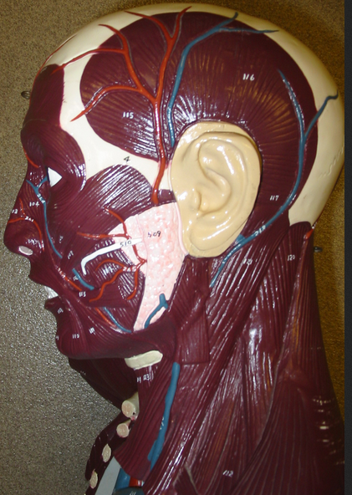
Superficial Temporal
Facial

Slide 6
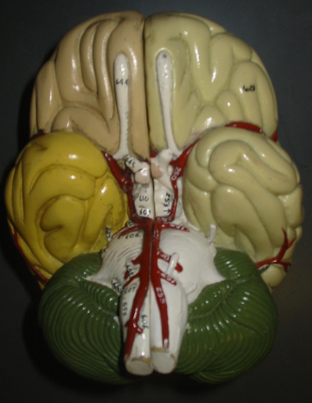
Anterior Communicating
Middle Cerebral
Internal Carotid
Posterior Cerebral
Posterior Communicating
Basilar
Vertebral

Slide 7
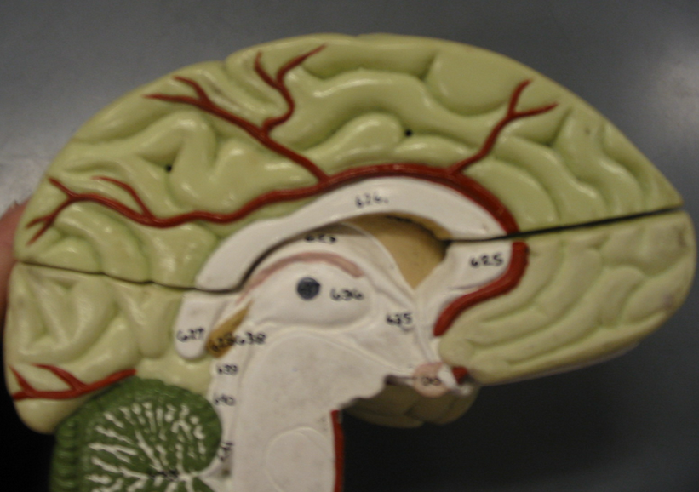
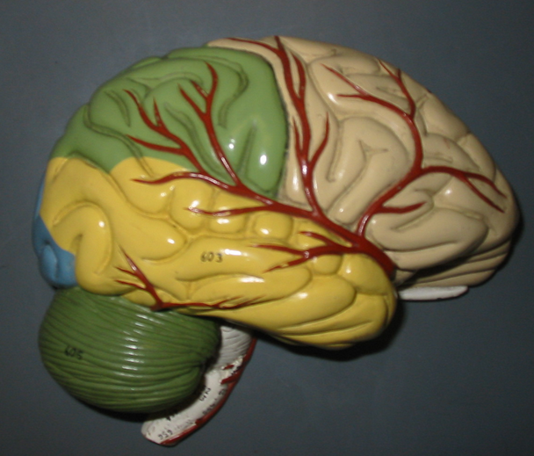
Anterior Cerebral
Middle Cerebral

Slide 8
External Jugular
Brachiocephalic
Subclavian
Subclavian
Internal Jugular
Internal Jugular
Veins

Slide 9
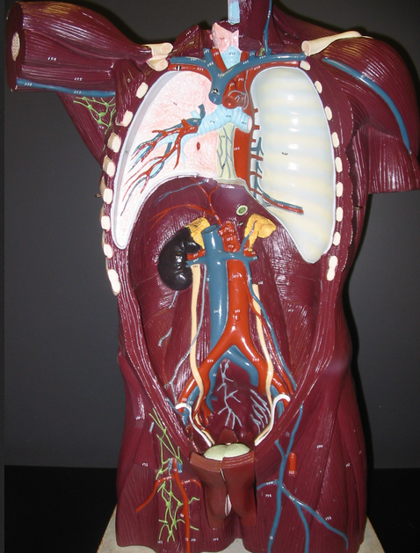
Cephalic
Basilic
Axillary
Hemiazygos
Intercostal Vein & Artery

Slide 10
Renal
Suprarenal
Gonadals (Testicular/Ovarian)
Renal
Gonadals (Testicular/Ovarian)
Inferior Vena Cava
Common Iliac
Internal Iliac
External Iliac

Slide 11
Superficial Temporal
Facial
External Jugular

Slide 12
Fetal Circulation
Review what fetal structures are called after birth:
Umbilical Vein → Round ligament of liver
Foramen ovale → Fossa ovalis
Ductus arteriosus → Ligamentum arteriosum
Know what causes these structures to close:
Foramen ovale: high left heart pressure
Ductus arteriosus: high oxygen
Ductus venosus: unknown

