Slide 1
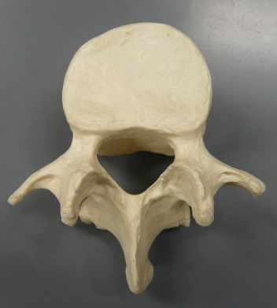
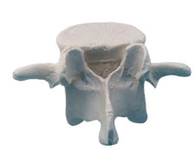
Typical Anatomy of a Vertebra
Body
Pedicle
Vertebral Foramen
Lamina
Superior Articular Process
Transverse Process
Inferior Articular Process
Spinous Process
BIOL 203 – Summer 2012
Instructor: Alexandra Okihiro

Slide 2
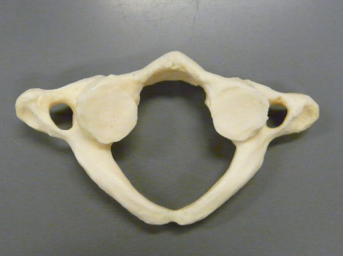
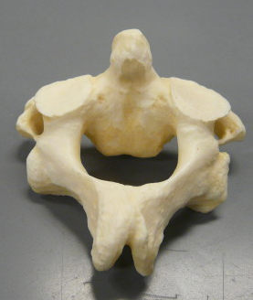
Transverse Foramen
Superior Articular Facet
Atlas
Dens
Transverse Foramen
Axis

Slide 3
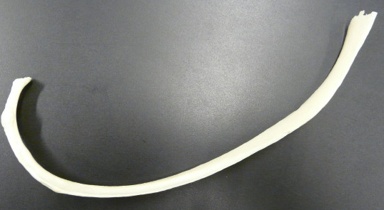
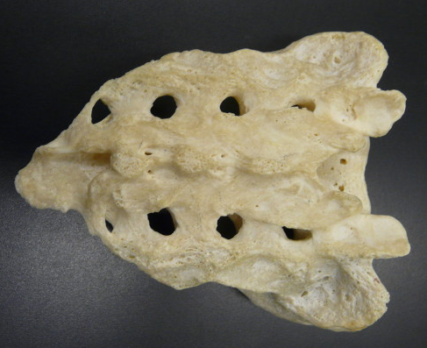
Rib
Head
Tubercle
Posterior View of Real Sacrum
Note: Sacral Promontory is seen on the anterior side only
Angle
Sacral Canal
Body
Sacral foramina
Sacral Hiatus
Sternal End

Slide 4
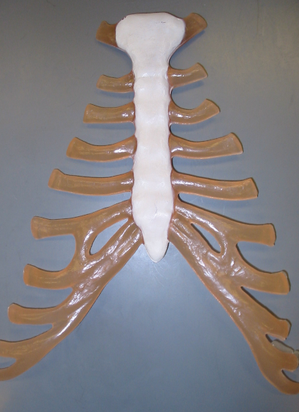
Jugular Notch
Sternum
Clavicular notch
Manubrium (the Sternal Angle is a bend in the manubrium)
Body
Xiphoid Process
Costal Cartilages
Costal Margin

Slide 5
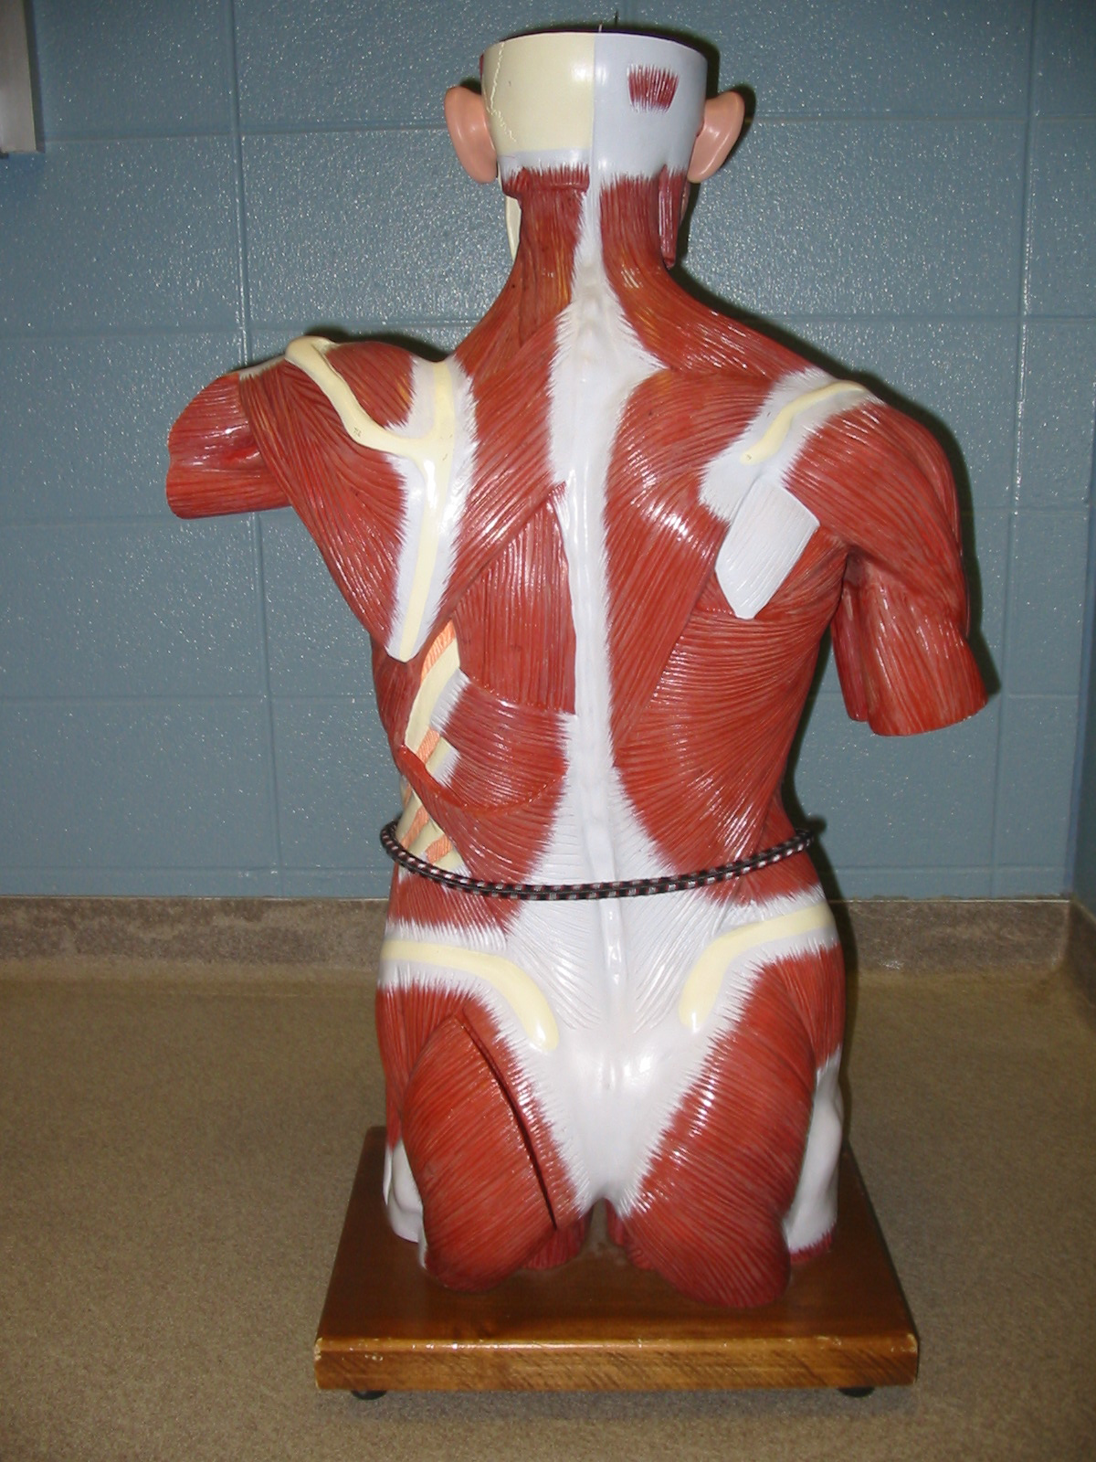
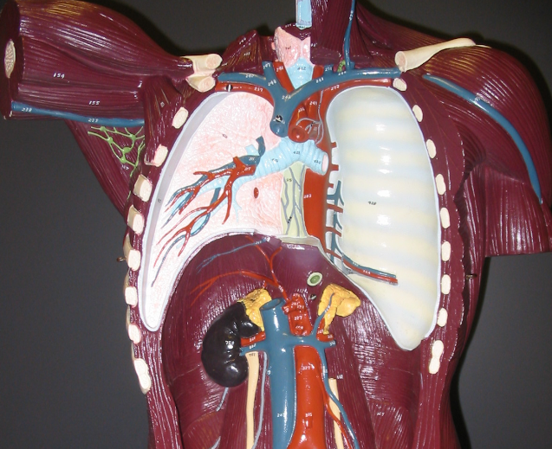
Erector Spinae group
Note: The muscle fibers of this group run vertically
Intercostal Nerves (inside the torso model; gray)

Slide 6
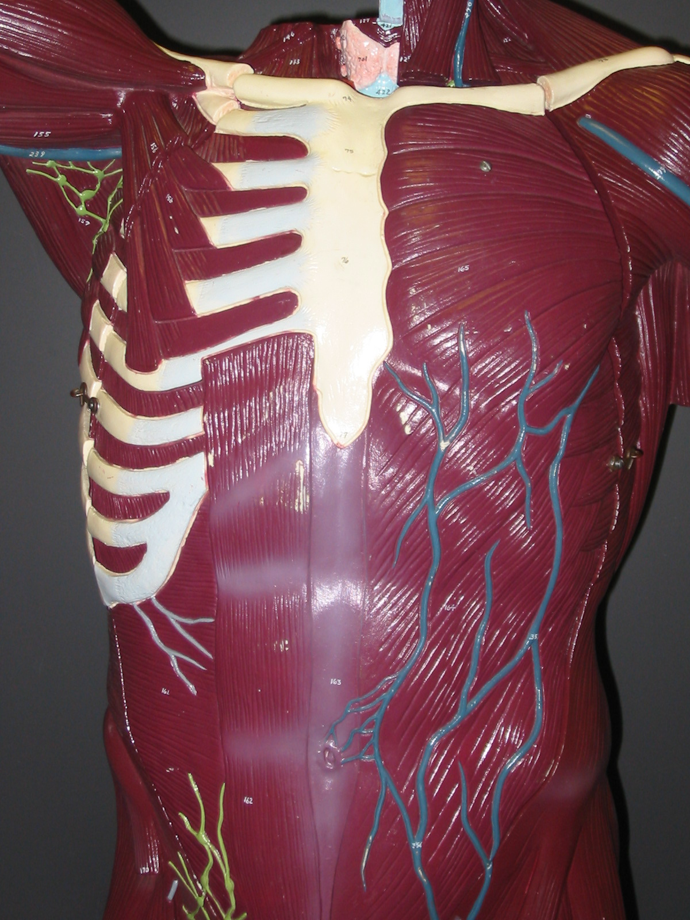
External Oblique (Internal Oblique is deep to this muscle)
Rectus Abdominis
Transversus Abdominis

Slide 7
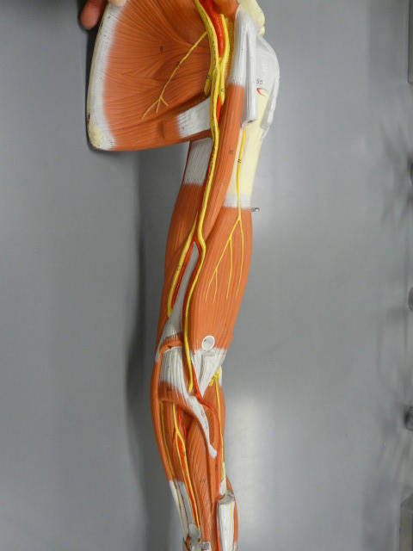
Brachial Plexus
Axillary Nerve
Musculocutaneous Nerve

Slide 8
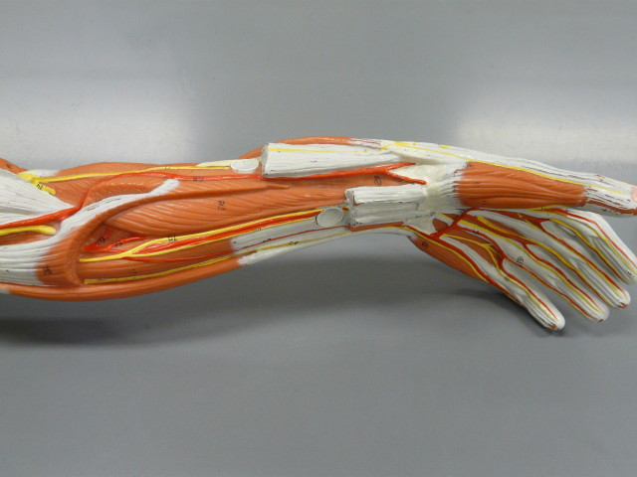
Radial Nerve
Median Nerve
Ulnar Nerve
Originates from Brachial Plexus

Slide 9
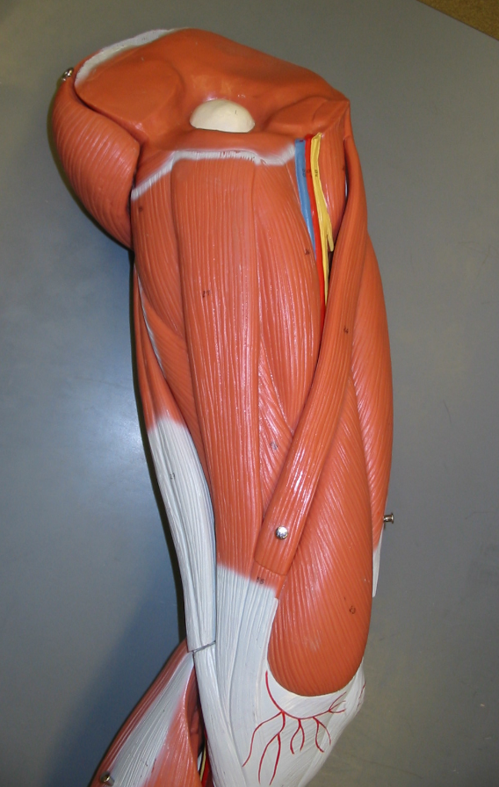
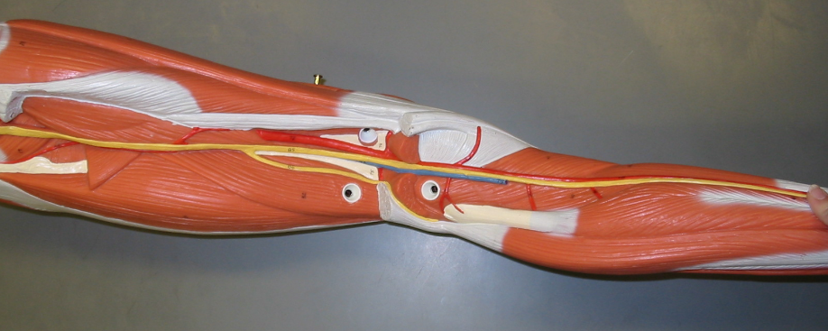
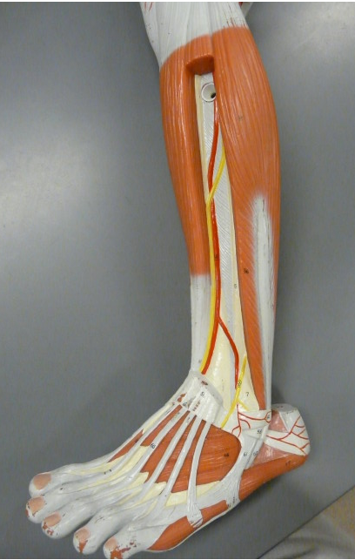
Originate from the Sacral Plexus
Femoral Nerve (Originates from Lumbar Plexus)
Sciatic Nerve
Common Peroneal Nerve
Tibial Nerve
Posterior Thigh and Leg

Slide 10
Typical Anatomy of a Vertebra

Slide 11
Atlas
Axis

Slide 12
Rib
Posterior View of Real Sacrum
Note: Sacral Promontory is seen on the anterior side only

Slide 13
Sternum

Slide 17
Originates from Brachial Plexus

Slide 18
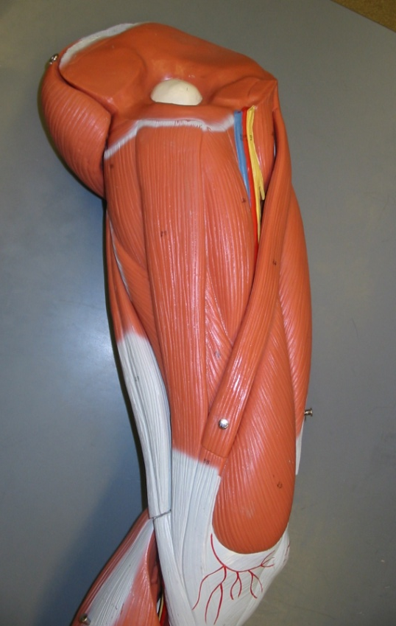
Originate from the Sacral Plexus
Posterior Thigh and Leg

