Slide 1
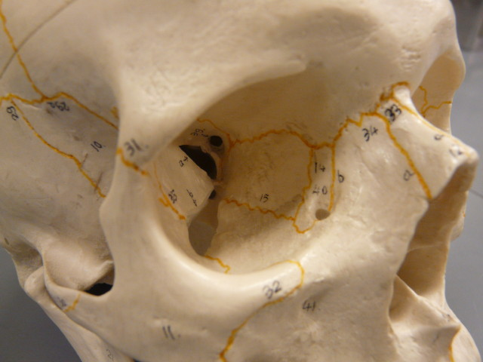
Orbital View
Frontal Bone
Sphenoid Bone
Supraorbital Margin
Optic Foramen (or optic canal)
Nasal Bone
Lacrimal Bone
Ethmoid Bone
Nasolacrimal Canal
Maxilla (or Maxillary Bone)
Zygomatic Bone
BIOL 203 – Summer 2012
Instructor: Alexandra Okihiro

Slide 2
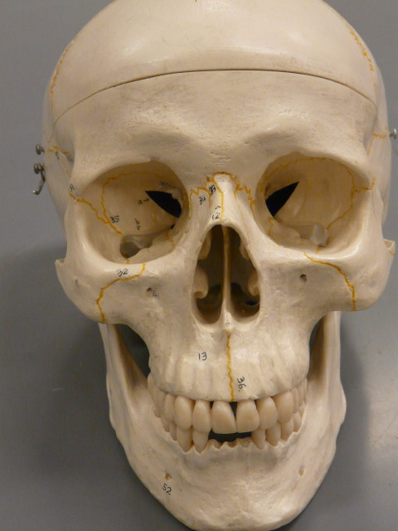
Anterior View
Frontal Bone
Supraorbital Margin
Sphenoid Bone
Nasal Bone
Zygomatic Bone
Middle Nasal Concha
Inferior Nasal Concha
Nasal Septum (Perpendicular plate of ethmoid and vomer)
Maxilla
Alveolar processes
Angle of Mandible
Mental Foramen

Slide 3
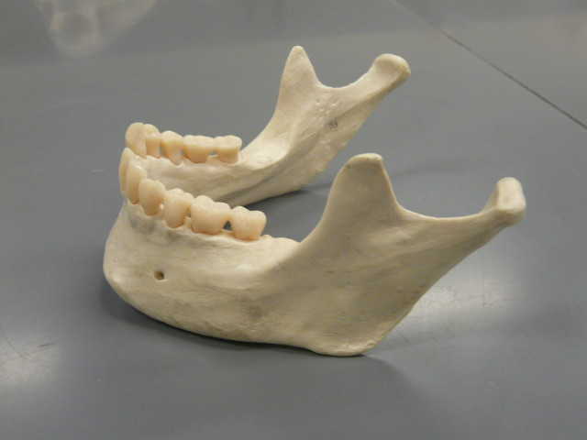
Mandible
Coranoid Process
Mandibular Condyle
Alveolar Processes
Mandibular Ramus
Mental Foramen
Angle of Mandible

Slide 4
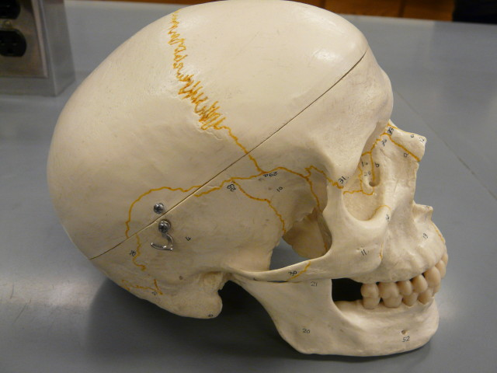
Lateral View
Coronal Suture
Parietal Bone
Frontal Bone
Nasal Bone
Lacrimal Bone
Nasolacrimal Canal
Sphenoid Bone
Temporal Bone
Zygomatic Bone
Zygomatic Arch
Mastoid Process
Mental Foramen
Angle of Mandible

Slide 5
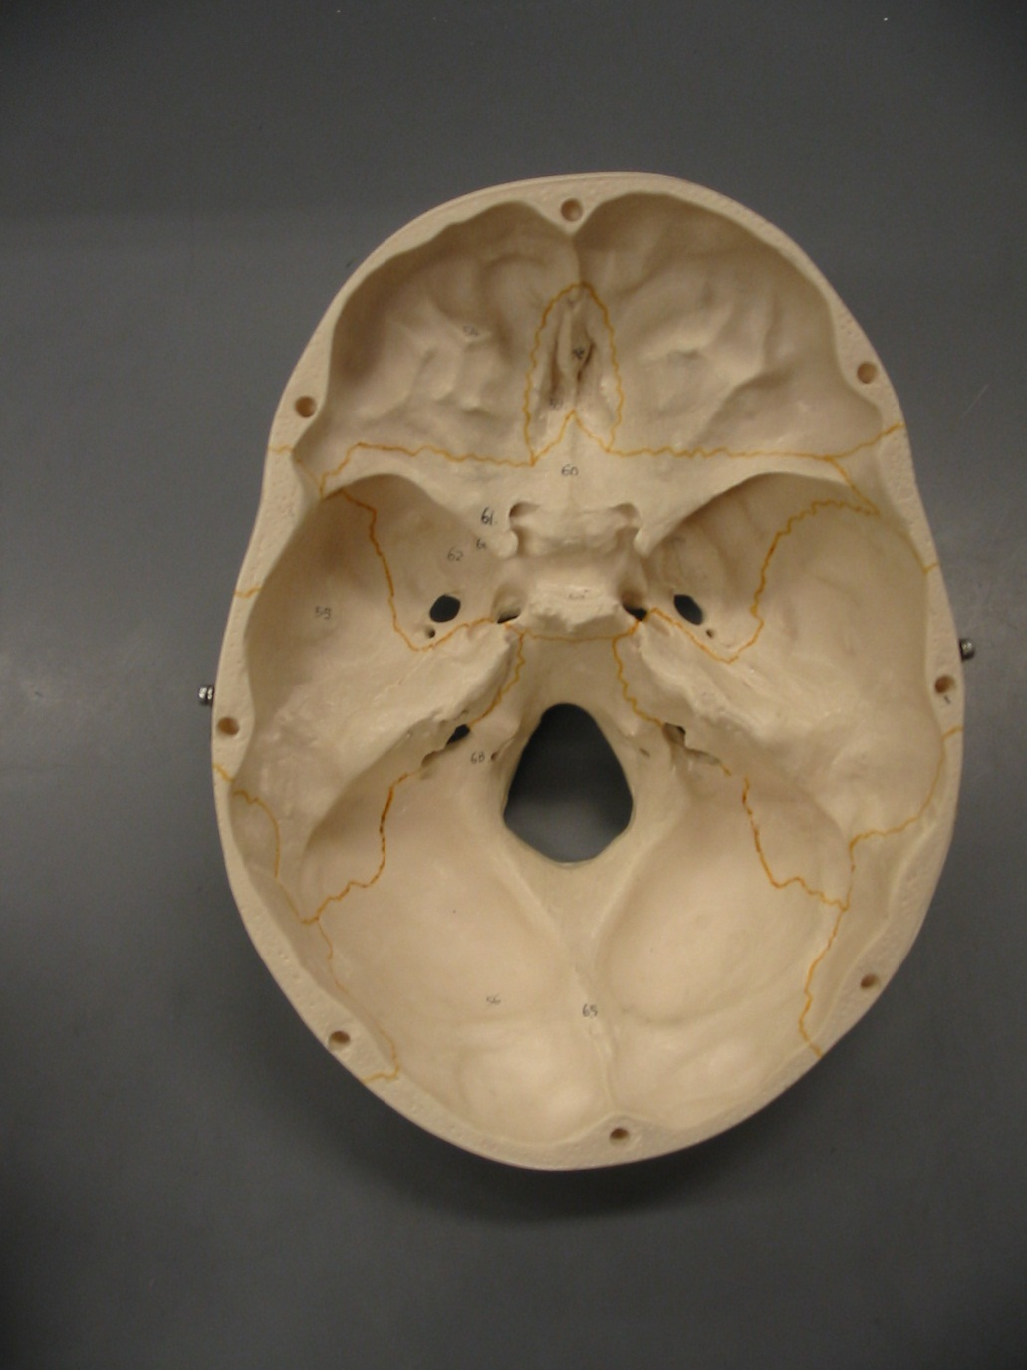
Cranial Floor View
Frontal Bone
Crista Galli
Ethmoid Bone
Cribriform Plate
Sphenoid Bone
Optic Foramen
Sella Turcica
Petrous Portion of Temporal Bone
Jugular Foramen
Foramen Magnum
Occipital Bone

Slide 6
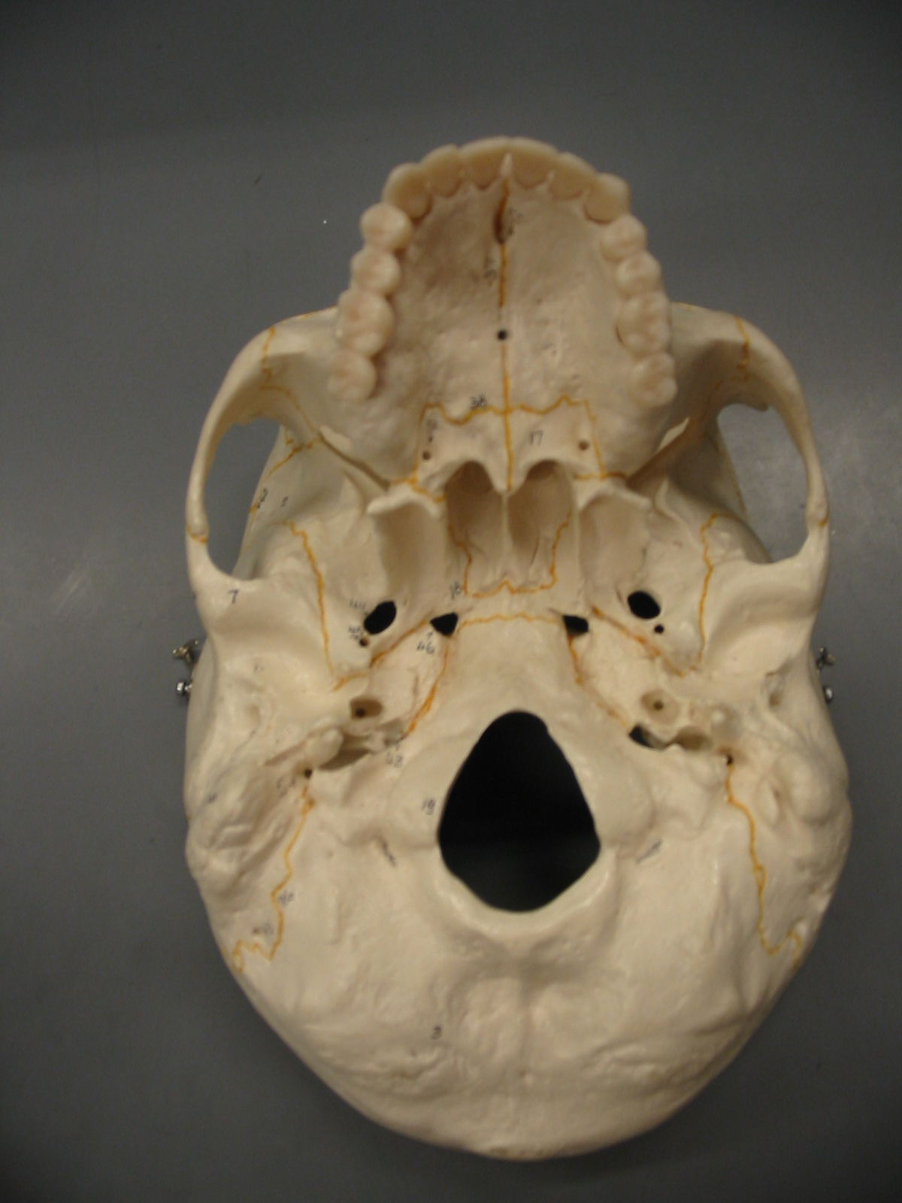
Inferior View
Palatine Process of Maxilla
Hard Palate
Palatine Bone
Vomer
Sphenoid Bone
Mandibular Fossa
Styloid Process
Jugular Foramen
Mastoid Process
Occipital Condyle
Foramen Magnum
Occipital Bone

Slide 7
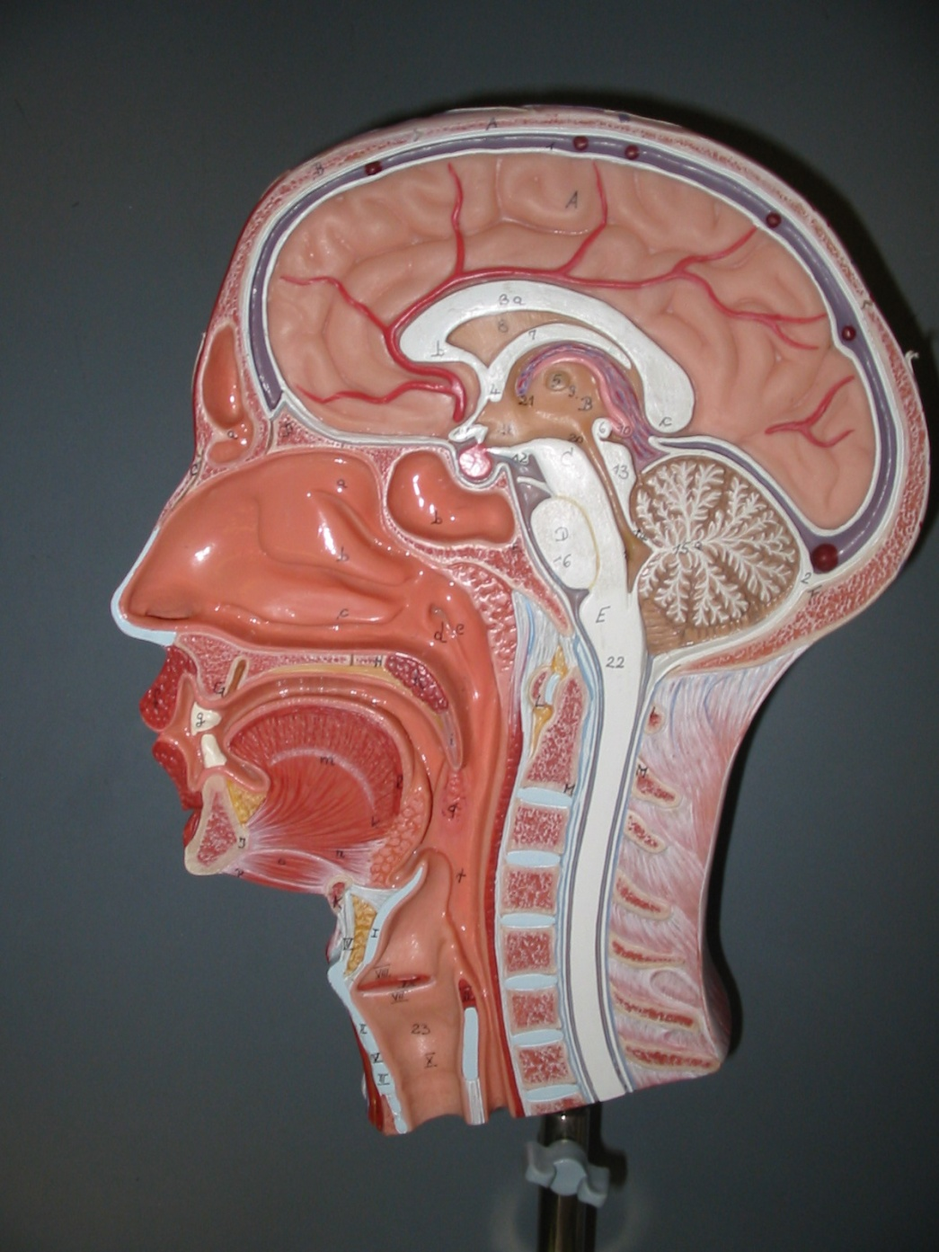
Half Head View
Frontal Sinus
Superior Nasal Concha
Sphenoidal Sinus
Middle Nasal Concha
Inferior Nasal Concha
Palatine Bone
Hard Palate
Palatine Process of Maxillary Bone

Slide 8
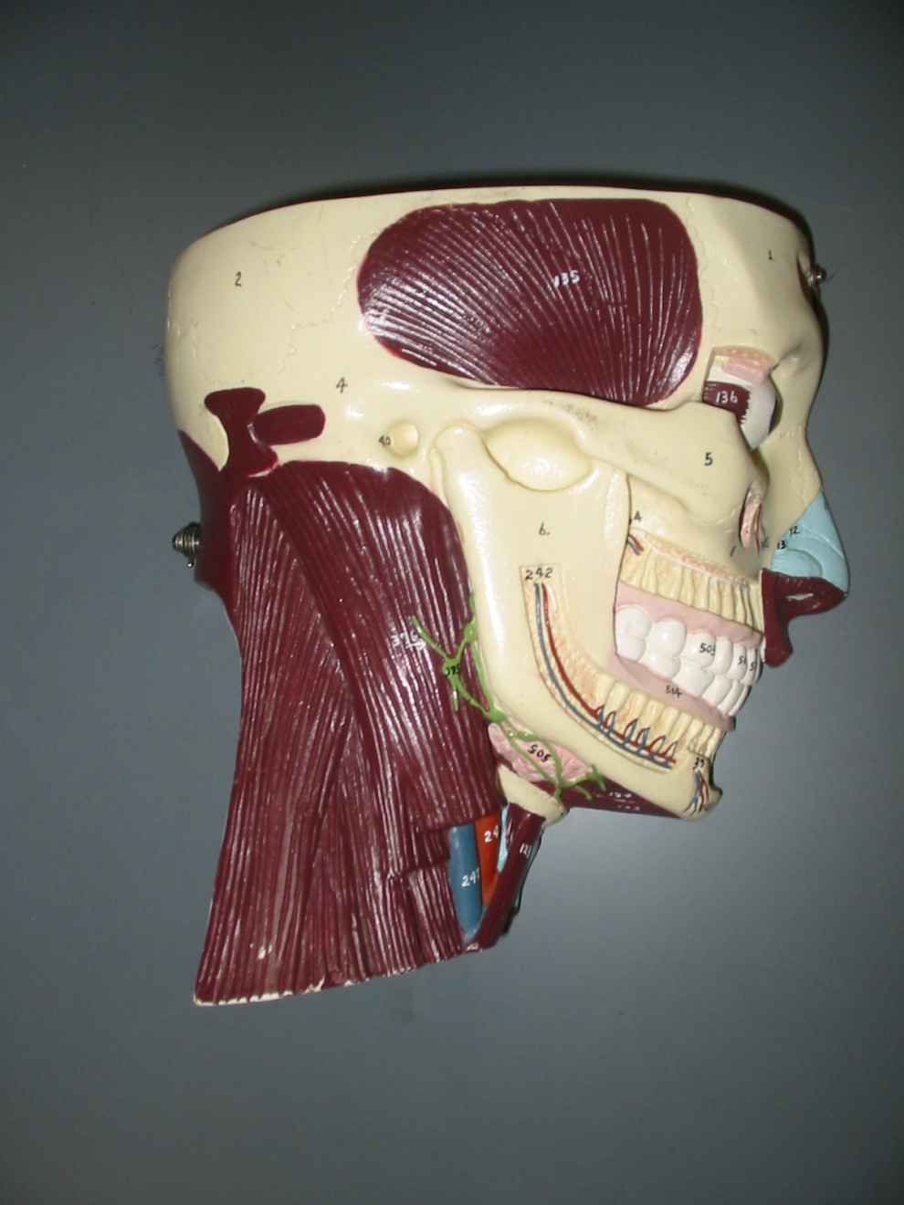
Torso Half Head (Lateral View)
Temporalis
Maxillary Sinus
Sternocleidomastoid

Slide 9
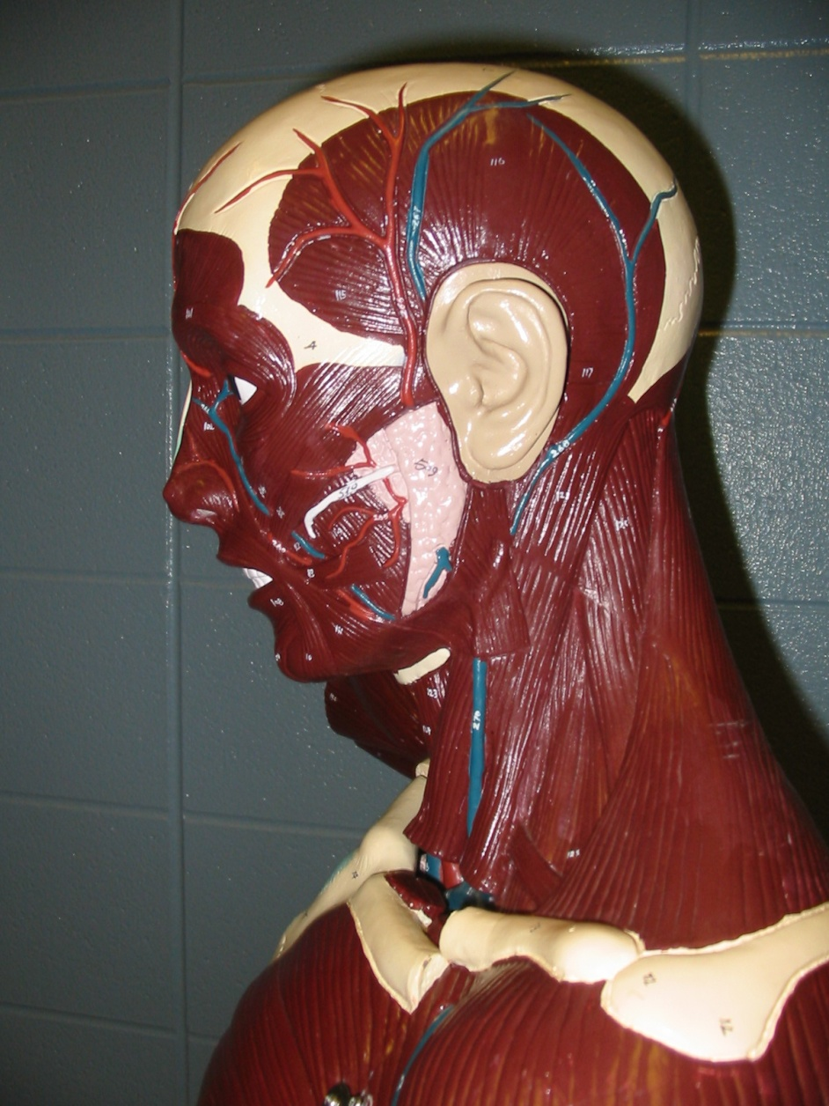
Torso Model View
Occipitofrontalis
Orbicularis Oculi
Zygomaticus Major
Masseter
Buccinator
Orbicularis Oris
Trapezius
Splenius Capitis
Sternocleidomastoid

Slide 10
Orbital View

Slide 11
Anterior View

Slide 12
Mandible

Slide 13
Lateral View

Slide 14
Cranial Floor View

Slide 15
Inferior View

Slide 16
Half Head View

Slide 17
Torso Half Head (Lateral View)

Slide 18
Torso Model View

