Slide 1
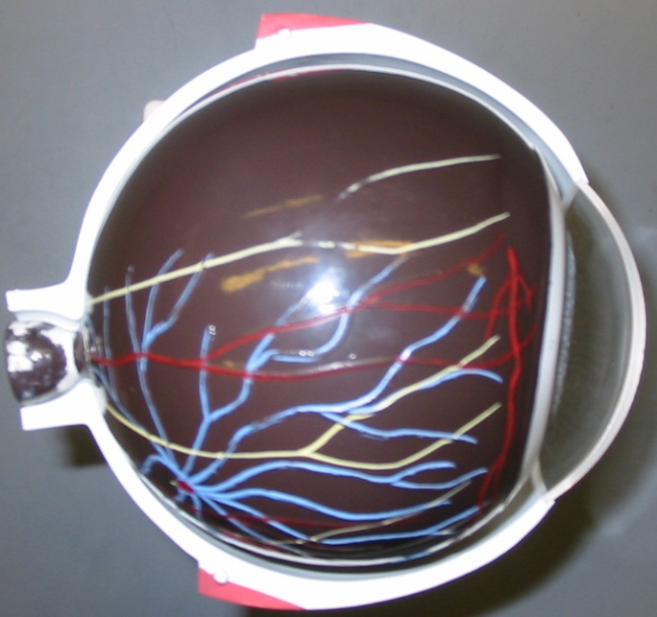
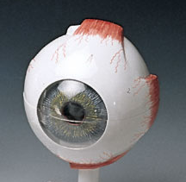
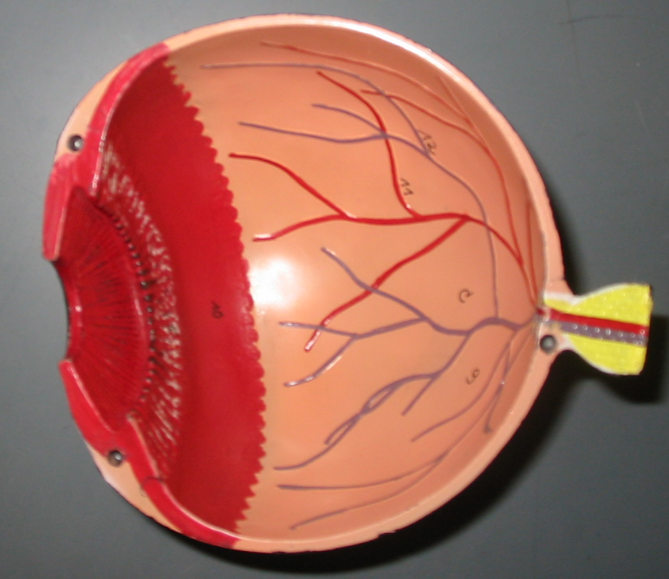
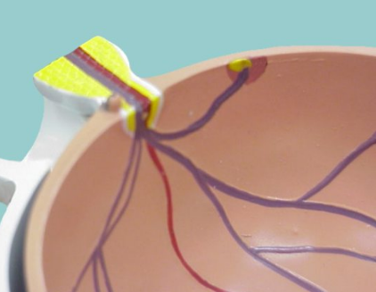
BIOL 203 – Summer 2012
Instructor: Alexandra Okihiro
The Eyeball
Sclera
Iris
Pupil
Cornea
Choroid
Retina
Ciliary Body
Suspensory Ligaments
Optic Disc
Optic Nerve
Iris
Macula Lutea

Slide 2
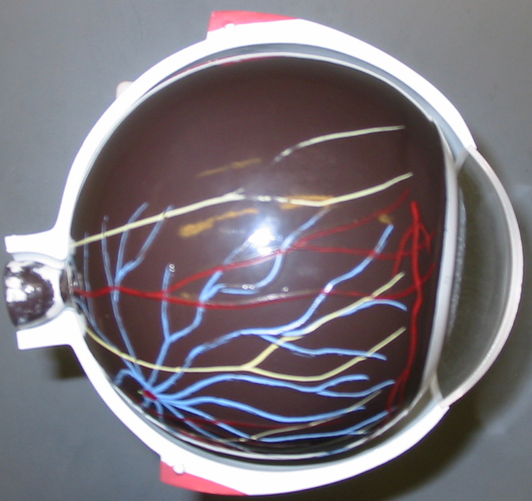
The Eyeball

Slide 3
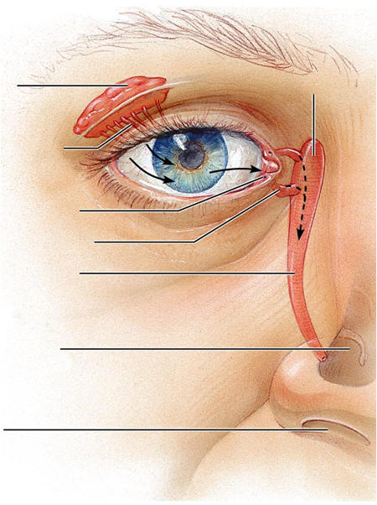
Lacrimal Apparatus
-for practical only (will not appear on a quiz)
Lacrimal Gland
Lacrimal Sac*
Lacrimal Duct
Puncta
Lacrimal Canaliculi
Nasolacrimal Duct
Nasal Cavity*
Nostril*
* Not on word list

Slide 4
Lacrimal Apparatus
-for practical only (will not appear on a quiz)

Slide 5
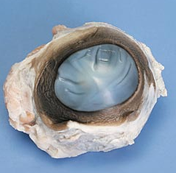
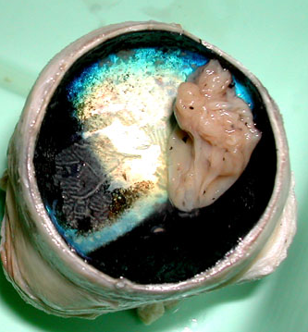
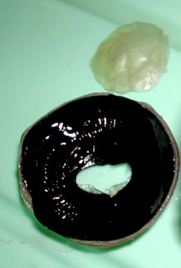
Cow (or Sheep) Eye Dissection - Practical
Cornea
Conjunctiva (this thin layer can be peeled back at the edge of the cornea)
Sclera
Posterior Eye (Cup)
Anterior Eye (Saucer)
Tapetum Lucidum
Cornea (cut away from the anterior eye)
Retina
Ciliary Body
Iris
Choroid
Pupil
Sclera
(Not Shown: Lens and lens capsule)
http://faculty.washington.edu/kepeter/119/images/cow_eye_dissections.htm

Slide 6
Cow (or Sheep) Eye Dissection - Practical
Posterior Eye (Cup)
Anterior Eye (Saucer)
(Not Shown: Lens and lens capsule)

Slide 7
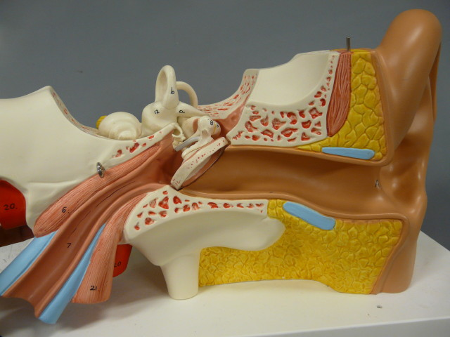
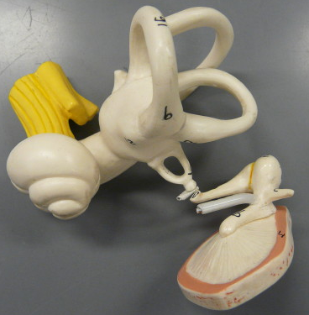
Cranial Nerve VIII: Vestibulocochlear Nerve
Stapes
The Ear
Semicircular Canals
Malleus
Incus
Auricle
Middle Ear/ Inner Ear
External Auditory Meatus
Vestibule
Tympanic Membrane
Cochlea
Tensor Tympani
Stapes
Eustachian Tube (Auditory Tube)
Incus
Malleus

Slide 8
The Ear
Middle Ear/ Inner Ear

