Slide 1
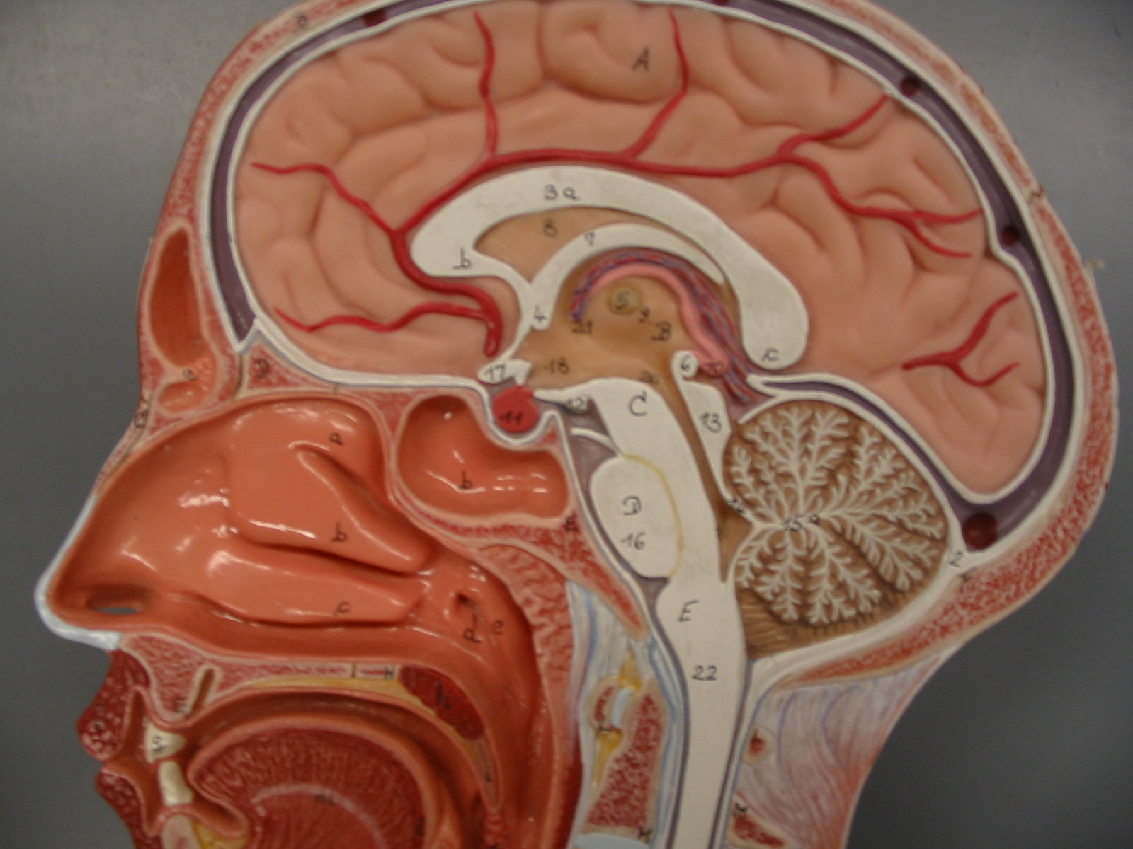
Structures of the Half-Head (Mid-Sagittal View)
Arachnoid Granulations
Superior Sagittal Sinus
Cerebrum
Corpus Callosum
Intermediate Mass
Thalamus
Diencephalon
Hypothalamus
Pineal Body
Optic Chiasma
Midbrain
Pituitary Gland
Cerebral Aqueduct
Cerebellum
Tree-like Pattern: Arbor Vitae
Fourth Ventricle
Pons
Medulla Oblongata
BIOL 203 – Summer 2012
Instructor: Alexandra Okihiro

Slide 2
Structures of the Half-Head (Mid-Sagittal View)
Tree-like Pattern:

Slide 3
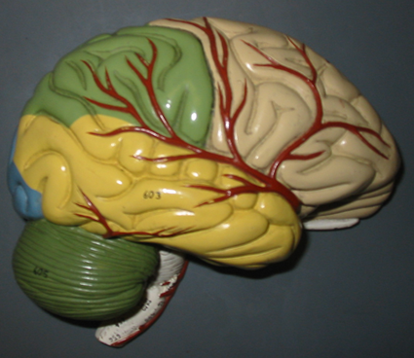
Overview: Lateral View of Colored Brain
Central Sulcus
Pre-Central Gyrus
Post-Central Gyrus
Parietal Lobe
Frontal Lobe
Temporal Lobe
Occipital Lobe
Posterior
Anterior
Lateral Fissure
Cerebellum

Slide 4
Overview: Lateral View of Colored Brain
Posterior
Anterior

Slide 5
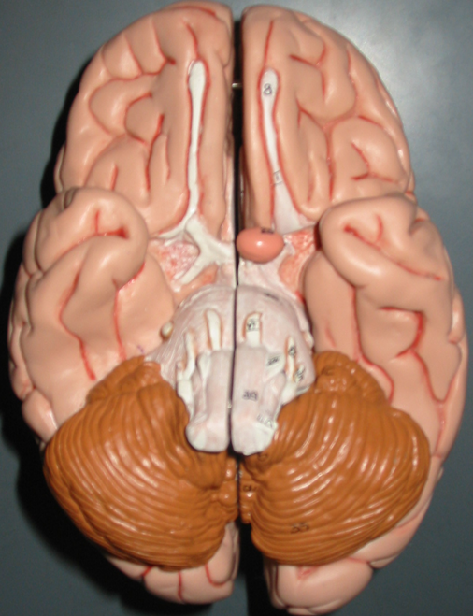
Inferior View of the Brain
Olfactory Bulb
Olfactory Tract
Cranial Nerve I: Olfactory Nerve
Cranial Nerve II: Optic Nerve
Optic Chiasma
Pituitary Gland
Cranial Nerve III: Oculomotor Nerve
Cranial Nerve IV: Trochlear Nerve
Pons
Medulla Oblongata
Cerebellum

Slide 6
Inferior View of the Brain
Pituitary Gland

Slide 7
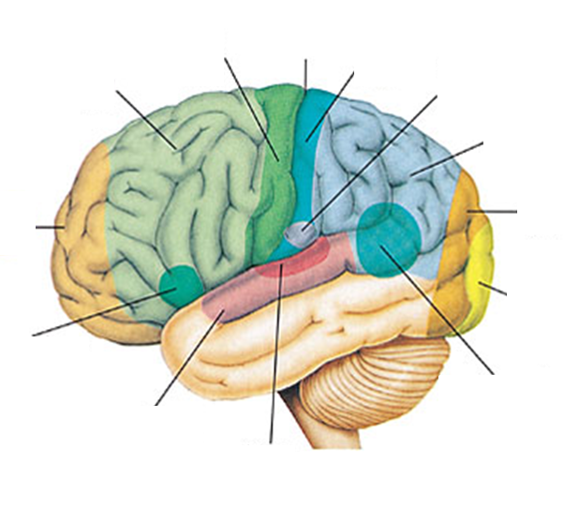
Functional Areas of Cerebral Cortex

