Slide 1
The Forearm, Wrist and Hand
BIOL 203 – Summer 2012
Instructor: Alexandra Okihiro
Head
Olecranon Process
Trochlear Notch (U shape)
Radial Tuberosity
Radial Notch
[Note: The ulna is the only bone where the “head” is found at the distal end instead of proximal end.]
Styloid Process
Head
Styloid Process

Slide 2
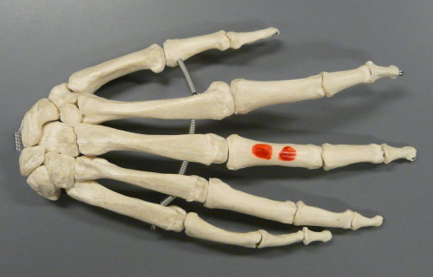
Right Hand
Distal Phalanx of Digit 5
Middle Phalanx of Digit 5
Distal Phalanx of Pollex (Digit 1)
Proximal Phalanx of Digit 5
Proximal Phalanx of Pollex (Digit 1)
Metacarpal 5
Metacarpal 1
Carpals (There are 8 total)

Slide 3
Muscles that Move the Forearm, Hand and Fingers
2
4
1
4
3
Palmaris Longus
Flexor Carpi Radialis
Flexor Carpi Ulnaris
Flexor Digitorum Superficilalis
Flexor Digitorum Profundus
Flexor Pollicis Longus
6
5

Slide 4
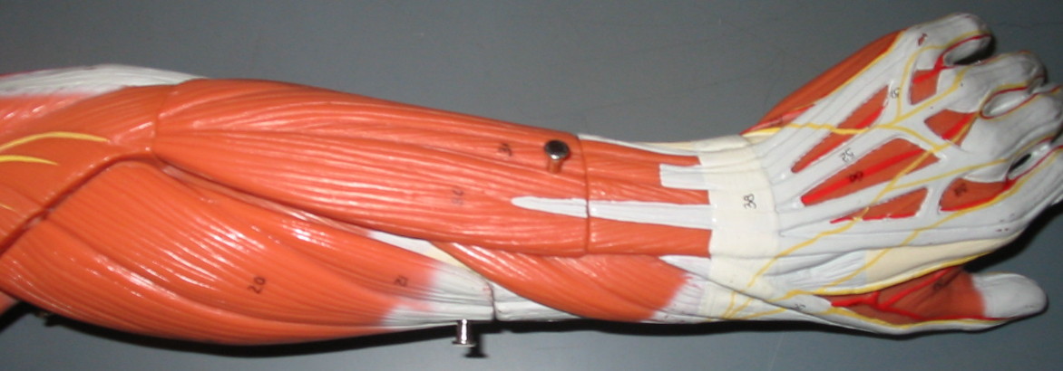
Muscles that Move the Forearm, Hand and Fingers
9
7
8
8
10
11
7. Extensor Digitorum
8. Extensor Carpi Radialis Longus & Brevis
9. Extensor Carpi Ulnaris
10. Extensor Pollicis Brevis
11. Abductor Pollicis Longus

Slide 5
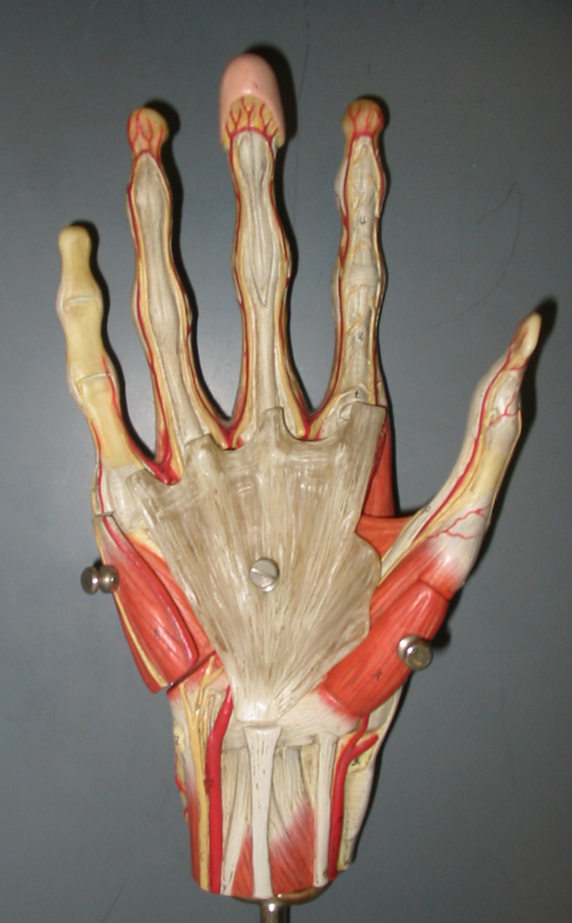
Hand
Palmar Aponeurosis
Flexor Retinaculum

Slide 6
The Forearm, Wrist and Hand
[Note: The ulna is the only bone where the “head” is found at the distal end instead of proximal end.]

Slide 8
Muscles that Move the Forearm, Hand and Fingers
2
4
1
4
3
6
5

Slide 9
Muscles that Move the Forearm, Hand and Fingers
9
7
8
8
10
11

Slide 10
Hand

