Slide 1
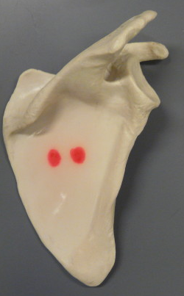
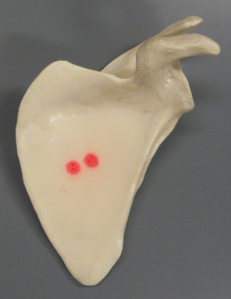
The Pectoral Girdle and Arm
BIOL 203 – Summer 2012
Instructor: Alexandra Okihiro
Supraspinous Fossa
Acromion Process
Coracoid Process
Glenoid Cavity
Spine
Infraspinous Fossa
Superior Border
Lateral Border
Medial Border
Inferior Angle
Right Scapula
(Posterior View)
Left Scapula
(Anterior View)

Slide 2
Left Humerus
(Anterior View)
Right Humerus
(Posterior View)
Head
Olecranon Fossa
Medial Epicondyle
Lateral Epicondyle
Trochlea
Capitulum

Slide 3
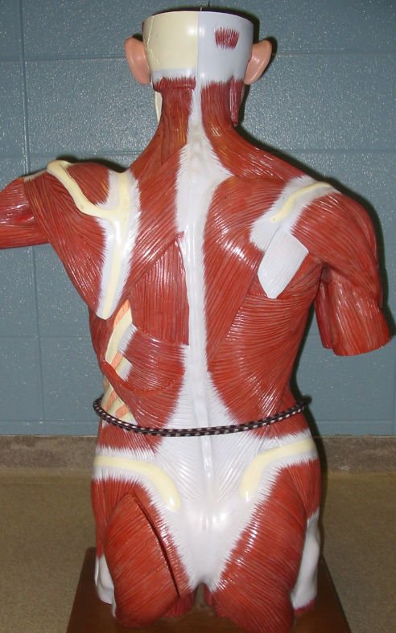
Muscles that move the Pectoral Girdle and Arm
Rhomboideus Minor
Rhomboideus Major
Deltoid
Trapezius
Latissimus Dorsi

Slide 4
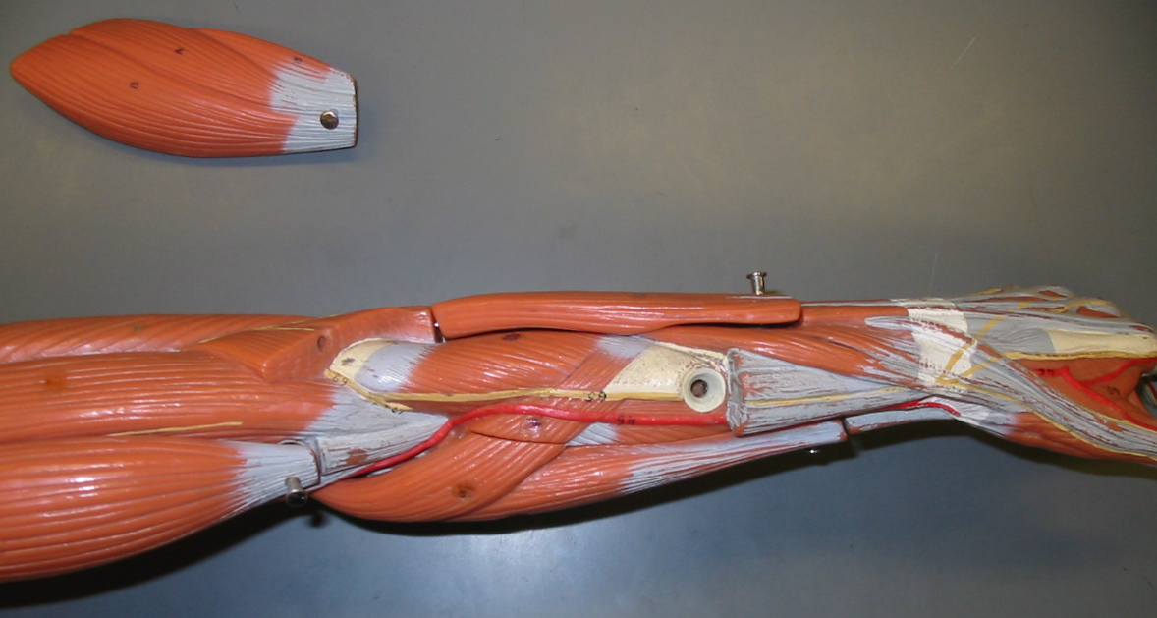
Muscles that move the Forearm
2
3
4
5
1
Biceps Brachii
Brachioradialis
Triceps Brachii
Supinator
Pronator Teres

Slide 5
The Pectoral Girdle and Arm
Right Scapula
(Posterior View)
Left Scapula
(Anterior View)

Slide 6
Left Humerus
(Anterior View)
Right Humerus
(Posterior View)

Slide 7
Muscles that move the Pectoral Girdle and Arm

Slide 8
Muscles that move the Forearm
2
3
4
5
1

