Slide 1
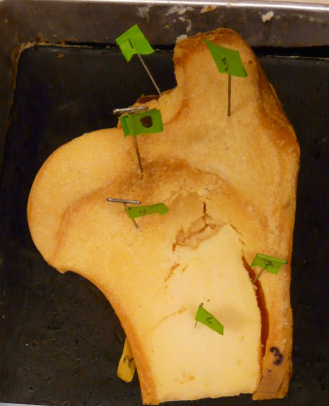
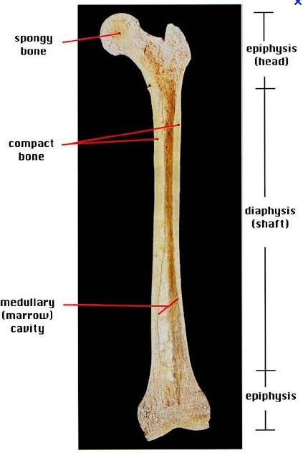
BIOL 203 – Summer 2012
Instructor: Alexandra Okihiro
1
5
8
4
7
6
2
Articular Cartilage
Periosteum
Compact Bone
Spongy Bone
Red Bone Marrow (In spaces of spongy bone)
Yellow Bone Marrow
Medullary Cavity
Epiphyseal Line

Slide 2
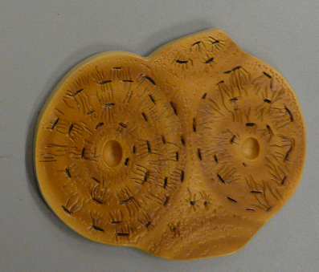
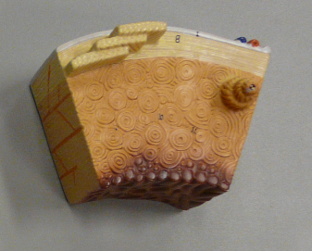
Canaliculi
Central Canal
Lacunae (a space for osteocytes)
Osteon
One circular layer in an osteon is called a concentric lamellae

Slide 3
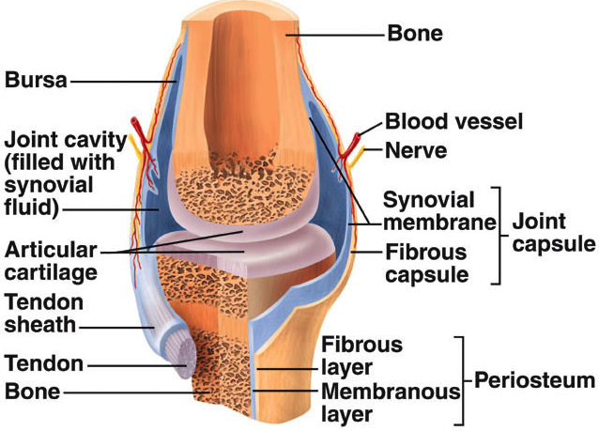
Synovial Joint (For Practical)

Slide 4
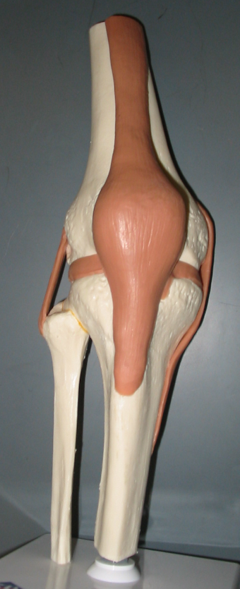
Right Knee
(Anterior View)
Femur
Quadriceps Femoris Tendon
Lateral Meniscus
Medial Meniscus
Lateral Collateral Ligament
Medial Collateral Ligament
Patellar Ligament
Fibula
Tibia

Slide 5
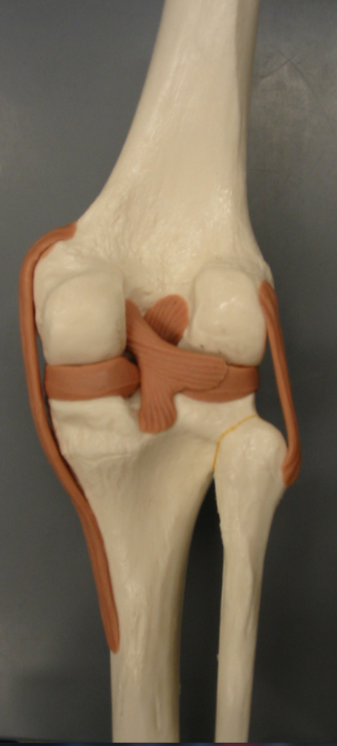
Right Knee
(Posterior View)
Medial Collateral Ligament
Anterior Cruciate Ligament
Lateral Collateral Ligament
Medial meniscus
Posterior Cruciate Ligament

Slide 6
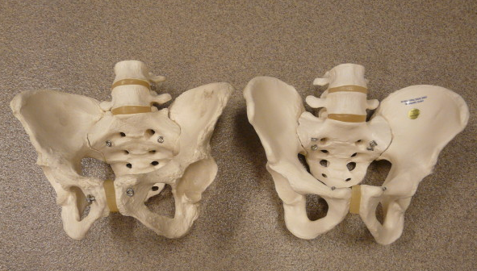
Male vs. Female Pelvic Girdle
Female
Oval Shaped Pelvic Inlet
Wider, Shorter Ilium
Subpubic Angle > 90º
Ischial Spines Further Apart
Wider Sacrum
Lighter in Weight
Male
Heart Shaped Pelvic Inlet
Steeper, Longer Ilium
Subpubic Angle < 90º
Ischial Spines Close Together
Sacrum is less wide
Heavier in Weight

Slide 7
Right Knee
(Anterior View)

Slide 8
Right Knee
(Posterior View)

