Slide 1
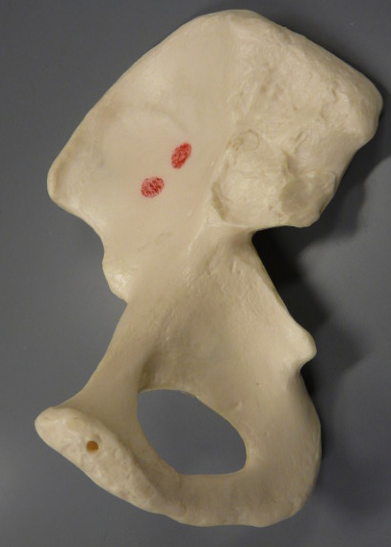
The Pelvic Girdle and Lower Limb
Iliac Crest
Ilium
Sacroiliac Joint
Anterior Superior Iliac Spine
Anterior Inferior Iliac Spine
Ischial Spine
Pubis
Obturator Foramen
Ischium
BIOL 203 – Summer 2012
Instructor: Alexandra Okihiro

Slide 2
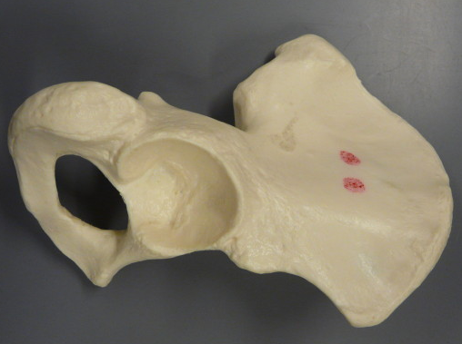
Iliac Crest
Ilium
Anterior Superior Iliac Spine
Anterior Inferior Iliac Spine
Acetabulum
Pubis
Ischium
Obturator Foramen
Ischial Tuberosity

Slide 3
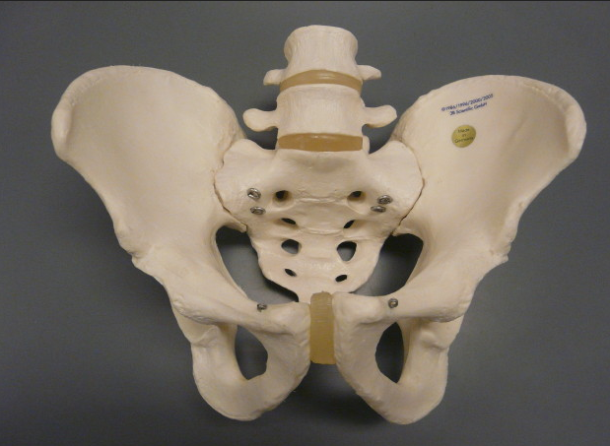
Sacroiliac Joint
Sacrum
Pelvic Inlet
Symphysis Pubis
Subpubic Angle

Slide 4
Right Femur
Left Femur
Head
Neck
Greater Trochanter
Lesser Trochanter
Linea Aspera
Lateral Epicondyle
Medial Epicondyle
Medial Condyle
Lateral Condyle
Posterior
Anterior

Slide 5
Left Tibia
Fibula
Medial Condyle
Lateral Condyle
Head
Tibial Tuberosity
[Note: The head of the fibula also has a structure that looks like the lateral malleolus.]
Tibial (Anterior) Crest
Medial Malleolus
Lateral Malleolus

Slide 6
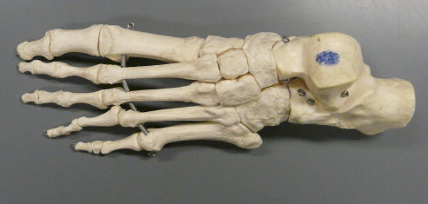
Left Foot
Distal Phalanx of Hallux (Digit 1)
Distal Phalanx of Digit 5
Proximal Phalanx of Hallux(Digit 1)
Middle Phalanx of Digit 5
Proximal Phalanx of Digit 5
Metatarsal 1
Metatarsal 5
Tarsals (There are 7 total)
Talus
Calcaneus

Slide 7
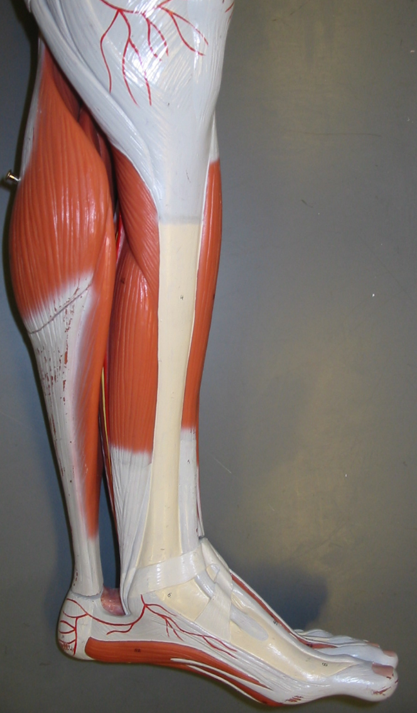
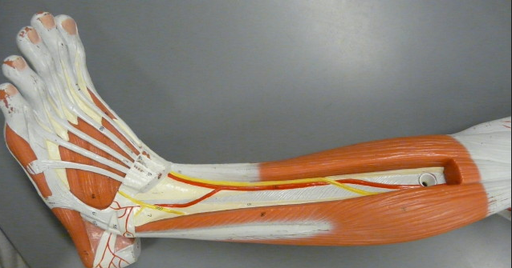
Movement of the foot and toes
Peroneus Longus
Extensor Digitorum
Tibialis Anterior
Flexor Digitorum
Gastrocnemius

Slide 8
Ilium
Anterior Superior Iliac Spine
Pubis
Ischium

Slide 9
Ilium
Pubis
Ischium

Slide 11
Right Femur
Left Femur
Anterior
Posterior

Slide 12
Left Tibia
Fibula
[Note: The head of the fibula also has a structure that looks like the lateral malleolus.]

Slide 13
Movement of the foot and toes

