Slide 1
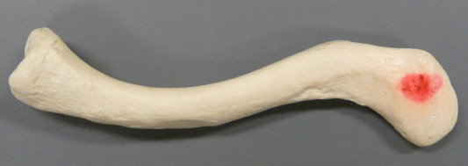
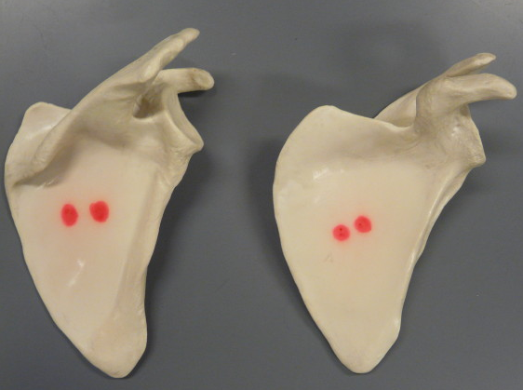
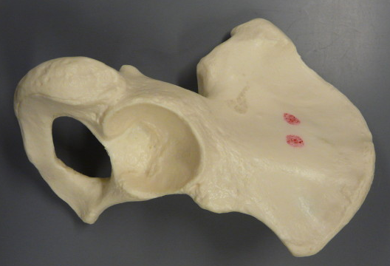
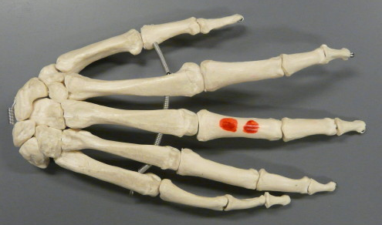
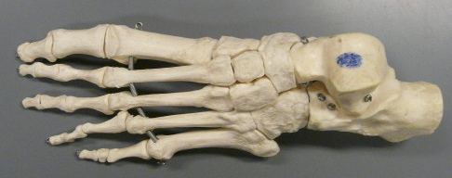
Bones of the limbs
BIOL 203 – Summer 2012
Instructor: Alexandra Okihiro
Proximal [medial] end
Distal [lateral] end
Clavicle
Right
Left
Scapula
(Right) Coxa
Phalanges
Metatarsals
Phalanges
Metacarpals
Tarsals
Carpals

Slide 2
Proximal end
(Left) Humerus
(Left) Ulna
Radius
(Right) Femur
(Left) Tibia
Fibula
Distal end

Slide 3
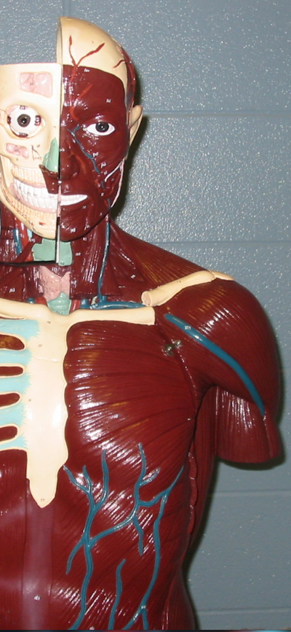
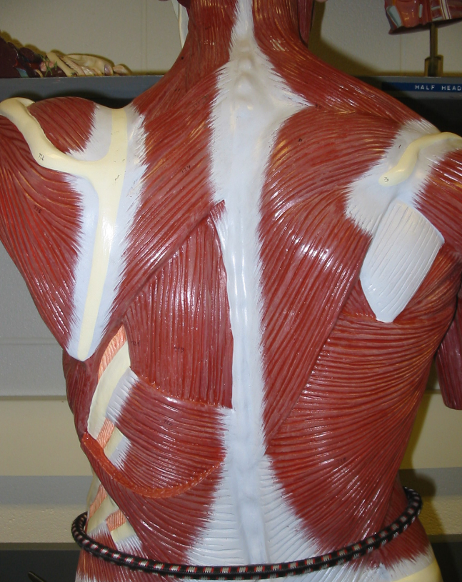
Muscles that Move the Limbs
Trapezius
Deltoid
Pectoralis Major
Latissimus Dorsi
Sternum

Slide 4
Deltoid
Biceps Brachii
Triceps Brachii
Brachioradialis
Flexors of wrist and fingers
Extensors of wrist and fingers

Slide 5
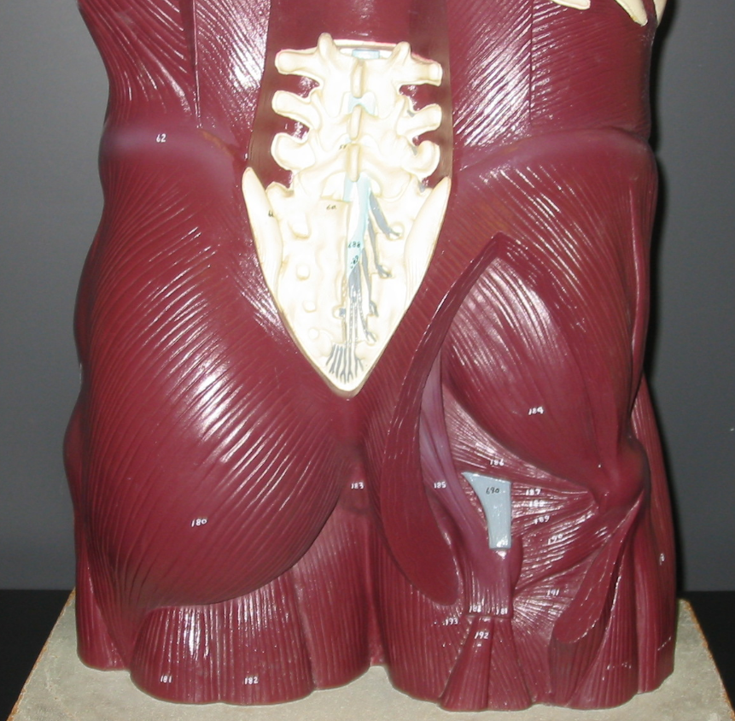
Adductors of thigh
Sartorius
Quadriceps Femoris Group
Hamstrings Group
Gastrocnemius
Tibialis Anterior
Gluteus Maximus
Gluteus Medius

Slide 6
Muscles that Move the Limbs

