Slide 1
Firestone and Ford
Starting in the early 1990s, the Ford Explorer running on Firestone tires began to have a large number of accidents (including fatalities) in the United States and internationally. What happened?
According to Ford... the tire design had high operating temperatures and weak construction.
Independently the designs probably met all of their requirements. But how subsystems interact together is extremely important!
According to Firestone… the vehicle ran at too low of a tire pressure and was more prone to rollovers.

Slide 2
Design Studio – Week 9
Today you will:
Package and deliver your circuit design from Logic.ly
Assist in integrating and testing the overall class design
Observe the circuit design for P and Q in PLC ladder logic
Assignments:
Exercise worksheet for digital circuit integration and test

Slide 3
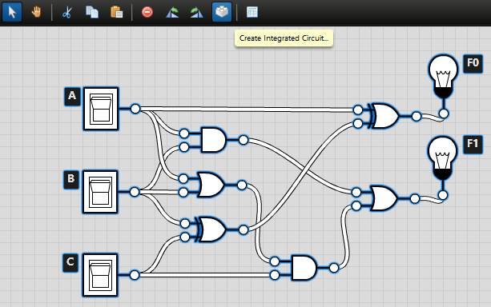
Integration – Logic.ly
Create
Use Create Integrated Circuit… button to package your design.

Slide 4
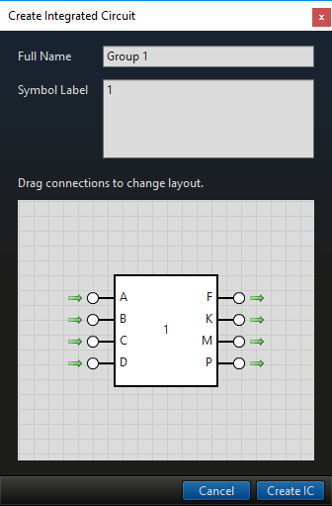
Integration – Logic.ly
Create
To package your design:
Use your group as the circuit name, e.g. “Group 1”
For the symbol label, just use the number of your group, e.g. “1”
Arrange the pins so all of the inputs are on the left and all of the outputs are on the right
Also arrange the inputs and outputs in alphabetical order
Click Create IC to add the part to your library (under “Custom”)

Slide 5
Integration – Logic.ly
Create
Your IC should appear at the bottom of the menu on the left.
Scroll and find it to ensure it’s there.
To export the library of custom ICs, use the menu to select File > Export Integrated Circuit Library…
Give the file a name including your group number and send the file to your instructor.

Slide 6
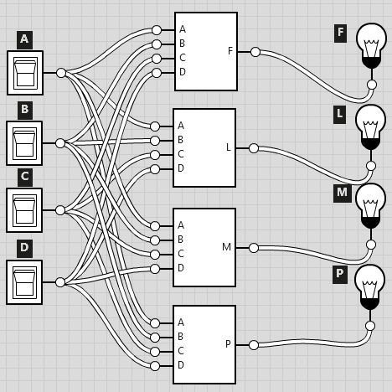
Integration – Logic.ly
Create
If a group has individual Logic.ly files for each output, it’s OK. You can help them package and build a single IC.
Start by having the group create and export an integrated circuit for each file they have.
Then start a new circuit file and import all of the libraries.
Have them wire up the new circuit as shown on the left and they can export that library to send to you.

Slide 7
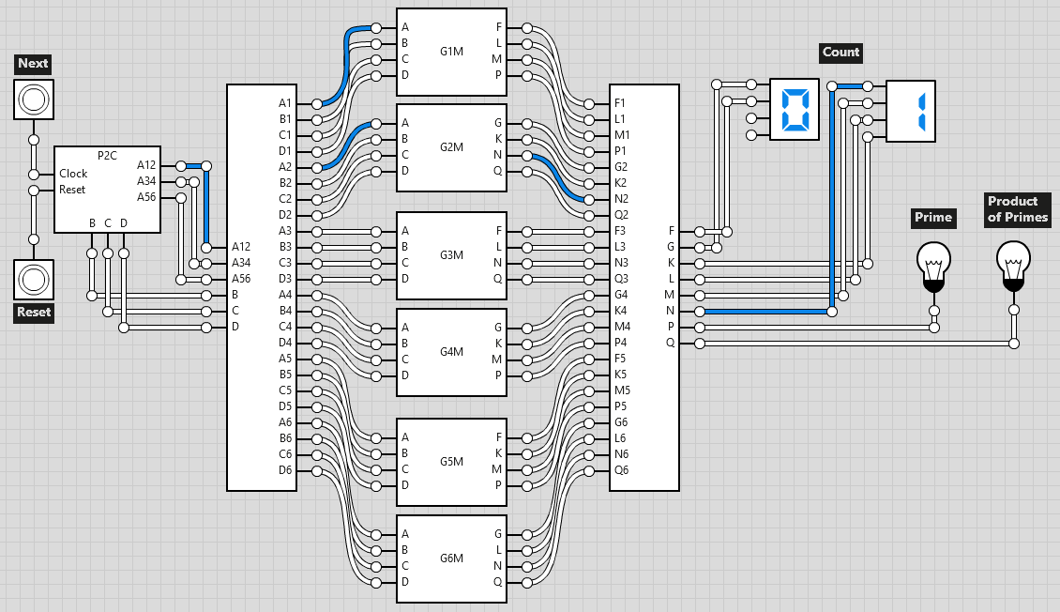
Building the Overall Model
Test
Import and replace the G#M blocks with the student ICs.

Slide 8
Project 2 Testing
Test
Follow along with the worksheet to test the overall design.

Slide 9
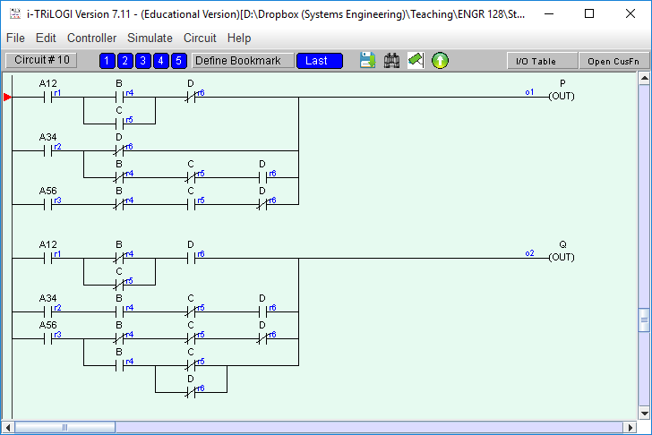
Building the Overall Model
Test
Update the iTRiLOGI file with the ladder logic in the exercise worksheet from Week 7 that the students submitted.
The master file shows good ladder logic that works.
Update the file with the ladder logic the students submitted.
Do this before Studio!

Slide 10
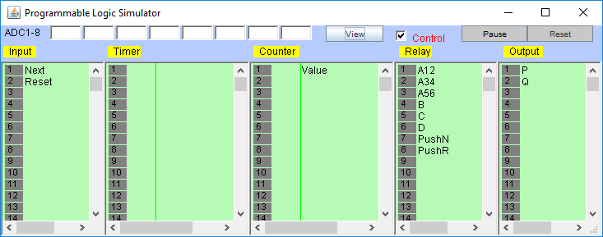
Project 2 Testing
Test
We’ll also test the implementation of primes (P) and product of primes (Q) in PLC ladder logic using i-TRiLOGI.

Slide 11
Week 9 Assignments
Next week we will have Exam 2 during Studio.
The following week we will begin our final project!
Questions after Studio? Email your instructor or go to office hours.
Exercise
Complete the Week 9 worksheet handed out earlier.
Follow the instructions test and analyze the overall circuit.
Submit the completed worksheet before leaving today.

