Slide 1
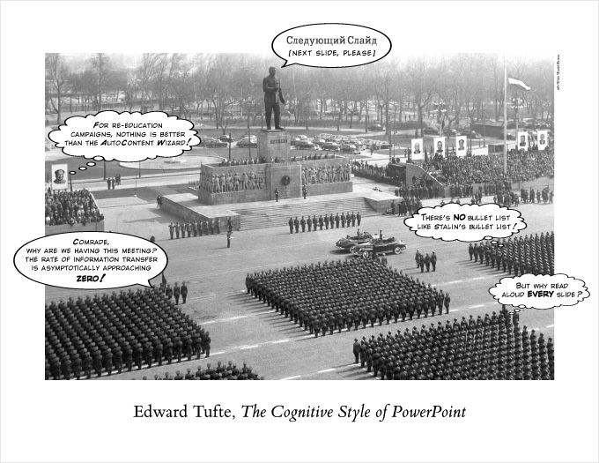
PowerPoint Is Evil*
*Ironically written in PowerPoint, source: https://www.wired.com/2003/09/ppt2/

Slide 2
Design Studio – Week 7
Today you will:
Review the rubrics for presentations and technical reports
Critique and improve a inadequate presentation
Explore different tools for modeling digital logic circuits
Continue development of your design for Project 2
Assignments:
Exercise worksheet for digital circuit design
Project 2 in-class presentation
Project 2 technical report

Slide 3
Communicating to an Audience
As you develop your design, there are many groups with whom
you will need to share information:
Co-workers and peers
Project managers and supervisors
Stakeholders (and senior leadership that represent them)
Potential customers
Of course, there are lots of ways to communicate, varying from informal to very regimented.
Examples include memos (including email), documentation, reports, presentations, brochures, and commercials.
You should choose the means appropriate to the audience.

Slide 4
Project 2 Presentation
Project 2 also includes a formal class presentation. Whether or
not this is your first presentation of your academic career, you will be given an opportunity to learn and apply valuable presentation techniques in a learning environment.
The purpose of the presentation is to provide an overview of your design to an audience of engineering peers and managers. You can assume they know a little bit about your project goal and have an equivalent understanding of engineering concepts.
Presenting to peers is a great way to get valuable feedback on your project. Engineers not associated with your project can help give a “beginner’s perspective” and identify things your team has missed.
The expected time for this presentation is 8 to 12 minutes.

Slide 5
Project 2 Technical Report
Project 2 again features a technical report.
Remember, the report can be viewed as an account of:
What you planned and decided (Methods)
What you did and what you learned (Results)
What you think you should do next (Conclusions)
The report should also include a cover page and references and appendices as needed.
Let’s review the rubric for both the presentation and
the technical report posted on the Studio website.

Slide 6
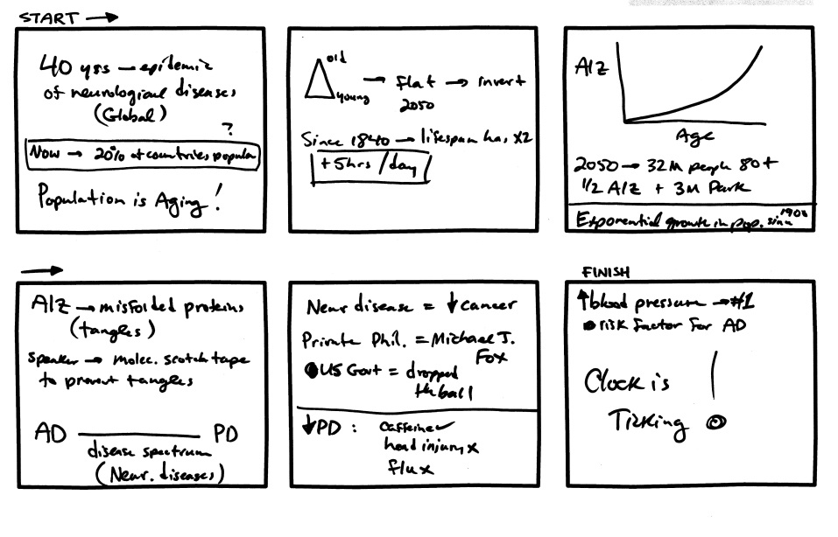
Planning Your Presentation
Like the technical memos and report you’ve been writing,
a presentation should tell a story. If your presentation is just a collection of bullet points, figures, and clip art, it probably won’t be very effective.
Try to develop an outline for your presentation. One effective way of developing the outline is storyboarding:
Draw the slides you’ll need, along
with the topics and relevant figures.
If you use Post-It notes, you can
rearrange and add slides as you go.
As you develop the slides, think
about the talking points and how
to transition between slides.

Slide 7
PowerPoint Presentation Tips
PowerPoint is just a tool. Using it effectively is powerful for conveying your message, but it can equally be dangerous.
Know your audience
Use slides as a guide and support for your verbal presentation
Avoid clutter and compressing too many topics
Make sure the text is readable
Employ figures and tables that convey exactly the information you want
There are lots of tips and strategies available online. Many of them are good, but always think about why they are important before you decide if they are appropriate for your presentation.

Slide 8
Practicing Your Presentation
The best way to confident in and comfortable with your presentation is to practice!
It might be tempting to simply review the slides, but it really does help to speak as if you were really presenting. Adding the words you intend to say will help you remember them later, and may identify discrepancies in your slides or difficult phrasings.
For team presentations, practicing as a group will help you identify the roles of each team member. Team practice will also help you avoid transitions such as “Now I’m going to pass it over to…”
Another helpful tool while practicing is a timer. Use the timer to check the length of your presentation and adjust timing and pacing of the material.

Slide 9
Giving Your Presentation
Planning and practicing will make your presentation easier,
but no one said it would be easy. Sometimes, even the most prepared still get anxious or nervous.
Here are some tips for facing the moment:
Come rested
Stay hydrated
Take a breath if you start to speed up or get worried
Smile and stay positive
Remember: you’re the expert at your own presentation!

Slide 10
Presentations – An Example
Please consider what needs to be improved in this presentation.
What would improve in the content of this presentation?
What would improve the spoken presentation
(other than the slides)?
What would improve the visual presentation (the slides)?

Slide 11
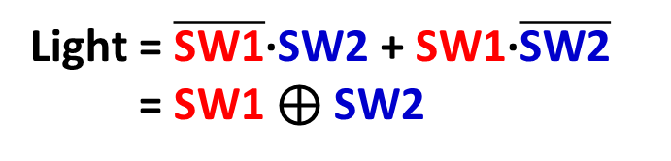
Concept Review – Logic Circuits
Logic designs include gates for Boolean operators (AND, OR, NOT). These circuits can also include logic like switches, relays, and timers.
Let’s consider the design of a 3-way light switch control.
SW1 | SW2 | Light
0 | 0 | 0
0 | 1
1 | 0
1 | 1
A three way light switch control has two switches.
Anytime a switch is changed (toggled) the light should change too.
1
1
Light = $\overline{\text{SW}\text{1}}$·SW2 + SW1·$\overline{\text{SW}\text{2}}$
= SW1 ⊕ SW2
0

Slide 12
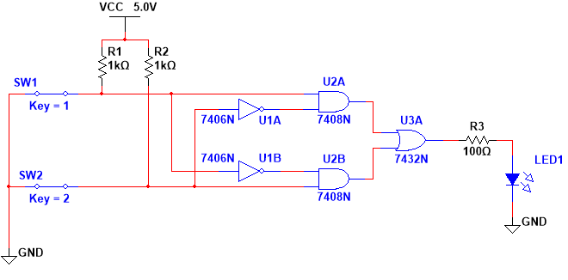
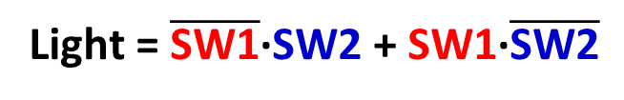
Modeling – Multisim
Create
Light = $\overline{\text{SW}\text{1}}$·SW2 + SW1·$\overline{\text{SW}\text{2}}$

Slide 13
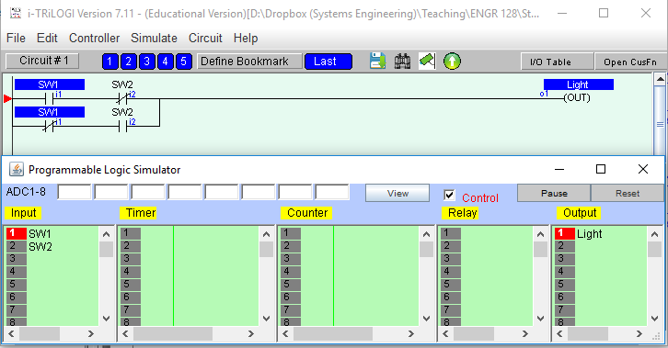
Modeling – iTRiLOGI
Create
Light = $\overline{\text{SW}\text{1}}$·SW2 + SW1·$\overline{\text{SW}\text{2}}$

Slide 14
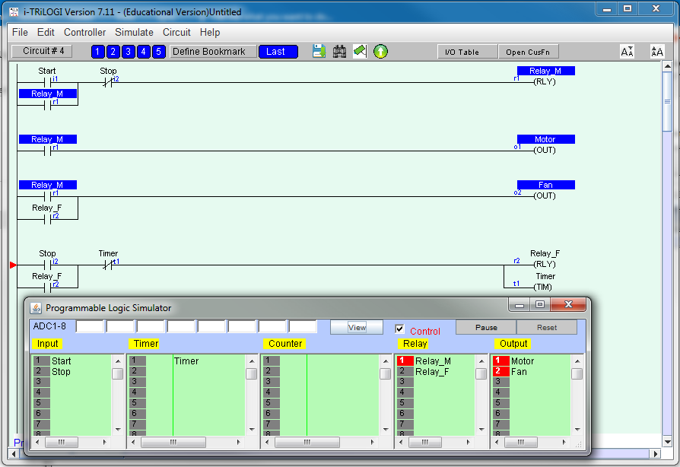
iTRiLOGI – Motor and Fan Controller

Slide 15
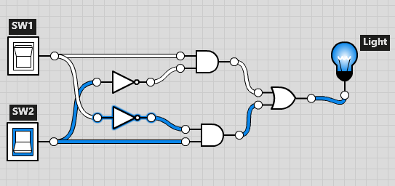
Modeling – Logic.ly
Create
Light = $\overline{\text{SW}\text{1}}$·SW2 + SW1·$\overline{\text{SW}\text{2}}$

Slide 16
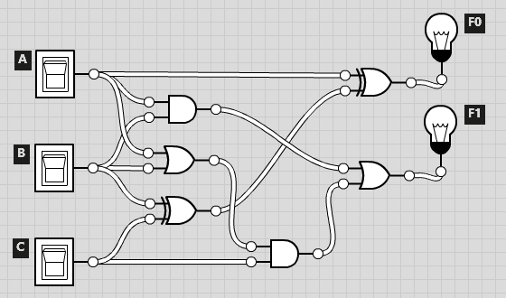
Logic.ly – 2-bit Counter

Slide 17
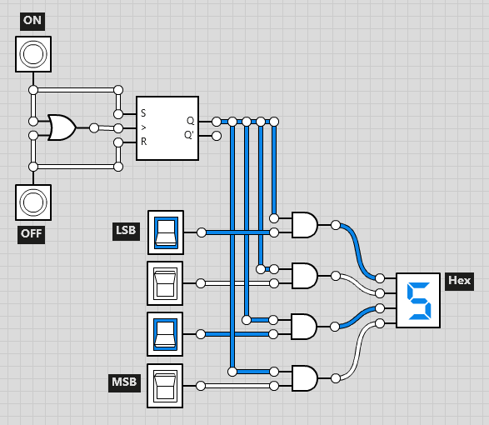
Logic.ly – Hex Display

Slide 18
Project 2 Modeling
Create
Build circuits for each of your four outputs in Logic.ly.
You can choose to design four separate circuits or one large circuit.
Additionally, build the ladder logic for your last output (P or Q) in iTRiLOGI and attach it to your exercise worksheet.
Your instructor is here to help answer guiding questions
and troubleshoot any problems that your team identifies.

Slide 19
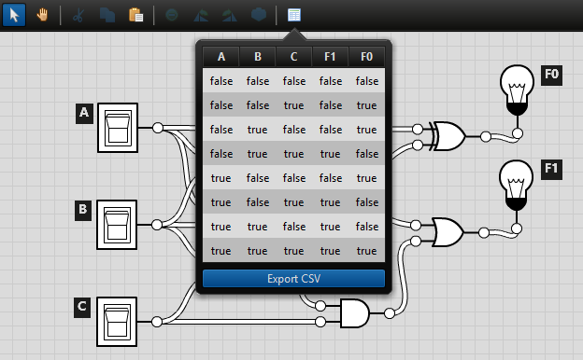
Project 2 Testing
Test
To test the circuit, you’ll need to try every combination of the
inputs (i.e. build a truth table).
In Logic.ly, you can automatically generate a truth table based on the inputs (switches) and outputs (light bulbs).

Slide 20
Week 7 Assignments
Questions after Studio? Email your instructor or go to office hours.
Exercise
Complete the Week 7 worksheet handed out earlier.
Follow the instructions to investigate the various modeling tools.
Capture your team’s feedback regarding the presentation.
Submit the completed worksheet at the start of the next Studio.
Project 2 Presentation
Create an group presentation by following the rubric posted online.
Present your design during the next Studio.
Project 2 Report
Draft a technical report by following the rubric posted online.
Submit the completed report at the start of Week 9 Studio.

