Slide 1


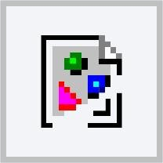

The All-Powerful Filter
We’ve been covering sine waves, frequency calculations, and filters.
Why is this topic even important in engineering?
Filters are extremely important in the field of signal processing:
Filters circuits are typical in many other electrical engineering fields:
The concepts of frequency response and filters touch all disciplines:
Audio and speech
Image and video
Wireless communication
Controls
Power and energy
Nanotechnology
Vibration and oscillation
Optics
Acoustics

Slide 2
Design Studio – Week 5
Today you will:
Discuss the process of designing your RLC circuit
Build and test a prototype of your circuit design
Observe additional ways to use and test a filter circuit
Assignments:
Exercise worksheet for RLC circuit prototype and test
Project 1 technical report (continued from last week)

Slide 3
Project 1 Review
Improve
Last week you designed, built, and tested an RLC filter circuit.
Did it work, i.e. did it meet the requirements?
Was it an improvement over the RC filter?
What was difficult about the design process?
What would you do differently next time?

Slide 4
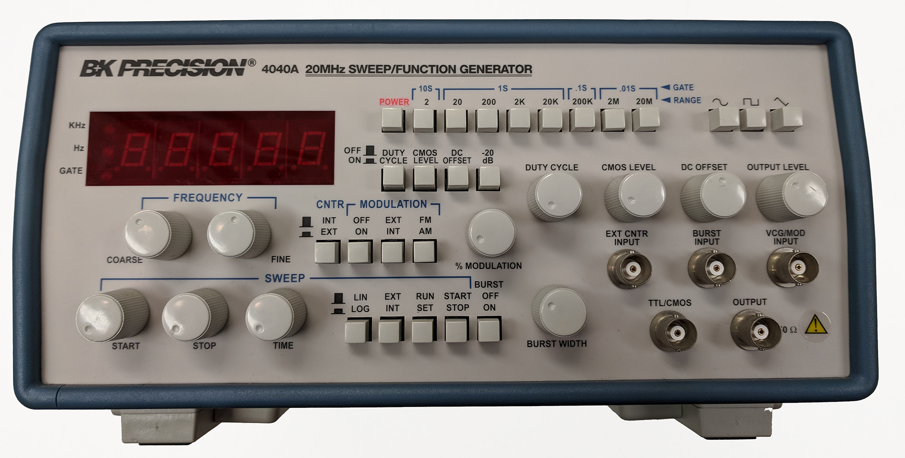
Engineering Tools – Function Generator
When developing your prototype, you’ll have to use a source that
can output a sine wave – a function generator.
Select a sine wave.
Adjust the frequency.
Choose the best range for your frequency.
The other settings aren’t needed (turn them off).
Turn on the device power to start.
Adjust and measure the output amplitude.

Slide 5
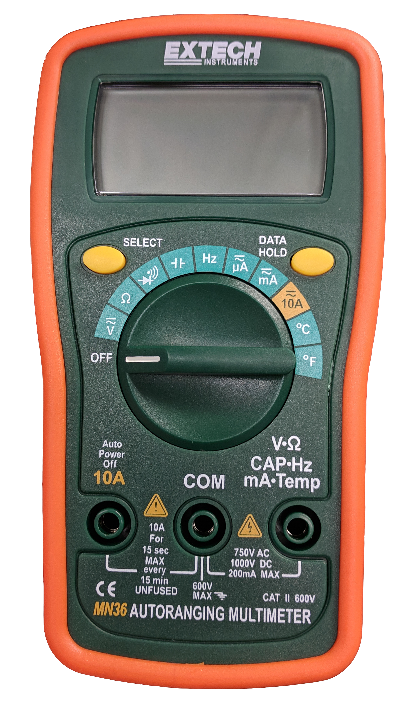

Engineering Tools – Multimeters
AC circuit measurements can be done with the multimeter, measuring current and frequency.
The AC voltage measurement here will be reported in “volts RMS”.
Remember for sines:
Vrms = magnitude/$\sqrt{\text{2}}$
Turn the dial here to measure frequency.
In most cases, you can check the accuracy of the frequency reading once at the beginning of your test.
Turn the dial here to measure voltage.
Press the SELECT button to toggle between DC and AC measurements.

Slide 6
Project 1 Prototype and Test
Create
We’re now going to build a breadboard prototype and test it.
One team at a time can come to the front and get the resistors, inductors, and capacitors they need for their design.
Follow along with the exercise worksheet to test your circuit once it has been built.
Your instructor is here to help answer guiding questions
and troubleshoot any problems that your team identifies.
When you finish your measurements, don’t disconnect your circuit and put away the components just yet.

Slide 7
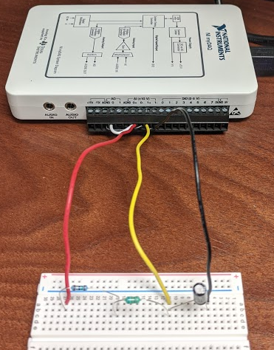
National Instruments myDAQ
The myDAQ is a programmable test platform that can create and record signals.
The circuit must be connected to the myDAQ interface first.
The inputs and ground are already wired on the myDAQ.
Connect the red wire (AI-0) to the circuit input, i.e. the resistor.
Connect the yellow wire (AI-1) to the circuit output, i.e. between the inductor and capacitor.
Connect the black wire to ground, i.e. the capacitor.
Resistor
Inductor
Capacitor

Slide 8
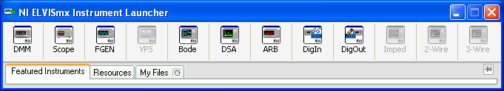
myDAQ Instrument Launcher
We can demonstrate some of the other frequency measurements using the National Instruments myDAQ.
Plug in the myDAQ to the USB interface of the computer.
Most of the common test equipment functions can be accessed by starting the NI ELVISmx Instrument Launcher.
Digital
multimeter
2-channel
oscilloscope
Function
generator
Bode
analyzer

Slide 9
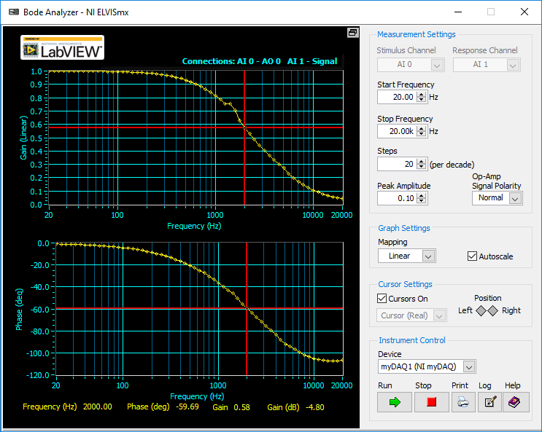
myDAQ Bode Analyzer
Set the frequency range
(e.g. 20 Hz to 20 kHz)
Increase the resolution of the plot, but note that more points = more time
Amplitude should be reduced to reduce current since most RLC filters have low Z near resonance.
Linear or log scale is fine
Click Run to start
Use cursors to view data points

Slide 10
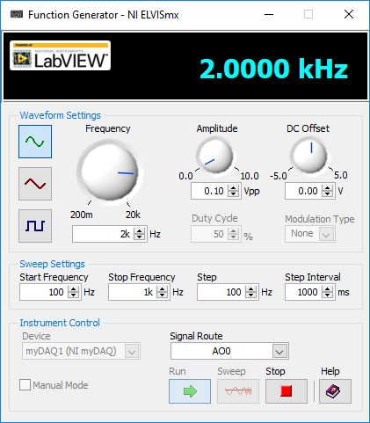
myDAQ Function Generator
Set for sine wave
Adjust to the desired frequency
Adjust the amplitude
Remember that the myDAQ might not be able to handle the current near resonance
Click Run to start

Slide 11
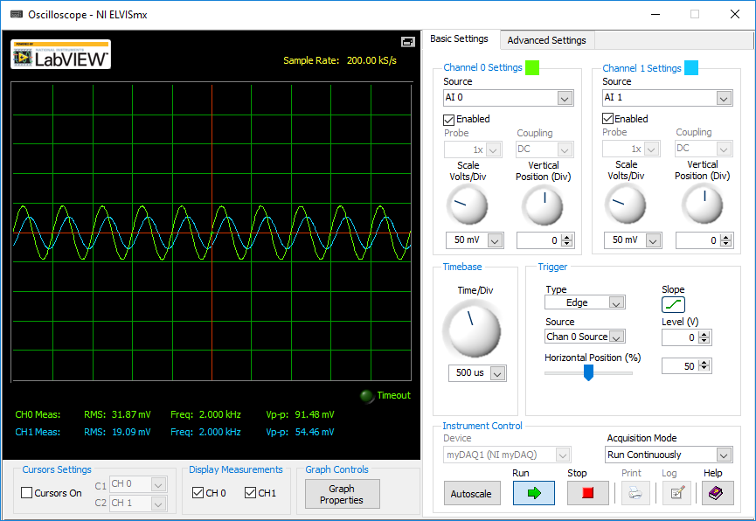
myDAQ Oscilloscope
Enable both channels
Adjust the voltage ranges based on the expected signal level
Adjust the time base to show 5-10 cycles of the sine wave
Edge triggering will have the most stable display
Click Run to start
Channel statistics are included

Slide 12
Week 5 Assignments
Please return your components to the container.
Do your best to keep them organized for the next section.
Questions after Studio? Email your instructor or go to office hours.
Exercise
Complete the Week 5 worksheet handed out earlier.
Follow the directions to build and test the RLC circuit design.
Submit the completed worksheet at the start of the next Studio.
Project 1 Report (continued)
Draft a technical report by following the rubric posted online.
Submit the completed report at the start of Week 6 Studio.

