Slide 1
“Engineering problems are under-defined, there are many
solutions, good, bad and indifferent. The art is to arrive at
a good solution. This is a creative activity, involving
imagination, intuition and deliberate choice.”
- Ove Arup, British structural engineer
“To an engineer, good enough means perfect.
With an artist, there’s no such thing as perfect.”
- Alexander Calder, American sculptor
“Failure is simply the opportunity to begin again,
this time more intelligently.”
- Henry Ford, American innovator

Slide 2
Design Studio – Week 2
Today you will:
Learn about iteration in an engineering design process
Become familiar with basic electronic test equipment
Build and test a prototype of your circuit design
Add a new requirement to the design and iterate the process
Assignments:
Exercise worksheet for modifications to the simple circuit design

Slide 3
Reviewing the Engineering Design Process
Ask
Imagine
Improve
Plan
Test
Create

Slide 4
Iteration in the Design Process
Engineering design is not a one-time, perfect process –
it requires an iterative, learning approach.
While the ideal case is that we “make it” to the Improve phase with nothing to improve, we don’t live in an ideal world.
You might not even make it to the Improve phase at all!
  If you realize that a previous part of the design has to change, return to that phase of the process as soon as possible.
  There are many possible reasons you might need to return to any of the previous design phases.
Think back to the phases of our simple circuit design last week. What reasons might exist to return to an earlier phase?

Slide 5
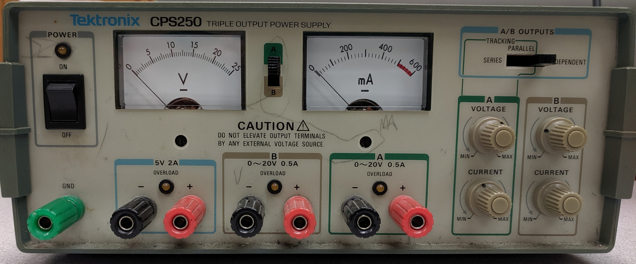
Engineering Tools – Power Supplies
Now that you’ve modeled your design, let’s go build a prototype!
First, we need to learn about the equipment.
meter reading
(if more accuracy is needed, use another meter)
voltage adjustment
measurement
selection
current limit
power switch
(set voltage before connecting your circuit)
5V supply
adjustable supply
(up to 20V)

Slide 6
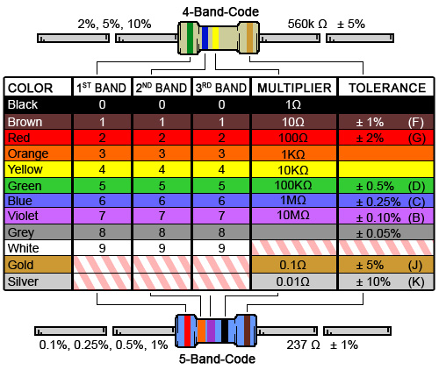
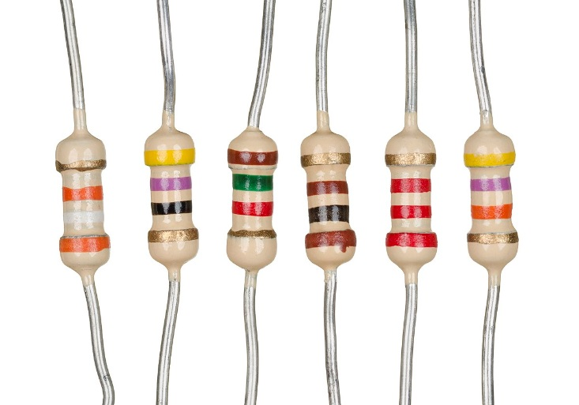
Engineering Tools – Resistors
Physical resistors come in many shapes and sizes.
39kΩ
100Ω
2.2kΩ
47Ω
1.5kΩ
47kΩ
Not all values of resistors are easy to find –
if the application requires it, you can combine resistors to achieve the desired resistance

Slide 7
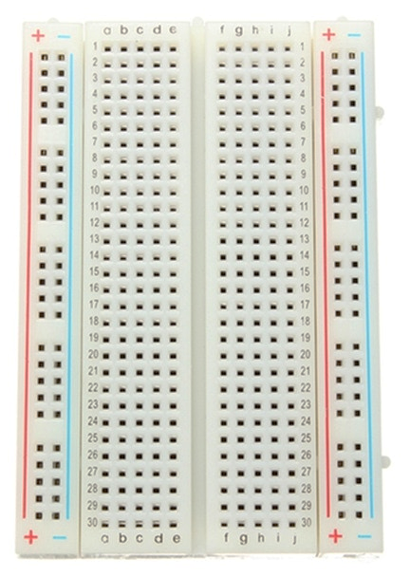
Engineering Tools – Breadboards
Breadboards allow you to physically connect parts of a circuit
in a quick, safe, and often temporary manner.
Individual holes can be filled with wires and part leads
The breadboard connects a-e of each numbered row and f-j of each numbered row
Adding wires and parts to the same row connects them.
The columns on the left and right of the breadboard are also connected.
These are useful for supplying voltage to multiple parts.

Slide 8
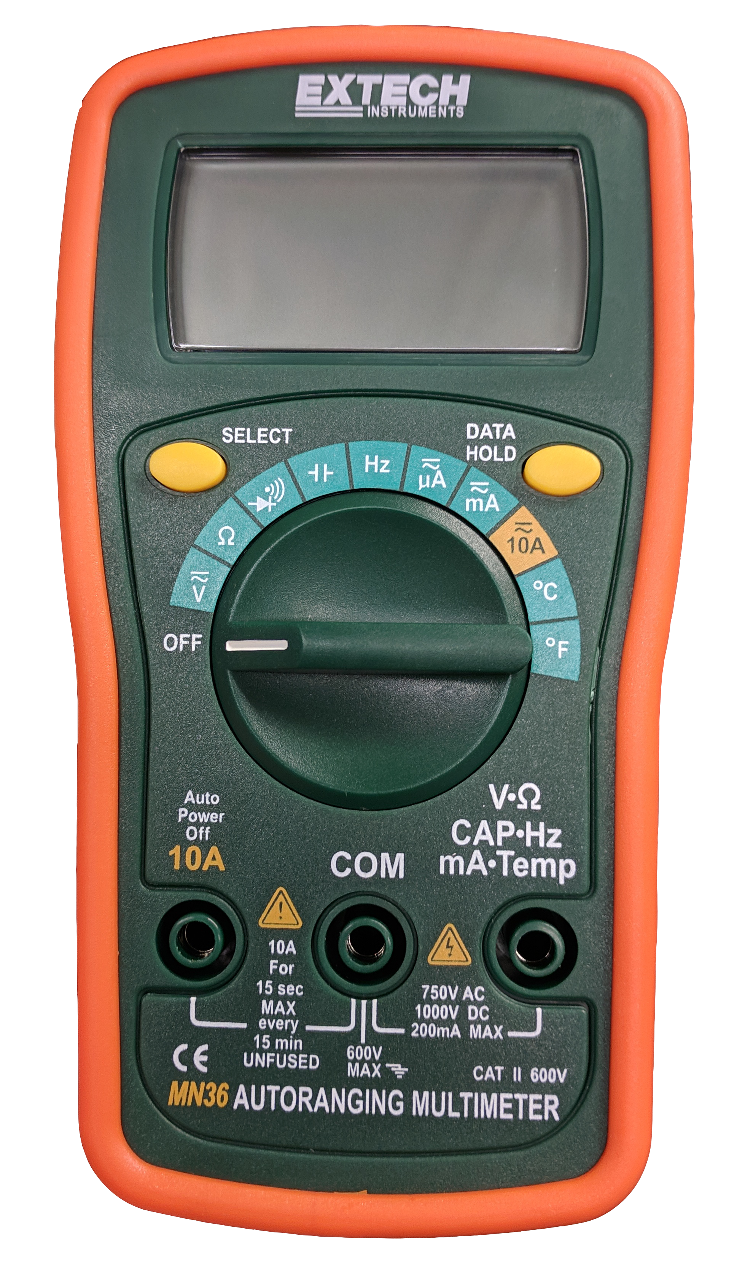
Engineering Tools – Multimeters
Breadboard circuit performance is usually measured with a multimeter, which can measure both voltage and current.
The measurement reading is shown here. Use the range setting for the best resolution of your measurement.
Turning the dial to this region will measure constant (DC) current.
Current readings are done “in series” and interrupt the circuit wiring to insert the meter between two components.
Turning the dial to this region will measure constant (DC) voltage.
Voltage readings are done “in parallel” and do not interrupt the circuit wiring.
The test probes connect to the multimeter here.

Slide 9
Iteration 1 – Prototyping
Create
We’re now going to build a breadboard prototype and test it.
Unfortunately, we don’t have enough equipment or space for everyone to test their own design – we’ll need to work in groups.
Each team already has at their workstation:
A power supply with test leads
A digital multimeter with test leads
A breadboarding kit containing a breadboard and 100 Ω resistor
Next, decide whose design you want to build
from among your group members.

Slide 10
Iteration 1 – Prototyping
Create
You still need a series resistor (Rs).
However, resistors don’t come in every possible value.
Here are the values that we have available:
Choose the closest value to your group’s design and
let your instructor know the value to get your resistor.
10 Ω | 12 Ω | 15 Ω | 18 Ω | 20 Ω | 22 Ω | 24 Ω | 27 Ω | 30 Ω | 33 Ω | 36 Ω
39 Ω | 43 Ω | 47 Ω | 51 Ω | 56 Ω | 62 Ω | 68 Ω | 75 Ω | 82 Ω | 91 Ω
100 Ω | 120 Ω | 150 Ω | 180 Ω | 200 Ω | 220 Ω | 240 Ω | 270 Ω | 300 Ω | 330 Ω | 360 Ω
390 Ω | 430 Ω | 470 Ω | 510 Ω | 560 Ω | 620 Ω | 680 Ω | 750 Ω | 820 Ω | 910 Ω

Slide 11
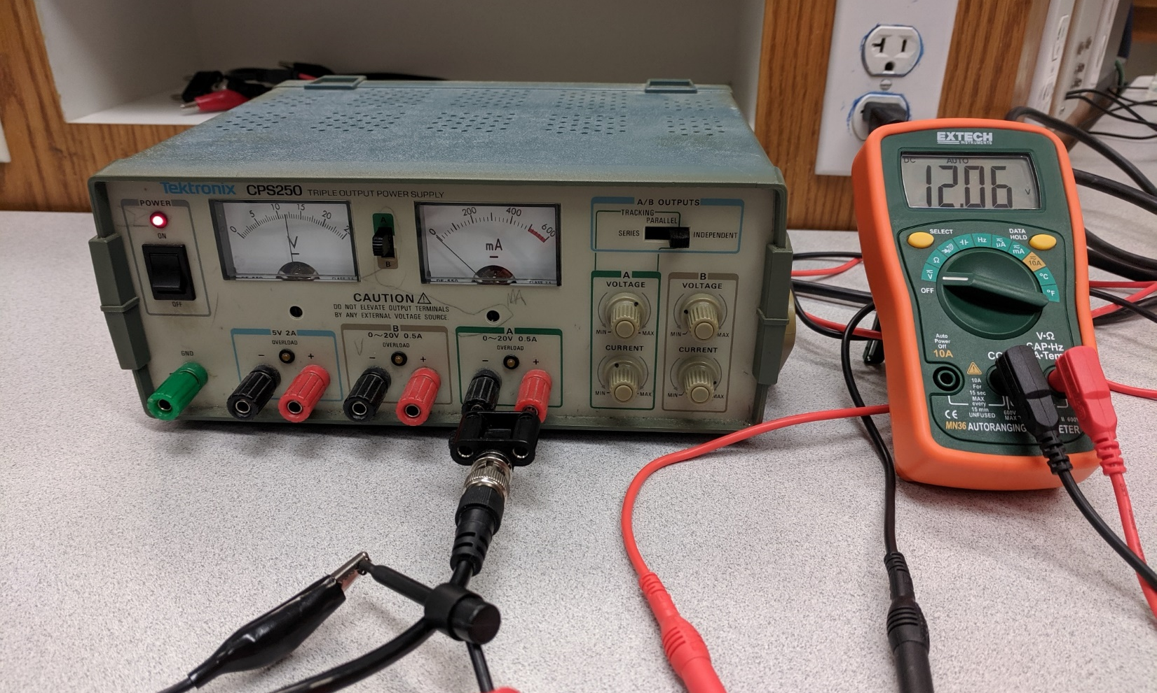
Iteration 1 – Prototyping
Create
Follow along these steps to build and test your design.
Set and measure the power supply voltage:
Turn off power before wiring
GND tab on the connector
corresponds to black wire
This design has VS = 12V

Slide 12
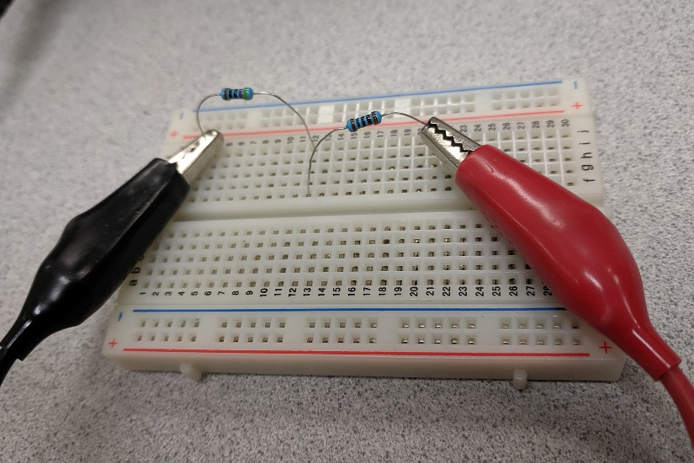
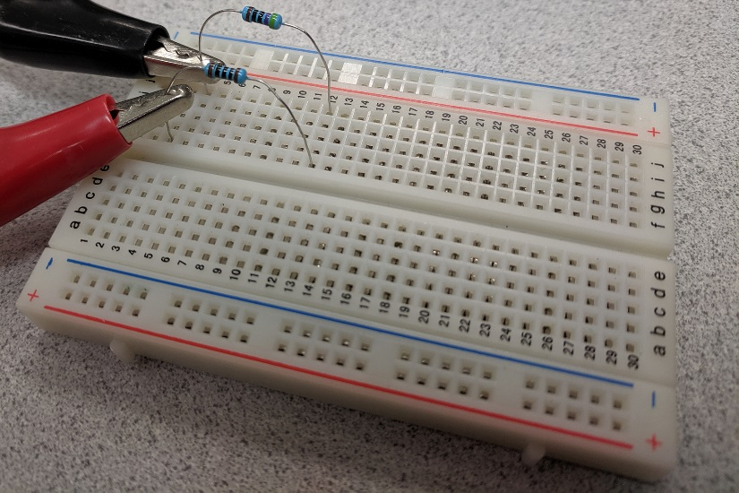
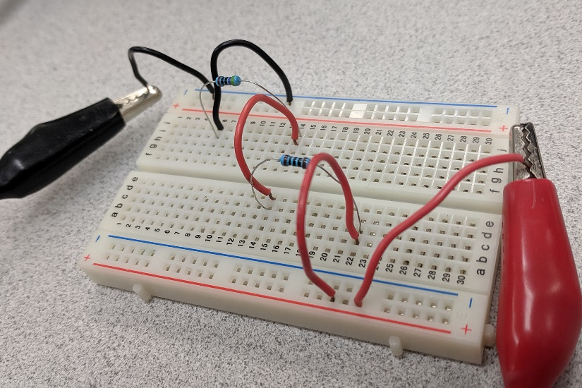
Iteration 1 – Prototyping
Create
There is no one correct way to layout a circuit on a breadboard.
These are all the same circuit!
Choose a layout that is easy
to follow and troubleshoot.

Slide 13
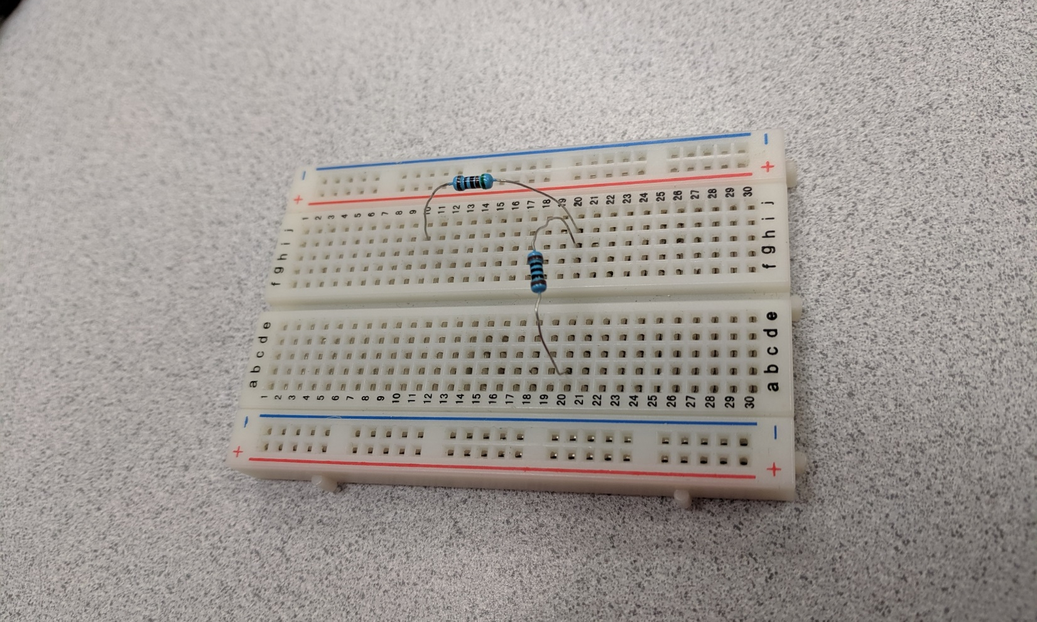
Iteration 1 – Prototyping
Create
Set and measure the power supply voltage: ✓
Place the circuit components:
h20 and i20 are connected
RS = 470Ω
RL = 100Ω
Making the circuit layout look like the drawing can help

Slide 14
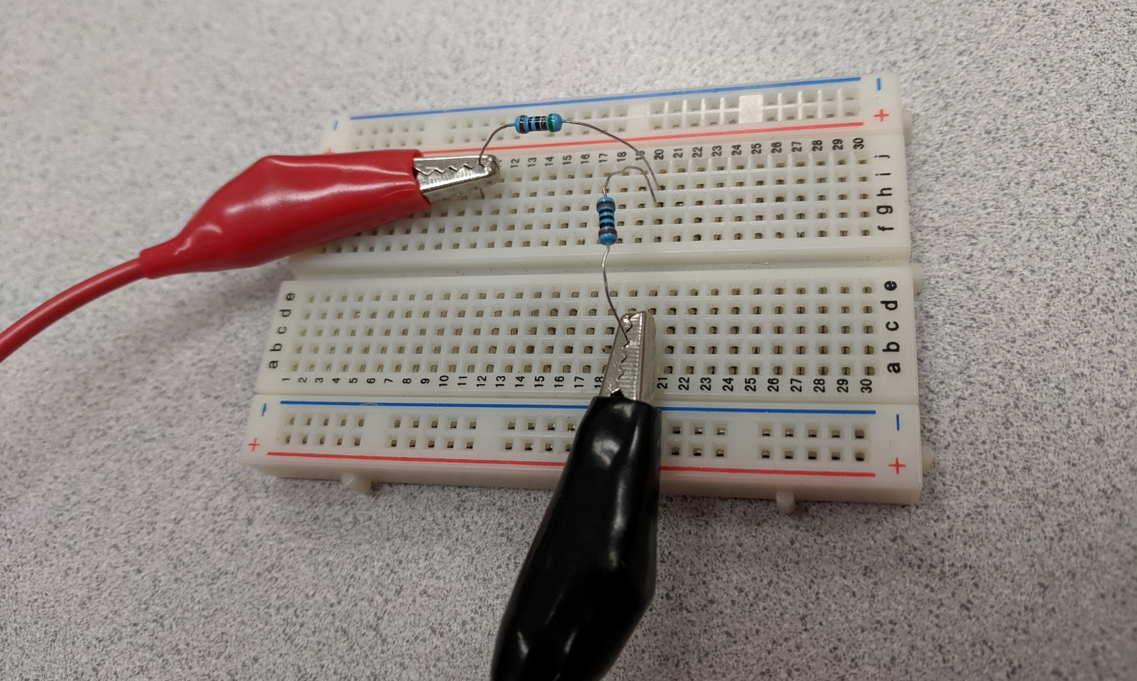
Iteration 1 – Prototyping
Create
Place the circuit components: ✓
Connect the power supply:
RS
VS +
RL
VS -
Check the wiring by following the loop

Slide 15
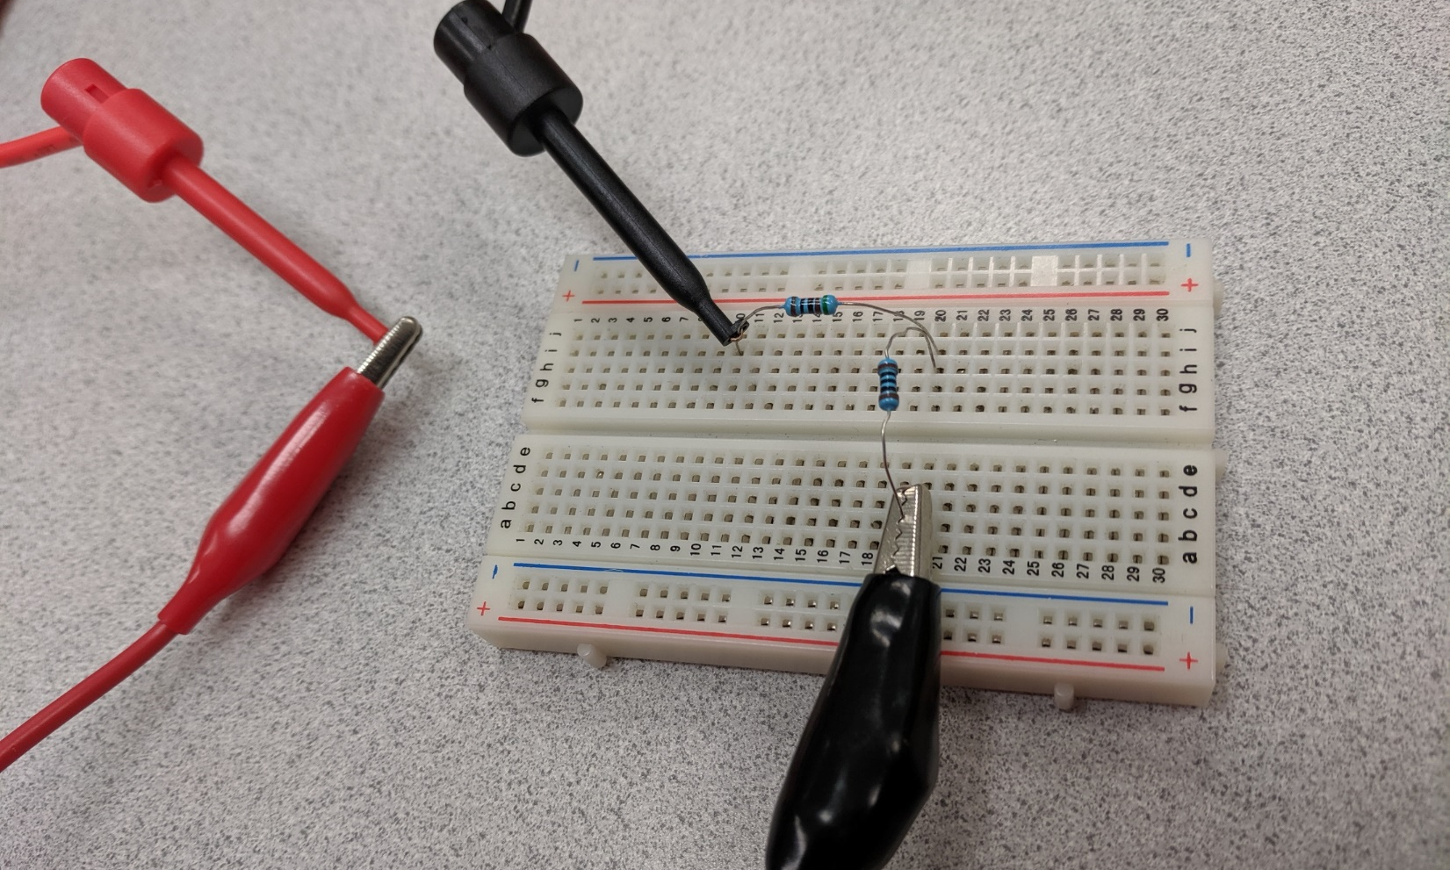
Iteration 1 – Testing the Prototype
Test
Connect the power supply: ✓
Connect the multimeter in series:
DMM -
DMM +
RS
RL
VS +
VS -
The connection between
VS+ and RS has been broken
Again, check the wiring by following the loop

Slide 16
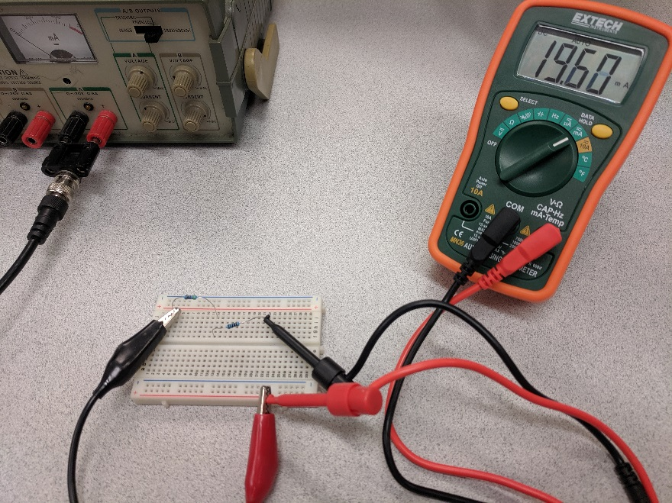
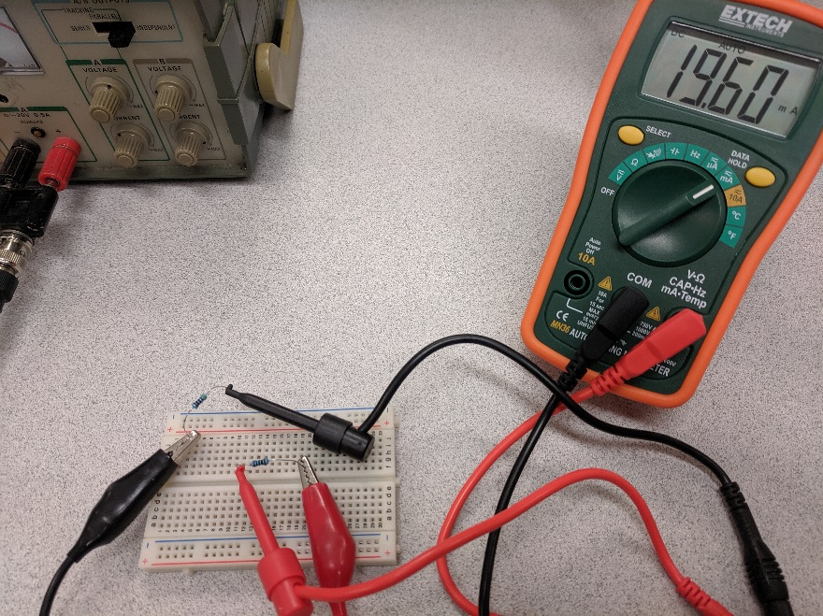
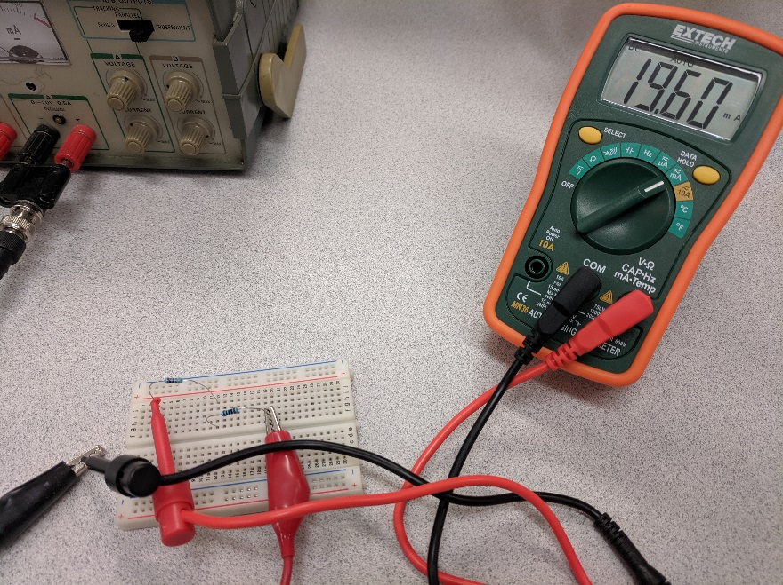
Iteration 1 – Testing the Prototype
Test
There is no one correct place to measure current.
Anywhere along the path works!
Just be sure to break the circuit to
insert the current meter.
Otherwise: short circuit!
between V_{S} and R_{S}
between R_{S} and R_{L}
between R_{L} and V_{S}

Slide 17
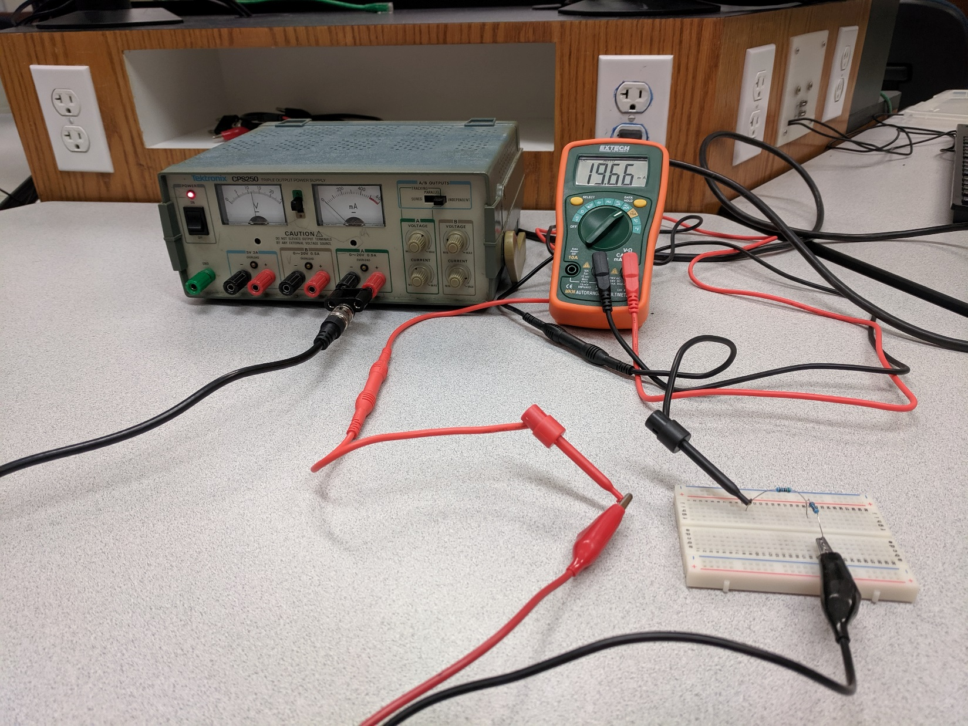
Iteration 1 – Testing the Prototype
Test
Connect the multimeter in series: ✓
Measure the current:
The current reads I = 19.7mA

Slide 18
Iteration 1 – Testing the Prototype
Test
Measure the current: ✓
For now, turn off the power supply and the multimeter.
We will need the circuit again in a bit so do not take it apart.

Slide 19
Iteration 1 – Test Analysis
Test
Think about the following questions:
How did your circuit measurement today compare to your
results from Multisim?
What advantages do you see to simulation in Multisim over prototyping on a breadboard?
What advantages do you see to prototyping over simulation?
You won’t always need to build both a model and a prototype of the same design. One may be more appropriate than the other, or perhaps each are more suited to different parts of the design.

Slide 20
Iteration 2 – Improve
Improve
There are still an enormous number of things we could do:
If your prototype met the requirement, you could start planning how to build a final version of the circuit.
If your prototype did not meet the requirement, you could start adjusting your component values and build a new prototype…
…or we could choose a new design concept and start over.
We could also add a new feature:
An LED light that turns on when the circuit is connected.
To add a new feature, we’ll also have to specify how it should work by adding another requirement.

Slide 21
Iteration 2 – New Requirements
Ask
We now have two requirements:
Supply 20 mA of current into a 100 Ω resistor.
Turn on an LED when the 100 Ω resistor is connected.
Our old design doesn’t even have an LED in the circuit,
so our design has to change!
Our first step to imagining a new design is understanding how LEDs work. Perhaps we can then adapt our current circuit design instead of brainstorming an entire new list of circuit designs.

Slide 22
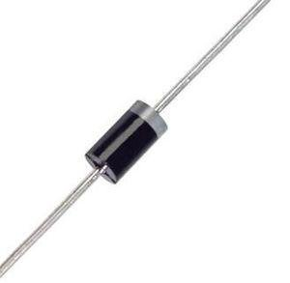
Concept Review – Diodes and LEDs
A diode is a simple semiconductor device that allows current
to flow in one direction.
A light emitting diode (LED) emits light when current is flowing through it. An LED anode is longer than the cathode by convention.
Every diode has a specified forward voltage, or the positive voltage between the anode and cathode that is required for current to flow.
For LEDs, this voltage can is typically in the range of 1.5V to 3V.
Anode (+)
Cathode (-)
Current
Current

Slide 23
Iteration 2 – Design Changes
Plan
We have a red LED with a forward voltage of 1.8V available
for both Multisim and breadboarding. Let’s use it:
To simplify the redesign, keep the same series resistor (Rs) value.
Calculate the new source voltage (Vs) needed for a 20 mA current.

Slide 24
Iteration 2 – Testing the New Prototype
Test
Your instructor will provide you with a red LED.
Modify your breadboard prototype to include the LED and
don’t forget to adjust the power supply voltage to your new value.
Measure the circuit performance:
What is the current going into the 100 Ω resistor?
Does the LED turn on?
Be sure to take a picture of your circuit before you break it down.
Put all of the equipment back as you found it and return the series resistor and LED to your instructor.

Slide 25
Week 2 Assignments
Questions after Studio? Email your instructor or go to office hours.
Exercise
Complete the Week 2 worksheet handed out earlier.
Follow the directions to build and test your own design.
Practice formatting the figure via the provided guidelines.
Submit the completed worksheet at the start of the next Studio.

