Slide 1
Welcome to Design Studio
What do we mean by design?
Design is a set of choices that are made with the intention to solve a problem.

Slide 2
ENGR 128 Design Studio
What skills do you think employers look for most when hiring an engineering student?
Lecture and Lab will help you understand engineering tools Studio is designed to strengthen these three engineering skills
Problem
solving
Communication
Teamwork

Slide 3
Design Studio – Week 1
Today you will:
Discuss the approach and expectations of the ENGR 128 Studio
Learn the basic stages of an engineering design process
Observe the process for a simple circuit design
Design your own simple circuit
Model your circuit in the Multisim simulation software
Assignments:
Exercise worksheet for simple circuit design

Slide 4
Approach of ENGR 128 Project Studio
At the end of the semester, students enrolled in the studio can:
plan and carry out a disciplined design project following a systematic design process
utilize appropriate analytical and computer tools in project work
write a precise and effective Technical Report Memo, including clear Abstract, Methodology, Recommendations, and Conclusions sections
prepare and deliver an effective oral technical presentation
organize an effective team including setting ground rules, project planning, and task management; explain and utilize effective group processes
You will learn and practice these skills in Studio before you are expected to apply them on your own.

Slide 5
Project Studio Grade Breakdown
Remember: Your Project Studio grade is 25% of your overall course grade.
Assignment Type | Points | Brief Description
Exercises | 48 pts | Worksheets started in-class and returned by the following Studio session (12 exercises @ 4 points each)
Reports | 32 pts | Technical reports at project completion (Project 1 @ 8 points, Projects 2 & 3 @ 12 points each)
Presentations | 20 pts | In-class project presentations (Project 2 @ 8 points, Project 3 @ 12 points)

Slide 6
Project Studio Schedule
No Project Studio during Spring Break.
Week(s) | Studio or Course Event | Project Topic
1 – 2 | Introduction to Studio | Simple resistor circuit
3 – 5 | Project 1 | Filter circuit design
6 | Exam 1 (during Lab)
6 – 9 | Project 2 | Digital logic design
10 | Exam 2 (during Studio)
11 – 15 | Project 3 | Sensor application design
15 | Lab practical (during Lab)
16 | Final exam

Slide 7
Project Studio Expectations
As shared in the course syllabus, I expect you as students to:
work hard and contribute to class and your project team(s)
be prepared for Studio (materials submitted on time and ready at the class start time)
help support the learning environment in Studio (ask questions and limit distractions)
act as a professional (learn with honesty, integrity, and respect for others)
In return, I will treat you with respect and do whatever is within my power to help you learn.

Slide 8
Engineering Design Process
Ask
Imagine
Improve
Plan
Test
Create

Slide 9
Engineering Design Process Phases – Asking
Ask
In starting any design, the first question should always be,
“Why am I doing this?”
Is there a problem you are trying to solve?
A person (or group of people) you are trying to help?
Are you designing something just to learn?
Every design has a customer –
a person or group of people that the design is for.
Understanding your customer is an important part of the Ask phase.

Slide 10
Engineering Design Process Phases – Asking
Ask
Sometimes we have to ask a lot of questions,
and at other times we only need to ask a few.
Here, our customer is simply telling us exactly what she wants:
Restated, the customer has given us a requirement:
Supply 20 mA of current into a 100 Ω resistor.
I have a 100 Ω resistor here. I need a circuit that provides 20 mA of current to that resistor.

Slide 11
Engineering Design Process Phases – Asking
Ask
Requirements are important (but not necessarily easy)!
They tell design engineers how the design is supposed to work.
Requirements provide direction for the rest of the design process!
Good requirements should not:
Explain the problem from the customer’s point of view
Completely define the solution
Requirements are the most common deliverable in the Ask phase.
We’ll encounter lots of ways to express requirements in Studio.

Slide 12
Engineering Design Process – Imagining
Imagine
Remember our example requirement?
Supply 20 mA of current into a 100 Ω resistor.
How might we go about meeting that requirement?
As you probably started doing already,
the Imagine phase requires brainstorming to come up with ideas.
While imagining, also remember this important guideline:
There are no bad ideas!

Slide 13
Engineering Design Process – Imagining
Imagine
We could hook a battery directly to the resistor!
Let’s use a power supply and another resistor!
How about lots of resistors?!
We should totally rub a balloon on our hair to generate static electricity!

Slide 14
Engineering Design Process – Planning
Plan
Now that we have a set of design ideas,
we need to decide on one to try.
We’ll learn ways throughout the semester to choose a design idea.
The decision doesn’t even have to occur in one step:

Slide 15
Engineering Design Process – Planning
Plan
Let’s choose the following design:
Note that we still have to choose values of the supply voltage (Vs) and series resistor (Rs).
Our Plan phase is only complete when we know what to make.
What values do you want to use for this design?

Slide 16
Concept Review – Simple Circuits
Ohm’s Law: V = IR
Kirchhoff’s Voltage Law: V – V1 – V2 = 0
or: V = V1 + V2

Slide 17
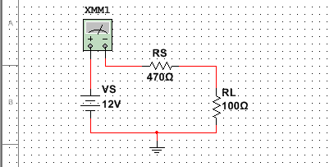
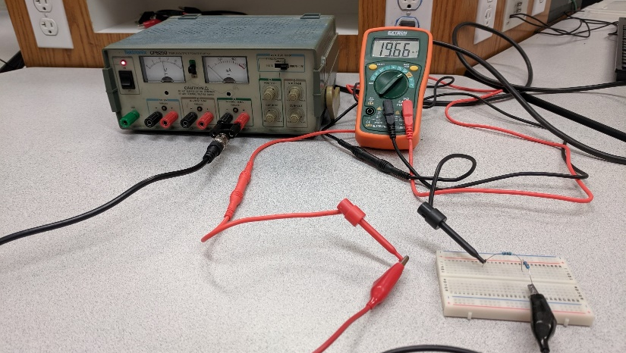
Engineering Design Process – Creating
Create
Now that we have a design, we are ready to build it.
If our customer wants 1,000 units, should we build them all now?
Of course not – we want to see our design work in reality first.
We will mainly focus on two ways of building a design to be tested: modeling and prototyping

Slide 18
Engineering Design Process – Creating
Create
So… what’s the difference between a model and a prototype?
Both imitate the performance and/or function of the design.
Both can be used to create and test the whole design…
…or create and test a small portion.
The only difference is that prototypes are physically capable of being used as the end product.
For circuit designs, we will model using simulation software packages such as Multisim, Logicly, and Matlab.
We will prototype by building circuits on breadboards.

Slide 19
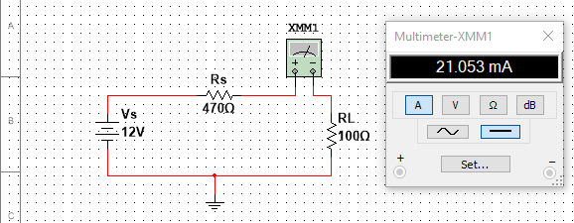
Engineering Design Process – Testing
Test
Once we have something built, we need to know if it works.
So how is the design supposed to work?
We have to check the requirements!
Requirement:
Supply 20 mA of current into a 100 Ω resistor.

Slide 20
Engineering Design Process – Improving
Improve
Did it work?
In most design projects, the answer is “not exactly” the first time.
Perhaps not all of the requirements were met.
Or maybe you only built a small part of the design.
Or maybe something totally unexpected happened.
The most important part of the design process is learning as you go, not jumping to a perfect solution.

Slide 21
Week 1 Assignments
Questions after Studio? Email your instructor or go to office hours.
Exercise
Complete the Week 1 worksheet handed out earlier.
Follow the directions to build and test your own design.
Submit the completed worksheet at the start of the next Studio.
Team Formation Survey
Complete the survey being handed out now.
The survey is not graded, but fill it out as accurately as you can – the results will help with forming project teams.
Submit the completed survey at the start of the next Studio.

