Slide 1
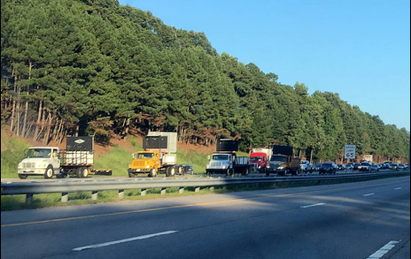
Course Project: Application of Rolling Slowdown Versus Roadblock on High Profile Roadways
Rolling Slowdown

Slide 2
Application
Rolling roadblocks are used for short term work on high-volume/high-speed urban and rural freeways.
Bridge construction and/or replacements.
Placing or removing overhead lights or sign structures.
Overhead utility work.
Blasting for rock excavation or debris removal.

Slide 3
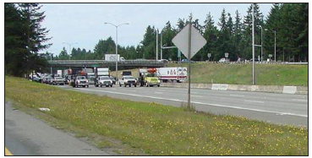
Rolling Slowdown

Slide 4
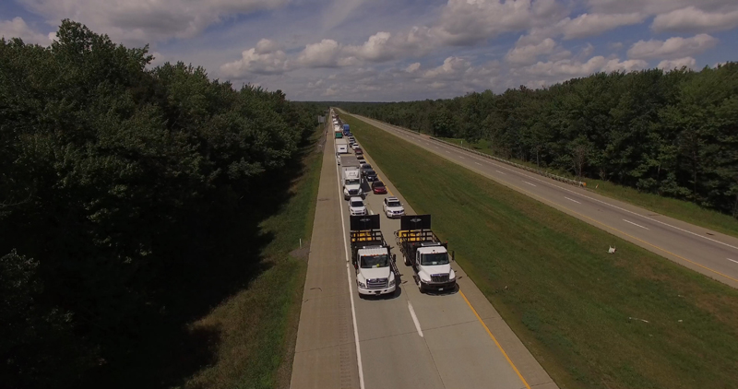
Rolling Slowdown

Slide 5
Schematic Diagram of Rolling Slow Down

Slide 6
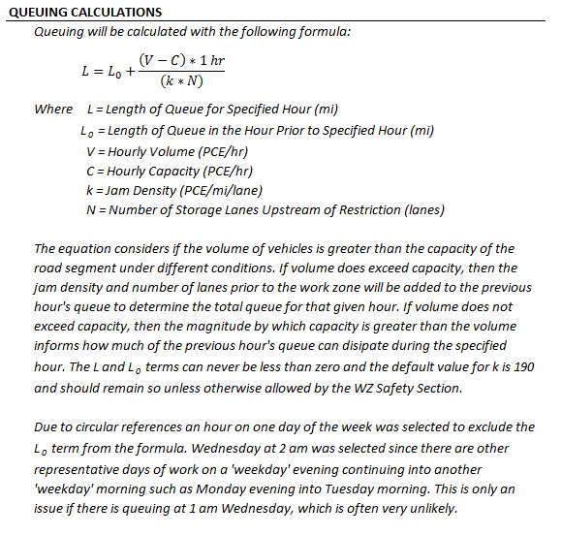
Queue Calculation by INDOT

Slide 7
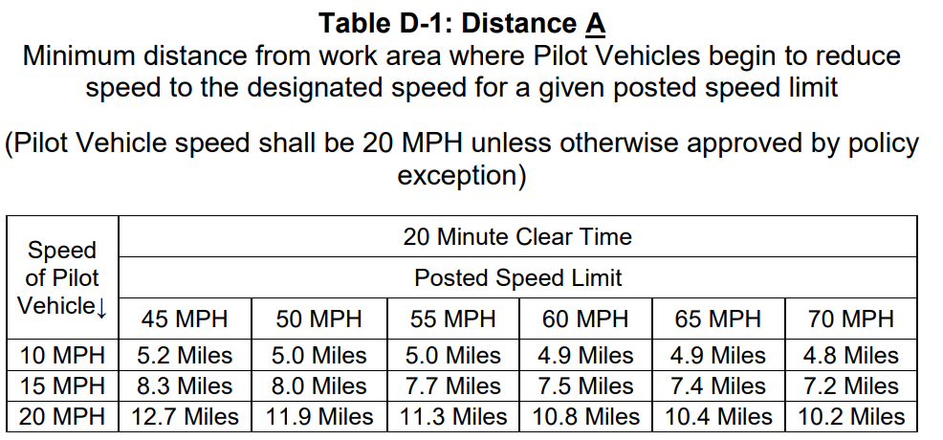
Minimum Distance of Pilot Vehicle

Slide 8
References
Guidelines on Rolling Roadblocks for Work Zone Applications, https://www.workzonesafety.org/training-resources/fhwa_wz_grant/atssa_rolling_roadblocks/
Safely Implementing Rolling Roadblocks for Short-term Highway Construction, Maintenance, and Utility Work Zones, https://ops.fhwa.dot.gov/publications/fhwahop19031/index.htm
Guidance on Rolling Roadblock Operations – Attachment, https://ops.fhwa.dot.gov/memorandum/rollingblockguide/rollingblockattach.htm
https://ops.fhwa.dot.gov/wz/resources/publications/FullClosure/CrossCutting/its.htm
https://secure.in.gov/indot/files/Safety_Interstate_Highways_Congestion_Policy_2013.pdf
https://secure.in.gov/indot/files/Safety_Interstate_Highways_Congestion_Policy_2013.pdf

Slide 9
References, cont.
https://flaggerforce.com/blog/precision-rolling-slowdowns/
https://www.in.gov/dot/div/contracts/design/mutcd/2011rev3/Chapters%206H%20and%206I.pdf
https://www.in.gov/dot/div/contracts/standards/drawings/sep19/e/sep800.htm

