Slide 1
Handouts / Materials
Worksheet
Class Schedule Overview
Course project template, schedule, rubric posted online.
Homework posted
Conduct the survey
Post slides
Reading assignments.

Slide 2
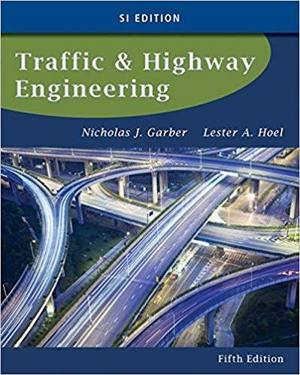
CE 34500 – Transportation Engineering
Chapter 7: Intersection Control
Course Outcome 6. Design basic traffic signal phasing and timing plan.

Slide 3
Learning Objectives and Outline
Understand the basic principles in intersection control
Become familiar with the different types of intersection control systems
Understand the procedures for signal timing for different color indications

Slide 4
Intersection Control
MUTCD provides guidelines for determining a appropriate control type for a given intersection.
MUTCD recommends engineering must consider following five factors:
Design 4. Maintenance
Placement 5. Uniformity
Operation
Source: https://mutcd.fhwa.dot.gov/pdfs/2009r1r2/pdf_index.htm
Notes:
Design: size, color, shape, message
Placement: be within the cone of vision of the road user
Operation: consistent
Maintenance: functional and physical
Uniformity: facilitate recognition

Slide 5
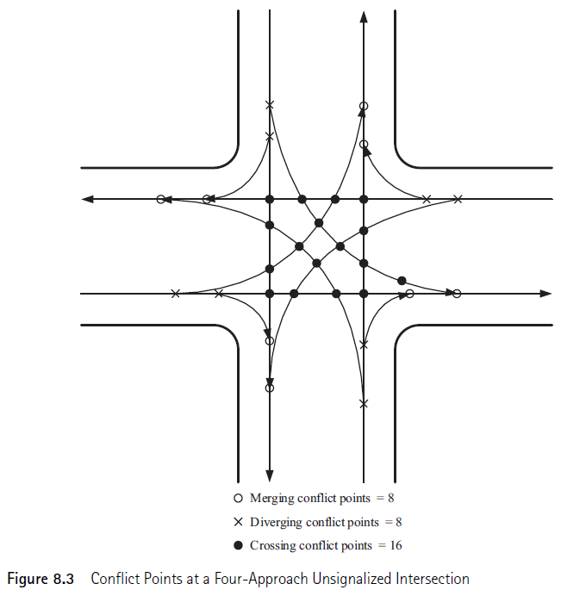
Objective of Traffic Control Devices
Conflicts occur when traffic streams moving in different directions interfere with each other.
Three types of conflicts:
Merging
Diverging
Crossing

Slide 6
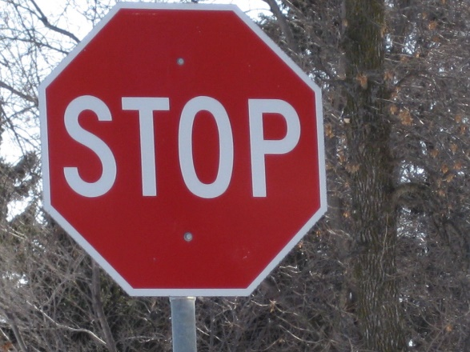
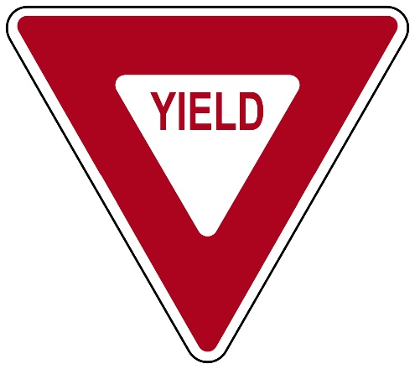
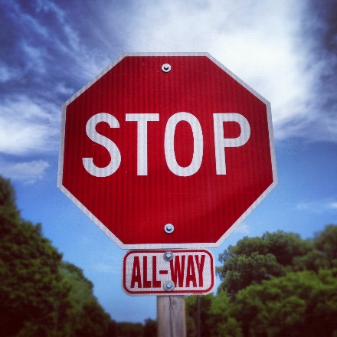
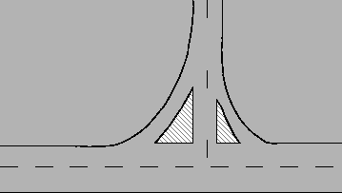
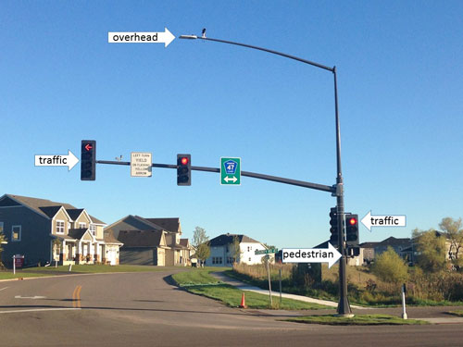
Traffic Control Devices
Stop Signs
Yield Signs
Multiway Stop Signs
Intersection
Channelization
Traffic Signals

Slide 7
Yield Signs
MUTCD suggests following guidelines:
At approaches to through streets…
At intersection withs medians of 30 ft or higher…
At a turn lane that is separated from travel lanes by a channelized island…
At merging lanes…
Engineering judgement…

Slide 8
Stop Signs
Stop signs will only be considered when at least one of the following conditions is met:
Through traffic > 6000 per day
Five or more crashes within 2 years.
Adequate conflicting points..

Slide 9
Multiway Stop Signs
MUTCD Guidelines:
An interim measure..
5 or more crashes within 12-month period
Traffic condition (show page 373)
If b or c is not met, but each satisfies 80% of the minimum requirement.

Slide 10
Example 8.1

Slide 11
Quiz
Full time Job Opportunity
Scores are posted in Blackboard. Pay attention to the missing items. Missing homework? Quiz?
Pass exam 1 papers

Slide 12
Traffic Signals
Warrant 1, Eight-Hour Vehicular Volume
Warrant 2, Four-Hour Vehicular Volume
Warrant 3, Peak Hour
Warrant 4, Pedestrian Volume
Warrant 5, School Crossing
Warrant 6, Coordinated Signal System
Warrant 7, Crash Experience
Warrant 8, Roadway Network
Warrant 9, Intersection Near a Grade Crossing
Source: https://mutcd.fhwa.dot.gov/htm/2009/part4/part4c.htm#table4C01
Notes:
Eight-Hour Volume
When volume is the main factor
Four-Hour Vehicular Volume
When high intersecting volume is the main factor
Peak Hour
Is used to justify the installation at intersections
Minimum Pedestrian Volume
When intersection mid-block crossings cause excessive delay
School Crossing
Main concern is to accommodate students (elementary-high school)
Coordinated Signal System
Main factor is the enhancement of movement along a highway segment
Crash Experience
Main focus is to reduce the number and severity of crashes
Roadway Network
Installation will encourage concentration of traffic flow on networks
Intersection Near a Grade Crossing
Considered when none of the criteria above are met

Slide 13
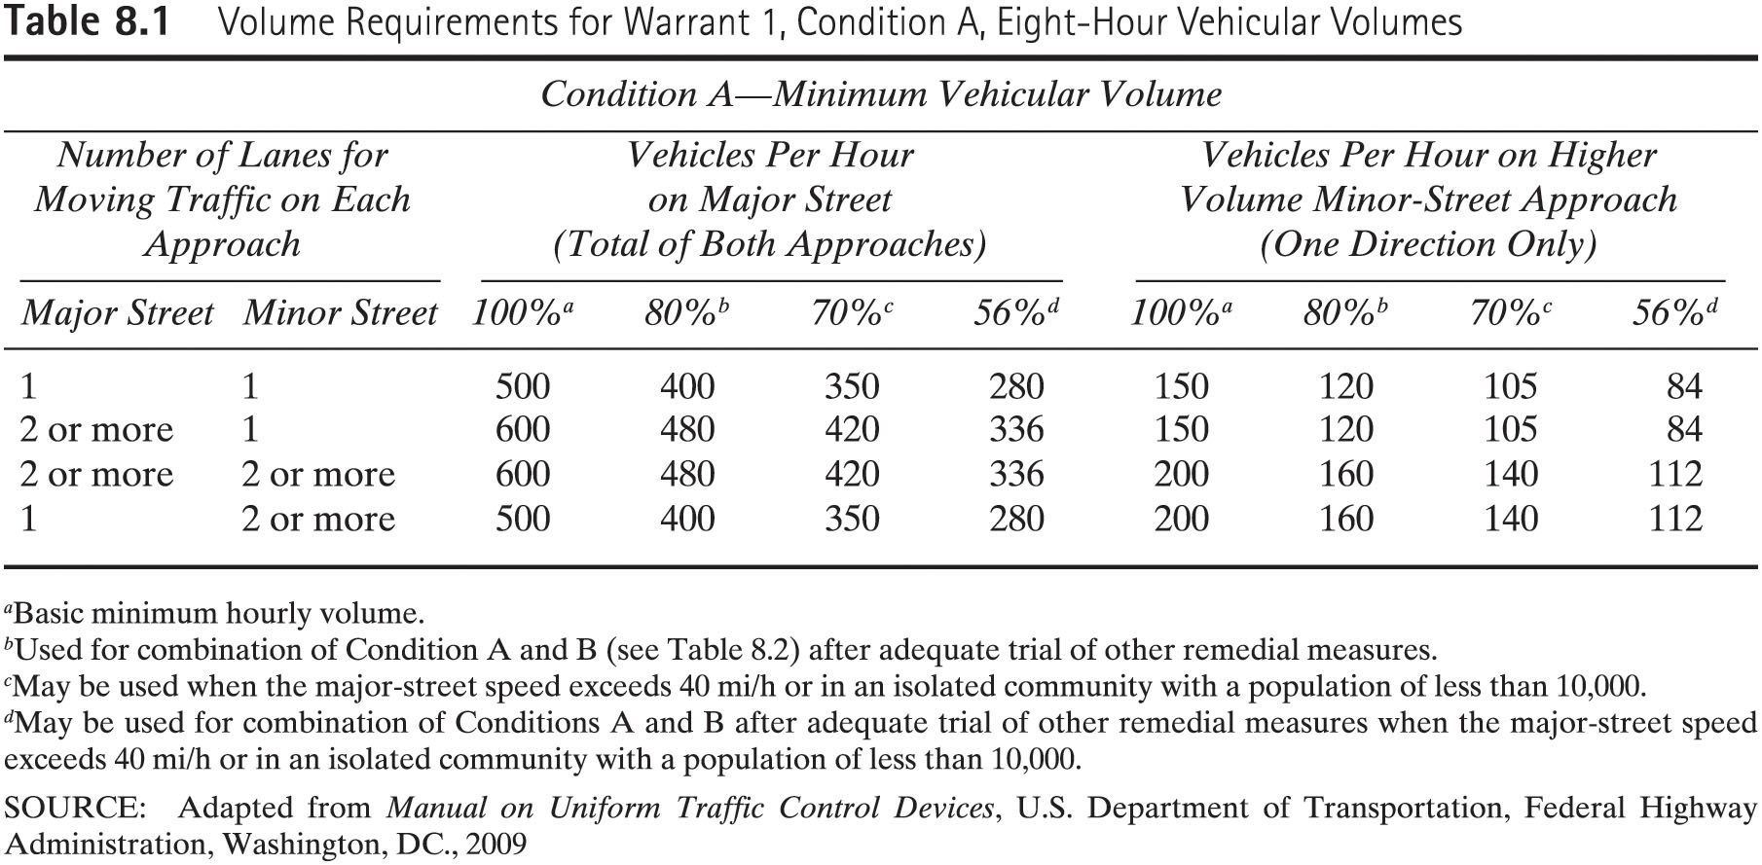
Warrant 1, Eight-Hour Vehicular Volume

Slide 14
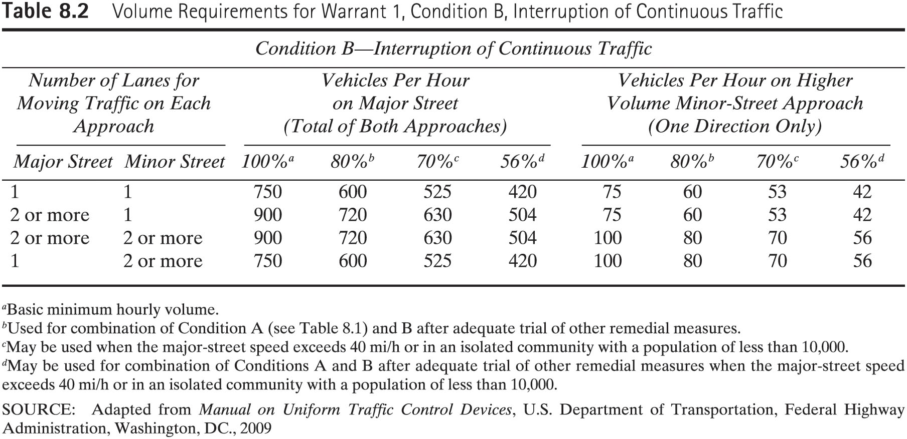
Warrant 1, Eight-Hour Vehicular Volume

Slide 15
Example 8.2

Slide 16
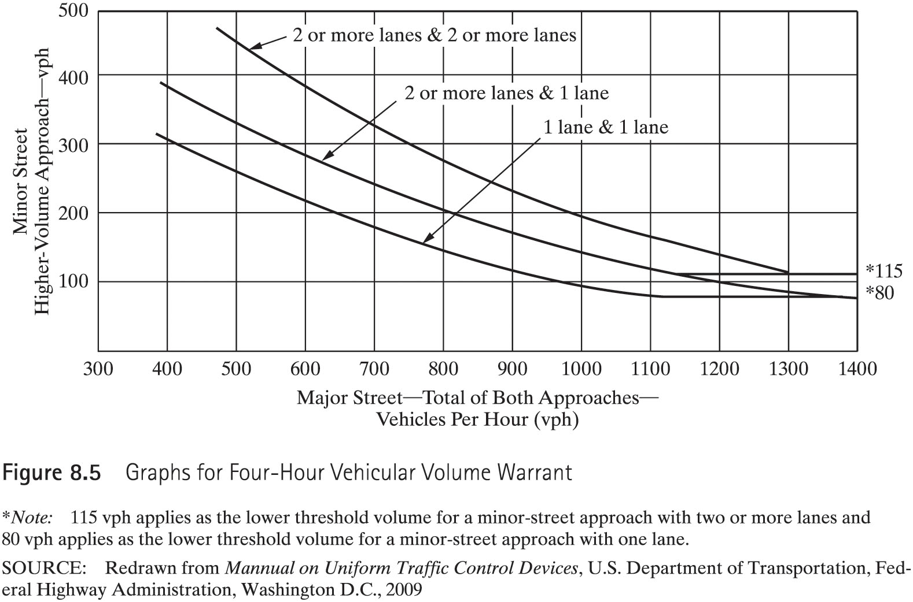
Warrant 2, Four-Hour Vehicular Volume

Slide 17
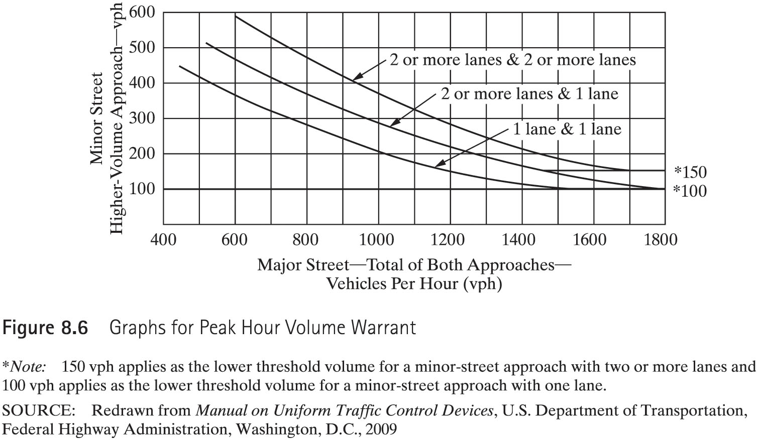
Warrant 3, Peak Hour

Slide 18
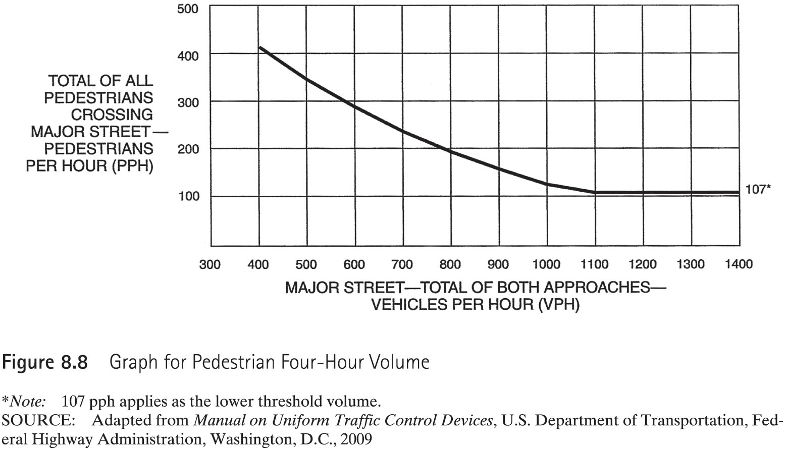
Warrant 4, Pedestrian Volume

Slide 19
Warrant 5, School Crossing
Time headway < acceptable gap.
At least 20 students during highest crossing hour.
Read page 381 carefully.

Slide 20
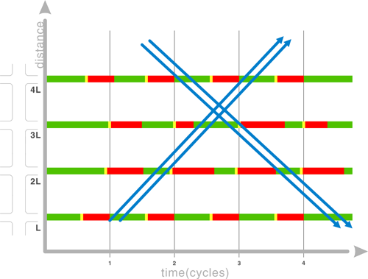
Warrant 6, Coordinated Signal System
This warrant is not applicable when the resultant spacing of the traffic signals will be less than 1000 ft.

Slide 21
Warrant 7, Crash Experience
5 or more crashes within 12 month period.
Crash frequency has not been reduced by an adequate trial of less restrictive measures.
Traffic volume should not be less than 80% requirements.

Slide 22
Warrant 8, Roadway Network
This warrant is justified when A or B is satisfied:
At least 1000 vehicles during peak hour of a typical weekday.
at least 1000 vehicles for each of any five hours on Saturday or Sunday.

Slide 23
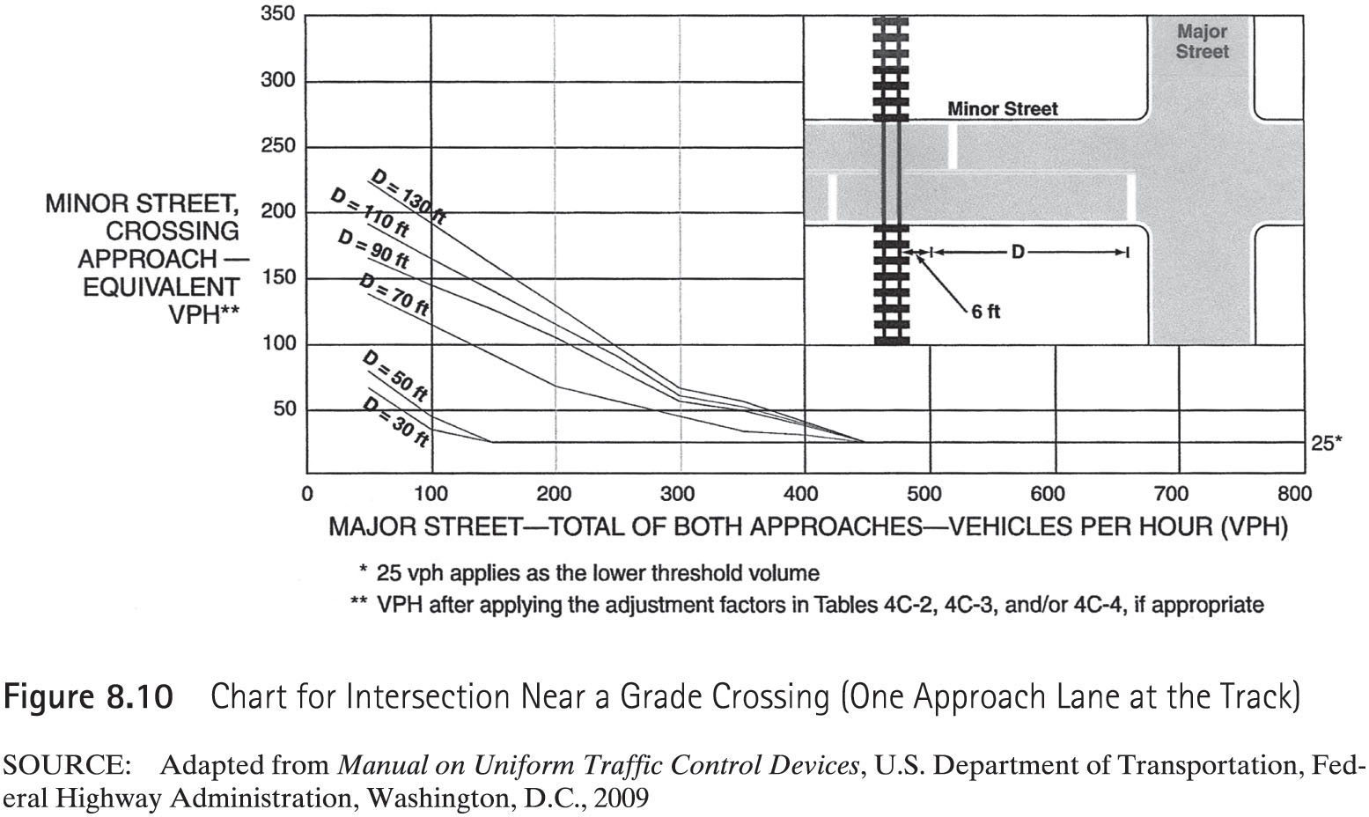
Warrant 9, Intersection Near a Grade Crossing

