Slide 1
Handouts / Materials
Quiz 3
Worksheet
Class Schedule Overview
Post slides
Reading assignments.
Next class: Exam 1 review

Slide 2
CE 34500 – Transportation Engineering
Chapter 9: Capacity and Level of Service for Multilane Highways

Slide 3
Different Highway Segments
Two-Lane Two-Way Highway
Multilane Highway

Slide 4
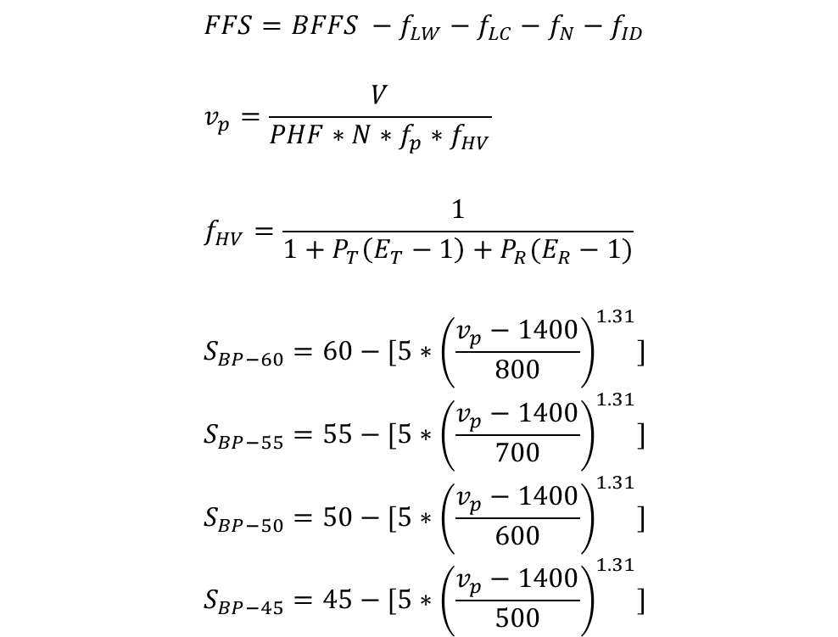
Equations to Determine LOS
$$FFS=BFFS −f_{LW}−f_{LC}−f_{N}−f_{ID}$$
$$v_{p}=\frac{V}{PHF∗N∗f_{p}∗f_{HV}}$$
$$f_{HV}=\frac{1}{1+P_{T}\left(E_{T}−1\right)+P_{R}(E_{R}−1)}$$
$$S_{BP−60}=60−[5∗{\left(\frac{v_{p}−1400}{800}\right)}^{1.31}]$$
$$S_{BP−55}=55−[5∗{\left(\frac{v_{p}−1400}{700}\right)}^{1.31}]$$
$$S_{BP−50}=50−[5∗{\left(\frac{v_{p}−1400}{600}\right)}^{1.31}]$$
$$S_{BP−45}=45−[5∗{\left(\frac{v_{p}−1400}{500}\right)}^{1.31}]$$

Slide 5
Examples 9.6, 9.7, 9.8

