Slide 1
Handouts / Materials
Worksheet_chapter 9
Class Schedule Overview
Post homework 1_solution
Post slides
Reading assignments.
Correction Exam 1: Wednesday, February 17
Traffic intern at INDOT Fort Wayne.
Extra credit- attend ASCE meeting on 2nd Monday

Slide 2
CE 34500 – Transportation Engineering
Chapter 9: Capacity and Level of Service for Multilane Highways
Course Outcome 4: Perform level of service analysis to determine LOS for selected highway segments. [1, 2]

Slide 3
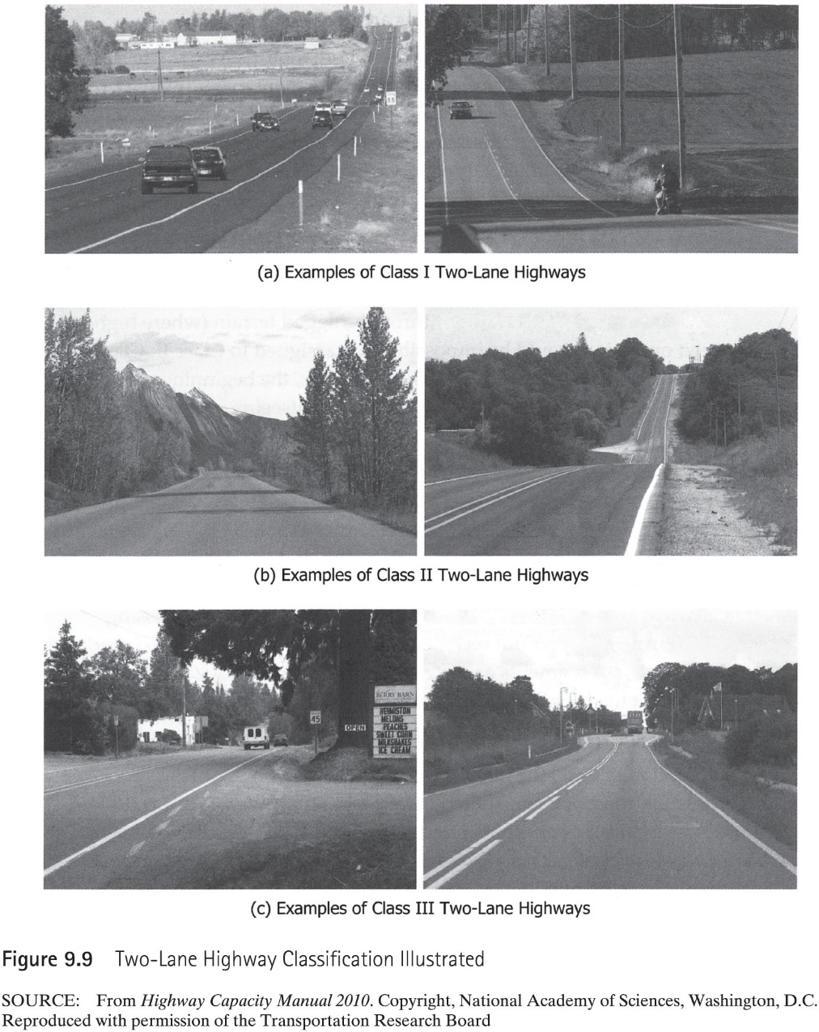
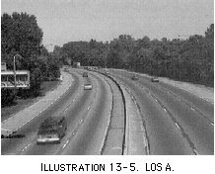

Slide 4
Freeways
A freeway is a divided highway with full access control and two or more lanes in each direction
Signalized or stop-controlled, at-grade intersections and direct access to adjacent land use are not permitted
Opposing traffic is separated by a raised barrier, an at-grade median, or a raised traffic island

Slide 5
Freeways

Slide 6
Basic Freeway Segment

Slide 7
Level of Service
A = Free-flow operations, vehicles completely unimpeded.
B = Reasonably free-flow conditions. Only slight impedance to maneuvers.
C = Noticeable restriction to maneuvers.
D = Speeds begin to decline. Reduction in comfort level.
E = Flows becomes unstable. Virtually no useable gaps. Facility at capacity.
F = Flow breakdown conditions. Arriving flow is greater than segment capacity.

Slide 8
Density Ranges for each LOS

Slide 9
Factors Affecting LOS for Freeways
Lane width
Lateral clearance
Vehicle Equivalents
Grade
Speed
Driver Population
Interchange spacing

Slide 10
Base Conditions for Freeways
Lane width: >= 12 ft.
Lateral clearance: >=12ft
Type of vehicle: passenger cars only
Interchanges are spaced at least 2 mi apart
Grades do not exceed 2%
Drivers are familiar with the freeway
Urban freeways are five lanes in each direction

Slide 11
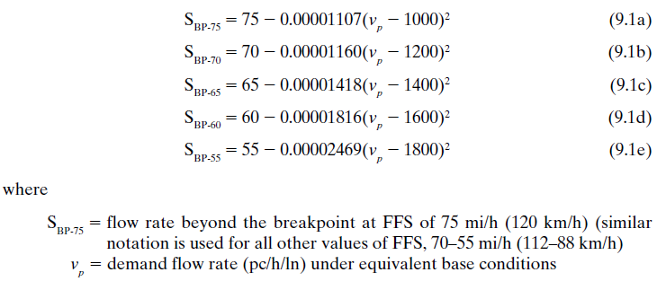
Equations for Freeway
$v_{p}=\frac{V}{PHF∗N∗f_{p}∗f_{HV}}$
$FFS=75.4−f_{LW}−f_{LC}−3.22∗TRD^{0.84 }$
$f_{HV}=\frac{1}{1+P_{T}\left(E_{T}−1\right)+P_{R}(E_{R}−1)}$

Slide 12
Example 9.4, 9.3, 9.5, 9.1, 9.2

