Slide 1
Handouts / Materials
Quiz 2
Class Schedule Overview
Post homework 2
Post slides
Reading assignments.
Schedule exam 1 on Chapter 3 & 6

Slide 2
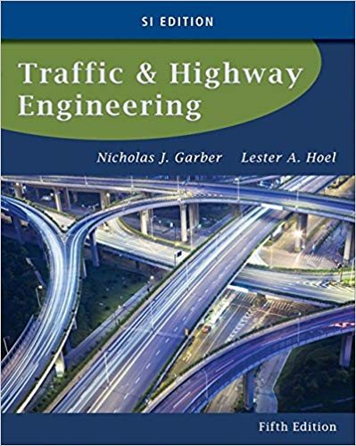
CE 34500 – Transportation Engineering
Chapter 6: Fundamental Principals of Traffic Flow

Slide 3
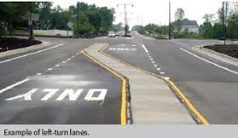
Applications of Traffic Flow Theory
Determine adequate lane lengths for storing left turn vehicles on separate left turn lanes

Slide 4
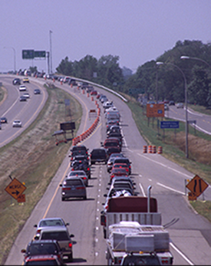
Applications of Traffic Flow Theory
Average delay at intersection.
Average delay at freeway ramp merging areas.
Estimate backups and queuing due to a crash, work zones, signal turning red etc.

Slide 5
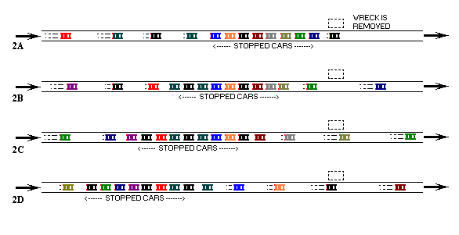
Shock Waves

Slide 6
Example of Shock Waves
Example:
https://www.youtube.com/watch?v=6ZC9h8jgSj4

Slide 7
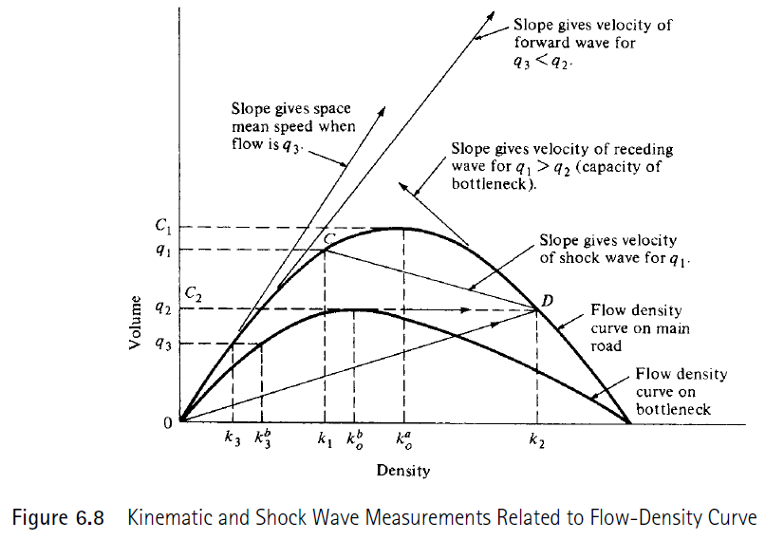
Shock Waves in Traffic Streams

Slide 8
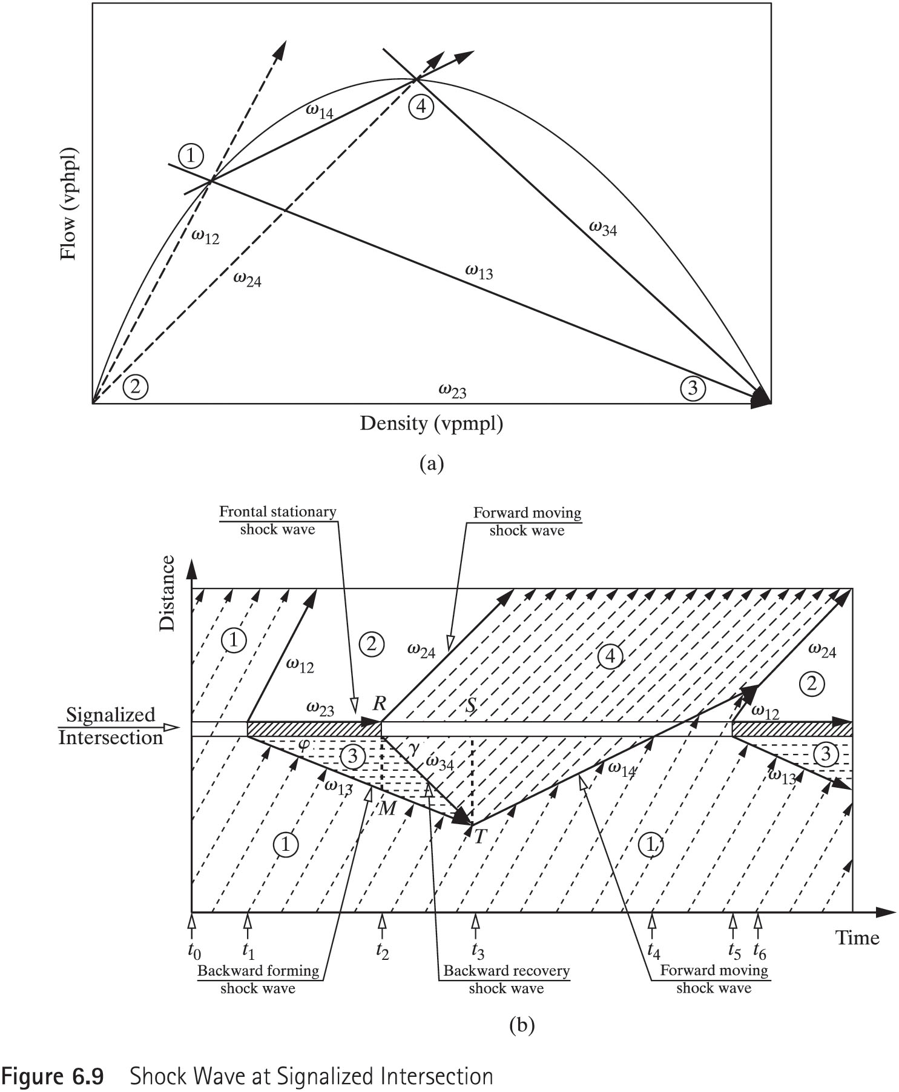
Shock Waves at Signalized Intersection

Slide 9
Types of Shock Waves
Frontal Stationary: Occurs when the capacity suddenly reduces to zero (i.e., closed lanes because of an accident)
Backward Forming: Formed when the capacity is reduced below the demand flow rate. Results in an upstream queue at the bottleneck (i.e., signal indication on an interchange becomes red)
Backward Recovery: Formed when the demand flow rate becomes less than the capacity of the bottleneck (i.e., signal indication on an interchange becomes green)
Rear Stationary and Forward Recovery: Occurs when the demand flow rate upstream of a bottleneck is first higher than the capacity of the bottleneck and then the demand flow rate reduces to the capacity of the bottleneck (i.e., peak hours in a tunnel)

Slide 10
Velocity of Shock Waves
Example:
u_{w}: shock wave moving speed at the density separation line
k₁: higher traffic density
k₂: lower traffic density
u₁: space mean speed of vehicles in traffic with density k₁
u₂: space mean speed of vehicles in traffic with density k₂
q₁ (flow rate) = k₁ x u₁
q₂ (flow rate) = k₂ x u₂

Slide 11
Example 6.5

Slide 12
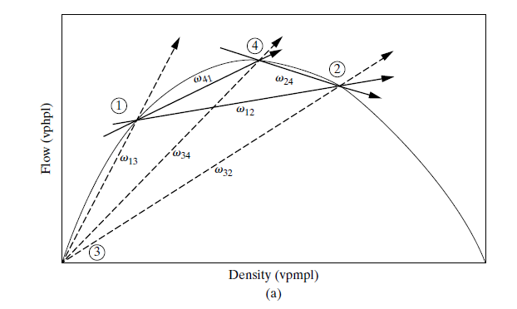
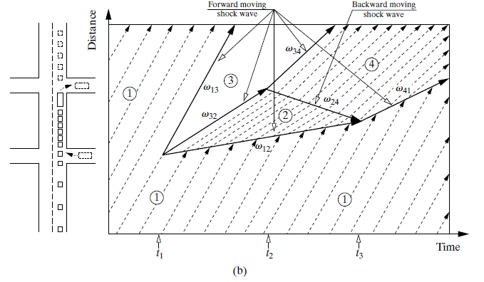
Shock Wave by Slow Traffic

Slide 13
Example 6.6

Slide 14
Gap Acceptance
A driver who intends to merge must evaluate the available gaps to determine which gap (if any) is large enough to accept the vehicle
Driver feels that the merging maneuver can be completed safely to join the new stream
This phenomenon is called gap acceptance

Slide 15
Introduction to Queuing Theory
One of the greatest concerns to engineers is the congestion that exists on urban highways, especially during peak hours
The queues occur on expressway on-ramps and off-ramps, signalized and unsignalized intersections, and on arterials
Mathematical algorithms are used to analyze queuing:
Deterministic Analysis: Assumes that all the traffic characteristics of the queue are deterministic and demand volumes and capacities are known
Stochastic Analysis: Considers that certain traffic characteristics such as arrival rates are not deterministic

Slide 16
Deterministic Analysis
Consider a one direction, three-lane highway with a maximum service volume of c veh/h
An incident results in the closure of one lane and drops the capacity to c_{R} for a period of t_{inc} hr
Demand volume continues to be V veh/h
The maximum queue length can be determined as:

Slide 17
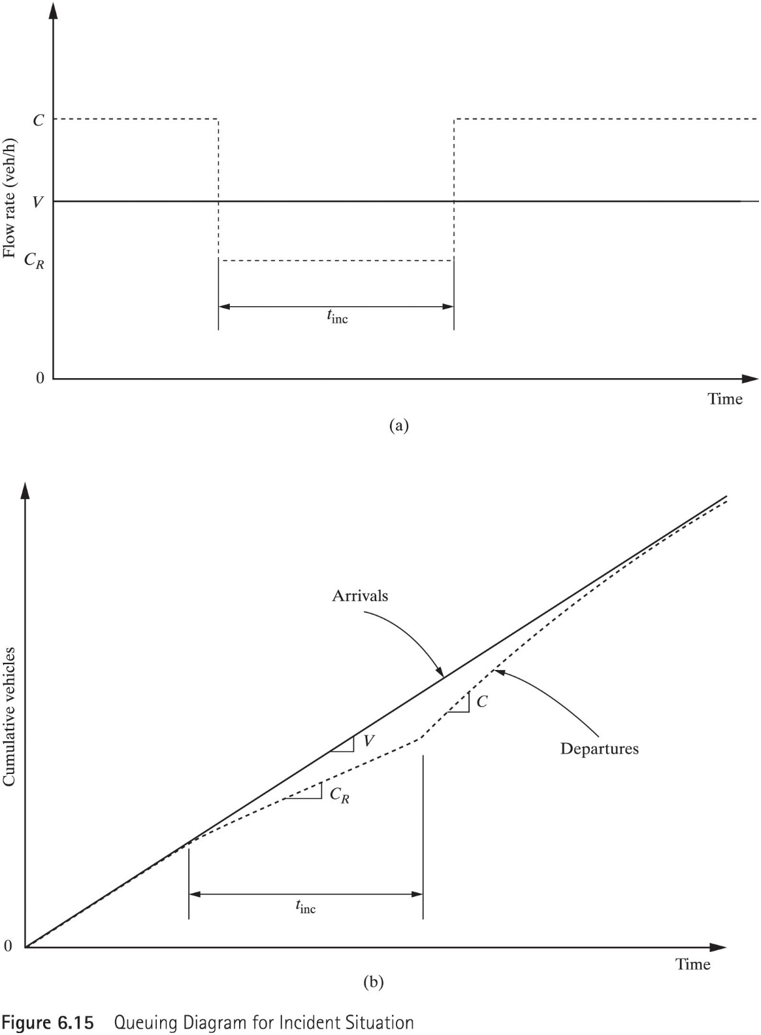
Queuing Diagram for Incident Situation

Slide 18
Example 6.10

Slide 19
Summary
Efficient use of any highway system entails the flow of the maximum volume of traffic without causing excessive delay to the traffic and inconvenience to the motorist.
Using the appropriate model for a traffic flow will facilitate the computation of any change in one or more elements due to a change in another element

