Slide 1
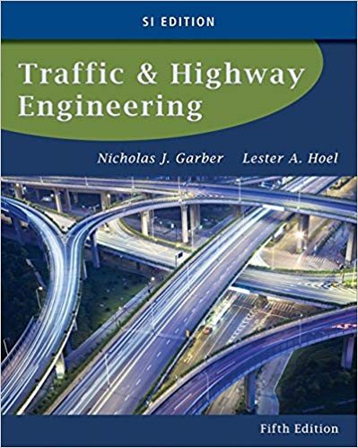
CE 34500 – Transportation Engineering
Chapter 6: Fundamental Principals of Traffic Flow
Course outcome: Understand basic traffic stream parameters and models, traffic flow models, and queuing theory

Slide 2
Traffic Flow Elements
Primary Elements
Flow
Density
Speed
Another Element:
Headway

Slide 3
Traffic Flow Elements
Flow:
Equivalent hourly rate at which vehicles pass a point on a highway during a period less than 1 hour

Slide 4
Traffic Flow Elements
Density/Concentration (k)
Number of vehicles traveling over a unit length of highway at an instant in time, veh/mile
Speed (u)
Distance traveled by a vehicle during a unit of time
Time mean speed is the arithmetic mean of the speeds of vehicles passing a point on a highway during an interval of time

Slide 5
Time Mean Speed (TMS)
The TMS is the arithmetic mean of the speeds of vehicles passing a point on a highway during an interval of time.
$$U_{t}=\frac{1}{n}\sum_{i=1}^{n}{u_{i}}$$

Slide 6
Space Mean Speed (SMS)
The SMS is the harmonic mean of the speeds of vehicles passing a point on a highway during an interval of time.
$$U_{s }=\frac{n}{\sum_{i=1}^{n}{{1/u}_{i}}}=\frac{nL}{\sum_{i=1}^{n}{t_{i}}}$$
The TMS is always higher than SMS

Slide 7
Traffic Flow Elements
Time Headway (h)
Difference between the time the front of a vehicle arrives at a point on the highway and the time the front of the next vehicle arrives at that same point
Usually expressed in seconds
Space Headway (d)
Distance between the front of a vehicle and the front of the following vehicle
Usually expressed in meters

Slide 8
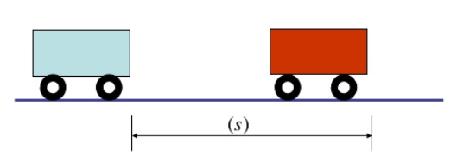
Time and Space Headway
Time Headway
Space Headway

Slide 9
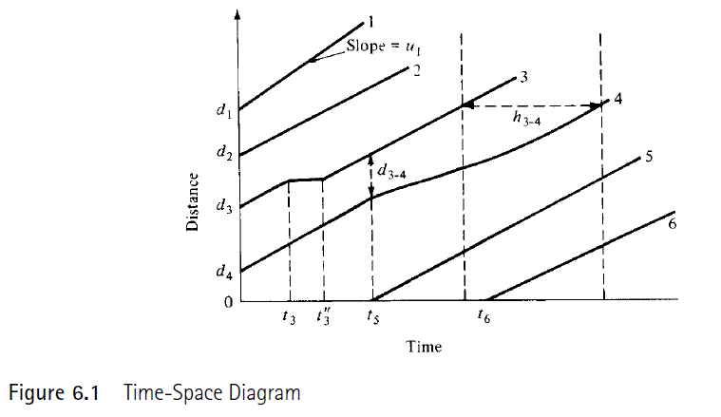
Traffic Flow Elements
Time-Space Diagram:

Slide 10
Example 6.1

Slide 11
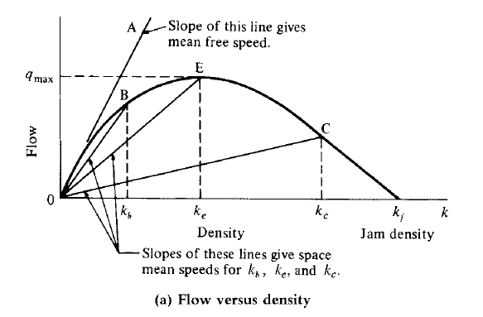
Flow-Density Relationship
When the density on the highway is 0, the flow is also 0
As the density increases, the flow decreases
When the density reaches its maximum (jam density), the flow must be 0
Flow= Density X space mean speed

Slide 12
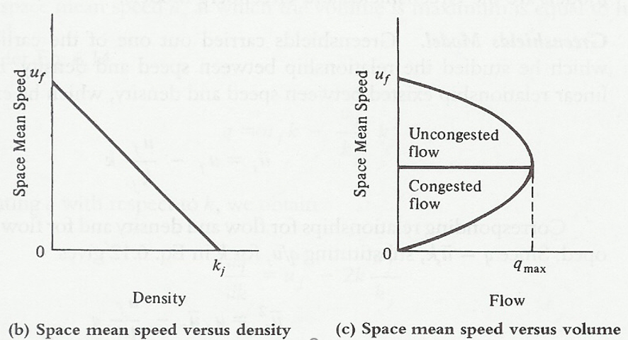
Flow-Density Relationship
Flow= Density X space mean speed

Slide 13
Example 6.2

Slide 14
Mathematical Relationship Describing Traffic Flow
Macroscopic Approach: Considers traffic streams and develops algorithms that relate the flow to the density
Greenshields Model: linear relationship between speed and density
Greenberg Model: fluid-flow analogy
Model Application
Regression Analysis: minimizing the squares of the differences between the observed and the expected values
If a dependent variable y and an independent variable x are related by an estimated regression function: y = a + bx
Microscopic Approach (Car-Following Theory)
Considers spacing between consecutive vehicles and speeds of individual vehicles

Slide 15
Greenshield Model
Prove: the space mean speed at which the volume is maximum is equal to half the free mean speed.
Prove: the density at which the volume is maximum is equal to half the jam density.

Slide 16
Example 6.3, 6.4

