Slide 1
Handouts / Materials
Worksheet_chapter 6
Quiz 1
Class Schedule Overview
Post homework 1
Post slides for road characteristics.
In-class activity: Example 3.8
Reading assignments.
Post slides for Chapter 6 as well.

Slide 2
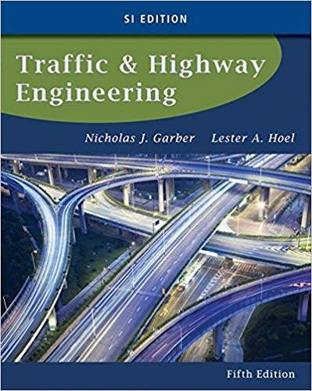
CE 34500 – Transportation Engineering
Chapter 2: Characteristics of the Driver, the Pedestrian, the Vehicle, and the Road

Slide 3
Road Characteristics
Available Sight Distance
Length of roadway a driver can see ahead at any time
Required Sight Distances
Stopping Sight Distance
Minimum sight distance required for driver to stop a vehicle after seeing object in vehicle’s path
Notes:
Available Sight Distance: Length of roadway a driver can see ahead at any time.
Available sight distance is a roadway characteristic—stopping distance itself, for example, is a driver/ vehicle characteristic.
Available sight distance at each point of the highway is a roadway characteristic-- must be such that when a driver is traveling at the highway’s design speed, adequate time is given, after an object is observed in the vehicle’s path, to make the necessary evasive maneuvers without colliding with the object.
Stopping Sight Distance (SSD): Minimum sight distance required for a driver to stop a vehicle after seeing an object in the vehicle’s path.
Stopping sight distance is the sum of the distance traveled during perception – reaction time and the distance traveled during braking.
It is essential that highways be designed such that sight distance along the highway is at least equal to the SSD.
Decision Sight Distance: “Distance required for a driver to detect an unexpected or otherwise difficult – to – perceive information source or hazard in a roadway environment that may be visually cluttered, recognize the hazard of its threat potential, select an appropriate speed and path, and initiate and complete the required safety maneuvers.” (AASHTO)
When the stimulus is unexpected or when it is necessary for the driver to make an usual maneuvers, longer distances are required, since the perception – reaction time is much longer-- -- this longer sight distance is the decision sight distance.
Passing Sight Distance: Minimum sight distance required on a two-lane, two-way highway that will permit a driver to complete a passing maneuver without colliding with an opposing vehicle and without cutting off the passed vehicle—or to abort pass if oncoming vehicle comes into view and is too close to complete pass.

Slide 4
Road Characteristics
Required Sight Distances
Decision Sight Distance
Minimum sight distance required for driver to detect unexpected or difficult-to-perceive information source or hazard and initiate & complete required safety maneuver
Passing Sight Distance
Minimum sight distance required on 2-lane, 2-way roadway that will permit a driver to safely complete or abort pass if oncoming vehicle comes into view
Notes:
Available Sight Distance: Length of roadway a driver can see ahead at any time.
Available sight distance is a roadway characteristic—stopping distance itself, for example, is a driver/ vehicle characteristic.
Available sight distance at each point of the highway is a roadway characteristic-- must be such that when a driver is traveling at the highway’s design speed, adequate time is given, after an object is observed in the vehicle’s path, to make the necessary evasive maneuvers without colliding with the object.
Stopping Sight Distance (SSD): Minimum sight distance required for a driver to stop a vehicle after seeing an object in the vehicle’s path.
Stopping sight distance is the sum of the distance traveled during perception – reaction time and the distance traveled during braking.
It is essential that highways be designed such that sight distance along the highway is at least equal to the SSD.
Decision Sight Distance: “Distance required for a driver to detect an unexpected or otherwise difficult – to – perceive information source or hazard in a roadway environment that may be visually cluttered, recognize the hazard of its threat potential, select an appropriate speed and path, and initiate and complete the required safety maneuvers.” (AASHTO)
When the stimulus is unexpected or when it is necessary for the driver to make an usual maneuvers, longer distances are required, since the perception – reaction time is much longer-- -- this longer sight distance is the decision sight distance.
Passing Sight Distance: Minimum sight distance required on a two-lane, two-way highway that will permit a driver to complete a passing maneuver without colliding with an opposing vehicle and without cutting off the passed vehicle—or to abort pass if oncoming vehicle comes into view and is too close to complete pass.

Slide 5
Required Stopping Sight Distance
Notes:
Formula for required stopping sight distance was derived previously.
Required SSD is a function of characteristics of driver (reaction time = 2.5 sec), vehicle and roadway (decel rate = 11.2 ft/sec^2, assuming that brakes and roadway surface are adequate to allow this rate to be achieved and grade of roadway)
Characteristic of the roadway is the available stopping distance.
Depends on driver/ vehicle characteristics (eye height = 3.5 ft. and object height = 2.0 ft.) and on roadway characteristics (grades and vertical curve lengths).
Will discuss this later in the geometric design section of this course.

Slide 6
Example 3.8

Slide 7
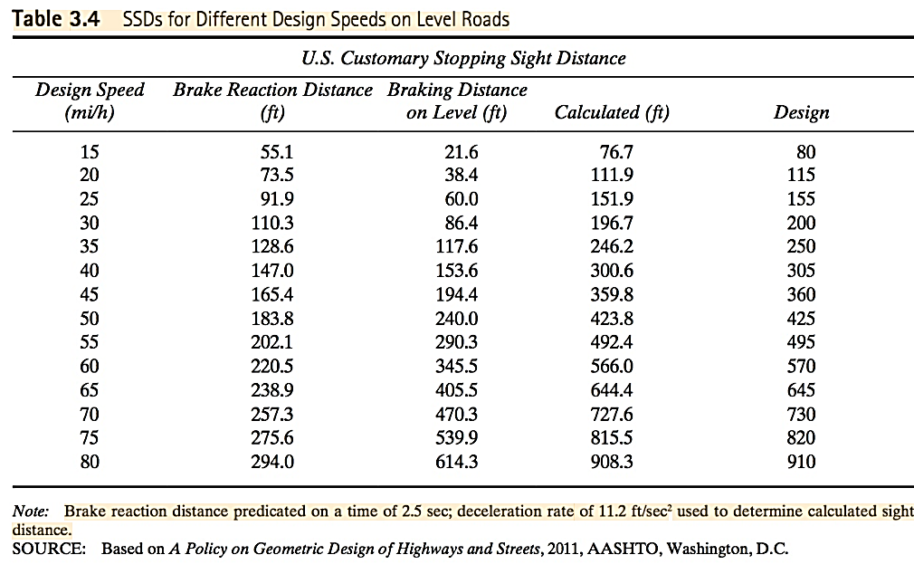
Required Stopping Sight Distance
Notes:
Table 3.4, page 85, shows required AASHTO stopping sight distances for different design speeds.

Slide 8
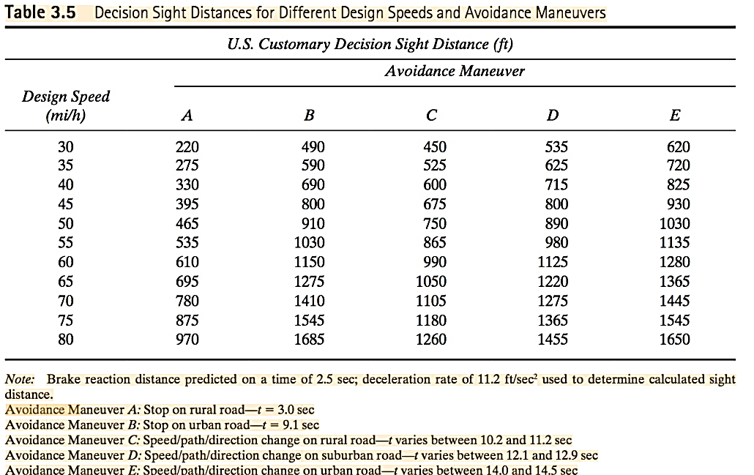
Required Decision Sight Distance
Notes:
Table 3.5, p. 90
The decision sight distances depend on the type of maneuver required to avoid the hazard on the road, and also on whether the road is located in a rural or in an urban area.
A: Stop on rural road t react = 3.0 s (add braking distance)
B: Stop on urban road t react = 9.1 s (add braking distance)
C: Speed / path / direction change on rural road t total = 10.2 – 11.2 s
D: Speed / path / direction change on suburban road t total = 12.1 – 12.9 s
E: Speed / path / direction change on urban road t total = 14.0 – 14.5 s
Characteristic of the roadway is the furnished decision sight distance. Depends on driver/ vehicle characteristics (eye height= 3.5 ft. and object height = 2.0 ft.) and on roadway characteristics (grades and vertical curve lengths).
Will discuss this later in the geometric design section of this course.

Slide 9
Required Passing Sight Distance
“That Was Then”
Long Formula—sight distance necessary to safely start and complete a pass
“This Is Now”
Short Formula—sight distance necessary to safely complete or abort a pass
Notes:
AASHTO passing sight distance (“ long formula”) was used previously in roadway design, represents the distance necessary to start and safely complete a pass.
However, passing and no – passing zones on completed highways have been marked for a long time in accordance with much shorter distances given in the Manual of Uniform Traffic Control Devices, resulting from the “short formula”
The MUTCD passing sight distance represents the distance required to safely start a pass. If the driver encounters and oncoming vehicle, he has the opportunity to abort to pass in return to the right lane.
In 2011 Green Book, minimum passing sight distances for use in design are now the same as the minimum PSD’s given in the MUTCD / now the same as the distances used to mark no-passing zones.
Regardless of the formula that is used, potential for conflicts in passing operations are ultimately determine by the judgment of drivers.
Recent research has shown that roadways marked with the short formula PSD’s result in 2-lane highways that experience very few crashes due to passing maneuvers.

Slide 10
“That Was Then” Required Passing Sight Distance
Notes:
d1 = distance traversed during perception-reaction time and during initial acceleration to the point where the passing vehicle just enters the left lane / considered to be “critical point” in one passing sight distance model
d2 = distance traveled during the time the passing vehicle is traveling in the left lane
d3 = distance between the passing and opposing vehicle at the end of the passing maneuver
d4 = distance traveled by the opposing vehicle during 2/3 of the time the passing vehicle is in the left lane (d4 = 2/3 * d2)

Slide 11
“That Was Then” Required Passing Sight Distance
Notes:
Exhibit is from 2004 Green Book
65 mph: Distance required to start and safely complete a pass = 2285 ft.—close to half a mile
Characteristic of the roadway is the furnished passing sight distance.
Depends on driver/ vehicle characteristics (eye height = 3.5 ft. and object height = 3.5 ft. / eye height of oncoming driver ) and on roadway characteristics (grades and vertical curve lengths).
Will discuss this later in the geometric design section of this course.

Slide 12
“This is Now” Required Passing Sight Distance
Assumptions
Driver will abort pass and return to right lane if oncoming vehicle comes into before reaching critical point, when driver is committed to complete pass
The perception-reaction time of the driver of the passing vehicle is 1.0 sec for aborting the pass.
Passing & oncoming vehicles traveling at design speed
Passed vehicle is traveling 12 mph slower
When passing vehicle returns to its normal lane, the time headway between the passing and oncoming vehicle is 1 sec.
Notes:
Some of assumptions regarding movements of vehicles in passing maneuver:
The passing and opposing vehicles travel at the same speed that represents the design speed of the road.
2. The speed of the vehicle being passed (impeder) does not vary during the passing maneuver and it is less than that of the passing vehicle by 12 mph.
5. The perception-reaction time of the driver of the passing vehicle is 1.0 sec for aborting the pass.
8. At the point where the passing vehicle returns to its normal lane, the time headway between the passing and impeder vehicles is 1 sec.
Although it is possible for multiple passing maneuvers to occur (that is, more than one vehicle pass or are passed in one maneuver), it is not practical for minimum design criteria to be based on them.

Slide 13
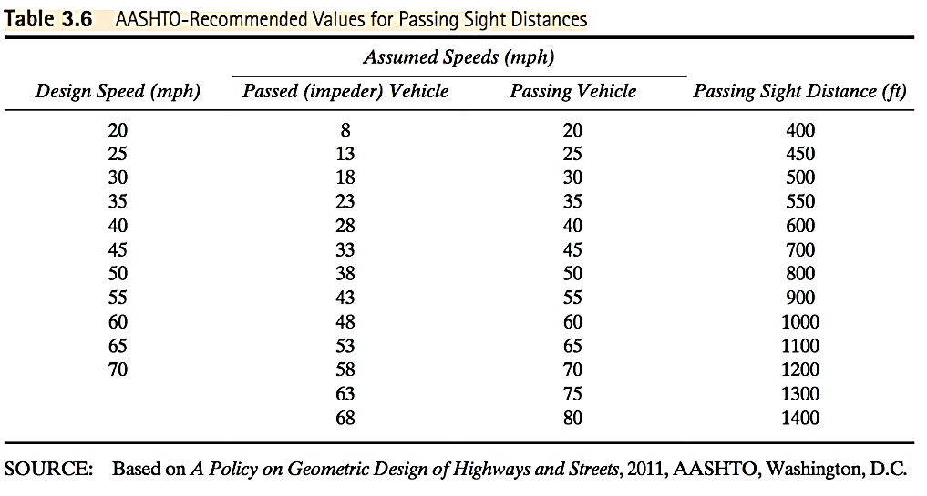
“This is Now” Required Passing Sight Distance
Notes:
65 mph: 1100 ft. required to safely start and abort a pass.
1100 / 2285 = 0.481

Slide 14
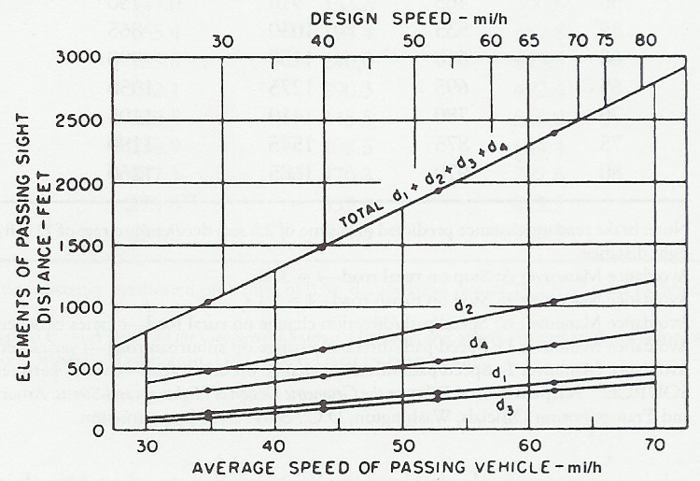
“That Was Then” Required Passing Sight Distance
Notes:
Figure. 3.9, p. 92
Components of AASHTO passing sight distance—shown graphically

