Slide 1
Handouts / Materials
Worksheet_chapter 3
Class Schedule Overview
Post slides.
In-class activity: Example 3.2
Reading assignments.

Slide 2
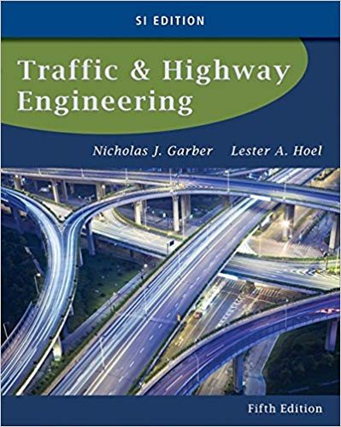
CE 34500 – Transportation Engineering
Chapter 3: Characteristics of the Driver, the Pedestrian, the Vehicle, and the Road

Slide 3
Characteristics of Driver, Pedestrian, Vehicle & Road
As a Transportation Engineer, What Do We Have Control Over?
Notes:
Transportation engineers have significant control only over the characteristics of the roadway.
The automotive design engineer has control over characteristics of the vehicle--braking ability, steering response, etc.
However, how vehicle actually behaves in the real world depends on driver, roadway, weather, traffic, time of day, etc.

Slide 4
Characteristics of Driver, Pedestrian, Vehicle & Road
If We Do Not Have Full Control Over All of the Characteristics,
Why do We Study Them?
Notes:
We can design our roadway environment to accommodate the other components…
….and compensate for their limitations to the maximum extent possible.

Slide 5
Driver Characteristics
No “Design Driver”
Wide range of abilities
Abilities vary under different conditions
85th to 95th percentile used for design criteria
How Do We Regulate Drivers?
Driver licensing
Minimum knowledge of the rules of the road
Minimum driving ability
Minimum physical ability
Notes:
No “design driver”—characteristics of a particular individual not used to design roadway.
p. 54: People exhibit a wide range of abilities to see, to hear, to evaluate information input, to react to information, etc.
For a particular individual, these abilities vary under different conditions--influence of alcohol, fatigue, time of day, etc.
Principal concern is engineer must balance tradeoffs between accommodating abilities of as many drivers as possible with potential cost implications of designing for drivers with abilities far below normal.
85th percentile to 95th percentile values have been used to select design criteria.
In general, higher chosen percentile, wider the range covered.
Control the quality of drivers—somewhat—by requiring them to have:
Min. knowledge of the rules of the road
Min. ability to control vehicle—steering, parking, etc.
Min. physical ability—ability to see roadway, signs, other vehicles, etc.

Slide 6
Driver Characteristics
Human Response Process
Five senses
See / Visual reception
Hear / Hearing perception
Touch / Kinesthetic / Equilibrium
Smell
Taste
What Sensory Processes Do We Use When Driving?
Notes:
Five senses as I learned them in elementary school…
….see, hear, touch smell, taste.
p. 54: Visual reception (see): most of the information received by a driver is visual--ability to see is of fundamental importance in the driving task: road signs.
P. 56: Hearing perception: warning sound of a siren on emergency vehicle—loss of some not critical (can normally be corrected wit hearing .
Movement (touch, kind of--kinesthetic): sense of speed being traveled.
Equilibrium ( touch, kind of--vestibular): sway of vehicle and tilting of vehicle (due to super) on a curve.
Smell: hot brakes on a long grade.
Taste: not used as part of driving process ☺

Slide 7
Driver Characteristics
Visual and Hearing Important
Visual most important
Visual acuity
Peripheral vision
Color vision
Glare vision & recovery
Depth perception
Hearing less important
Can compensate for deafness & operate vehicle safely
Notes:
Vision so important (90% of information used for driving) that we will discuss various aspects that are applicable to the driving process on the next couple of slides.
The principal characteristics of the eye are:
visual acuity
peripheral vision
color vision glare vision and recovery,
depth perception.

Slide 8
Visual Reception
Visual Acuity
Ability to see fine details
Static acuity
Dynamic acuity
Normal visual acuity taken as 20/20--an individual with a 20/20 visual acuity can distinguish a letter that is subtended by an angle of 5' of arc ( 1/12 of a degree) at the eye--0.35 in therefore represents the height of a 20/20 letter – prove?
Notes:
Visual Acuity– the ability to see fine details of an object
Usually measured by using the Snellen eye chart
Based on the usual standard length of an eye exam room--20 ft in the USA
Normal visual acuity taken as 20/20--an individual with a 20/20 visual acuity can distinguish a letter that is subtended by an angle of 5' of arc ( 1/12 of a degree) at the eye--0.35 in therefore represents the height of a 20/20 letter
Lower bottom number in the acuity ratio, better the acuity. For example, an acuity vision of 20/15 is better than that of 20/20.
If driver with visual acuity of 20/20 is just able to distinguish a sign at a distance d ft. from the sign, then a driver with a visual acuity of 20/30 can see the same sign at a distance of (20/30) × d ft.
See my calcs.
Static acuity-Identification of object with no relative movement is 0.5 – 1.0 sec.
Increases with more background brightness (up to 3 candles/ sf), then remains constant.
Dynamic acuity--clear vision 3 – 5 deg, fairly clear from 10 to 12 degrees, beyond is blurred—important for location of traffic signs, etc.
Peripheral vision-ability to see objects beyond the cone of clearest vision--up to 160 deg.--affected by speed of vehicle
Details and colors not clear.
At about age 60, significant reductions can occur in a person’s peripheral vision.

Slide 9
In Class Problem 1
Example 3.1: A driver with w visual acuity of 20/30 can just decipher a sign a distance 20 ft. from a sign. Determine the maximum distance from the sign at which drivers with the following visual acuity will be able to see the same sign: [Ans. 40, 12 ft.]
20/15
20/50

Slide 10
Visual Reception
Peripheral Vision
Ability to see objects clearly beyond cone of clearest vision
Color Vision
Ability to differentiate one color from another
Glare Vision & Recovery
Decrease in visibility & comfort
Takes time to recover from glare effects
Depth Perception
Ability to estimate distance
Notes:
Color vision-ability to differentiate one color from another.
Black/ white and black/ yellow are the most sensitive.
Can compensate for lack of color vision by recognizing, for example, shape of traffic sign.
Glare-two types (direct and indirect / specular) which result in decrease in visibility and cause discomfort to eyes.
Of greatest importance in night driving--esp. for older drivers, who see much more poorly at night--at about age 40, a significant increase occurs in a person’s sensitivity to glare.
Glare recovery-time required to recover from effects of glare after passing a lighting source.
Dark to light = 3 sec. +- / Light to dark = 6 sec. +-
Depth perception-affects ability of person to estimate distances
Human eye not very good at estimating absolute values of size, distance, etc.—hence standard shape, color, size, etc. for traffic signs.
Esp. important in passing maneuvers,. to avoid head-ons and turning maneuvers.

Slide 11
Perception – Reaction Process
Perception
Conscious awareness that something happened
Identification
Acquire info. to make decision
Emotion
Select appropriate action
Volition
Execute selected action
Perception-reaction time
Sum of PIEV times
Notes:
Process through which a driver evaluates and reacts to a stimulus can be divided into four, PIEV subprocesses.
Time that elapses during PIEV processes also known as perception-reaction time
Perception – Developing a conscious awareness that something has happened—see a traffic control device, warning sign, etc.
Identification – Acquire sufficient information to base a decision on—identify the object and understand the stimulus.
Emotion (Decision) – select an appropriate action to take—stepping on the brake.
Volition/ reaction – Brain issues command and selected action is executed.

Slide 12
Perception – Reaction Time
Perception – Reaction Time
Varies among individuals
Varies for different situations
85th percentile time—ranges from 1.6 to 7.8 sec. for unexpected info.
Per AASHTO Green Book—use 2.5 sec. for design (90th percentile value)
Used to determine reaction portion of braking distance
Notes:
Perception-reaction time is an important factor in the determination of braking distances--dictates the minimum sight distance required on a highway and the length of the yellow phase at a signalized intersection.
Varies among individuals—may vary for the same person as the occasion changes.
Depends on how complicated the situation is, driver training, the existing environmental conditions, age, gender, whether the person is tired or under the influence of drugs and/or alcohol—and especially, whether the stimulus is expected or unexpected.
85 th percentile time to brake, for various situations varies from 1.60 sec. to 7.8 sec. for unexpected information.
As mentioned previously, reaction time selected for design should be long enough to include reaction time for most drivers.
AASHTO Green Book uses 2.5 sec. for stopping sight distance—enough time from 90 percent of most drivers to make decision to hit the brake pedal under most highway conditions.
2.5 sec. may not be adequate for unexpected or complex situations—e.g. unexpected traffic signal can increase reaction time by 35%
2.5 sec. does not allow for drunk, drugged, “highway hypnotized,” etc. drivers.

Slide 13
Perception – Reaction Time
What Does 2.5 Sec. Perception Reaction Time Mean in Terms of Roadway Design?
Notes:
How far are you going to travel before you even BEGIN to apply the brakes.
EX 3.2
You are driving 65mph when you suddenly see an accident ahead. How far do you travel before you hit the brakes?
Reaction distance = Reaction time * Velocity
= 2.5 sec. X* 95.6 ft/ sec
= 239.8 ft.
Therefore, need 240 ft. PLUS the time/ distance to brake the vehicle to a stop.

Slide 14
Perception – Reaction Time
In Class Problem 2
A driver with a perception reaction time of 2.5 sec is driving at 65 mph when she observes that an accident has blocked the road ahead. Determine the distance the vehicle would move before the driver could activate the brakes. The vehicle to continue to move at 65 mph during the perception reaction time of 2.5 sec. [Ans. 238.9 ft.]

Slide 15
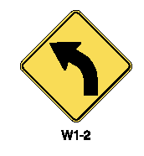
Perception – Reaction Time
Use of Symbols in Roadway Signs
Standard symbols (v. “wordy” explanation) decreases perception-reaction time
Slow Down. There is a curve ahead. Advise no more than 25 mph.
25 MPH
Notes:
Use of standard symbols (v. a “wordy” explanation) on roadway signs increases the clarity of the message and decreases the perception-reaction time.

Slide 16
Perception – Reaction Time
Use of Symbols in Roadway Signs
Slippery When Wet
Notes:
Use of standard symbols (v. a “wordy” explanation) on roadway signs increases the clarity of the message and decreases the perception-reaction time.

Slide 17
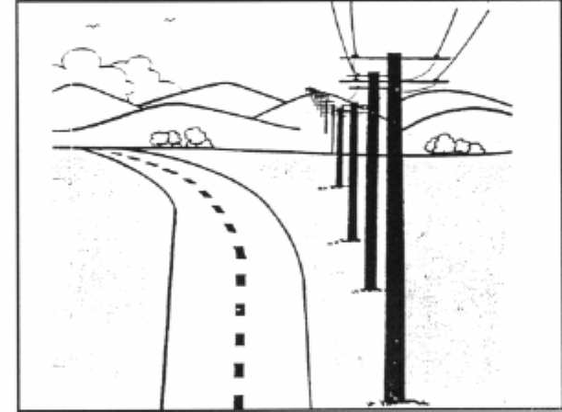
Driver Expectancy
Driver Expectancy
Drivers become conditioned to react in certain way in certain situation
Notes:
Driver expectancy-drivers become conditioned to react in certain way in certain situations.
Try not to create situations which violate driver expectancy/ which may lead to delayed reactions and taking inappropriate actions.
Line of utility poles has been adjacent and parallel to roadway for a long distance/ driver has become accustomed to following the line of poles/ curve violates driver expectancy.
When road changes direction, guidance provided by line of poles may override the guidance provided by the edges of the roadway, centerline stripe, etc.
May have add to add chevron warning signs to the curve to call the driver’s attention to the changed situation/ to change his expectancy.
This is called providing positive guidance to the driver.

Slide 18
Driver Expectancy
When met:
Performance tends to be error free
When violated:
Decisions take more time
Performance is poorer
Situation may cause crash
Notes:
Text on slide is self-explanatory.

Slide 19
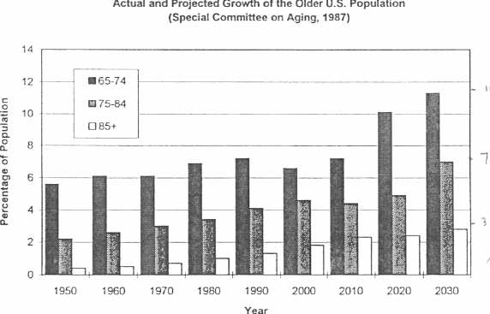
Older Drivers
Changing Demographics
Notes:
Graph was deleted from this edition of the text—useful info., but somewhat out of date.
Based on older edition of this text:
Older drivers (65+) are making up a larger percentage of the population.
In 2010, people in the 65 to 74 age range made up 7% of the population v. an expected 11% in 2030.
In 2030, the expected age range percentages are 65-74/ 11%, 75-84/ 7% and 85+/ 3%, for a total of 21% of the population between 65 and 85.
Per this edition of text:
Per Administration on Aging by 2030:
Population of persons aged 60+ in the United States will be about 17.1 million, representing about 19.3 percent of the population, compared to 12.9 percent in 2009.
20 percent of U.S. drivers will be 65 years or older (v. 21% from graph)
Older drivers seem to be depending more on the automobile for meeting their transportation needs.
Effects of aging can result in older drivers being less safe than their younger counterparts and having a higher probability of being injured when involved in a crash.

Slide 20
Older Drivers
Diminished Visual Capabilities
Reductions in Acuity
Ability to discriminate high contrast features
Reductions in Contrast Sensitivity
Ability to detect low-contrast features
Reductions in Visual Field
Reduced peripheral visions
Notes:
Therefore, vital that traffic and highway engineers consider diminished characteristics of older drivers in making decisions about highway design and operational characteristics.
Reductions in Acuity – Ability to discriminate high contrast features (reading the signs)
Reductions in Contrast Sensitivity – Ability to detect low-contrast features (worn pavement lines, conditions at dusk)
Reductions in Visual Field – Peripheral vision

Slide 21
Older Drivers
Diminished Visual Capabilities
Restrictions in Area of Visual Attention
Ability to discriminate relevant from irrelevant information
Increased Sensitivity to Glare
Ability to see in the presence of oncoming headlights
Decreased Dark Adaptation
Ability to see objects when moving from areas of light to dark
Decreased Motion Sensitivity
Ability to determine how fast other vehicles are moving
Notes:
Restrictions in Area of Visual Attention – Ability to discriminate relevant from irrelevant information (necessary for responding to constantly changing traffic scene)
Increased Sensitivity to Glare – Ability to see in the presence of oncoming headlights
Decreased Dark Adaptation – Ability to see objects when moving from areas of light to dark
How can older people drive at all?
Ability to compensate for their physical shortcomings

Slide 22
Pedestrian Characteristics
In What Situations Do Pedestrian Characteristics Most Affect Road Design?
Pedestrian Walking Speeds
Speed varies between 3 & 8 ft/sec
3.5 ft/sec used for design purposes
3.0 ft/sec in areas with large elderly population
Notes:
Situations where the pedestrians must cross the roadway--how quickly can they cross?
Observations of pedestrian movements have indicated that walking speeds vary between 3.0 and 8.0 ft/sec.
Pedestrian control devices include special pedestrian signals, safety zones and islands at intersections, pedestrian underpasses, elevated walkways, and crosswalks.
Example: determination of the length of an all-red phase at a traffic signal which permits peds. to cross an intersection with heavy traffic.
Mean male walking speed has been determined to be 4.93 ft/sec, and for females, 4.63 ft/sec.
A more conservative value of 4.0 ft/sec is normally used for design purposes.
Decreases to 3.0 ft/sec when the percentage of elderly pedestrians is higher than 20 percent
Has been recommended that a walking speed of 2.9 ft/sec should be used for pedestrian clearance at intersections where pedestrians 65 years and older are predominant.
Notes continue on next page.

Slide 23
Pedestrian Characteristics
Other Pedestrian Considerations
Allowance for handicapped pedestrians in design—Americans with Disabilities Act (ADA)
Audible info. / vibrating surfaces at intersections
Wheelchair ramps at intersections and other ADA facilities
Notes:
Notes continued from previous page.
2009 Manual of Uniform Traffic Control Devices recommends that a pedestrian walking speed of 3.5 ft/sec rather than 4 ft/sec be used in the design of pedestrian intervals and signal phases—(recent revision) 3.0 ft/sec is also to be used.
Also, have to make other allowances for handicapped in design:
Many states are now incorporating accessible pedestrian signals (APSs)
Devices that transmit information on pedestrian signal timing in a nonvisual format such as audible tones, speech messages, and /or vibrating surfaces.
Ramps are also now being provided at intersection curbs to facilitate the crossing of the inter- section by the occupant of a wheelchair.
Compliance with Americans with Disabilities Act (ADA) so that disabled individuals are not deprived of civil rights.

Slide 24
Bicyclists and Bicycles
Three Classes of Bicyclists
Class A
Experienced--comfortably ride in traffic
Class B
Less experienced—prefer to ride on neighborhood streets or bicycle paths
Class C
Children w/ or w/o parents—ride mainly on residential streets to schools, playgrounds, etc
Design of Bicycle Facilities.
Notes:
A: Experienced—consider bicycle as a motor vehicle and can comfortably ride in traffic.
B: Less Experienced—prefer to ride on neighborhood streets and are more comfortable on designated bicycle facilities, such as bicycle paths.
C: Children, on their own or with parents—use mainly residential streets that provide access to schools, rec. facilities, stores, etc.
Design of urban roads and streets--consider the feasibility of incorporating bicycle facilities that will accommodate class B and class C bicyclists.
Bicyclists in the “casual and less confident” class include the majority of bicyclists--recreational riders--those who are comfortable riding only on bicycle facilities on low-volume streets when conditions are favorable--those for whom the necessary mode of transportation is the bicycle.
Well-designed, physically visible network of bicycle facilities is necessary if this group is to select the bicycle as the mode of transportation.
For experienced and confident riders, speeds vary from 20 mph on level terrain to 45 mph on steep downgrades.
Casual and less confident riders, speeds are usually between 8 and 12 mph.
AASHTO Guide for Development of Bicycle Facilities:
Design Speed--20mph on level (8mph uphill, 31mph downhill).
Mean bicycle speed when crossing an intersection from a stopped position is 8 mph/ mean accel. Rate is 3.5 ft/sec^2,

Slide 25
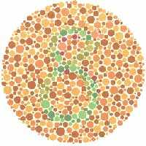
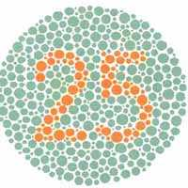
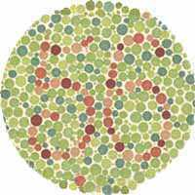
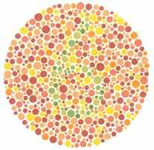
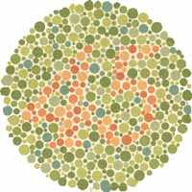
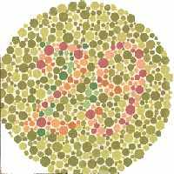
Visual Reception

Slide 26
Driver Expectancy
Mac Duff
Mac Donald
Mac Hinery

Slide 27
Driver Expectancy
3 – 6 – 9 – ?
3 – 9 – 27 – ?
3 – 14 – 159 – ?
Notes:
9 + 3 =12
27 * 3 = 81
??

Slide 28
Vehicle Characteristics
Maximum allowable sizes and weights on Interstates and Federal Aid Highways
80,000 lb. gross weight,
Axle loads up to 20,000 lb. for single axles
34,000 lb. for tandem (double) axles
102 in. width for all trucks
48 ft. length for semitrailer and trailers
28 ft. length for each twin trailer
Notes:
The Surface Transportation Act of 1982 established maximum allowable truck sizes and weights on Interstate and many other federal highways—see values given on slide.

Slide 29
Vehicle Characteristics
In-class Problem 2
A 5 axle truck traveling on an interstate highway has the following axle characteristics.
Distance bet ween the front single axle and the front set of tandem axles = 20 feet.
Distance between the front single axle and the back set tandem axle = 65 feet.
Distance between the front set of tandem axles and the back set of tandem axles = 48 feet.
Load carried by front set of single axles = 10000 lb
Load carried by each axle of the tandem-axles = 16000 lb
Determine whether this truck satisfies federal weight regulations.

