Slide 1
CE 34500 – Transportation Engineering
Chapter 20: Design of Rigid Pavements

Slide 2
Homework posted due April 27
No lecture day after tomorrow
Exam review on next week Monday
Discussion on course project description – recorded on live?

Slide 3
Stresses in Rigid Pavements
Stress develops from several factors:
Traffic wheel loads, expansion/contraction, yielding of subbase
Stress form complex system: Simplifying assumptions
Concrete pavement slabs are considered unreinforced beams
Combination of flexural and direct tensile stresses will result in transverse and longitudinal cracks
Supporting subbase acts as an elastic material

Slide 4
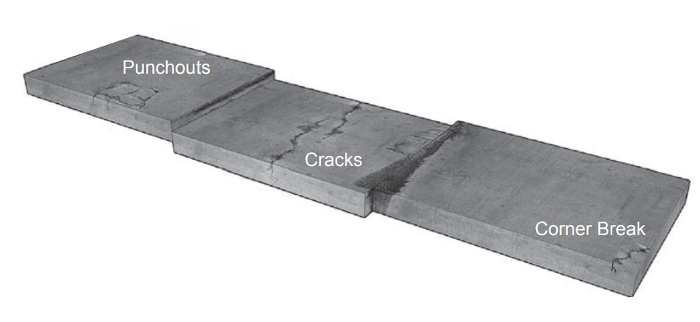
Major Distress Conditions
Source: http://www.ce.memphis.edu/4155/Powerpoints/17%20-%20Curling%20Stresses%20in%20Concrete%20Slabs.pdf

Slide 5
Major Distress Conditions
Cracking
– Bottom-up transverse cracks
– Top-down transverse cracks
– Longitudinal cracks
– Corner breaks
– Punchouts (CRCP)
Joint Faulting
Pumping

Slide 6
Sources of Stress
• Wheel Loads
• Curing Shrinkage
• Thermal Contraction/Expansion
• Thermal Curling
• Moisture Warping

Slide 7
Design Considerations
• Slab Thickness
• Base Type and Thickness
• Drainage
• Joint Spacing
• Temperature Steel
• Dowel Bars
• Tie Bars

Slide 8
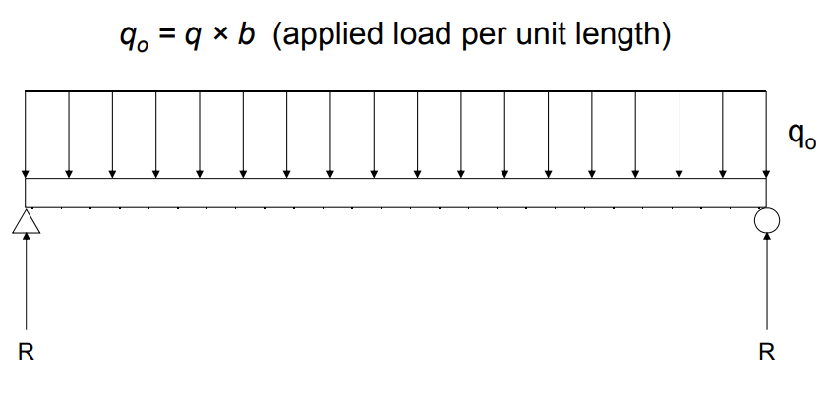
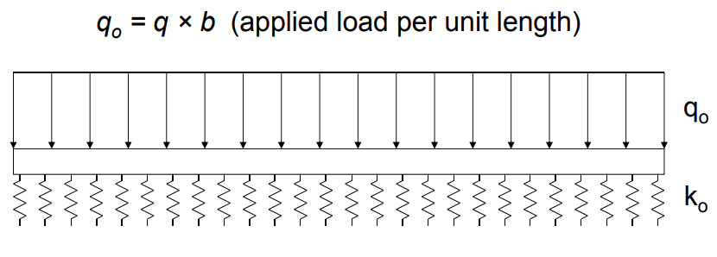
Beam Bending

Slide 9
Deformation of a Beam on Elastic Foundation

Slide 10
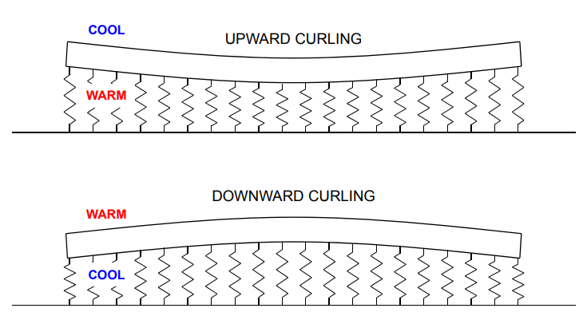
Temperature Curling

Slide 11
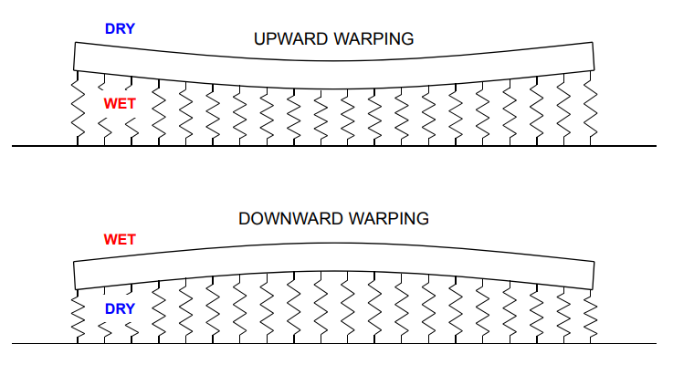
Moisture Wraping

Slide 12
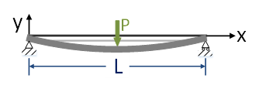
Deflection of a Beam
$$y\left(x\right)=−\frac{P }{12 EI}\left(\frac{3L^{2}}{4}x−x^{3}\right)$$

