Slide 1
CE 34500 – Transportation Engineering
Chapter 19: Design of Flexible Highway Pavements

Slide 2
Pavement Design
Two Main Categories of Pavement Design
Rigid
Wearing surface is usually Portland cement concrete
Acts as beam over irregularities in underlying supporting materials
Flexible
Wearing surface is usually asphalt concrete
Layers of surfacing material remain in contact with underlying material when minor irregularities occur
Notes:
New: Highway pavements are divided into two main categories: rigid and flexible.
Wearing surface of a rigid pavement usually is constructed of Portland cement concrete such that it acts like a beam over any irregularities in the underlying sup- porting material.
Wearing surface of flexible pavements, on the other hand, usually is constructed of bituminous materials such that they remain in contact with the underlying material even when minor irregularities occur.
Flexible pavements usually consist of a bituminous surface underlaid with a layer of granular material and a layer of a suitable mixture of coarse and fine materials.
Traffic loads are transferred by the wearing surface to the underlying supporting materials through the interlocking of aggregates, the fric- tional effect of granular materials, and cohesion of fine materials.
Flexible pavements are further divided into three subgroups: high type, intermediate type, and low type.
End new: We will consider high-type pavements that have wearing surfaces which adequately support the expected traffic load without visible distress due to fatigue and are not susceptible to weather conditions.
Rigid – Portland cement concrete pavements – flexural strength of the concrete allows PCC pavements to act as a beam over subsurface irregularities. Covered in Chapter 21.
Flexible – all other pavement types

Slide 3
Pavement Design
Two Main Categories of Pavement Design
Flexible
Further divided into three sub-groups: high, intermediate and low types
High-type pavements have wearing surfaces that adequately support traffic loads without visible distress and are not susceptible to weather conditions
Notes:
New: Highway pavements are divided into two main categories: rigid and flexible.
Wearing surface of a rigid pavement usually is constructed of Portland cement concrete such that it acts like a beam over any irregularities in the underlying sup- porting material.
Wearing surface of flexible pavements, on the other hand, usually is constructed of bituminous materials such that they remain in contact with the underlying material even when minor irregularities occur.
Flexible pavements usually consist of a bituminous surface underlaid with a layer of granular material and a layer of a suitable mixture of coarse and fine materials.
Traffic loads are transferred by the wearing surface to the underlying supporting materials through the interlocking of aggregates, the fric- tional effect of granular materials, and cohesion of fine materials.
Flexible pavements are further divided into three subgroups: high type, intermediate type, and low type.
End new: We will consider high-type pavements that have wearing surfaces which adequately support the expected traffic load without visible distress due to fatigue and are not susceptible to weather conditions.
Rigid – Portland cement concrete pavements – flexural strength of the concrete allows PCC pavements to act as a beam over subsurface irregularities. Covered in Chapter 21.
Flexible – all other pavement types

Slide 4
Structural Components of Flexible Pavement
Typical Section for Flexible Pavements
Notes:
Subgrade (Prepared road bed) – usually natural material but may also be a layer of select borrow material, well compacted to prescribed level (i.e. 95% Procter density) / may be necessary treat subgrade material to achieve required strength properties
Subbase – requirements are usually given in terms of gradation, plastic characteristics and strength / requirements may be omitted for high quality subgrade conditions / often imported granular or native material, usually not crushed
Base course – granular materials such as crushed stone, crushed or uncrushed slag, crushed or uncrushed gravel and sand / has stricter requirements than subbase materials with regard to plasticity, gradation, and strength.
Surface course – misture of mineral aggregates and asphalt binder / capable of withstanding high tire pressure, resisting abrasive forces due to traffic, providing a skid resistant driving surface, and preventing penetration of surface water into underlying layers / thickness of surface course can vary from 3 to 6 or more inches
Wearing course (not shown but usually present)—provides drainage and skid resistant surface / chip seal, plant mix wearing course, tec.

Slide 5
Flexible Pavement Design
Flexible Pavement Structure
Maintains contact with and distributes loads to the subgrade
Depends on aggregate interlock, particle friction, and cohesion for pavement stability
Combined thickness of subbase (if used), base, and surface layers must be great enough to reduce stresses in subgrade to values that will not cause significant distortion or displacement of subgrade

Slide 6
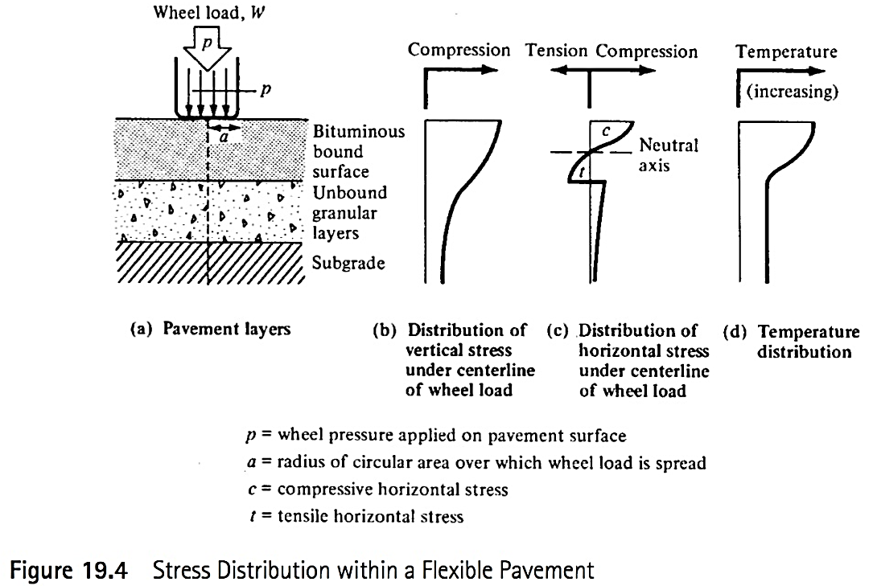
Flexible Pavement Design
Notes:
Figure 19.4
New: Maximum vertical stresses are compressive and occur directly under the wheel load.
Maximum horizontal stresses also occur directly under the wheel load but can be either tensile or compressive / When load and pavement thickness are within certain ranges, horizontal compressive stresses will occur above the neutral axis, whereas horizontal tensile stresses will occur below the neutral axis.
Vertical stresses “spread out” with depth below surface and decrease / pavement structure must be thick enough to “spread the vertical stresses far enough” / to achieve reduced vertical stress level at surface of subgrade that does not exceed the strength of the subgrade material.
Temperature distribution within the pavement structure, as shown in Figure 19.4d, will also have an effect on the magnitude of the stresses.
Design of the pavement, therefore, is generally based on strain criteria that limit both the horizontal and vertical strains below those that will cause excessive cracking and excessive permanent deformation.
These criteria are considered in terms of repeated load applications because the accumulated repetitions of traffic loads are of significant importance to the development of cracks and permanent deformation of the pavement.

Slide 7
Flexible Pavement Design
Major Design Methods
AASHTO Design Method
California (Hveem) Design Method
Mechanistic-Empirical Pavement Design Method (MEPD)
Asphalt Institute Method (not in this edition of text)
Notes:
Will consider only AASHTO Design Method in this class

Slide 8
Mechanistic-Empirical Design (MEPD) Method
To Determine Adequacy of Pavement Structure
Empirical relationships between cumulative damage and pavement distress are used
Site conditions including traffic, climate, subgrade, etc. are considered
Design process is iterative, starting with trial design
If predicted performance criteria for trial design are not adequate, design is revised
Predicted performance criteria include pavement distresses (rutting, faulting, cracking, etc.) and pavement smoothness
Notes:
New: Mechanistic-Empirical Pavement Design:
As I understand it, is coming into wider and wider use / gives better results than AASHTO method for pavement overlays, which are a major portion of surfacing work in many states (including Wyoming) because of shortage of funds for roadway construction.
(MEPD) method uses empirical relationships between cumulative damage and pavement distress to determine the adequacy of a pavement structure to carry the expected traffic load on the pavement.
The procedure is iterative in that the designer first selects a trial design considering site conditions that include traffic, climate, and subgrade.
If the predicted performance criteria do not satisfy the input performance criteria at the specified reliability, the trial design is revised and the evaluation repeated.
As I understand it, a testing program must be carried out in the particular area in which MEPD method is being used to calibrate the method for that area / to determine appropriate values of empirical parameters that are used in this method.
UW has been involved in the MEPD calibration process for Wyoming.

Slide 9
AASHTO Design Method
Design Considerations
Pavement performance
Traffic
Roadbed soils (subgrade material)
Materials of construction
Environment
Drainage
Reliability
Notes:
Each of considerations given above will be discussed individually
New: The AASHTO method for design of highway pavements is based primarily on the results of the AASHTO road test that was conducted in Ottawa, Illinois
Was a cooperative effort carried out under the auspices of 49 states, the District of Columbia, Puerto Rico, the Bureau of Public Roads, and several industry groups.
Tests were conducted on test sections of flexible and rigid pavements constructed on Tests were conducted on short-span bridges and test sections of flexible and rigid pavements constructed on A-6 subgrade material (poor soils).
The test sections consisted of two small loops and four larger ones, with each being a four-lane divided highway / tangent sections consisted of a successive set of pavement lengths of different designs.
Three levels of surface thicknesses ranging from 1 to 6 in. were used in combina- tion with three levels of base thicknesses ranging from 0 to 9 in. Each of these nine combinations was then combined with three levels of subbase thicknesses ranging from 0 to 6 in.
Test traffic consisting of both single-axle and tandem-axle vehicles was then driven over the test sections until several thousand load repetitions had been made. Ten different axle-arrangement and axle-load combinations were used, with single-axle loads ranging from 2000 to 30,000 pounds and tandem-axle loads ranging from 24,000 to 48,000 pounds.
Data were then collected on the pavement condition with respect to the extent of cracking and amount of patching required to maintain the section in service / longitudinal and transverse profiles were also obtained to determine the extent of rutting, surface deflection caused by loaded vehicles moving at very slow speeds / stresses imposed on the subgrade surface /
temperature distribution in the pavement layers / etc
These data then were analyzed thoroughly, and the results formed the basis for the AASHTO method of pavement design.
AASHTO initially published an interim guide for the design of pavement structures in 1961 (tests began in 1950’s) / revised in 1972 / further revision was published in 1986 / another edition in 1993, mainly involving changes to the overlay design procedure.
Design procedure presented cannot possibly include all conditions that relate to any one specific site.
/ therefore recommended that, in using the guide, local experience be used to augment the procedures given in the guide.
The AASHTO design method is test-based / is not a theory-mechanistic based method—hence MEPD.

Slide 10
AASHTO Design Method
Pavement Performance
Structural performance
Physical condition of pavement with respect to factors having negative impact on capability of pavement to carry traffic load
Cracking faulting, raveling, etc.
Functional performance
Indication of how effectively pavement serves user
Riding comfort
Notes:
Functional performance depends on structural performance

Slide 11
AASHTO Design Method
Pavement Performance
Serviceability Performance
Present Serviceability Index (PSI) based on roughness and distress (extent of cracking, patching & rut depth)
Ranges from 0 to 5 with 0 as lowest
Initial Serviceability Index (p_{i}) immediately after construction
Terminal Serviceability Index (p_{t}) minimum acceptable value before resurfacing or reconstruction necessary

Slide 12
AASHTO Design Method
Pavement Performance
Initial Serviceability Index (p_{i})
4.2 or value estimated by agency
Terminal Serviceability Index (p_{t})
2.5 or 3.0 for major highways
2.0 for lower classification roadways
1.5 for special cases (lowest roadway classification, economic constraints, etc.)

Slide 13
AASHTO Design Method
Traffic Load
Traffic load in terms of number of repetitions of 18,000 lb single-axle load
Equivalent single axle loads (ESALs)
Tire contact area: dual tires 4.51” radius, 13.57” apart (70 psi tire pressure)
Equivalence values based on axle type, terminal serviceability index, and pavement structural number
Need distribution of vehicle types, AADT, design period, and traffic growth factor
Convert to single ESAL value for design life of pavement
Notes:
To determine the ESAL, the number of different types of vehicles (cars, buses, single-unit trucks, and multiple-unit trucks) expected to use the facility during its lifetime must be known.
The distribution of the different types of vehicles expected to use the proposed highway can be obtained from results of classification counts that are taken by state highway agencies at regular intervals.
Flexible highway pavements are usually designed for a 10 to 20-year period.
Since traffic volume does not remain constant over the design period of the pavement, it is essential that the rate of growth be determined and applied

Slide 14
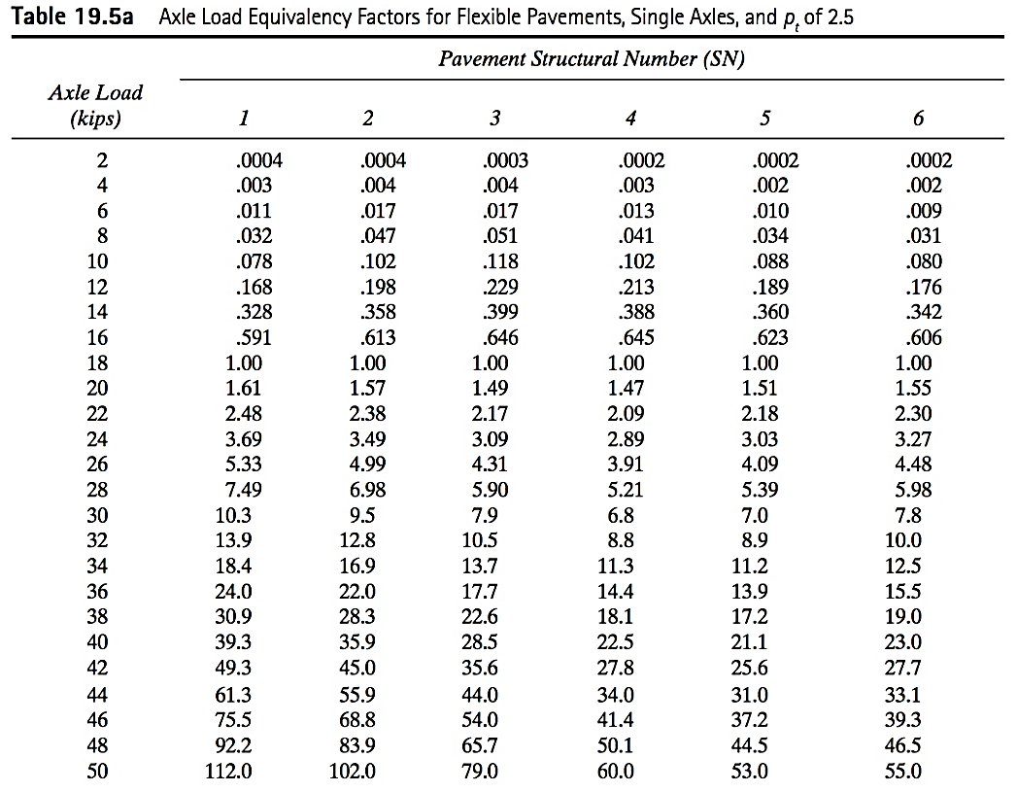
AASHTO Design Method
Notes:
Table 19.5a: Single Axles, pt = 2.5
Add descriptions of different cases

Slide 15
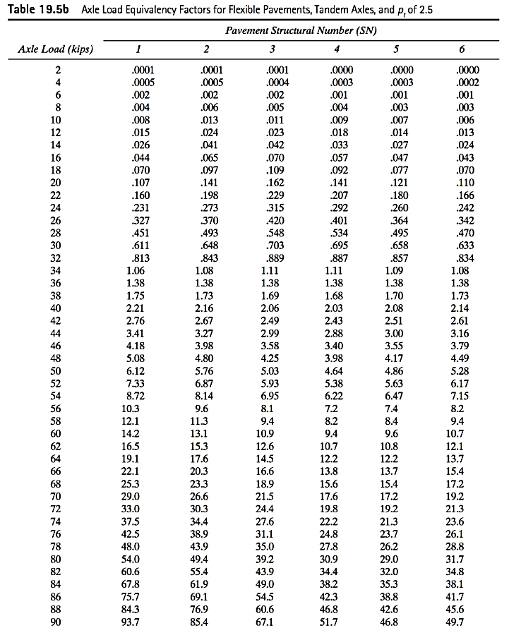
Notes:
Table 19.5b: Tandem axles, pt = 2.5
Add descriptions of different cases.

Slide 16
AASHTO Design Method
Growth Factor
Based on growth rate (r) and design life (n) in years
ESAL_{i} = f_{d} x G_{rn} x AADT_{i} x 365 x N_{i}
x F_{Ei}
Sum over all axle categories (i)
or Table 19.6
Notes:
Growth factor is same as Uniform Series Compound Amount Factor: F (total future value at end n years) given A (amount per year)
r = rate of traffic increase per year / n = number of years
fd = Design lane factor = Percent of traffic in design lane (given value in this text)
AADT = First year Average Annual Daily Traffic (veh/day)
N = Number of axles on each vehicle in category I
FEi = Load equivalency factor for axle category i
Gm = Growth factor (formula given above or from Table 19.6)

Slide 17
Example 19.1
An eight-lane divided highway is to be constructed on a new alignment. Traffic volume forecasts indicate that the average annual daily traffic (AADT) in both directions during the first year of operation will be 12,000, with the following vehicle mix and axle loads.
Passenger cars (2000 Ib/axle) = 50%
2-axle single-unit trucks (6000 Ib/axle) = 33%
3-axle single-unit trucks (10,000 Ib/axle) = 17%
The vehicle mix is expected to remain the same throughout the design life of the pavement. If the expected annual growth rate is 4% for all vehicles, determine the design ESAL, given a design period of 20 years. The percent of traffic on the design lane is 45%, the pavement has a terminal serviceability index ($p_{t}$) of 2.5 and NS of 5.
Notes:
Growth factor [(1.04)^20-1]/.04 = 29.78 (or table 19.6)
All from Table 19.5a)
Passenger cars 0.00002 (extrapolate backwards)
2-axle SU 0.010
3-axle SU 0.088
ESAL_{i}= f_{d} x G_{rn} x AADT_{i} x 365 x N_{i} x F_{ei}
ESAL_{pass}= 0.45 x 29.78 x (12000x0.50) x 365 x 2 x 0.00002 = 1,174 (negligible)
ESAL_{2axleSU}= 0.45 x 29.78 x (12000x0.33) x 365 x 2 x 0.010 = 387,396
ESAL_{3axleSU}= 0.45 x 29.78 x (12000x0.17) x 365 x 3 x 0.088 = 2,634,293
ESAL = 3,022,863

Slide 18
AASHTO Design Method
Roadbed Soils (Subgrade Material)
Resilient modulus (M_{r}) in lb/in²
Given directly or converted
M_{r} = 1500 CBR
CBR: California Bearing Ratio
For fine-grain soils with soaked CBR of 10 or less
M_{r} = 1000 + 555 R value (for R≤20)
R: R-Value
For R <= 20
Notes:
Reslient modulus:
Modulus of soil (something like E for linear elastic material) / under effects of cyclic load with realistic confining pressure.
Tough to measure / application of cyclic loads / tri-axial soil test equipment
CBR and R-values are often converted to resilient modulus values using equations given above.
California Bearing Ratio (CBR):
Common way of measuring subgrade’s resistance to deformation under load for pavement thickness design.
Ratio of psi for 0.1 in penetration of piston into subgrade material and psi for same penetration depth into crushed rock (taken to be 1000 psi) x 100
R-value:
Different test procedure / same idea as CBR / used by WYDOT

Slide 19
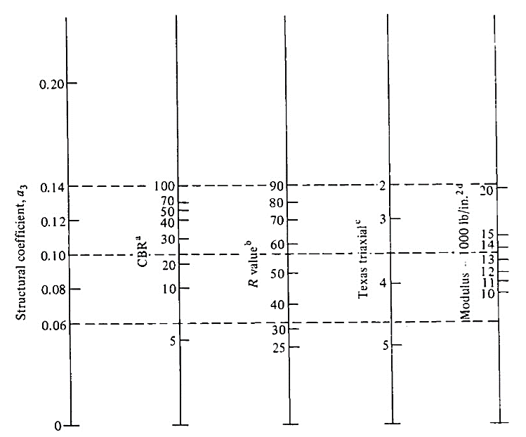
AASHTO Design Method
Materials of Construction
Subbase construction Materials
Figure 19.5 Subbase Layer Coefficient a₃
Notes:
Will be discussed later: SN = a1 * D1 + a2 * D2 + a3 * D3
SN = Structural number of subgrade material (roadbed soil)
SN depends on total number of ESAL’s, resilient modulus of subgrade, etc.
1 = Surface material (e.g. bit. pavement)
2 = Base material (e.g. crushed base)
3 = Subbase material (e.g. pit run base)
a = Layer coefficient
D = Depth of layer in inches
Higher a-value indicates a “stronger” material that is more resistant to deformation under load
a-values are obtained from results of traditional tests—CBR and R-value
For our example: CBR = 22
a3 = 0.10

Slide 20
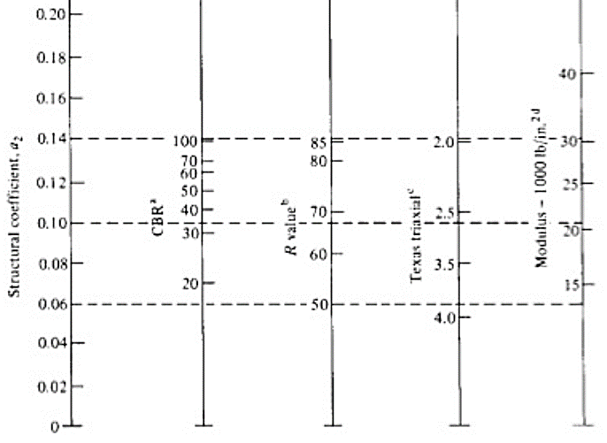
AASHTO Design Method
Materials of Construction
Base Course Construction Materials
Figure 19.6 Granular Base Layer Coefficient a₂
Notes:
Will be discussed later: SN = a1 * D1 + a2 * D2 + a3 * D3
SN = Structural number of subgrade material (roadbed soil)
SN depends on total number of ESAL’s, resilient modulus of subgrade, etc.
1 = Surface material (e.g. bit. pavement)
2 = Base material (e.g. crushed base)
3 = Subbase material (e.g. pit run base)
a = Layer coefficient
D = Depth of layer in inches
Higher a-value indicates a “stronger” material that is more resistant to deformation under load
a-values are obtained from results of traditional tests—CBR and R-value
For our example: CBR = 100
a2 = 0.14
Better / stronger material than subbase—higher layer coefficient (0.14 v. 0.10)

Slide 21
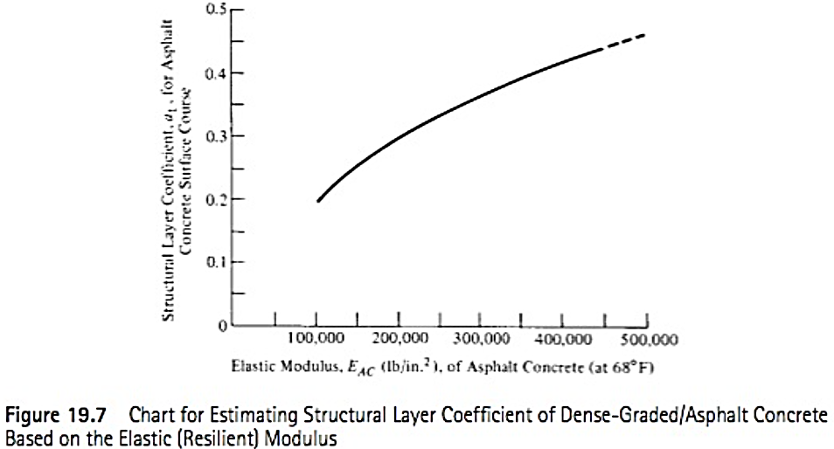
AASHTO Design Method
Materials of Construction
Surface Course Construction Materials
Notes:
For our example: Mr (resilient modulus) @ 68 deg F = 450,000 psi
a3 = 0.44
Better / stronger material than subbase—higher layer coefficient (0.44 v. 0.14)
Thinner layer of pavement can have same contribution to SN as thicker layer of base

Slide 22
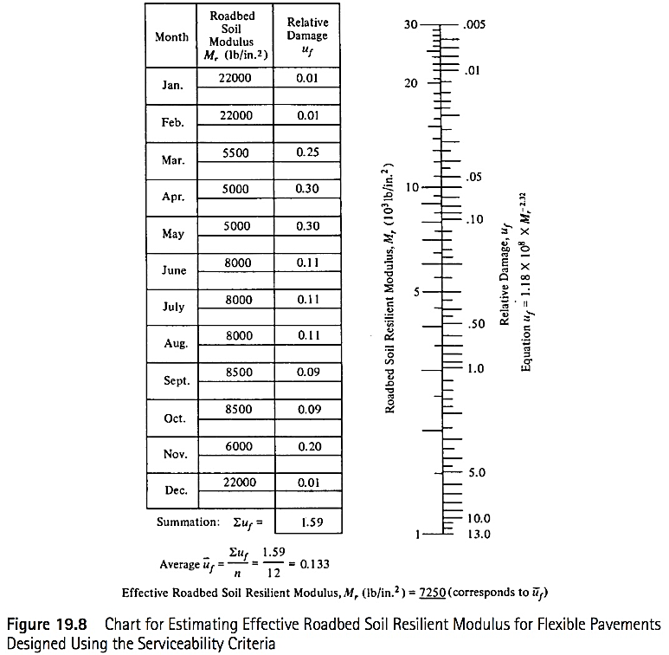
AASHTO Design Method
Effective M_{r} for Subgrade (Roadbed Soils)
Notes:
Won’t discuss in great detail / calling your attention to effective Mr for roadbed soils for future use
Temperature and rainfall accounted for by using an effective annual roadbed soil resilient modulus
Resilient modulus of subgrade material varies throughout year---22,000 in Jan/Feb when subgrade is frozen v. 5000 in April (spring thaw)
Mr of frost susceptible soils during thaw period is 50% to 85% of summer/fall Mr
Bar graph gives relative damage (uf) to pavement as function of Mr / Mr = 5x10^3 >> Uf = 0.3
Average uf = (Sum uf for each month) / 12
Effect Mr = Mr for average uf
Assume given Mr is effective Mr for purposes of this class

Slide 23
AASHTO Design Method
Drainage
Presence of water reduces strength of base material and roadbed soil
Provide suitable layer of porous material (part of subbase or beneath subbase) to promote rapid drainage of free water
Apply drainage factor m_{i} to base and subbase layer coefficients (a₂ and a₃) to allow for drainage effects
Notes:
Drainage factors (m2 & m3) depend on:
Time required to drain base layer to 50% saturation
Percentage of time pavement structure is exposed to moisture levels approaching saturation.

Slide 24
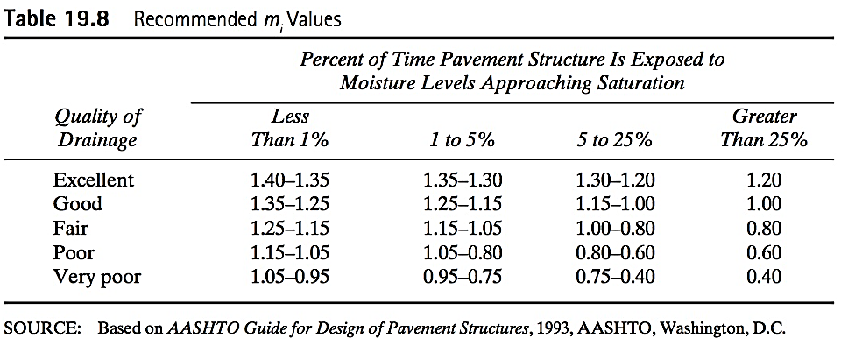
AASHTO Design Method
Drainage
Notes:
For our example:
Time required to drain base layers to 50% saturation = 1 week >> Fair drainage
Time pavement structure is exposed to moisture levels approaching saturation = 30% (> 25%)
Therefore: m = 0.8

Slide 25
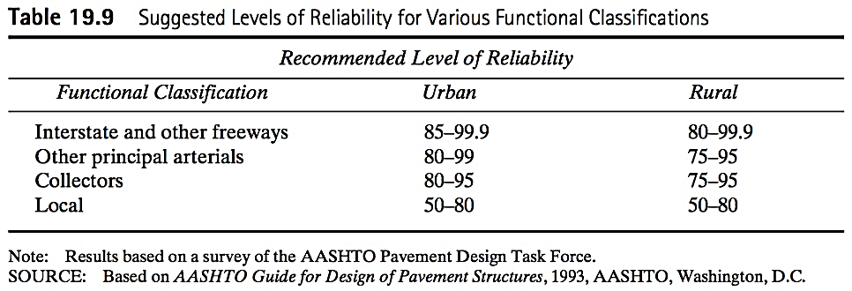
AASHTO Design Method
Reliability
Reliability design level (R%) considers uncertainties in predictions of traffic and performance
Notes:
R% values are higher for roadways with higher functional classification, where consequences of pavement failure are more severe:
For our example:
Urban interstate highway
Use R% = 99%

Slide 26
AASHTO Design Method
Reliability
Overall variation (S_{o}) accounts for chance variation in traffic forecast and pavement performance
Flexible pavements 0.40 – 0.50
Rigid pavement 0.30 – 0.40
Notes:
So: Standard deviation of level of reliability
For our example:
Flexible pavement: Use So = 0.49

Slide 27
AASHTO Design Method
Structural design
Determine flexible pavement structural number (SN) adequate to carry projected design ESAL’s
SN = a₁D₁ + a₂D₂m₂ +a₃D₃m₃
Determine thickness of each layer working from “top to bottom,” using SN for underlying layer
Notes:
Definitions of variables discussed previously
For the sake of simplicity, we will come up with one possibility for thicknesses of asphalt concrete, base course and subbase course.
However, the layer thicknesses should be determined working “from the top down,” to make sure that each layer is thick enough to achieve the SN for the underlaying layer.
For example, Mr for the base course is 31,000 psi.
Using this Mr in the nomograph results in SN1 = 2.6
SN1 = a1 x D1 >>> D1 = SN1 / a1 = 2.6 / 0.44 = 5.9 in
Use D1 = 6 in.
Determine SN2 based on Mr of subbase course: SN2 = a1 x D1 + a2 * m2 * D1 = 0.44 * 6 + 0.14 * 0.8 X D2
Ditto for SN3 based on Mr of subgrade to determine D3

Slide 28
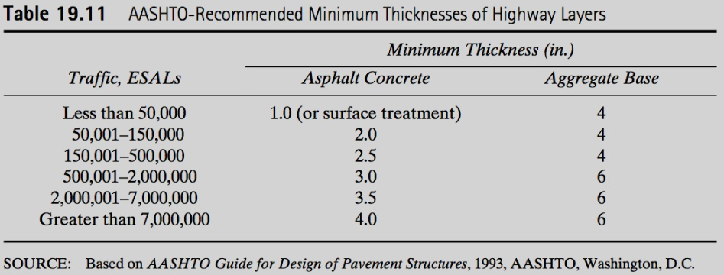
AASHTO Design Method
Structural Design
Notes:
Selection of layer thicknesses is based on constraints associated with maintenance and construction practices so that a practical design design is obtained.
Normally impractical and uneconomical to construct any layer with a thickness less than some minimum value.
Layer thicknesses are also rounded to facilitate construction– 4 in. of bit. pavement which can be placed in 2 – 2 in. lifts.
Since the cost of material in each layer is different, layer thicknesses are also selected to minimize the total cost of the entire pavement structure.
Price of ton of bit. pavement can be 2 to 3 times the cost of a ton of crushed base.

Slide 29
AASHTO Design Method

Slide 30
Example 19.3
Interstate Highway with a design ESAL of 2 X 10⁶. Takes a week for water to be drained from pavement and pavement will be exposed to moisture levels approaching saturation for 30% of the time.
Resilient modulus of asphalt concrete at 68°F = 450,000 lb/in²
CBR base = 100, M_{r} = 31,000 lb/in²
CBR subbase = 22, M_{r} = 13,500 lb/in²
CBR of subgrade = 6
Determine suitable pavement structure
Notes:
Mr of subgrade = 6 * 1500 = 9000 lb/in^2
Interstate Highway
*Reliability (R%) between 85 and 99.9 from table 19.7 . Set at 99%
*Standard Deviation (So) between 0.4 and 0.5. Set at 0.49
*Initial serviceability (pi) = 4.5
*Terminal serviceability = 2.5
Nomograph Figure 19.8
Step 1: Reliability of 99% to S0 of 0.49. Extend to intersect first turning line, TL
Step 2: Point A to ESAL of 2X10^6 and extend to second turning line
Step 3: Draw line to resilient modulus of roadbed soil and intersect with design serviceability los chart at point C
Step 4: Draw horizontal line from point C to design serviceability loss (delta PSI) at point D. Delat PSI 4.5-2.5 = 2
Step 5: Draw vertical line to intersect design SN and read this value of SN = 4.4
Step 6: Using SN = 4.4
*Using resilient value of asphalt, a1 = 0.44
*CBR of base material = 100, a2 = 0.14
*CBR of subbase material = 22, a3 = 0.10
Step 7: Drainage coefficients. Same conditions for both base materials so mx = m2. From Table 19.5 drainage condition fair. Percent of time = 30
So mi = 0.80
Step 8 determine appropriate layer thickness
SN = a₁D₁ + a₂D₂m₂ +a₃D₃m₃
4.4 = (0.44)D₁ + (0.14)D₂(0.80)+(0.10)D₃(0.80)
-Layer thicknesses rounded to nearest ½ inch. Multiple solutions.

Slide 31
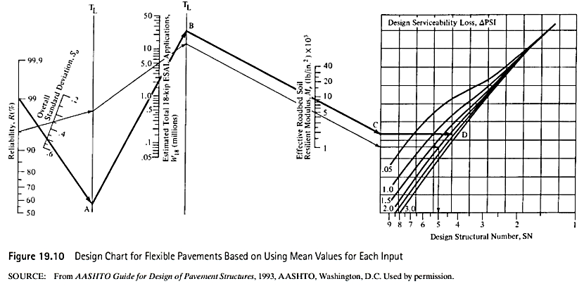
Example 19.3
Notes:
Mr of subgrade = 6 * 1500 = 9000 lb/in^2
Interstate Highway
*Reliability (R%) between 85 and 99.9 from table 19.7 . Set at 99%
*Standard Deviation (So) between 0.4 and 0.5. Set at 0.49
*Initial serviceability (pi) = 4.5
*Terminal serviceability = 2.5
Nomograph Figure 19.8
Step 1: Reliability of 99% to S0 of 0.49. Extend to intersect first turning line, TL
Step 2: Point A to ESAL of 2X10^6 and extend to second turning line
Step 3: Draw line to resilient modulus of roadbed soil and intersect with design serviceability los chart at point C
Step 4: Draw horizontal line from point C to design serviceability loss (delta PSI) at point D. Delat PSI 4.5-2.5 = 2
Step 5: Draw vetical line to intersect design SN and read this value of SN = 4.4
Step 6: Using SN = 4.4
*Using resilient value of asphalt, a1 = 0.44
*CBR of base material = 100, a2 = 0.14
*CBR of subbase material = 22, a3 = 0.10
Step 7: Drainage coefficients. Same conditions for both base materials so mx = m2. From Table 19.5 drainage condition fair. Percent of time = 30 so mi = 0.80
Step 8 determine appropriate layer thickness
SN = a₁D₁ + a₂D₂m₂ +a₃D₃m₃
4.4 = (0.44)D₁ + (0.14)D₂(0.80)+(0.10)D₃(0.80)
-Layer thicknesses rounded to nearest ½ inch. Multiple solutions.

Slide 32
Flexible Pavement Design
Combined thickness of subbase (if used), base, and surface layers must be great enough to reduce stresses in subgrade to values that will not cause significant distortion or displacement of the subgrade.

Slide 33
Soil Stabilization
Soil stabilization is the treatment of natural soil to improve its engineering properties
Two categories
Mechanical stabilization
Chemical stabilization
Notes:
Mechanical stabilization – blending of different grades of soil to obtain a required gradation
Chemical stabilization – blending of natural soil with chemical agents

Slide 34
Soil Stabilization
Cement Stabilization
5 to 14% by volume Portland cement
Primarily for base course materials
Best results on well-graded granular material but can be used on all types of soils
Process
Pulverize the soil
Mixing in required cement (road or plant mixing)
Compact mixture
Cure the compacted layer

Slide 35
Soil Stabilization
Asphalt (Bituminous) Stabilization
Used to:
Waterproof Natural Materials
Maintain water content at required level
Prevent seepage to subgrade
Bind Natural Materials
Improve durability of natural soil by providing adhesion
Best for soils <25% passing No. 200
Process
Mixing done by plant or road mixing
Spread layers of uniform thickness (2 to 6 in)
Aerate to remove volatile materials
Compact Each Layer

Slide 36
Soil Stabilization
Lime Stabilization
Best for clayey materials with PI<10
Percentage of lime varies but 3 to 10% most common

Slide 37
Soil Stabilized Roads
Mechanical Soil Stabilization
How do you obtain the desired materials mix?
Notes:
Subgrade soil properties (less desirable) and borrow material properties (more desirable)
Mechanical Analysis – weighted average
PI = (%A)(%#40A)(PI A) + (%B)(%#40B)(PI B) / [(%A)(%#40A) + (%B)(%#40B)]
Liquid Limit conversion done similarly
Ex: (50)(63)(10) + (50)(13)(2) / [((50)(63) +(50)(13)]

Slide 38
Soil Stabilized Roads
Road Mixing

Slide 39
Soil Stabilized Roads
Plant Mixing

Slide 40
Flexible Pavement Design
Percentage of Trucks in Design Lane (f_{d})
Number of Traffic Lanes (Two Directions) | Percentage of Trucks in Design Lane (f_{d})
2 | 50
4 | 45 (35-48)
6 or More | 40 (25-48)
Notes:
This problem the traffic volume was given for the design lane.

Slide 41
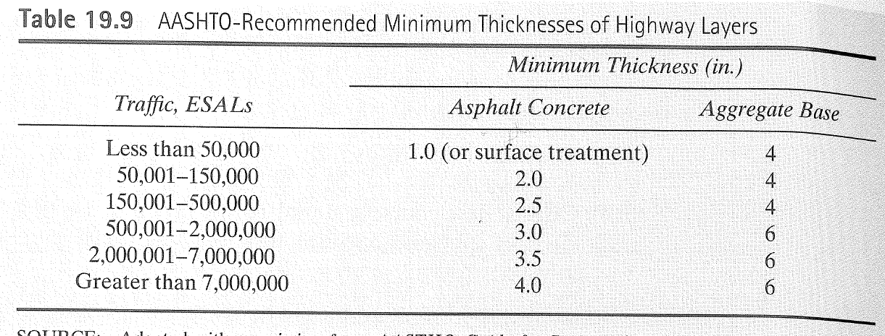
AASHTO Design Method

Slide 42
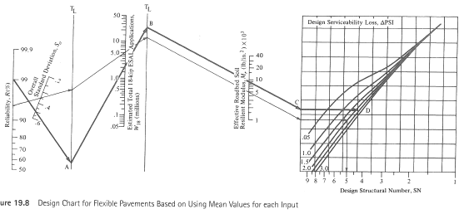
AASHTO Design Method

