Slide 1
Chapter 17: Soil Engineering for Highway Design

Slide 2
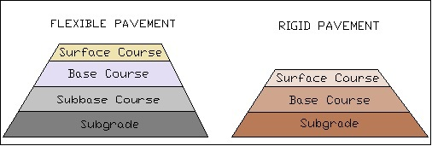
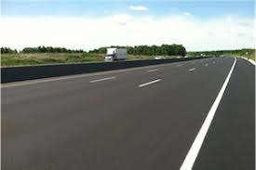
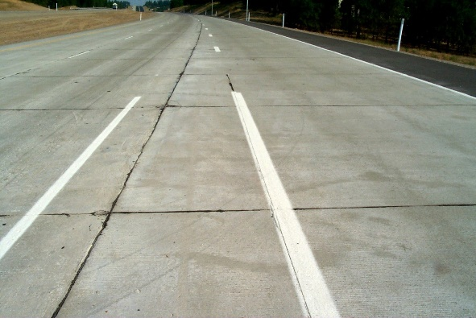
Pavement Types
Pavement types

Slide 3
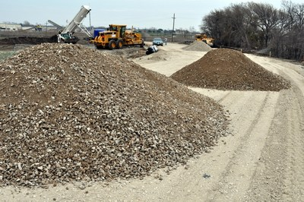
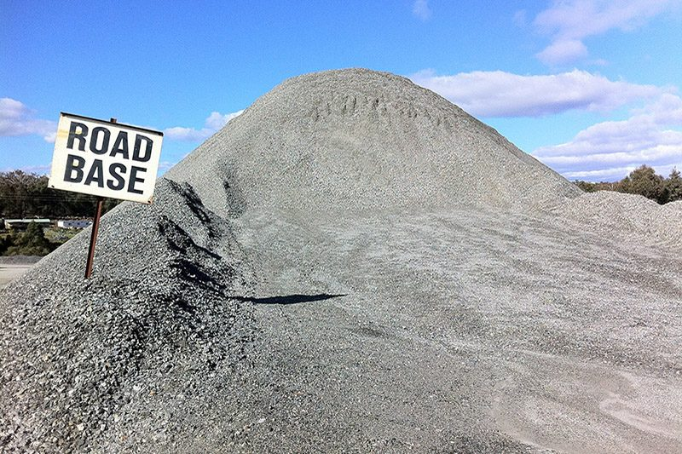
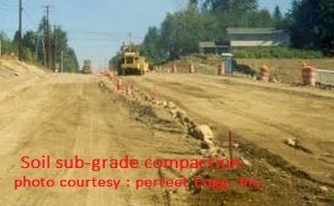
Pavement Materials
Pavement Materials
Subbase

Slide 4
Chapter Outline
basic characteristics of a soil sample
procedure for classifying soils
procedures and equipment used in compacting soils
procedures for testing soils
effect of frost action
Course outcome: Understand and use AASHTO method for soil classification.

Slide 5
Basic Engineering Properties of Soil
Must be familiar with properties and behavior under various external loads
Phase Relations
Porosity
Void Ratio
Moisture Content
Degree of Saturation
Density of Soil
Specific Gravity
Atterberg Limits

Slide 6
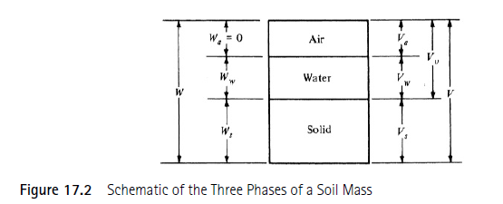
Phase Relations
Three-phase systems: air, water, and solids
Porosity: Relative amount of voids
Void Ratio: Vol. of voids to vol. of solids
Moisture Content: Mass of water to solid
Density of Soil: Ratio of mass to volume
Specific Gravity: ratio of density to density of water

Slide 7
Equations of Phase Relations
$Porosity, n=\frac{V_{v}}{V}$
$void ratio,e=\frac{V_{v}}{V_{s}}$
$Degree of Saturation, S=\frac{V_{w}}{V_{v}}$
$moisture content, w=\frac{W_{w}}{W_{s}}$
$Density of Soil, γ=\frac{W}{V}$, $γ_{d}=\frac{γ}{1+w}$, $γ_{sat}=\frac{W_{s}+W_{w}}{V_{s}+V_{w}}$
$Specific gravity,γ=\frac{G_{s}+S_{e}}{1+e}γ_{w}$

Slide 8
Example 17.1
The wet weight of a specimen of soil is 340g and the dried weight is 230g. The volume of the soil before drying is 210 cc. If the specific gravity of the soil particles is 2.75, determine void ratio, porosity, degree of saturation, and dry density.

Slide 9
Example 17.2
The moisture content of a specimen of soil is 26%, the bulk density is 116 Ib/ft3. If the specific gravity of the soil particles is 2.76, determine the void ratio and the degree of saturation.

Slide 10
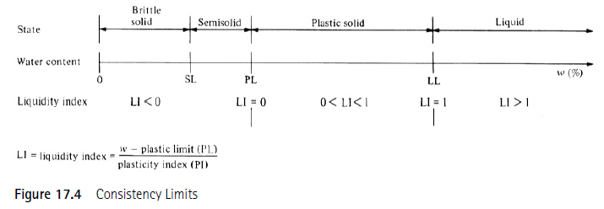
Atterberg Limits
Soil with low moisture will form solids
As water content increases, soil becomes plastic
Shrinkage Limit: Volume shrinks with drying
Plastic Limit: Point where soil crumbles
Liquid Limit: Minimum moisture for flow

Slide 11
AASHTO Soil Classification

Slide 12
AASHTO Soil Classification
Based on the Public Roads Classification System
Soils classified in to seven groups
Evaluated by using an empirical formula
GI values near indicate good soils, while values of or more indicate very poor soils.

Slide 13
Suitability of Soil for use in highway Construction
Subgrade or subbase: A-1-a, A-1-b, A-2-4, A-2-5, and A-3
Materials classified as A-2-6, A-2-7, A-4, A-5, a-6, A-7-5, and A-7-6 will require a layer of subbase material if used as subgrade.
When soils are properly drained and compacted, their value as subgrade material decreases as the GI increases.

Slide 14
Example 17.3
The following data were obtained for a soil sample.
Sieve No. | Percent Finer | Plasticity Tests
4 | 97 | LL=48% PL=26%
10 | 93
40 | 88
100 | 78
200 | 70
Using AASHTO method for classifying soil, determine the classification of the soil and state whether this materials is suitable in its natural state for use as a subbase material.

Slide 15
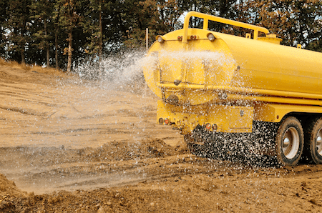
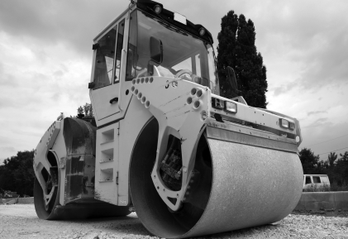
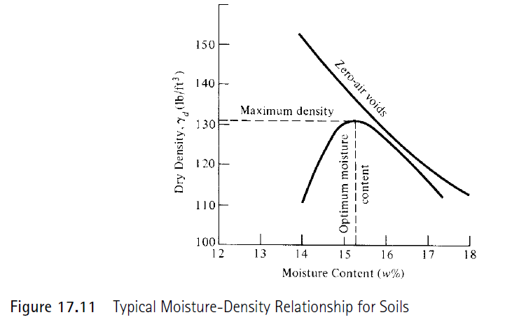
Soil Compaction
Essential that soil be placed in uniform layers and compacted to high density
Compaction reduces subsequent settlement and volume change which enhances the strength of embankments or subbase
Strength is directly related to the maximum dry density achieved through compaction

Slide 16
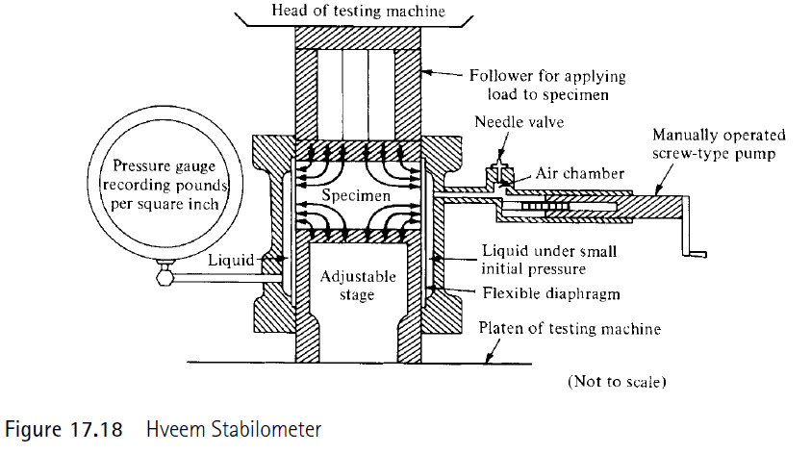
Special Soil Tests
Tests undertaken to determine the strength of a soil for use as a subgrade or subbase material
Two commonly used tests
California Bearing ratio (CBR) Test
Hveem Stabilometer Test

Slide 17
Frost Action in Soils
When ambient temperature falls below freezing, ice forms
As water expands, frost heave may occur
Three conditions for severe frost action:
Ambient temperature below freezing for several days
Shallow water table that provides capillary water to the frost line
Soil must be susceptible to frost action

