Slide 1
CE 34500 – Transportation Engineering
Chapter 15: Geometric Design and Highway Facilities

Slide 2
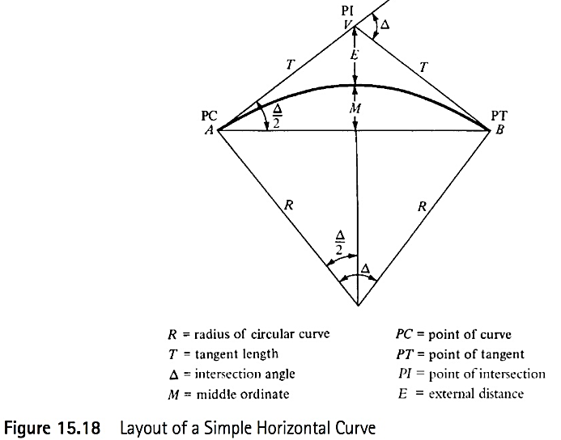
Simple Curves
Notes:
Figure 15.18
Simple Curve is a segment of a circle with radius R
PC = point of curvature
PT = point of tangency
PI = point of intersection
Stationing for horizontal alignment runs along the curve itself

Slide 3
Geometric Design
Geometric Design consists of four major
components
Roadway Cross Section
Vertical Alignment
Horizontal Alignment
Roadside Area
Notes:
This lecture will cover the basics of horizontal alignment design and an introduction to roadside design.
Roadside design information is taken from AASHTO Roadside Design Guide / lastest version is 4th Ed., 2011
The horizontal alignment consists of straight sections of the road (known as tangents) connected by curves / curves are usually segments of circles, which have radii that will provide for a smooth flow of traffic.

Slide 4
Horizontal Alignment
Tangent Sections
Horizontal Curves
Design criteria
Centrifugal Force: Resisted by friction force between tires & roadway and by component of vehicle’s weight resulting from superelevation
Sight Distance: Roadside obstacle must be far enough from edge of roadway to allow a driver to see far enough ahead to react and stop to avoid striking an obstacle in roadway (stopping sight distance)

Slide 5
Horizontal Alignment
Centrifugal Force Criterion
Notes:
Eqn. 3.34
R = minimum radius in feet
u = design speed in mph
e = rate of superelevation (0.08 max in WY due to winter weather)
fs = coefficient of side friction (Table 3.3, range from 0.16 to 0.10, decreases with speed)
Back to Chapter 3, where this formula was derived
e + fs = u^2 / ( 15 * R)
Recall that this is fundamentally an equilibrium of forces parallel to roadway.
Left side = Resisting forces = Component of weight of vehicle (e) + Side friction (fs)
Right side = Motivating force = Centrifugal force
fs = Coefficient of “side friction” / based on driver comfort
Can use any curve with R < Min R in design.
Green Book contains tables giving e values for different R’s for rural/ high speed roadways and for low speed urban streets based on Max e and design speed.

Slide 6
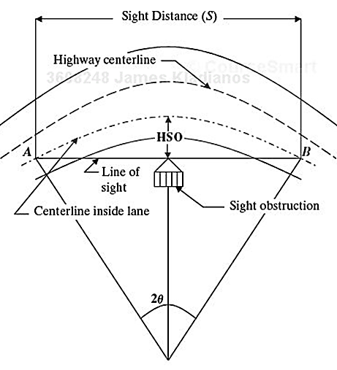
Horizontal Alignment
Horizontal Sight Distance Criterion
Notes:
Object must be far enough from the roadway to allow the driver to see far enough ahead to stop at the design speed—i.e., to see a portion of the roadway of length S.
Show right triangles used to develop formula on following slide

Slide 7
Horizontal Alignment
Horizontal Sight Distance Criterion
$$M=R(1−cos\frac{28.65}{R}s)$$
Notes:
m = Middle ordinate from CL lane to sight obstruction
R = radius of horizontal curve
S = sight distance provided (length of arc)
Formula is based on simple right triangle geometry shown on previous slide
See handwritten notes for derivation of horizontal sight distance formula given above / omit or shorten derivation depending on available lecture time

Slide 8
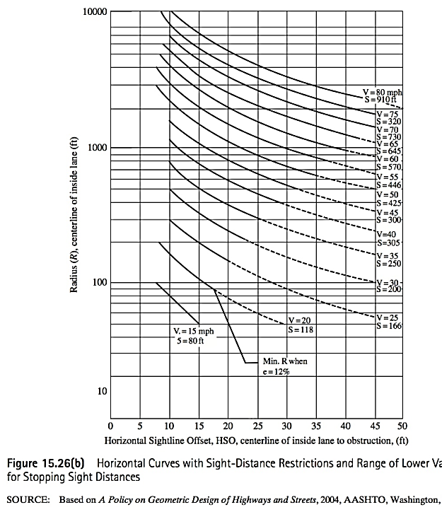
Horizontal Alignment
Horizontal Sight Distance Criterion
Notes:
Fig. 15.26(b)
Note that scale for radius is NOT linear.

Slide 9
Horizontal Curves
Types of Horizontal Curves
Simple: single circular curve connecting two tangents
Compound: combination of two back-to-back circular curves in same direction with no tangent section between them (PCC)
Reverse Curve: same as compound curve, except curves are in opposite direction
Transition (Spiral): single circular curve with spiral curves (varying radii) at each end)
Notes:
Four types of horizontal curves
By far, single, simple curves are the most common type
Compound curves are usually used at intersections to accommodate large design vehicles or on sharp curves at interchange ramps.
Transition or spiral curves: on sharp, circular curves with high speeds, precede and follow the circular curve with spirals to provide a spiral path that follows the actual path of the vehicle/ to minimize encroachment on adjoining lanes
Use of spirals, as shown in the next slide, also presents a more pleasing, smoothly flowing appearance.

Slide 10
Simple Curves
Notes:
Figure 15.18
Simple Curve is a segment of a circle with radius R
PC = point of curvature
PT = point of tangency
PI = point of intersection
Stationing for horizontal alignment runs along the curve itself

Slide 11
Simple Curves
Notes:
Equations 15.20, etc.
See various elements of curve on previous slide Fig. 15.18
R = curve radius
Da = Degree of curvature (arc definition)
T = tangent lengths – equal in length (Distance from PC to PI = Distance from PI to PT)
Delta = deflection angle
Etc,
See handwritten notes for derivation of the formulas given above—basically just simple right triangle geometry.

Slide 12
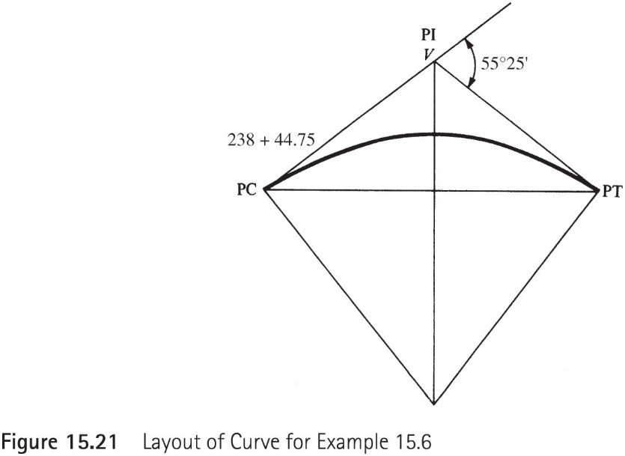
Example 15.6
The intersection of a 4⁰ curve is 55⁰25’, and the PC is located at station 238+44.75. Determine the length of the curve, the station of the PT, the deflection angles, and the chord lengths for setting out the curve at whole stations from the PC. Figure 15.21 illustrates a layout of the curve.

Slide 13
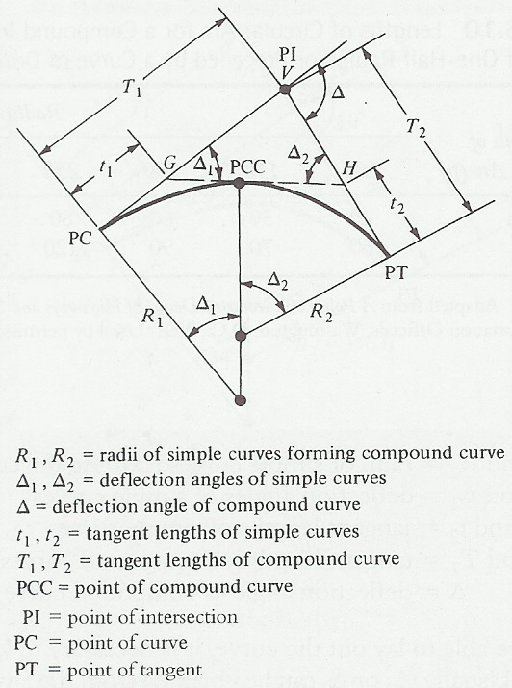
Compound Curve
Notes:
Do not include this slide in lecture outline-compound curves are relatively uncommon
Figure 16.23

Slide 14
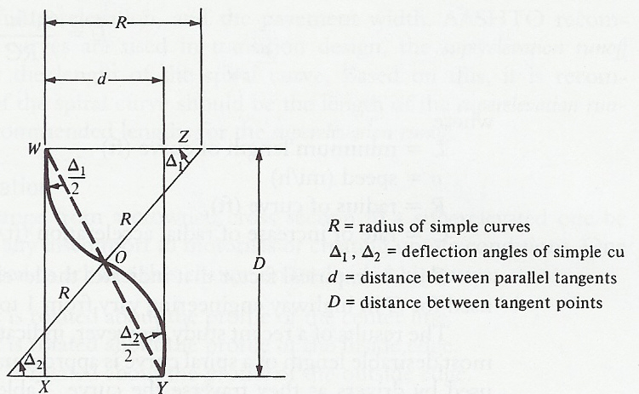
Reverse Curve
Notes:
Do not include this slide in lecture outline-reverse curves are relatively uncommon/ need tangent between curves for proper super runout
Figure 16.25

Slide 15
Transition (Spiral) Curves
Notes:
Do not include this slide in lecture outlines.
Short’s formula (given above) is not usually used to determine the min. length of highway spirals , although it is apparently used for railroad spirals

