Slide 1
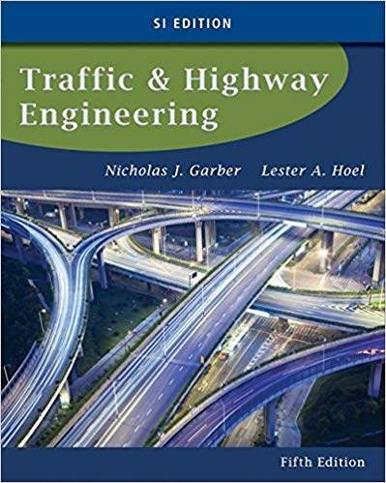
CE 34500 – Transportation Engineering
Chapter 15: Geometric Design of Highway Facilities

Slide 2
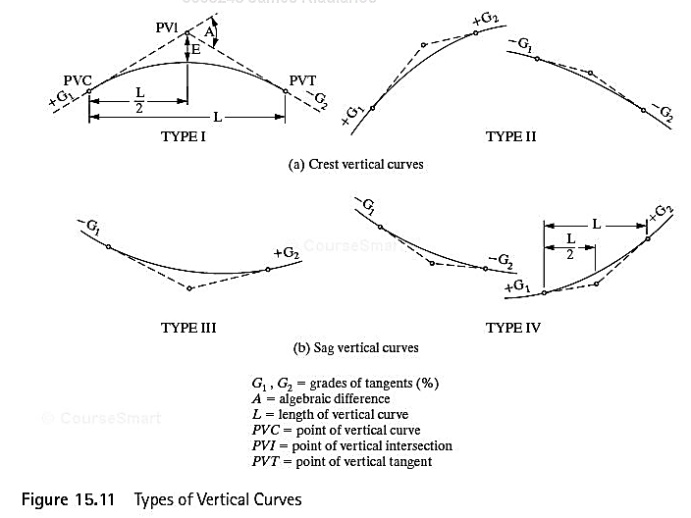
Vertical Alignment
Notes:
The topography of the area through which the road traverses has a significant impact on the design of the vertical alignment; e.g., grades of tangents / steeper grades used in mountainous terrain.
Station = Horizontal distance measured along centerline of roadway
1 Station = 100 ft.
Stations expressed as 5 + 21 = 5 stations (500 ft.) + 21 ft.
Grade between two points = (Vertical distance between points) / (Horizontal distance between points)
= (Difference between elevations) / (Difference in stations)—expressed as %
To set a vertical alignment / “gradeline”:
Select PVI stations/ elevations—establishes tangent grades
Select vertical curve lengths to furnish stopping sight distance at design speed—will discuss this in detail shortly.
Recommended maximum grades are shown on following slides based on:
Functional classification—arterial, collector or local (not given)
Rural or urban
Type of terrain—level, rolling or mountainous
Type of facility—Freeways are a special case
Note that values given are from 2004 GB—not latest 2011 GB

Slide 3
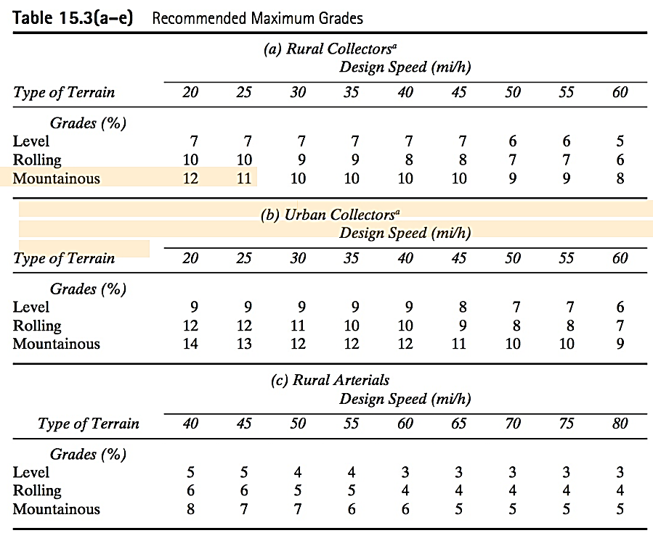
Notes:
Table 15-3—Recommended Maximum Grades from Green Book for rural/ urban collectors and rural arterials
Speed of a heavy vehicle can be reduced significantly if grade is steep and/ or long.
To limit effects of grades on vehicular operations, max. grades on any highway should be selected judiciously.
Grade depends on design speed—lower max. grades for higher design speeds (less horsepower available to counteract grade resistance at higher speeds)
Note that steeper grades are allowed on lower class roadways for the same design speed.
Don’t use max. grades from table frequently—esp. over long lengths/ if there are lots of trucks.
Be careful not to make grade too flat---could result in drainage problems.
0% grades can be used (over short lenghs / only if necessary) on uncurbed pvmts. w/ cross slopes steep enough to laterally drain the water.
Use 0.5% min. (possibly down to 0.3%) on curbed pavements to drain water longitudinally.

Slide 4
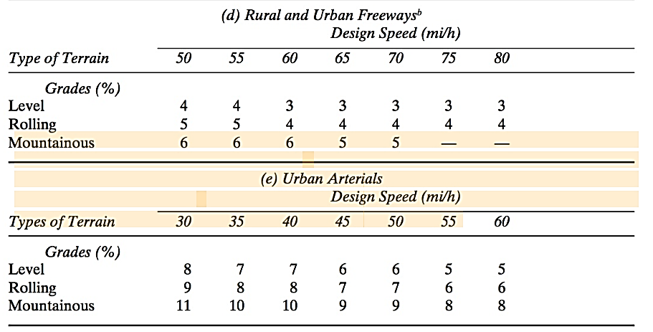
Notes:
Table 15.3 : Maximum Grades from Green Book for rural/ urban freeways and urban arterials

Slide 5
Vertical Curves
Main Design Criteria
Crest & Sag Vertical Curves
Provision of minimum stopping sight distance
Sag Vertical Curves
Adequate drainage
Comfortable in operation
Apprearance
Notes:
Vertical curves: Provide gradual change from one tangent grade to another. Are parabolic in shape.
Main design criteria for vertical curves are given above.
Note that the textbook author checks min. length for drainage only for sag VC’s only. Green Book has these requirements for crest VC’s also.
Comfortable operation considerations are mainly applicable to sag VC’s because the force due to the radial acceleration of vehicle and gravity effects are additive.

Slide 6
Vertical Curves
Two cases for minimum length based on sight distance
Sight distance is less than the length of the vertical curve (S < L)
Sight distance is greater than the length of the vertical curve (S > L)
Must make assumption about which case is true and then check your assumption
Use of S < L criteria for design results in conservative (longer) vertical curve lengths
Notes:
Sight distance > L: Eye and object are both on VC
Sight distance < L: Eye on tangent/ object on VC

Slide 7
Crest Vertical Curve
One criteria for length
Sight distance: Vertical curve must be long enough so that driver can see far enough ahead (stopping sight distance) to react and stop before striking an object in roadway
Eye height = 3.5 ft.
Object height = 2.0 ft.

Slide 8
Crest Vertical Curves
Notes:
Figure 15.13
Equation 15.4: Min. length of a crest vertical curve. For S < L
A = Algebraic difference in grade in % = Abs (G1 – G2)
For H1 = Eye ht. = 3.5 ft. and H2 = Object height = 2.0 ft.:
LMIN = A * S^2/ ( 200 * (3.5^0.5 + 2.0^0.5)^2 ) = A * S^2 / 2158 (Eqn 15.5)
K = LMIN / A = S^2 / 2158>>>>Given in Table 15.4, p. 796
Determine minimum length for vertical curve very simply in design:
LMIN = K * A

Slide 9
Crest Vertical Curves
Notes:
Figure 15.12
Equation 15.2: Min. length of a crest vertical curve. For S > L
This formula is used very seldom in practice, because the use of the formulas given on the previous slide for S > L is conservative/ always yields vertical curve lengths which are longer than those produced by Eqn. 15.4.

Slide 10
Sag Vertical Curve
Four criteria for length
Sight distance provided by the headlight beam is >= Stopping sight distance
Headlight height = 2.0 ft.
Upward divergence of headlight beam = 1º
Driver comfort: Radial acceleration <= 1 ft/sec²
Control of drainage: “Almost flat spot” not too long
General appearance: Vertical curve doesn’t “look like a kink”
Notes:
No sight restriction associated with a sag vertical curve during daylight hours—driver can see the entire curve.
Formulas used to determine the length of sag vertical curves are based on headlight sight distance/ providing vertical curve long enough so that the headlights illuminate a length of roadway >= SSD at design speed.
Headlight height = 2.0 ft.
Headlight beam diverges 1 degree upward from a tangent to vertical curve.

Slide 11
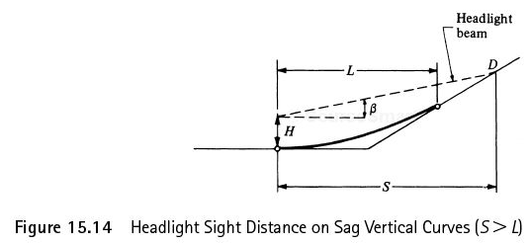
Sag Vertical Curve
H=2’
β = 1 degree
Notes:
Equation 15.6: LMIN for S > L
Figure 15.14
Equation 16.8: LMIN for S < L
As for crest vertical curves, the formula for S < L gives conservative VC lengths and is routinely used for design.
For H = Headlight ht. = 2.0 ft. and B = Upward divergence of headlight beam = 1 degree :
L = A * S^2 / (400 + 3.5 * S) or K = L/A = S^2 / (400 + 3.5 * S)
For routine design:
LMIN = K * A, where K values for sag vertical curves are given in Table 15.5. p. 797

Slide 12
Sag Vertical Curve
Comfort Criterion
Notes:
Equation 15.10
This expression assumes that a comfortable ride will be provided if the radial acceleration of the vehicle as it traverses a sag VC is <= 1 ft/sec^2
The length obtained from Eq. 15.10 is typically about 75 percent of that obtained from the headlight sight distance requirement. Minimum Length of Curve Based on Appearance Criterion. The criterion for
This distance is usually about 75% of that obtained from the headlight sight distance requirement, and thus does not govern for design.

Slide 13
Sag Vertical Curve
Drainage Criterion
Use when road has curbs
Maximum length instead of minimum
“Almost flat spot”: Minimum grade of 0.35% provided within 50 ft of the level point
K <= 167
Notes:
It has been observed that the maximum length determined using this drainage criteria is usually greater that the minimum lengths for the other criteria for speeds up to 60 mph and about the same for a speed of 70 mph.
Green Book gives max K value (167) based on drainage/ recommends that special attention be paid to providing proper drainage if the recommended values are exceeded.

Slide 14
Sag Vertical Curve
Appearance Criterion
Per AASHTO Green Book for Sag and Crest Vertical Curves:
L_{MIN} (ft) = 3 x Design Speed (mph)
Notes:
Equation 15.10
This eqn. is a rule of thumb/ is equivalent to using a minimum K value of 100/ corresponds to using a minimum design speed of 50 mph.
K values < 100/ design speeds < 50 mph are often used in design.
Experience has shown that longer curves are frequently necessary for high-type highways if the general appearance of the highways is to be improved.
Green Book recommends providing a minimum vertical curve length of 3 * design speed in mph.

Slide 15
Crest & Sag Vertical Curve
K is length of vertical curve per % change in A
K values for crest vertical curves for a given design speed found in Table 15.4
K values for sag vertical curves for a given design speed found in Table 15.5

Slide 16
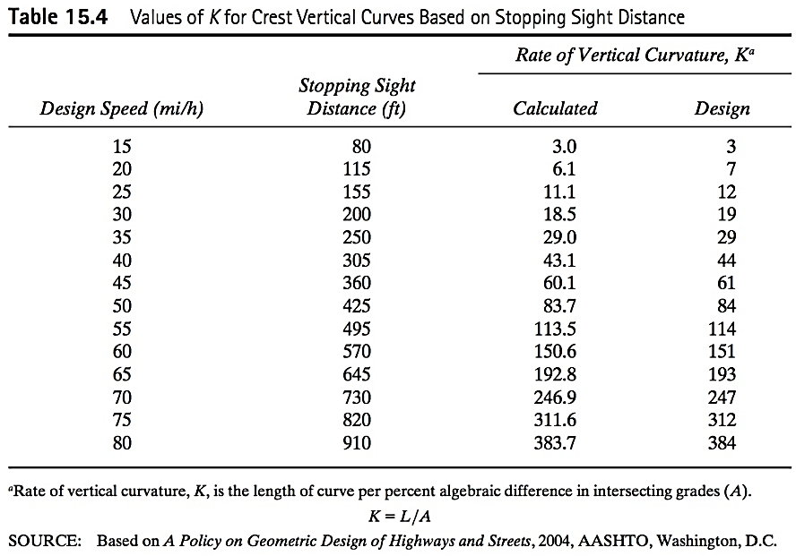
Crest & Sag Vertical Curve

Slide 17
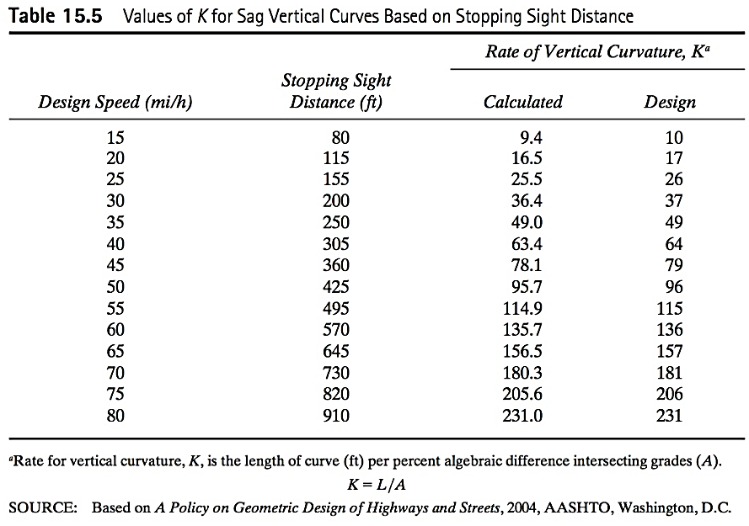
Crest & Sag Vertical Curve

Slide 18
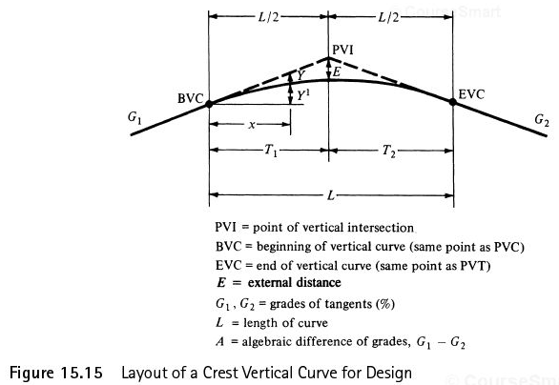
Vertical Curve Elevations
Notes:
Figure 15.15
Vertical curve is a parabola, and equations for computing elevations on VC can be derived using the equation of a parabola.
See handwritten notes.

Slide 19
Vertical Curve Elevations
Vertical curves are parabolas with origin at BVC
General form of a parabola:
y = c + bx + ax²
Vertical curve fomula:
y = y_{BVC} + G₁ * x + a * x²
a = ( G₂ - G₁ ) / ( 2 * L)
High or low point: dy/dx = 0

Slide 20
Vertical Curve Elevations
Determine the minimum length of curve to satisfy sight distance requirements (and other requirements, if desired).
Determine from the plan sheet the station and elevation of the PVI—that is, the point where the grades intersect and the grades on either side of the PVI are given,
Compute the elevations of the BVC and EVC.
Compute elevations on the curve, usually 100 ft. apart at even stations, beginning with the first whole station after the BVC.
If necessary, compute station and elevation of high or low point.

Slide 21
Vertical Curves
Offset from tangent elevation
Distance from BVC
Offset from BVC Elevation

Slide 22
Example 15.3
A sag vertical curve is to be designed to join a -5% grade to a +2% grade. If the design speed is 40 mph, determine the minimum length of the curve that will satisfy all criteria. Assume a = 11.2 ft/sec² and perception-reaction time = 2.5 sec.

Slide 23
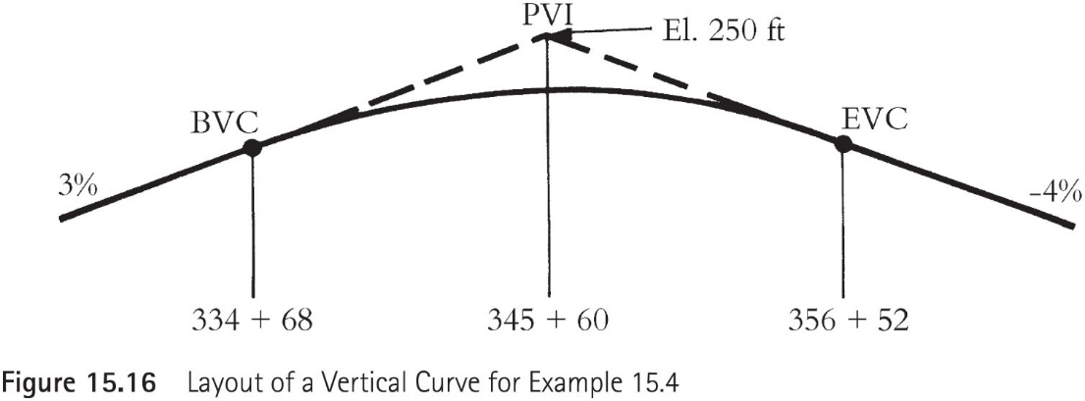
Example 15.4
A crest vertical curve joining a +3% and a -4% grade is to be designed for 75 mph. If the tangents intersect at station (345+60.00) at an elevation of 250 ft, determine the stations and elevations of the BVC and EVC. Also, calculate the elevations of intermediate points on the curve at the whole stations. A sketch of the curve is shown in Figure 15.16.

Slide 24
Example 15.5
A sag vertical curve joins a -3% grade and a +3% grade. If the PVI of the grades is at station (345+50) and has an elevation of 235 ft, determine the station and elevation of the BVC and EVC for a design speed of 70 mph. Also, compute the elevation on the curve at 100-ft intervals. Figure 15.17 shows a layout of the curve.

