Slide 1
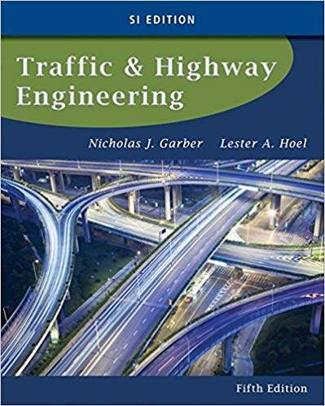
CE 34500 – Transportation Engineering
Chapter 15: Geometric Design of Highway Facilities

Slide 2
Geometric Design
Geometric Design consists of four major
components:
Roadway Cross Section
Vertical Alignment
Horizontal Alignment
Roadside Area
Notes:
This lecture covers features, dimensions, etc. of roadway cross section.

Slide 3
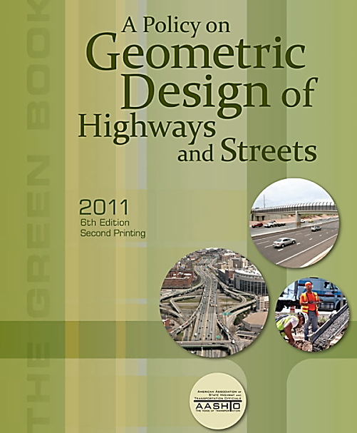
Geometric Design
A Policy on Geometric Design of Highways And Streets (AASHTO)
6th Ed. (2011)
Referred to as the “Green Book”
Notes:
The American Association of State Highway and Transportation Officials (AASHTO) serves a critical function in developing guidelines and standards used in highway geometric design.
The membership of AASHTO includes representatives from every state highway and transportation department in the United States as well as the Federal Highway Administration (FHWA).
Green Book provides a policy or set of guidelines for geometric design of highways.
It is the decision of individual state transportation departments to adopt the AASHTO publication guidelines in whole or in part regarding geometric design policy.
Even though the Green Book is developed by the states, is adopted by the FHWA for the design of facilities which are designed & constructed with federal funds—used for design of almost all rural and urban roads in US.
Green Book design standards are for the construction of new roadways or the complete reconstruction of existing roadways. All jurisdictions have lower design standards for upgrading existing roadways.

Slide 4
Highway Design
Factors Influencing Design
Functional classification
Expected traffic volume and vehicle mix
Design speed
Design vehicle
Topography of the area in which highway will be located
Vehicles on steep grades
Level of service to be provided
Available funds
Safety
Social and environmental factors
Notes:
Many of the factors that affect roadway design are interrelated: Functional classification and traffic volumes influence design speed. For example, often use higher design speeds on arterials which carry large traffic volumes.
Principal factors determining design standards are:
LOS to be provided
Expected traffic volume
Design speed
Design vehicle
No single set of geometric design standards can be used for all highways.
Sooooo, selection of appropriate design standards is first step in design of any highway

Slide 5
Functional Classification
Principal arterials
Minor arterials
Major collectors
Minor collectors
Local roads and streets
Notes:
New: Highways are classified according to their functions in terms of the type of service they provide.
Figure from the AASHTO Green Book
Arterials: principal purpose is mobility/ carry mainly through traffic.
Freeways/ interstates are special types of arterials which have special characteristics to favor through travel--no at-grade intersections, limited access, etc.
Collector: servers to carry through travel and to provide access to adjoining property
Local: traffic on this type of roadway is mainly there to access adjoining property. The “ultimate, local roadway is a cul-de-sac” in urban area/ no through travel whatsoever.
Principal arterials are arterials with higher traffic volumes
Minor arterials are arterials with lower traffic volumes
Ditto for collectors

Slide 6
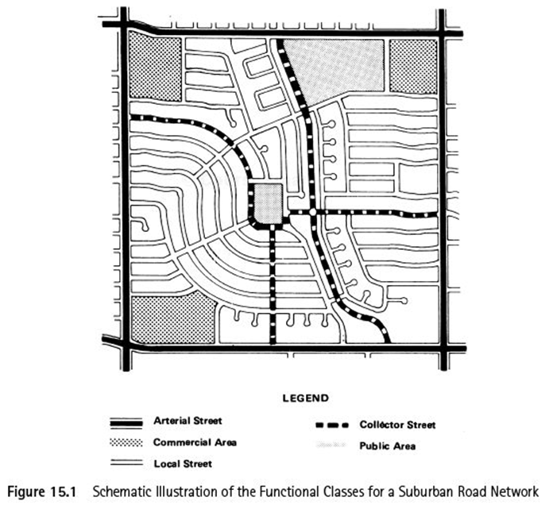
Functional Classification
Notes:
Figure 15.1
New: Urban roads comprise highway facilities within urban areas as designated by responsible state and local officials to include communities with a population of at least 5000 people.
New: Urban areas are further subdivided into urbanized areas, with populations of 50,000 or more, and small urban areas, with populations between 5000 and 50,000.
End new: Federal requirement that transportation planning be carried out by Metropolitan Planning Organization (MPO) for urban areas w/ population >= 50,000—involving all affected jurdisdictions: city, county, state DOT, etc.
In urban and suburban areas, arterials surround an particular area (i.e. CBD) / carry high proportion of Vehicle Miles Traveled (VMT)/ carry most trips with an origin or destination in the urban area.
Interstates and expressways are special types of arterials that can exist in large urban areas:
Interstate: access control and no at-grade intersections
Expressway: access control/ possibly has at-grade intersections.
Collectors connect to/ carry traffic onto and off of the arterials / penetrate the interior of the area/ divide the area into “subareas”
Locals connect to collectors/ carry traffic onto and off of the collectors and arterial/ mainly provide access to adjoining property / through traffic is discouraged on these streets

Slide 7
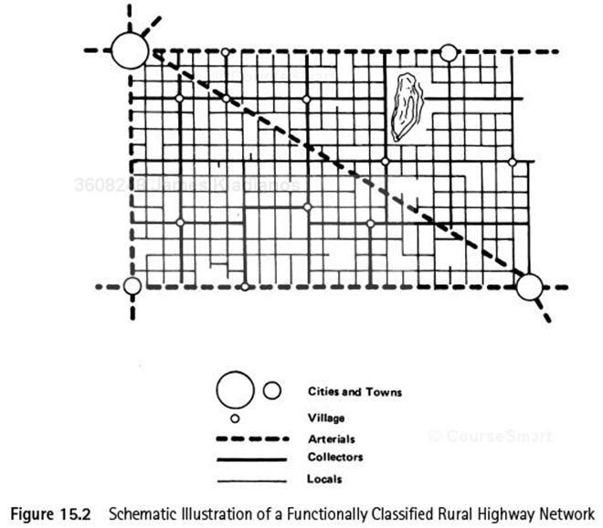
Notes:
Figure 15.2
New:
In rural areas, arterials connect major cities & towns
New: Principal arterial system consists of a network of highways that serves most of the interstate trips and a substantial amount of intrastate trips m/ virtually all highway trips between urbanized areas and a high percentage of trips between small urban areas with populations of 25,000 or more are made on this system.
Rural freeways are normally divided highways/ have fully controlled access/ don’t have at-grade intersections..
Collectors connect small towns and villages.
New: Major collectors carry traffic within and between county seats and large cities that are not directly served by the arterial system
Local roadways connect to collectors and provide access to adjoining property.

Slide 8
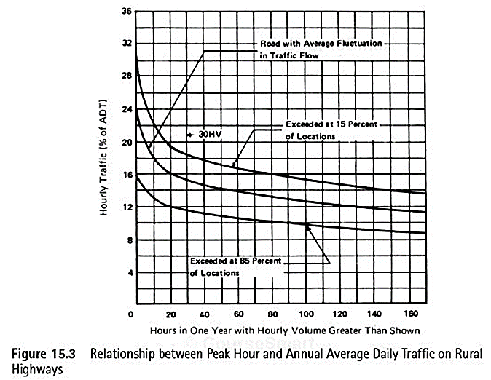
Highway Design Standards
Design Hourly Volume (DHV)
Notes:
Figure 15.3
DHV is the PROJECTED hourly volumes used for design/ to determine design standards.
Between 0 and 25 hours there is a large increase in hourly volumes--therefore, uneconomical to design in this area.
Hence, Design Hourly volume is taken at the 30th highest hour.
From figure given above, Rural DHV (at 30th highest hour) varies from 11% (exceeded at 85% of locations) +- to 15% (average) to 18% (exceeded at 15% of locations)
In urban areas, DHV ranges from 8% to 12%, due to daily traffic fluctuations. Possibly use the average of highest afternoon peak hour volumes for each week in year as DHV.
DHV is expressed at a percent of ADT. DHV varies only slightly year to year, even when the ADT changes significantly.
Beware of using DV on roads with unusual or high seasonal traffic fluctuations--results in a high percentage of high-volume hours
New: For this type of rural road, it is desirable to select 50 percent of the volume that occurs for only a few peak hours during the design year as the DHV, even though this may not be equal to the 30th-highest hourly volume.

Slide 9
Highway Design Standards
Design Speed
Notes:
Table 15.1
Green Book is divided into sections giving recommended design standards for locals, collectors and arterials in rural and urban areas.
Note that minor state highways in Wyoming are classified as collectors, but despite Green Book recs., we often use a 65 mph design speed because of the posted 65 mph speed limit on these roadways—also because to meet driver expectancy.
Recently, most of WY’s rural two-lane highways have been posted at 70 mph at direction of Legislature.
Per current Green Book, design speed is “a selected speed used to determine geometric features of the roadway.”
In previous editions, design speed was the max. SAFE speed at which the roadway can be driven when speed is controlled only by the geometric features of the roadway (I.e., the “low traffic, good weather” speec)
Legal liability considerations caused the change in the definition, because people got killed or injured while driving at the “safe” design speed for the roadway.
Obviously, design speed varies with terrain--higher in flatter country / cite values on table
Higher design speeds for higher traffic volumes—efficient traffic flow / cite values on table
It is VERY IMPORTANT that the “design speed selected not be significantly different from the the speed at which motorists are expected to drive”--driver expectancy again

Slide 10
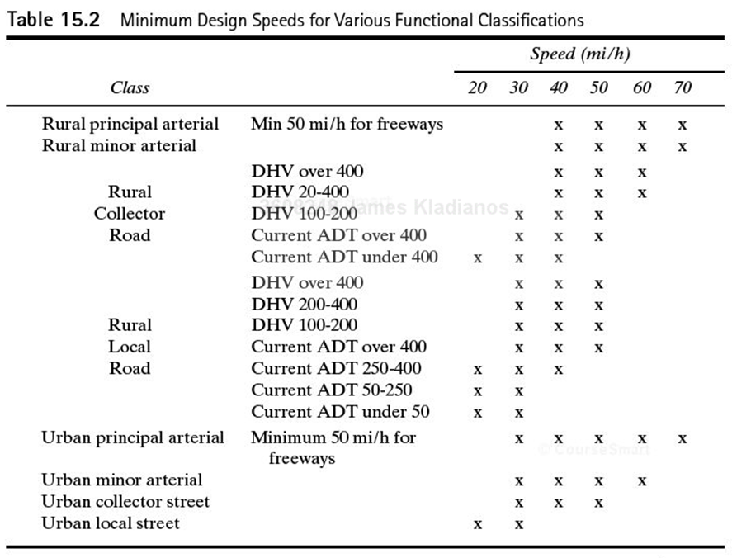
Highway Design Standards
Design Speed
Notes:
Table 15.2
From the above figure, design speed ranges for rural roadways/ high traffic volumes are:
For DHV > 400:
Principal arterial: 40 to 70 mph
Collector: 40 to 60 mph
Local: 30 to 50 mph

Slide 11
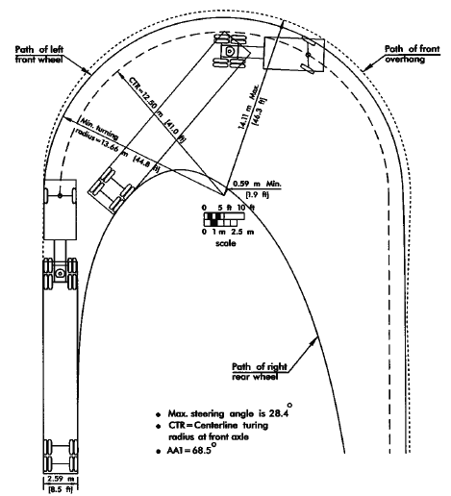
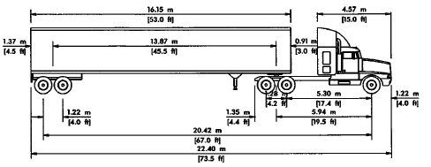
Design Criteria
19 Standard AASHTO Design Vehicles
Interstate Semi-Trailer
WB-67 (WB-20)
Notes:
As discussed previously.
Do you think design vehicles represent vehicles of average size?—nope, dimensions are those of larger vehicles in a particular class/ most vehicles in this class would be smaller
New: Design vehicle is the largest that is likely to use the highway with considerable frequency.
New: Selected design vehicle is used to determine critical design features such as radii at intersections and turning roadways as well as highway grades.
From Chapter 3:
Table 3.3 has a table of typical vehicle dimensions
Figure 3.2 shows a minimum turning path for WB-67
Figure 3.5 shows speed-distance curves for acceleration of heavy trucks on upgrades

Slide 12
Design Criteria
Design Vehicles
Where parking lots are the main traffic generators: passenger car
Design of intersection at local streets and park roads:
SU truck
Intersection of state highway and city streets that serve buses but few trucks: city transit bus
Intersections on collector streets and other facilities utilized by single trucks: 3-axle truck
Notes:
Not given in 5th Ed.:
Intersection of highways and low-volume country highway or local roads <400 ADT: 84-passenger large school bus, 40’ long or 65-passenger conventional bus, 36’ long
Intersection of freeway ramp terminals and arterial crossroads, and at intersection of state highways and industrialized street with high volumes: WB-65/67 Min

Slide 13
Cross Section Elements
Width of Travel Lanes
9 to 12 ft. for all types of roadways
12 ft. for rural arterials
9 ft. only for very low volume urban roadways with narrow right-of-way
Shoulders
Provide area for vehicles to stop when necessary
2 ft. to 12 ft. width
10 ft. width (preferably 12 ft.) on roadways with high truck volumes
4ft. min. width if used by peds. / bikes
2 ft. width only on lowest types of highways
Notes:
Widths of lanes & shoulders are given in the Green Book based on functional classification, design speed, ADT
Travel lanes:
Vary in width from 9 ft. to 12 ft.
Usually use 12 ft. lanes on arterials, one reason being that 10 ft. lanes are more expensive to maintain due to wheel concentrations near pvmt. Edges.
On rural roadways, use 10 ft. to 12 ft. lanes. For pvmt. widths , 22 ft., crash rates go up for large trucks. Capacity significantly decreases as lane width goes below 12 ft.
9 ft. lanes used only for low volume urban roadways with extremely tight R/W
Shoulders:
10 ft., preferably 12 ft., on highways with large numbers of trucks, high traffic volumes, and high speeds to allow to park 1 ft., preferably 2 ft., from edge of pvmt.
6 to 8 ft. shoulders are preferable
Min 4 ft. shoulder for peds/ bikes (6 ft. if rumble strips are used)
Min. 2 ft. shoulder on lowest types of highways
Medians:
Separates lanes in opposing directions
Provide recovery area for out-of-control vehicles
Stopping area in emergencies
Storage area for left turning vehicles
Refuge for peds
Etc.
Raised, flushed or depressed
Widths (between edges of inside lanes) from 4 ft. min. to 80 ft. or more

Slide 14
Cross Section Elements
Medians
Separate opposing lanes
Provide recovery area & emergency stopping area for vehicles
Provide refuge area for pedestrians
Can be raised, flush or depressed
Raised medians control left turn traffic in urban areas
Widths from 4 ft to 80 ft. or more
Notes:
Widths of lanes & shoulders are given in the Green Book based on functional classification, design speed, ADT
Travel lanes:
Vary in width from 9 ft. to 12 ft.
Usually use 12 ft. lanes on arterials, one reason being that 10 ft. lanes are more expensive to maintain due to wheel concentrations near pvmt. Edges.
On rural roadways, use 10 ft. to 12 ft. lanes. For pvmt. widths , 22 ft., crash rates go up for large trucks. Capacity significantly decreases as lane width goes below 12 ft.
9 ft. lanes used only for low volume urban roadways with extremely tight R/W
Shoulders:
10 ft., preferably 12 ft., on highways with large numbers of trucks, high traffic volumes, and high speeds to allow to park 1 ft., preferably 2 ft., from edge of pvmt.
6 to 8 ft. shoulders are preferable
Min 4 ft. shoulder for peds/ bikes (6 ft. if rumble strips are used)
Min. 2 ft. shoulder on lowest types of highways
Medians:
Separates lanes in opposing directions
Provide recovery area for out-of-control vehicles
Stopping area in emergencies
Storage area for left turning vehicles
Refuge for peds
Etc.
Raised, flushed or depressed
Widths (between edges of inside lanes) from 4 ft. min. to 80 ft. or more

Slide 15
Cross Section Elements
Roadside Barriers
Protect vehicles from hazardous obstacles, steep slopes, etc
Median Barriers
Prevent errant vehicles from crossing area separating traveled ways for traffic in opposite directions
Curbs and Gutters
Used in urban areas to delineate pavement edges & sidewalks, to control access, to control drainage, etc.
Notes:
Median and roadside barriers:
Also know as guard rail or guide rail (E. of Mississippi river)
A separate, specialized area of design. Very volatile, as crash requirements frequently change. Guardrail design requirements are given in the AASHTO Roadside Design Guide.
New: A median barrier is defined as a longitudinal system used to prevent an errant vehicle from crossing the portion of a divided highway separat- ing the traveled ways for traffic in opposite directions.
New: Roadside barriers, on the other hand, protect vehicles from obstacles or slopes on the roadside.

Slide 16
Cross Section Elements
Sidewalks
Provide area separate from roadway for pedestrians
Must be designed to accommodate disabled individuals (American with Disabilities Act--ADA)
Roadway Cross Slopes
1.5% to 2% for paved roadways to drain water off roadway surface
Roadside Earth Slopes
Embankment slopes can be traversed safely by errant vehicles if flatter that 1V:4H
Embankment & excavation slopes have major effect on grading volumes
Notes:
Sidewalks:
Need to give major consideration in design to meeting ADA requirements, particularly w.r.t to widths (5 ft. minimum), wheelchair ramps, etc.
Cross slopes:
1.5% to 2 % commonly used for drainage
Side slopes:
Affected by safety (4:1 embankment slopes or flatter), economy in grading, etc.
Also by geotechnical stability, erosion control, etc.

Slide 17
Cross Section Elements
Right-of-way
Width sufficient to accommodate all cross section elements, future widening, etc
Notes:
Right-of-way:
Sufficient to accommodate all elements of highway cross section and future widening, if practical
Widths range from 40 – 60 ft. for two-lane urban collector to 120 – 300 ft. for divided, four lane arterial.

Slide 18
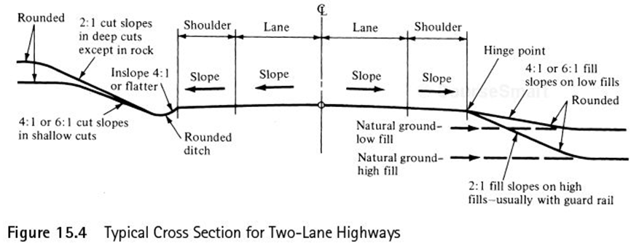
Cross Section Elements
Notes:
Figure 15.4 Two-Lane Roadway
Shows lanes, shoulders, medians, excavation slopes, embankment slopes, etc.

Slide 19
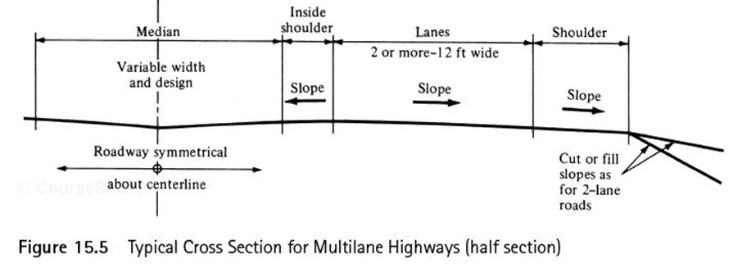
Cross Section Elements
Notes:
Figures 15.5 Half-section Multi-lane Highway
Shows lanes, shoulders, medians, excavation slopes, embankment slopes, etc.

Slide 20
Example 15.1
A crest vertical curve is to be designed to join a +3% grade with a -2% grade at a section of a two-lane highway. Determine the minimum length of the curve if the design speed of the highway is 60 mph, S<L, and a perception-reaction time of 2.5 sec. The deceleration rate for braking (a) is 11.2 ft/sec².
$SSD = 1.47 u∗t$+$\frac{u^{2}}{30\left\{\frac{a}{32.2}−\left.G\right\}\right.}$
$L_{min}$ = $\frac{{AS}^{2}}{2158} for S<L$
$$L_{min}= 2S –\frac{2158}{A} for S>L$$

Slide 21
Example 15.2
An existing vertical curve on a highway joins a +4.4% grade with a -4.4% grade. If the length of the curve is 275 ft, what is the maximum safety speed on this curve? What speed should be posted if 5 mph increments are used? Assume a= 11.2 ft/sec², perception-reaction time = 2.5 sec, and S<L.

