Slide 1
Announcement
Online homework submission through Blackboard. Show how to submit homework.
Exam 2
Worksheets posted online.

Slide 2
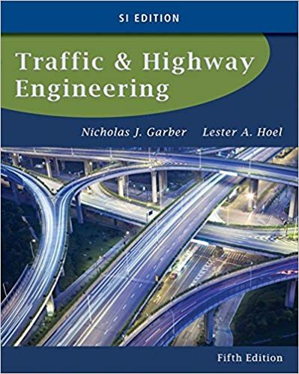
CE 34500 – Transportation Engineering
Chapter 12: Forecasting Travel Demand

Slide 3
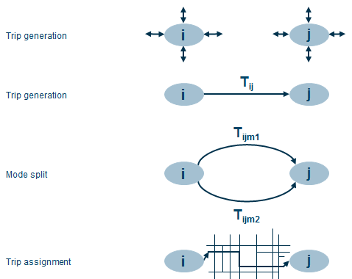
4-step Models
Trip Generation: How many people travel?
Trip Distribution: What are the travel patterns for the study area?
Mode Choice: What travel modes are used?
Trip Assignment: What trip paths will be followed through the transportation network?

Slide 4
Two types of Models
Automobile
Transit
Three types of Transit Estimating Procedures
Direct generation of transit trips
Use of trip end models
Trip interchange modal split models

Slide 5
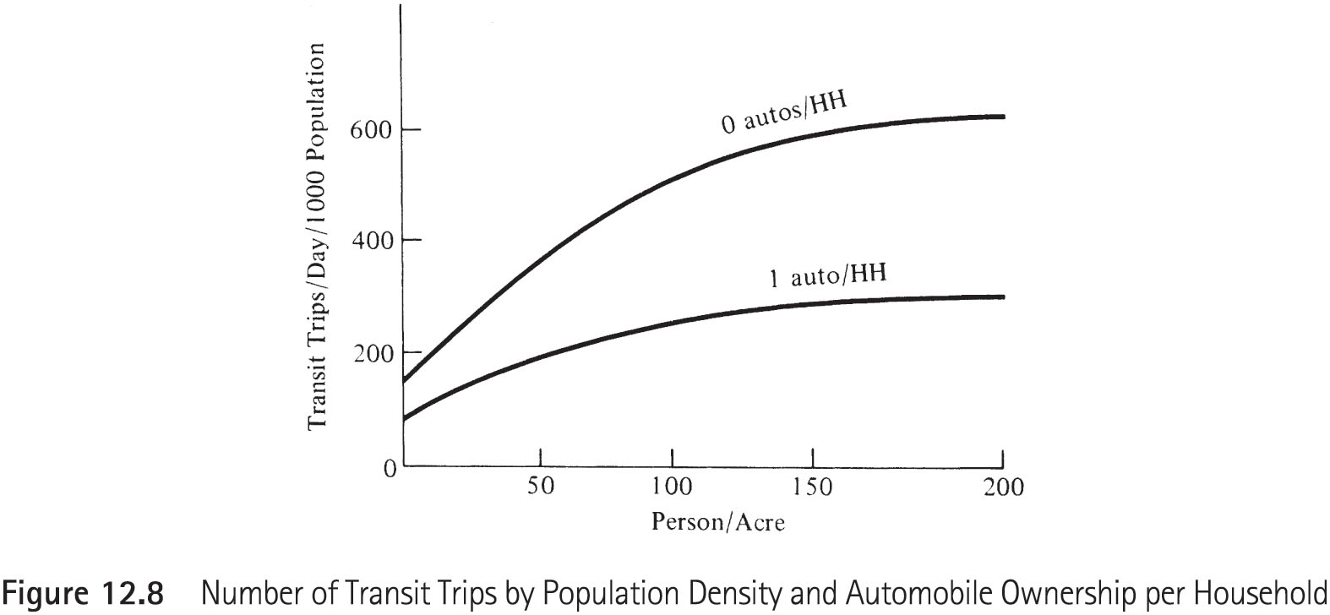
1. Direct generation of transit trips

Slide 6
Example 12.8
Determine the number of transit trips per day in a zone, which has 5000 people living on 50 acres. The auto ownership is 40% zero autos per household and 60% one auto per household.

Slide 7
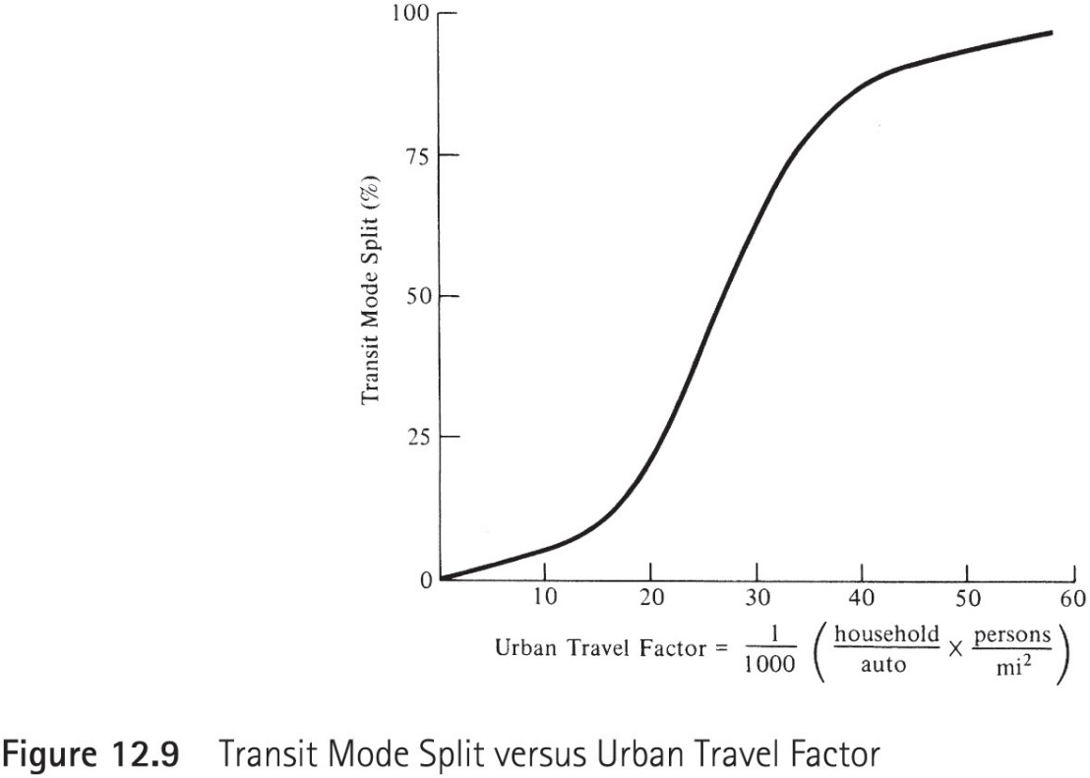
2. Trip End models
To determine the % of total person that will use transit.

Slide 8
Example 12.9
The total number of productions in a zone is 10,000 trips/day. The number of households per auto is 1.8, and residential density is 15,000 persons/square mile. Determine the percent of residents who can be expected to use transit.

Slide 9
3. Trip interchange modal split models
To determine the % of total person that will use transit.
P_{auto ij} = probability of selecting auto mode for trip from TAZ i to TAZ j
U_{auto ij} = utility of auto mode for trip from TAZ i to TAZ j: f (auto LOS ij, auto cost ij, income i…)
P_{transit ij} = probability of selecting transit mode for trip from TAZ i to TAZ j
U_{transit ij} = utility of transit mode for trip from TAZ i to TAZ j: f (transit LOS ij, transit cost ij, income i…)

Slide 10
3. Trip interchange modal split models
U_{auto} = 1+0.003*Income/1000-0.04*TravelTime-0.24*Cost
U_{transit} = -3-0.001*Income/1000 -0.04*TravelTime-0.24*Cost

Slide 11
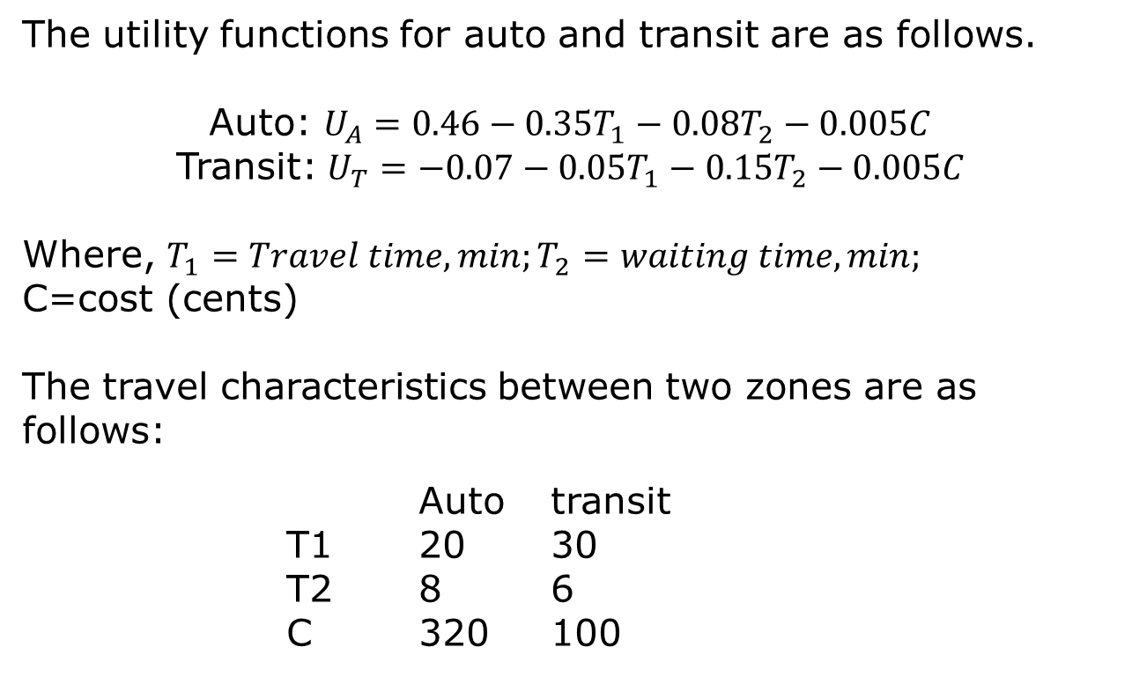
Example 12.11
The utility functions for auto and transit are as follows.
Auto: $U_{A}=0.46−0.35T_{1}−0.08T_{2}−0.005C$
Transit:$U_{T}=−0.07−0.05T_{1}−0.15T_{2}−0.005C$
Where, $T_{1}=Travel time, min;T_{2}=waiting time, min;$
C=cost (cents)
The travel characteristics between two zones are as follows:
Auto transit
T1 20 30
T2 8 6
C 320 100

Slide 12
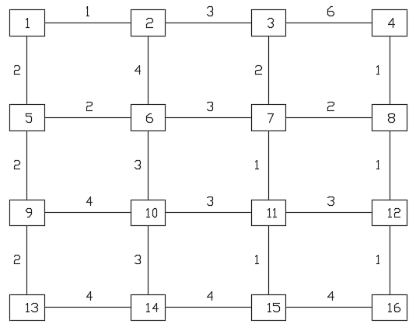
4Th Step: Traffic Assignment
Minimum path algorithm

