Slide 1
CE 34500 – Transportation Engineering
Chapter 12: Forecasting Travel Demand

Slide 2
What is Travel Demand Modeling (TDM)
Estimate travel demand for a specific future time frame (20 to 30 years) based on a number of assumptions.
Traffic Volume (AADT)?

Slide 3
Why Travel Demand Modeling?
Primarily used for evaluating
Roadway improvements,
Improvements to bus service,
Pollution emission estimates,
Congestion management.

Slide 4
Factors Influencing Travel Demand
Location and Intensity of Land Use
Socioeconomic Characteristics of the Population
Extent, Cost, and Quality of the available Transportation
Notes:
You can divide these factors in these three major categories.
Land use: Amount of traffic generated by a particular piece of land depends on how land is used—residential area, shopping center, office building, etc.
Socioeconomic characteristics: Residential area consisting of high income white collar workers generates more auto trips than an area populated primarily by retirees.
Extent, quality, etc. of available transportation: In deciding to travel at all all/ which mode to use, etc., travelers consider travel time, cost, convenience, comfort, etc.

Slide 5
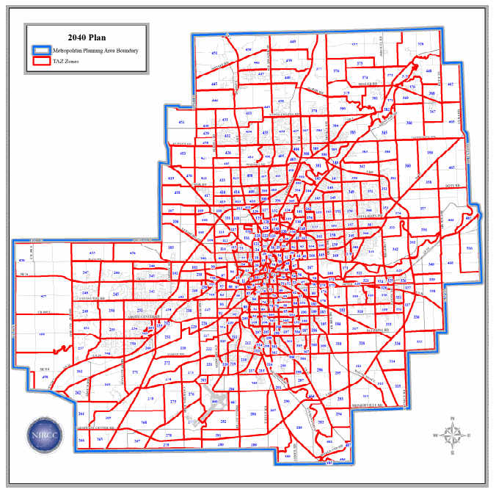
Fort Wayne TAZs
Notes:
TAZ = Transportation Analysis zone.
Rule of thumb – zones small enough so that intrazonal trips are 10-15% or less.

Slide 6
Defining Study Area
Delineate boundaries of study area and subdivide into zones
Zones Should Have Following Characteristics
Homogeneous Socioeconomic Characteristics
Intra-zonal Trips Should Be Minimized
Use Physical, Political, and Historical Boundaries if Possible
Zones Should Not Be Created Within Other Zones
The Zone System Should Generate and Attract Approximately Equal Trips, Households, Population, or Area
Use Census Tract Boundaries Where Possible
Notes:
1st step in forecasting urban travel is to define the boundaries of the study area, and subdivide it into Traffic Analysis Zones (TAZ’s).
TAZ’s should have the characteristics given above.
The smaller the zones the more detail and more work.

Slide 7
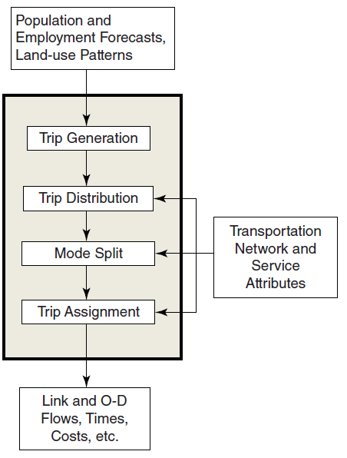
Sequential Steps for Travel Forecasting
Travel Demand Modeling (4-step models)
Trip Generation
Trip Distribution
Mode Choice
Trip Assignment

Slide 8
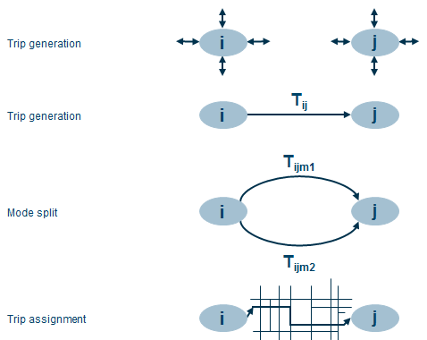
4-step Models
Trip Generation: How many people travel?
Trip Distribution: What are the travel patterns for the study area?
Mode Choice: What travel modes are used?
Trip Assignment: What trip paths will be followed through the transportation network?

Slide 9
Examples of 4-steps Models
Trip Generation
Mode Choice
Zone | Trip Productions
1
2
3
Zone | Trip Attractions
1
2
3
Mode 1
Mode 2
Traffic Assignment
Trip Distribution
 | 1 | 2 | 3
1
2
3
Route 1
Route 2
Route 3

Slide 10
Trip Generation
Process for determining the number of trips that will begin and end in each traffic zone. Trips determined without regard to destination
Notes:
As discussed in a previous lecture, must first divide the traffic study area into traffic analysis zone (TAZ’s)
Trip generation: process for determining the number of trips that will begin and end in each traffic zone.
Trips are determined without regard to destination—hence are referred to as trip ends.

Slide 11
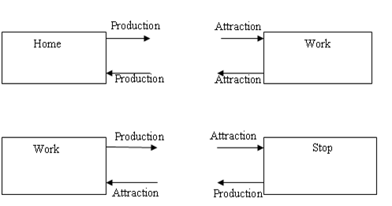
Define Trip Production and Attraction

Slide 12
TAZ 1
TAZ 6
Home
Work
A worker leaves TAZ 1 in the morning to go to work in TAZ 6. In the evening, same worker comes back TAZ 1.
How many trips?
Notes:
When going: This results in 2 trip ends:
One Origin for Zone 1
One Destination for Zone 6
When coming back: This results in another 2 trip ends:
One Destination for Zone 1
One Origin for Zone 6

Slide 13
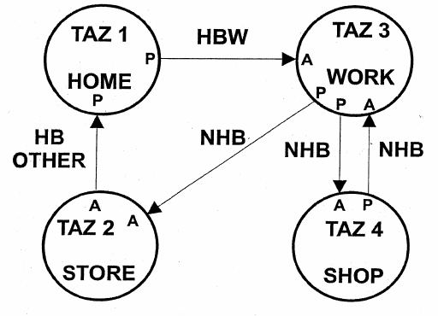
Example

Slide 14
Step 1: Trip Generation
Trip Production Modeling Techniques:
Regression Techniques
Cross Classification (or category) Analysis.
Trip attraction models

Slide 15
Example 12.1: Trip Generation
HH Number | Trips per HH | HH Income ($1000s) | Cars/HH
1 | 2 | 16 | 0
2 | 4 | 24 | 0
3 | 10 | 68 | 2
4 | 5 | 44 | 0
5 | 5 | 18 | 1
6 | 15 | 68 | 3
7 | 7 | 38 | 1
8 | 4 | 36 | 0
9 | 6 | 28 | 1
10 | 13 | 76 | 3
11 | 8 | 72 | 1
12 | 6 | 32 | 1
13 | 9 | 28 | 2
14 | 11 | 44 | 2
15 | 10 | 44 | 2
16 | 11 | 52 | 2
17 | 12 | 60 | 2
18 | 8 | 44 | 1
19 | 8 | 52 | 1
20 | 6 | 28 | 1

Slide 16
Example 12.2 Cross Classification
Determine the number of trips per day generated for each trip purpose.
Number of dwelling units: 60
Average income per dwelling unit: $44,000
Income ($) | Households
Low (under 32,000) | 9
Medium (32,000 – 48,000) | 40
High (over 48,000) | 51

Slide 17
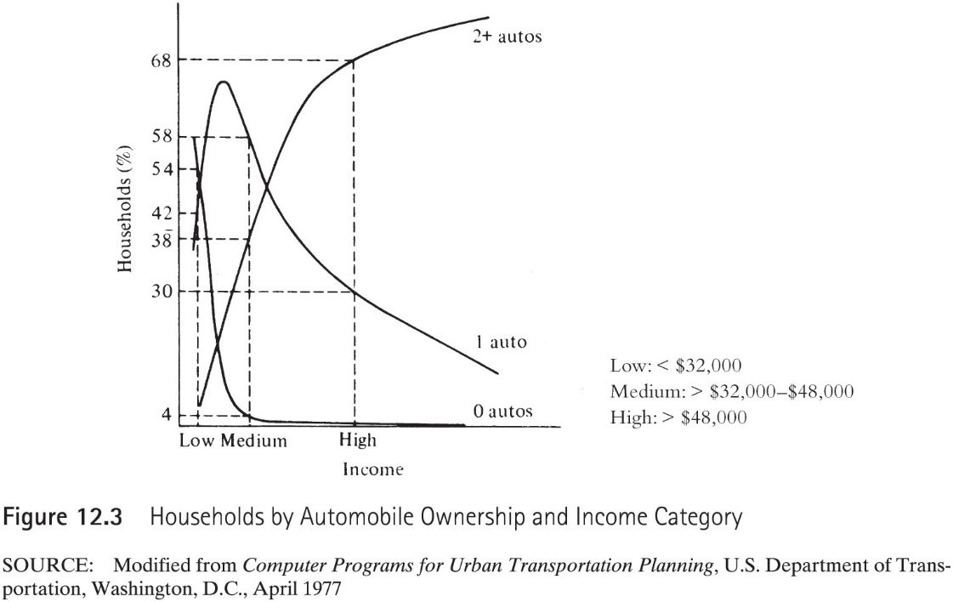
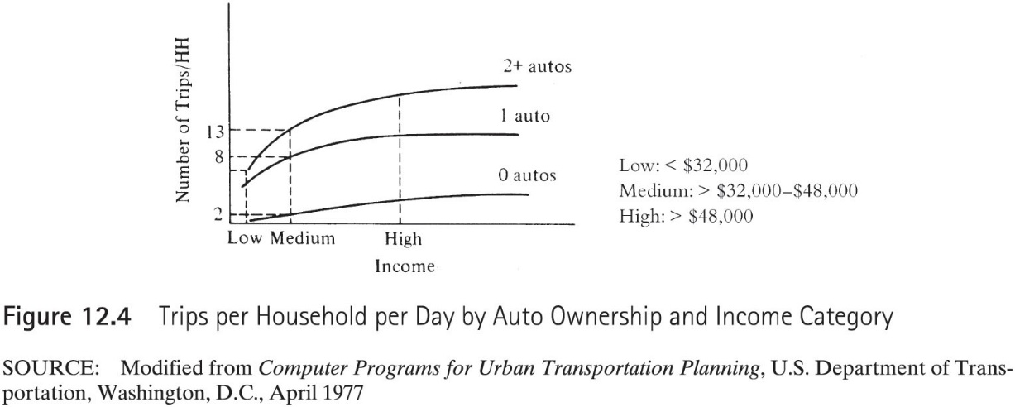
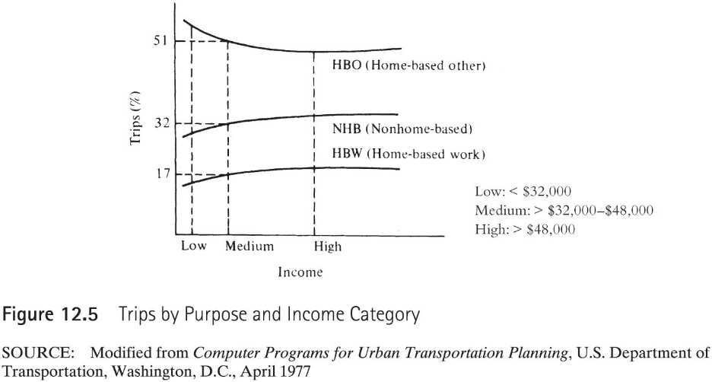

Slide 18
Example 12.3 Trip Attraction
Employed at a downtown commercial center are 650 non-retail and 220 retail workers. Determine the number of trips per day attracted to this zone.
Notes:
Can develop similar tables, such as Table 12.7 given on the next slide, to determine the number of trips not produced at the home/ trips attracted to a commercial zone.
Rather than income, auto ownership, etc., (which are used for home based trips), trips attracted to commercial activity zones are related to number of households in the zone, the number of different types of employees (nonretail, downtown retail and other retail) in the zone, etc.

Slide 19
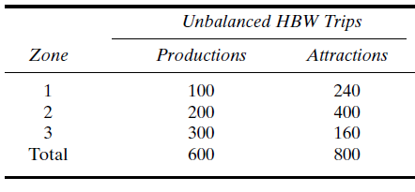
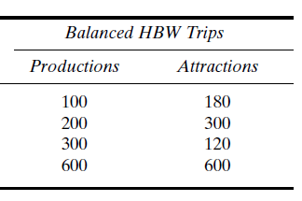
Balancing Productions and Attractions
f_{a} = ΣP_{i}/ ΣA = 600/800 = 0.75
Source: Traffic & Highway Engineering, Garber & Hoel

