Slide 1
Purdue University Fort Wayne
Annual Report for
American Society of Civil Engineers Student Chapter
Notes:
Use your own theme and layout (View-slide master or similar). Add photos, logos and graphics. Throughout this template file, text in italics should be replaced with more specific titles.

Slide 2
Contact Information
2101 E. Coliseum Blvd
Fort Wayne, IN
ASCE@pfw.edu

Slide 3
Student Officers
Role | 2018-2019 | 2019-2020
President | AJ Mirra | Clare Cholewa
Vice President | Jacob Taylor | Jada Hall
Secretary | Andrew Shields | Julie Marchut
Treasurer | Stas Kosnik | Benjamin Holtz
Notes:
Photos!

Slide 4
Advisors
Role | 2018-2019 | 2019-2020
Faculty Advisor | Fawad Niazi, niazif@pfw.edu | Promothes Saha, Sahap@pfw.edu
Practitioner Advisor | N/A | Dave Devine, dpd02ce@yahoo.com
Notes:
Photos!

Slide 5
Financial Summary
Dues are $10/semester
2018-2019 Academic Year
Income = $2571.16
Expenditures = $3852.06
Cash balance = $6592.87
No accounts receivable/payable
Goal for 2019-2020: $0 net spending

Slide 6
Goals and Objectives
Mission Statement: Grow our ASCE chapter and foster a spirit of engagement within the Civil Engineering major on our predominantly commuter campus.

Slide 7
Goals and Objectives
Membership
1
Increase percentage of students in Civil Engineering major that are chapter members.
Funding
2
Decrease reliance on chapter funds.
Diversity
3
Focus on female member engagement and recruitment.
Notes:
Three goals are suggested, add more if you wish

Slide 8
Increase percentage of students in Civil Engineering major that are chapter members.
Increase percentage of students in CE major that are chapter members to above 30%
Speak with introductory engineering classes.
The CE Department has 50 students for 2018-2019. We had a membership of 14 CE members = 28% engagement. 3 additional members from the Construction Management program.
In the coming year, we plan to increase awareness on campus by continuing to encourage professors to discuss ASCE in classes, and by incentivizing members to bring friends to meetings with a reduction of their dues.

Slide 9
Decrease reliance on chapter funds.
Maintain net balance of chapter account over 1 fiscal year.
Request funding from PFW Student Travel Committee for WSCL
Request funding from Student Government for Great Lakes Student Conference Projects
Increase cooperation with the Civil and Mechanical Department to get funding for events that improve students.
Overall, we are doing better on this action plan than in past years. Funding from the Student Government helped our chapter significantly, and we developed a positive working relationship with our Student Activities Resource office.
In the coming months we want to increase net chapter balance by outside fundraising. Reach out to local industry professionals.

Slide 10
Focus on female member engagement and recruitment.
Recruit female members for officer roles, and balance project teams with 1:3 ratio of female/male
Invite senior female members to increase their involvement and encourage them to take on officer roles.
Acknowledge the importance of diversity in the field overall.
We now have 3 female officers, which is very new for the chapter. Female-balanced teams at GLSC provided better opportunity for learning teamwork for all.
Plan events in cooperation with the Society of Women Engineers, invite speakers focused on diversity.

Slide 11
Membership Statistics
Total Members: 17
Society Members: 12
75% Members are society members
6 Junior/Senior members
20 Juniors/Seniors eligible to join
30% of Juniors/Seniors in CE Major are members
Notes:
Fill in numbers (from Statistical Data tab in excel sheet) where words are underlined.

Slide 12
Meeting Metrics
Meetings with Invited Speaker | 2
Meetings with Student Presentations | 8
Field Trips | 1
Social Functions | 2
Students Attending Section/Branch Meetings | 5
Notes:
Fill in numbers (from Statistical Data tab in excel sheet) where words are underlined.

Slide 13
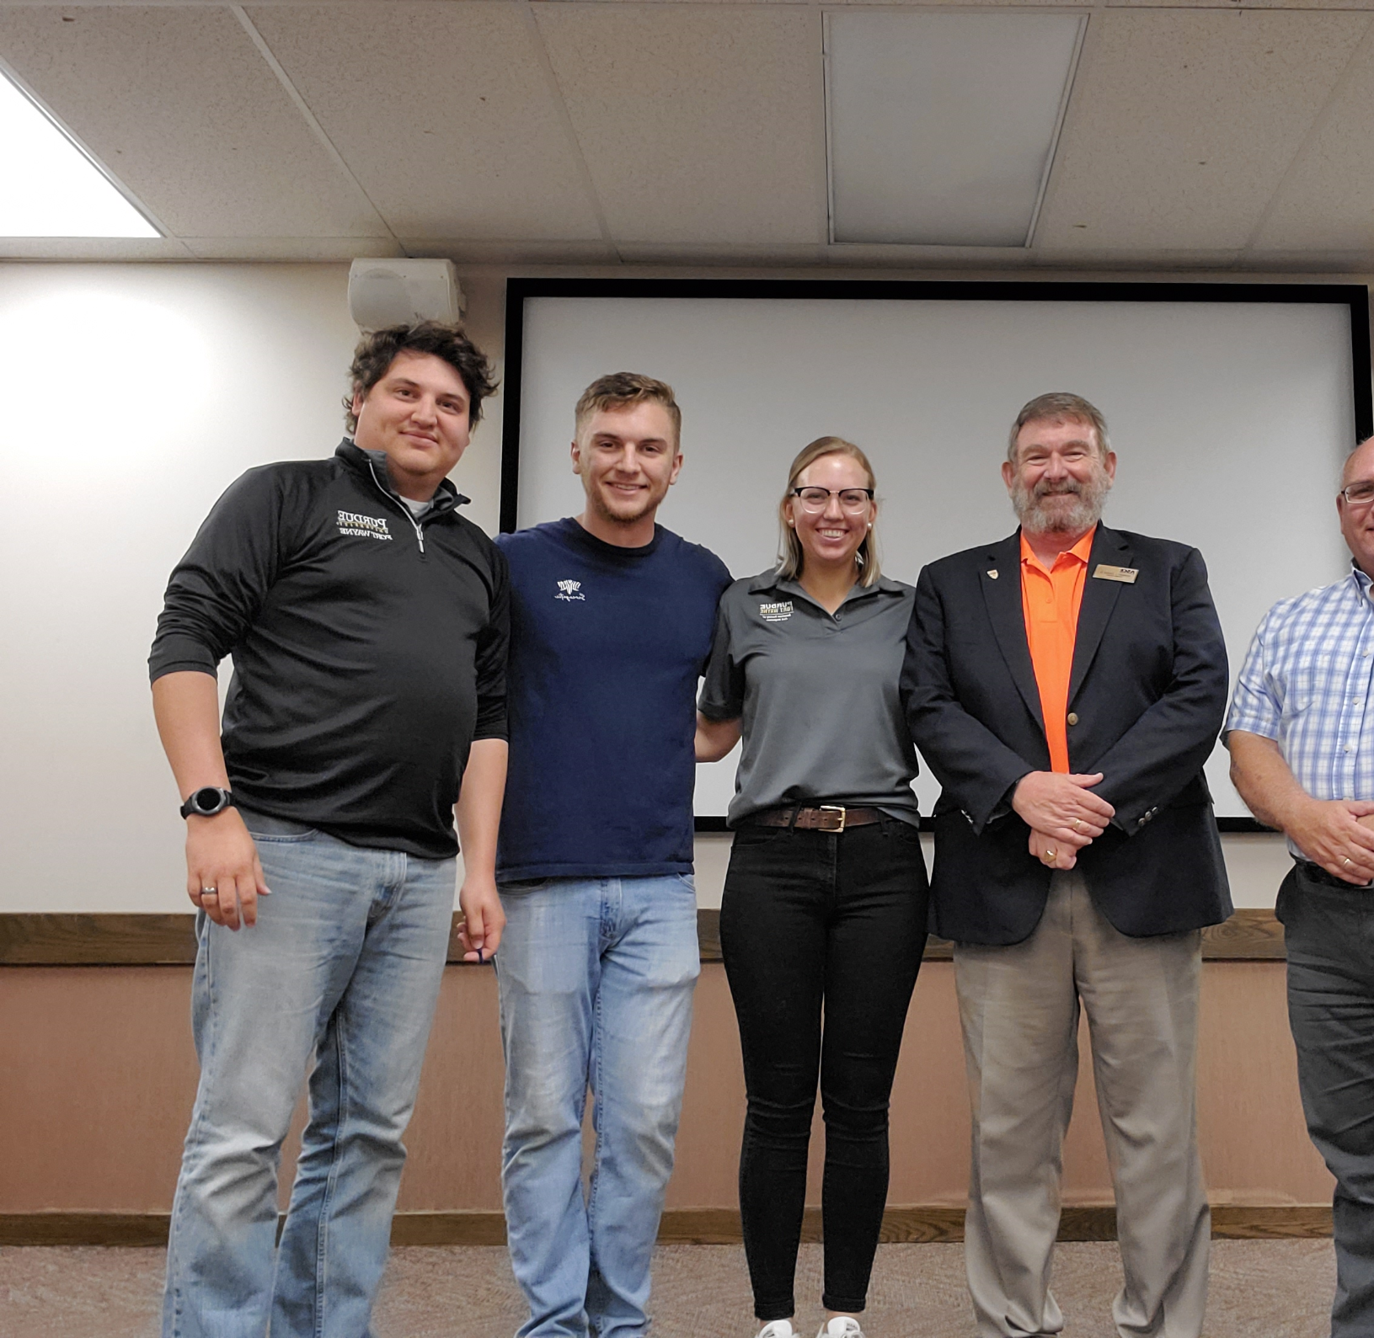
Region 4 Director Visit
Bob Cagle presented "Life After Concrete Canoe" to members of our student chapter and branch.
10 student attendees, 5 branch attendees, and 4 faculty members attended
While not as well-attended as we would've liked, this was an incredible opportunity for our faculty to learn more about ASCE and understand how a student chapter fits into the university, as well an international organization.
At our university, ASCE is sometimes taken for granted as a student competition club. Having leadership like Mr. Cagle visit allows everyone to learn more about what students can do with ASCE and how student chapters impact the Civil Engineering community.
Notes:
Use photos, logos, etc.

Slide 14
Tincaps Game with Northeast Branch
Social Event with the Northeast Indiana Branch
Minor League baseball game, attended by both the Branch and Student Chapters
10 student members attended, as well as the faculty advisor.
Tincaps Games are an event students often do on Thursday nights anyway. ASCE rented a pavilion and provided food, which provided a place for both student chapters in the branch to network with branch members.
Importantly, this event showed the student chapter the way that a social event can quickly become a networking opportunity.
Notes:
Use photos, logos, etc.

Slide 15
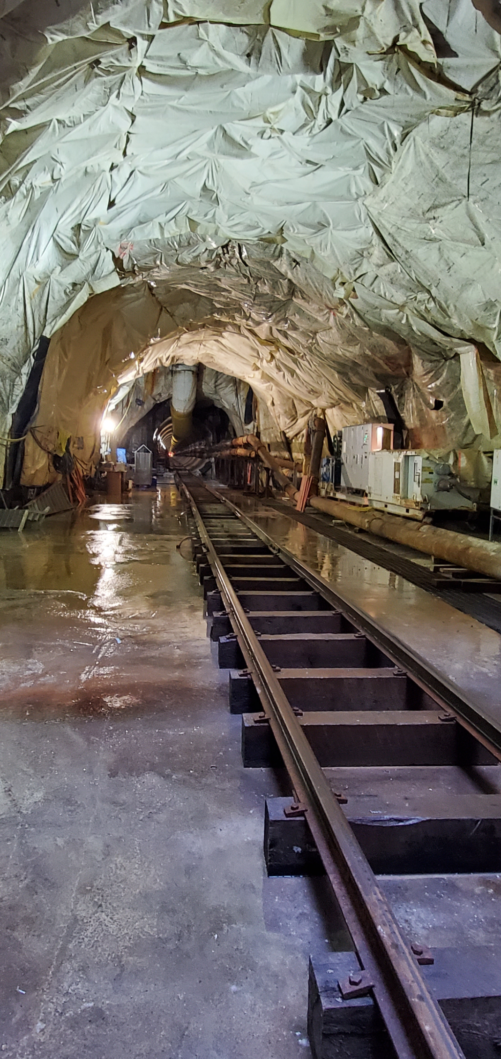
Fort Wayne Tunnel Project Field Trip
TJ Short, the Senior Project Engineer for the Fort Wayne CSO Tunnel took students from Trine University and PFW down into the tunnel.
4 students from PFW attended. A small group of us were invited by Trine
There is high demand to repeat this event next year and could be a powerful recruiting tool for the chapter. The tunnel is popular in Fort Wayne and lots of people would appreciate the opportunity to see it firsthand.
Trine University had about 25 students attend, and we've found that working with their chapter is a good way to participate in events so that the total attendance justifies the time and expense of the meeting.
Notes:
Use photos, logos, etc.

Slide 16
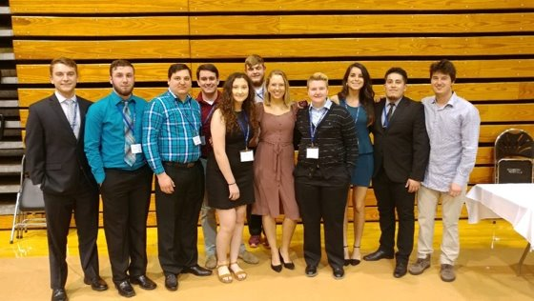
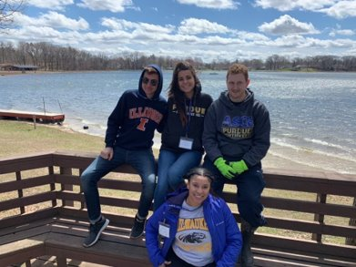
Great Lakes Student Conference
Valparaiso University
April 11-13, 2019
12 students attended
Notes:
Add slides as necessary to highlight results

Slide 17
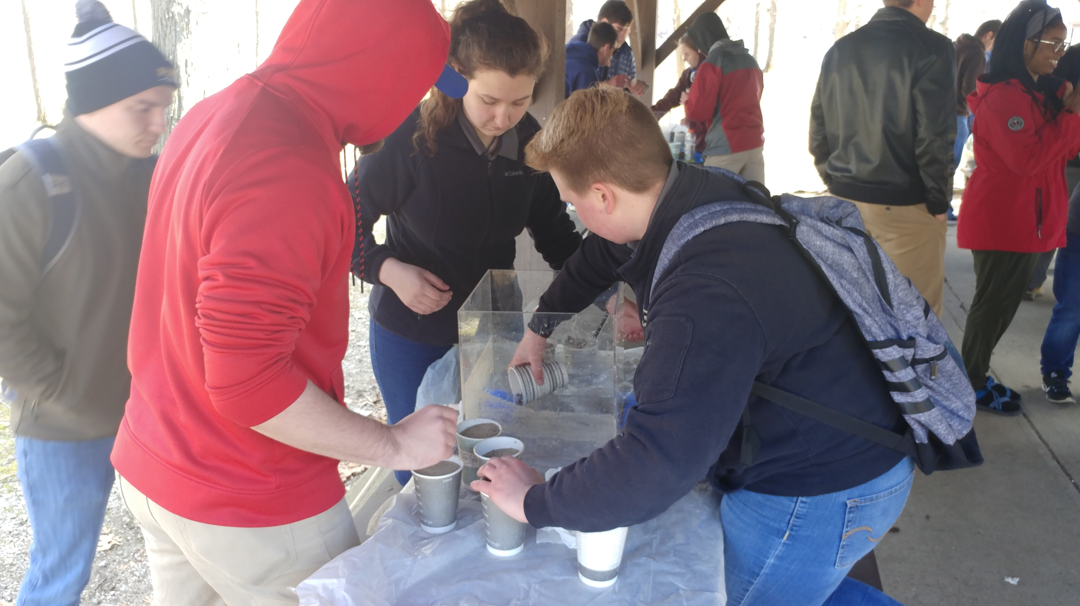
Mystery Design
In this competition we had 2 freshman, and 1 Computer Engineering major take the lead.
Encouraging freshman and new members to partake in events with no preparation required made conference an enjoyable and meaningful experience for them.
Slowly allowing new members to familiarize themselves with ASCE and take on responsibility gradually has been the most successful way to get future captains for larger projects.
Notes:
Add slides as necessary to highlight results

Slide 18
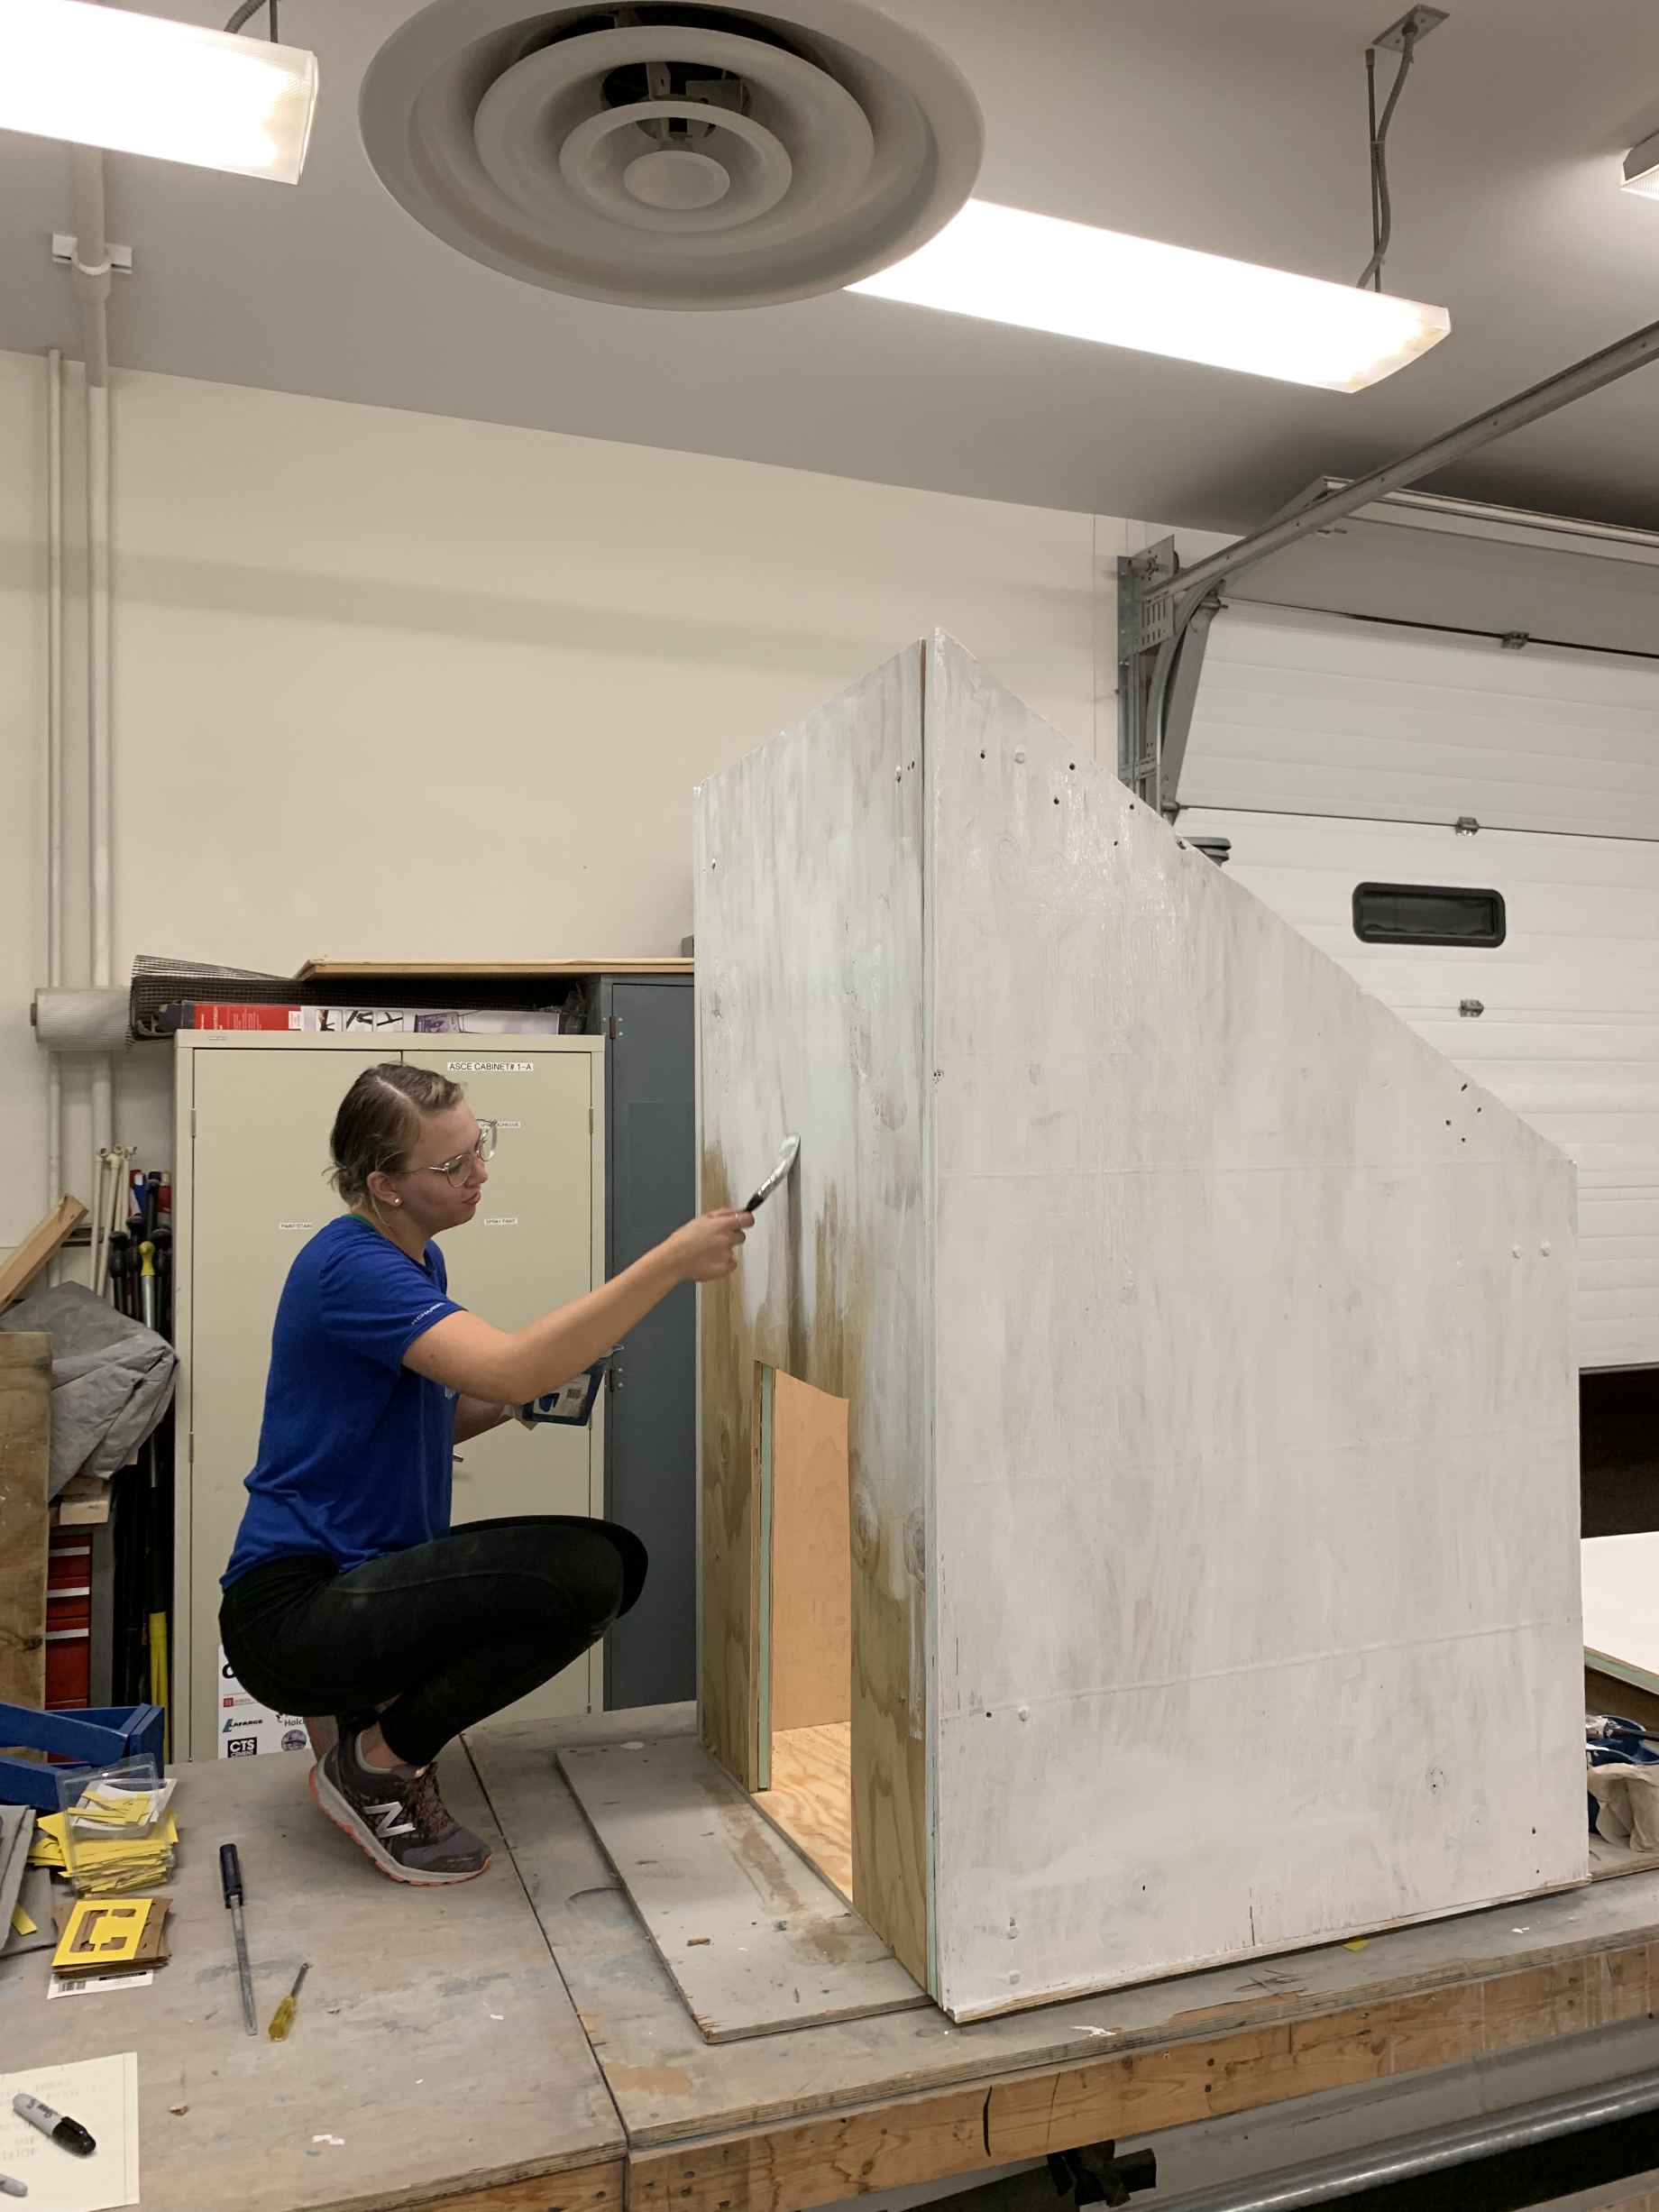
Sustainable Solutions: Dog House
This competition was taken on by a new ASCE member, who became President for 2019-2020!
We chose to not take on a canoe this year, due to the lack of interest from the chapter.
The Dog House was a great place for the people interested in canoe to divert their efforts.
The Dog House was built by almost entirely rookie ASCE members. For upcoming competitions, those people now know what to expect from judging and the rigors of the competition.
Notes:
Add slides as necessary to highlight results

Slide 19
Leadership Development
Workshop for Student Chapter Leaders (WSCL)
Philadelphia, PA
30 January-1 February
4 officers attended
Favorite Aspects
Finance and Fundraising Small Group Discussion
Region—Section Breakout Session
Notes:
Add a slide for each activity or conference attended. Other activities besides WSCL may be presented as well.

Slide 20
This Year's Challenges
Advisor Change
This year we had the added challenge of training up a new advisor and familiarizing him with how the chapter runs.
Membership Engagement
Though our membership numbers did not drastically change, losing several seniors reduced how active our membership was. Additionally, replacing the seniors we lost with freshmen did not add any expertise to the chapter. This made experienced students scarce for working on projects for our upcoming competition.

Slide 21
The Year Ahead
We would like to thank everyone who reads this report and works to help student chapters. We would like to acknowledge that our student chapter is charting a new course for itself. We are seeking to keep better records, and actively engage on the national level more often.
Much of the information in this report had to be developed from previous EZ reports, which were realized to not be fully accurate or up to date. This year we have tried hard to set a new standard for how the chapter will develop goals and look ahead.
In the year ahead, we hope to grow from this report and become the best chapter we can be.

Slide 22
Summary
Deficit of $1281 this year
3 Goals
Increase percentage of students in Civil Engineering major that are chapter members.
Decrease reliance on chapter funds.
Focus on female member engagement and recruitment.
13 Meetings
Notes:
We would prefer that you limit to 60 slides or less, but if you have more that’s ok. When actually presenting to other groups, reorder the slides (instead of deleting, move extras to the end so you have them if questions come up) to only present a reasonable amount in the time you are given.

Slide 23
Questions?

