Slide 1
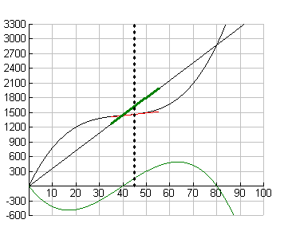
R’ > C’ ? Yes! P increases since P’ > 0
C R

Slide 2
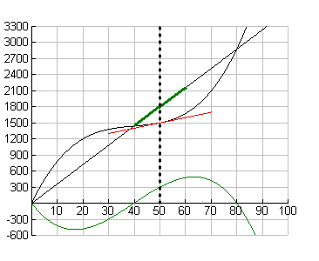
R’ > C’ ? Yes! P increases since P’ > 0
C R

Slide 3
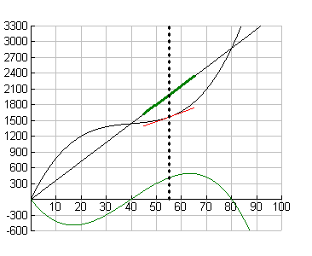
R’ > C’ ? Yes! P increases since P’ > 0
C R

Slide 4
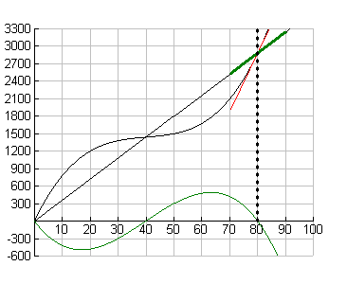
R’ > C’ ? No! P decreases since P’ < 0
C R

Slide 5
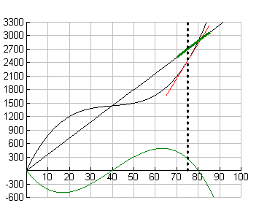
R’ > C’ ? No! P decreases since P’ < 0
C R

Slide 6
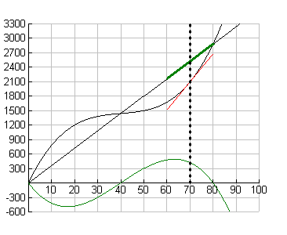
R’ > C’ ? No! P decreases since P’ < 0
C R

Slide 7
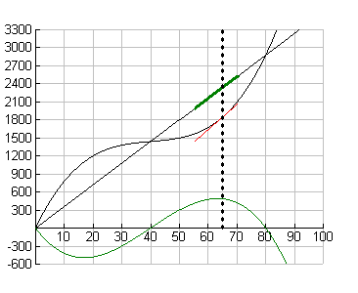
R’ > C’ ? No! P decreases since P’ < 0
C R

Slide 8
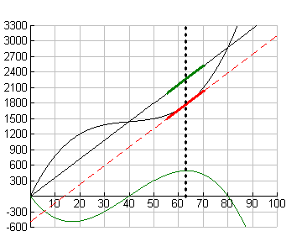
R’ = C’ and P’ = 0. Sweet Spot!
C R

