Slide 1
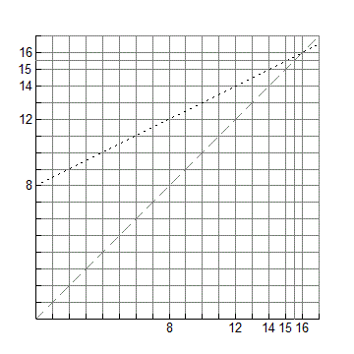
y = x
y = 0.5x + 8
First partial sum S₁ = a = 8
First term a₁ = a = 8

Slide 2
y = x
y = 0.5x + 8
First partial sum S₁ = a = 8
First term a₁ = a = 8

Slide 3
y = x
y = 0.5x + 8
Second partial sum S₂ = a +ar =12
Second term a₂ = ar = 4
First term a₁ = a = 8

Slide 4
y = x
y = 0.5x + 8
Second partial sum S₂ = a +ar =12
Second term a₂ = ar = 4
First term a₁ = a = 8

Slide 5
y = x
y = 0.5x + 8
Third partial sum S₃ = a +ar + ar² =14
Third term a₃ = ar² = 2
Second term a₂ = ar = 4
First term a₁ = a = 8

Slide 6
y = x
y = 0.5x + 8
Third partial sum S₃ = a +ar + ar² =14
Third term a₃ = ar² = 2
Second term a₂ = ar = 4
First term a₁ = a = 8

Slide 7
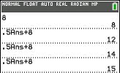
y = x
y = 0.5x + 8
S₄ = a +ar + ar² + ar³ = 15
Fourth term a₄ = ar³ = 1
Third term a₃ = ar² = 2
Second term a₂ = ar = 4
First term a₁ = a = 8

Slide 8
y = x
y = 0.5x + 8
S₄ = a +ar + ar² + ar³ = 15
Fourth term a₄ = ar³ = 1
Third term a₃ = ar² = 2
Second term a₂ = ar = 4
First term a₁ = a = 8

Slide 9
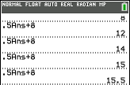
y = x
y = 0.5x + 8
S₅ = a +ar + ar² + ar³ + ar⁴ =15.5
Fifth term a₅ = ar⁴ = 0.5
Fourth term a₄ = ar³ = 1
Third term a₃ = ar² = 2
Second term a₂ = ar = 4
First term a₁ = a = 8

Slide 10
y = x
y = 0.5x + 8
S₅ = a +ar + ar² + ar³ + ar⁴ =15.5
Fifth term a₅ = ar⁴ = 0.5
Fourth term a₄ = ar³ = 1
Third term a₃ = ar² = 2
Second term a₂ = ar = 4
First term a₁ = a = 8

Slide 11
y = x
y = 0.5x + 8
S₅ = a +ar + ar² + ar³ + ar⁴ =15.5
Fifth term a₅ = ar⁴ = 0.5
Fourth term a₄ = ar³ = 1
Third term a₃ = ar² = 2
Second term a₂ = ar = 4
First term a₁ = a = 8

Slide 12
y = x
y = 0.5x + 8
S₅ = a +ar + ar² + ar³ + ar⁴ =15.5
Fifth term a₅ = ar⁴
S₄ = a +ar + ar² + ar³ = 15
Fourth term a₄ = ar³
Third partial sum S₃ = a +ar + ar² =14
Third term a₃ = ar²
Second partial sum S₂ = a +ar =12
Second term a₂ = ar
First partial sum S₁ = a = 8
First term a₁ = a

